Slide 1
SOUTHERN ONTARIO CITY DISPATCH · ROADSTAR HACKATHON 2026
One Platform. Own Your Data.
Stop Renting Your Dispatch.
An AI-native dispatch platform for South-Ontario city freight — built to replace five subscriptions
with one system a carrier owns.
BATMAN'S BUTLER
Hackathon Final Demo · September 13, 2026

Slide 2
THE PROBLEM
Death by a Thousand Subscriptions
Five disconnected systems, and what running dispatch on top of them actually costs — both straight from the hackathon brief.
THE FRAGMENTED STACK
WHAT THAT COSTS
1
Load / Contract Boards
~$800/mo per device
$1K–$7K
1–3 / day
2
ELD / Logbooks
~$600/yr per truck
Value of one missed load quote
Jobs missed to manual workflow
3
TMS / Dispatch
~$50/mo per user
4
Quoting & Rate Tools
extra subscription fees
~$6,000/day
$15K–$50K+/mo
5
Maintenance & Accounting
separate enterprise setup
Missed opportunity, one desk
Estimated lost revenue per desk
None of it shares data. None of it is owned.
Judging criterion #1 is literally “Workflow Speed & Financial Value.” Everything from here on is our answer to that number.
BATMAN'S BUTLER
2

Slide 3
OUR PROCESS
We Started From Real Data, Not Assumptions
Before designing a single feature, we mined the hackathon's own operational export — five real tables, one region, real dispatch history.
5,192
1,326
~2 months
5 tables
real ON-ON dispatch legs analyzed
distinct trips, Southern Ontario
Late June – late August 2026
Tlorder · Dispatch · Driver · Trucks · Trailers
Checked for a known export artifact — ~16 exact-duplicate legs (0.3%) found and excluded from every downstream count.
Six lenses we ran every trip through:
Order / run type
(8-way classifier)
Time periods
(dwell, dock timing)
Detention
(geofence completeness)
Deadhead miles
(empty, no revenue)
Revenue & cost
(what a miss is worth)
Data ownership
(what unlocks deeper analysis)
The ceiling on better ML here isn't modeling — it's data. Detailed travel logs, granular fleet telemetry, and historical quote/bid history would sharpen this optimizer further. Closing that gap is exactly what owning this platform buys a carrier.
BATMAN'S BUTLER
3

Slide 4
FINDINGS
Trip Shapes, and Where Freight Actually Is
Every ON-ON trip resolves to one of four dominant shapes — and the two real hubs aren't where the freight starts.
Hubs run hotter than the fleet average
Fleet-wide deadhead share: 27.3%. At Milton and London — the brief's own “Primary Hubs” — it's far higher.
Milton (busiest origin, 2,397 legs)
36.2%
London
50.6%
Oshawa (2nd-busiest, 1,508 legs)
10.5%
Real freight demand concentrates in GTA-adjacent cities — Oshawa, Vaughan, Guelph — not at the company's own terminals. A truck parked at a hub is disproportionately likely to deadhead just to reach a load.
70.7% of real trips are single-load FTL — exactly the unit a day-ahead solver assigns.
BATMAN'S BUTLER
4

Slide 5
FINDINGS
This Is a Day-Shift Fleet — Not a 24-Hour One
Real dispatch timestamps, not an assumption — and it's the reason the AI dispatcher solves once a day instead of continuously.
89.8%
of departures fall between 6am and 7pm
89%
of trips start and finish the same calendar day
4h
median trip length
Most trucks aren't out overnight — they run a shift and become available again together, in a predictable evening window. That's why the AI dispatcher solves the whole day once, end-of-day — not by re-optimizing continuously.
Busiest hour: 8am, 774 legs — a real morning shift start, not a 24-hour spread.
BATMAN'S BUTLER
5

Slide 6
PROBLEMS IDENTIFIED
Six Problems, Each Grounded in Real Numbers
1
Deadhead miles
2
Detention billing gaps
3
Lost revenue, unfilled orders
6,255 no-revenue miles driven right after deliveries in just 2 months (327 legs) — no return load lined up.
549 of 2,652 dock events (21%) have no geofence timestamp at all — automatic billing is impossible without one.
1–3 missed jobs/day at $1K–$7K each — our own live run left 10 of 40 orders unassigned in one day.
4
Lost revenue, low-margin picks
5
Time & complexity
6
No data ownership
Under time pressure, dispatchers grab the easiest order, not the most profitable one.
Five disjoint systems, manual “check calls,” one truck dragged onto one order at a time.
Operational data lives locked inside vendor systems — without owning it, a carrier can't build custom analytics or train real AI on its own history.
BATMAN'S BUTLER
6

Slide 7
OUR SOLUTION
A Unified, AI-Native Dispatch Platform
Three pillars, one Supabase-owned database, zero per-seat software tax.
01
02
03
AI Load-Matching
Optimization
Geofencing +
Automated Detention Billing
Live Simulation +
Unified Fleet Dashboard
Google OR-Tools CP-SAT solves the whole day's truck × order × driver assignment jointly — not one quote at a time.
Real dock arrival/departure timestamps, auto-billed past the free 2-hour window — no manual check calls.
Free OSRM road-network routing, a Supabase backend the carrier owns, real-time telemetry end to end.
BATMAN'S BUTLER
7

Slide 8
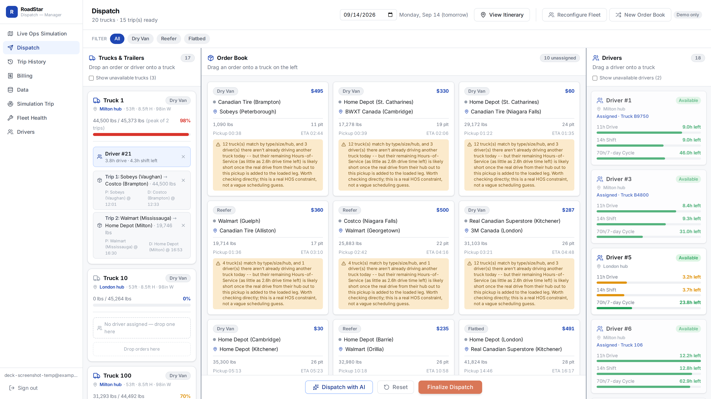
SOLUTION 1 · THE MATH
Why This Is Combinatorial, Not Manual
20 trucks × 15 orders alone
20¹⁵ ≈ 33 quintillion
raw ways to assign orders to trucks — before sequencing stops, before pairing drivers, before a single HOS clock. This is a combinatorial optimization problem, solved with Google OR-Tools CP-SAT.
Three decisions the solver makes at once:
X[t,o]
does order o ride truck t
Y[t,d]
does driver d drive truck t
Next[t,i,j]
does order j immediately follow order i on truck t's route
We built this as reinforcement learning first — then realized a day is solved once, not trained over millions of episodes. That's constraint satisfaction, not policy learning, so we moved to CP-SAT. (A fully custom, domain-specific solver could likely do even better — scoped, but out of time to build safely.)
The real Dispatch board — 20 trucks, 15 ready trips, 18 drivers, one day
BATMAN'S BUTLER
8

Slide 9
SOLUTION 1 · THE REWARD ENGINE
How AI Scores Every Assignment
maximize: Σ (order revenue − deadhead cost − lateness penalty) + tiny HOS tie-break − HUGE × unassigned orders
* HUGE = 2 × the sum of every order's rate that day — see “unassigned_penalty” below.
order_revenue
deadhead_cost
lateness_penalty
The real linehaul rate, earned in full the moment a truck is assigned — however it's sequenced.
Empty miles × $1.75/mi. Priced from the prior drop-off when chained — not a phantom hub round-trip.
$40 × hours-late^1.5, convex. Hard 2h cutoff on chain-link timing — never a wildly-late chain.
unassigned_penalty — “never lose an order”
HOS_tie_break_bonus
Deliberately removed
2 × every order's rate that day. Strictly bigger than all revenue combined — the solver can never profit by dropping a load.
+$0.10 per hour of a driver's own remaining HOS margin — only breaks ties between equal placements.
A synthesized breakdown-risk term with no real data behind it, and RL-era reward shaping that only makes sense for a trained policy — not a one-shot solve.
BATMAN'S BUTLER
9

Slide 10
SOLUTION 1 · THE BREAKTHROUGH
Constraints, and the Sequencing Breakthrough
HARD CONSTRAINTS — never even offered to the solver
THE SEQUENCING FIX — one real day, 2026-07-14
Equipment / capacity match
Before
After
One truck, one driver
Trucks used
38
22–24
Real 4-clock HOS budget
Single-order trucks
25
2–5
2h hard cutoff on chain-link timing
Net revenue
$5,800
$8,375
SOFT COSTS — priced in, never impossible
Deadhead miles
3,920
2,568
First-leg and chain-leg lateness
Deadhead miles
+44%
−34%
The bug that cost the most: every 2nd/3rd order of the day was priced as if the truck left fresh from the hub — not from where it just dropped off. Found from an implausible backtest: revenue worse than reality despite a “provably optimal” solve.
net revenue, same day, same orders
deadhead miles, same day
No subtour-elimination machinery needed — chain links only run forward in time, so the route graph is a DAG by construction.
BATMAN'S BUTLER
10

Slide 11
PROOF
46 Real Days: AI vs. the Real Dispatcher
Same real order book, same real South-Ontario driver roster, July–August 2026 — replayed two ways.
MODE A · STRESS TEST AI boxed into REAL's own tiny driver pool that day. Still +5.2% revenue, −28.6% deadhead vs. REAL.
MODE B · DEPLOYED Full 42-driver South-Ontario fleet available every day — exactly how this runs in production.
+19%
net revenue, Mode B vs. REAL
−21%
deadhead miles, Mode B vs. REAL
92.8% → 93.5%
service rate, REAL → Mode B
Metric | REAL | AI – Mode A | AI – Mode B
Orders served | 1,659 | 1,414 | 1,671
Orders missed | 128 | 373 | 116
Avg net revenue / day | $2,561 | $2,693 | $3,055
BATMAN'S BUTLER
11

Slide 12
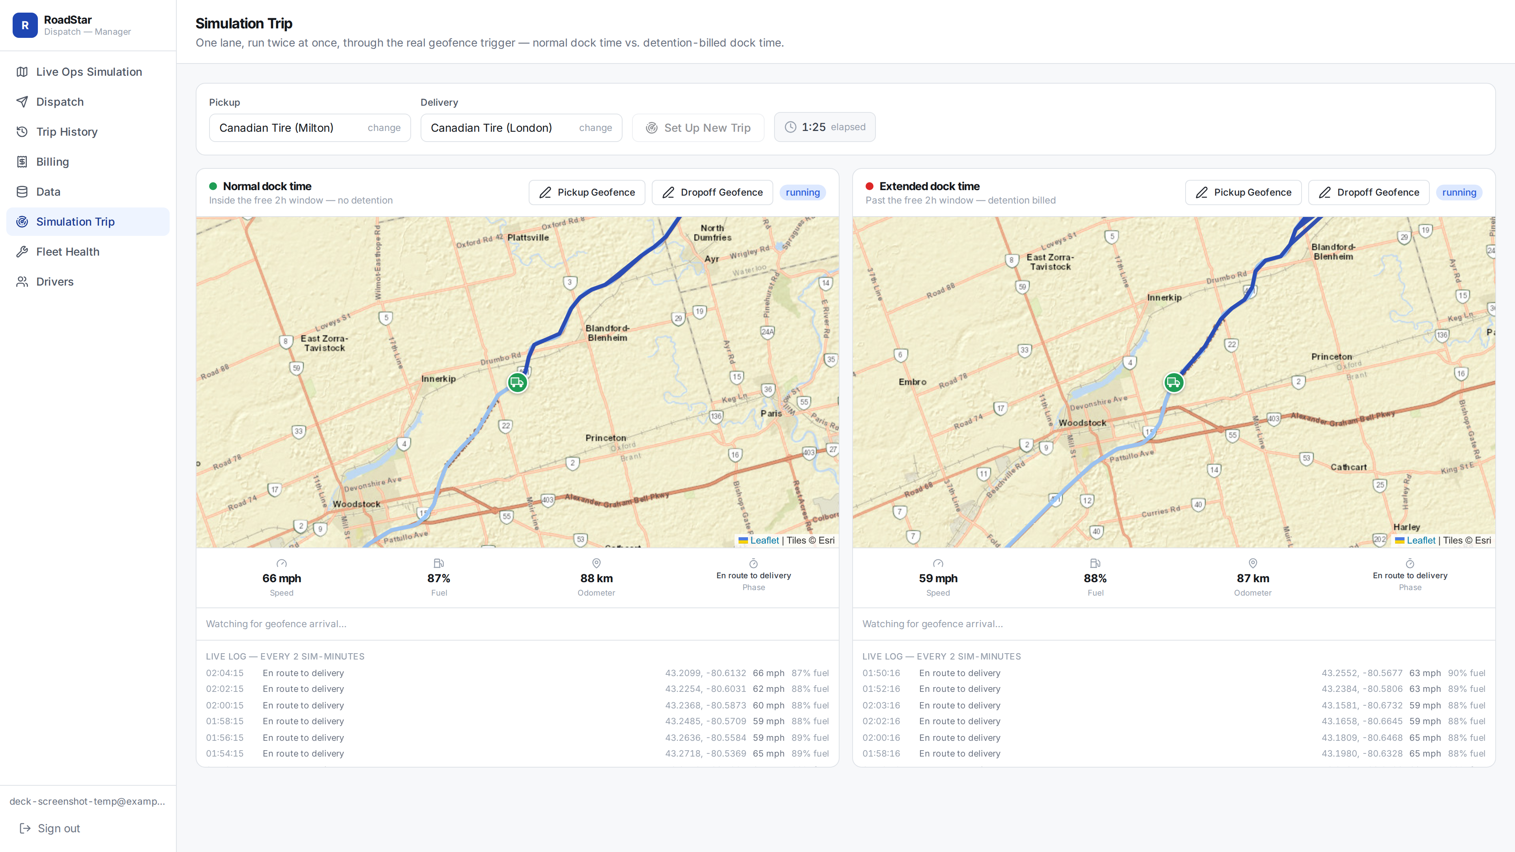
SOLUTION 2
Geofencing & Automated Detention Billing
549 / 2,652
real dock events (21%) had NO geofence timestamp — automatic billing was impossible
67 stops
of the rest ran past the free 2h window — 89 billable hours found, previously unbilled
$84.16
real detention line item, auto-calculated on a live invoice
Yard-shuttle legs (same facility, 0 road miles) sit parked for a full shift — not a customer wait. Naively billing them would add 192 more “hours” that aren't real detention; excluded here.
Every truck crossing a facility geofence writes a real timestamp to Postgres. Detention past 2 hours calculates itself; nothing depends on a dispatcher remembering to log it.
Same lane, run twice at once — normal dock time vs. detention-billed dock time
BATMAN'S BUTLER
12

Slide 13
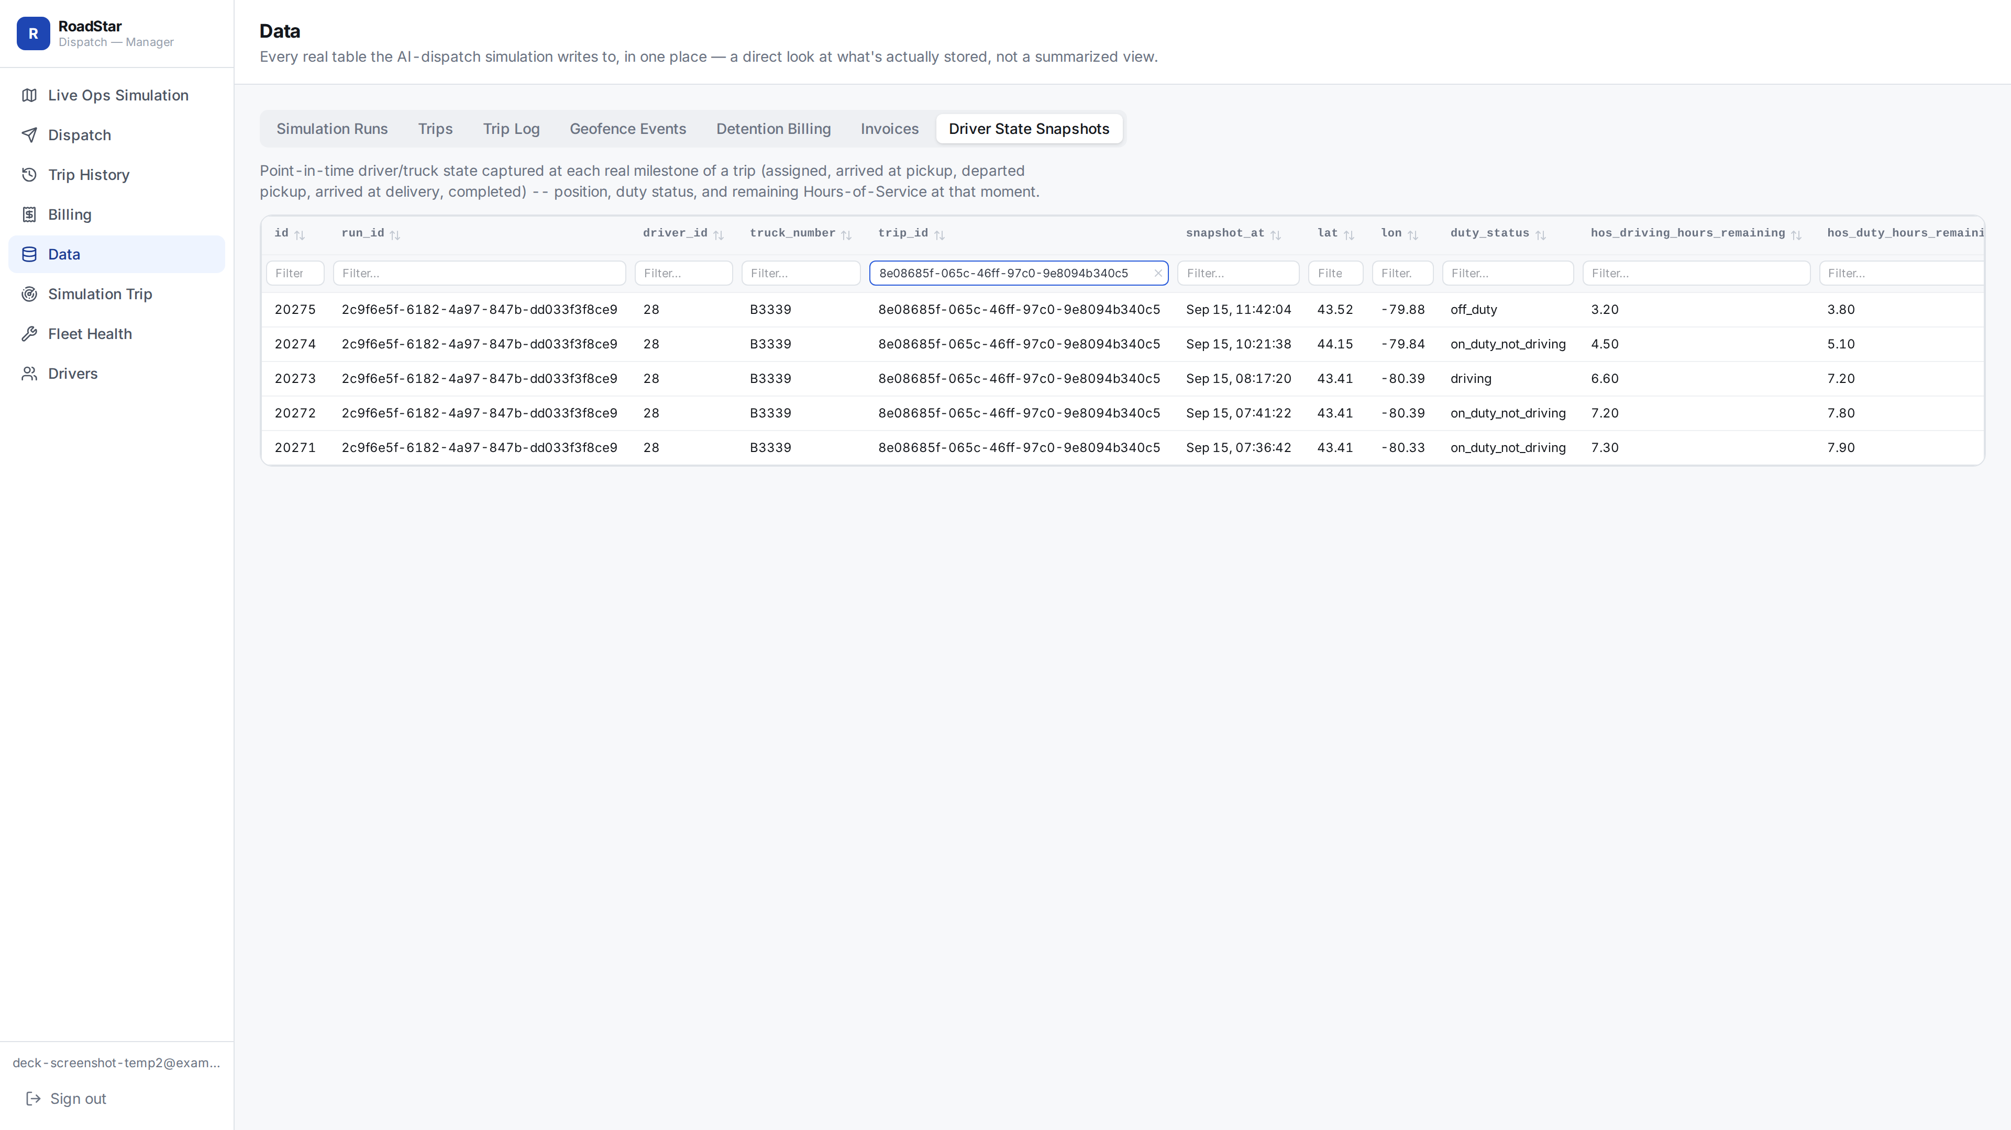
OWN YOUR DATA
Every Milestone, Fully Queryable
The same Data tab a carrier can point any BI tool or model at — filtered here to one real trip's full driver-state history.
SEVEN REAL TABLES, ALL QUERYABLE
Simulation Runs
Trips
Trip Log
Geofence Events
Detention Billing
Invoices
Driver State Snapshots
driver_state_snapshots filtered to one trip_id — assigned → arrived → departed → delivered → completed
BATMAN'S BUTLER
13

Slide 14
OWN YOUR DATA · THE SCHEMA
A Real Schema, Not a Data Dump
Two Postgres schemas back every screen in this deck — the day-ahead AI plan, and the full live-ops audit trail.
DISPATCH · day-ahead AI planning (5 tables)
SIMULATION · live-ops audit trail (5 table groups)
days PK id
One row per service date — draft → finalized.
runs PK run_id
One row per day the AI's plan is replayed.
day_trucks PK (day_id, truck_number)
Which trucks are available that day.
trips PK trip_id · FK run_id, driver_id
One row per trip inside that plan.
day_drivers PK (day_id, driver_id)
Driver availability + 4 live HOS clocks.
trip_log · geofence_events · driver_state_snapshots FK trip_id ×3
Completed-trip metrics, dock timestamps, and HOS at every milestone.
day_orders PK id · FK day_id
The day's real order book — pickup/dest, weight, rate.
detention_billing PK (trip_id, location_id)
billable_hours — computed by Postgres itself, past the free 2h window.
assignments PK (day_id, truck_number)
The AI's output: driver + order_ids[] per truck.
invoices PK invoice_id · FK trip_id
Linehaul + detention + tax — totals computed by Postgres itself.
Both schemas read from the same real fleet data — ground_truth.drivers/trucks/trailers, reference.locations, calibration.truck_profile — plus public.profiles for auth. Nothing here is a copy of the source Excel; it's a designed relational schema a carrier can query, join, and extend on its own.
BATMAN'S BUTLER
14

Slide 15
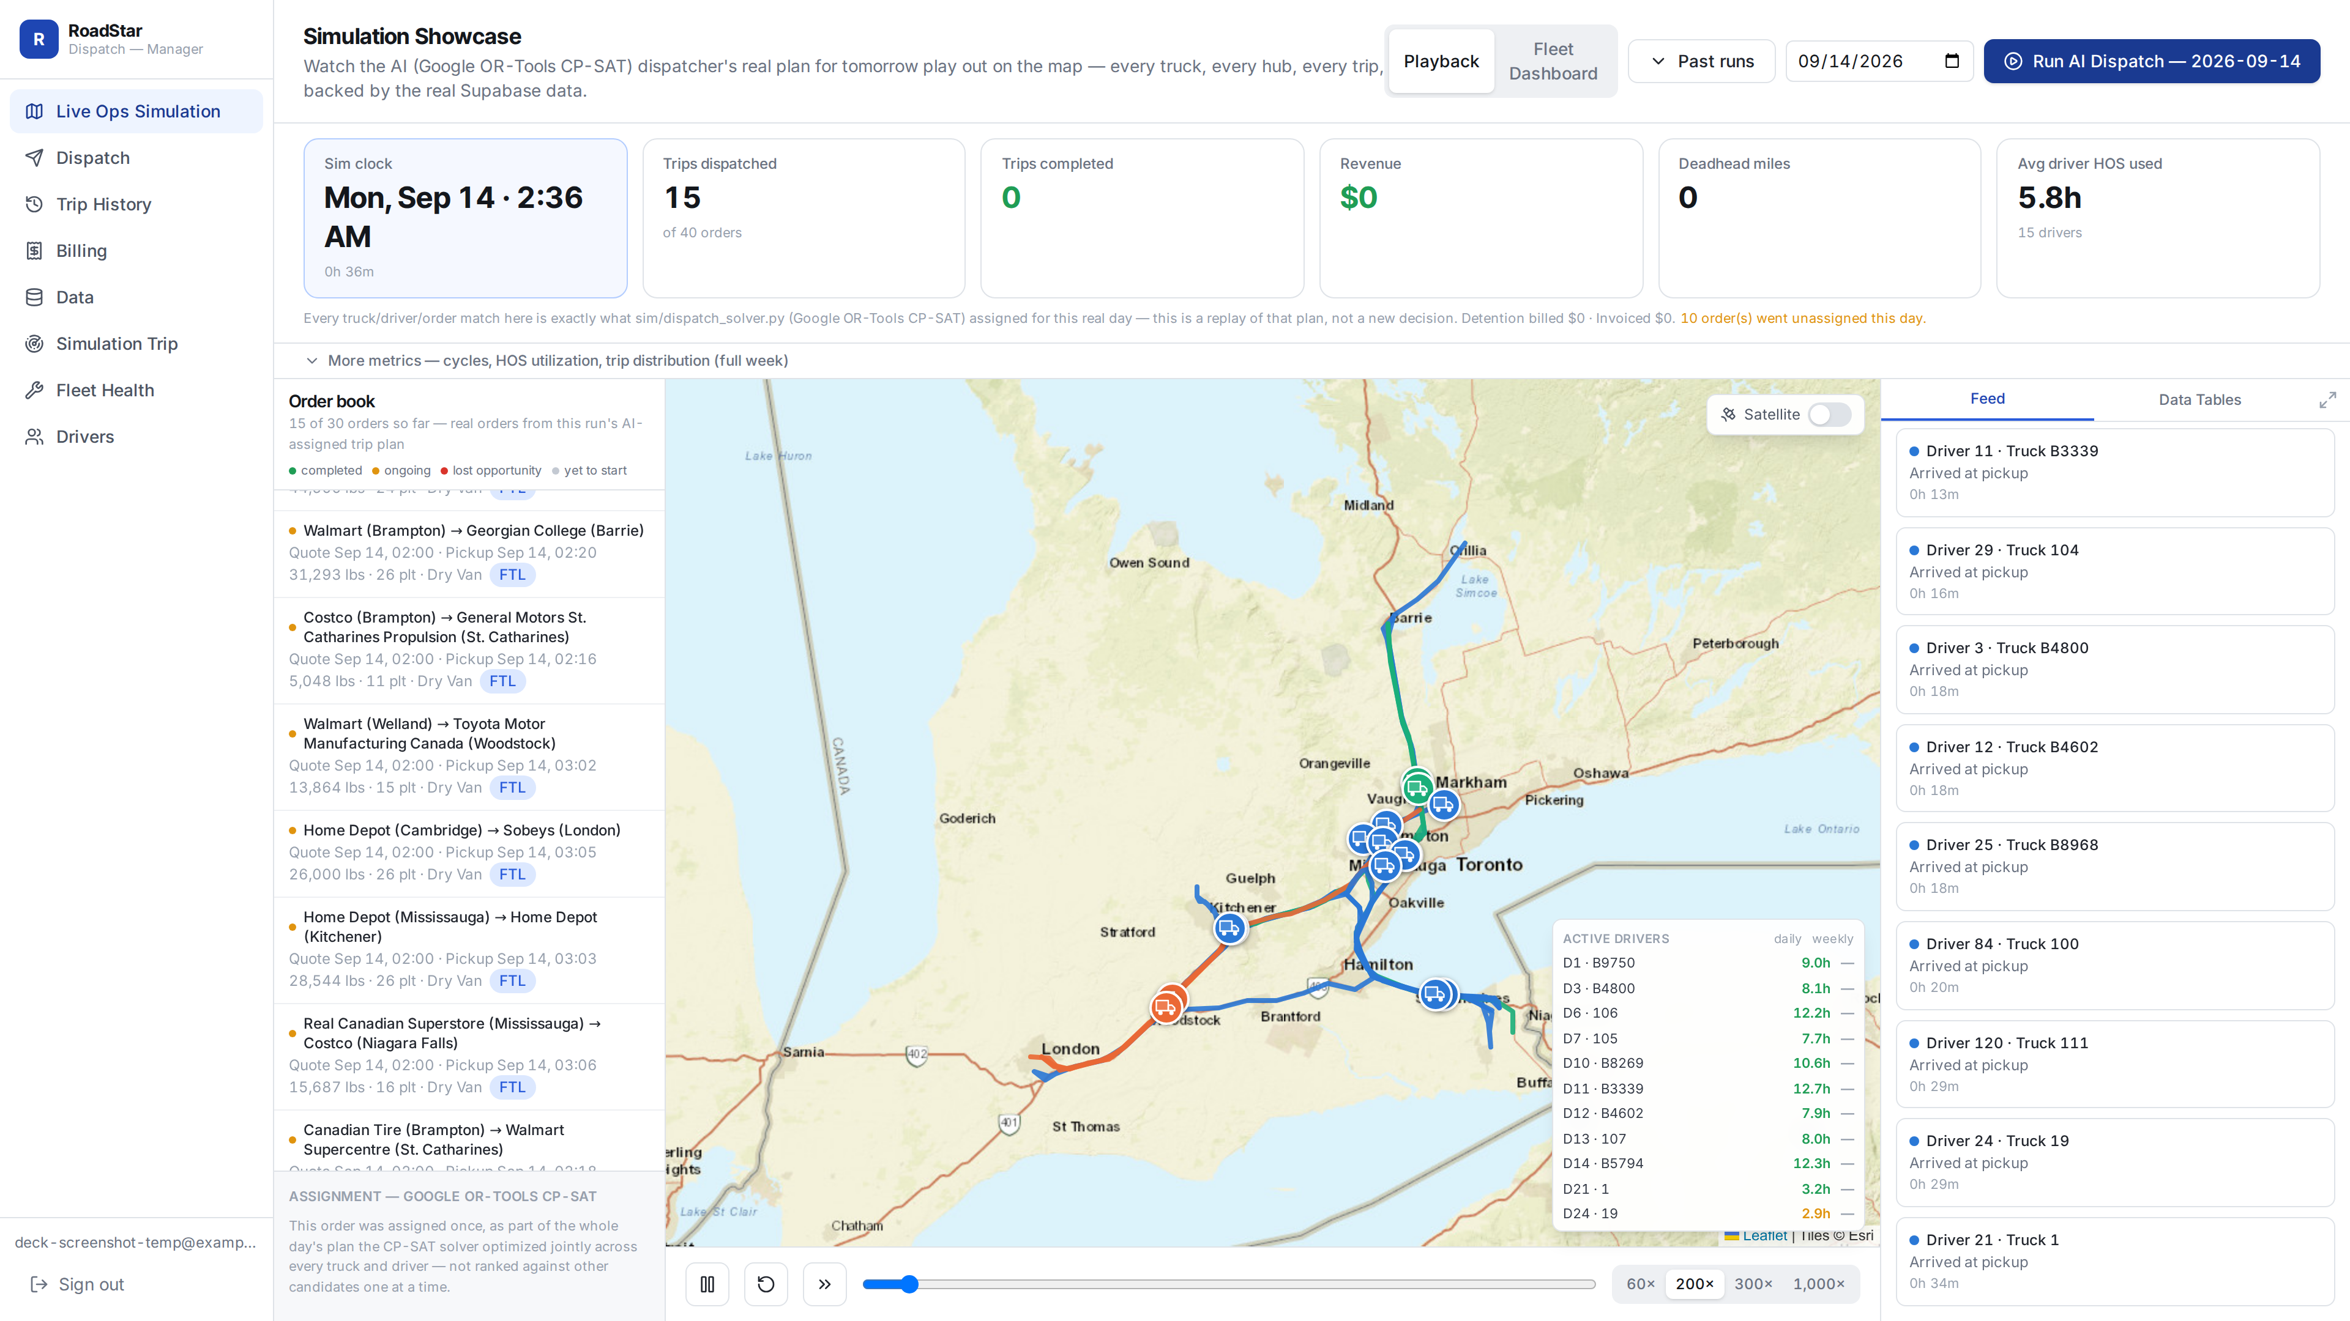
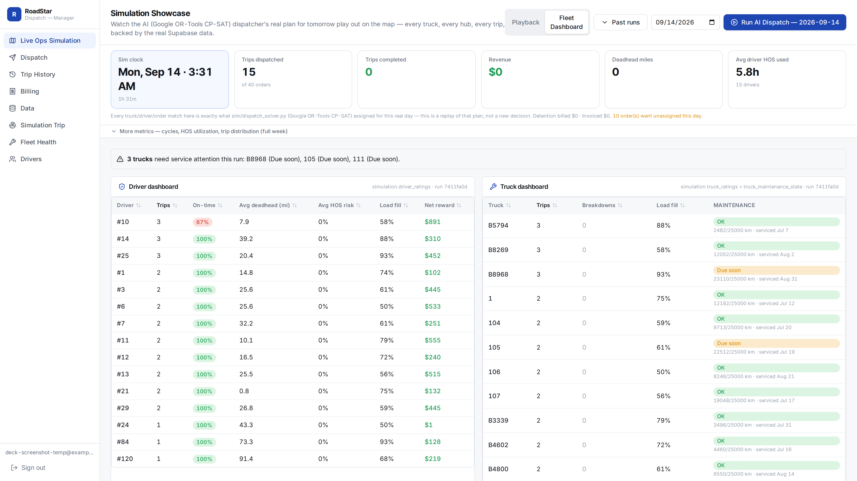
SOLUTION 3
Live Simulation & a Fleet Platform You Own
Live-ops replay — real OSRM routes, real hubs, real order book
Per-driver net reward, live — the same score from the reward-engine slide, on real assignments
BATMAN'S BUTLER
15

Slide 16
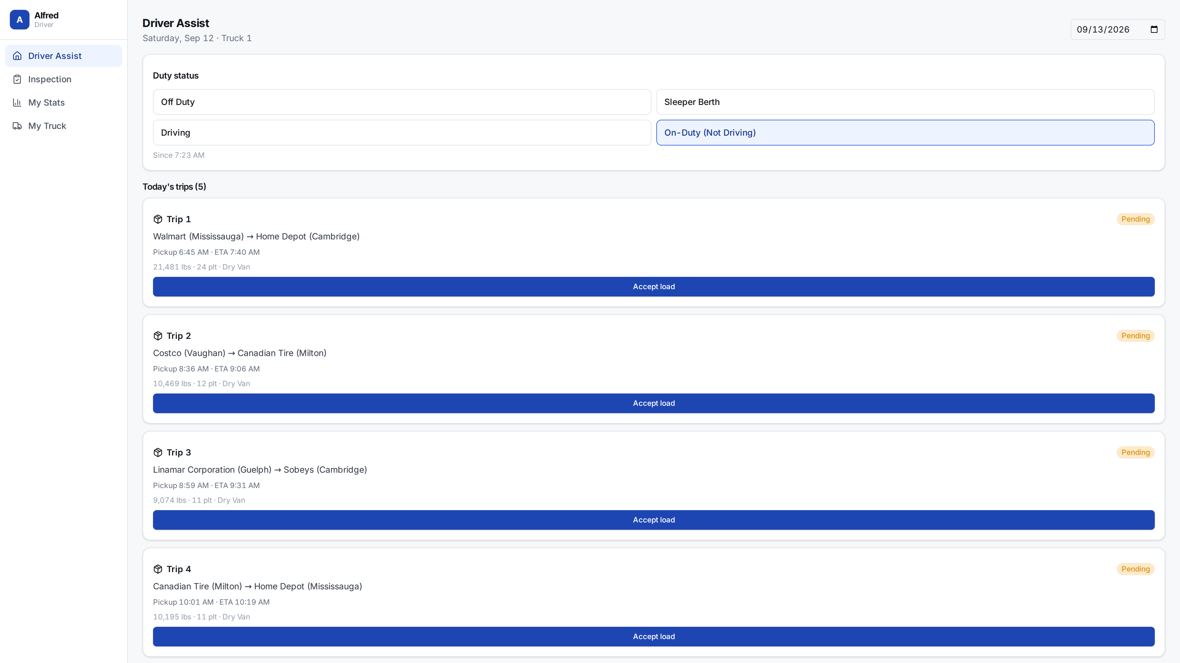
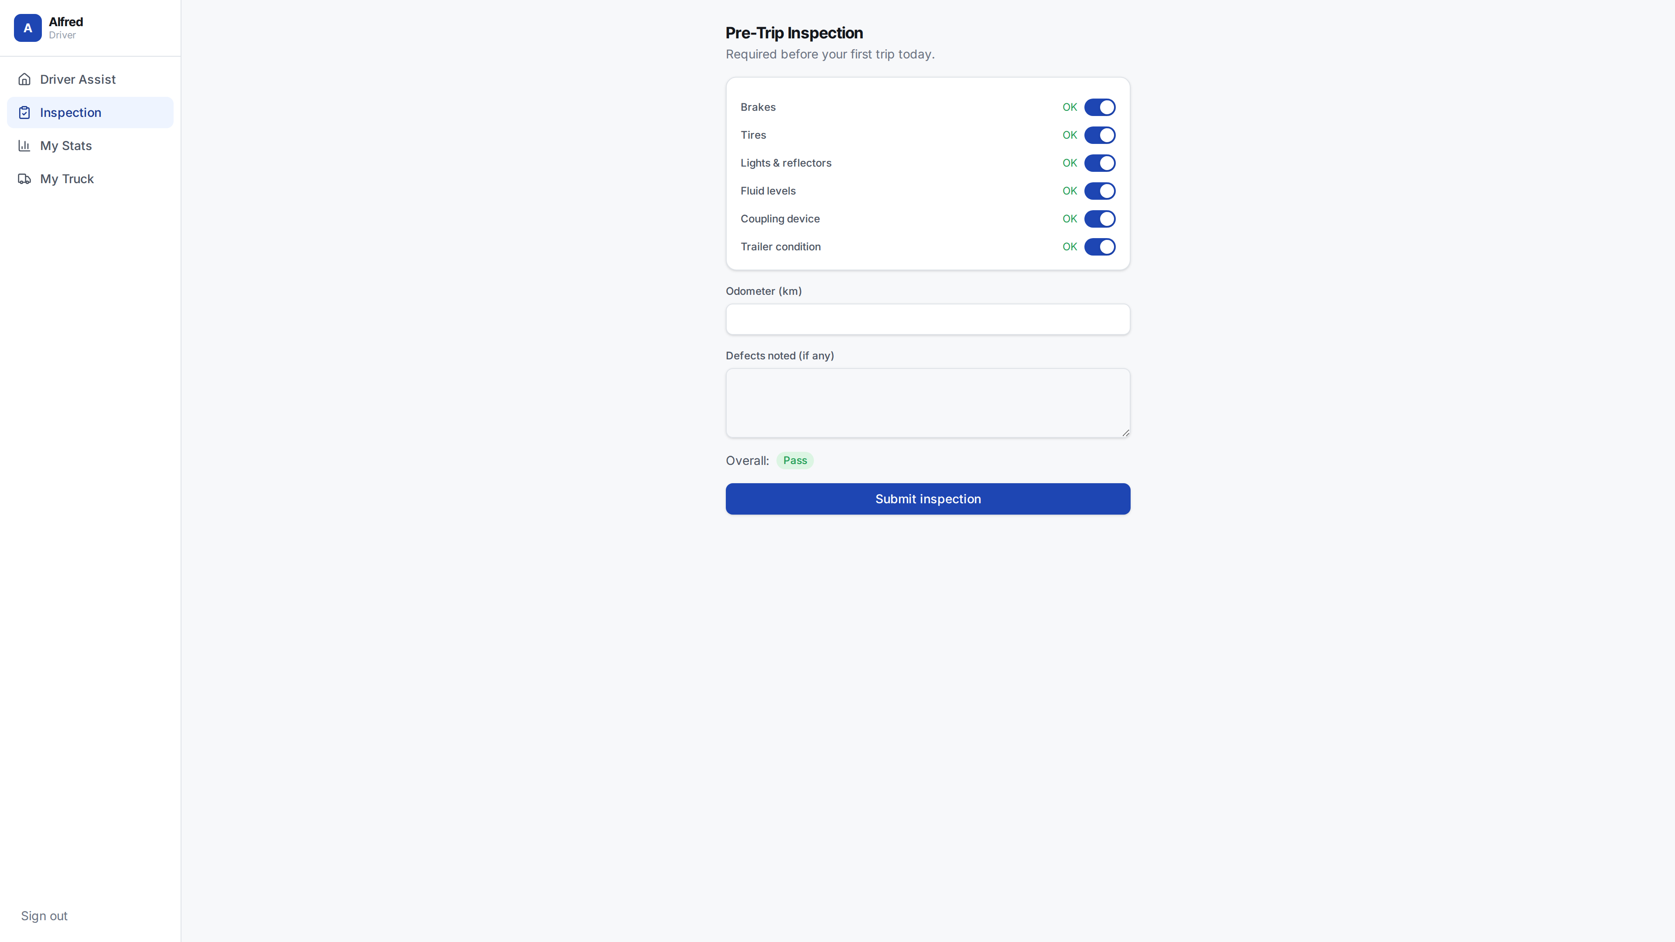
CLOSING THE LOOP
The Driver Side: Accept, Inspect, Drive
The brief's third required component — a real driver interface, not just a dispatcher view. Same login, the same real trip data.
Driver Assist — today's 5 real assigned trips, accept load, live duty status (ELD)
Pre-trip DVIR — pass/fail checklist, logged straight to Postgres
BATMAN'S BUTLER
16

Slide 17
THE BUSINESS CASE
Built in a Hackathon. Priced Like It.
STACK
TRUE COST OF OWNERSHIP
React + Vite
Dispatcher & driver web app
The fragmented stack
$800/mo load boards + $600/yr/truck ELD + $50/mo/user TMS + quoting fees + a separate maintenance/accounting system — rented forever, none of it owned, none of it customizable.
FastAPI (Python)
Scoring, simulation, dispatch API
Google OR-Tools
CP-SAT day-ahead solver
OSRM
Free, self-hosted road routing
This platform
One Supabase-backed system the carrier owns outright. No per-seat tax, no vendor lock-in, scales with the fleet, customizable because it's yours — built in one hackathon.
Supabase / Postgres
Owned data, RLS, live tables
That's the hackathon's own ask, answered: intelligent dispatch dashboards, built rapidly and affordably, in the AI revolution.
BATMAN'S BUTLER
17

Slide 18
SEE IT LIVE NOW
One Platform.
Owned Data. Real Revenue.
AI Load-Matching
+19% revenue, −21% deadhead — 46 real days, full deployed fleet
Detention Billing
Automatic past 2h — no manual check calls
Owned Platform
OSRM + Supabase — no per-seat software tax
BATMAN'S BUTLER
Live demo follows this deck.

Slide 19
Thank You.
Questions, feedback, or want to help build this further? Always happy to chat.
GitHub
github.com/hazardscarn/roadstar-challenge
Email
davidacad10@gmail.com
BATMAN'S BUTLER
RoadStar Hackathon 2026 · Southern Ontario City Dispatch

