Slide 1
Car Resale Prediction using Machine Learning
and Deep Learning
Project Presentation
By : Name: Farhan Khatib Hazarika
Enrol No: 2313018025
B. Tech (CSE), 7th Sem
Institute: Girijananda Chowdhury University,
Assam

Slide 2
Problem Statement
The problem:
Used-car prices depend on many interacting factors such as age, kilometers driven, vehicle specifications, location, ownership and market signals
Why it matters?
A data-driven estimate can support more consistent pricing decisions and reduce reliance on subjective manual valuation.
Prediction task
Supervised regression: predict the continuous target variable ‘sale price’ for a used car.

Slide 3
Problem Objective
Objective:
Predicting the resale price of a used car using various factors based on its characteristics using various ML and ANN.
Detailed Analysis: To develop a machine learning and Artificial Neural Network (ANN) based system that predicts the resale/sale price of a used car using factors such as car details, manufacturing year, kilometers driven, fuel type, location, ownership, transmission, vehicle condition, and other relevant features.

Slide 4
Dataset Overview
Data Source: Used_Car_Price_Prediction.csv
https://www.kaggle.com/datasets/vrajesh0sharma7/used-car-price-prediction
The dataset contains detailed information about used cars, including their manufacturing details, usage, location, specifications, ownership history, and pricing information. This data is used to estimate the resale value of a car.
Features: Car Name, Manufacturing Year, Fuel Type, Kilometers Run, City, Body Type, Transmission, Variant, Manufacturer, Model, Total Owners, Original Price, Broker Quote, Car Rating, Times Viewed, and other car-related attributes.
Target Variable: Sale Price
The target variable is the sale price of the used car, which represents the estimated resale value that our Machine Learning and Deep Learning models aim to predict.

Slide 5
Data Preprocessing
1
Duplicates
2
Data types
3
Dropped columns
Removed rto, source, car_availability,
ad_created_on, emi_starts_from,
booking_down_pymnt and reserved.
Removed duplicate rows.
Converted key numeric columns to
numeric with coercion.
4
Missing values
5
Standardized numerical features using
StandardScaler.
Encoding
6
Scaling
• Numeric: median imputation
• Categorical: most-frequent imputation.
One-hot encoded categorical /
Boolean features; unknown
categories ignored.

Slide 6
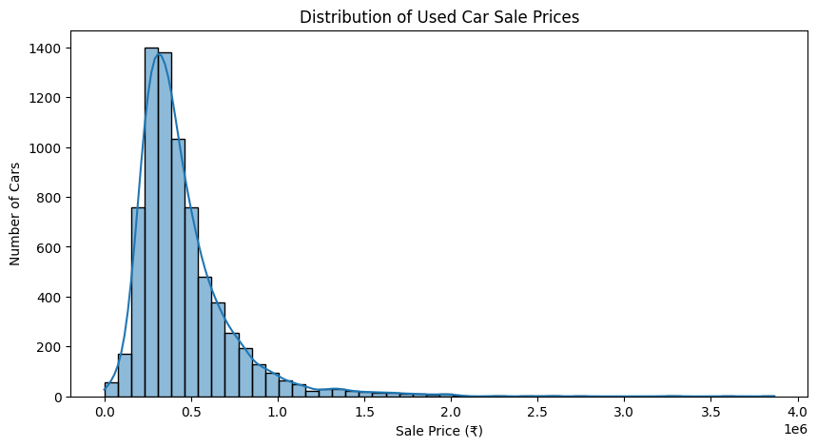
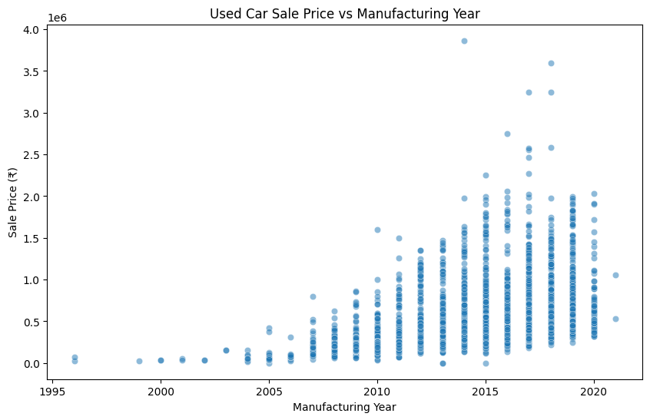
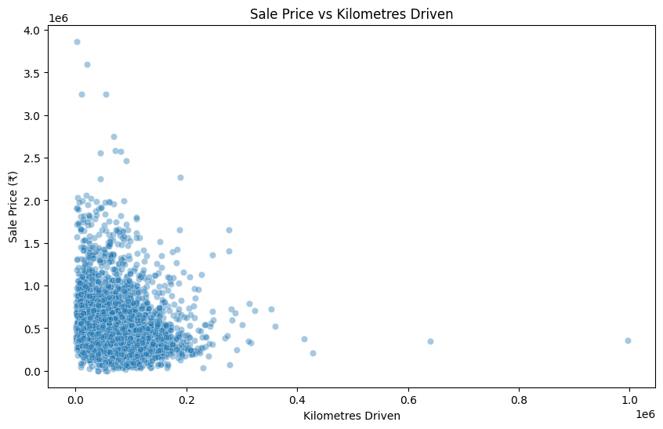
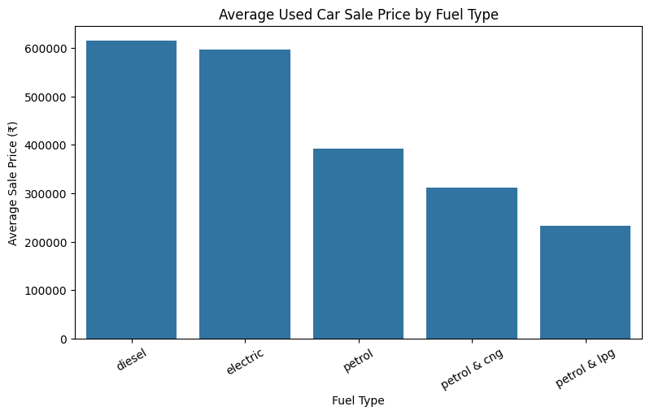
EDA & Visual Insights

Slide 7
ML Methodology
Raw dataset
7,400 rows,
29 columns
Clean
duplicates+leakage
Prepare
impute + encode + scale
Split
80% train / 20% test
Predict
new car price
Select
best R² / less errors
Evaluate
MAE • RMSE • R²
Train
4 regression models
Evaluation rule
Lower MAE/RMSE is better; higher R² is better. The notebook selects Gradient Boosting as the final model.

Slide 8
Models Implemented
Linear Regression:
Simple linear relationship modeling between features and target variable for baseline prediction performance.
Random Forest:
Ensemble of decision trees that captures nonlinear interactions.
Gradient Boosting:
Sequentially improves weak decision trees and gives strong performance on structured tabular data.
ANN:
Dense neural network with ReLU layers and dropout for nonlinear function approximation.

Slide 9
Model Evaluation
The models were evaluated on the basis of Mean Absolute Error (MAE) , Root Mean Square Error and R2 score. The model having the best R2 score and less possible error is chosen to be the best. Upon Evaluation, Gradient Boosting is found to be the best with highest R2 score(0.9278) and the lowest error.
Model | MAE (₹) | RMSE (₹) | R2
Gradient Boosting | 18,915 | 80,673 | 0.9278
Random Forest | 18,884 | 86,717 | 0.9166
ANN | 25,372 | 85,471 | 0.9190
Linear Regression | 26,157 | 86,589 | 0.9168

Slide 10
Prediction Demo
Prediction based on user input
Example input
ESTIMATED RESALE PRICE
Car: Maruti Swift Manufacturing year: 2018 Fuel: Petrol Kilometers: 35,000 City: Mumbai Body type: Hatchback Transmission: Manual Variant: VXI Owners: 1 Broker quote: ₹4,50,000 Original price: ₹6,00,000 Car rating: Great Fitness certificate: True Warranty: False
₹4,78,853.38
Prediction generated by the selected Gradient Boosting model

Slide 11
Results, Conclusion & Limitations
Main findings:
Gradient Boosting selected R² = 0.9278 RMSE ≈ ₹80.7K MAE ≈ ₹18.9K
Conclusion:
The project successfully developed an ML and DL-based system for predicting used car resale prices. The models identified important patterns from vehicle features and provided reliable price estimates. Gradient Boosting achieved the best performance with an R² score of 0.9278, showing strong predictive capability.
Current limitations:
Dataset contains missing values One-hot encoding creates 1,508 processed features No explicit outlier-removal step is implemented ANN training uses a fixed 100-epoch setup

Slide 12
Future Scope & Plans
Model Improvement:
Explore advanced ML/DL models and hyperparameter tuning to improve prediction accuracy.
Real-Time Price Prediction:
Develop a user-friendly application that provides instant resale price estimates based on car details.
More Data Integration:
Include real-time market trends, location-based pricing, and updated vehicle listings for better predictions.
Github URL:
https://github.com/hazarikafarhan05/Car-Resale-Value-Prediction-PBEL-PROJECT.git

Slide 13
Thank You

