Slide 1


Implementation of Core decomposition of deterministic and uncertain Graphs
Team members Hazar Snoussi
Ananta Purohit
Lokesh Parappurath
Soudabeh Barghi

Slide 2
Outline
INTRODUCTION
PROBLEM SPECIFICATION
IMPLEMENTATION
EVALUATION ON REAL WORLD DATASETS
CONCLUSION
REFERENCES

Slide 3
Outline
INTRODUCTION
PROBLEM SPECIFICATION
IMPLEMENTATION
EVALUATION ON REAL WORLD DATASETS
CONCLUSION
REFERENCES

Slide 4
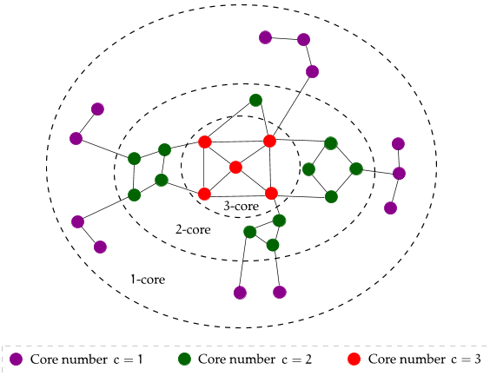
k-Core Decomposition
INTRODUCTION
PROBLEM SPECIFICATION
IMPLEMENTATION
EVALUATION ON REAL WORLD DATASETS
CONCLUSION
REFERENCES
G <V,E> undirected graph.
A subgraph H = (C,E|C); C ⊆ V
is a k-core / core of order k
iff ∀v ∈ C : degreeH(v) ≥ k =>H is the maximum subgraph.

Slide 5
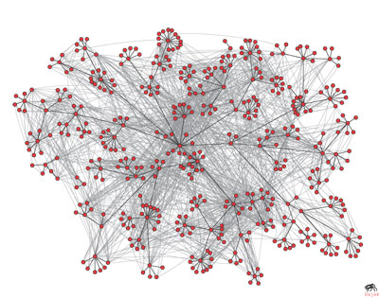
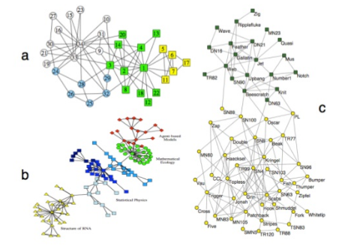
Application of k-Core Decomposition
INTRODUCTION
PROBLEM SPECIFICATION
IMPLEMENTATION
EVALUATION ON REAL WORLD DATASETS
CONCLUSION
REFERENCES

Slide 6
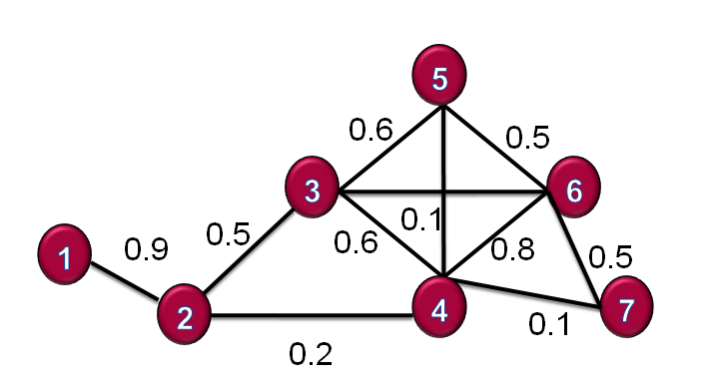

…what about Uncertain Graphs ??
INTRODUCTION
PROBLEM SPECIFICATION
IMPLEMENTATION
EVALUATION ON REAL WORLD DATASETS
CONCLUSION
REFERENCES

Slide 7
Reasons of uncertainty
INTRODUCTION
PROBLEM SPECIFICATION
IMPLEMENTATION
EVALUATION ON REAL WORLD DATASETS
CONCLUSION
REFERENCES
Intentional for Privacy purpose.
Outcome of Link Prediction.
Influence of one node on another
(E.g.. Homophily ,Viral Marketing)

Slide 8
Outline
INTRODUCTION
PROBLEM SPECIFICATION
IMPLEMENTATION
EVALUATION ON REAL WORLD DATASETS
CONCLUSION
REFERENCES

Slide 9
INTRODUCTION
PROBLEM SPECIFICATION
IMPLEMENTATION
EVALUATION ON REAL WORLD DATASETS
CONCLUSION
REFERENCES
“Can the core decomposition of an uncertain graph be computed efficiently ?”

Slide 10
Outline
INTRODUCTION
PROBLEM SPECIFICATION
IMPLEMENTATION
EVALUATION ON REAL WORLD DATASETS
CONCLUSION
REFERENCES

Slide 11
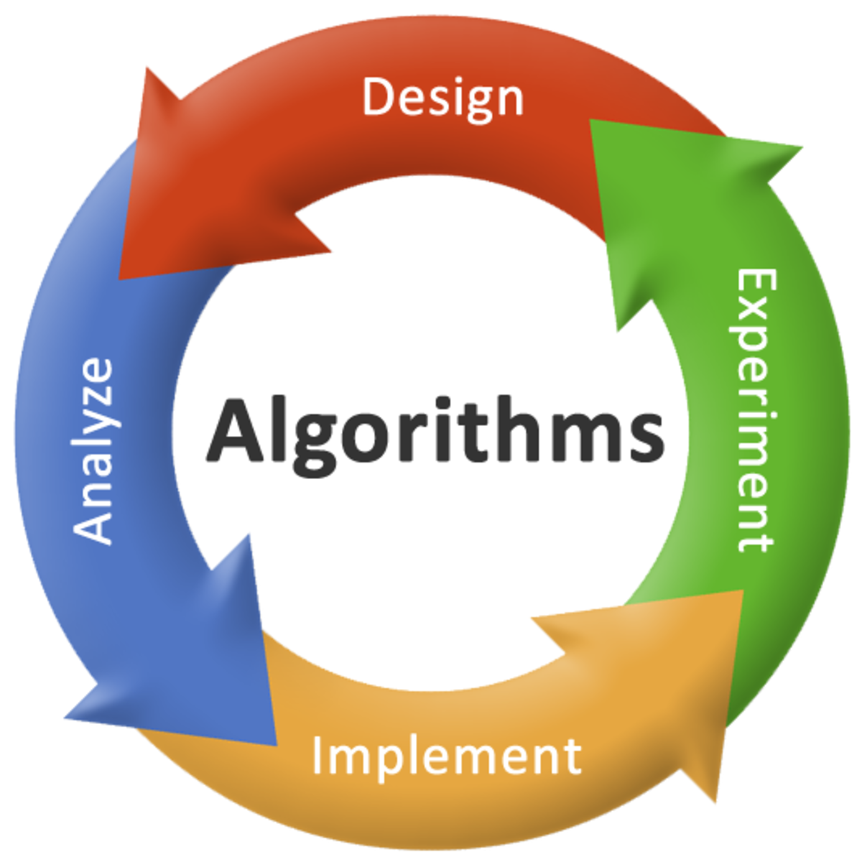
COMPUTING K-CORES IN DETERMINISTIC GRAPH
INTRODUCTION
PROBLEM SPECIFICATION
IMPLEMENTATION
EVALUATION ON REAL WORLD DATASETS
CONCLUSION
REFERENCES

Slide 12
Core Decomposition for Deterministic Graph
n_dimensional vector
core number

Slide 13

INTRODUCTION
PROBLEM SPECIFICATION
IMPLEMENTATION
EVALUATION ON REAL WORLD DATASETS
CONCLUSION
REFERENCES
5
3
6
1
2
4
7

Slide 14
d[1] | d[2] | d[3] | d[4] | d[5] | d[6] | d[7]
1 | 3 | 4 | 5 | 3 | 4 | 2
INTRODUCTION
PROBLEM SPECIFICATION
IMPLEMENTATION
EVALUATION ON REAL WORLD DATASETS
CONCLUSION
REFERENCES
D[1] | D[2] | D[3] | D[4] | D[5]
1 | 7 | 2 | 3 | 4
 |  | 5 | 6
5
3
6
1
2
4
7
c[1] | c[2] | c[3] | c[4] | c[5] | c[6] | c[7]
0 | 0 | 0 | 0 | 0 | 0 | 0

Slide 15
d[1] | d[2] | d[3] | d[4] | d[5] | d[6] | d[7]
1 |  | 4 | 5 | 3 | 4 | 2
INTRODUCTION
PROBLEM SPECIFICATION
IMPLEMENTATION
EVALUATION ON REAL WORLD DATASETS
CONCLUSION
REFERENCES
3
2
D[1] | D[2] | D[3] | D[4] | D[5]
 |  |  | 3 | 4
 |  |  | 6
5
1
7
2
5
3
6
k=1
1
2
4
7
c[1] | c[2] | c[3] | c[4] | c[5] | c[6] | c[7]
 | 0 | 0 | 0 | 0 | 0 | 0
0
1

Slide 16
d[1] | d[2] | d[3] | d[4] | d[5] | d[6] | d[7]
1 | 2 | 3 | 3 | 3 | 3 | 2
D[1] | D[2] | D[3] | D[4] | D[5]
5
3
4
3
6
k=3
5
6
1
2
4
7
c[1] | c[2] | c[3] | c[4] | c[5] | c[6] | c[7]
1 | 2 |  | 0 | 0 | 0 | 2
3
0

Slide 17
d[1] | d[2] | d[3] | d[4] | d[5] | d[6] | d[7]
1 | 2 | 3 | 3 | 3 | 3 | 2
D[1] | D[2] | D[3] | D[4] | D[5]
5
4
5
3
6
k=3
6
1
2
4
7
c[1] | c[2] | c[3] | c[4] | c[5] | c[6] | c[7]
1 | 2 | 3 |  | 0 | 0 | 2
3
0

Slide 18
d[1] | d[2] | d[3] | d[4] | d[5] | d[6] | d[7]
1 | 2 | 3 | 3 | 3 | 3 | 2
D[1] | D[2] | D[3] | D[4] | D[5]
5
5
6
3
6
k=3
1
2
4
7
c[1] | c[2] | c[3] | c[4] | c[5] | c[6] | c[7]
1 | 2 | 3 | 3 |  | 0 | 2
0
3

Slide 19
d[1] | d[2] | d[3] | d[4] | d[5] | d[6] | d[7]
1 | 2 | 3 | 3 | 3 | 3 | 2
D[1] | D[2] | D[3] | D[4] | D[5]
6
5
3
6
k=3
1
2
4
7
c[1] | c[2] | c[3] | c[4] | c[5] | c[6] | c[7]
1 | 2 | 3 | 3 | 3 |  | 2
0
3

Slide 20
INTRODUCTION
PROBLEM SPECIFICATION
IMPLEMENTATION
EVALUATION ON REAL WORLD DATASETS
CONCLUSION
REFERENCES
5
3
6
1
2
4
7
c[1] | c[2] | c[3] | c[4] | c[5] | c[6] | c[7]
1 | 2 | 3 | 3 | 3 | 3 | 2

Slide 21


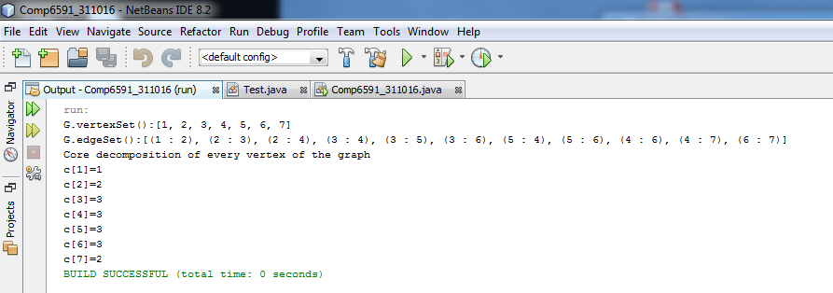
Mathematical Graph-Theory & Algorithms
K-Core Decomposition of Large Networks on a Single PC

Slide 22
INTRODUCTION
PROBLEM SPECIFICATION
IMPLEMENTATION
EVALUATION ON REAL WORLD DATASETS
CONCLUSION
REFERENCES

Slide 23
5
0.6
0.5
3
6
0.1
0.5
0.6
1
0.9
0.8
0.5
2
4
7
0.1
0.2

Slide 25
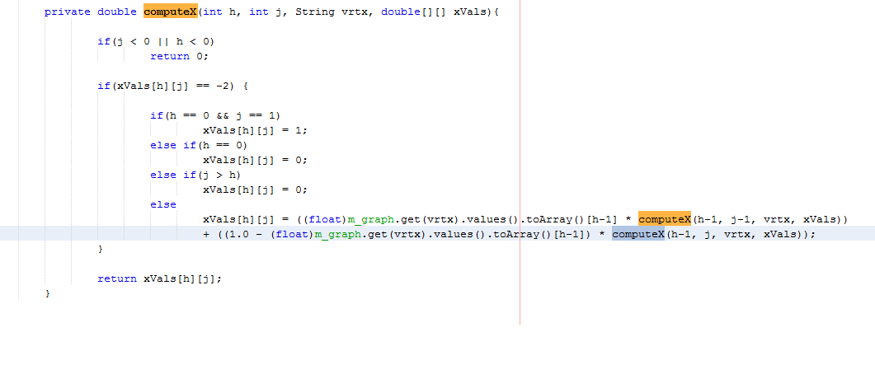
INTRODUCTION
PROBLEM SPECIFICATION
IMPLEMENTATION
EVALUATION ON REAL WORLD DATASETS
CONCLUSION
REFERENCES

Slide 26
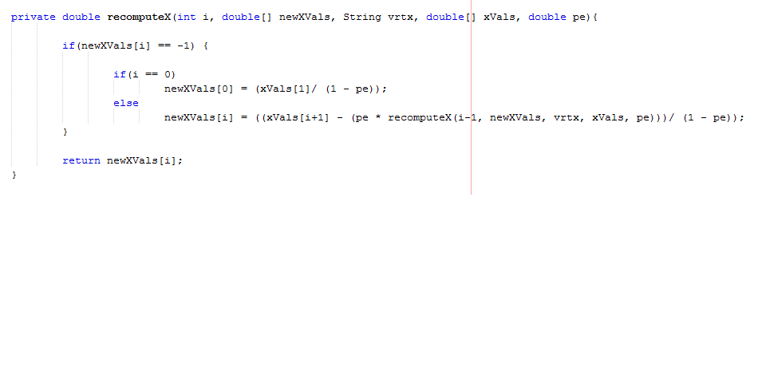
INTRODUCTION
PROBLEM SPECIFICATION
IMPLEMENTATION
EVALUATION ON REAL WORLD DATASETS
CONCLUSION
REFERENCES

Slide 27
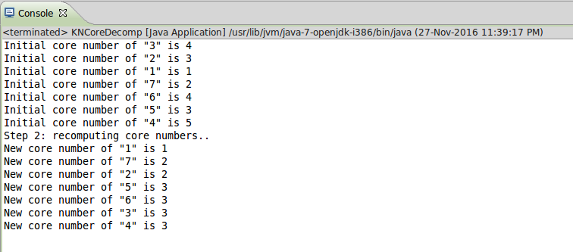
INTRODUCTION
PROBLEM SPECIFICATION
IMPLEMENTATION
EVALUATION ON REAL WORLD DATASETS
CONCLUSION
REFERENCES

Slide 28
Outline
INTRODUCTION
PROBLEM SPECIFICATION
IMPLEMENTATION
EVALUATION ON REAL WORLD DATASETS
CONCLUSION
REFERENCES

Slide 29
Quantitative Experiments
INTRODUCTION
PROBLEM SPECIFICATION
IMPLEMENTATION
EVALUATION ON REAL WORLD DATASETS
CONCLUSION
REFERENCES
Efficiency
Accuracy
Social Networking Website | No. Vertex | No. Edge | Definition of Probability
Flicker www.flicker.com | 24125 | 300836 | Homophily
DBLP www.informatik.uni-trier.de/~ley/db/ | 684911 | 2284991 | Co-authored (at least once)
BioMine www.biomine.org | 1008200 | 6742939 | Biological Interaction

Slide 30
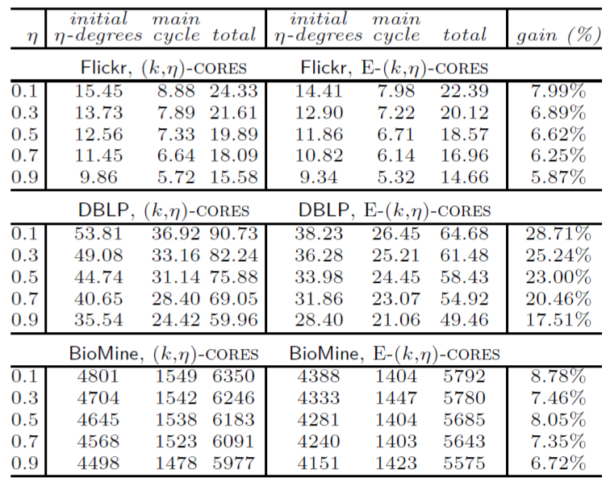
Efficiency
INTRODUCTION
PROBLEM SPECIFICATION
IMPLEMENTATION
EVALUATION ON REAL WORLD DATASETS
CONCLUSION
REFERENCES
(k,ɳ)-CORES
E-(k,ɳ)-CORES
Source: Bonchi,F. et , 2014

Slide 31
Accuracy
INTRODUCTION
PROBLEM SPECIFICATION
IMPLEMENTATION
EVALUATION ON REAL WORLD DATASETS
CONCLUSION
REFERENCES
Enlarging range and/or precision
! Slow down the overall computation
=>GOAL: minimising the number of critical operations
Dynamic programming method

Slide 32
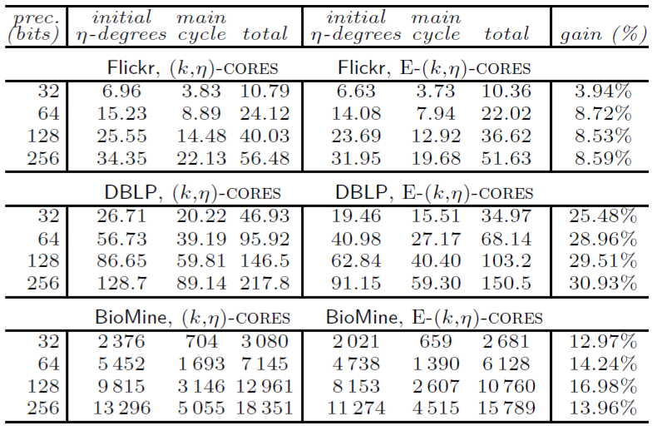
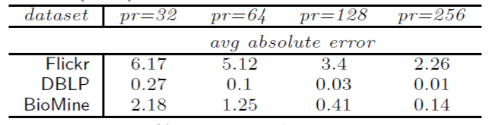
Note:
Larger precision
leads to:
better accuracy
worse efficiency

Slide 33
Outline
INTRODUCTION
PROBLEM SPECIFICATION
IMPLEMENTATION
EVALUATION ON REAL WORLD DATASETS
CONCLUSION
REFERENCES
INTRODUCTION
PROBLEM SPECIFICATION
IMPLEMENTATION
EVALUATION ON REAL WORLD DATASETS
CONCLUSION
REFERENCES

Slide 34
INTRODUCTION
PROBLEM SPECIFICATION
IMPLEMENTATION
EVALUATION ON REAL WORLD DATASETS
CONCLUSION
REFERENCES
Conclusion
Implemented the algorithm proposed by Batagelj and Zaversnik
Dynamic programming approach outperforms the EQ5
method and solves the issue of numerical Stability
and re-computation.
Proposed algorithm has a polynomial time complexity.
Speeding Up

Slide 35
Outline
INTRODUCTION
PROBLEM SPECIFICATION
IMPLEMENTATION
EVALUATION ON REAL WORLD DATASETS
CONCLUSION
REFERENCES

Slide 36
References
INTRODUCTION
PROBLEM SPECIFICATION
IMPLEMENTATION
EVALUATION ON REAL WORLD DATASETS
CONCLUSION
REFERENCES
http://jgrapht.org/
https://docs.oracle.com/javase/8/docs/api/
http://delab.csd.auth.gr/~apostol/tutorial-edbt-2016-summary.pdf
http://www.vldb.org/pvldb/vol9/p13-khaouid.pdf

