Slide 1
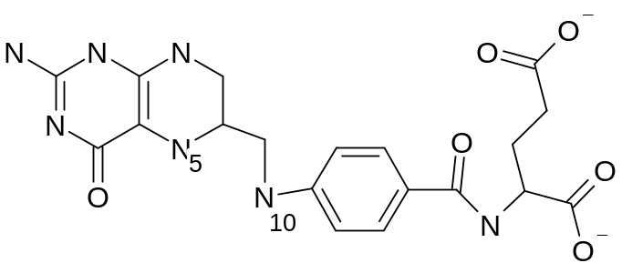
A
NADP⁺
NADPH
DHFR
Hcys
Met
10
MTR
4
THF
7
FAICAR
DHF
5
6
HCOOH
12
FDS
ATP
ATIC
11
2R
2
ATIC
Ser
FTS
CHODHF
HCHO
ADP
SHMT
Gly
AICAR
13
CH₃THF
FGAR
1R
1
GART
NADP⁺
NADPH
GAR
NADP⁺
NADPH
MTHFD
CHOTHF
3
MTHFR
8
9
CH₂THF
TS
B
dUMP
dTMP

Slide 2
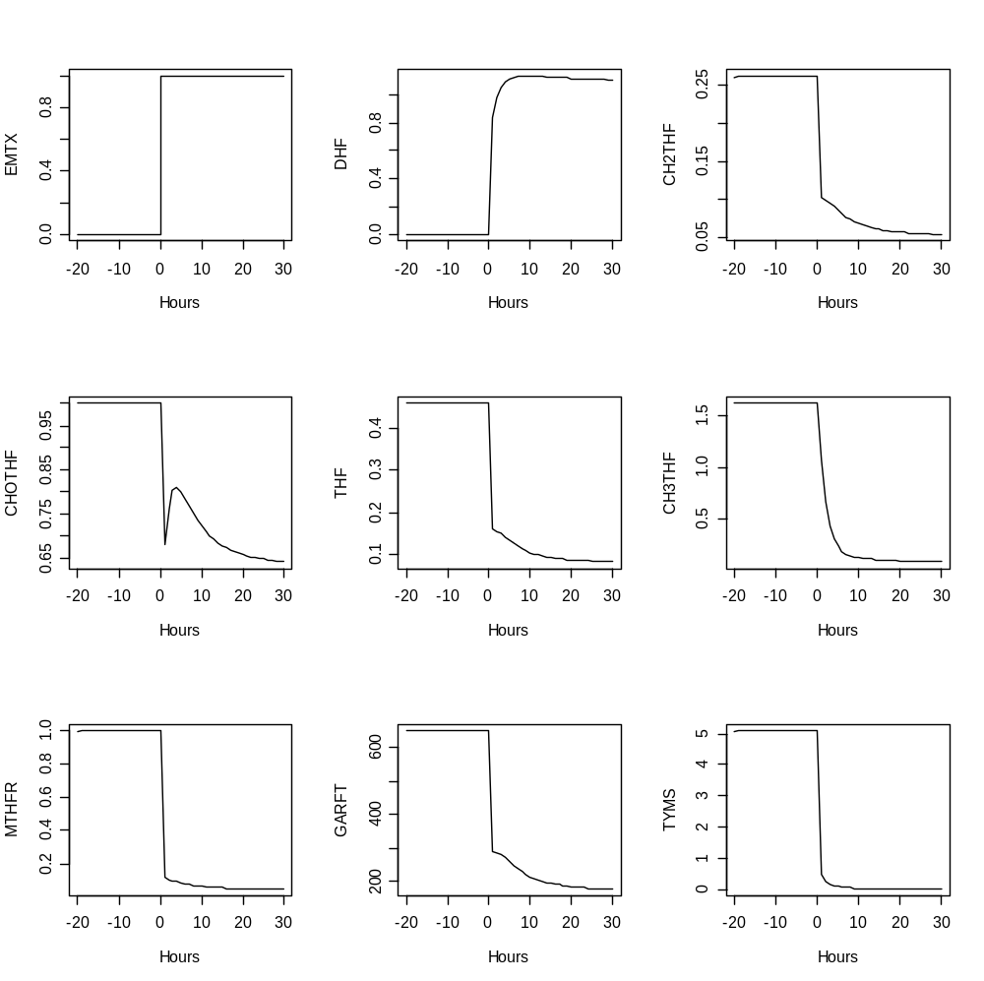

Slide 3
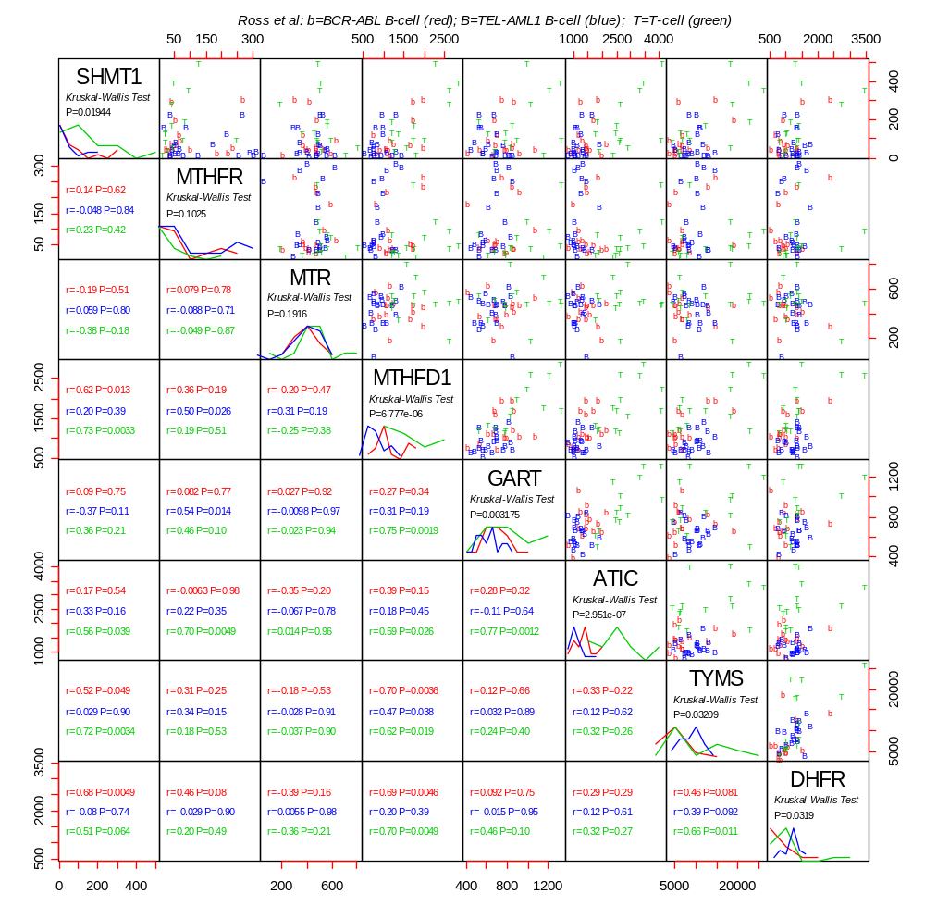

Slide 4
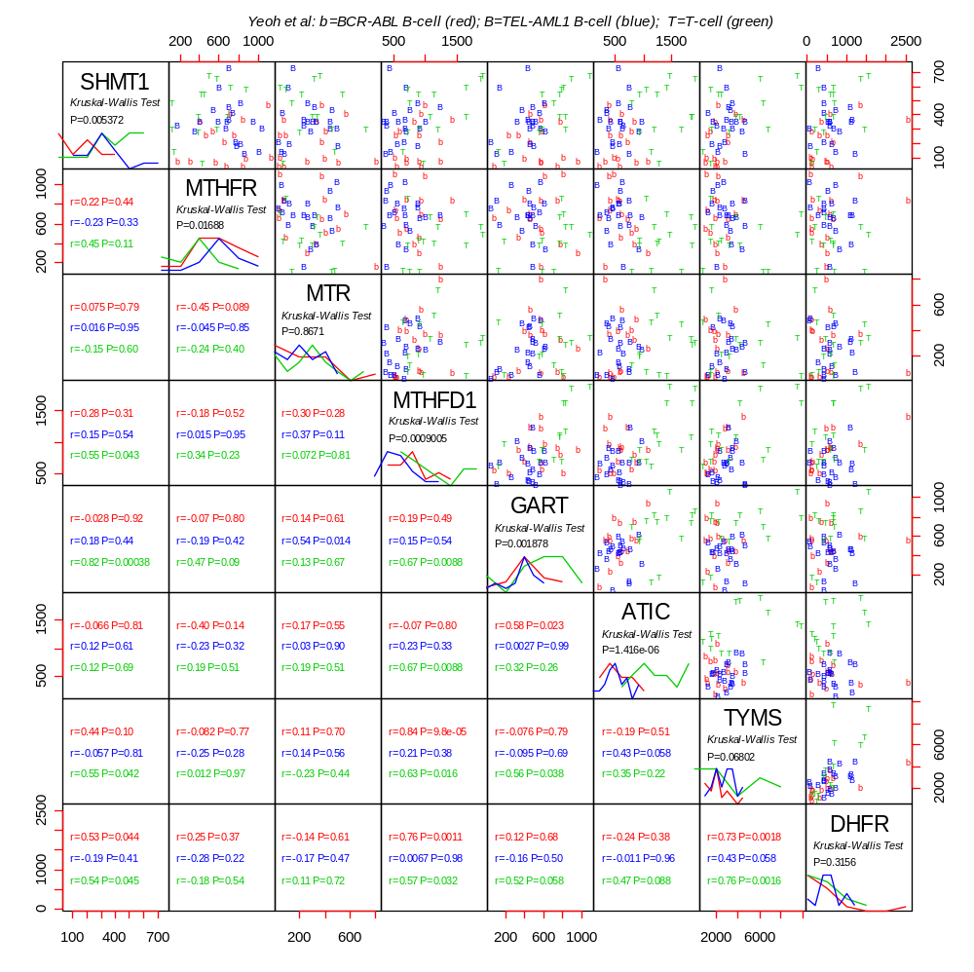

Slide 5
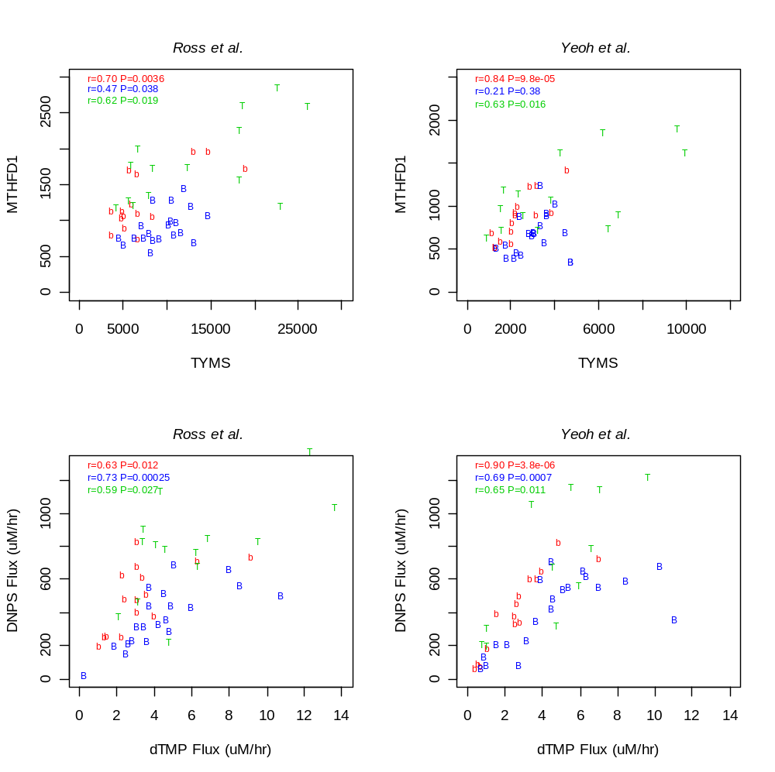

Slide 6
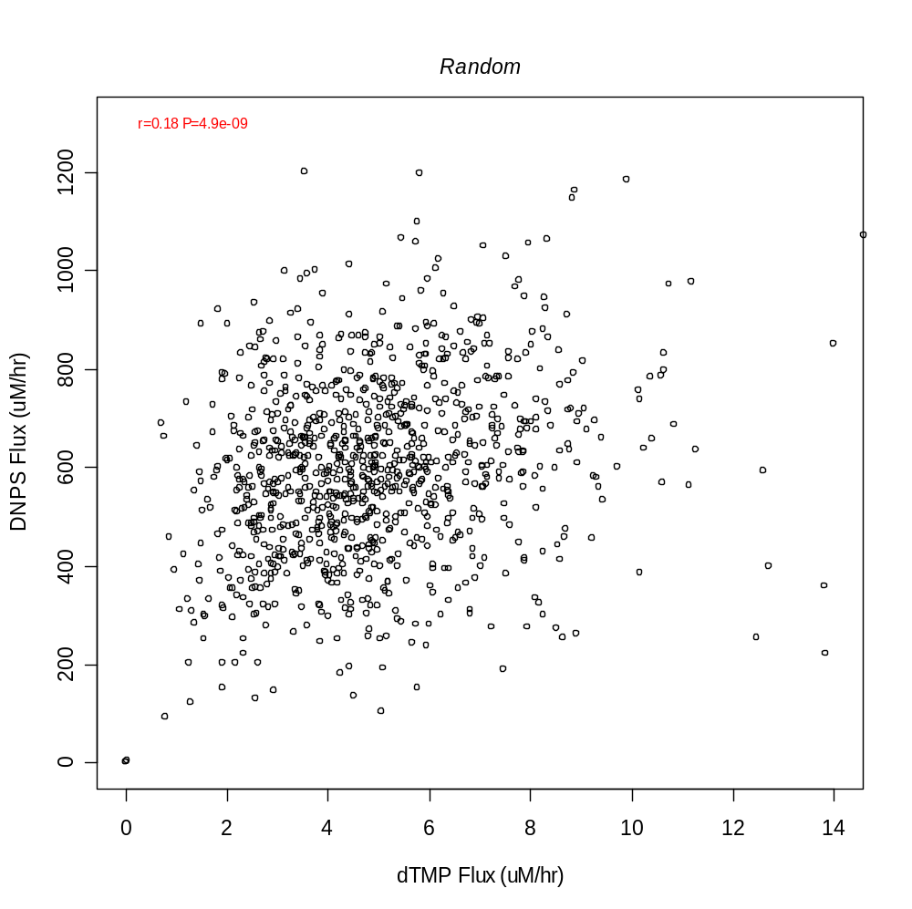

Slide 7
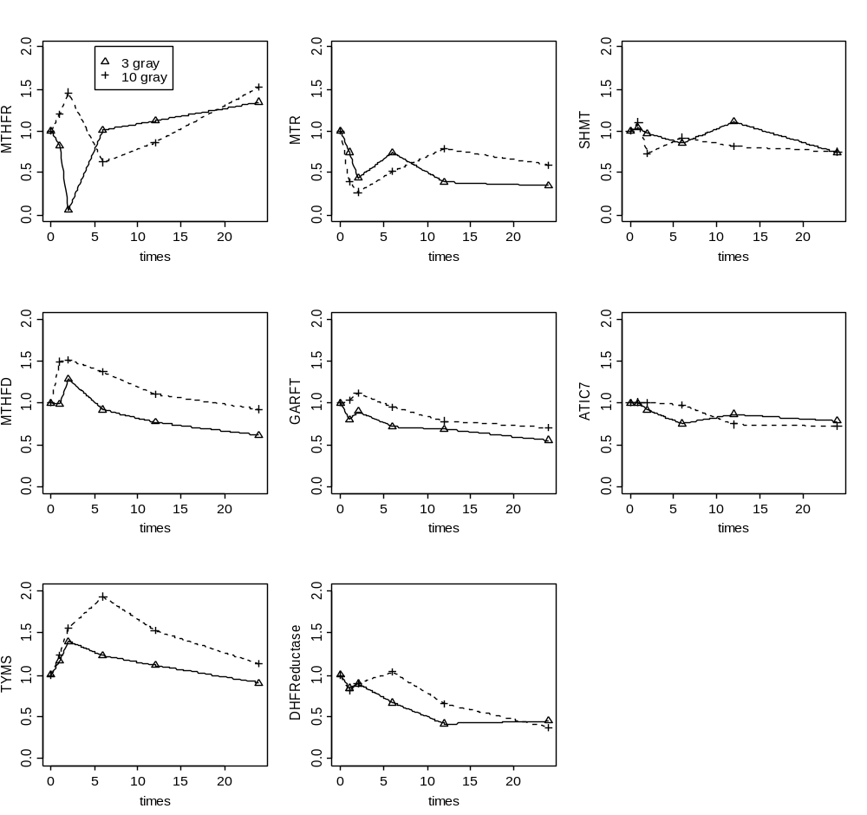

Slide 8
