Slide 1
Foursquare restaurants in Tokyo
Coursera Capstone Project

Slide 2
Introduction
Coursera Capstone Project
Foursquare API
Restaurants in Tokyo
For consumers
For restaurant owners

Slide 3
Data
Location table from Wiki
Geopy for coordinates
Foursquare for venues

Slide 4
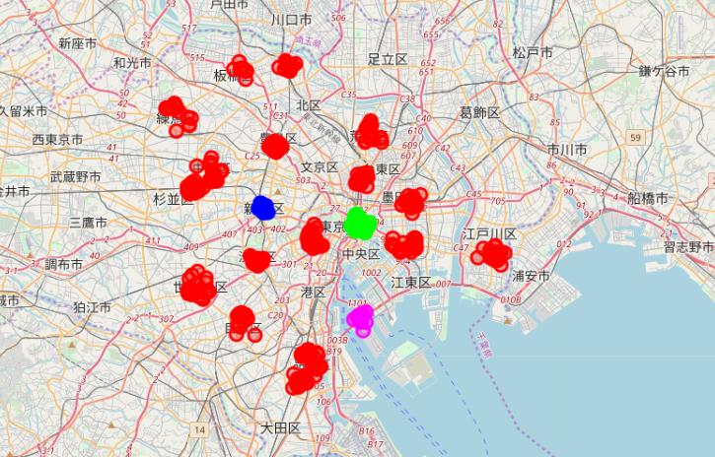
Restaurants in Tokyo

Slide 5
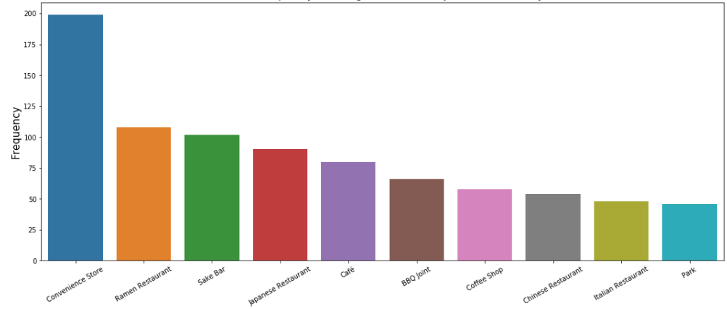
Top 10 popular locations

Slide 6
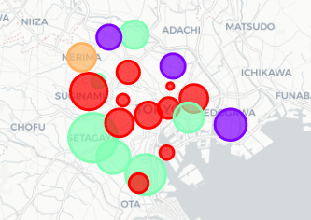
Kmeans 5 clusters

Slide 7
Conclusion
Tokyo is a big city with wide variety
Data analysis can help to sort and visualize data in a meaningful way

