Slide 1


2019
群眾與心理分析
期中報告

Slide 2

标题文字添加此处
print the presentation and make it into a film to be used in a wider field
01
02
03
04
标题文字
添加此处
标题文字
添加此处
标题文字
添加此处
标题文字
添加此处

Slide 3

01
複習

Slide 4

标题文字添加此处
print the presentation and make it into a film to be used in a wider field
标题文字添加
Far far away, behind the word mountains, far from the countries Vokalia and Consonantia, there live the blind texts. Far far away, behind the word mountains, far from the countries Vokalia and Consonantia, there live the blind texts.

Slide 5
集體暴力範式
print the presentation and make it into a film to be used in a wider field
社會危機:秩序、階級鬆動
人際危機:敵意交換、行為均一化
心理危機:不安、恐慌
抗拒灰色地帶
恐懼投射於他人
單一歸因、外在歸因
極端值:內邊緣、外邊緣
系統外差異
建設性、合理化的暴力
社會出現危機
歸罪於某群人
選擇受害者
施加暴力

Slide 6
迫害者心態
print the presentation and make it into a film to be used in a wider field
投射
暴力與激情
負面情緒向外「投射」到某對象身上
歸罪於替罪羊，安撫自身焦慮感
以狂暴的情緒取代焦慮.
焦慮、受虐化
面對危機恐懼不安、將自身定義為受害者.
平靜後的罪惡感
感到內疚並設法補償.

Slide 7
02
規則說明

Slide 8




Dos and Don'ts
print the presentation and make it into a film to be used in a wider field
人物操作
請不要按其他鍵
左右鍵移動 上箭頭跳躍
否則程式會當掉，神秘的bug...
吃金幣
請不要在未回答完問題就離開
金幣分成與替罪羊有關的專有名詞和與無關的
吃到無關的會扣生命值.
雖然遊戲到一半前往下一關的通道會出現通道但分數越高者獲勝喔
撞擊磚塊回答問題
答題時請勿亂動
以滑鼠點選正確選項，若錯誤會跳出說明對話框，按Enter說明即會消失.
回答問題時怪物會停止，除非自己移動否則是不會被怪物碰到的

Slide 9
标题文字添加此处
print the presentation and make it into a film to be used in a wider field
标题文字添加
标题文字添加
文字添加
文字添加
Far far away, behind the word mountains, far from the countries Vokalia and Consonantia, there live the blind texts.
Far far away, behind the word mountains, far from the countries Vokalia and Consonantia, there live the blind texts.
标题文字添加
标题文字添加
文字添加
文字添加
Far far away, behind the word mountains, far from the countries Vokalia and Consonantia, there live the blind texts.
Far far away, behind the word mountains, far from the countries Vokalia and Consonantia, there live the blind texts.

Slide 10
标题文字添加此处
print the presentation and make it into a film to be used in a wider field
标题文字添加
标题文字添加
Far far away, behind the word mountains, far from the countries Vokalia and Consonantia, there live the blind texts. Far far away, behind the word mountains, far from the countries Vokalia and Consonantia, there live the blind texts.
Far far away, behind the word mountains, far from the countries Vokalia and Consonantia, there live the blind texts. Far far away, behind the word mountains, far from the countries Vokalia and Consonantia, there live the blind texts.

Slide 11



标题文字添加此处
print the presentation and make it into a film to be used in a wider field
标题文字添加
标题文字添加
标题文字添加
Far far away, behind the word mountains, far from the countries Vokalia and Consonantia, there live the blind texts.
Far far away, behind the word mountains, far from the countries Vokalia and Consonantia, there live the blind texts.
Far far away, behind the word mountains, far from the countries Vokalia and Consonantia, there live the blind texts.

Slide 12
标题文字添加此处
print the presentation and make it into a film to be used in a wider field
标题文字添加
标题文字添加
Far far away, behind the word mountains, far from the countries Vokalia and Consonantia, there live the blind texts.
Far far away, behind the word mountains, far from the countries Vokalia and Consonantia, there live the blind texts.
标题文字添加
标题文字添加
Far far away, behind the word mountains, far from the countries Vokalia and Consonantia, there live the blind texts.
Far far away, behind the word mountains, far from the countries Vokalia and Consonantia, there live the blind texts.

Slide 13




标题文字添加此处
print the presentation and make it into a film to be used in a wider field
标题文字添加
标题文字添加
标题文字添加
标题文字添加
Far far away, behind the word mountains, far from the countries Vokalia and Consonantia, there live the blind texts.
Far far away, behind the word mountains, far from the countries Vokalia and Consonantia, there live the blind texts.
Far far away, behind the word mountains, far from the countries Vokalia and Consonantia, there live the blind texts.
Far far away, behind the word mountains, far from the countries Vokalia and Consonantia, there live the blind texts.

Slide 14
03
标题文字添加此处
The user can demonstrate on a projector or computer, or print the presentation and make it into a film to be used in a wider field

Slide 15
标题文字添加此处
print the presentation and make it into a film to be used in a wider field
01
02
Far far away, behind the word mountains, far from the countries Vokalia
Far far away, behind the word mountains, far from the countries Vokalia
03
04
Far far away, behind the word mountains, far from the countries Vokalia
Far far away, behind the word mountains, far from the countries Vokalia
05
06
Far far away, behind the word mountains, far from the countries Vokalia
Far far away, behind the word mountains, far from the countries Vokalia

Slide 16
标题文字添加此处
print the presentation and make it into a film to be used in a wider field
文字添加
文字添加
文字添加
文字添加
标题文字添加
标题文字添加
标题文字添加
标题文字添加
Far far away, behind the word mountains, far from the countries Vokalia and Consonantia, there live the blind texts.
Far far away, behind the word mountains, far from the countries Vokalia and Consonantia, there live the blind texts.
Far far away, behind the word mountains, far from the countries Vokalia and Consonantia, there live the blind texts.
Far far away, behind the word mountains, far from the countries Vokalia and Consonantia, there live the blind texts.

Slide 17
标题文字添加此处
print the presentation and make it into a film to be used in a wider field
01
标题文字添加
标题文字添加
02
Far far away, behind the word mountains, far from the countries Vokalia and Consonantia, there live the blind texts.
Far far away, behind the word mountains, far from the countries Vokalia and Consonantia, there live the blind texts.
03
04
标题文字添加
标题文字添加
Far far away, behind the word mountains, far from the countries Vokalia and Consonantia, there live the blind texts.
Far far away, behind the word mountains, far from the countries Vokalia and Consonantia, there live the blind texts.

Slide 18
标题文字添加此处
print the presentation and make it into a film to be used in a wider field
$589
$589
$589
标题文字添加
标题文字添加
标题文字添加
Far far away, behind the word mountains, far from the countries Vokalia and Consonantia, there live the blind texts.
Far far away, behind the word mountains, far from the countries Vokalia and Consonantia, there live the blind texts.
Far far away, behind the word mountains, far from the countries Vokalia and Consonantia, there live the blind texts.

Slide 19
04
标题文字添加此处
The user can demonstrate on a projector or computer, or print the presentation and make it into a film to be used in a wider field

Slide 20


标题文字添加此处
print the presentation and make it into a film to be used in a wider field
标题文字添加
Far far away, behind the word mountains, far from the countries Vokalia and Consonantia, there live the blind texts. Far far away, behind the word mountains, far from the countries Vokalia and Consonantia, there live the blind texts. Far far away, behind the word mountains, far from the countries Vokalia and Consonantia, there live the blind texts. Far far away, behind the word mountains, far from the countries Vokalia and Consonantia, there live the blind texts.

Slide 21


标题文字添加此处
print the presentation and make it into a film to be used in a wider field
标题文字添加
标题文字添加
Far far away, behind the word mountains, far from the countries Vokalia and Consonantia, there live the blind texts.
Far far away, behind the word mountains, far from the countries Vokalia and Consonantia, there live the blind texts.
标题文字添加
标题文字添加
Far far away, behind the word mountains, far from the countries Vokalia and Consonantia, there live the blind texts.
Far far away, behind the word mountains, far from the countries Vokalia and Consonantia, there live the blind texts.

Slide 22



标题文字添加此处
print the presentation and make it into a film to be used in a wider field
标题文字添加
Far far away, behind the word mountains, far from the countries Vokalia and Consonantia, there live the blind texts.
标题文字添加
Far far away, behind the word mountains, far from the countries Vokalia and Consonantia, there live the blind texts.

Slide 23
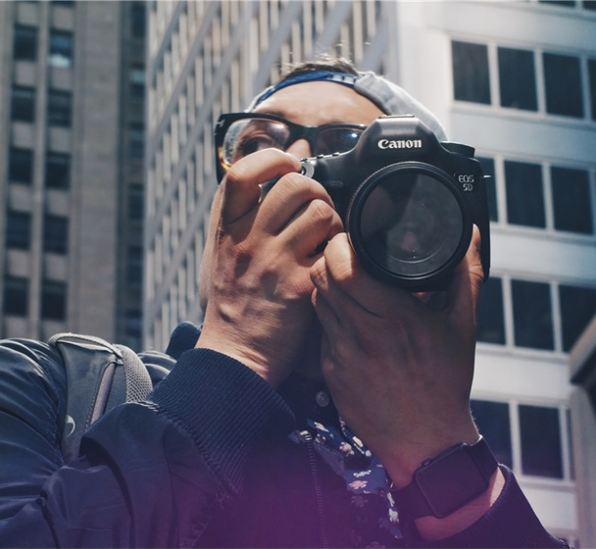



标题文字添加此处
print the presentation and make it into a film to be used in a wider field
Far far away, behind the word mountains, far from the countries Vokalia and Consonantia, there live the blind texts.
Far far away, behind the word mountains, far from the countries Vokalia and Consonantia, there live the blind texts.
Far far away, behind the word mountains, far from the countries Vokalia and Consonantia, there live the blind texts.

Slide 24

标题文字添加此处
print the presentation and make it into a film to be used in a wider field
标题文字添加
Far far away, behind the word mountains, far from the countries Vokalia and Consonantia, there live the blind texts. Far far away, behind the word mountains, far from the countries Vokalia and Consonantia, there live the blind texts.

Slide 25
THANKS

