Slide 1
Sentiment Analysis on the Amazon Book Review Dataset
Hazel Kim

Slide 2
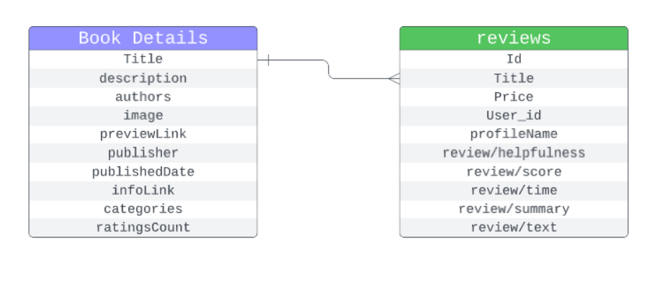
Notes:
I wanted to find out the polarity of sentiment on amazon book reviews. I used two datasets, the first is about the book itself like the author and publisher, and the second one is more directly related to reviews. And they have a title column in common.

Slide 3
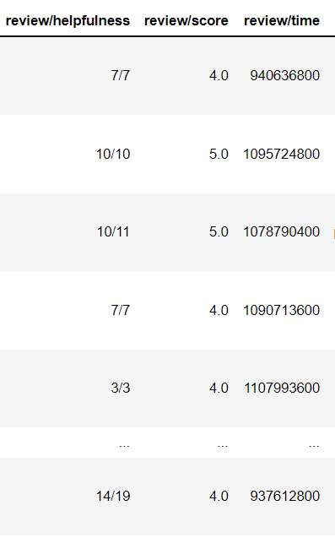
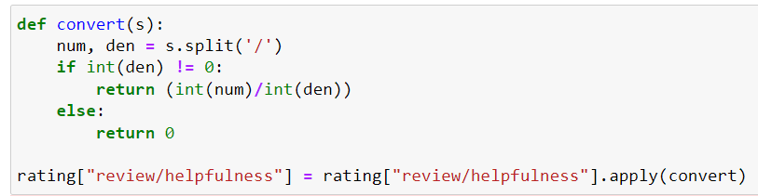
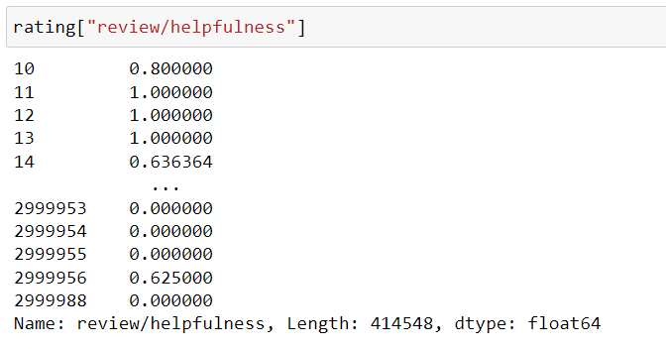
Notes:
Checking the shape of these datasets, what I first did was drop the NA values. And I checked that the review/helpfulness column is described as a fraction, which is not good to interpret in python. With a slash, it can’t be analyzed as a numerical value. So I wanted to change them as float and make consistency with others. So I changed them to the decimal type.

Slide 4
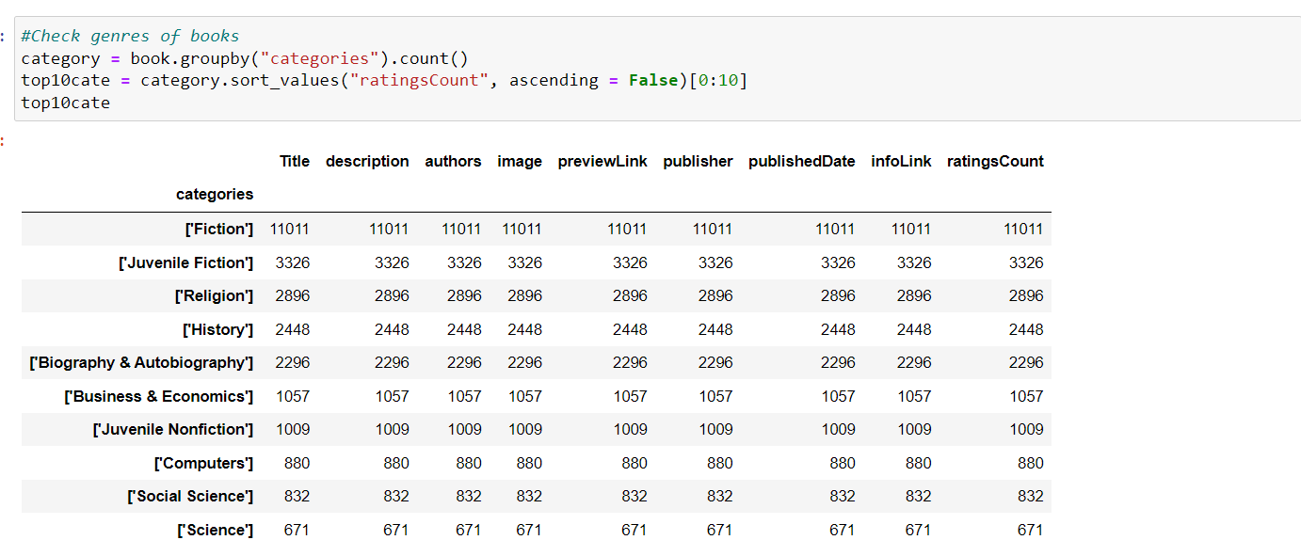
Notes:
And seeing the columns, I wanted to check the number of books by the genres, so grouped them by categories and picked the 10 most frequently appeared categories.

Slide 5
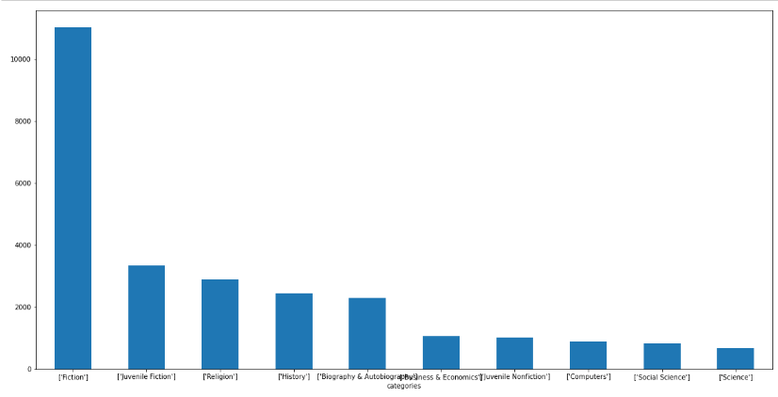
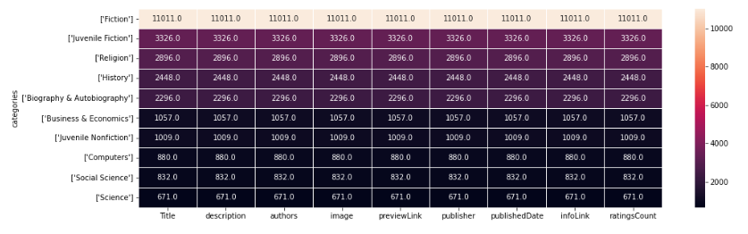
Notes:
It can be shown as this graph, or more intuitively, the heatmap here. Since there’s a wide gap in these colors, we can directly feel that the amount of fiction is overwhelming in the category, more than triple the second most frequently appeared one.

Slide 6
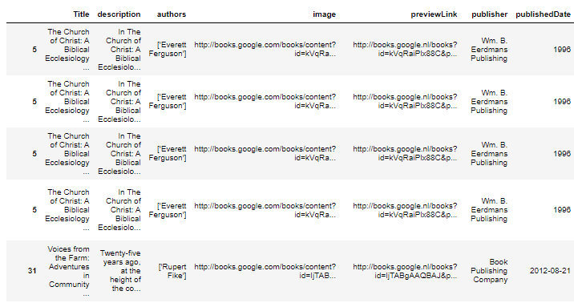
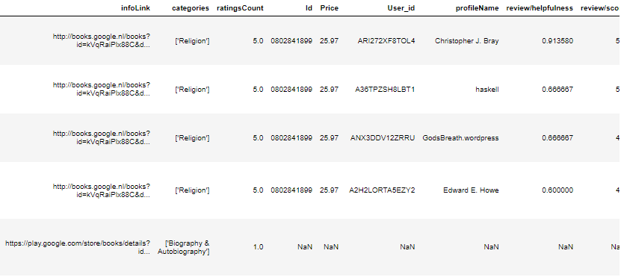
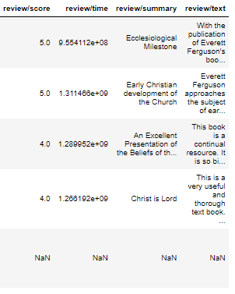
205031 rows × 19 columns
Notes:
After this, I wanted to join the two datasets, so I joined them by the title using SQL. And I grouped by each title so that we can avoid redundancy problems. It means that each row can represent each book, therefore not having any overlapped review problem. So now it has 19 columns in a table, with more than 200 thousand rows. This is quite a clean dataset compared to the original one which had three million rows.

Slide 7
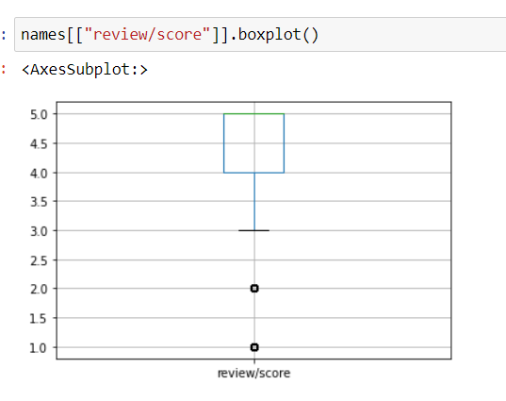
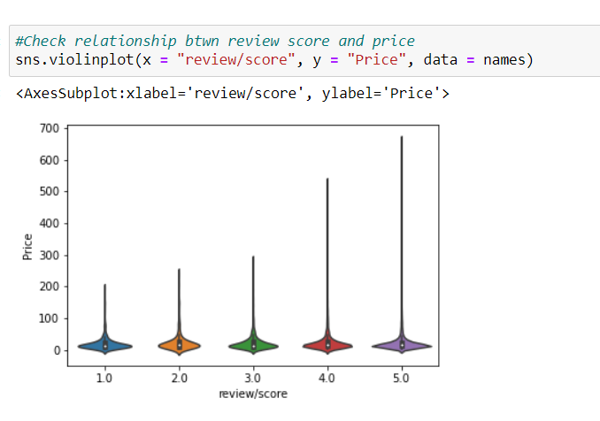
Notes:
Then I checked the review scores, and most of them were 5. To see it in the boxplot, we can check third quantiles are far below the average and the median. And I first made a hypothesis that there might be correlation between price and review score, as we tend to have a higher expectation of the book that I paid a lot. But when I checked their relationship and the distribution of the correlation by the violin plot, it was evenly distributed. So I could conclude that regardless of the price, most people give a 5 score.

Slide 8
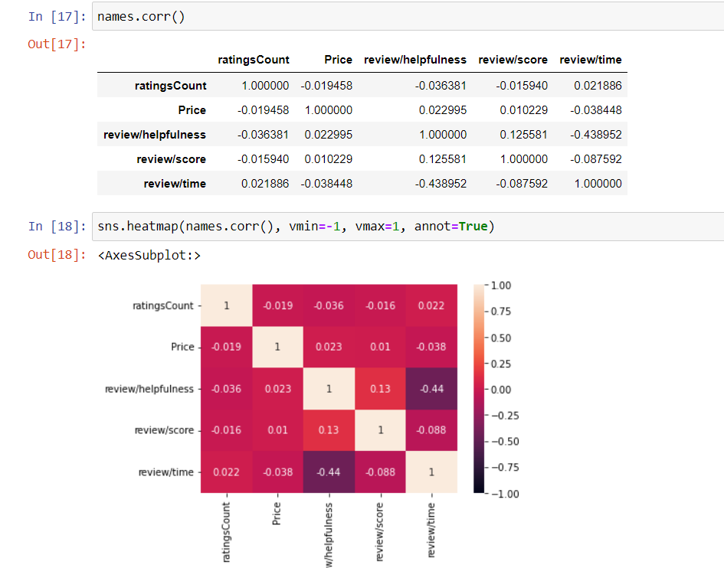
Notes:
After then, I had to find out the correlations between features more concretely, not only the relationship between price and review scores. So I checked the correlation of each feature comprised of numbers and described them as a heatmap. As we can see in the heatmap, none of the absolute values are above 0.5, so they are not correlated. It means, if I want to focus on the effect of one feature, I don’t need to consider others, as features are not directly related to each other. If there was a relationship, I would have done some linear models like lm or ls regression, but since there isn’t, I could directly jump into the sentiment analysis itself.

Slide 9
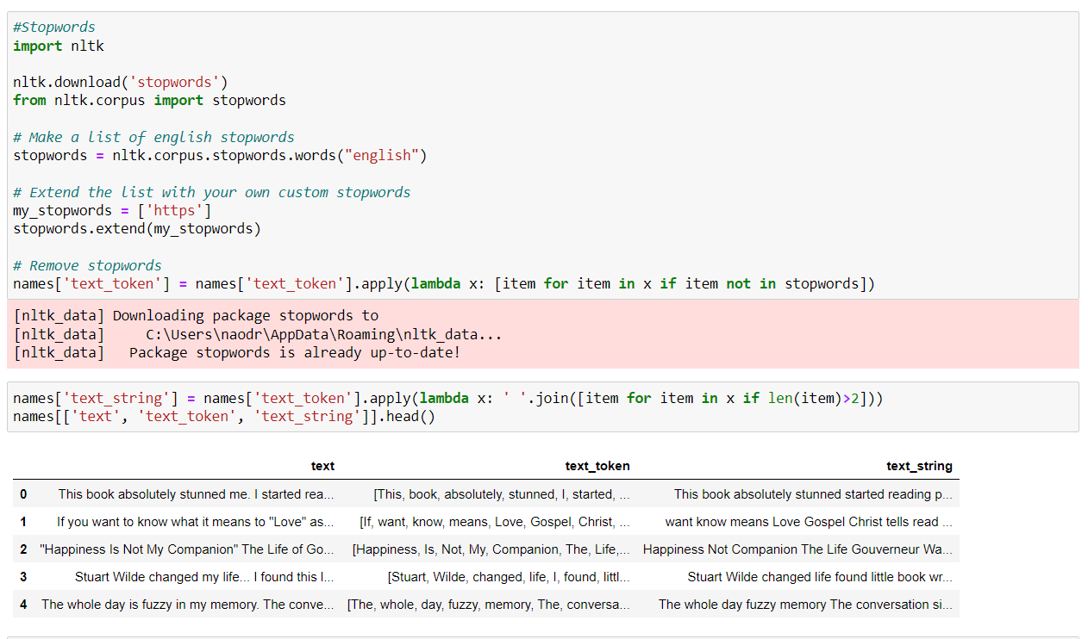
Notes:
Now we can sketch the rough image of the dataset, so it’s time to move on to the main part of my project, sentiment analysis. Our goal is to classify reviews into 3 emotions: positive, negative, and neutral. First, I tokenized reviews with regular expressions, which means I cut each word in the sentence and made it one token. Then I set stop words that can be dropped before analyzing natural language data since they don’t contain valuable information. These stopwords are then removed from the tokens by the lambda function.

Slide 10
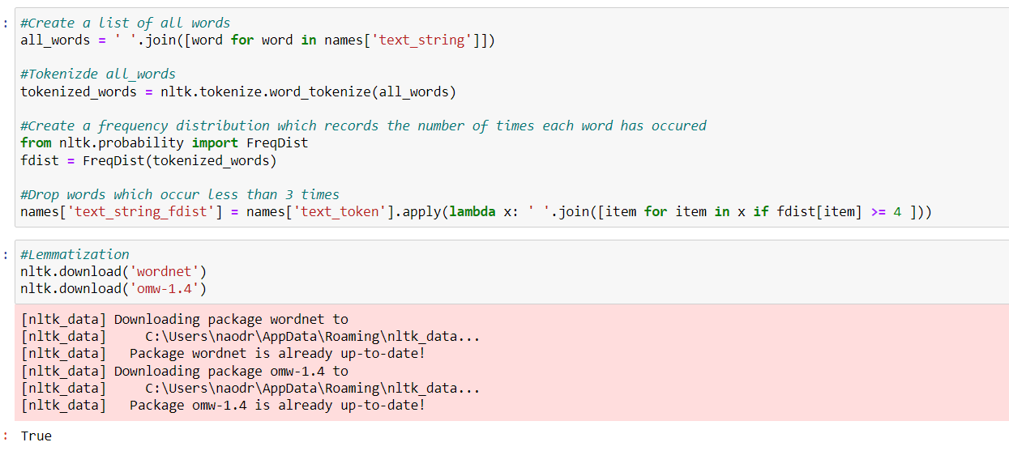
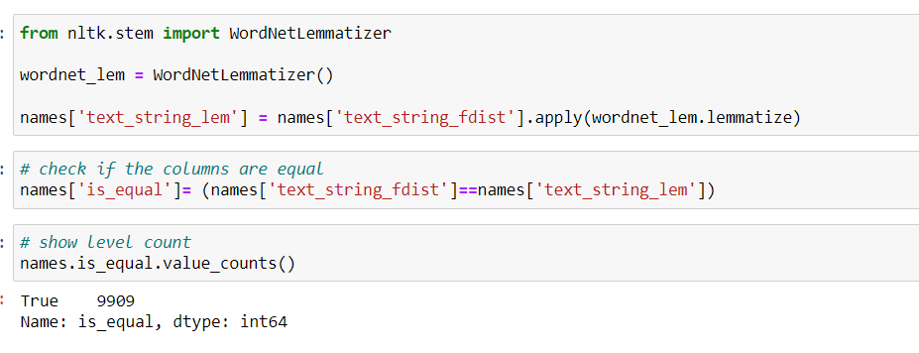
Notes:
Then I removed infrequent words, creating a frequency distribution that records the number of times each word has occurred. And I dropped words that occur less than 3 times. After that, I did lemmatization, which means grouping the inflected forms of a word so they can be analyzed as a single item. With lemmatization, I can set base words. For example, if there are three words running, runs, ran, I don’t want python to recognize them as three different words. Cuz they have a common root verb : run. Lemmatization is a process of setting this base word, so avoid the redundant word-recognizing problem.

Slide 11
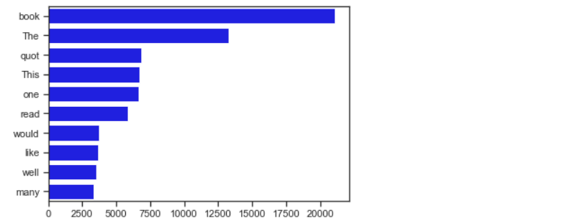
Notes:
Anyway, I checked 10 common words after lemmatization, but unfortunately there was nothing special. Most of the words were used to describe their sentiment, not directly related to it.

Slide 12
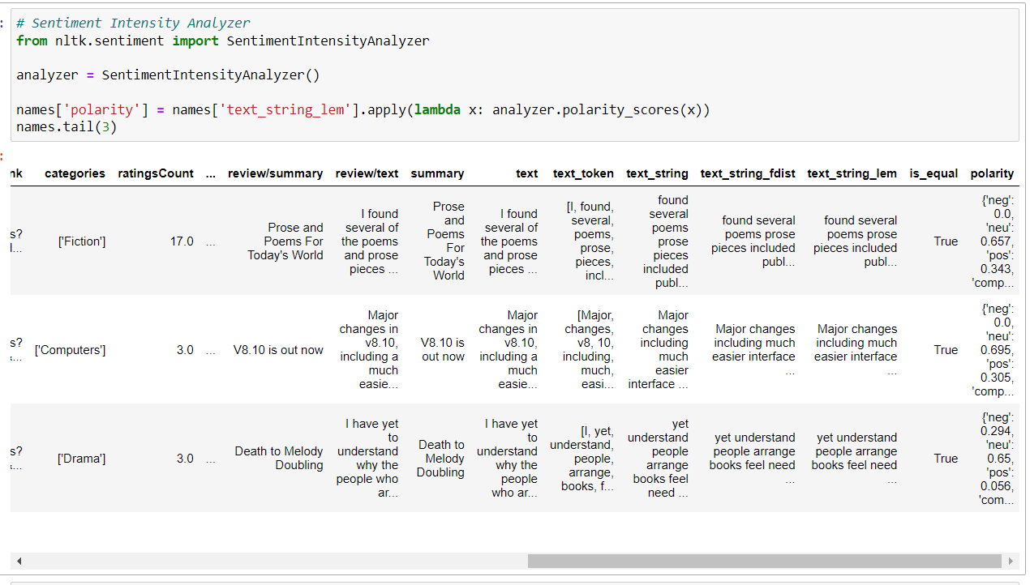

Notes:
So I did VADER lexicon, a rule-based model for general sentiment analysis. It automatically gives the polarity score, like this.

Slide 13
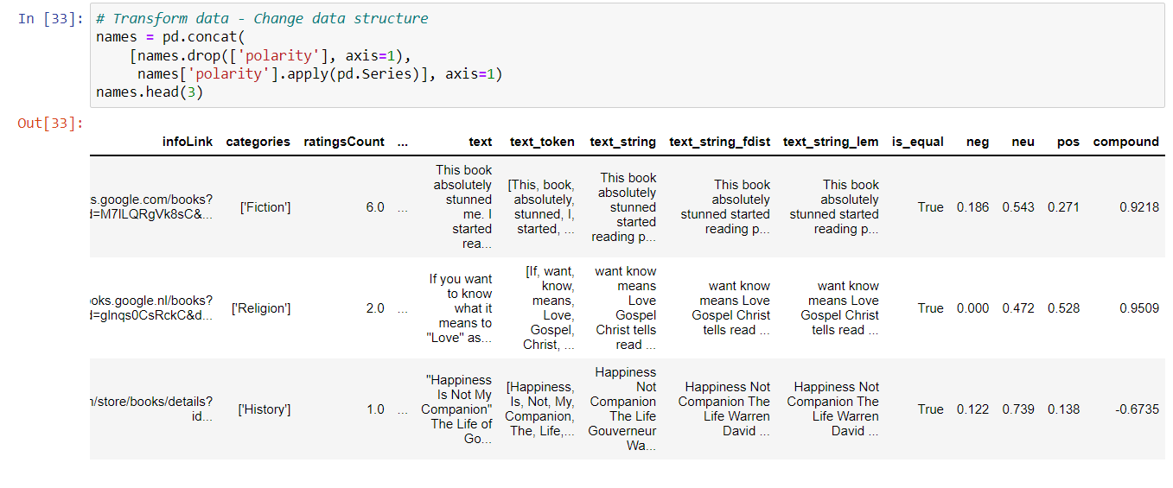




Notes:
To see it more clearly, I changed the data structure, having own column for negative, neutral, positive, and total scores.

Slide 14
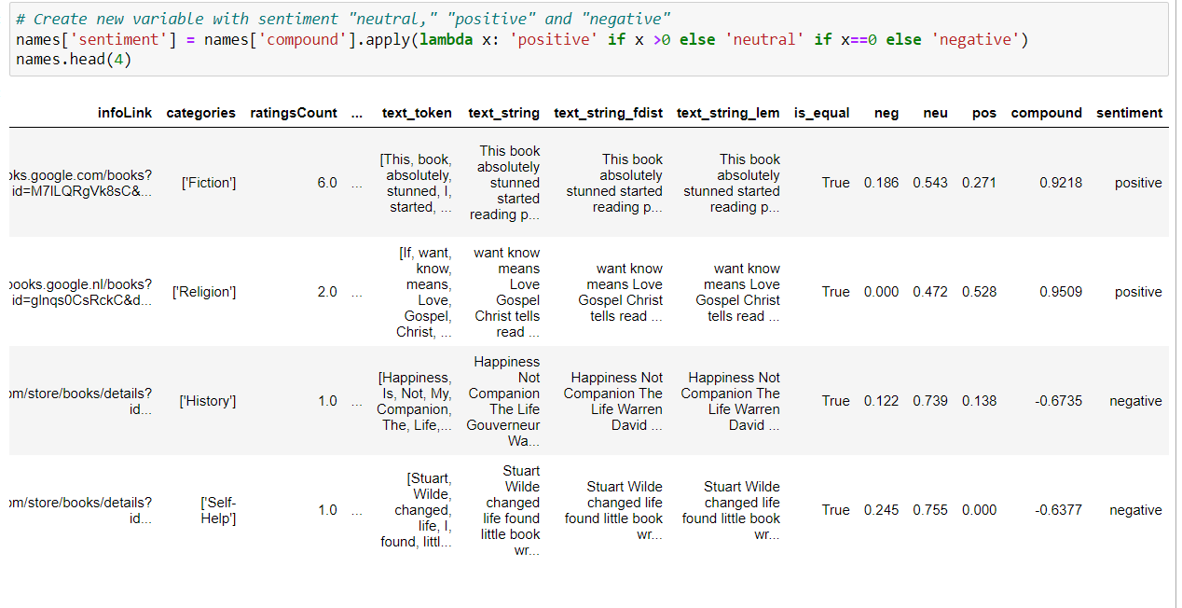

Notes:
Based on this compound total score, I created a new variable that decides whether the sentiment is negative, neutral, or positive.

Slide 15
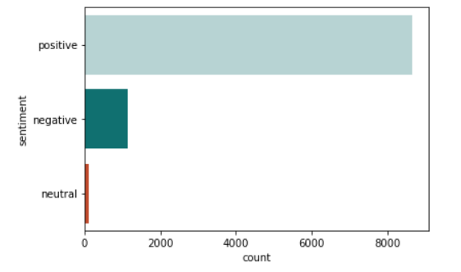
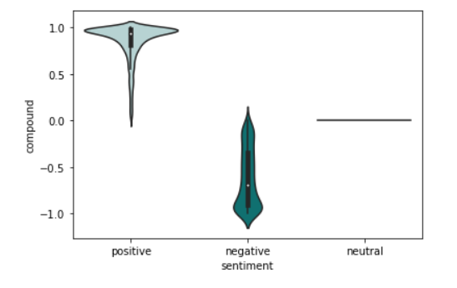
Notes:
And the result can be visualized as follows. Reviews with positive sentiment overwhelmed the number of reviews with negative sentiment. This is kind of valid, as the raw dataset had a bunch of review scores of 5. To check its distribution with the violin plot, most of the positive values were highly positive, close to 1.0 value. But the negative sentiment was evenly distributed, neither having strong negative sentiment nor weakly negative emotion. And neutrals are so few that we can just ignore their distribution.

Slide 16
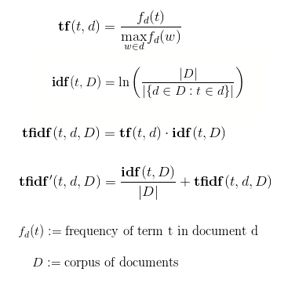
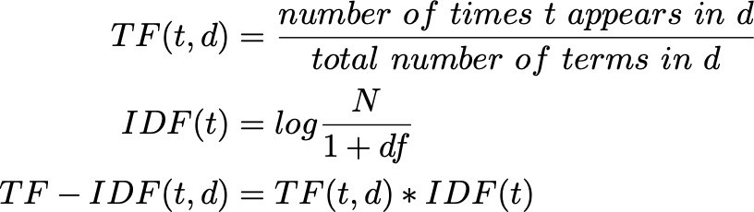
Further Development?
TF-IDF
CNN
GPT 3
Notes:
So these are how I analyzed the polarity of the sentiment and their distribution, but it can be more improved. What I thought as the further research is TF-IDF, Term frequency Inverse document frequency, CNN, Convolution Neural Network, or GPT, Generative Pre-trained Transformer three. I’m thinking of using TF-IDF as it’s the easiest NLP-applied method, that can reflect how important a word is in the sentence. TF-IDF can also be calculated by hand, as follows. But I’ll definitely use python, for sure.

Slide 17
Thank you☺

