Slide 1

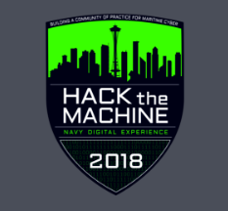
HACKtheMACHINE
September 21-23rd
Team: #WestCoastIsTheBestCoast
Joe Ortiz, James Eitelberg, Chris Chen, Jessica Kimball, Chris Cirullo, Thuy Nguyen-Cirullo (SSC PAC); Richard Brereton (COMNAVSURFPAC); Rock Pereira (Consultant)
Track 2: Data Science and The Seven Seas

Slide 2
#WestCoastIsBestCoast Approach #1
Clean-Up and Prioritization
Remove unneeded data (8 fields, e.g. IMO, width)
Filter erroneous data (e.g. Tug Boats, negative COG, moored, anchored vessels)
Divide data into 10-minute periods
Processing and Visualization
Determine distance between vessels using k-d trees
Import data into ArcGIS map over maritime layers
Results
Computation time based on same data set:
Brute force: ~30/40 min
Our machine learning based kd-tree algorithm we were able to improve performance to 10-15 min
> 50% improvement

Slide 3
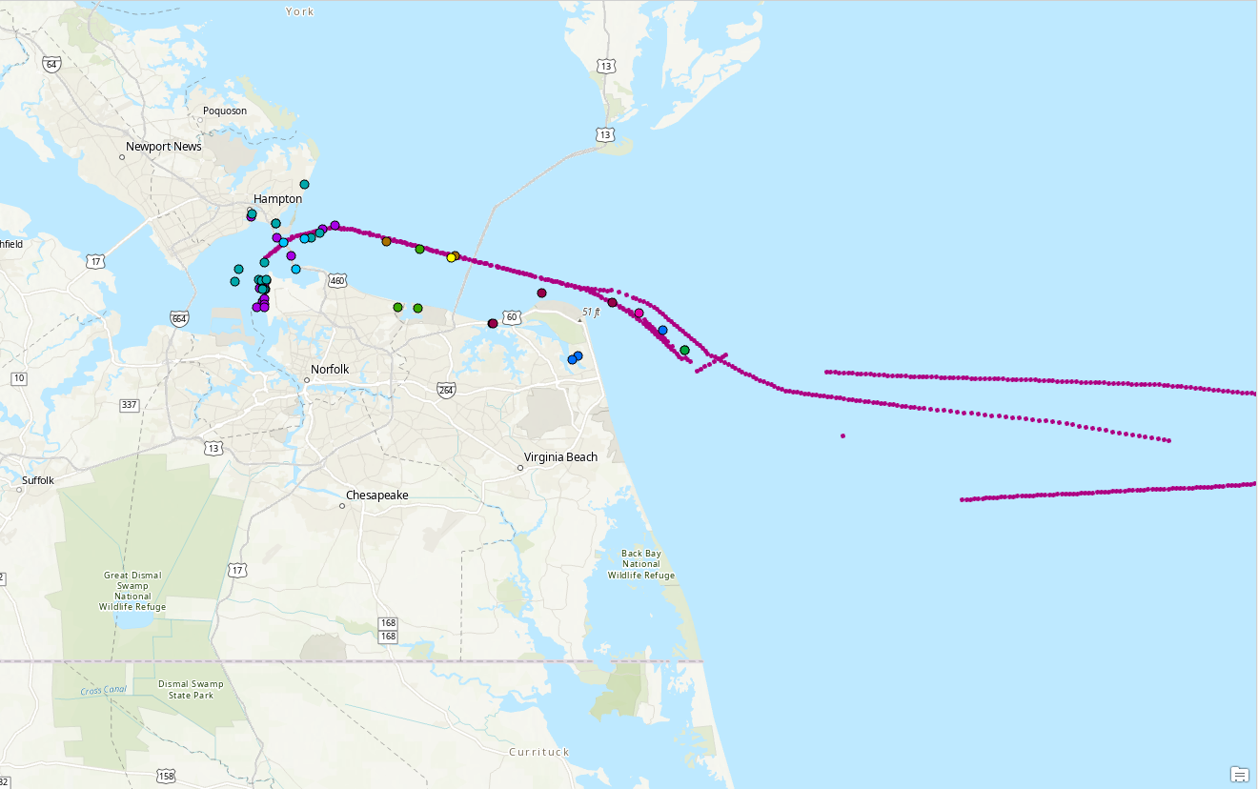
#WestCoastIsBestCoast Approach #2
Simple geospatial calculation filtered by ship types
Follow one ship at time and create view frames
AIS data stored into AWS Cloud!
Data for 3 years in Zone 10
All zones for 1 month (DEC 2017)

Slide 4
Challenge #2
HARD!!
Preprocess each of the features:
For continuous variables, normalize it by subtracting by the means and dividing by standard deviation
For categorical variables, encode it to a number
PCA and/or Factorial Analysis
To determine which features are the most important
Multiclass Classification Algorithms
ie: K-means Clustering, defining the clusters, etc.

Slide 5
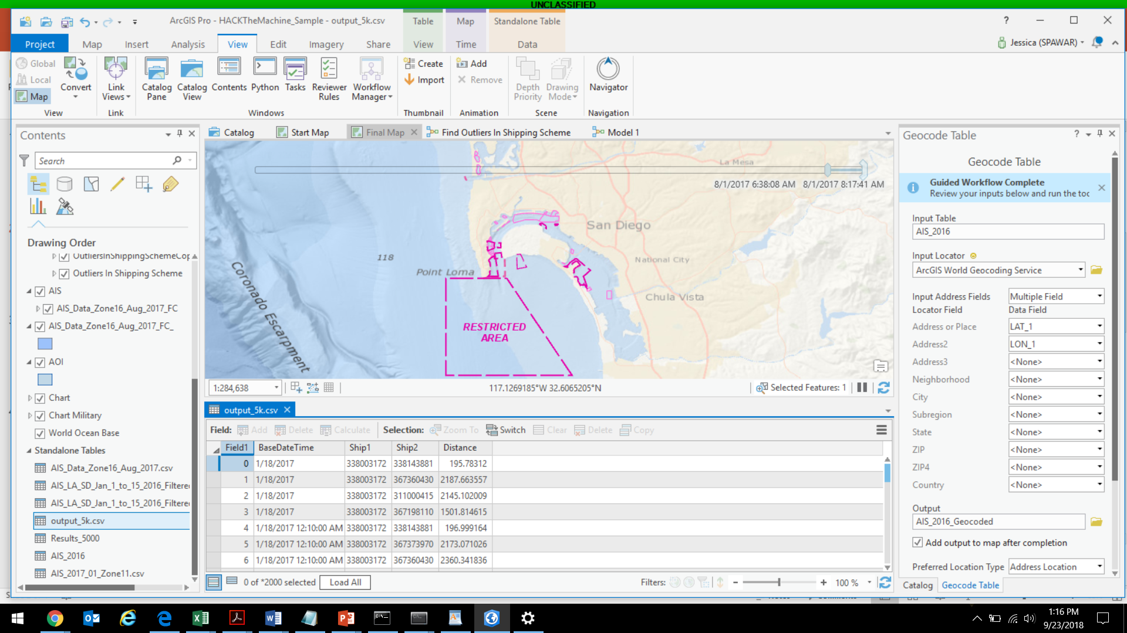
Output:
Time
Ship 1
Ship 2
Distance Calculation

Slide 6
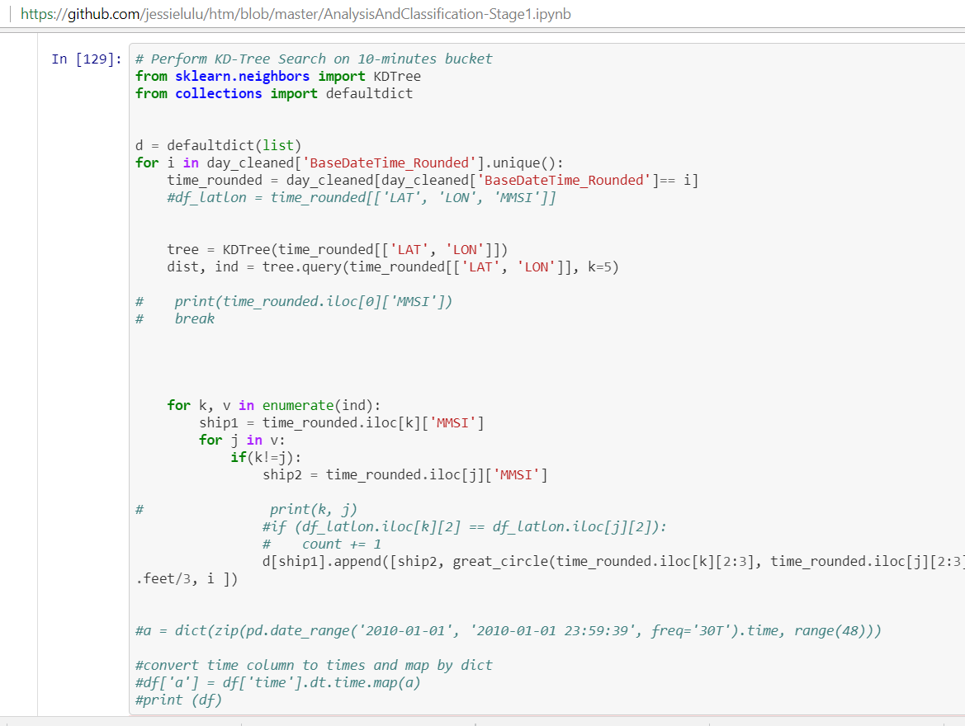
Jupyter Notebook Example

Slide 7
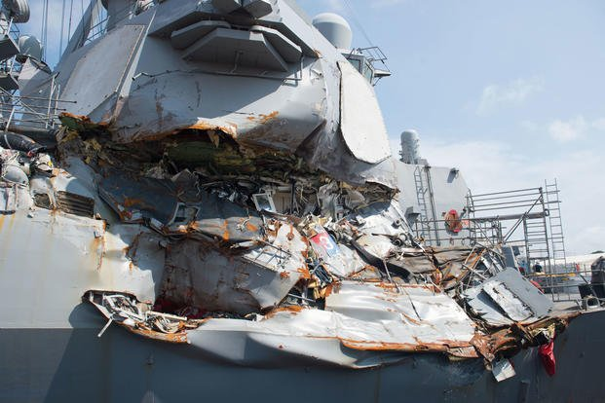
Conclusion
Why are we all here?
USS Fitzgerald: THIS IS PERSONAL

