Slide 1
Borough Recommender for an Asian Restaurant
Applied Data Science Final Capstone
HAZEM KAMEL

Slide 2
SYNOPSIS
Part 1 : Problem Description:
In this project, the problem attempted to solve will be to find the best possible location or the most optimal, for an Asian restaurant in the city of London, England. To achieve this task, an analytical approach will be used, based on advanced machine learning techniques and data analysis, concretely clustering and perhaps some data visualization techniques.
During the process of analysis, several data transformations will be performed including the number of Asians per borough , working hours per borough , Asian restaurants already opening per borough and earnings per borough, in order the find the best possible data format for the machine learning model to ingest. Once the data is set up and prepared, a modeling process will be carried out, and this statistical analysis will provide the best possible places to locate the Asian restaurant.

Slide 3
SYNOPSIS
Part 2: Data Used
London’s boroughs geo-location data: We used Geopy library to get the Longitude and Latitude geo-location data providing it with the Borough’s names.
Most common venues : Foursquare API was used to obtain the most common venues per neighborhood in the city of London. This way, it is possible to have a taste of how the city's Asian restaurants are distributed, what are the most common places for an Asian restaurant to open, and in general, it will provide an idea of what people's likes are.
Asians population per borough : data.london.gov This site provides information about ethnicity of population in London which is of great utility to solve this problem. The data is uploaded as an excel file and the Asian population of London is converted into DataFrame. The data contains information about the immigrant population per borough and per nationality. This data will be analyzed in such a way that one could determine the best location of a new Asian restaurant based on people's nationalities. For the sake of simplicity, it will be assumed for this exercise that people's likes varies according to their nationality, and that people from one specific country will be more attracted to place that matches the environment and culture of their own countries, rather than the ones from foreign countries.

Slide 4
SYNOPSIS
Part 2: Data Used
C) Earnings per hour : data.london.gov This site provides information about earnings per hour of the population in London which is of great utility to solve this problem. The data is uploaded as an excel file and the earning per hour of London's population is converted into DataFrame. The data contains information about the earnings per hour and per borough. This data will be analyzed in such a way that one could determine the best location of a new Asian restaurant based on people's earnings .For the sake of simplicity, it will be assumed that people could spend more money in eating outside if there earning is higher than people who have a less earning job per hour.
D) Working hours per week: data.london.gov This site provides information about working hours per borough of the population in London which is of a great utility to solve this problem. The data is uploaded as an excel file and the working hours per borough of London's population is converted into DataFrame. The data contains information about the working hours per borough. This data will be analyzed in such a way that one could determine the best location of a new Asian restaurant based on people's working hours .For the sake of simplicity, it will be assumed that people would eat outside in a restaurant if they have more working hours rather than a less working hour job which they will have more flexibility and time to eat at home.

Slide 5
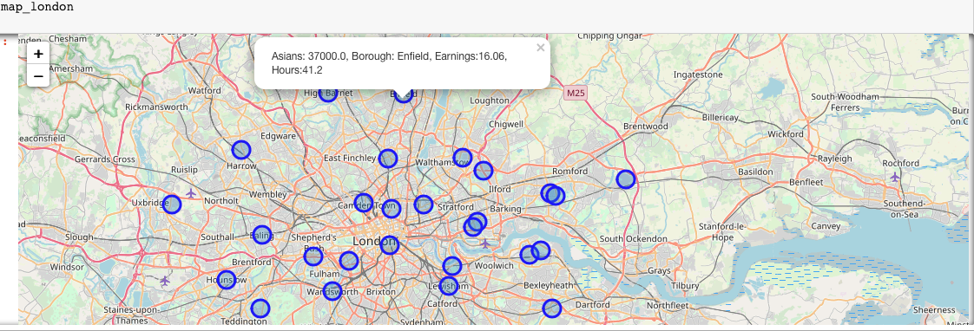
MAIN ARTICLE
Part 1: Identifying Borough’s geo-location data with Asian population, working hours and Earnings per hour

Slide 6
MAIN ARTICLE
Part 2:Connecting to Foursquare API and Retriving Location Data for Each Venue and Venue Category in Every Borough
After finding the list of Boroughs, we then connect to the Foursquare API to gather information about venues inside each and every Borough. For each Borough, we have chosen the radius to be 1000 meter. It means that we have asked Foursquare to find venues that are at most 1000 meter far from the center of the neighborhood.

Slide 7
MAIN ARTICLE
Part 3: Processing the Retrieved Data and Creating a DataFrome for All the Venues inside the Borough
When the data is completely gathered, we will perform processing on that raw data to find our desirable features for each venue. Our main feature is the category of that venue. After this stage, the column "Venue's Category" will be One-hot encoded and different venues will have different feature-columns.

Slide 8
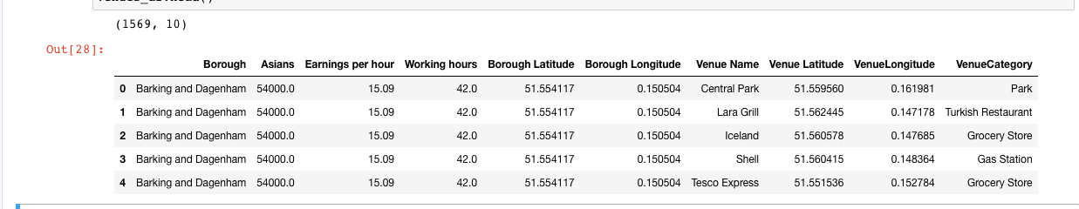
MAIN ARTICLE
Part 3: Processing the Retrieved Data and Creating a DataFrome for All the Venues inside the borough

Slide 9
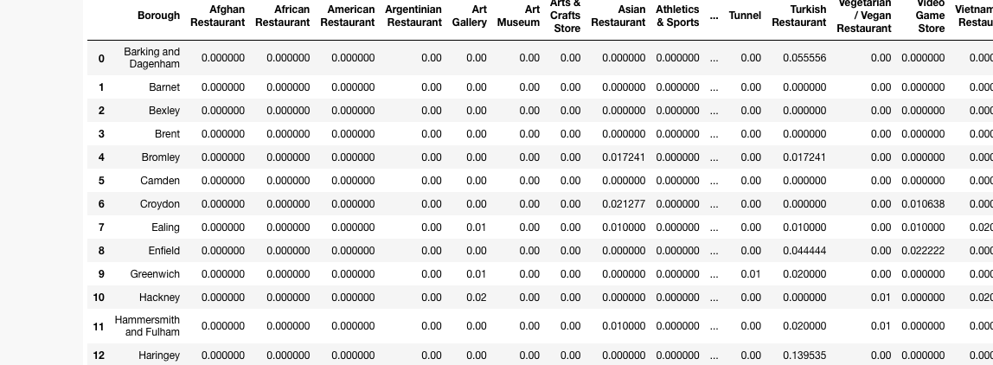
MAIN ARTICLE
Now, the dataset is fully ready to be used for machine learning (and statistical analysis) purposes.

Slide 10
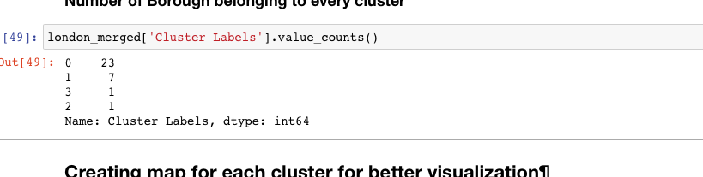
Decision Making and Reporting Results
Part 4: Applying one of Machine Learning Techniques (K-Means Clustering)

Slide 11
Decision Making and Reporting Results
Now, we focus on the clusters and compare them for their ”Asian Restaurants" and their ”Asian Population” , “Earnings” , “Working hours” . The group which has the highest values will be our best recommendation to the Restaurant Location.
Result:
Best Group is : Labeled 1
Second Best Group is: Labeled 0
Third Best Group is: Labeled 2
Fourth Best Group is: Labeled 3

Slide 12
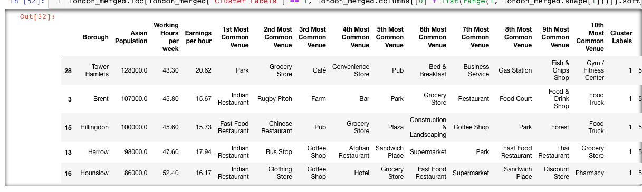
Decision Making and Reporting Results
Best Group ”1” :

Slide 13
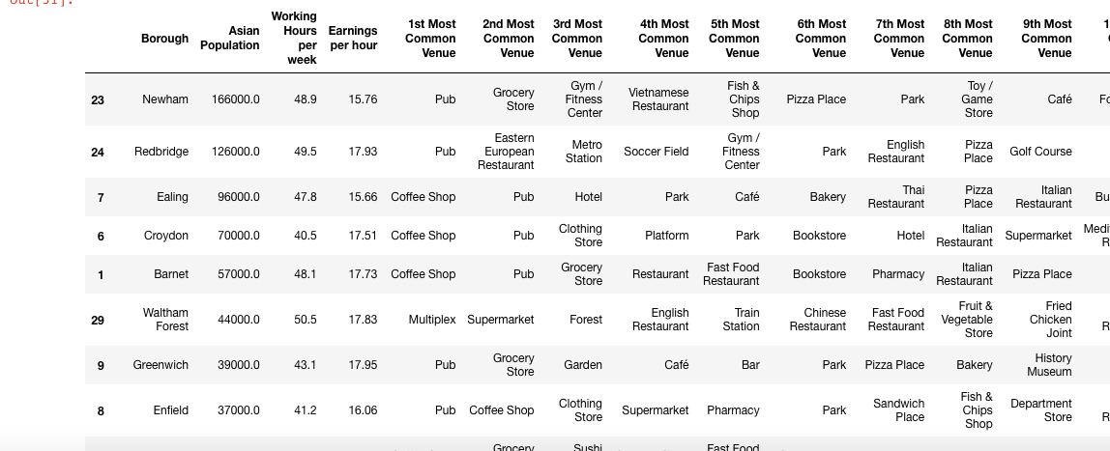
Decision Making and Reporting Results
Second Best Group ”0” :

Slide 14
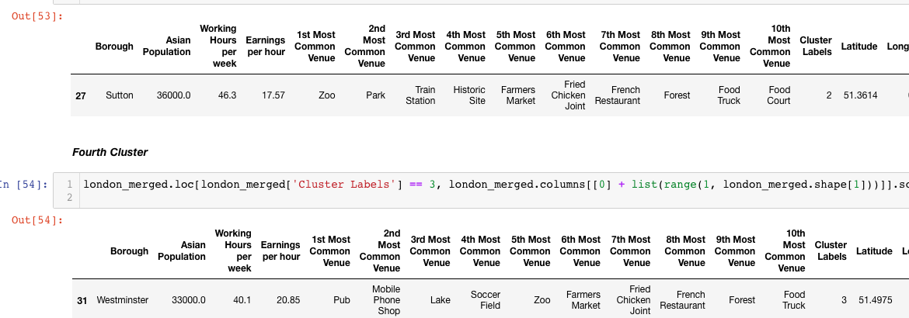
Decision Making and Reporting Results
Third and Fourth Best Group ”2,3” :

Slide 15
Conclusion
Our choice based on Asians Restaurants already opened , Working hours , Earnings and Asians Population per Borough will be :
Label 1 Cluster : Tower Hamlets , Hounslow as Tower Hamlets has a 128000 asian population with 43.3 working hours and one of the heighest earnings per hour 20 .62 and no Asian restaurant to serve this needs as the rest of the cluster Boroughs which we can observe the high presence of Asian restaurants due to high asian population , working hours and earnings. Hounslow Already have an Asian restaurant as a Top Venue due to the 86000 asian population , the highest working hours 52.4 and 16.17 as earnings per hour , opening another Restaurant would be recommended in this Borough.
Label 0 Cluster :Newham , Redbridge as both have 120000>asian population , 45>working hours , 15>earnings per hour and not much asian restaurants to serve this population needs,As less asian population boroughs which have more asian restaurants and less population to serve with the same working hours and earnings range.
We will choose the Label 1,0Cluster choice “Tower Hamlets , Redbridge“ .

Slide 16
THANK YOU.

