Slide 1


COMPARATIVE ANALYSIS OF FACE DETECTION ALGORITHMS
Evaluating Performance, Accuracy, and Efficiency
Face Detection Research Team

Slide 2




INTRODUCTION TO METHODOLOGIES
CORE OBJECTIVE
EVALUATION METRICS
This study evaluates three fundamental approaches to face detection: Haar Cascade, HOG + SVM, and Deep Learning (DNN). We aim to provide a definitive benchmark for real-world deployment.
Precision & Recall
F1-Score (Accuracy Balance)
Computational Speed (ms)
SIGNIFICANCE
DATASET CONTEXT
Understanding these trade-offs is critical for deploying vision systems on various hardware, from low-power mobile devices to high-end workstations.
Testing was conducted on a large-scale dataset of 914 images featuring diverse lighting conditions and challenging poses.

Slide 3
HAAR CASCADE: THE SPEED PIONEER
MECHANISM
LIMITATION
Utilizes Haar-like features and an AdaBoost-based cascade classifier. It scans images with a sliding window, rejecting non-face regions early to save computation.
Suffers from higher false-positive rates compared to modern methods. It is sensitive to lighting and head orientation.
PERFORMANCE SNAPSHOT
KEY ADVANTAGE
1.00
0.93
Extremely fast performance on CPU, making it the go-to choice for real-time mobile applications and legacy hardware.
RECALL
PRECISION
38.15
0.96
AVG TIME (MS)
F1-SCORE

Slide 4

HOG + LINEAR SVM: THE BALANCED PERFORMER
TOP OVERALL PERFORMER
ROBUSTNESS
MECHANISM
Highly resilient to varying illumination conditions. It maintains consistent performance where simpler methods like Haar Cascade often fail.
Extracts Histogram of Oriented Gradients (HOG) to capture edge directions and local shape information. A Linear SVM classifier then distinguishes faces from the background.
BENCHMARK RESULTS
0.98
31.20
KEY ADVANTAGE
F1-SCORE
TIME (MS)
Offers the best balance between processing speed and detection accuracy, making it highly efficient for general-purpose computing.
0.96
0.99
PRECISION
RECALL

Slide 5

DEEP LEARNING (DNN): THE ACCURACY POWERHOUSE
MECHANISM
TRADE-OFF
Employs a Single Shot Detector (SSD) with a ResNet backbone for deep feature extraction. It uses neural networks to learn hierarchical representations of faces.
Requires significant computational power (GPU recommended). It is the slowest algorithm in our benchmark, making it less suitable for low-power edge devices.
KEY ADVANTAGE
PERFORMANCE SNAPSHOT
Superior performance in challenging poses and complex environments. It is highly robust to occlusions and extreme lighting variations.
1.00
0.90
RECALL
PRECISION
45.85
0.95
AVG TIME (MS)
F1-SCORE

Slide 6




DATASET & TESTING ENVIRONMENT
SCALE & DIVERSITY
TESTING RIGOR
914
To ensure a fair comparison, all algorithms were executed in a strictly controlled environment.
TOTAL IMAGES
The benchmark utilizes a comprehensive dataset designed to simulate real-world variability.
HARDWARE CONSISTENCY
Variable Lighting Conditions
All tests were performed on identical hardware to eliminate CPU/GPU variance in processing time measurements.
Multiple Face Scenarios
Diverse Head Poses & Angles
STATISTICAL RELIABILITY
The large sample size (n=914) ensures that the recorded metrics are statistically significant for general-purpose vision applications.

Slide 7

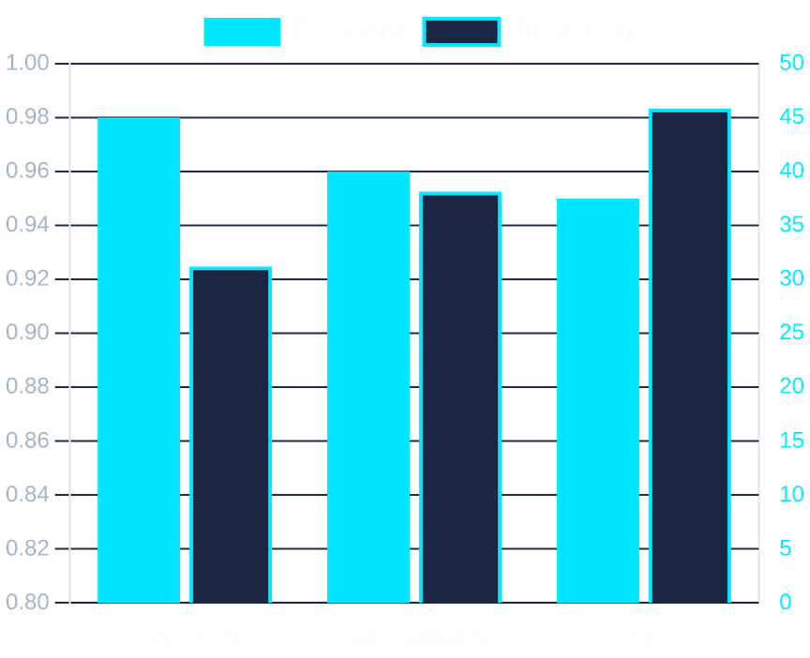
COMPARATIVE PERFORMANCE RESULTS
ALGORITHM
PRECISION
RECALL
F1-SCORE
TIME (MS)
HOG_SVM
0.96
0.99
0.98
31.20
Haar_Cascade
0.93
1.00
0.96
38.15
Deep_Learning_DNN
0.90
1.00
0.95
45.85
KEY OBSERVATION
HOG_SVM achieved the best overall performance with an F1-Score of 0.98 and the fastest processing time. Both Haar Cascade and DNN achieved perfect Recall (1.00), ensuring zero missed faces.
Visualizing the trade-off between Accuracy (F1) and Speed (ms).

Slide 8

STRATEGIC RECOMMENDATIONS
BEST FOR GENERAL USE
BEST FOR COMPLEX SCENARIOS
HOG + SVM
Deep Learning (DNN)
Recommended for PC-based applications where a superior balance of speed (31.2ms) and precision (0.96) is paramount.
The superior choice for maximum recall in unconstrained environments where computational power is not a constraint.
BEST FOR MOBILE & EDGE
KEY INSIGHT
Haar Cascade
Accuracy vs. Speed
Remains highly relevant for low-power devices and legacy systems requiring real-time performance on CPU.
Both Haar and DNN achieved 100% recall, ensuring no faces were missed, though at different computational costs.
FINAL VERDICT
"Algorithm selection must be driven by the specific constraints of the target hardware and the environmental complexity of the deployment scenario."

