Slide 1
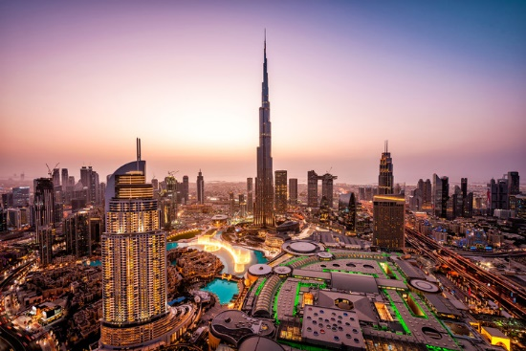
Exploring Dubai
Hazem Bakkar

Slide 2
Introduction
In May 2013, the government of Dubai launched the Dubai Tourism Strategy 2020.
the key objective to attract 20 million visitors a year by 2020
In 2018, the strategy was expanded by setting new goals of attracting
21-23 million visitors in 2022
23-25 million visitors by 2025.

Slide 3
Problem
How can I plan my trip, with the massive number of attractive sites in Dubai??
My trip is short, where should I start?
I like cafes, where should I go??

Slide 4
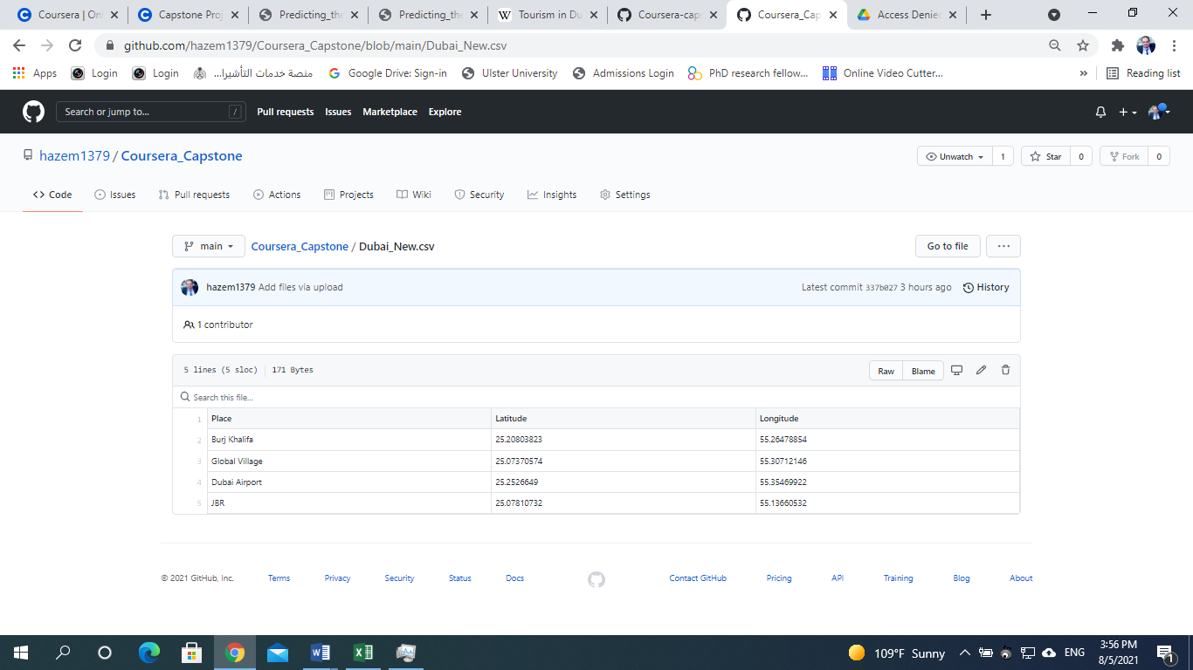
Data ??

Slide 5
Methodology
Preprocessing Data.
Using Foursquare.com API to obtain venues information and features.
Comparing venues around the four places shown in the previous slide.
Using one hot coding to estimate the frequency of the categories around the four places.
Using K-means to identify the venues that are frequent around each one of the four places, assuming that each place of the four is a centroid.

Slide 6
Results
JBR has many venues that may have more attraction than the other place.
Dubai airport has less attractive venues than other places.
Burj Khalifa has a great number of venues, but it is still less than the ones which are surrounding the Walk of JBR.
So as a tourist, I will visit the four places in the following order:
1- JBR.
2- Burj Khalifa.
3- Global Village.
4- Dubai Airport.

Slide 7
Discussion
Dubai has many places to visit
Using this notebook will help a lot if the user keeps changing the four places to study.
we can in a later stage include more than 4 four places, we can study 20 places, or 30.
The goal of this notebook is to give a sample about what we can do to get to know any city in the world using some well-known places that resides in it.

Slide 8
Conclusion
This report discusses a methodology that uses foursquare.com API to study any city in the world in terms of tourism and leisure.
The results of this experience show that using K-means algorithm can help to cluster the places that have common aspects and categories, which can be useful to plan a tourism trip to Dubai, as see in our experiment.

Slide 9
Thank you
Hazem bakkar

