Slide 1
Title
Subtitle

Slide 2
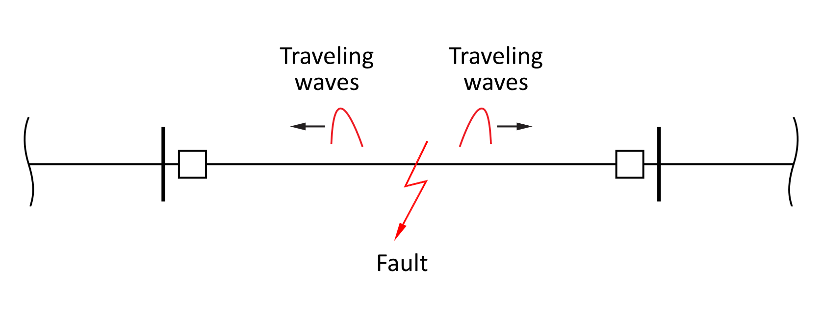
Fault Induced Transients
A fault results in an abrupt change in voltage at the point of the fault and sets up traveling waves.
They propagate from the fault point towards the line terminals at a speed close to light speed.
The earliest possible evidence available to a relay that a fault has occurred.
Relays can be designed to utilize these propagation to detect the presence of a fault.
These relays have the potential of becoming the fastest responding relays.

Slide 3
The traveling waves contain high frequency transients and are typically nonperiodic.
Therefore, their detection requires a Suitable signal processing technique such as the wavelet transform.

Slide 4
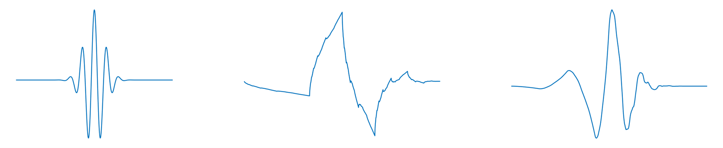
The Wavelet Transform
Wavelets are families of functions generated from one single function, called the mother wavelet.
Wavelets are oscillatory, decay quickly to zero, and have an average value of zero.
A family of wavelets is created by means of scaling and shifting of the mother wavelet.
This family of wavelets serves as the basis for representing the signal to be analyzed.

Slide 5
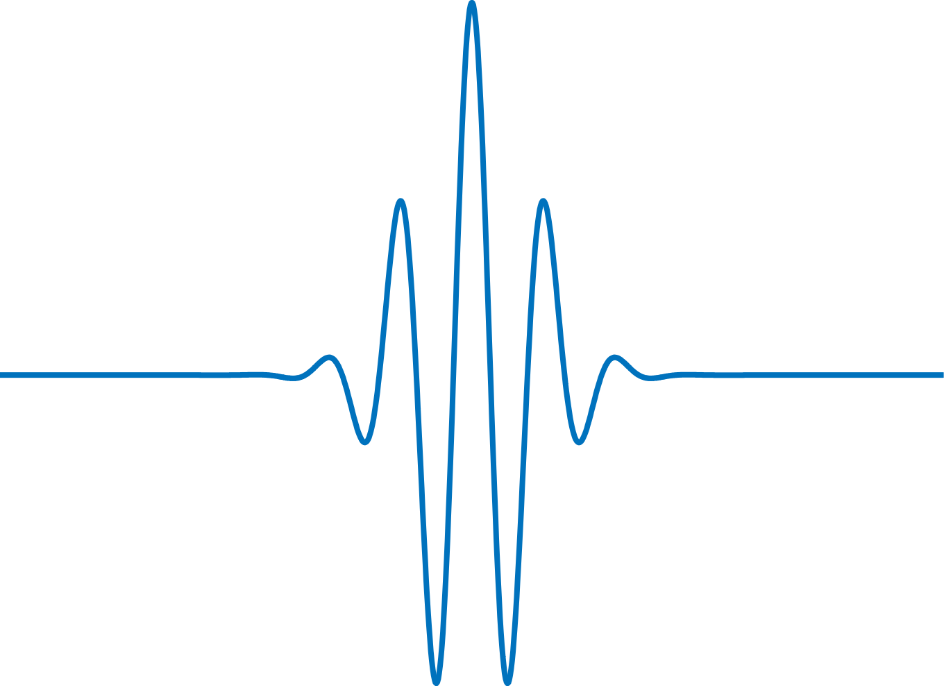
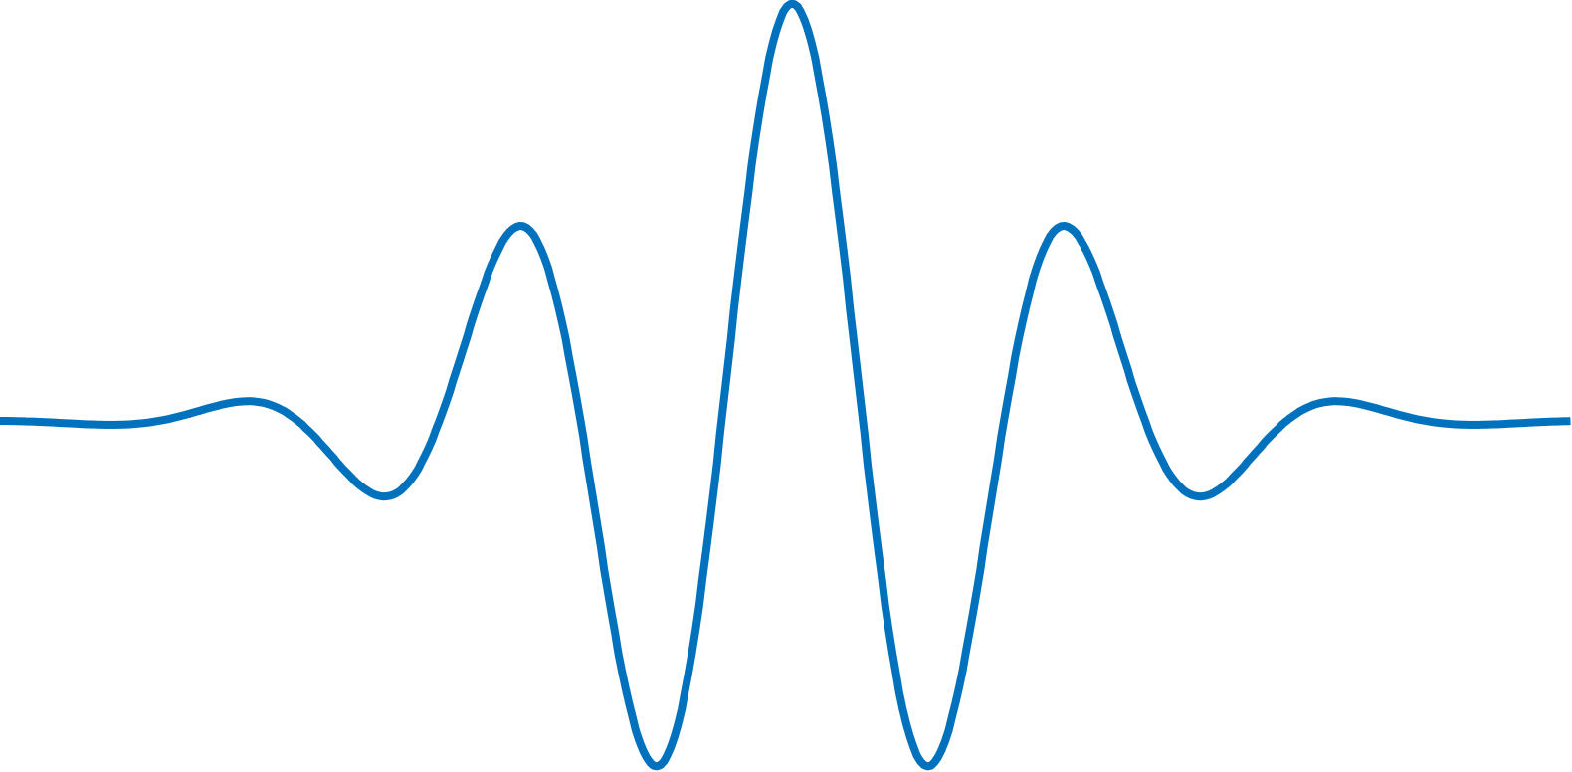
The scaling operation is used to dilate and compress the mother wavelet to obtain the respective low and high frequency information of the signal to be analyzed.
compressed wavelets obtain
the high frequency information
of the signal.
dilated wavelets obtain
the low frequency information
of the signal.

Slide 6
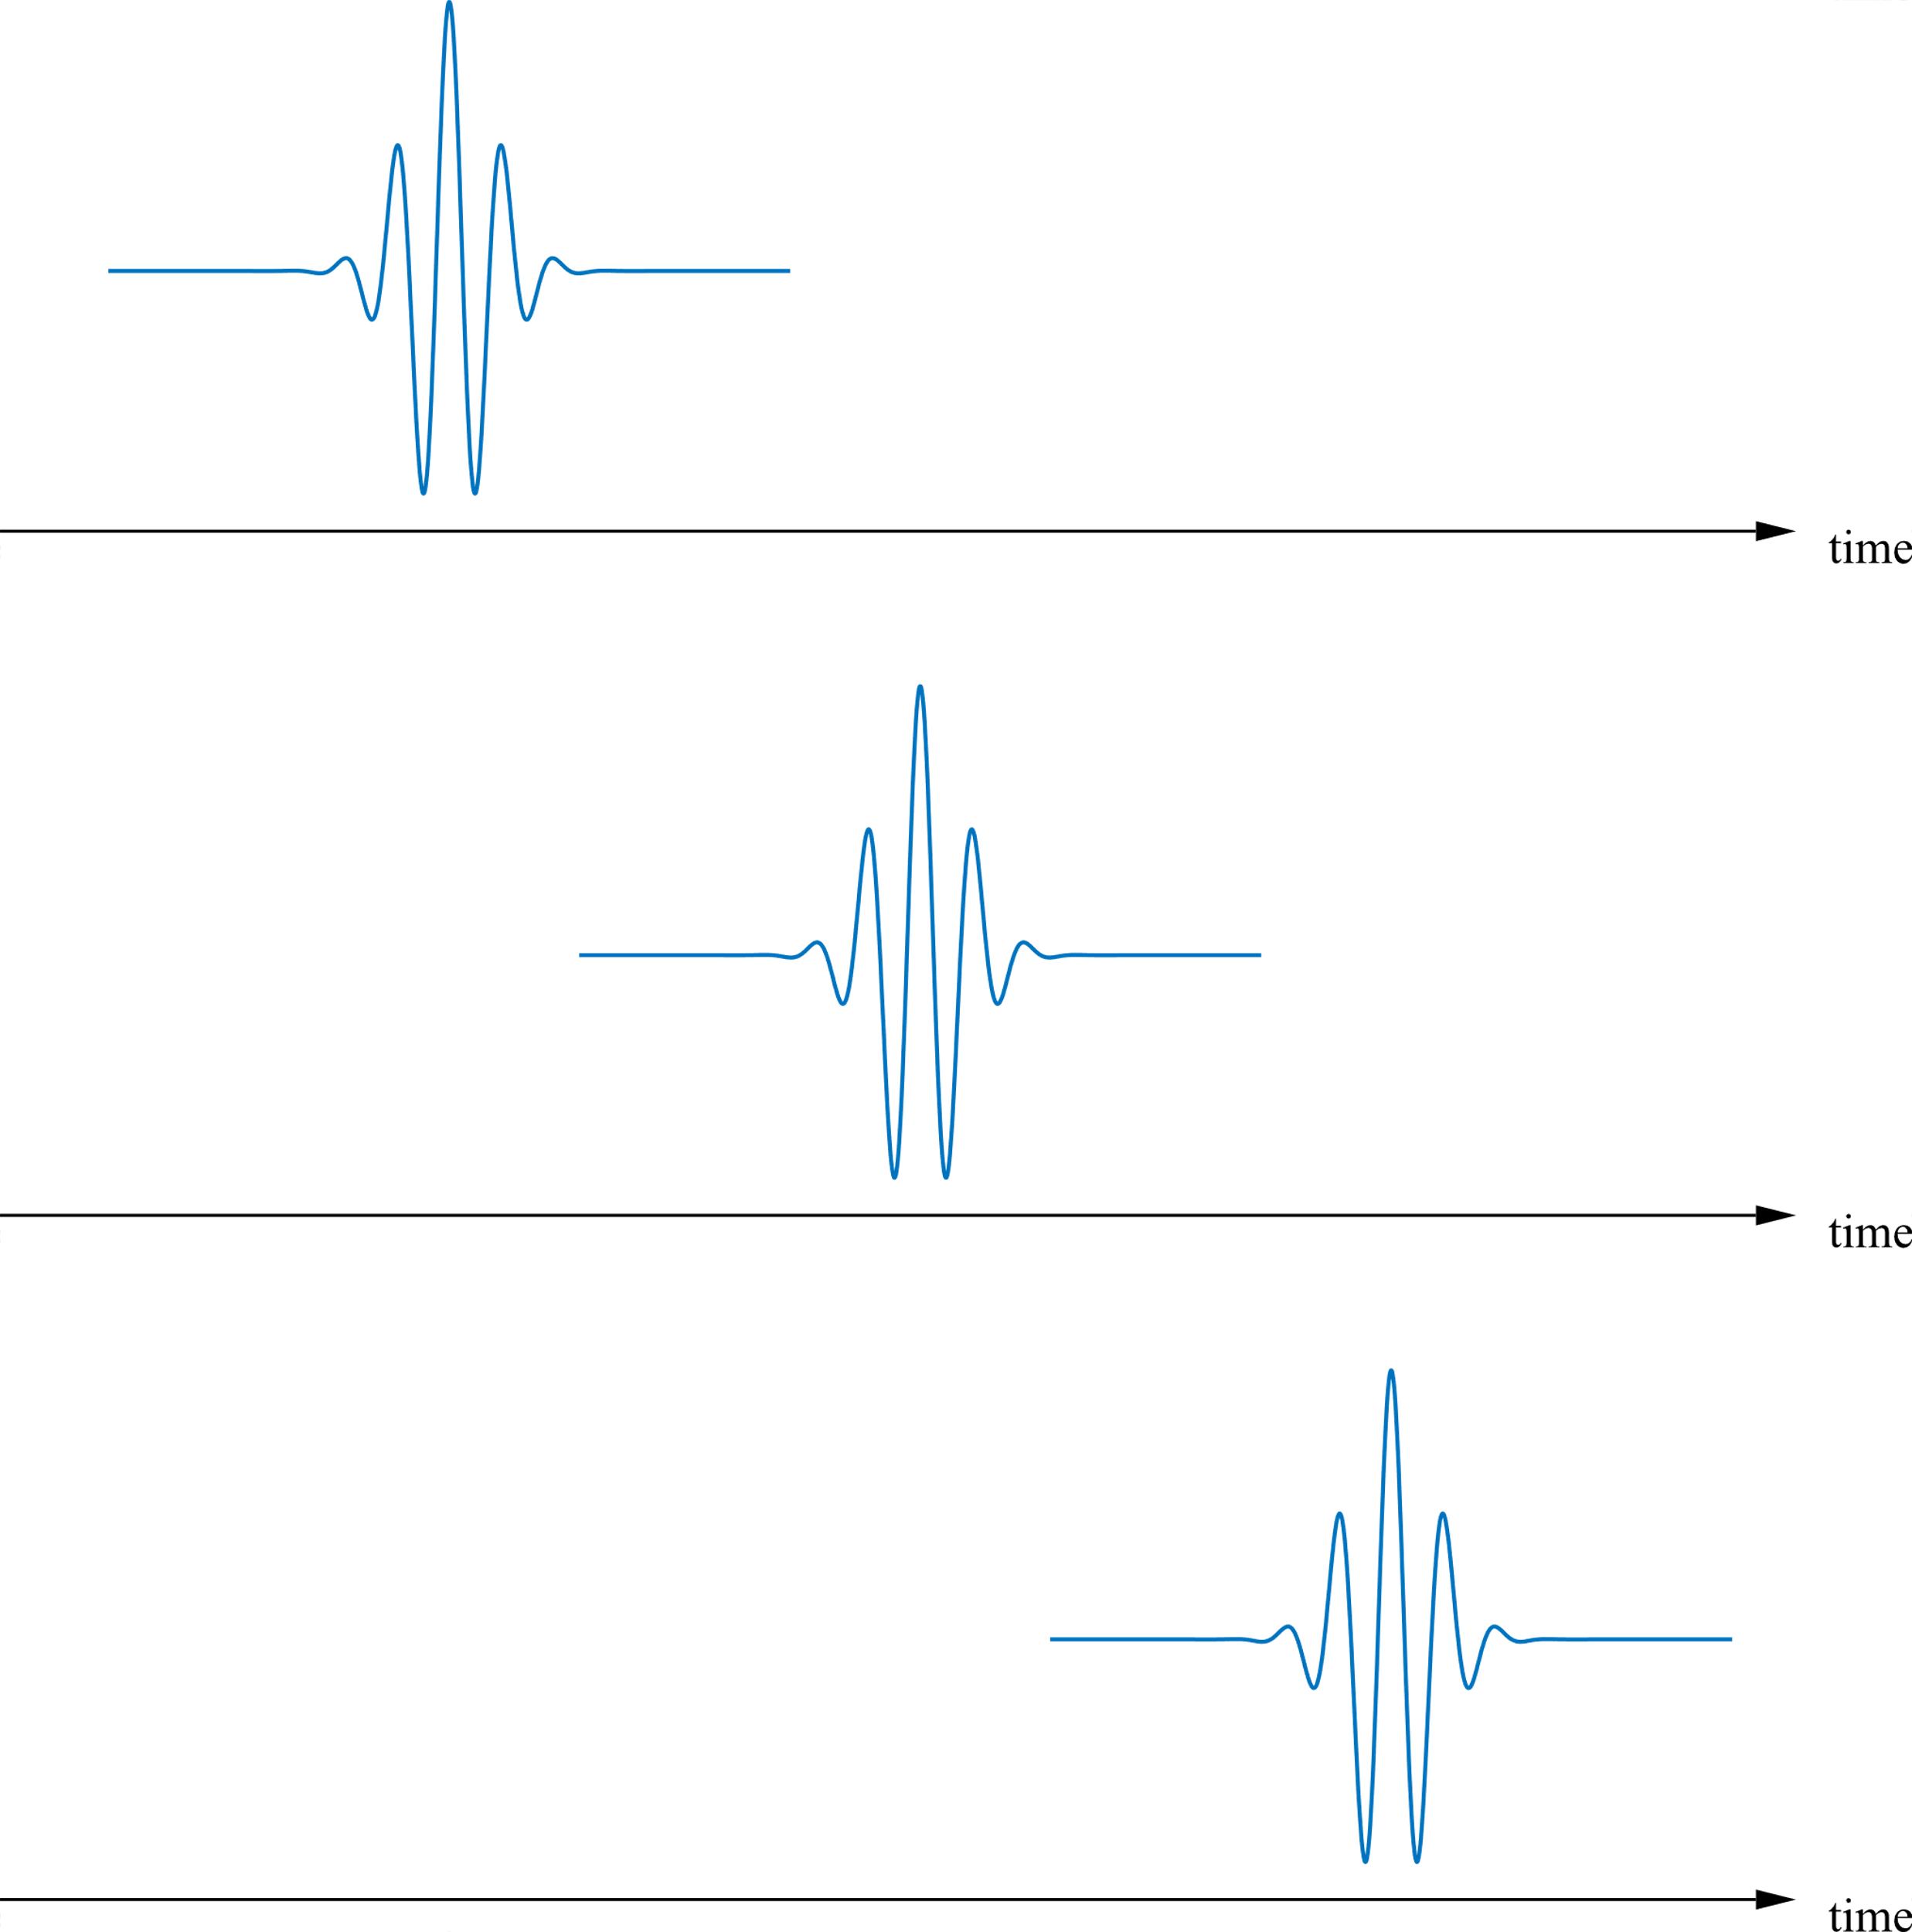
Then, the translation operation is used to obtain the time information.

Slide 7
When implemented digitally, the wavelet transform is called Discrete Wavelet Transform (DWT).
The DWT of a signal is given by:
where: is the mother wavelet
is the scale parameter
is the translation parameter
The wavelet transform is a correlation analysis which determines the amount of similarity of a given signal to the scaled and shifted versions of the mother wavelet.

Slide 8
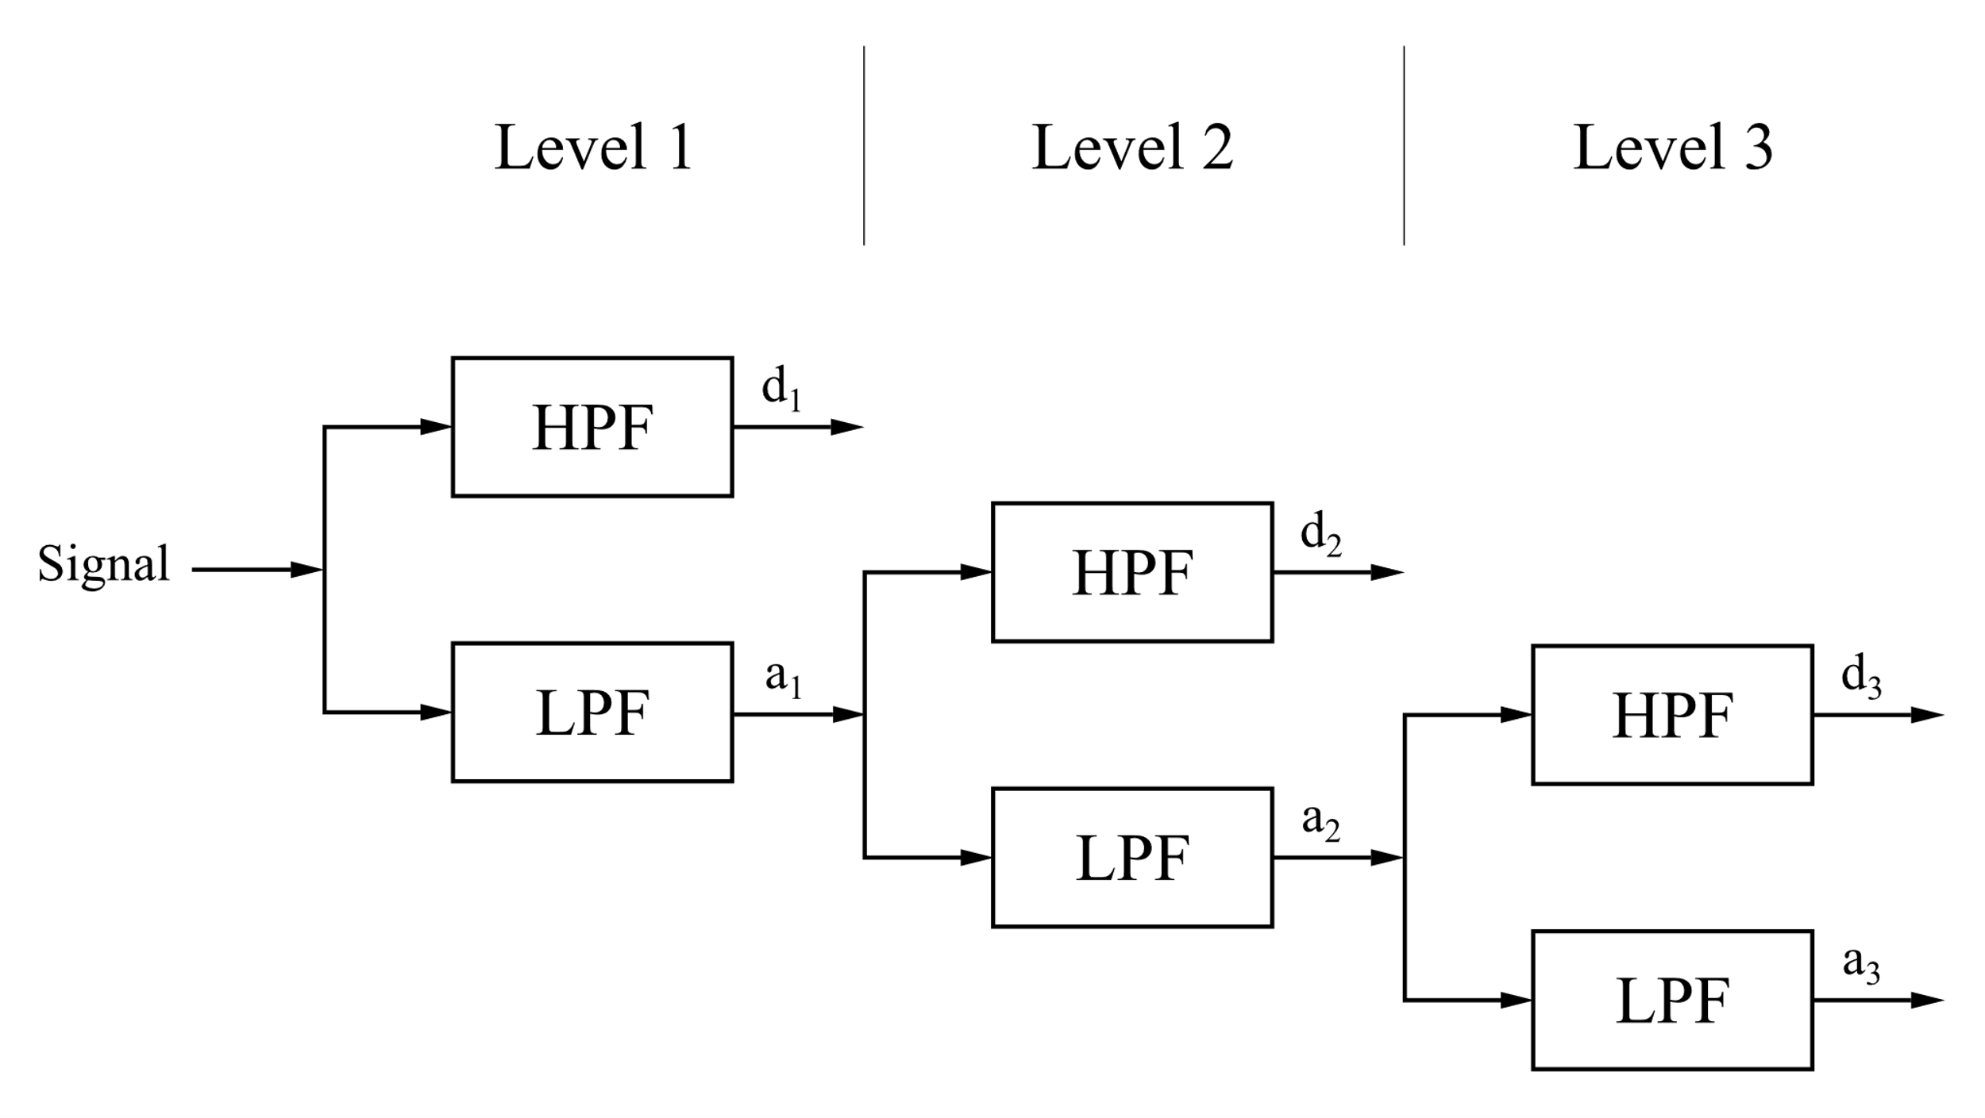
The DWT is equivalent to multistage successive pairs of high-pass and low-pass filters, this implementation is known as Multi-Resolution Analysis.

Slide 9
Each decomposition level provides information related to a particular frequency range.
The first level covers highest frequency components and the higher levels cover the lower end of the frequency spectrum.

Slide 10
At each level, the filters produce two sets of coefficients:
Detail Coefficients (represent high frequency content of the signal)
Approximation Coefficients (represent low frequency content of the signal)

Slide 11
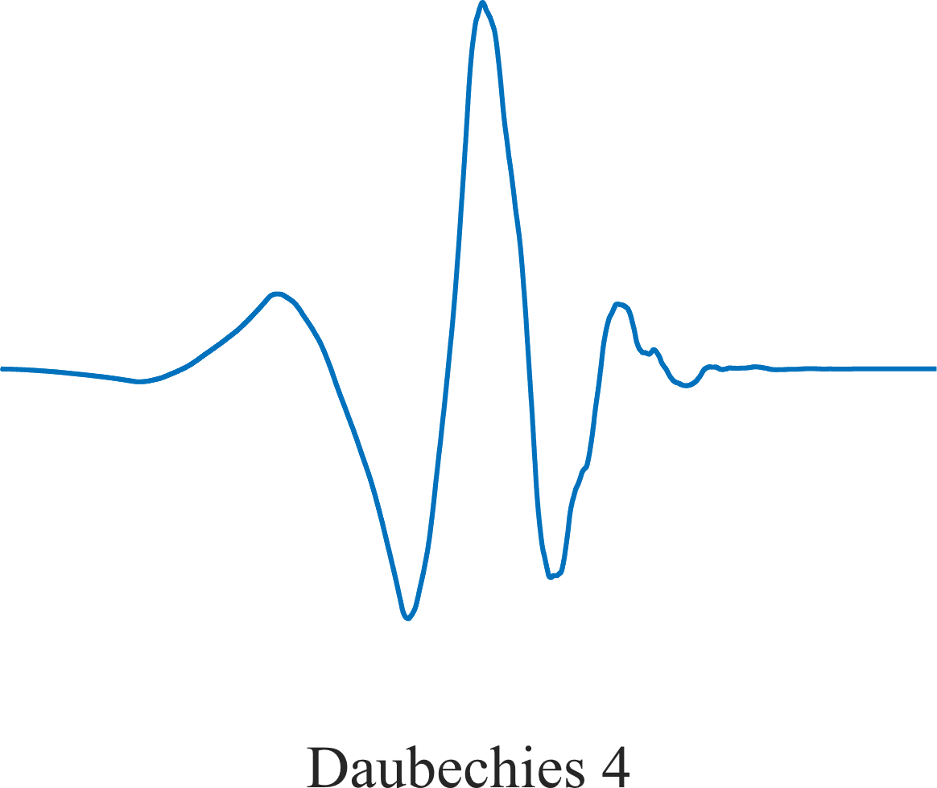
The effectiveness of the wavelet analysis is influenced by the choice of the mother wavelet.
The selection of mother wavelet is based on the type of application.
The wavelet Daubechies 4 (db4) provides an accurate detection of the transients in power systems*

Slide 12
Applications in Power System Protection
Wavelet transform is a powerful signal processing tool in the analysis of transients.
It can localize transient signals in both time and frequency.
It can be used in many power system protection applications such as:
Fault location
Detection of high impedance arcing faults
High speed relaying

Slide 13
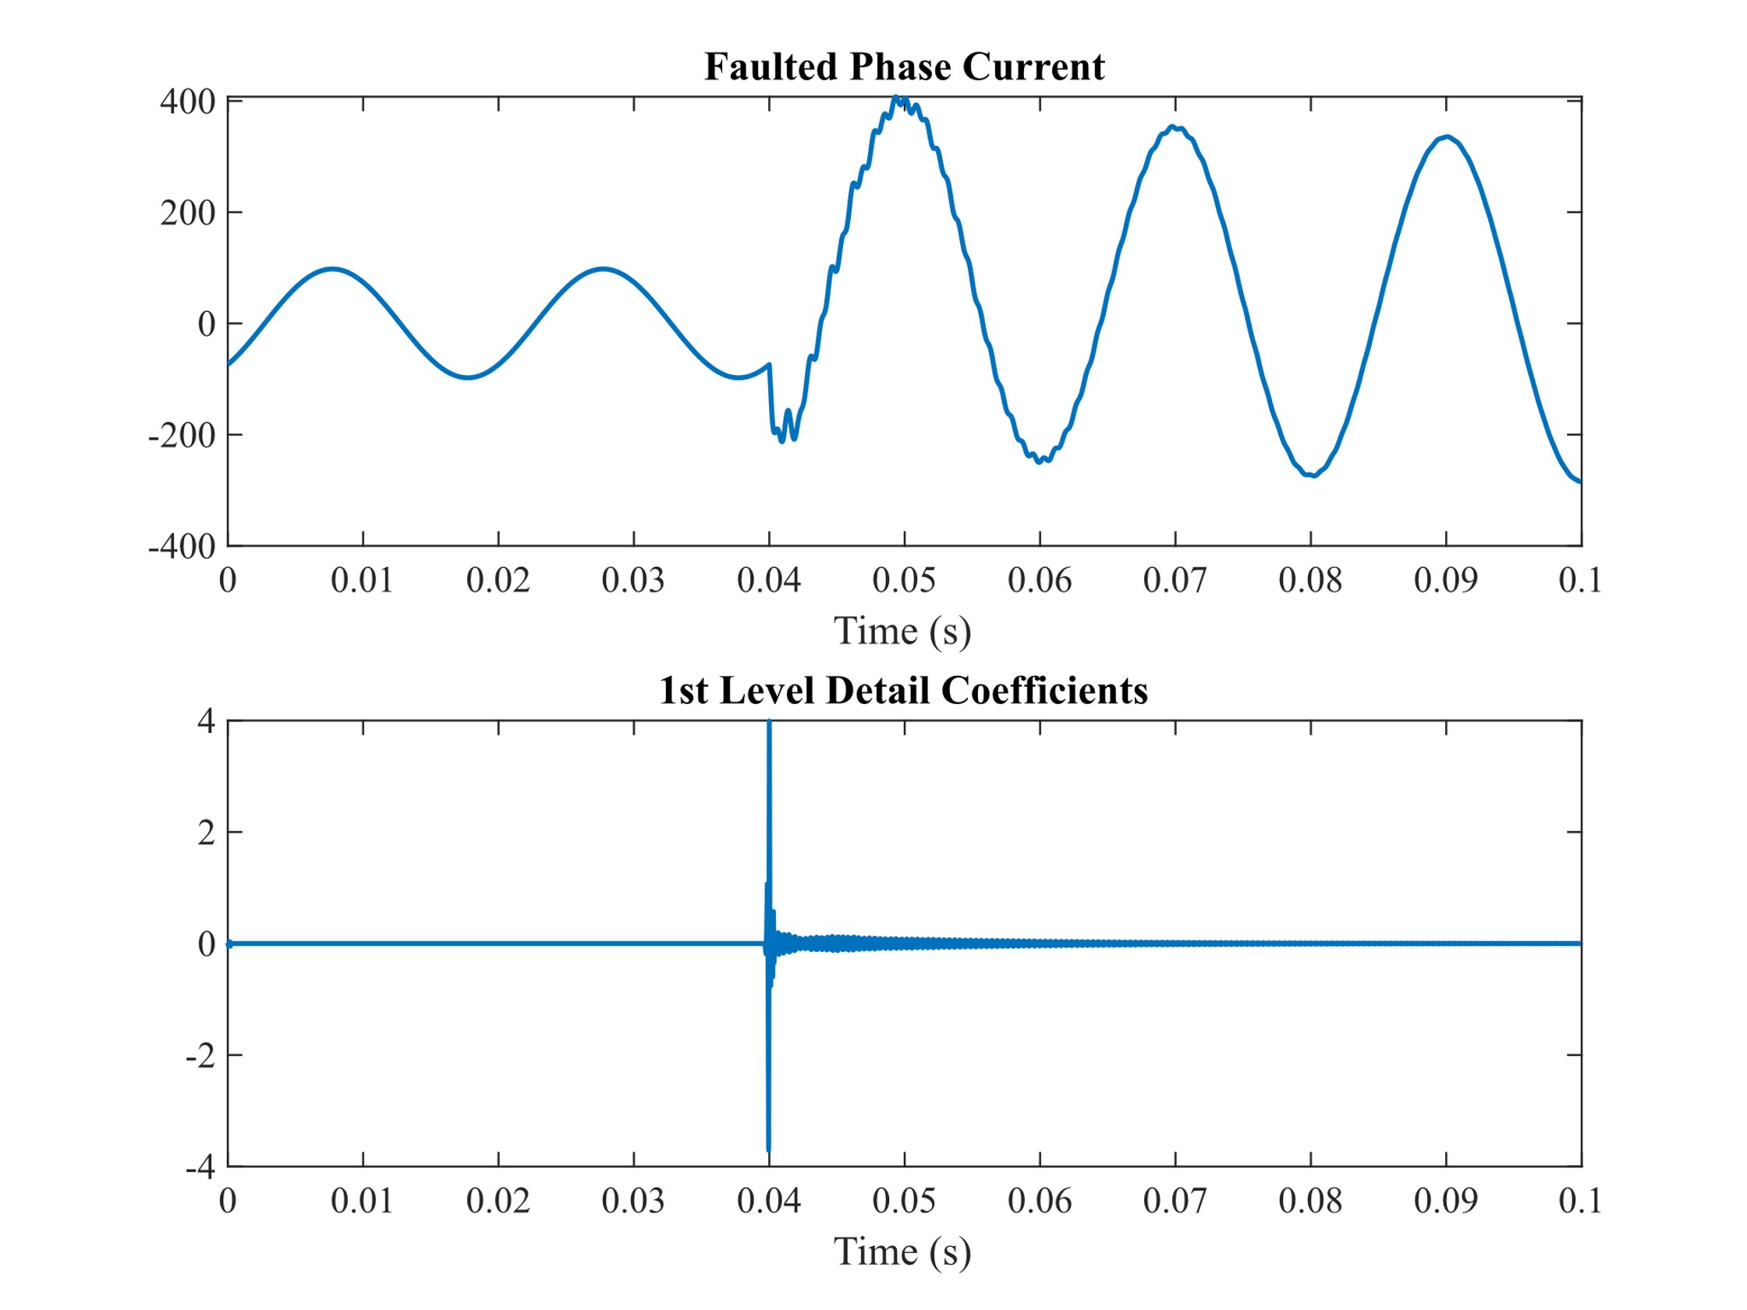
Wavelet Based Fault Detection
Fault-induced transients can be detected at each line end by using detail coefficients at the first decomposition level of current signals.
These coefficients are used to distinguish faults from steady-state.
The wavelet coefficients due to the fault-induced transients are higher than the ones related to steady-state.

Slide 14
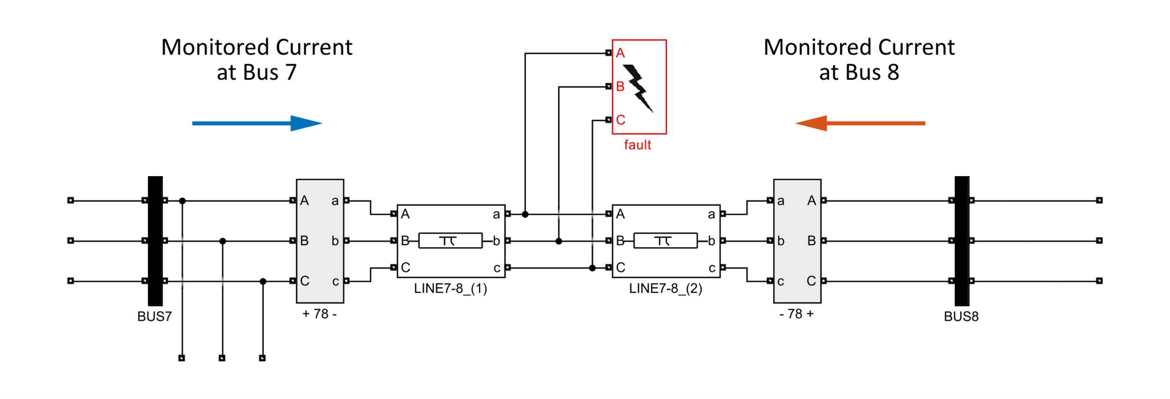
Wavelet Based Fault Detection
As shown, Line 7-8 is divided onto two lines to represent different cases of internal line faults based on varying the distance of both divided lines.
The current is monitored at the beginning of Line 7-8 at bus 7 with the shown polarity and the same exact current is monitored with the opposite polarity at the end of the line at bus 8.

Slide 15
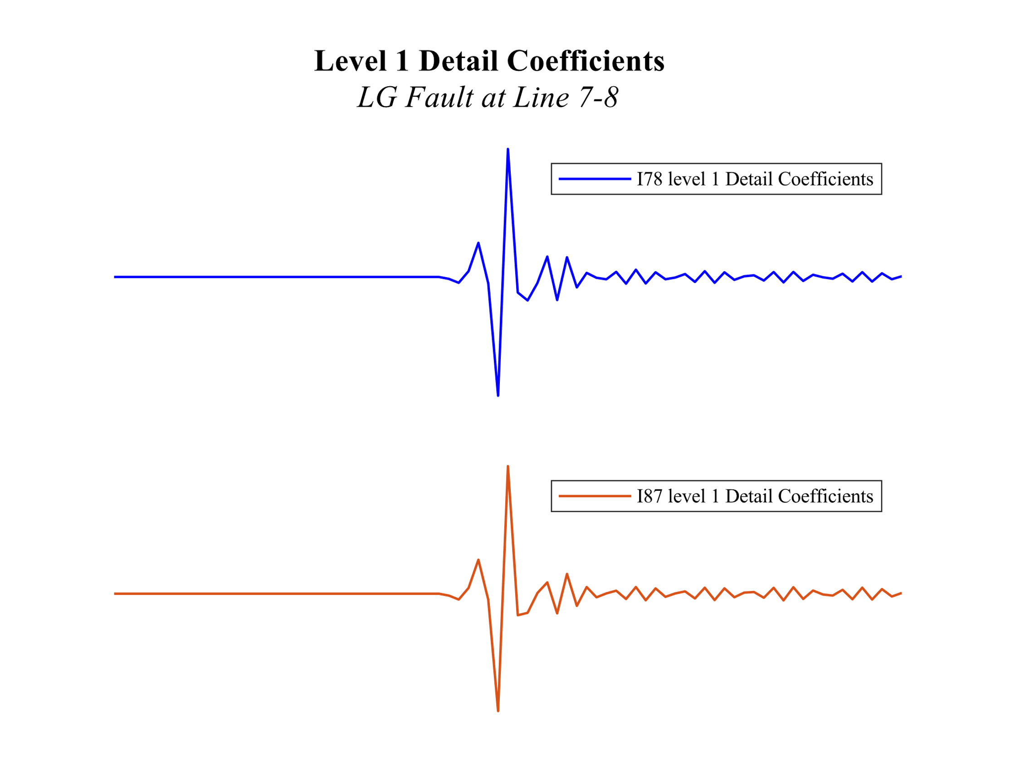
Wavelet Based Fault Detection Algorithm
The detection algorithm is based on two criteria and those two are threshold and directionality of every analyzed line current in the system
Threshold is the peak value for the chosen detailed current coefficient corresponding to time at which the fault occurred.
When an internal fault occurs in the line, the faulted section is fed from both buses at the end and the beginning of the line.
Hence, the concept of directionality is introduced.
As shown, both currents show the same direction even though they have opposite polarity.

Slide 16
Effect of Fault Inception Angle
??

Slide 17
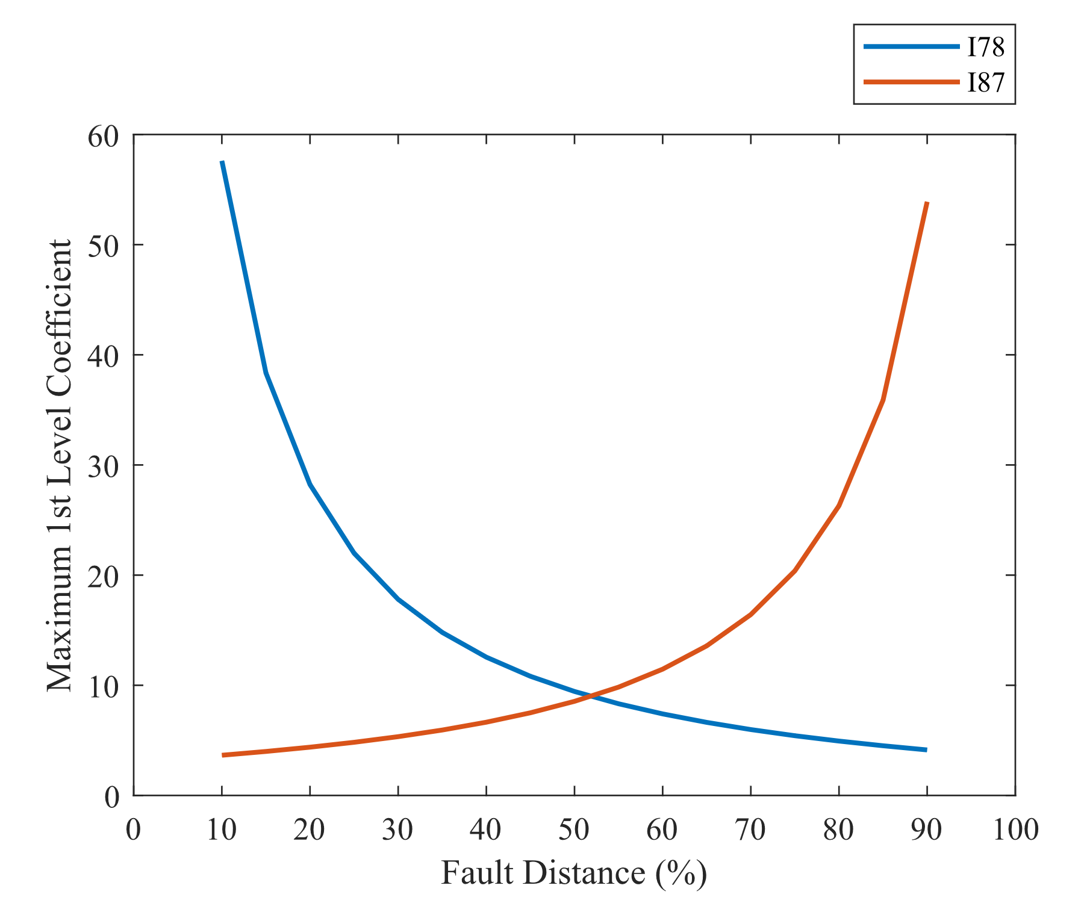
Effect of Fault Distance
The wavelet coefficients regarding the transients are affected by the fault distance.
The value of the maximum first level wavelet details decreases with the increase in fault distance.
Hence, when selecting a threshold value, it is selected to ?????

Slide 18
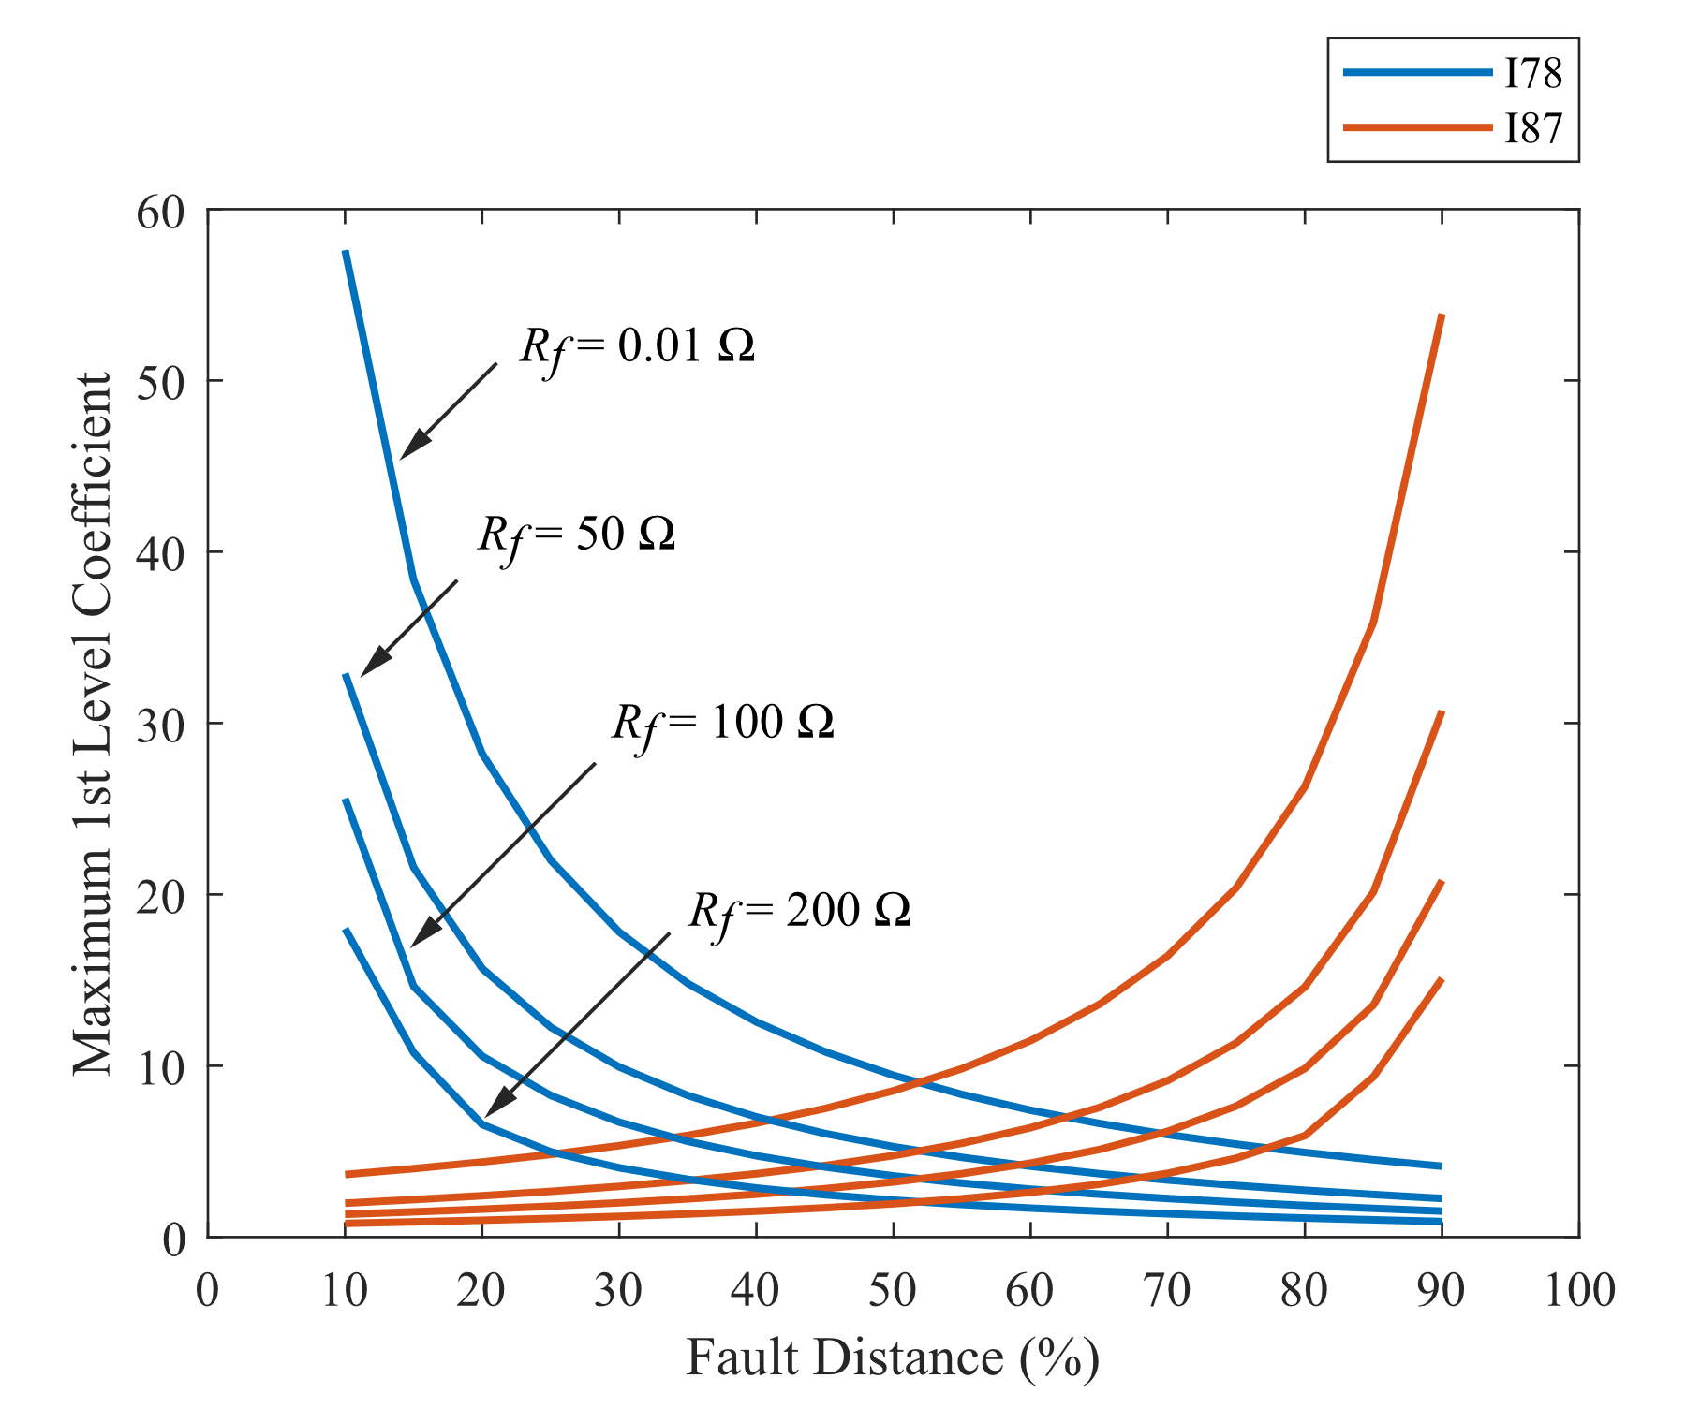
Effect of Fault Resistance
The wavelet coefficients are also affected by the fault resistance.
?

Slide 19
Conclusion
??

