Slide 1
Business Intelligence
& Data Analytics
Data Warehousing Project — Final Presentation
🥉 Bronze
🥈 Silver
🥇 Gold
📊 Dashboard
Project Team
Youssef Hassan · Ali Mohamed · Omar Samer · Bahaa Ahmed · Hazem Adel
Instructor: Dr. Shaimaa Masry
Medallion Architecture | Microsoft SQL Server | Power BI

Slide 2
Project Overview
Medallion Architecture — Bronze → Silver → Gold → Power BI
What We Built
A fully functional retail data warehouse ingesting 19 CSV source files from CRM and ERP systems, processed through three data quality layers and surfaced in an interactive Power BI dashboard.
📂
🥉
🥈
🥇
📊
19 CSV Files
Bronze Layer
Silver Layer
Gold Layer
Power BI
▶
▶
▶
▶
CRM + ERP Sources
Raw Ingestion
Cleansed & Typed
Star Schemas
Dashboard
19
2
9
Galaxy
SQL Server
Source Tables
Fact Tables
Dimension Tables
Schema Design
Platform
Database Platform: Microsoft SQL Server | Load Strategy: Batch Processing, Full Load, TRUNCATE & BULK/INSERT | 19 total source files: 4,000 customers, 6,000 POS transactions, 3,000 online orders

Slide 3
🥉 Bronze Layer — Raw Data Ingestion
First tier: immutable audit trail of all source data
Purpose & Approach
19 Bronze Tables — Source Categories
▸ Ingests all 19 CSV files into SQL Server with ZERO transformations
CRM Tables (8)
▸ All columns stored as NVARCHAR — preserving the raw format exactly
customers, employees, online_orders, online_order_items, payments, deliveries, delivery_providers + more
▸ Full Load strategy: TRUNCATE then BULK INSERT on every run
▸ Acts as an immutable audit trail for source data
ERP Tables (11)
products, brands, departments, stores, warehouses, suppliers, product_suppliers, promotions, registers, pos_transactions, transaction_items, inventory
▸ Stored procedure: bronze.load_bronze automates all loading
▸ Log table: bronze.load_log records row counts, timestamps & status
19
BULK INSERT
None
All NVARCHAR
Stored Procedure
Tables Created
Load Method
Transformations
Data Types
Automation
Schema: bronze | All data preserved exactly as received — no filtering, no type casting, no cleansing

Slide 4
🥈 Silver Layer — Cleansing & Transformation
Second tier: typed, standardised, enriched data
Key Transformations Applied
Derived Columns Added in Silver
TRY_CAST()
All columns cast to proper types (INT, DATE, DATETIME, DECIMAL)
customers.Full_Name
TRIM(First_Name) + ' ' + TRIM(Last_Name)
order_items.Total_Line_Amount
Quantity × Unit_Price
TRIM()
Leading/trailing whitespace removed from all text fields
transaction_items.Total_Line_Amount
Quantity × Unit_Price
LOWER()
Emails standardised to lowercase
deliveries.Delivery_Days
DATEDIFF(DAY, Ship_Date, Delivery_Date)
CASE WHEN
Gender & Order_Status normalised to consistent values
promotions.Duration_Days
DATEDIFF(DAY, Start_Date, End_Date)
ISNULL()
NULL Package_Size replaced with 'N/A'
Specifications
Schema:
silver
Tables:
19 (mirrors Bronze)
WHERE filter
Rows with NULL/blank primary keys excluded
Procedure:
silver.load_silver
Source:
bronze schema
Silver retains the operational structure — no star schema reshaping. That is reserved for Gold.

Slide 5
🥇 Gold Layer — Galaxy Schema Design
Kimball dimensional modelling: 2 Star Schemas + 4 Conformed Dimensions
GALAXY SCHEMA
★ dim_date
★ dim_customer
★ dim_product
★ dim_promotion
Conformed Dimensions — shared by BOTH fact tables
⭐ Star Schema 1 — Store Sales
⭐ Star Schema 2 — Online Sales
fact_store_sales
fact_online_sales
Measures: Quantity · Unit_Price · Sales_Amount
Grain: one row per POS transaction line item
Measures: Quantity · Unit_Price · Sales_Amount
Grain: one row per online order line item
dim_store
dim_employee
dim_warehouse
dim_order_status
dim_payment_method
Schema-specific dims
Schema-specific dims
11 Gold tables total · Surrogate keys (IDENTITY) on all dims · FK constraints enforced · gold.load_gold stored procedure · 14,962 store line items · 7,151 online line items

Slide 6
🥇 Gold Layer — Table Summary
All 11 tables, their type, usage, and approx. row counts
Table Name
Type
Used By
Row Count
gold.dim_date
Conformed Dimension
Both Schemas
Derived from dates
gold.dim_customer
Conformed Dimension
Both Schemas
4,000 rows
gold.dim_product
Conformed Dimension
Both Schemas
600 rows
gold.dim_promotion
Conformed Dimension
Both Schemas
120 rows
gold.dim_store
Schema 1 Dimension
fact_store_sales
64 rows
gold.dim_employee
Schema 1 Dimension
fact_store_sales
800 rows
gold.dim_warehouse
Schema 2 Dimension
fact_online_sales
8 rows
gold.dim_order_status
Schema 2 Dimension
fact_online_sales
4 statuses
gold.dim_payment_method
Schema 2 Dimension
fact_online_sales
Derived
gold.fact_store_sales
Fact Table
Star Schema 1
14,962 line items
gold.fact_online_sales
Fact Table
Star Schema 2
7,151 line items
Load order: TRUNCATE facts → DELETE dims → INSERT dims → INSERT facts | Surrogate keys: IDENTITY(1,1) on all dimensions

Slide 7
📊 Power BI Dashboard — Overview & User Personas
Multi-channel retail analytics · 5 pages · 5 personas · 25 business questions
5
5
25
35+
6
Dashboard
Pages
User
Personas
Business
Questions
Visuals
& KPIs
Cross-Schema
Questions
💼 Alex Chen
🏪 Jordan Rivera
🌐 Priya Nair
👥 Morgan Lee
📣 Sam Patel
Sales Director
Store Ops Manager
E-Commerce & Fulfilment
Customer Insights
Marketing & Promotions
Revenue vs goals, channel trends, regional performance
Store metrics, dept revenue, employee productivity
Delivery rates, warehouses, payment methods
Loyalty tiers, top customers, geography
Promo lift, discount correlation, channel comparison
★ Cross-schema = 24% of all business questions (6/25) — requiring DAX measures that span both fact tables. Satisfies the minimum 3–4 requirement.

Slide 8
📊 Page 1 — Sales Performance Overview
Audience: Alex Chen (Sales Director) · Cross-schema: ★ YES (multiple)
Purpose: High-level combined revenue view across store & online channels — goal tracking, regional map, and channel split.
Visualisation / KPI
Business Question Answered
Cross-Schema
Total Transactions KPI
Q1: How many transactions occurred vs. goal?
No
Total Online Revenue KPI
Q3: What is total online revenue vs. goal?
No
Total Store Revenue KPI
Q3: What is total store revenue vs. goal?
No
Total Combined Revenue KPI
Q1 (Alex): What is our total combined revenue vs. goal this period?
No
Revenue Trend by Month (Line)
Q2 ★: How does store revenue compare to online revenue over time?
★ YES
Store Revenue Map (State & Region)
Q3 (Alex): Which U.S. regions generate the most store revenue?
No
Combined Revenue vs Goal (Gauge)
Q1 (Alex): How close are we to the overall revenue goal?
No
Store vs Online Donut Chart
Q2 ★: What is the store vs. online revenue split?
★ YES

Slide 9
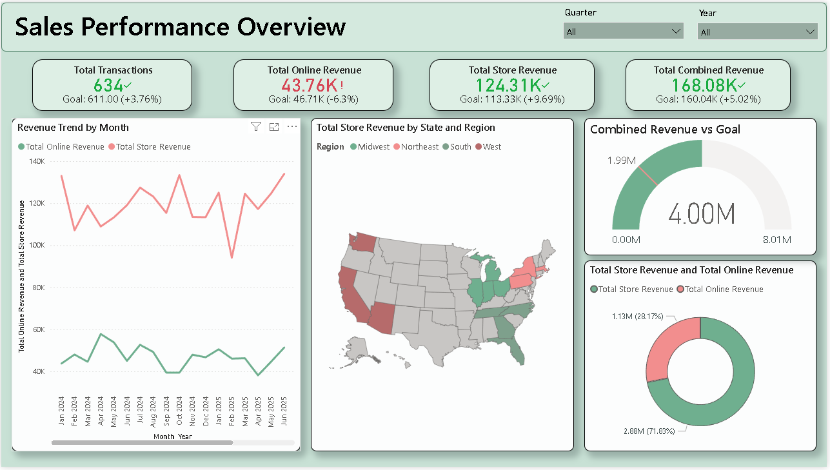

Slide 10
📊 Page 2 — Store Sales Performance
Audience: Jordan Rivera (Store Ops Manager) · Cross-schema: ★ 2 questions
Purpose: Detailed store-level metrics — department revenue breakdown, employee productivity rankings, regional analysis, and time intelligence (YTD, MoM, vs. prior year).
Visualisation / KPI
Business Question Answered
Cross-Schema
Store Revenue YTD KPI Card
Q5: How does store YTD compare to goal? | Q4 ★: Trending above/below goal?
★ YES
Revenue MoM % KPI Card
Q4: What is the month-over-month revenue growth for store sales?
No
Avg Transaction Value KPI Card
Supporting metric: store efficiency analysis
No
Sales Trend & Time Intelligence (Bar+Line)
Q5 ★: How does current revenue compare to the same period last year?
★ YES
Revenue by Department (Treemap)
Q1: Which product departments drive the most store revenue?
No
Top 10 Employees Table
Q2: Who are the top 10 revenue-generating store employees?
No
Revenue by Region (Bar Chart)
Q3: How does store revenue vary by geographic region?
No

Slide 11
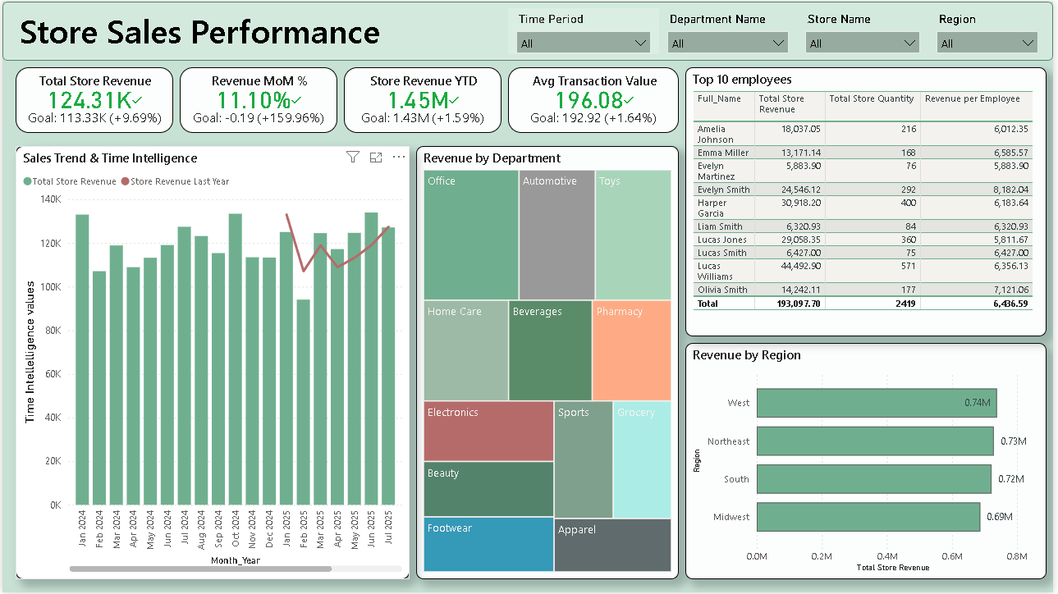

Slide 12
📊 Page 3 — Online Orders & Fulfillment
Audience: Priya Nair (E-Commerce & Fulfillment Manager) · Cross-schema: No
Purpose: Online channel deep-dive — fulfilment rates, warehouse throughput, top products, payment preferences, and order status breakdown.
Visualisation / KPI
Business Question Answered
Cross-Schema
Total Online Revenue KPI
Q3: How does current online revenue track vs. goal?
No
Cancellation Rate KPI
Q5: What proportion of orders are cancelled?
No
Total Orders KPI
General fulfillment volume monitoring
No
Delivery Rate KPI
Q1: What is the current online delivery rate vs. goal?
No
Revenue by Warehouse (Bar Chart)
Q4: Which warehouses generate the highest online revenue?
No
Orders by Payment Method (Pie)
Q2: Which payment methods are most popular among online customers?
No
Top 10 Products Bar Chart
Q3: What are the top 10 products by online revenue?
No
Orders by Status (Donut Chart)
Q5: What proportion of orders are cancelled, returned, or pending?
No

Slide 13
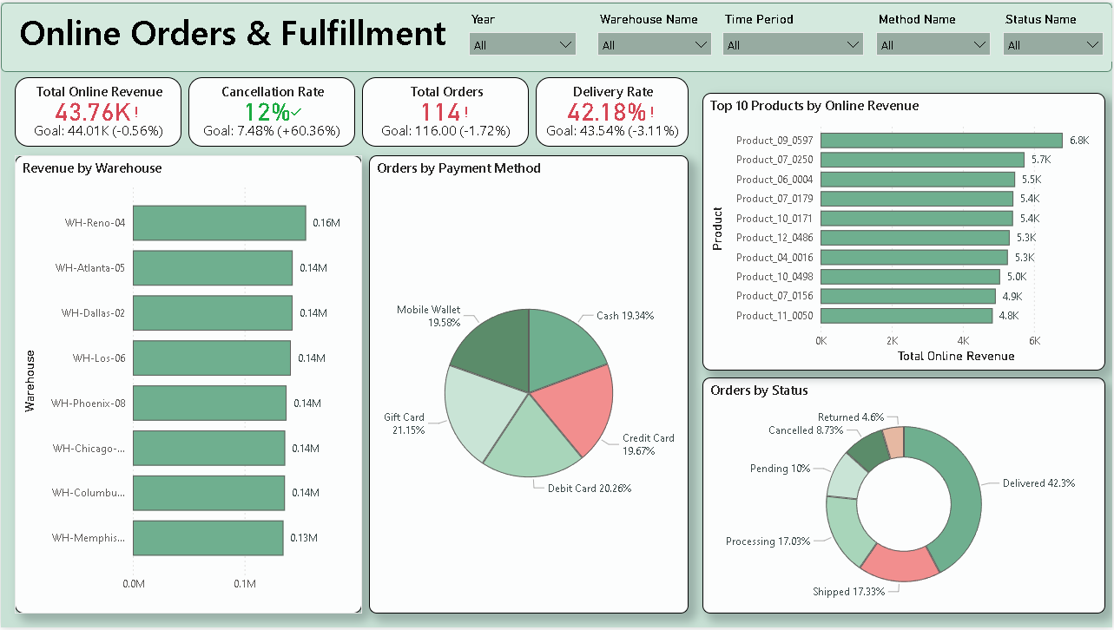

Slide 14
📊 Page 4 — Customer & Loyalty Analysis
Audience: Morgan Lee (Customer Insights Analyst) · Cross-schema: ★ 2 questions
Purpose: Customer segmentation by loyalty tier, gender, and geography — top-customer identification and average order value analysis.
Visualisation / KPI
Business Question Answered
Cross-Schema
Total Customers KPI Card
General customer base size overview
No
Customer Combined Revenue KPI
Q1 ★: Top customers by combined revenue context
★ YES
Avg Revenue Per Customer KPI
Q5: Average revenue efficiency across loyalty tiers
No
Revenue by Loyalty Level (Stacked Bar)
Q2: How is combined revenue distributed across loyalty levels?
No
Combined Revenue by Gender (Donut)
Q3: What is the revenue split between male and female customers?
No
Customer Revenue by City (Bubble Map)
Q4 ★: Which cities have the highest customer revenue concentration?
★ YES
Top 10 Customers Table
Q1 ★: Who are the top 10 customers by combined revenue?
★ YES
Avg Order Value by Loyalty Level (Bar)
Q5: How does average order value differ across loyalty tiers?
No

Slide 15
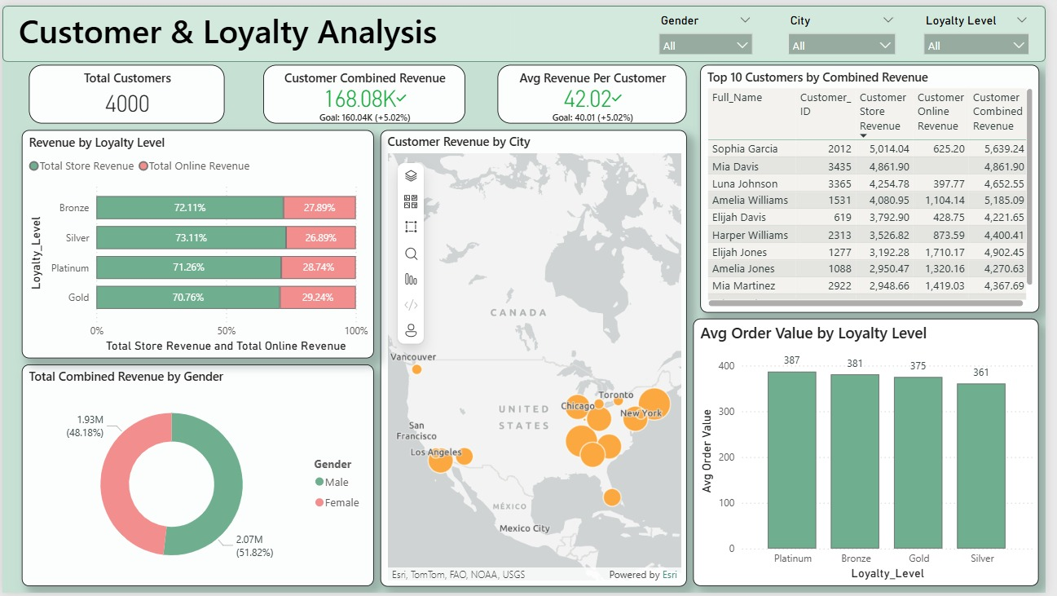

Slide 16
📊 Page 5 — Promotions Analysis
Audience: Sam Patel (Marketing & Promotions Analyst) · Cross-schema: ★ 1 question
Purpose: Promotional effectiveness — lift % vs. goal, promo-type revenue, discount-revenue correlation, duration impact, and channel comparison.
Visualisation / KPI
Business Question Answered
Cross-Schema
Combined Promo Revenue KPI
General promo revenue vs. goal overview
No
Promo Lift % KPI Card
Q1: What is the overall promotional lift percentage vs. goal?
No
Combined Non-Promo Revenue KPI
Supporting baseline for promo effectiveness analysis
No
Discount % vs Store Revenue (Line)
Q3: How does discount percentage correlate with store revenue?
No
Promo vs Non-Promo by Channel (Grouped Bar)
Q2: Which promotion types generate the most revenue by channel?
No
Revenue by Promo Type (Multi-series Bar)
Q5 ★: How does promo revenue compare across store and online channels?
★ YES
Promo Revenue by Duration Days (Scatter)
Q4: Does promotion duration affect combined promotional revenue?
No

Slide 17
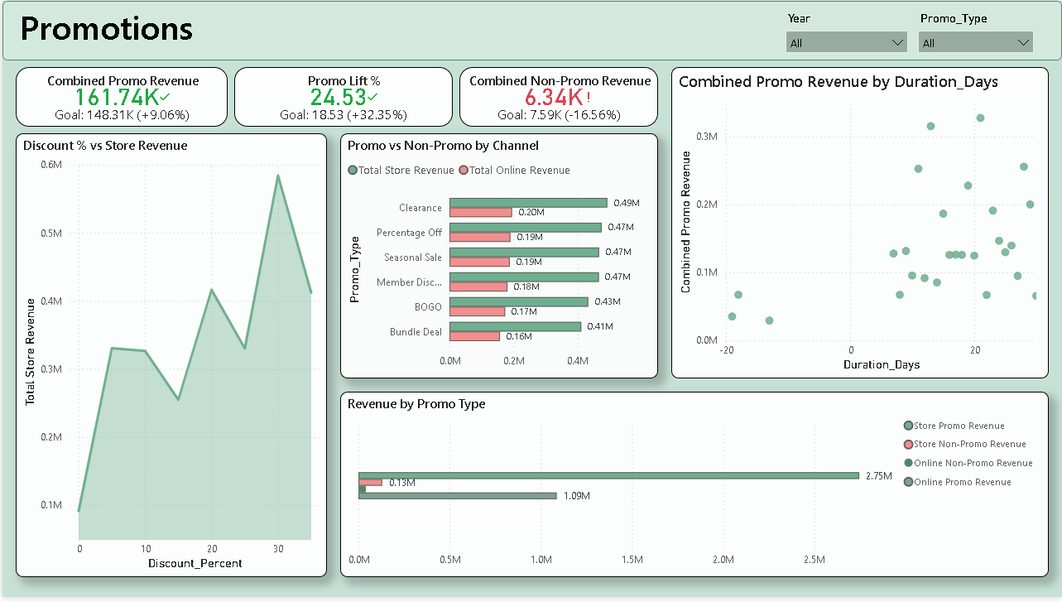

Slide 18
★ Cross-Schema Business Questions
6 questions spanning multiple schemas — 24% of all 25 business questions
Cross-schema questions require DAX measures that join data across fact_store_sales AND fact_online_sales (and/or customer / promotions / time schemas). These are the most analytically complex visuals in the dashboard.
#
Business Question
Persona
Schemas Involved
★1
How does total store revenue compare to total online revenue over time?
Alex Chen — Sales Director
Store Sales + Online Sales
★2
Are we trending above or below our revenue goals year-to-date?
Alex Chen — Sales Director
Store Sales + Online Sales + Goals
★3
How does current combined revenue compare to the same period last year?
Alex Chen — Sales Director
Store Sales + Online Sales + Time Intelligence
★4
Who are the top 10 customers by combined revenue?
Morgan Lee — Customer Insights
Customer + Store Sales + Online Sales
★5
Which cities have the highest customer revenue concentration?
Morgan Lee — Customer Insights
Customer + Store Sales + Online Sales + Geography
★6
How does promo revenue compare across store and online channels?
Sam Patel — Marketing Analyst
Promotions + Store Sales + Online Sales

Slide 19
Project Summary
🥉 Bronze
19 tables · Raw ingestion · NVARCHAR · Stored procedure + log
🥈 Silver
19 tables · Type casting · Cleansing · 5 derived columns · Validation
🥇 Gold
2 fact tables · 9 dims · 4 conformed · Galaxy schema · FK constraints
📊 Dashboard
5 pages · 5 personas · 25 questions · 35+ visuals · 6 cross-schema
Thank You

