Slide 1

AlexBank Digital Transformation
Name: Hazem Adel ID: 13006278
Name: Omar Khaled ID: 13003972
Name: Moaz Abdelaleem ID: 13007327
Name: Mohammed Gamal ID: 13001305
Name: Omar Ehab ID: 13006897
Name: Anas Ahmed ID: 13008336

Slide 2


Company Overview
Founded in 1957
Established over six decades ago, the company has a long history in providing banking services.
Privatized in 2006
Acquired by Intesa Sanpaolo, it became a private entity to enhance growth and adaptability.
Banking Sector Focus
The core operations revolve around banking and financial services, navigating both traditional and modern challenges.

Slide 3



Reasons for Digital Transformation
1
Legacy Systems
2
Customer Expectation
Manual processes caused delays and ineffciencies.
Growing demand for mobile and digital banking services.
3
Fintech competition
4
Declining Branch Visits
New digital banks pushed AlexBank to Modernize.
Customers preferred online channels over in-person banking.
5
New Technologies
6
Operational Effciency
AI, cloud, and analytics became industry standards.
Need to reduce costs and automate routine tasks.

Slide 4

Transformation Goals
1
Boosting Customer Digital Engagment
2
Automating Repetitive
Back-Office Processes
3
Improving Visibility Into
Risk- Prone Customers
By promoting mobile and online banking use across all age group
Such as loans approvals and document handing, to reduce delays and operating costs
Using data and analytics to proactivily manage financial risk and defaults

Slide 5

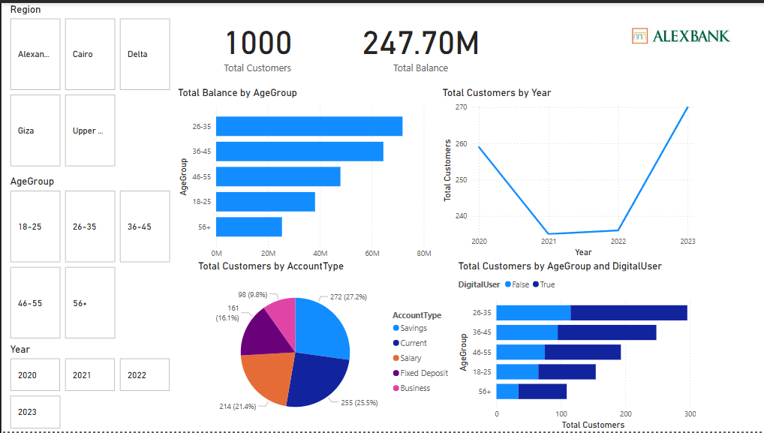
Customer Profile Insights
Savings Account Usage
27.2% of customers prefer savings accounts.
Current Account Usage
Total Customers
25.5% of customers prefer current accounts.
The bank has a total of 1,000 customers.

Slide 6

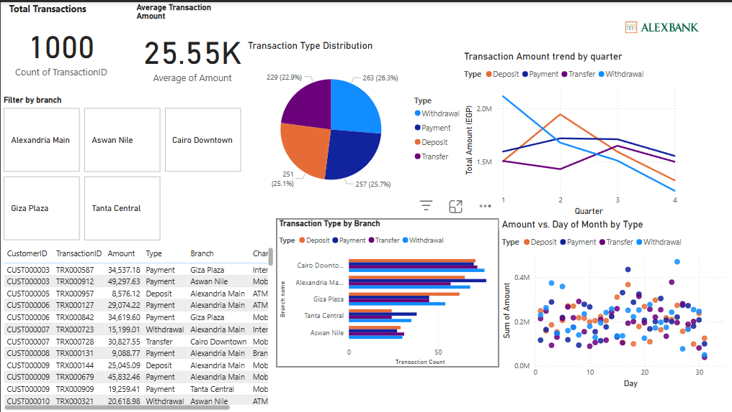
Transaction Insights
Average Transaction
Withdrawal Transactions
Avg. Transaction: 25.55K EGP
Most popular transaction type at 26.3%.
Payment Transactions
Payment transactions account for 25.7%.

Slide 7
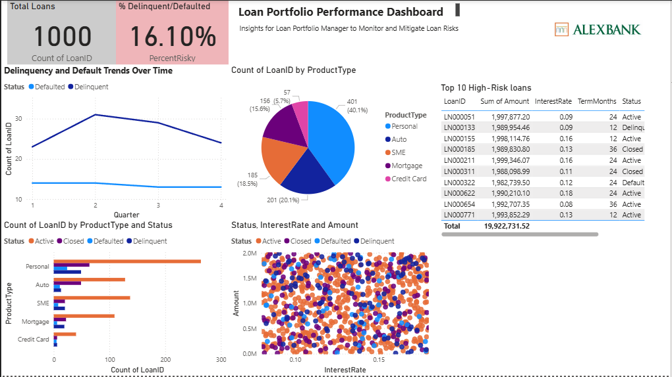
Loan Insights
1
Top Loans
Personal and SME loans are leading.
2
Issues Identified
High default rates in Auto and SME loans.
3
Strategic Approach
Implement AI in credit scoring and provide SME financial planning.

Slide 8
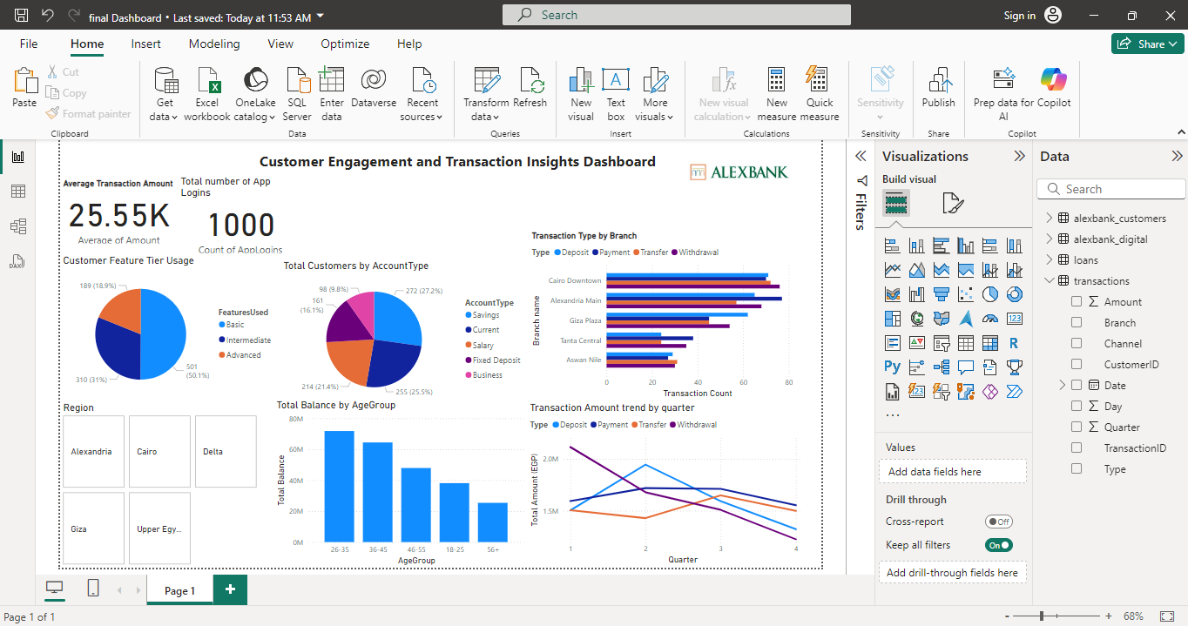
Engagement Overview
1
Total Balance
247.7M EGP
2
Top Digital Users Age
Ages 26–45
3
Customer Growth
Strong customer growth rebound in 2023

Slide 9

XR in Banking
1
Virtual Reality (VR)
Immersive staff training for customer service and digital tools.
2
Augmented Reality (AR)
Interactive ATM/app guides for onboarding new users.
3
Impact
Faster onboarding, reduced customer confusion, and a stronger brand image.

Slide 10

Strategic Technologies
1
AI/ML
2
IoT
3
Cloud
Predicting customer churn and smart credit scoring.
Monitoring ATM and branch performance.
Real-time, scalable data access.
4
RPA
5
Blockchain
6
Business Intelligence
Automating back-office tasks like HR and invoicing.
Providing transparency in loan contracts.
Enhancing customer segmentation and product planning.

Slide 11


Process Redesign Priorities
1
Digitize Onboarding
2
Loan Applications
Streamline the new user registration process with digital tools.
Implement online forms for convenience and efficiency.
3
Complaint Resolution
4
Remote Advisory Enablement
Utilize digital channels for quicker responses to customer issues.
Provide clients with financial advice through mobile apps.

Slide 12

Ethical AI Strategies
1
Fair AI Use
Prioritize transparency and explainability in AI decisions.
2
Data Privacy
Adhere to GDPR and local compliance regulations.
3
Inclusivity Training
Provide mobile banking training for elderly customers.

Slide 13

Digital Transformation Roadmap
1
Phase 1
Data analysis & customer insight
2
Phase 2
Tech assessment & process redesign
3
Phase 3
Pilot digital tools, XR features, and AI systems

Slide 14

Conclusion & Next Steps
Data-driven strategies
1
2
Digital engagement
Implement analytics to enhance customer insights.
Strengthen customer interactions through digital platforms.
3
Ethical tech adoption
4
Next Steps
Prioritize responsible technology practices and data security.
Pilot digital features in Cairo and Alexandria branches.

Slide 15

Any Questions

Slide 16

Thank You

