Slide 1

AI-Powered Construction Safety Monitoring System
Automated PPE Detection Using YOLO
Presented by: Hazem Alaa

Slide 2
The Imperative for Automated Safety Monitoring
Construction sites present dynamic and high-risk environments. Ensuring consistent adherence to Personal Protective Equipment (PPE) standards is critical but often challenging to manage manually.
Mitigating High-Risk Hazards
Ensuring Regulatory Compliance
Scaling Site Oversight
Construction remains one of the most hazardous industries, where even minor lapses in PPE compliance can lead to severe injury or fatality.
Manual inspections are time-consuming and prone to human error, leading to inconsistent safety records and potential regulatory fines.
Safety managers cannot be everywhere at once. An automated system provides 24/7, objective oversight across multiple concurrent work zones.

Slide 3


Project Objective: Real-Time PPE Compliance
Our primary goal is to leverage advanced computer vision to create a robust system capable of immediately identifying safety non-compliance on site.
Real-Time Detection
Targeted PPE Classes
Process live video feeds and uploaded files instantly to provide actionable insights.
Focus detection specifically on required gear: helmets and safety vests.
Accurate Reporting
Generate objective compliance reports based on visual evidence, reducing ambiguity.

Slide 4
Building the Foundation: Dataset and Labeling
A high-quality, diverse dataset is essential for training a reliable object detection model that performs well under varied site conditions and lighting.
2.2K+
4
Images Collected
Core Classes
Sourced from diverse construction environments globally.
Helmet, Vest, No Helmet, No Vest.

Slide 5
Model Architecture: Selecting YOLOv11
We chose the YOLO (You Only Look Once) architecture for its exceptional speed, accuracy, and real-time detection capability, making it perfectly suited for live safety monitoring in construction environments.
Why YOLO?
Single-Pass Detection:YOLO analyzes the entire image in one forward pass, predicting bounding boxes and class probabilities simultaneously.
Real-Time Performance:Capable of processing multiple frames per second — ideal for video streams and on-site surveillance.
High Precision:Accurately detects small and overlapping objects, such as helmets, vests, and workers, even in complex scenes.
Lightweight & Deployable:Efficient enough for deployment on both edge devices and cloud platforms.

Slide 6
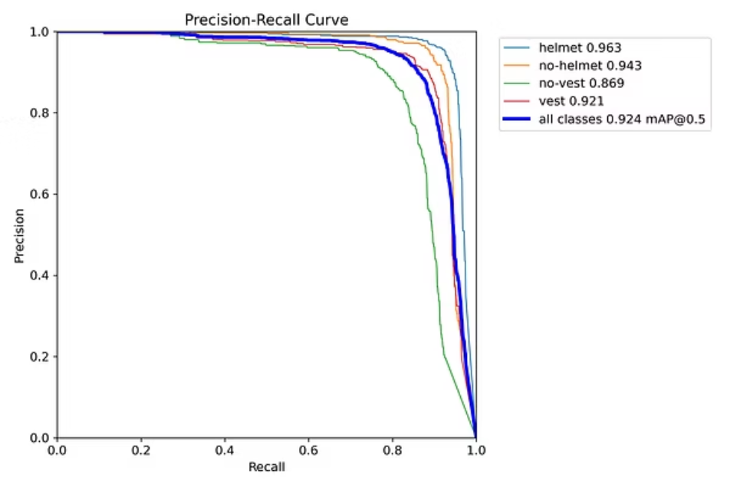
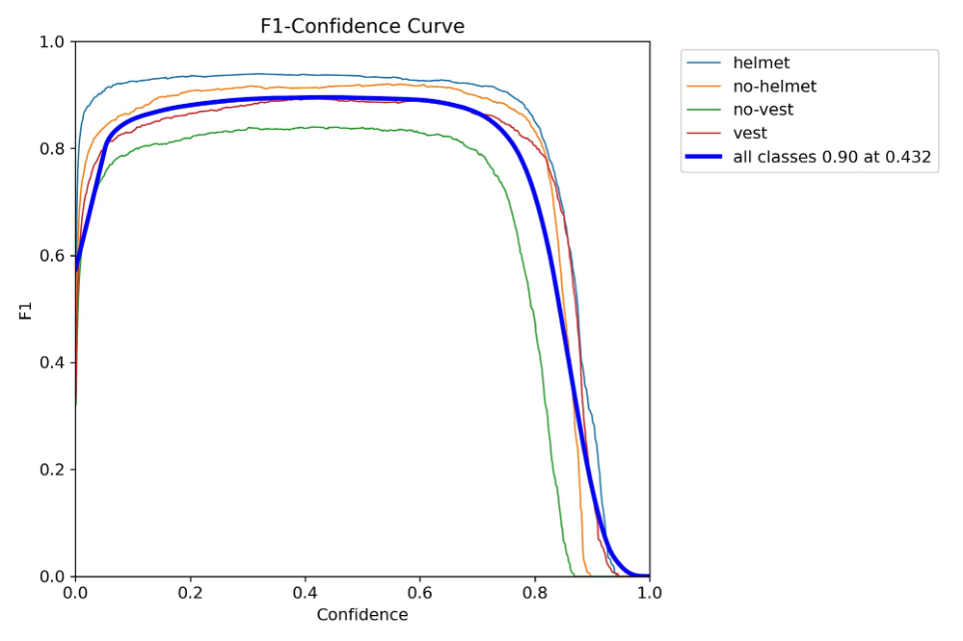
Model Training and Performance Metrics
The model was rigorously trained, utilizing image augmentation techniques like rotation and scaling to enhance robustness against real-world variations.
Key Evaluation Metrics
Mean Average Precision (mAP): Measures the average quality of bounding box and classification predictions across all classes.
Precision: Indicates the accuracy of positive predictions (when the model says "PPE detected," is it correct?).
Recall: Measures the model's ability to find all relevant instances (did it catch all instances of missing PPE?).
Initial testing achieved high confidence, confirming the model’s viability for deployment.

Slide 7
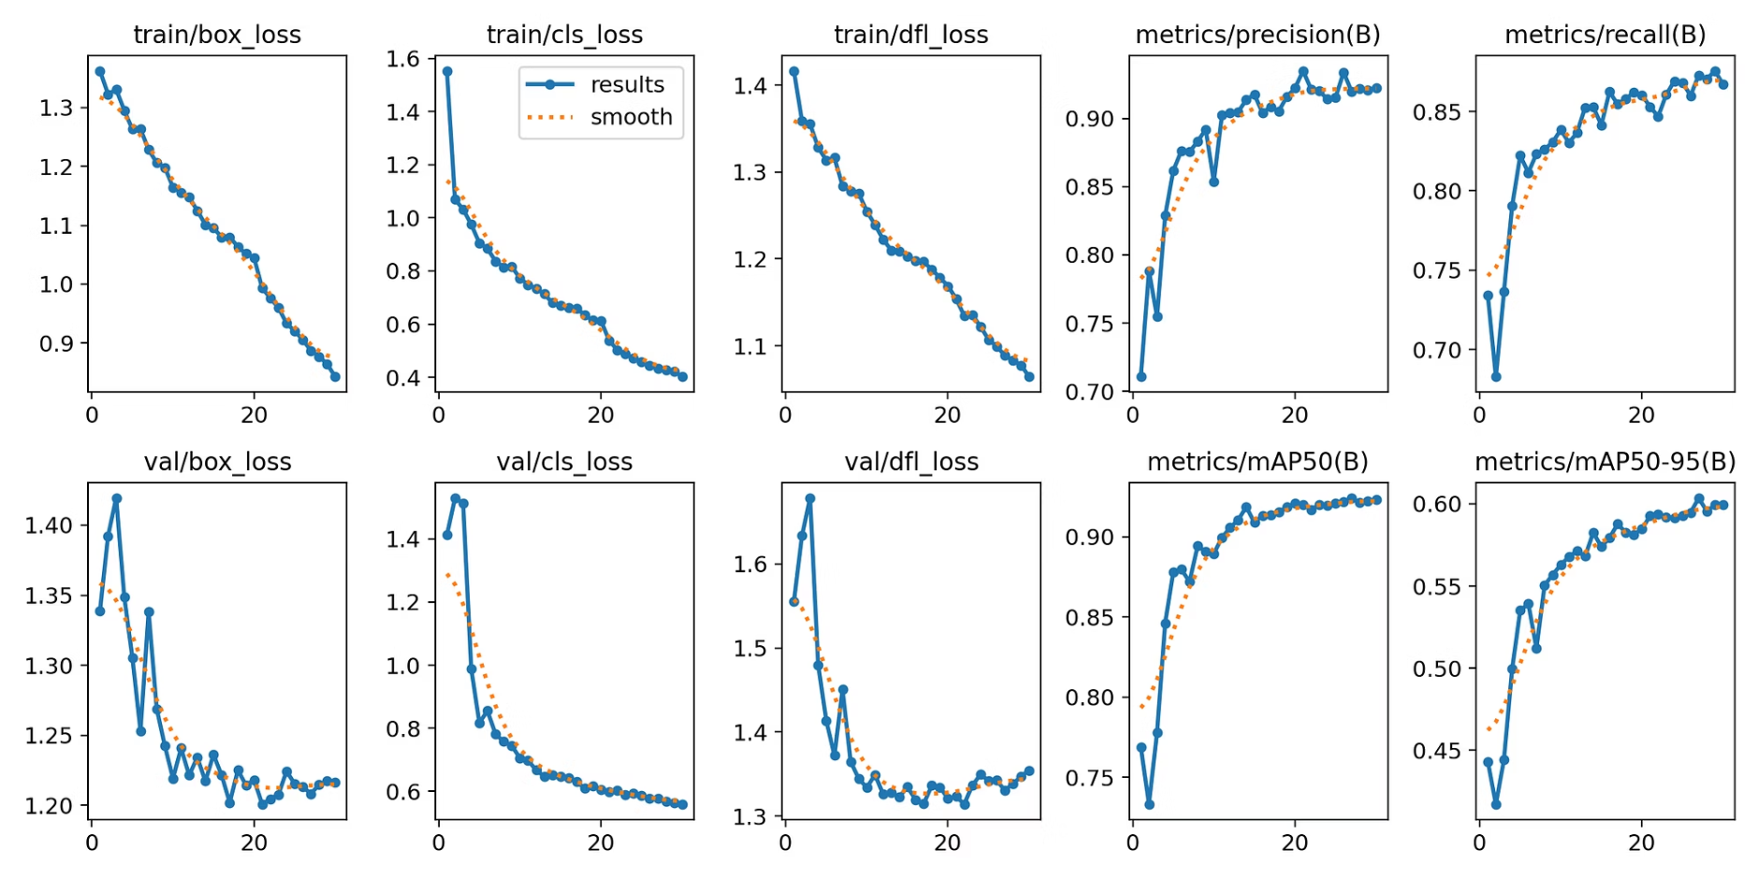
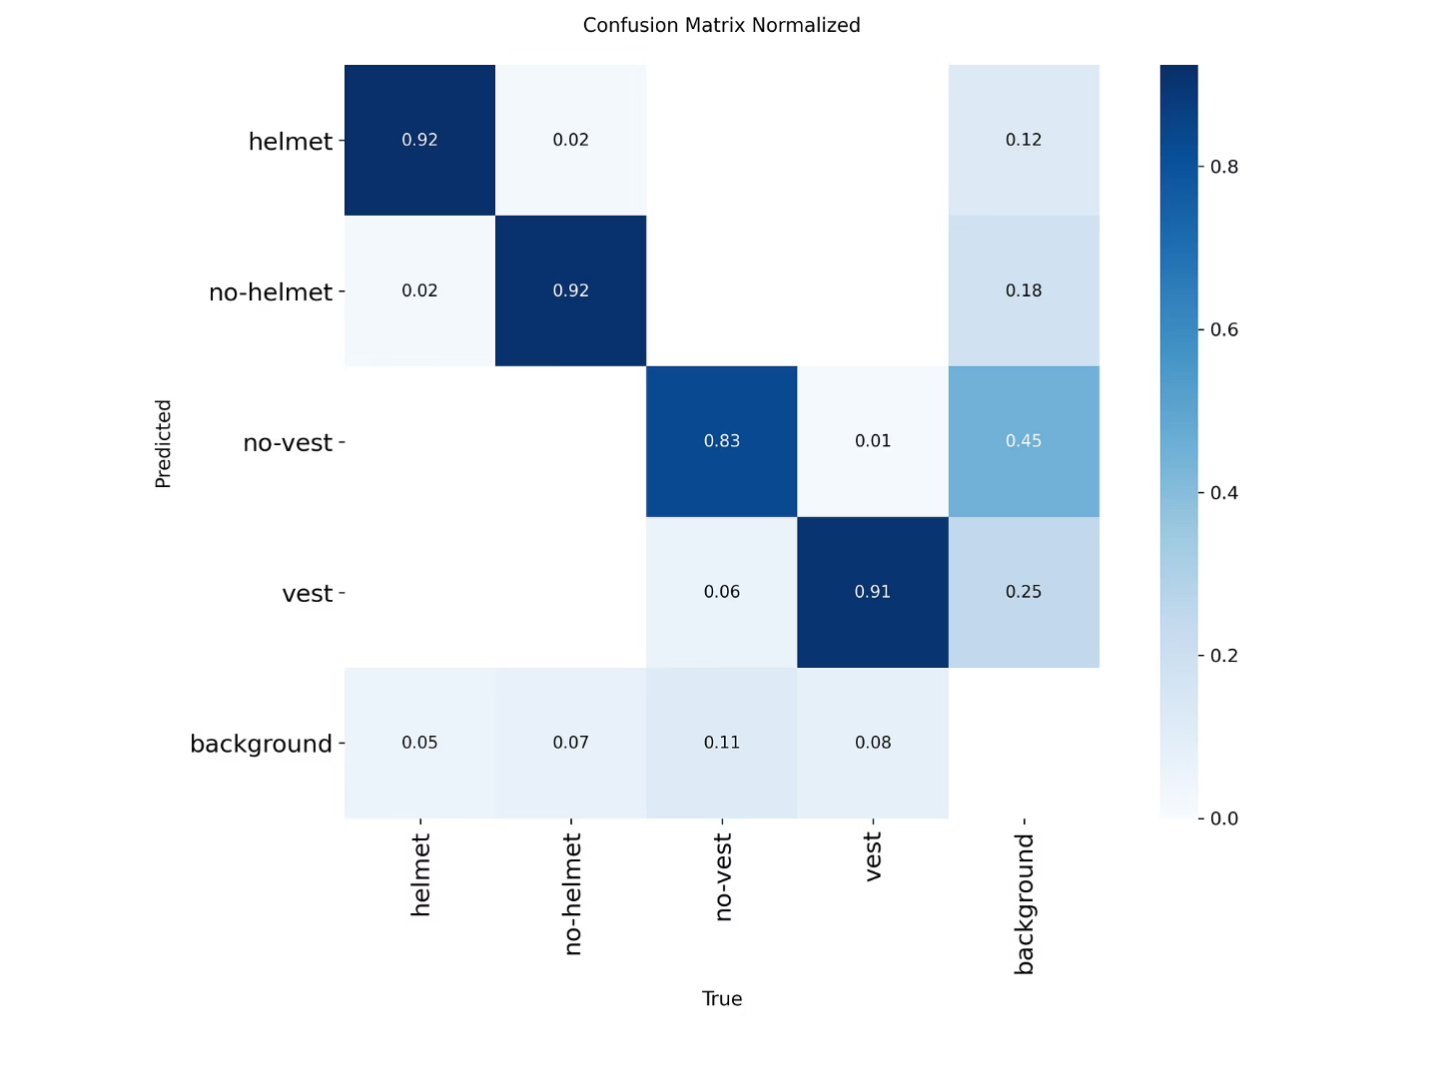
Confirmed Results: Accurate PPE Detection
Our model's performance was rigorously evaluated, showcasing strong capabilities in identifying PPE on construction sites. Below are the key metrics demonstrating its effectiveness.
Confusion Matrix: Predicted vs. Actual
Training & Validation Loss Over Epochs

Slide 8
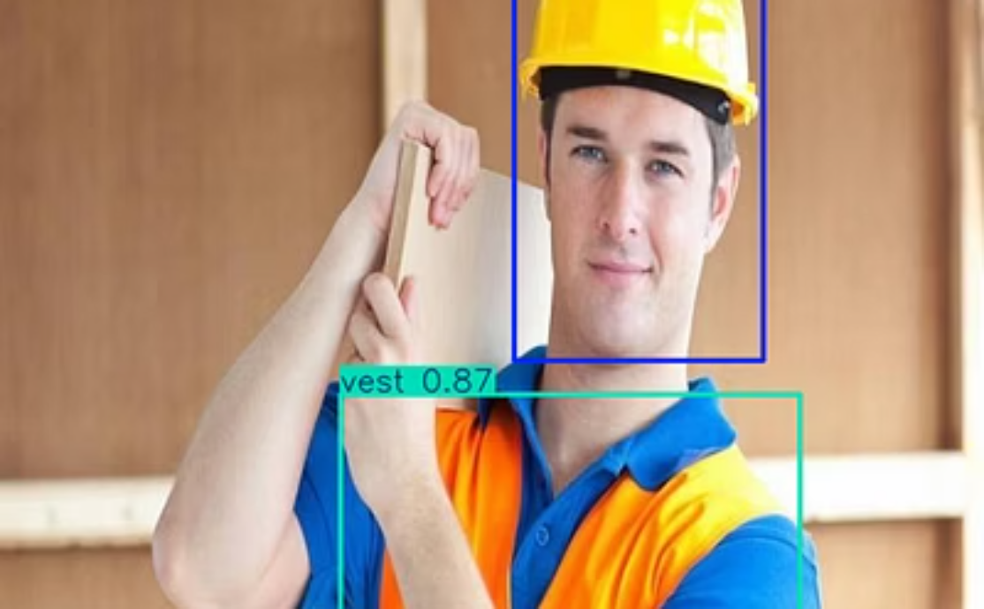
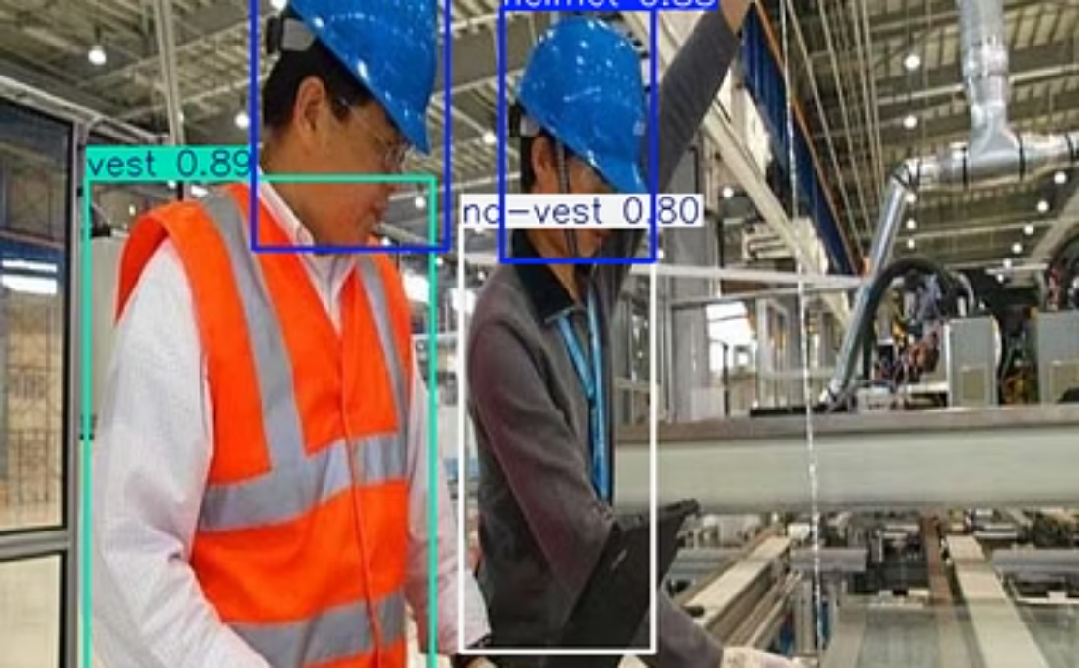
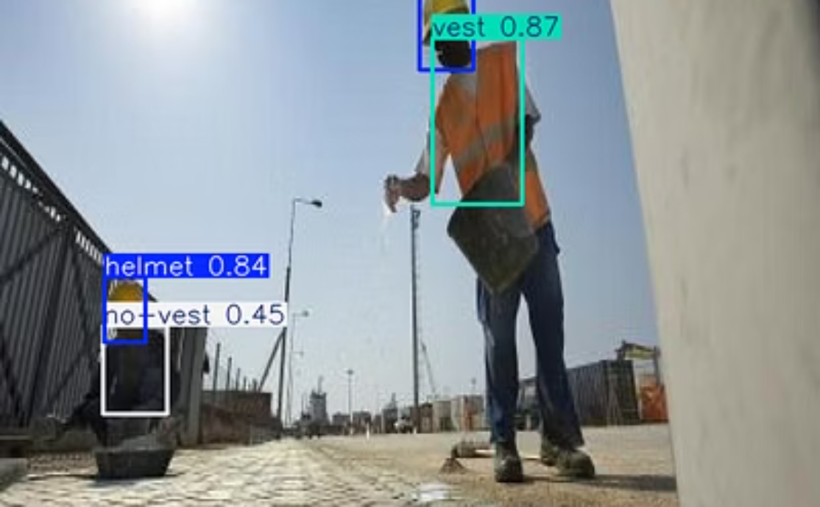
Confirmed Results: Accurate PPE Detection
The trained YOLO model demonstrates high reliability and confidence in identifying the presence or absence of mandated safety equipment.
Model Performance:
Overall Accuracy (mAP50): ~93%
Overall Accuracy (mAP50-95): ~61%
Precision: 93%, Recall: 92%

Slide 9

Deployment Strategy: Accessible Web Application
To make the system immediately usable by safety managers, we deployed the model via a user-friendly Streamlit web application.
Flexible Input: Users can upload various video formats or connect directly to a local webcam for live site monitoring.
Visual Feedback: The application displays the processed video with real-time bounding boxes and confidence scores overlayed.
Downloadable Reports: Users can download the processed video file, complete with all safety violation detections, for auditing and training purposes.
This simplified interface ensures minimal technical training is required for site personnel.
Demo Link: https://construction-safety-yolov11-object-detection-rhggazsepcpcpera4.streamlit.app/

Slide 10

Conclusion and Future Road Map
The AI-Powered Safety Monitoring System successfully transitions safety oversight from reactive to proactive, enhancing compliance and worker well-being.
Project Achievements
Deployed a real-time, high-accuracy PPE detection model.
Established an accessible web application for safety audits.
Validated the system's performance on real construction footage.
Next Generation Safety Features
Worker Tracking: Implementing multi-object tracking to monitor individual worker compliance over time.
Real-Time Alerts: Integrating SMS/email notifications when persistent violations are detected.
Extended PPE Detection: Expanding the model to detect fall harnesses, gloves, and protective eyewear.

