Slide 1
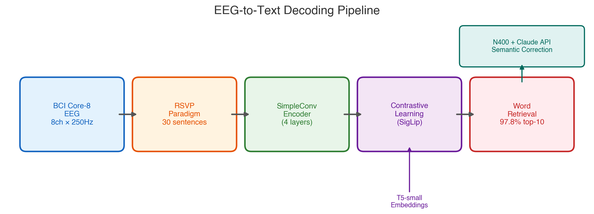
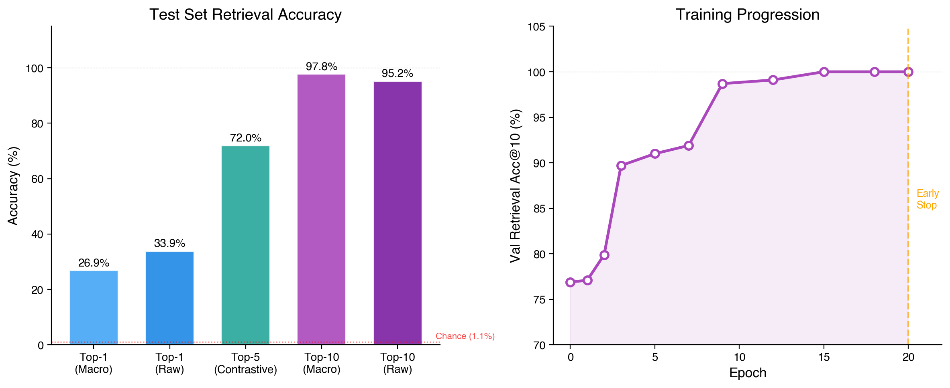
EEG-to-Text Decoding with BCI Core-8
Contrastive learning maps 8-channel EEG to T5 word embeddings • 97.8% top-10 retrieval

Slide 2
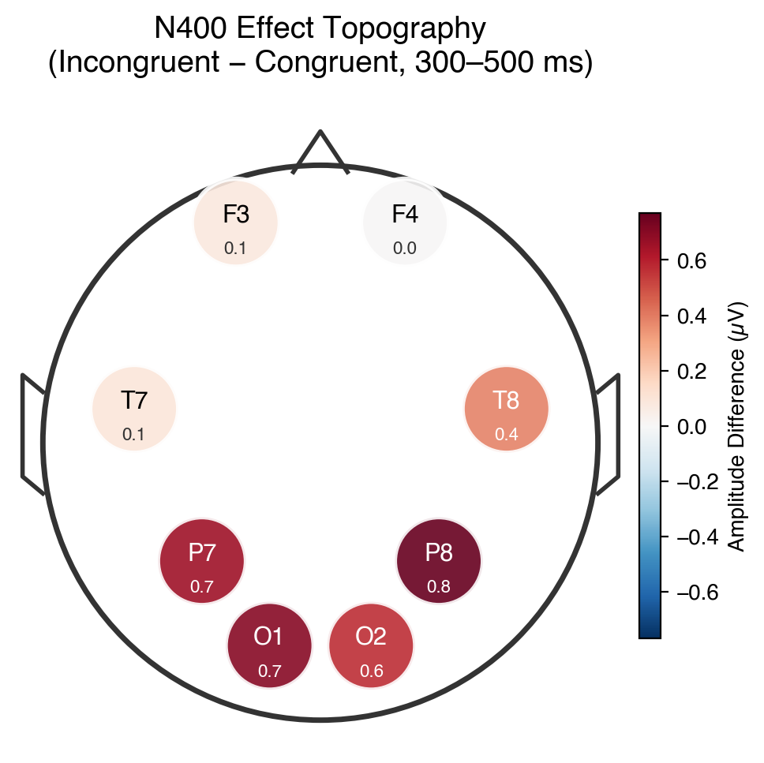
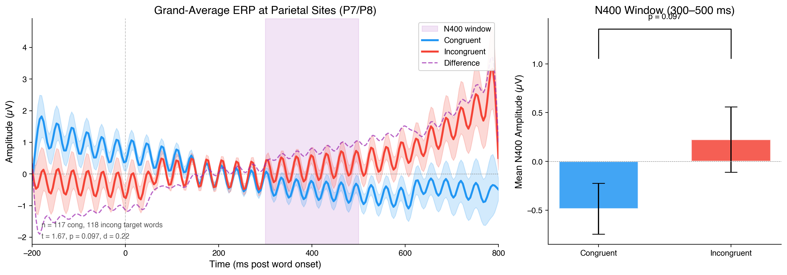
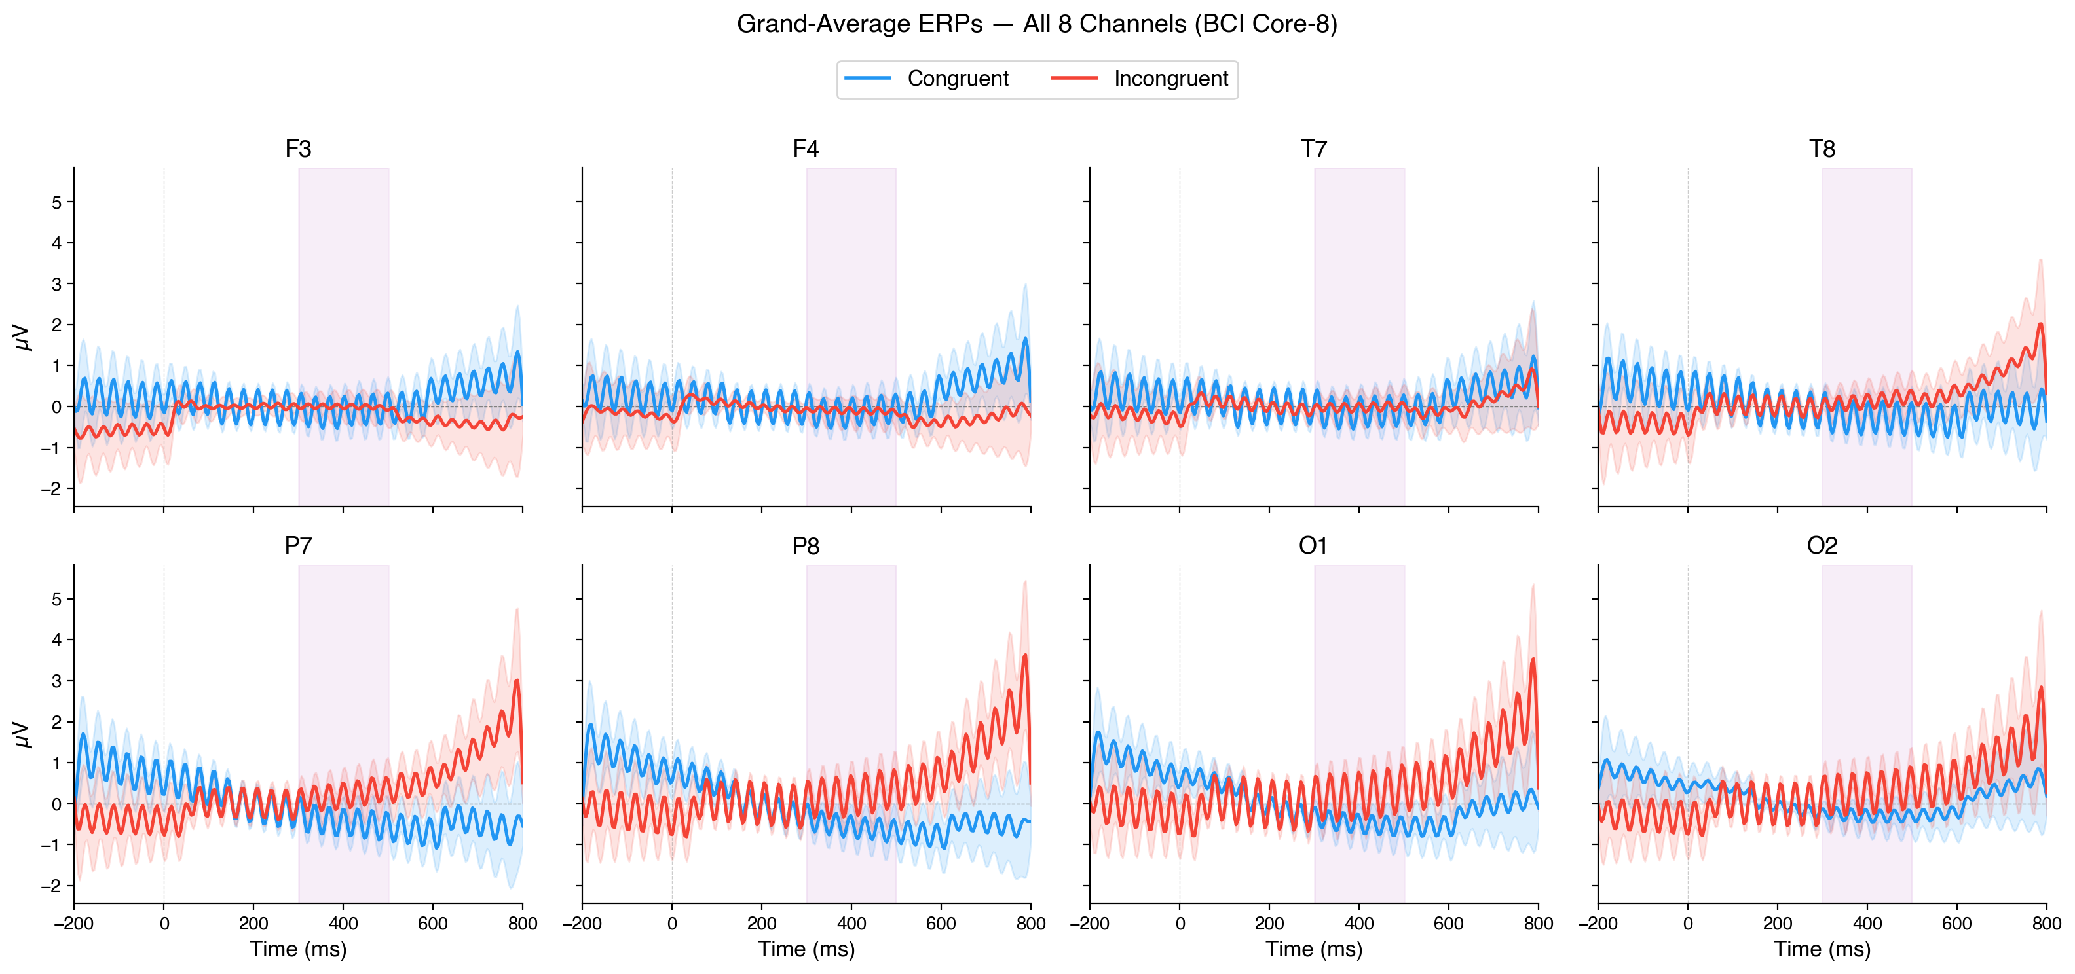
N400 Semantic Violation Detection
N400 effect detected: t = 1.67, p = 0.097, Cohen's d = 0.22 • Brain signals flag semantically incongruent words → Claude API corrects

