Slide 1


ARAB REPUBLIC OF EGYPT | WSIS+10 REVIEW
Egypt's Digital Decade
Overall review of the implementation of the WSIS outcomes, 1999 to 2014

Slide 2
ROADMAP
A Decade in Review
Part 1
Part 2
Part 3
Part 4
A decade of achievement, 1999 to 2014: from MCIT's founding to the 2014 constitution
The 11 WSIS Action Lines: C1 governance through C11 cooperation, with Egypt's flagship programs
Achieving WSIS Targets: the indicator evidence for 2010 to 2013
Funding mechanisms, the National ICT Strategy 2014 to 2021, and the vision beyond 2015

Slide 3
HEADLINES
Egypt's Digital Decade
99.7M
38.75M
EGP 52.3B
No. 4
181,854 Mbps
mobile subscribers in 2013, up from 13.63M in 2005
internet users in 2013, up from 0.65M in 2000
ICT real GDP in 2012/13, 3.4% of national GDP
A.T. Kearney outsourcing rank 2011, up from No. 12
international bandwidth by 2011, 97.32% yearly growth since 2001

Slide 4
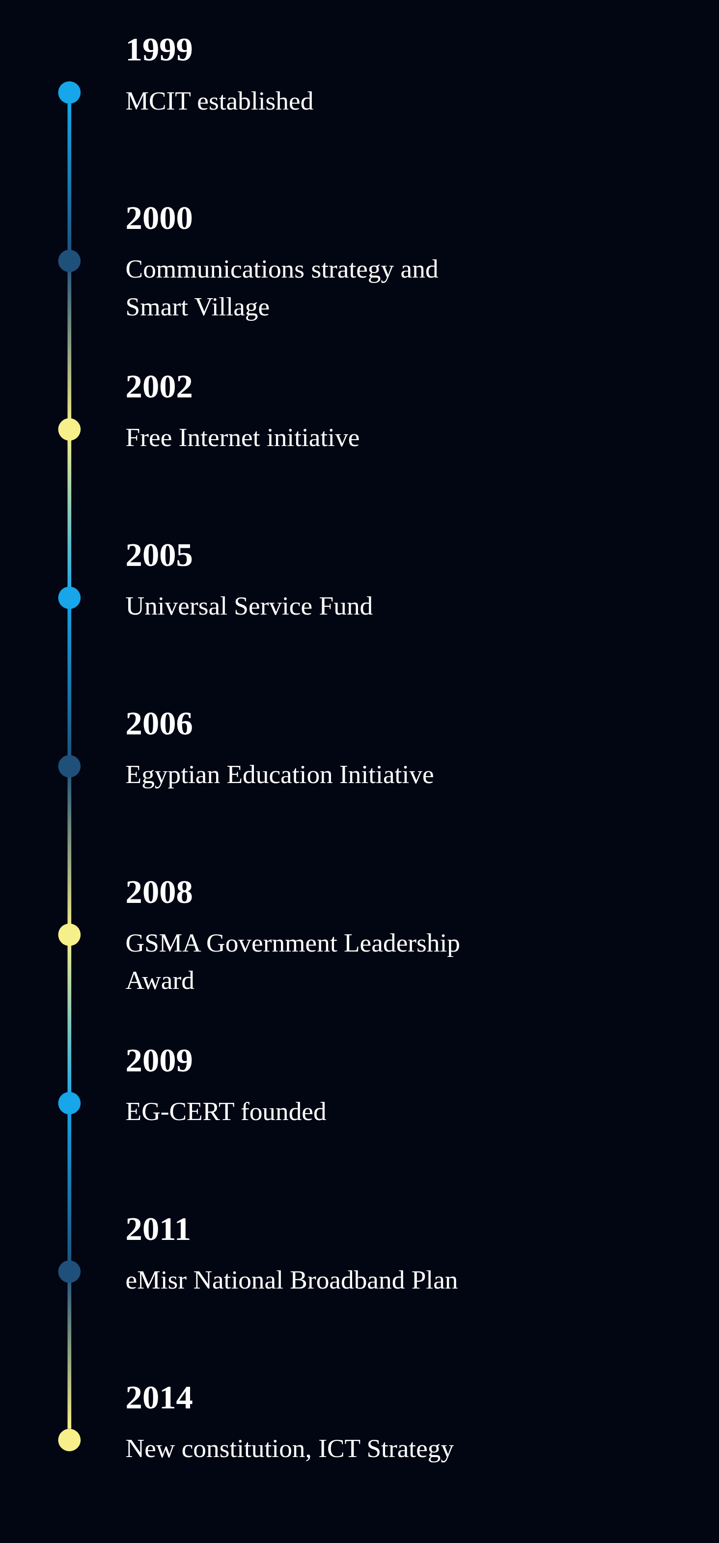
DECADE
1999 to 2014
▪ A fifteen year run from a new ministry to a constitutional right to information
▪ MCIT founded 1999; National Communications Strategy and Smart Village launched 2000
▪ Free Internet 2002, Universal Service Fund 2005, Broadband Plan 2011
▪ 2014: a new constitution protects cyberspace and guarantees information access

Slide 5
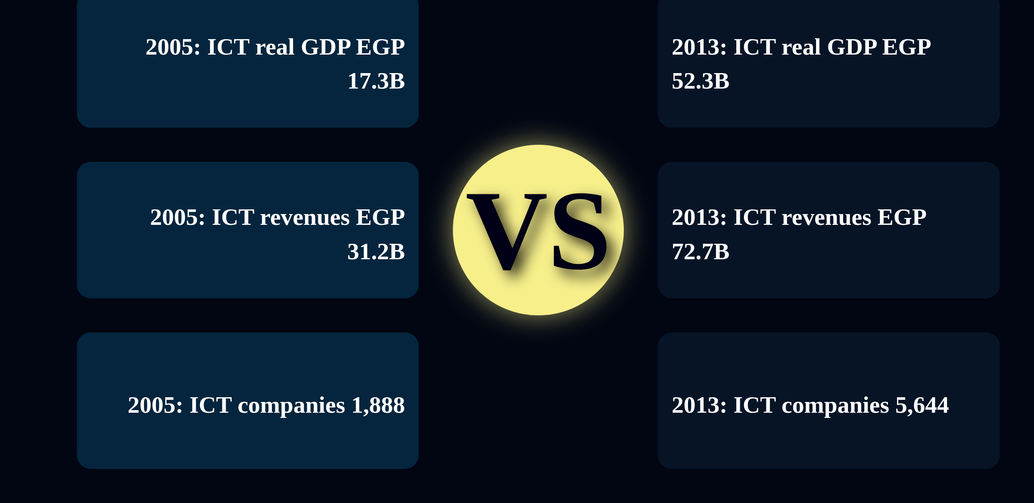
ECONOMY
An Economic Engine
▪ ICT paid the treasury about EGP 71B from licenses, sales, tariffs and dividends, 2003 to 2010
▪ EGP 30B invested over seven years drove 700% sector growth
▪ In 2011/12 the sector generated EGP 65B revenue and EGP 48B of GDP, 3.2% of the total
▪ ICT exports reached EGP 1.44B in 2013; 3,756 new ICT companies founded 2005 to 2013

Slide 6
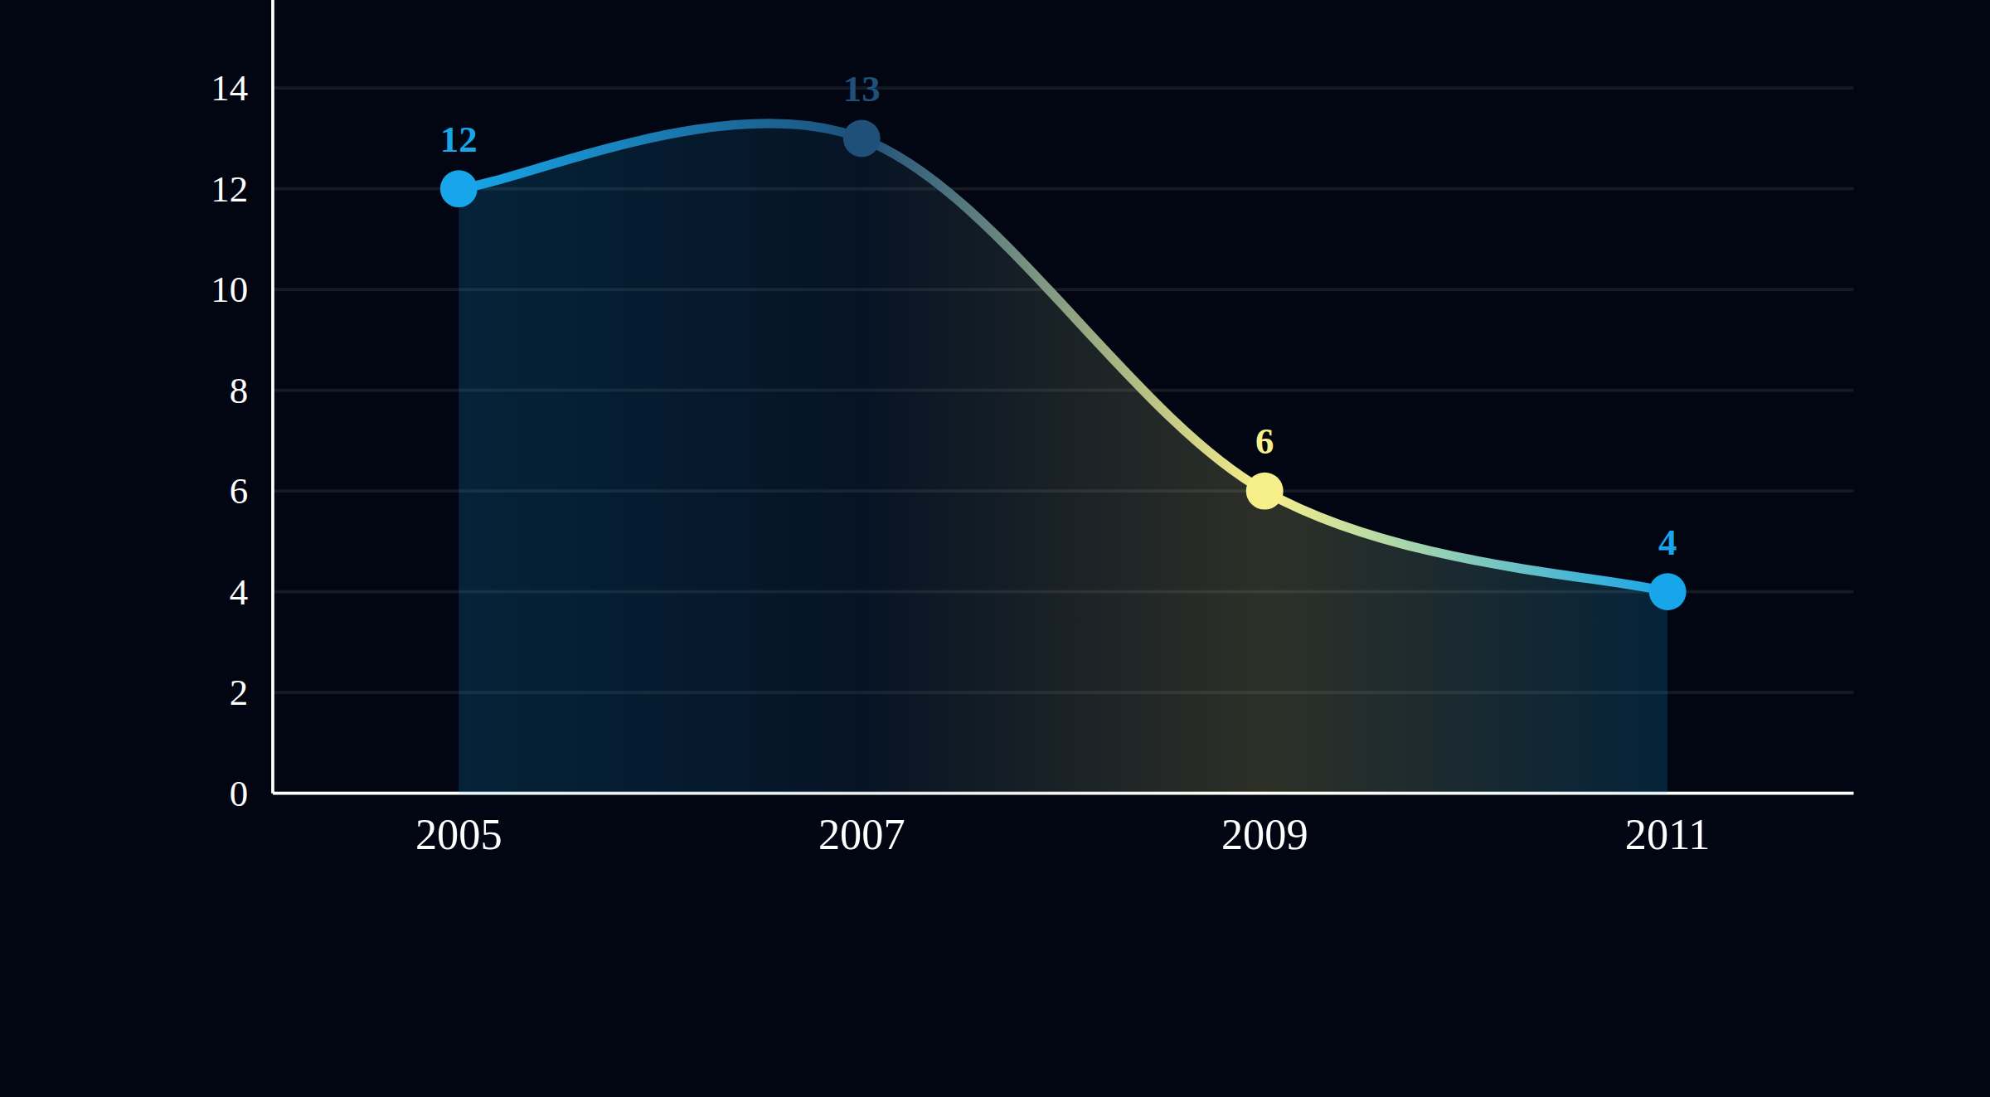
C1
Governed Together
▪ Multistakeholder committees shape every strategy: legislation, digital society, green ICT, open standards, cloud
▪ Strategy lineage: 2000 Communications, 2003 Information Society, 2007 ICT, 2011 Broadband, 2014 Digital Society
▪ Post-2011 community dialogue produced about 55 amendments to the Telecommunication Regulation Law

Slide 7
C2
Wires to Wireless
▪ Free Internet launched January 2002: access at local call rates on prefixes 0707 and 0777, nationwide by September
▪ Revenue shared 70/30 between Telecom Egypt and ISPs; local loop unbundling followed in April 2002
▪ Broadband prices cut from EGP 150/month (2004) to EGP 95 (2006) to EGP 45 (2007)
▪ 2011 landline tariffs cut: installation fees down 50%, landline to mobile calls down 33%

Slide 8
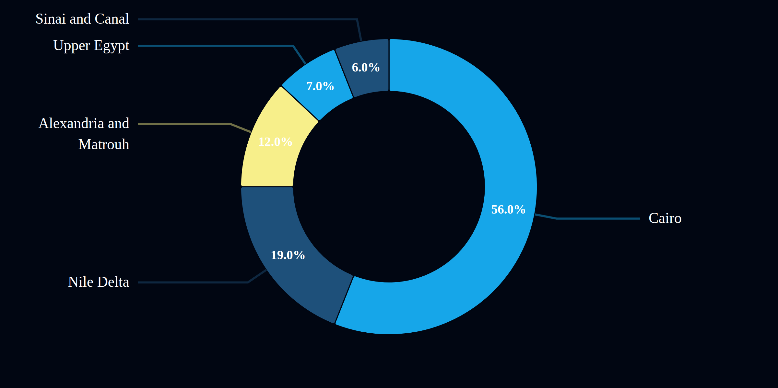
C2
Broadband Nation
▪ eMisr National Broadband Plan (Nov 2011): 75% of households at 2 Mbps by 2016, 90% at 25 Mbps by 2021
▪ Seven submarine cables land in Egypt, from FLAG FEA (1997) to TE North (2010)
▪ Cairo Internet Exchange Point traffic grew from 200 Kbps (2002) to 1.2 Gbps (2013)

Slide 9
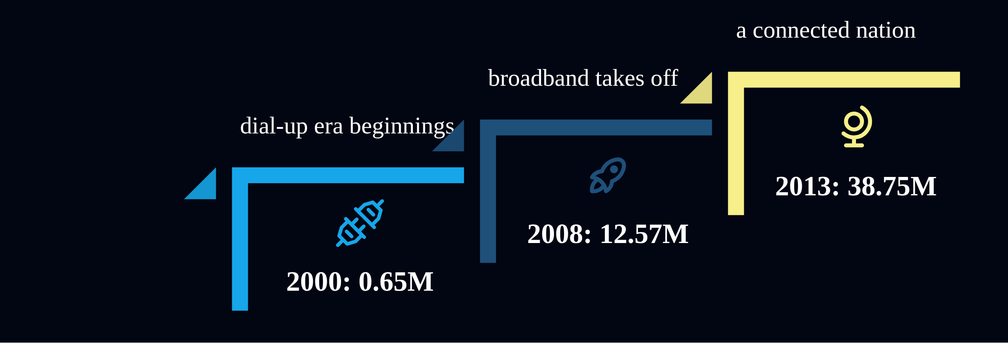
C2
The Mobile Leap
▪ Mobile subscribers jumped from 13.63M (2005) to 99.7M (2013); fixed lines fell from 10.4M to 6.82M
▪ Mobile penetration hit 118.19% as three competing operators drove prices down
▪ Low usage mobile basket fell from USD 4.57 (Q4 2007) to USD 2.90 (2010)
▪ Mobile broadband in households grew about 80% per year, reaching 10% by 2013

Slide 10
C3
Knowledge for All
▪ Bibliotheca Alexandrina and the National Library digitized more than 90M documents
▪ Government Services Portal (2004) and Ministry of Education website (2007) opened official information online
▪ A multistakeholder committee is drafting the national free and open source software strategy
▪ Kenana Online community portal (2004) sparked thousands of personal sites and spin off portals

Slide 11
C3
Reaching the Margins
▪ 2,000+ IT Clubs nationwide by end 2010; 36% placed in under served Upper Egypt
▪ Mobile IT Clubs: buses and caravans with computer labs and satellite internet tour remote areas
▪ Technology Homes (from 2011) turn IT Clubs into ICT led community service centers
▪ Public internet access centers reached 53% of localities by 2011, up from 37% in 2007

Slide 12
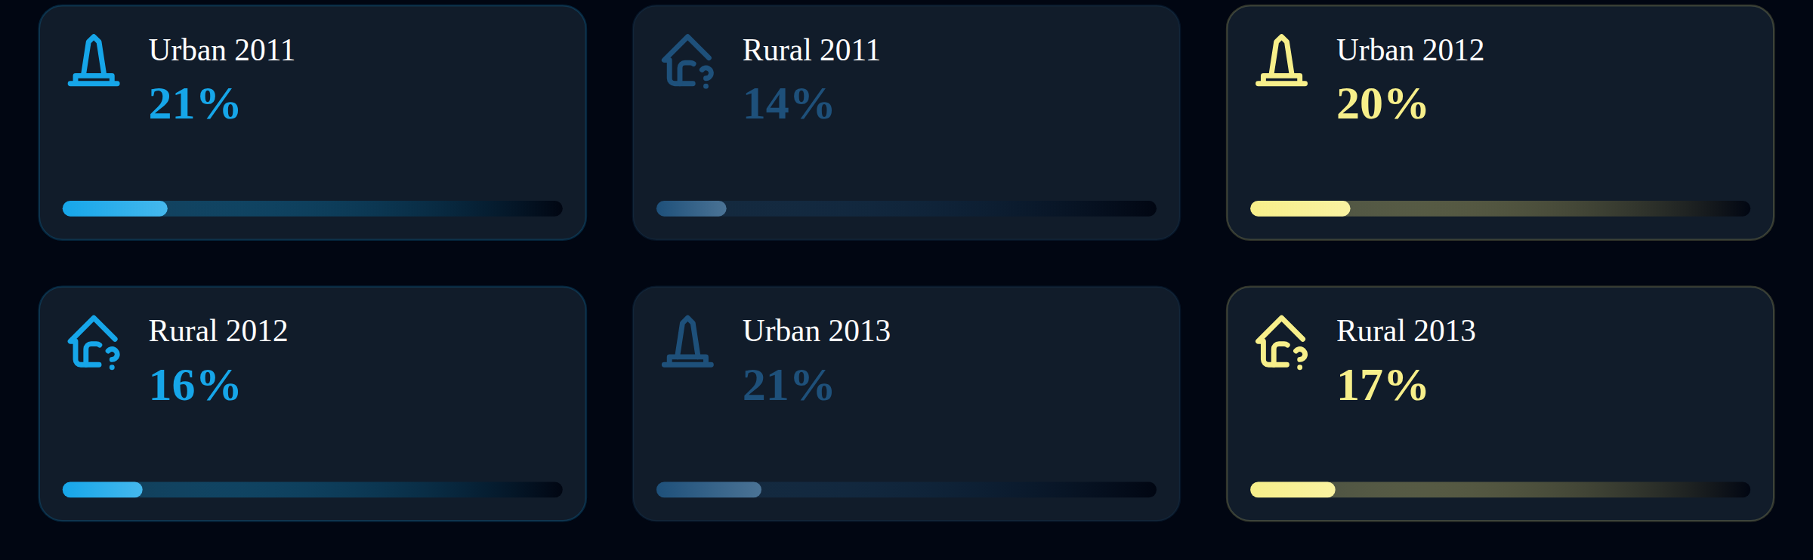
C3
Closing the Divide
▪ Home is the top access point: 83.1% of users connected from home in 2012
▪ Households using the internet at home rose from 18.59% (2007) to 44.24% (Dec 2012)
▪ Rural users grew 19% in a year, reaching 19.5% of rural Egyptians sampled in 2012
▪ 3G equipped mobiles reached 27.3% of individuals in 2013, up from 20.4% in 2011

Slide 13
C4
Skilled Nation
▪ ITI and NTI specialized training graduates nearly doubled: 23K (2005) to 43.2K (2013)
▪ e-Learning Competence Center runs 700+ delivery centers nationwide
▪ ICDL program (MCIT, UNESCO, ECDL Foundation, 2006) targets 1M certified Egyptians
▪ ITI Nine-Month Professional Training Program reached CMMI-SVC Level 3 in December 2012
▪ ITI exports expertise across Africa: Burundi, Eritrea, Kenya, Sudan, Uganda

Slide 14
C4
Learning Without Walls
▪ Egyptian Education Initiative (2006): public private partnership reforming the whole education system
▪ First Egyptian tablet "Inar" launched April 2013; 9,300 tablets distributed to university students
▪ Egyptian e-Learning University opened 2009 with virtual and distance learning
▪ 94% of faculties connected to the internet by 2012; 98% of university instructors online

Slide 15
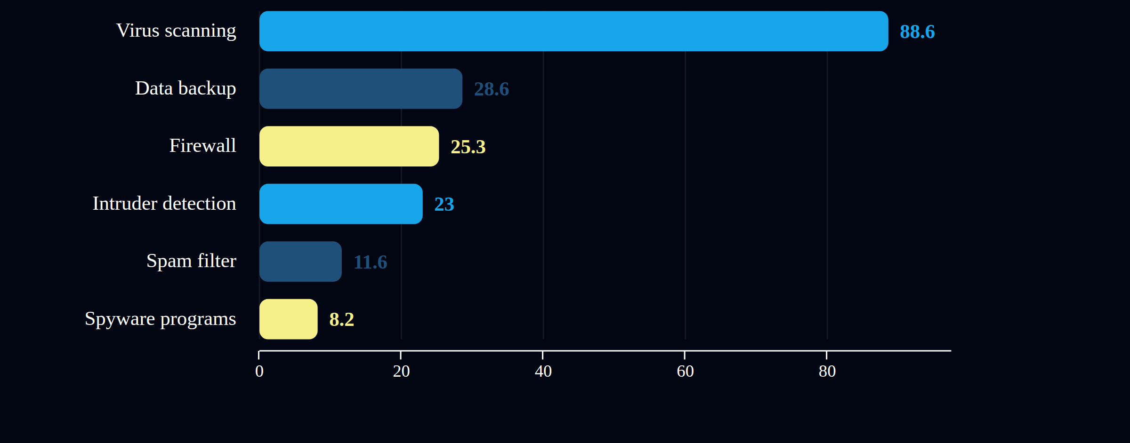
C5
Trust by Design
▪ EG-CERT (2009, NTRA): 24 hour incident response, member of FIRST and OIC-CERT
▪ National PKI: Root CA Trust Center at ITIDA, three licensed e-signature issuers
▪ Child online protection program from 2007; Child Law 126/2008; national committee 2013
▪ Draft laws in motion: cybersecurity, freedom of information, e-commerce

Slide 16
C6
Rules for Growth
▪ 2014 Constitution: Article 31 protects cyberspace, 57 guards correspondence, 68 guarantees information access
▪ About 55 amendments plus 3 new articles drafted for the Telecommunication Regulation Law after public dialogue
▪ WTO Basic Telecommunications Agreement (2002) and ITA (2004) opened the market
▪ Unified licensing regime proposed 2012: technology and service neutral

Slide 17
C6
Open for Business
3 sq km
160+
40,000
80/20
EGP 25M
Smart Village Egypt tech cluster
companies on site
employees
private/MCIT PPP ownership, replicated for new parks
new incentives via Social Fund for Development

Slide 18
C7
Government in Your Pocket
▪ Government Services Portal (2004): G2C, G2B and G2G services from vehicle licensing to industrial zones
▪ UN Public Service Awards: 2nd place 2011 (anti corruption procurement portal), 2nd place 2012 (voter database)
▪ OECD e-Government Studies: Egypt 2013 benchmarked the whole effort
▪ 100% of government entities own computers; 85% are online; web presence rose 49% to 58% (2010-12)

Slide 19

C7
Work Without Borders
▪ Outsourcing exports hit USD 1.487B a year by end 2011; target USD 2.5B plus USD 1B from IP
▪ Offshoring Destination of the Year 2008; European Outsourcing Award 2009
▪ With 60% of 85M+ Egyptians under 30, e-employment is a national jobs strategy

Slide 20
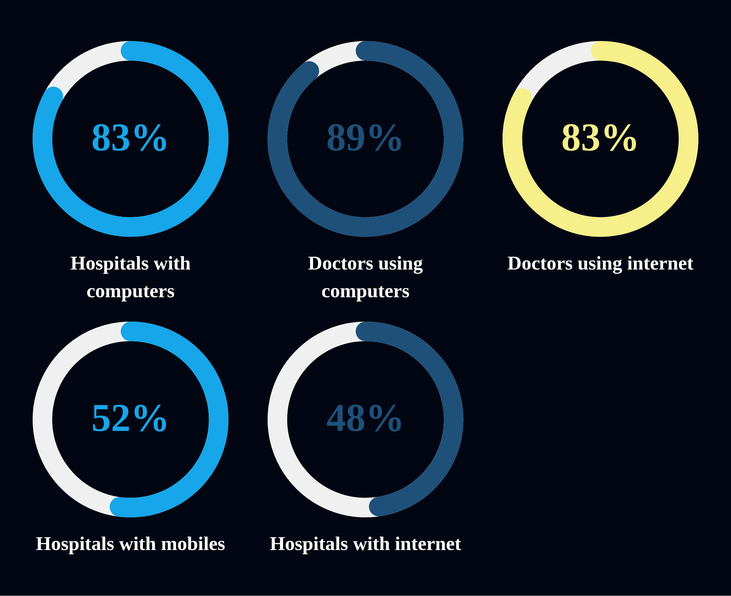
C7
Care and Classrooms, Connected
▪ Egyptian Ambulance Organization automated 2008: digital fleet, real time call reports
▪ Telemedic@Egypt links city specialists to remote clinics; Siwa linked to Shatby Children's Hospital
▪ Women's Mobile Health Unit (2007): free screening for women over 45
▪ National Cancer Registry Program centralizes incidence data for research and policy

Slide 21
C7
Green, Fed and Curious
▪ Green ICT Initiative 2010 (MCIT plus Environment); 47 air monitoring stations
▪ VERCON (2000) and RADCON (2004-08, with FAO) wired agricultural extension to farming communities
▪ Aradina farm portal draws about 90,000 visits a month
▪ RDI Program: EUR 11M (2007) then EUR 20M phase 2 (2011); BA's VISTA VR science lab

Slide 22
C8
Seven Millennia Online
▪ Bibliotheca Alexandrina (2002) and CultNat (2000) document 7,000 years of heritage
▪ Egypt became the first country with an Arabic language country code domain (ICANN, June 2010)
▪ e-Content Strategy 2013-20 and National e-Content Committee (2012) grow Arabic content
▪ Arabic dominates use: 32% of users browse mainly in Arabic vs 5% in English

Slide 23
INDICATORS
Measuring the Leap
118.9
44%
49%
47.6%
0.31%
mobile subscriptions per 100 people in 2012, up from 104.7
individuals using the internet, up from 39.5% in a year
schools on fixed broadband in 2012, up from 26%
hospitals online; doctors online 82.7%
public libraries with broadband in 2013: now a core eMisr target

Slide 24
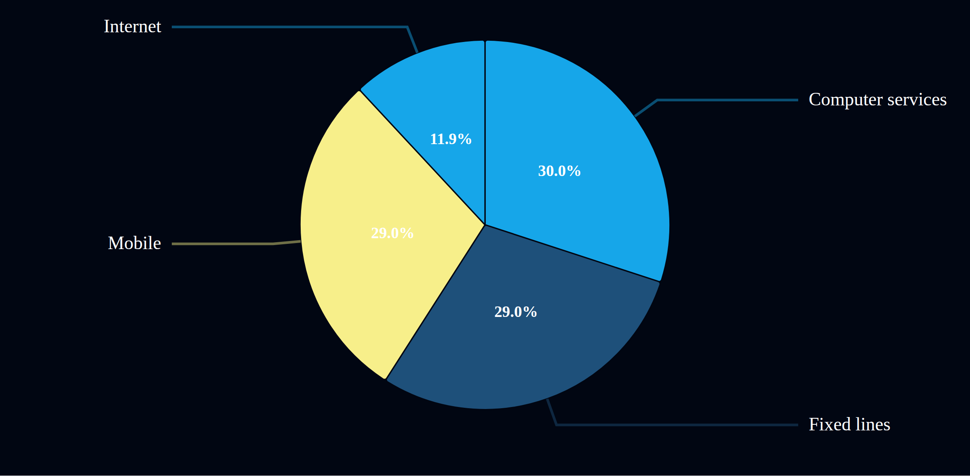
INDICATORS
The Connected Household
▪ TV in nearly every home (95-97%); radio fading at about 30% a year
▪ 3G mobiles: 20.4% (2011) to 27.3% (2013), a 34% growth rate
▪ Facebook users: 4.2M (2010) to 16.4M (2013); Twitter: 19.3K to 465.7K (2010-12)
▪ 62.7% of smartphone owners used their device for political life in 2013

Slide 25
C9
Airwaves to Apps
▪ Media Free Zone (2000) and Egyptian Media Production City (3 sq km) anchor private broadcasting
▪ 3G licenses in 2007 brought video and streaming to mobile networks
▪ 2014 Constitution: Articles 70 to 72 ban press censorship and custodial sentences for publication
▪ Citizen journalists and bloggers reshaped a traditionally pro government industry after 2011

Slide 26
C10
A Principled Net
▪ Nine elements of digital citizenship promoted nationwide by the ICT Trust Fund outreach team
▪ Internet safety posters reached 750+ nonprofits; 300 trainers via IT Clubs
▪ Microsoft's Arabic STOP. THINK. CONNECT. reached 200,000+ children, youth and parents
▪ Post revolution dialogue rewrote telecom law around access, expression and privacy

Slide 27
C11
Egypt and the World
▪ Founder of the African Ministerial Council of ICTs (2008); chaired its first two sessions
▪ Executive bureau member of the Arab Telecommunications and Information Council of Ministers
▪ Nile ICT Corridor Initiative (2012): outsourcing and network security capacity for the Nile Basin
▪ Pan-African e-Network: Alexandria University is North Africa's regional hub
▪ National contact point for EU FP7 ICT research (2007); leads ITU child online protection group

Slide 28
FUNDING
Paying for Progress
▪ Universal Service Fund (2005, NTRA): seed EGP 50M to connect unprofitable areas
▪ Italian Egyptian debt swap (2001-08): USD 149M retired, 53 projects, EGP 48.5M to ICT
▪ Egypt ICT Trust Fund (2002, MCIT plus UNDP): PPPs across community, agriculture, education, health
▪ Smart Village PPP model: 80% private, 20% MCIT, replicated for new parks
▪ Partners: World Bank, EU EUMEDIS, USAID, GIZ, IDRC, Islamic Development Bank, WHO

Slide 29
WAY FORWARD
Beyond 2015
▪ National ICT Strategy 2014-2021: an integrated digital platform, a stronger ICT industry, Egypt as an international hub
▪ 20 key areas: broadband, cybersecurity, e-commerce, cloud, open source, green ICT, tech parks and more
▪ Egypt's post 2015 agenda: digital citizenship, open standards, cloud, big data, youth empowerment
▪ Knowledge based capital and big data flagged as the next growth engines
▪ From MDGs to SDGs: one converging global development agenda with sustainability at its core

Slide 30

Thank You
Ministry of Communications and Information Technology
www.mcit.gov.eg

