Slide 1

Automated License Plate Recognitio

Slide 2
Bright Future
S.Mohamed Affy
S.Rashad Ramy
S.AL_Moatasem Mahmoud
S.Mohamed Mahmoud
S.Mahmoud Adel

Slide 3

INTRODUCTION
This project implements a secure vehicle entry system that automatically identifies
license plate numbers from images or video streams. The system combines object detection for plate localization and Optical Character Recognition (OCR) for text extraction.

Slide 4
Goal OF Project
Vehicles not authorized to enter a certain area, or vehicles that are stolen, are prohibited from entering.

Slide 5
System Components
Plate
Localization
OCR Module
Gate Logic
Logging

Slide 6
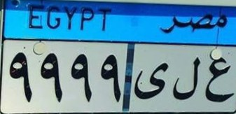
System Components
Plate
Localization
OCR Module
Gate Logic
Logging
A state-of-the-art object detection model trained on the provided dataset to locate license plates

Slide 7
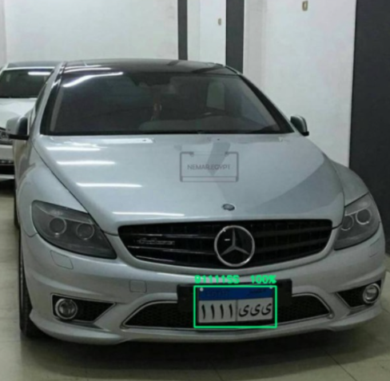
System Components
Plate
Localization
OCR Module
Gate Logic
Logging
Converts cropped license plate images into alphanumeric text strings.

Slide 8
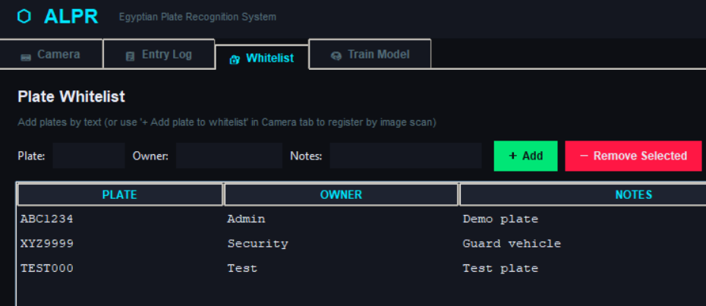
System Components
Plate
Localization
OCR Module
Gate Logic
Logging
Implements a whitelist-based authorization system to simulate gate operations.

Slide 9
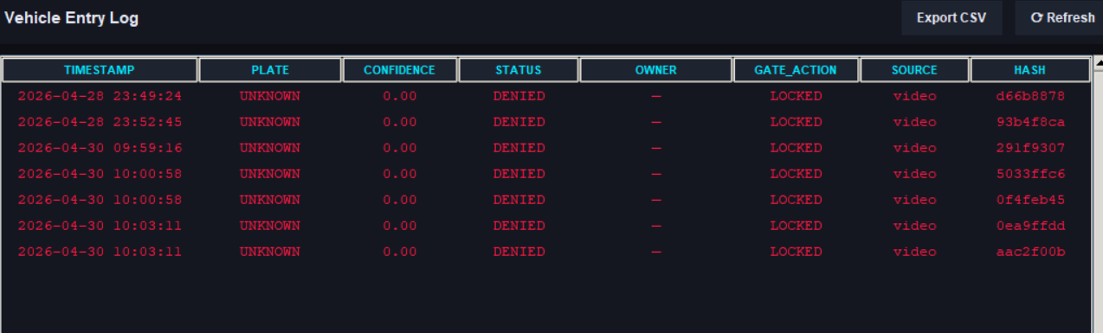
System Components
Gate Logic
Plate
Localization
OCR Module
Logging
Maintains a vehicle_entry_log.csv for all processed vehicles.

Slide 10
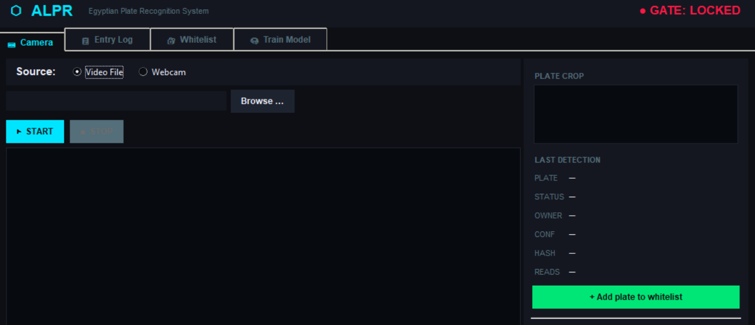
INTERFACE
Gate Logic
Plate
Localization
OCR Module

Slide 11
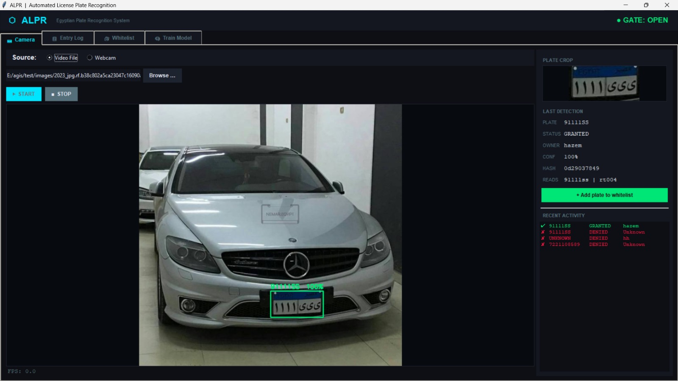
INTERFACE
Gate Logic
Plate
Localization
OCR Module

Slide 12
INTERFACE
Gate Logic
Plate
Localization
OCR Module

Slide 13
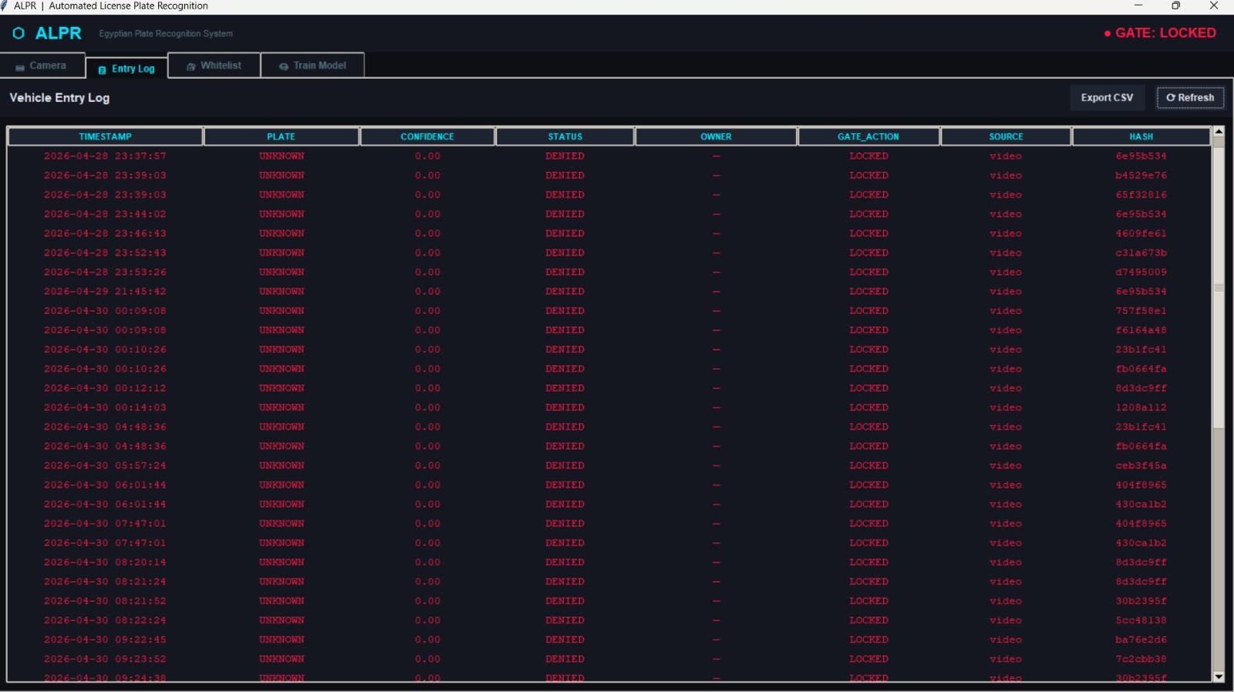
INTERFACE
Gate Logic
Plate
Localization
OCR Module

Slide 14
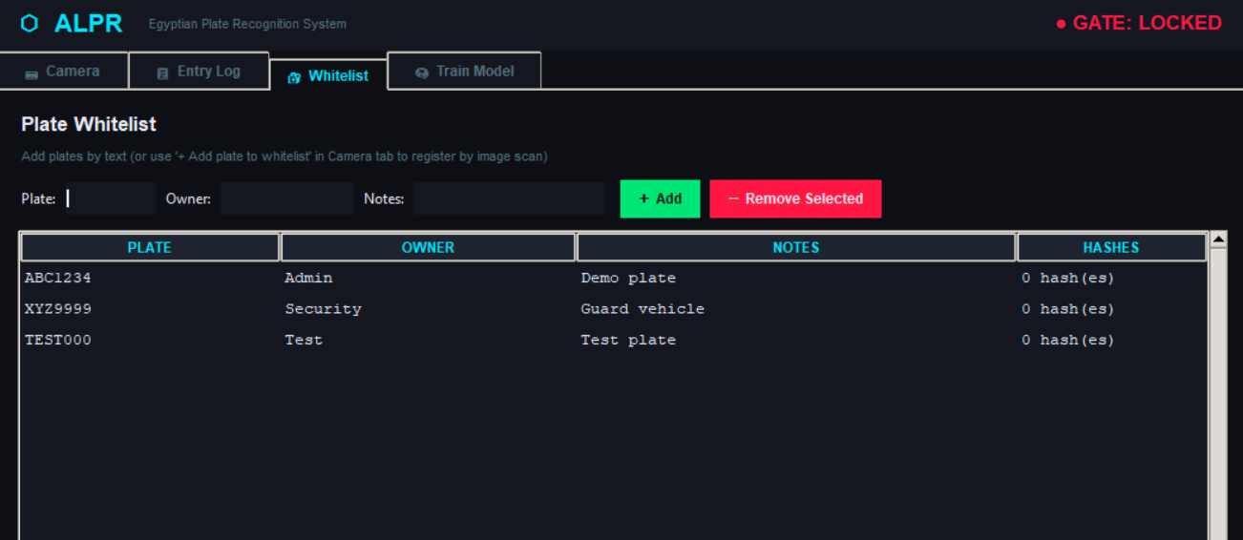
INTERFACE
Gate Logic
Plate
Localization
OCR Module

Slide 15
THANK YOU

