Slide 1
I²C Communication Protocol
National Telecommunication Institute (NTI)
Digital IC Design Using FPGA — RTL Implementation and Verification
Team members :
Ahmed Shaaban Elnegaar
Hazim Osama shams elden
Mohamed Abdel Sadek

Slide 2
1. Introduction
I²C provides a simple synchronous serial interface using two shared lines: SDA and SCL.
The design contains an I²C Master, I²C Slave, clock-divider function, shared open-drain bus, FSM controllers, and verification testbench.
The system supports both write and read transactions.
The project verifies operation using a self-checking testbench.

Slide 3
2. Project Objectives
Design a complete functional I²C communication system in Verilog HDL.
Implement both Master and Slave modules.
Support Master → Slave write transactions and Slave → Master read transactions.
Verify communication scenarios using a self-checking testbench.
Provide monitoring and debugging signals for internal operation.

Slide 4
3. I²C Protocol Fundamentals
I²C = Inter-Integrated Circuit protocol.
A synchronous serial communication protocol using a shared two-wire bus.
SCL: Serial Clock Line generated by the Master in this implementation.
SDA: Bidirectional Serial Data Line shared by all devices.
Target implementation clock: 100 kHz SCL.

Slide 5
4. Open-Drain Bus Operation
Master
Slave
Pull-Up Resistor
Devices can drive SDA LOW or release it to high impedance (Z).
No device actively drives SDA HIGH.
When all devices release SDA, the external pull-up resistor makes the bus HIGH.
The same principle is used for SCL in the implementation's bus interface.

Slide 6
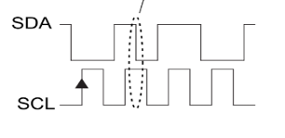
5. Transmission Rules
• Data is transferred in 8-bit bytes.
• Bits are sampled while SCL is HIGH; SDA only changes when SCL is LOW.
• Standard transfer rates: 100 kbps (Standard mode) and 400 kbps (Fast mode).

Slide 7
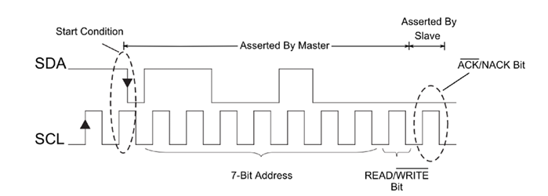
6. START, STOP and ACK/NACK
Start condition (S): SDA goes LOW while SCL is HIGH. This wakes the slaves.
Stop condition (P): SDA goes HIGH while SCL is HIGH. This signals the end of communication.

Slide 8
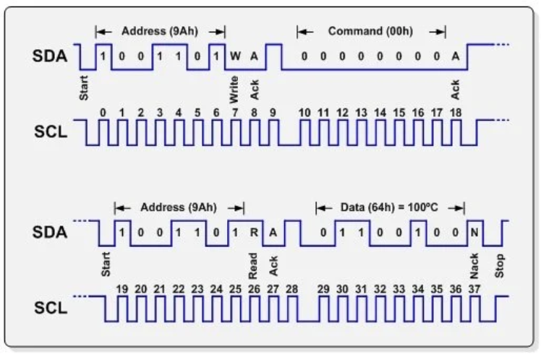
7. Communication Sequence

Slide 9
8. System Architecture
Clock Divider 50 MHz → 100 kHz
I²C Master
Shared SDA / SCL Bus
I²C Slave
Top level contains Master controller, Slave controller, clock-divider function, and shared SDA/SCL bus.
The Master initiates transactions and controls SCL.
The Slave monitors the bus and responds only when its address is detected.

Slide 10
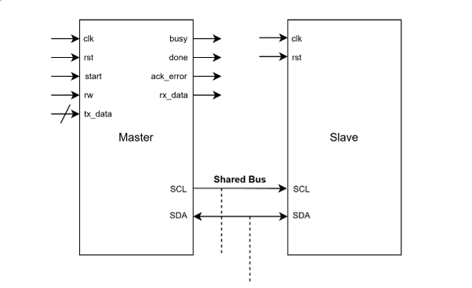
System Architecrture

Slide 11
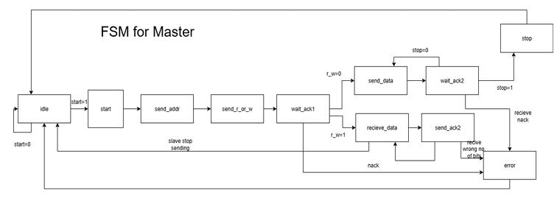
9. Master FSM

Slide 12
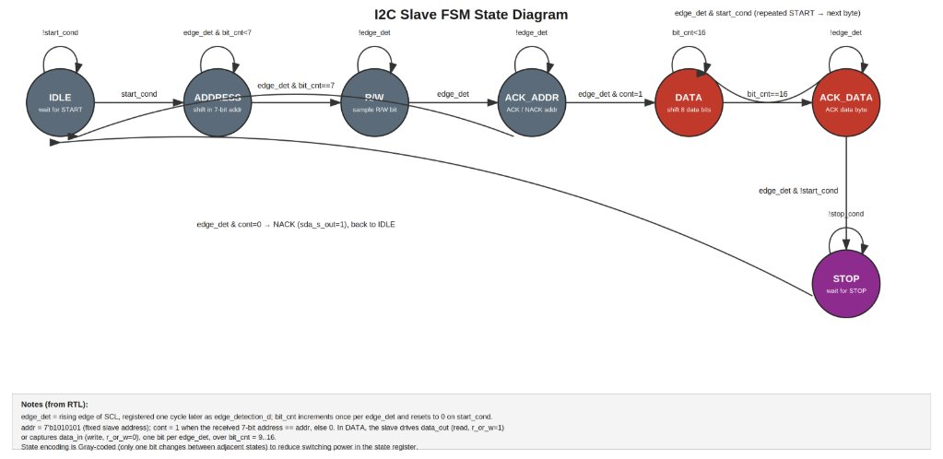
10. Slave FSM

Slide 13
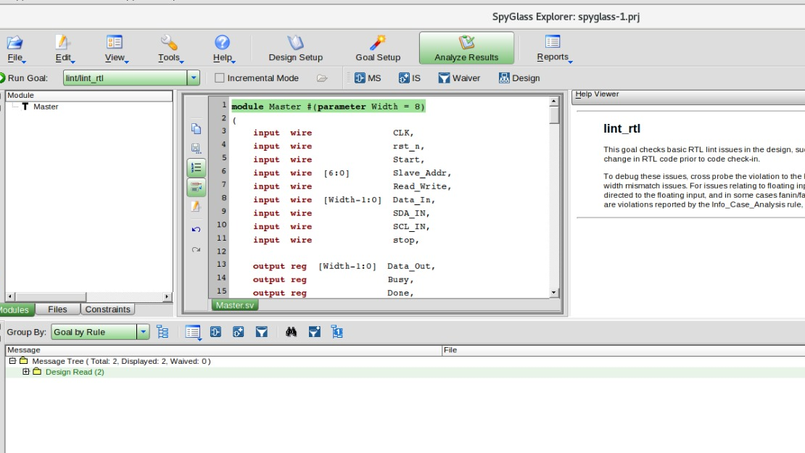

Slide 14
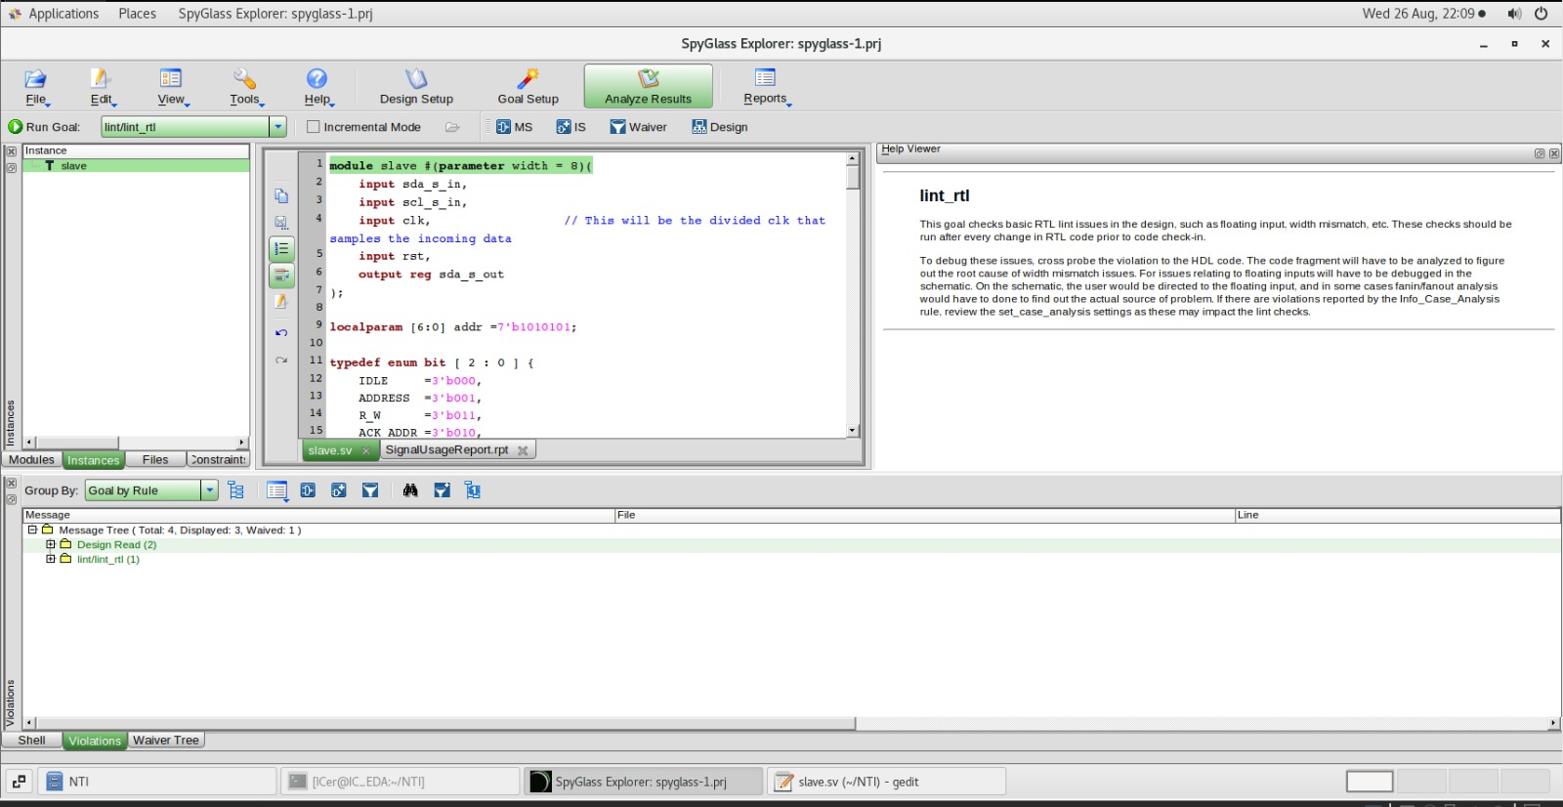

Slide 15
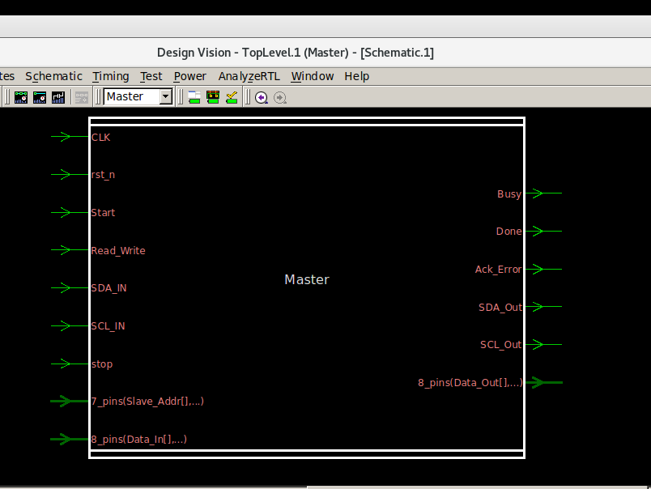
Schematic_master

Slide 16
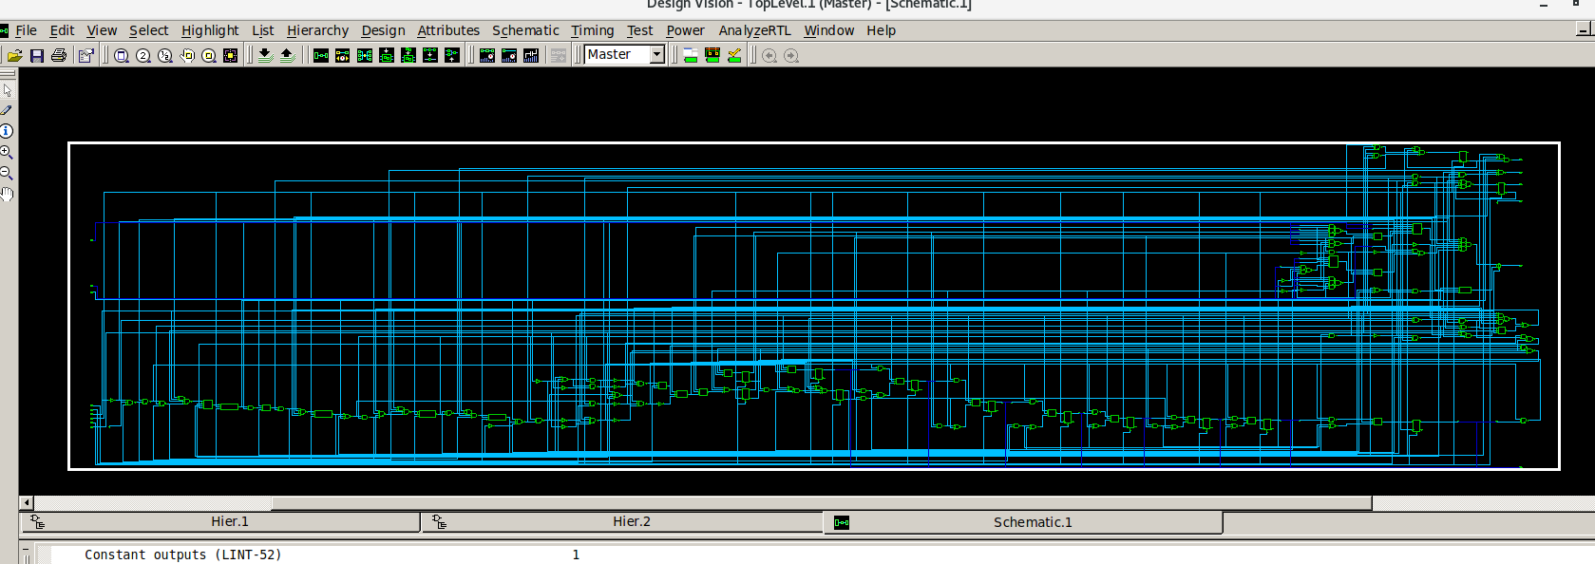
Schematic_master

Slide 17
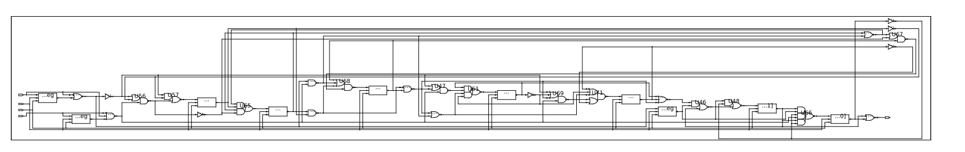
Schematic_slave

Slide 18
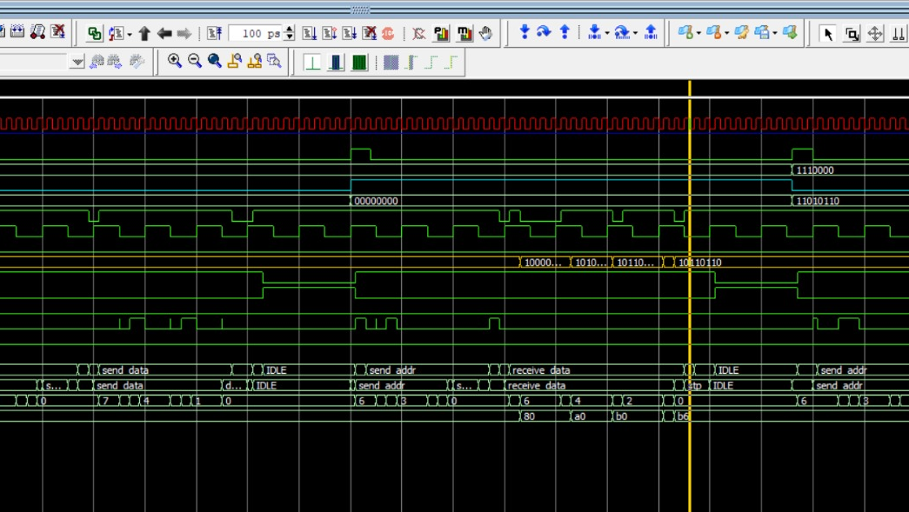

Slide 19
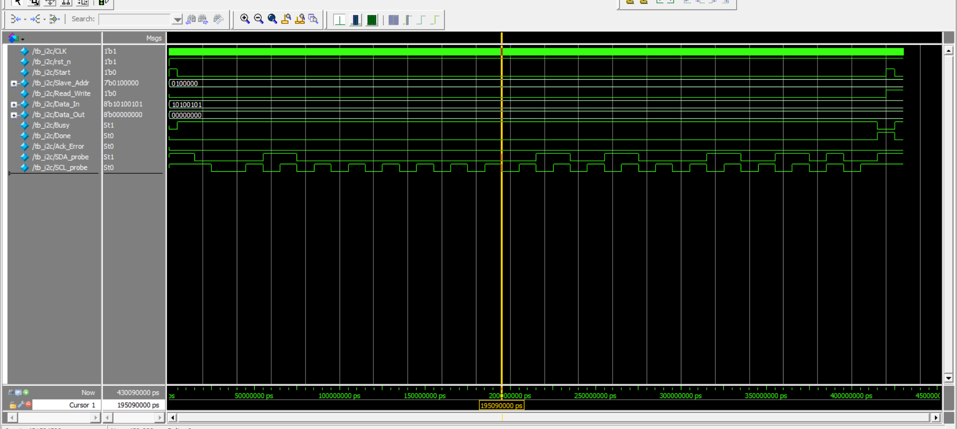
Waveform

Slide 20
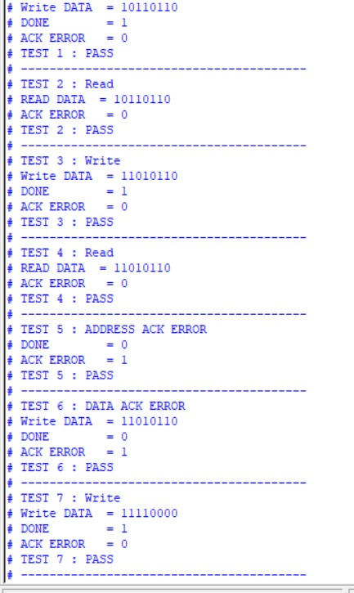

Slide 21
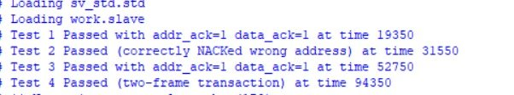

Slide 22
Results
Simulation confirmed:
• The master correctly initiates start/stop conditions.
• The slave acknowledges when addressed.
• Data transfers successfully between master and slave.
• ACK/NACK behavior matches specification.
• Debug signals help visualize FSM progression.

Slide 23
Thank You
Questions?

