Slide 1
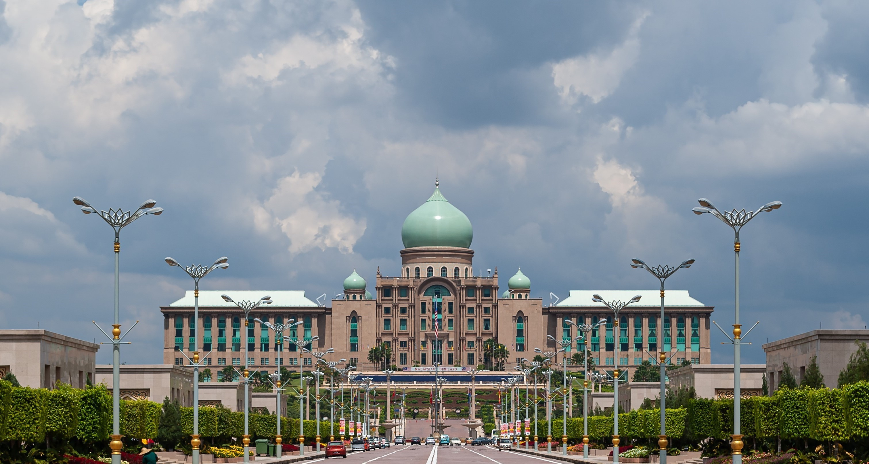










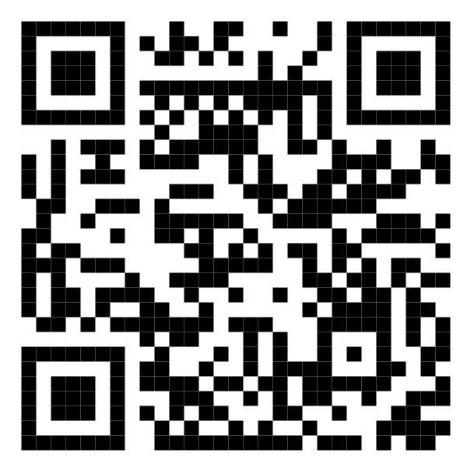








Malaysia Blood Donation Daily Updates (2024)
Data as of 2024-01-25
Cumulative count of blood donation from 2024-01-01 to 2024-01-25
KUALA LUMPUR
SELANGOR
14,216
1,963
MALAYSIA
KEDAH
40,634
N. SEMBILAN
1,464
1,355
PERAK
KELANTAN
3,107
1,374
JOHOR
Scan QR code below for more updates
TERENGGANU
3,503
1,564
SARAWAK
PAHANG
2,943
1,740
PULAU PINANG
PERLIS
3,066
0
SABAH
PUTRAJAYA
2,445
0
MELAKA
LABUAN
1,894
0

