Slide 1
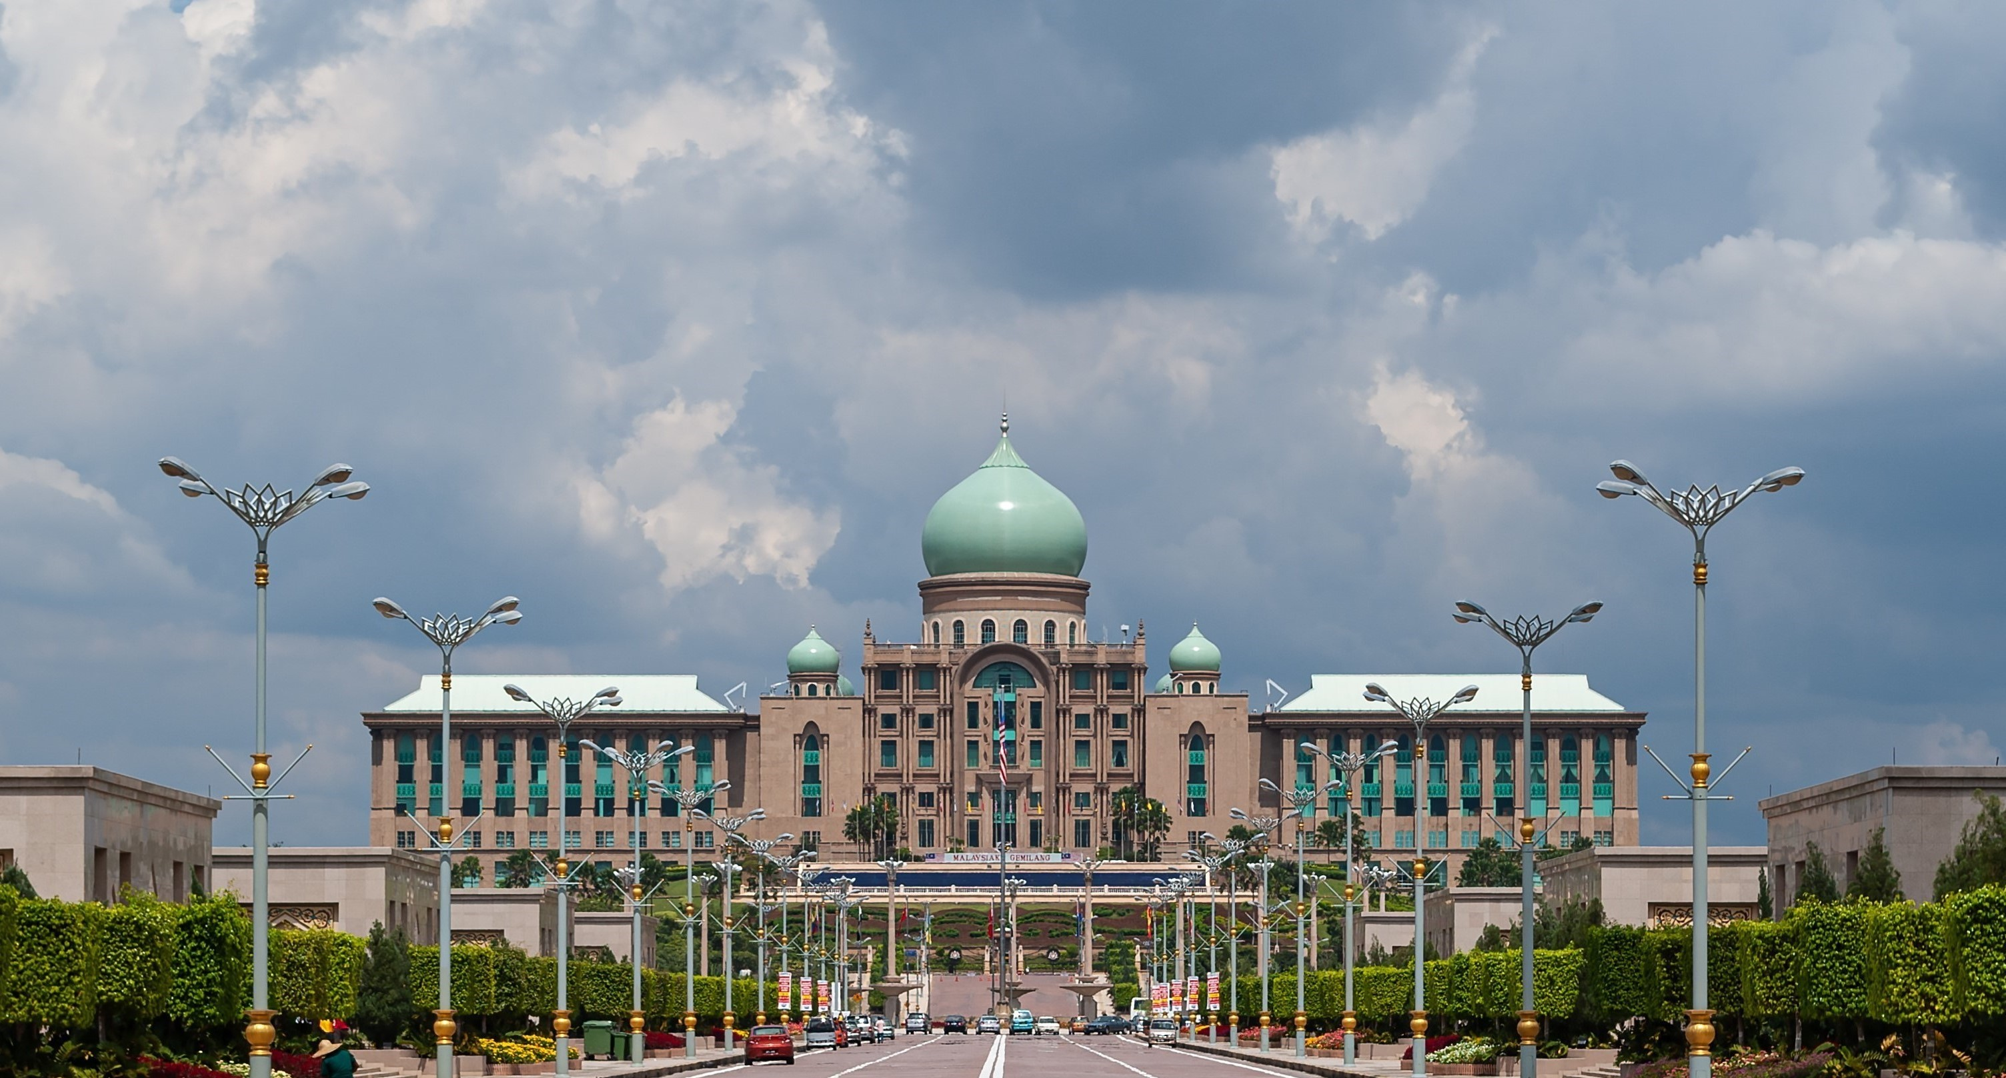












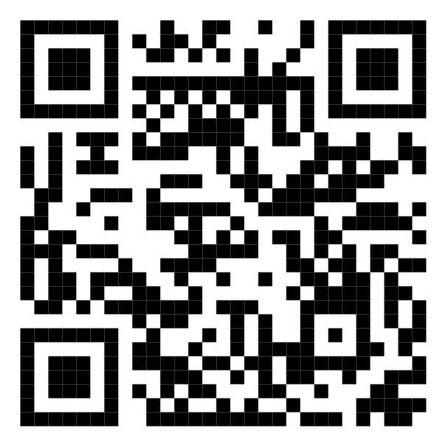






Malaysia’s Blood Donation Daily Updates (2024)
Data as of 2024-01-28
Cumulative count of blood donation from 2024-01-01 to 2024-01-28
JOHOR
PULAU PINANG
3,875
3,516
+250
MALAYSIA
+361
KEDAH
45,798
SABAH
1,628
+2,650
2,814
+56
+193
KELANTAN
SARAWAK
1,519
3,489
SELANGOR
2,153
+36
+264
MELAKA
SELANGOR
2,190
2,153
+184
+104
N. SEMBILAN
Scan QR code below for more updates or click here
TERENGGANU
1,574
1,817
+106
+57
PAHANG
KUALA LUMPUR
1,991
15,533
+106
+633
PERAK
PUTRAJAYA
3,699
0
+300
+0
PERLIS
LABUAN
0
0
+0
+0

Slide 2
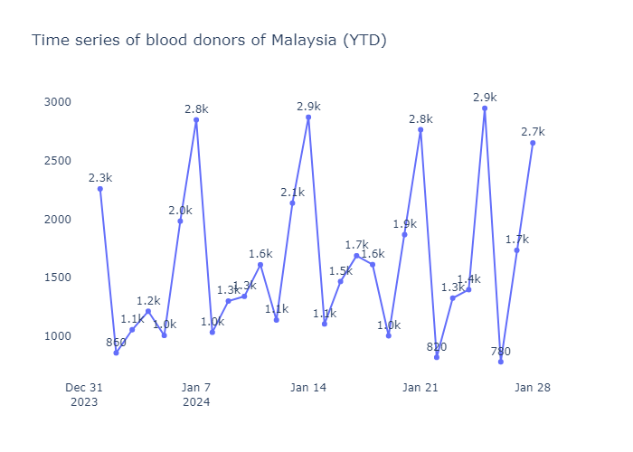
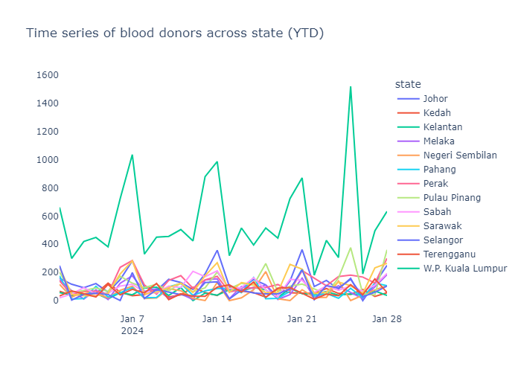
Malaysia’s Blood Donation Daily Trends (2024)
Data as of 2024-01-28

Slide 3
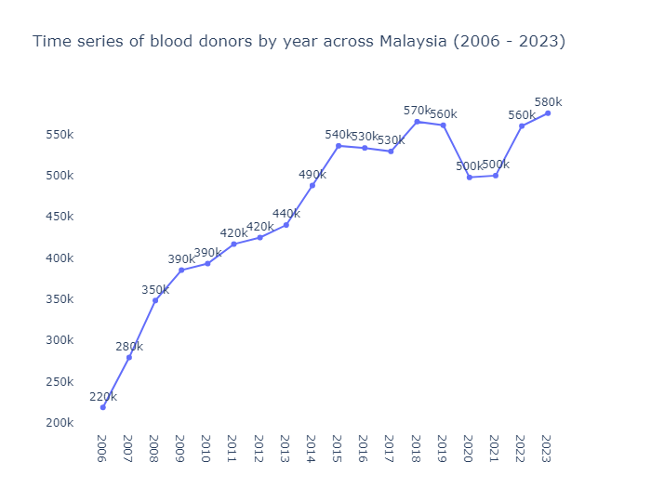
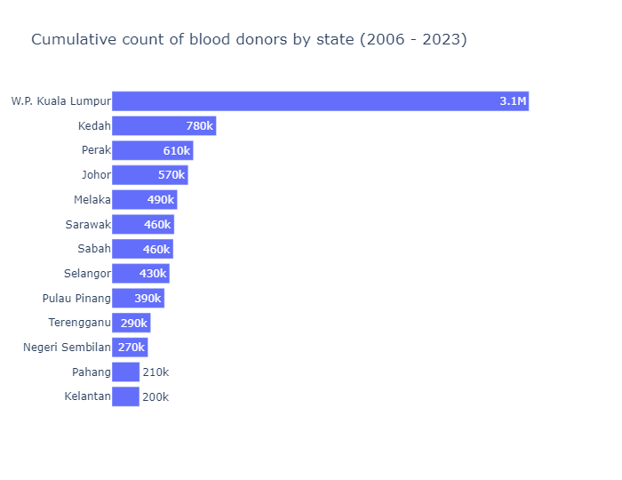
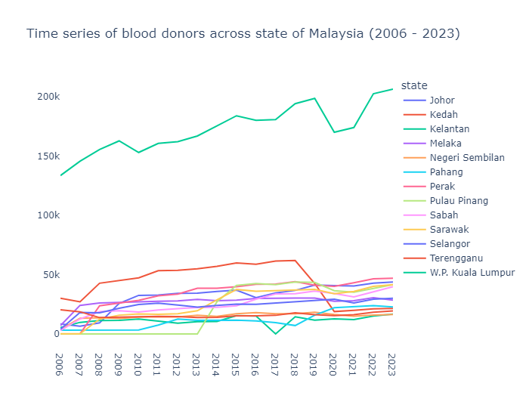
Malaysia’s Blood Donation Historical Trends (2006 – 2023)

Slide 4
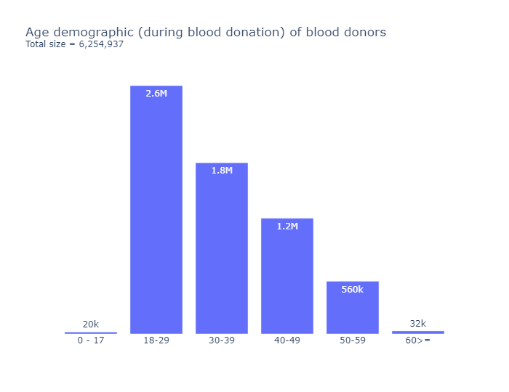
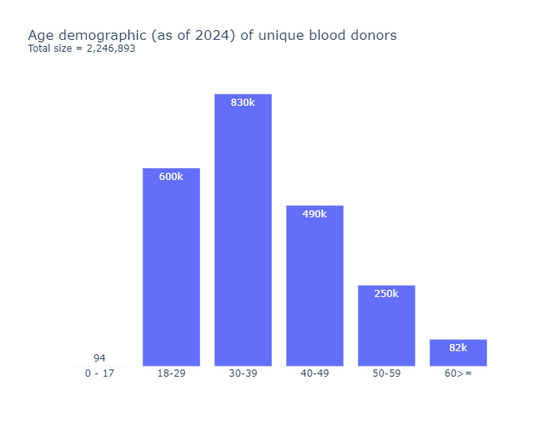
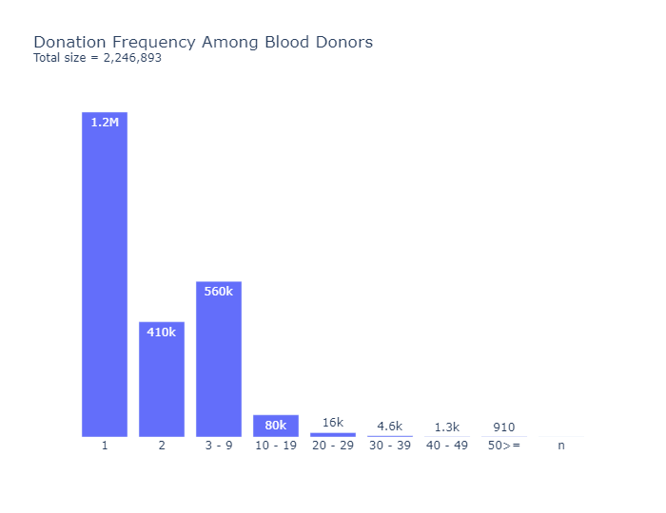
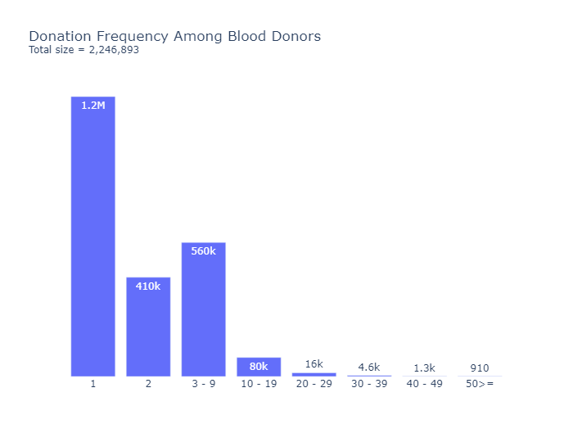
Malaysia’s Blood Donation Retention Trends (2012 – 2024)
Data as of 2024-01-28
Total Donations
Total Unique Donors
6,254,937
2,246,893

