Slide 1






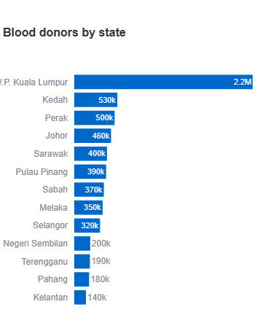









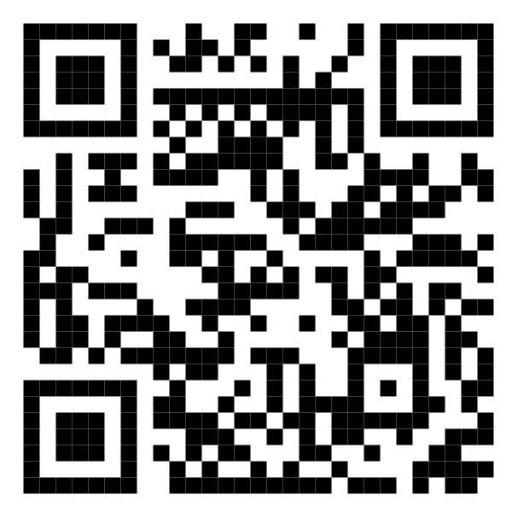
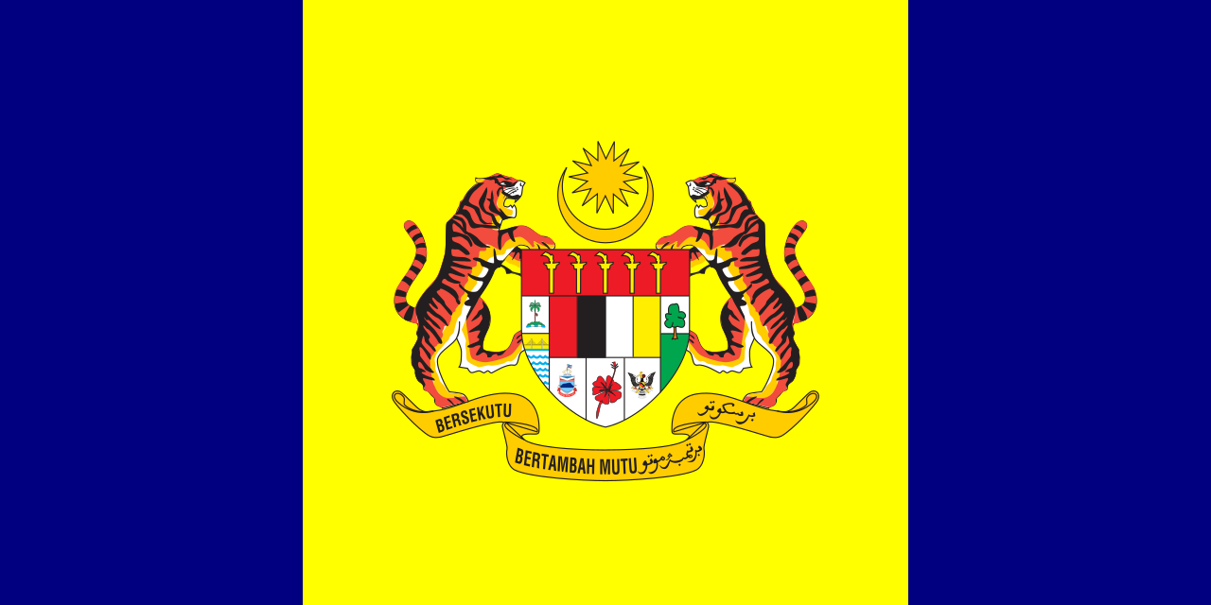


Malaysia's Blood Donation Count Daily Update
Data shown is for the daily update of:
date
KUALA LUMPUR
SELANGOR
kuala lumpur
selangor
MALAYSIA
KEDAH
2,934
N. SEMBILAN
kedah
n. sembilan
PERAK
KELANTAN
perak
kelantan
JOHOR
TERENGGANU
johor
terengganu
SARAWAK
PAHANG
sarawak
pahang
PULAU PINANG
PERLIS
pulau pinang
perlis
For more update, scan the QR code below:
SABAH
PUTRAJAYA
sabah
putrajaya
MELAKA
labuan
melaka
labuan

