Slide 1
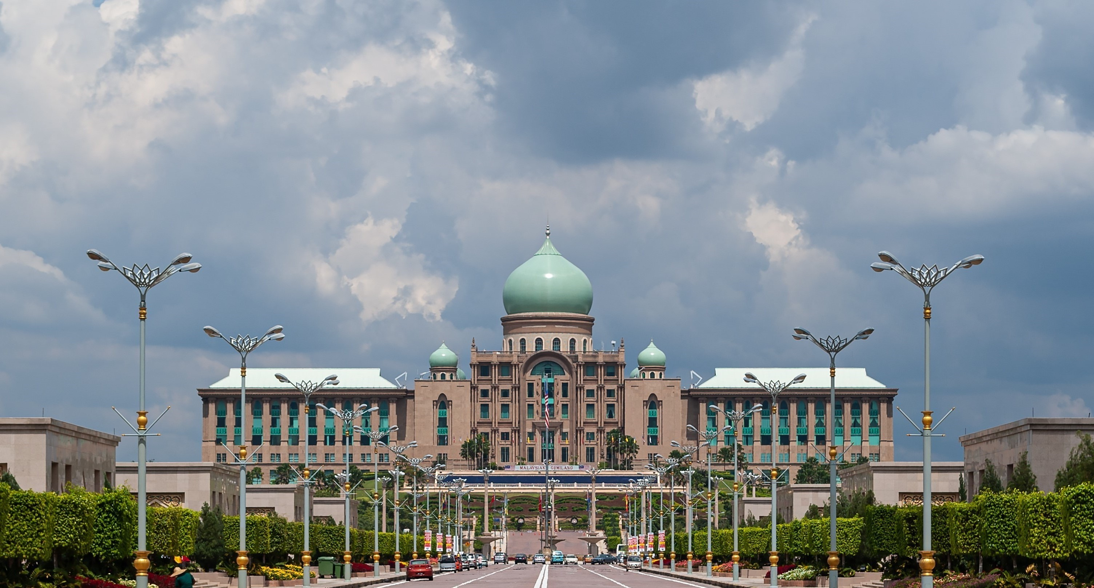












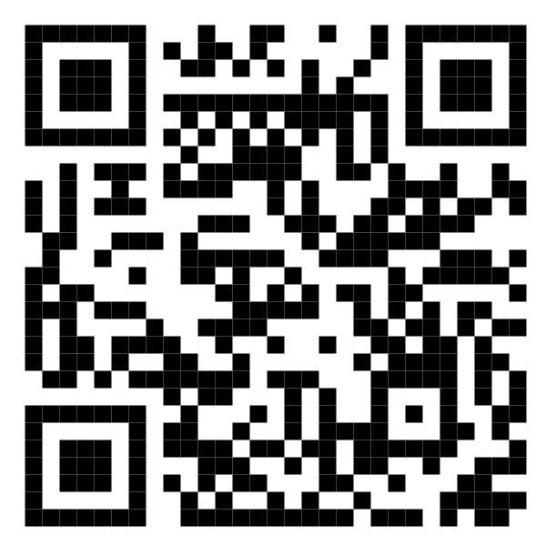






Malaysia Blood Donation Daily Updates (2024)
Data as of 2024-01-26
Cumulative count of blood donation from 2024-01-01 to 2024-01-26
KUALA LUMPUR
SELANGOR
14,405
1,990
New: 189
MALAYSIA
New: 27
KEDAH
41,415
N. SEMBILAN
1,543
New: 781
1,392
New: 79
New: 37
PERAK
KELANTAN
3,274
1,415
New: 167
New: 189tn
JOHOR
TERENGGANU
3,503
1,606
New: 0
New: 42
SARAWAK
Scan QR code below for more updates or click here
PAHANG
2,993
1,760
New: 50
New: 20
PULAU PINANG
PERLIS
3,115
0
New: 49
New: 0
SABAH
PUTRAJAYA
2,511
0
New: 66
New: 0
MELAKA
LABUAN
1,908
0
New: 14
New: 0

