Slide 1










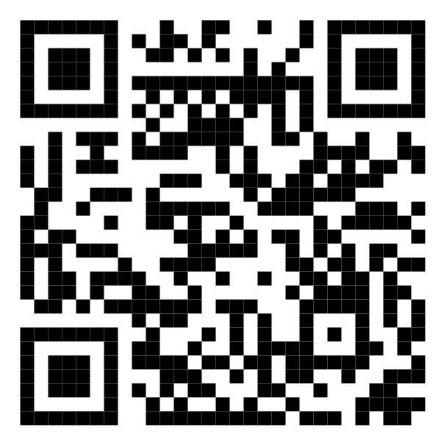








Malaysia's Blood Donation Daily Up3,345s (2024)
Data as of
3,345
Cumulative count of blood donation from 2024-01-01 to
count
KUALA LUMPUR
SELANGOR
12,695
1,812
MALAYSIA
KEDAH
37,688
N. SEMBILAN
1,420
1,355
PERAK
KELANTAN
2,926
1,326
JOHOR
Scan QR code below for more up3,345s
TERENGGANU
3,345
1,451
SARAWAK
PAHANG
2,837
1,653
PULAU PINANG
PERLIS
2,690
0
SABAH
PUTRAJAYA
2,341
0
MELAKA
LABUAN
1,837
0

