Slide 1
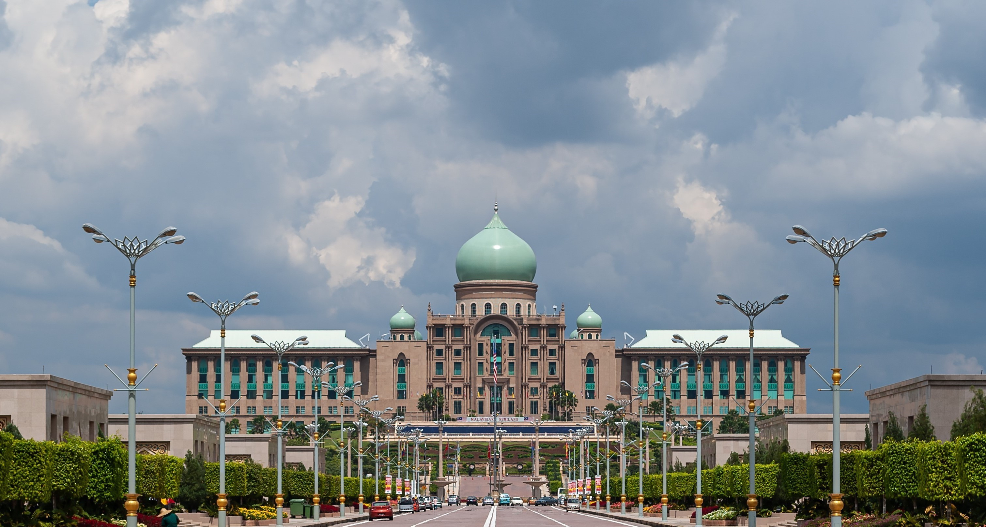












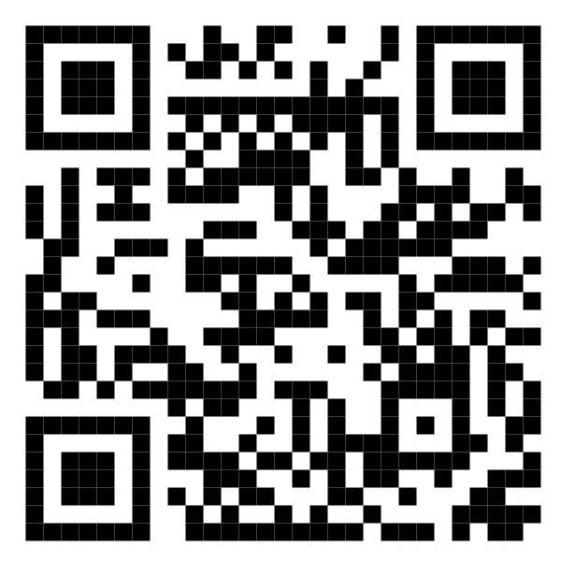






Malaysia Blood Donation Daily Updates (2024)
Data as of max_date
Cumulative count of blood donation from 2024-01-01 to last_date
KUALA LUMPUR
SELANGOR
kuala lumpur
selangor
MALAYSIA
KEDAH
malaysia
N. SEMBILAN
kedah
n. sembilan
PERAK
KELANTAN
perak
kelantan
JOHOR
TERENGGANU
johor
terengganu
SARAWAK
Scan QR code below for more updates or visit the link below
PAHANG
sarawak
https://blood-donation.streamlit.app/
pahang
PULAU PINANG
PERLIS
pulau pinang
perlis
SABAH
PUTRAJAYA
sabah
putrajaya
MELAKA
LABUAN
melaka
labuan

