Slide 1
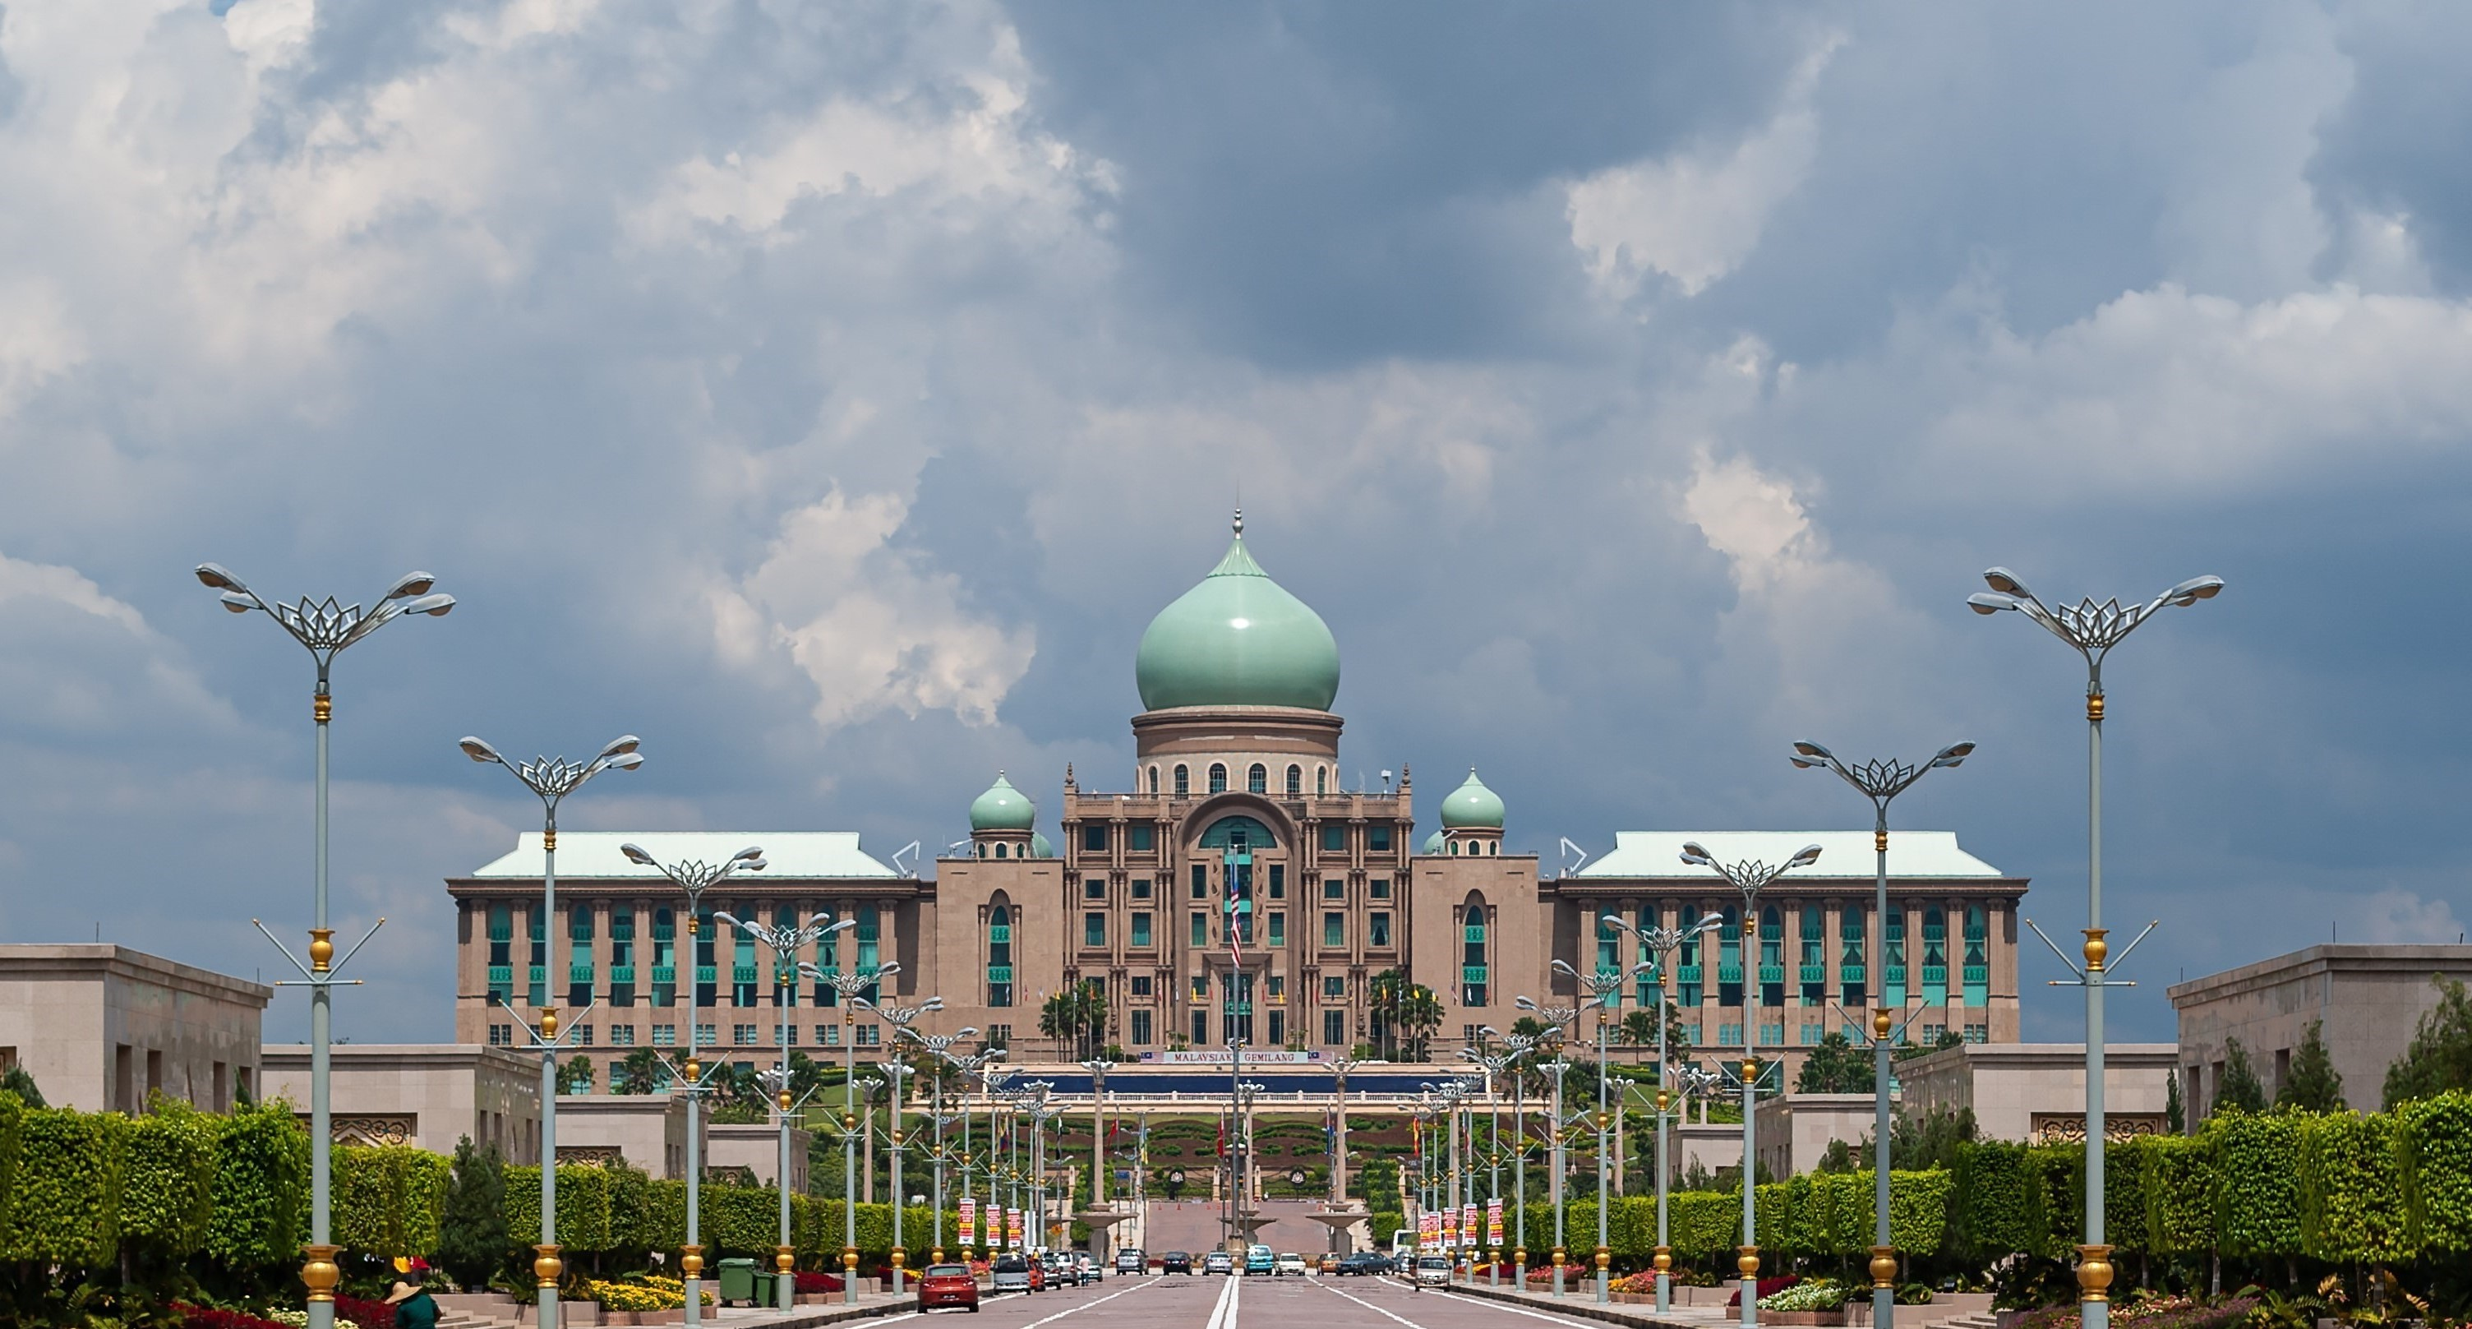












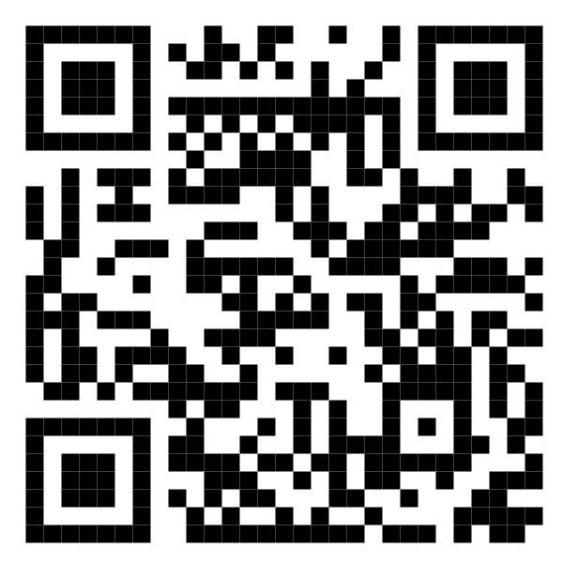






Malaysia Blood Donation Daily Updates (2024)
Data as of 2024-01-27
Cumulative count of blood donation from 2024-01-01 to 2024-01-27
JOHOR
PULAU PINANG
3,625
3,155
+122
MALAYSIA
+40
KEDAH
43,148
SABAH
1,572
+1,733
2,621
+29
+110
KELANTAN
SARAWAK
1,483
3,225
SELANGOR
2,049
+68
+232
MELAKA
SELANGOR
2,006
2,049
+98
+59
N. SEMBILAN
Scan QR code below for more updates or click here
TERENGGANU
1,468
1,760
+76
+154
PAHANG
KUALA LUMPUR
1,885
14,900
+125
+495
PERAK
PUTRAJAYA
3,399
0
+125
+0
PERLIS
LABUAN
0
0
+0
+0

