Slide 1
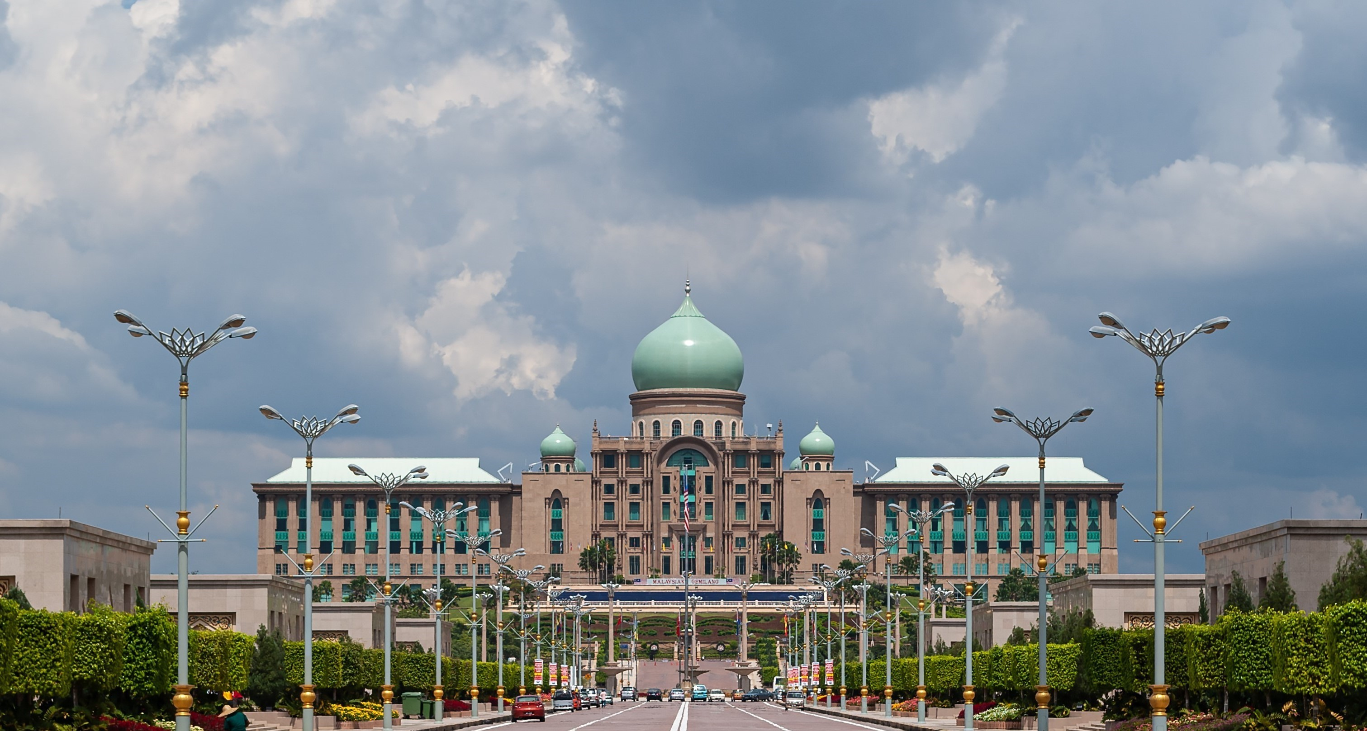












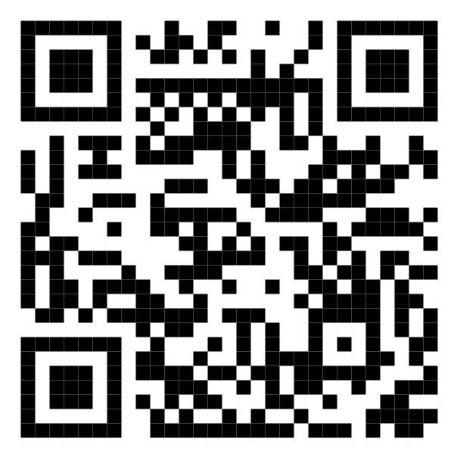






Malaysia Blood Donation Daily Updates (2024)
Data as of 2024-01-26
Cumulative count of blood donation from 2024-01-01 to 2024-01-26
KUALA LUMPUR
SELANGOR
14,405
1,990
MALAYSIA
KEDAH
41,415
N. SEMBILAN
1,543
1,392
PERAK
KELANTAN
3,274
1,415
JOHOR
TERENGGANU
3,503
1,606
SARAWAK
Scan QR code below for more updates or visit the link below
PAHANG
2,993
https://blood-donation.streamlit.app/
1,760
PULAU PINANG
PERLIS
3,115
0
SABAH
PUTRAJAYA
2,511
0
MELAKA
LABUAN
1,908
0

