Slide 1










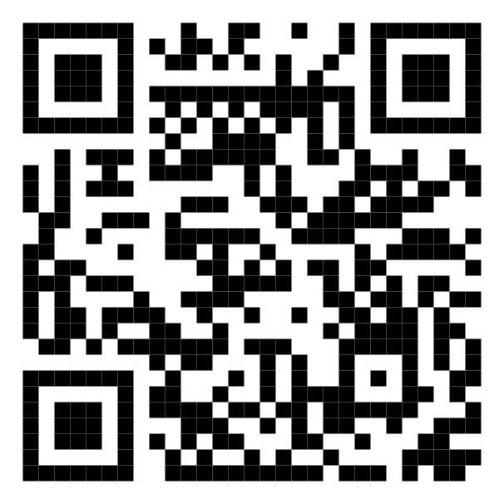








Malaysia's Blood Donation Daily Updates (2024)
Data as of
date
Cumulative count of blood donation from 2024-01-01 to
count
KUALA LUMPUR
SELANGOR
12,695
1,812
MALAYSIA
KEDAH
2,934
N. SEMBILAN
1,420
1,355
PERAK
KELANTAN
2,926
1,326
JOHOR
Scan QR code below for more updates
TERENGGANU
3,345
1,451
SARAWAK
PAHANG
2,837
1,653
PULAU PINANG
PERLIS
2,690
0
SABAH
PUTRAJAYA
2,341
0
MELAKA
LABUAN
1,837
0

