Slide 1

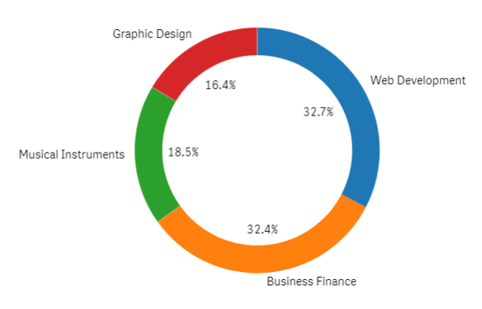
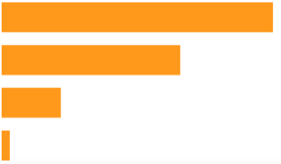
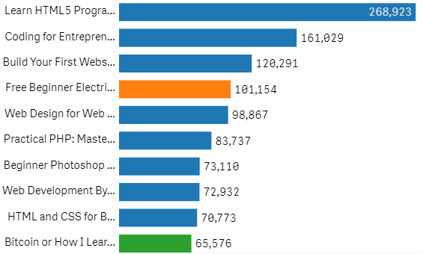
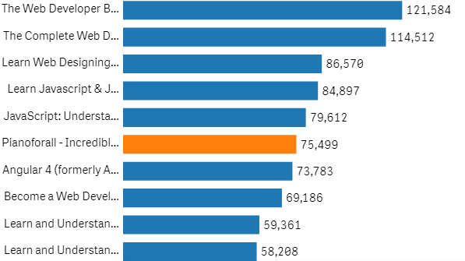
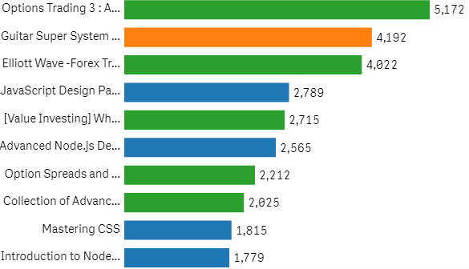
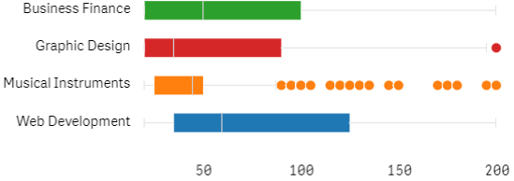
Courses Analysis (2012-2017)
Courses by subject
Legend
Total Course
Paid
Free
Web Development
3,672
3,362 (92%)
310 (8%)
Total Revenue
Level
Musical Instruments
$242,930
All
1,929 (53%)
Business Finance
Beginner
421 (11%)
1,270 (35%)
Intermediate
58 (1%)
Expert
Graphic Design
Web Development courses stand out as the predominant subject in both the top 10 free courses and paid courses where it fills more than 80% of the spots for both category
Top 10 free courses
Top 10 paid courses
Business Finance courses dominate the top 10 spot
Business Finance courses dominate the top 10 spot
Top 10 expert level courses
Top 10 expert level courses

