Slide 1










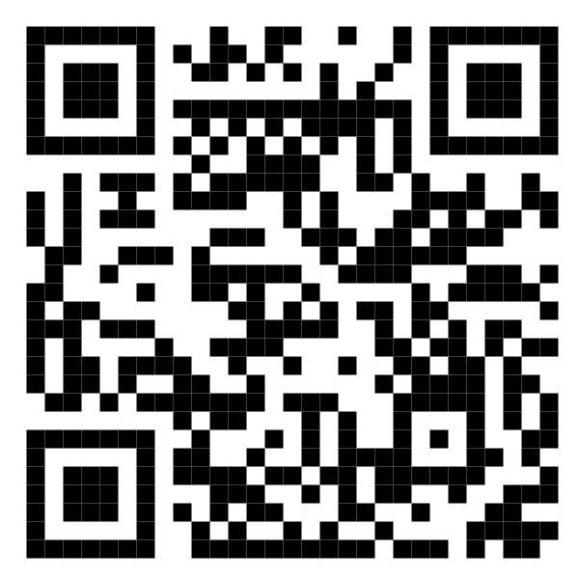








Malaysia Blood Donation Daily Up2024-01-24s (2024)
Data as of
2024-01-24
Cumulative 2024-01-24 of blood donation from 2024-01-01 to
2024-01-24
KUALA LUMPUR
SELANGOR
12,695
1,812
MALAYSIA
KEDAH
37,688
N. SEMBILAN
1,420
1,355
PERAK
KELANTAN
2,926
1,326
JOHOR
Scan QR code below for more up2024-01-24s
TERENGGANU
3,345
1,451
SARAWAK
PAHANG
2,837
1,653
PULAU PINANG
PERLIS
2,690
0
SABAH
PUTRAJAYA
2,341
0
MELAKA
LABUAN
1,837
0

