Slide 1
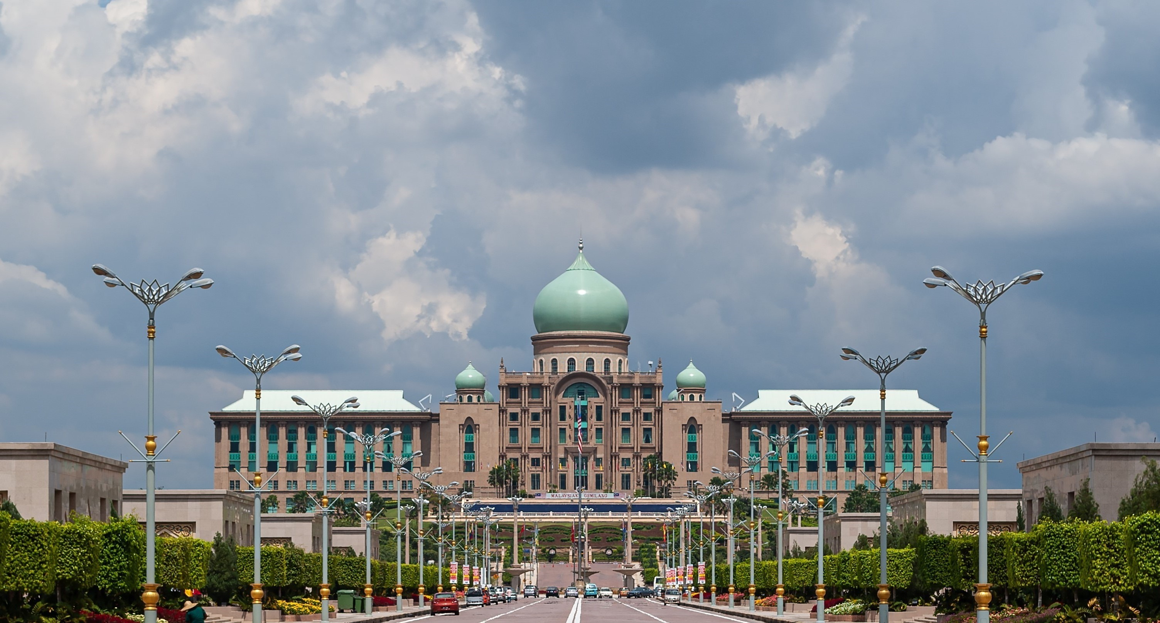












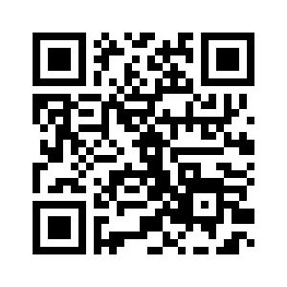






Malaysia’s Blood Donation Daily Updates (2024)
Data as of max_date
Cumulative count of blood donation from 2024-01-01 to last_date
JOHOR
PULAU PINANG
johor
pulau pinang
+daily_jhr
MALAYSIA
+daily_png
KEDAH
malaysia
SABAH
kedah
+daily_mly
sabah
+daily_kdh
+daily_sbh
KELANTAN
SARAWAK
kelantan
sarawak
SELANGOR
selangor
+daily_ktn
+daily_srwk
MELAKA
SELANGOR
melaka
selangor
+daily_mlk
+daily_slgr
N. SEMBILAN
Scan QR code below for more updates or click here
TERENGGANU
n. sembilan
terengganu
+daily_ns
+daily_trgn
PAHANG
KUALA LUMPUR
pahang
kuala lumpur
+daily_phg
+daily_kl
PERAK
PUTRAJAYA
perak
putrajaya
+daily_prk
+daily_pjy
PERLIS
LABUAN
perlis
labuan
+daily_pls
+daily_lbn

Slide 2
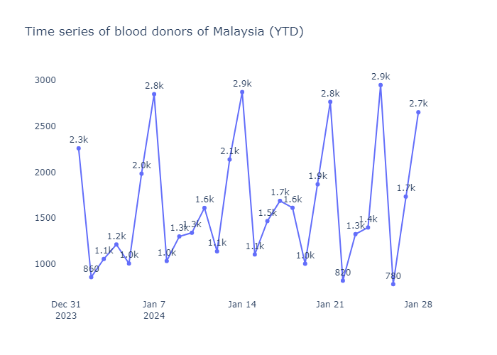
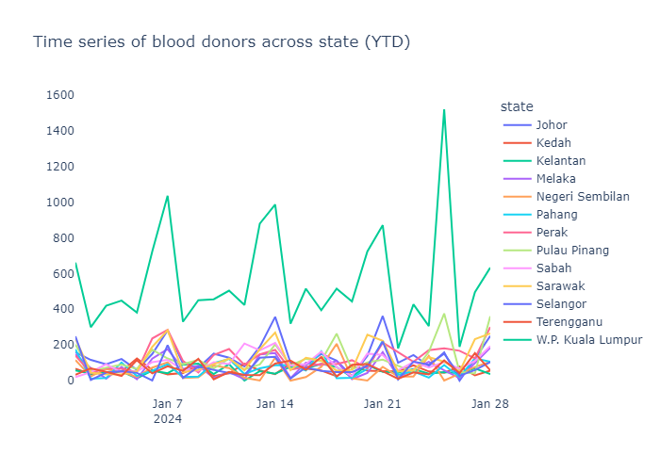
Malaysia’s Blood Donation Daily Trends (2024)
Data as of max_date

Slide 3
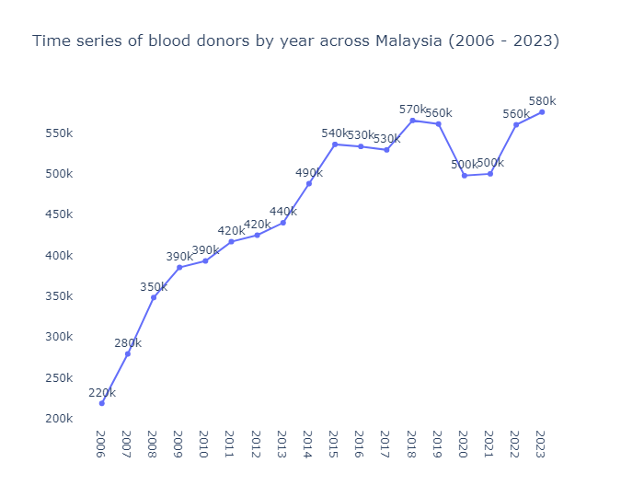
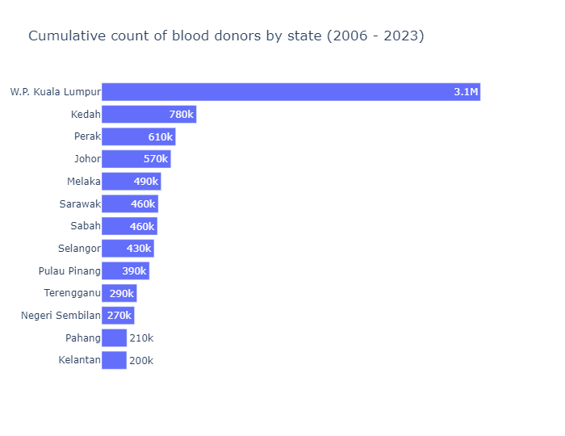
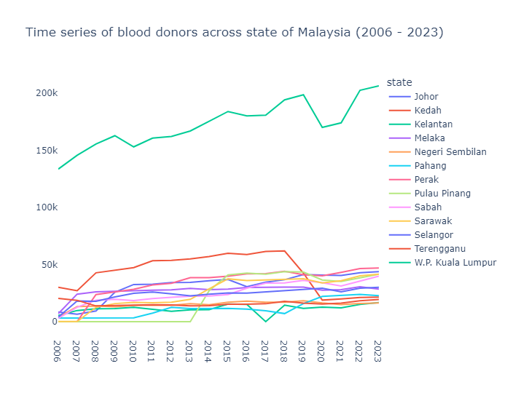
Malaysia’s Blood Donation Historical Trends (2006 – 2023)

Slide 4
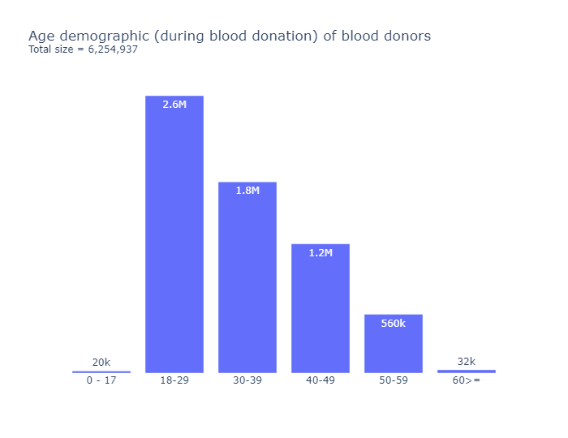
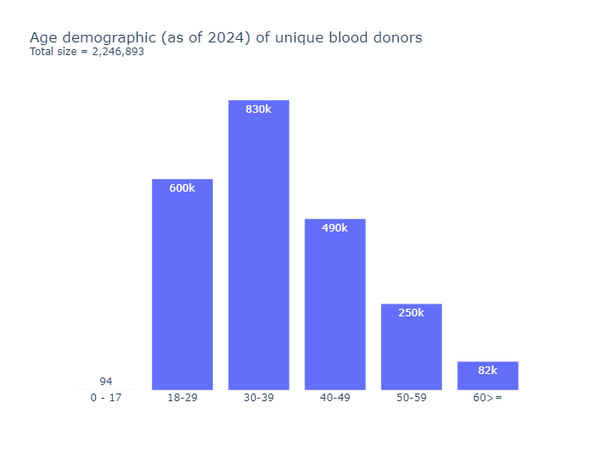
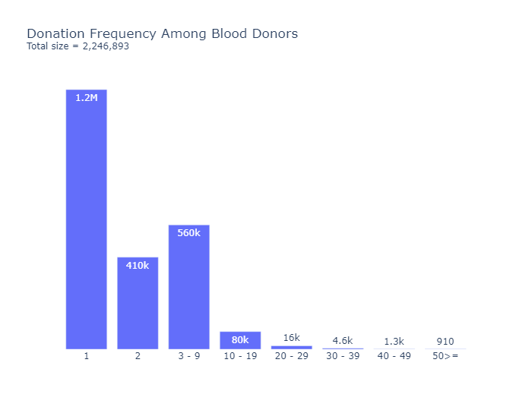
Malaysia’s Blood Donation Retention Trends (2012 – 2024)
Data as of max_granular_date
Total Donations
Total Unique Donors
total_donation
unique_donor

