Slide 1
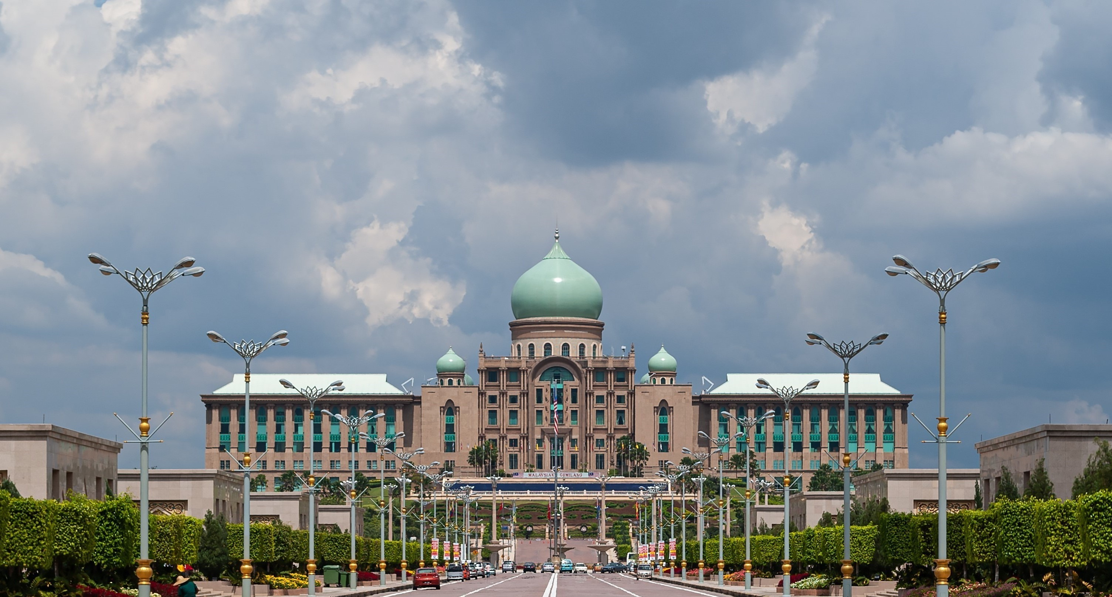












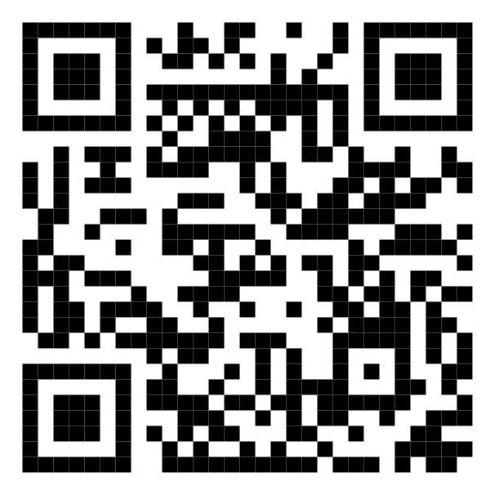






Malaysia Blood Donation Daily Updates (2024)
Data as of max_date
Cumulative count of blood donation from 2024-01-01 to last_date
KUALA LUMPUR
SELANGOR
kuala lumpur
selangor
New: daily_kl
MALAYSIA
New: daily_slgr
KEDAH
malaysia
N. SEMBILAN
kedah
New: daily_mly
n. sembilan
New: daily_kdh
New: daily_ns
PERAK
KELANTAN
perak
kelantan
New: daily_prk
New: daily_kltn
JOHOR
TERENGGANU
johor
terengganu
New: daily_jhr
New: daily_trgn
SARAWAK
Scan QR code below for more updates or click here
PAHANG
sarawak
pahang
New: daily_srwk
New: daily_phg
PULAU PINANG
PERLIS
pulau pinang
perlis
New: daily_png
New: daily_pls
SABAH
PUTRAJAYA
sabah
putrajaya
New: daily_sbh
New: daily_pjy
MELAKA
LABUAN
melaka
labuan
New: daily_mlk
New: daily_lbn

