Slide 1
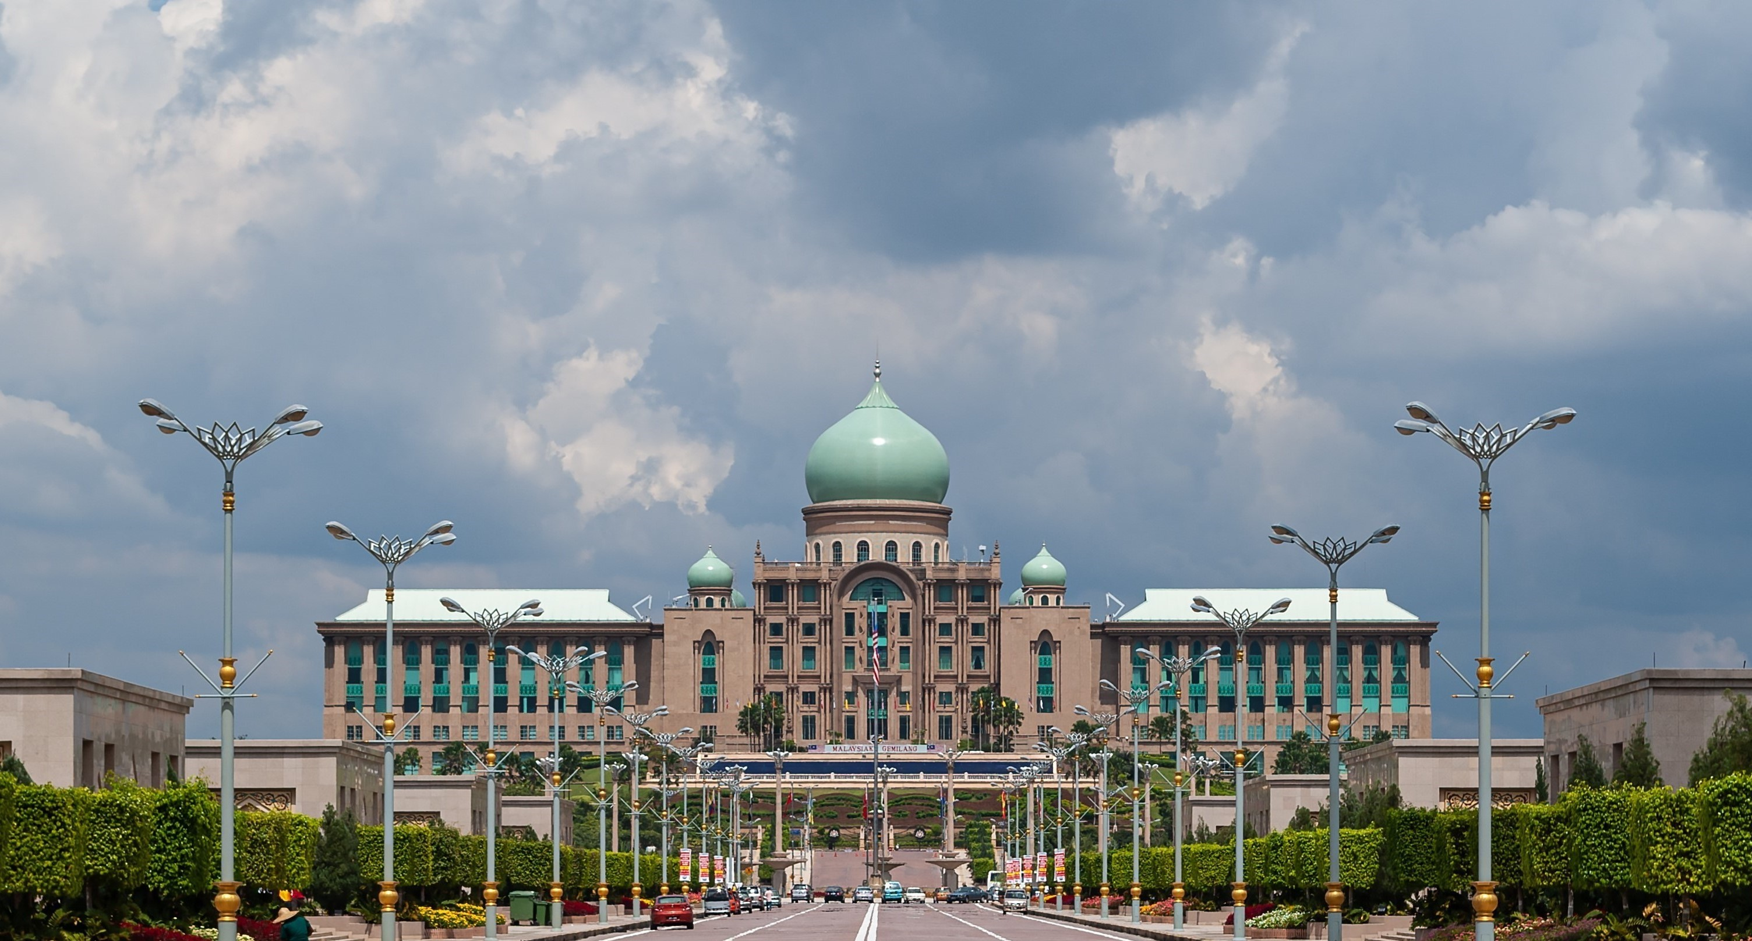












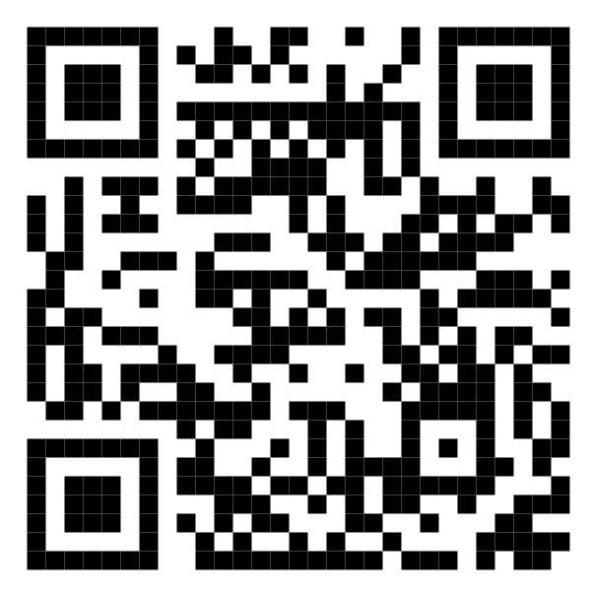






Malaysia Blood Donation Daily Updates (2024)
Data as of 2024-01-27
Cumulative count of blood donation from 2024-01-01 to 2024-01-27
KUALA LUMPUR
SELANGOR
14,900
2,049
+495
MALAYSIA
+59
KEDAH
43,148
N. SEMBILAN
1,572
+1,733
1,468
+29
+76
PERAK
KELANTAN
3,399
1,483
+125
+68
JOHOR
TERENGGANU
3,625
1,760
+122
+154
SARAWAK
Scan QR code below for more updates or click here
PAHANG
3,225
1,885
+232
+125
PULAU PINANG
PERLIS
3,155
0
+40
+0
SABAH
PUTRAJAYA
2,621
0
+110
+0
MELAKA
LABUAN
2,006
0
+98
+0

