Slide 1
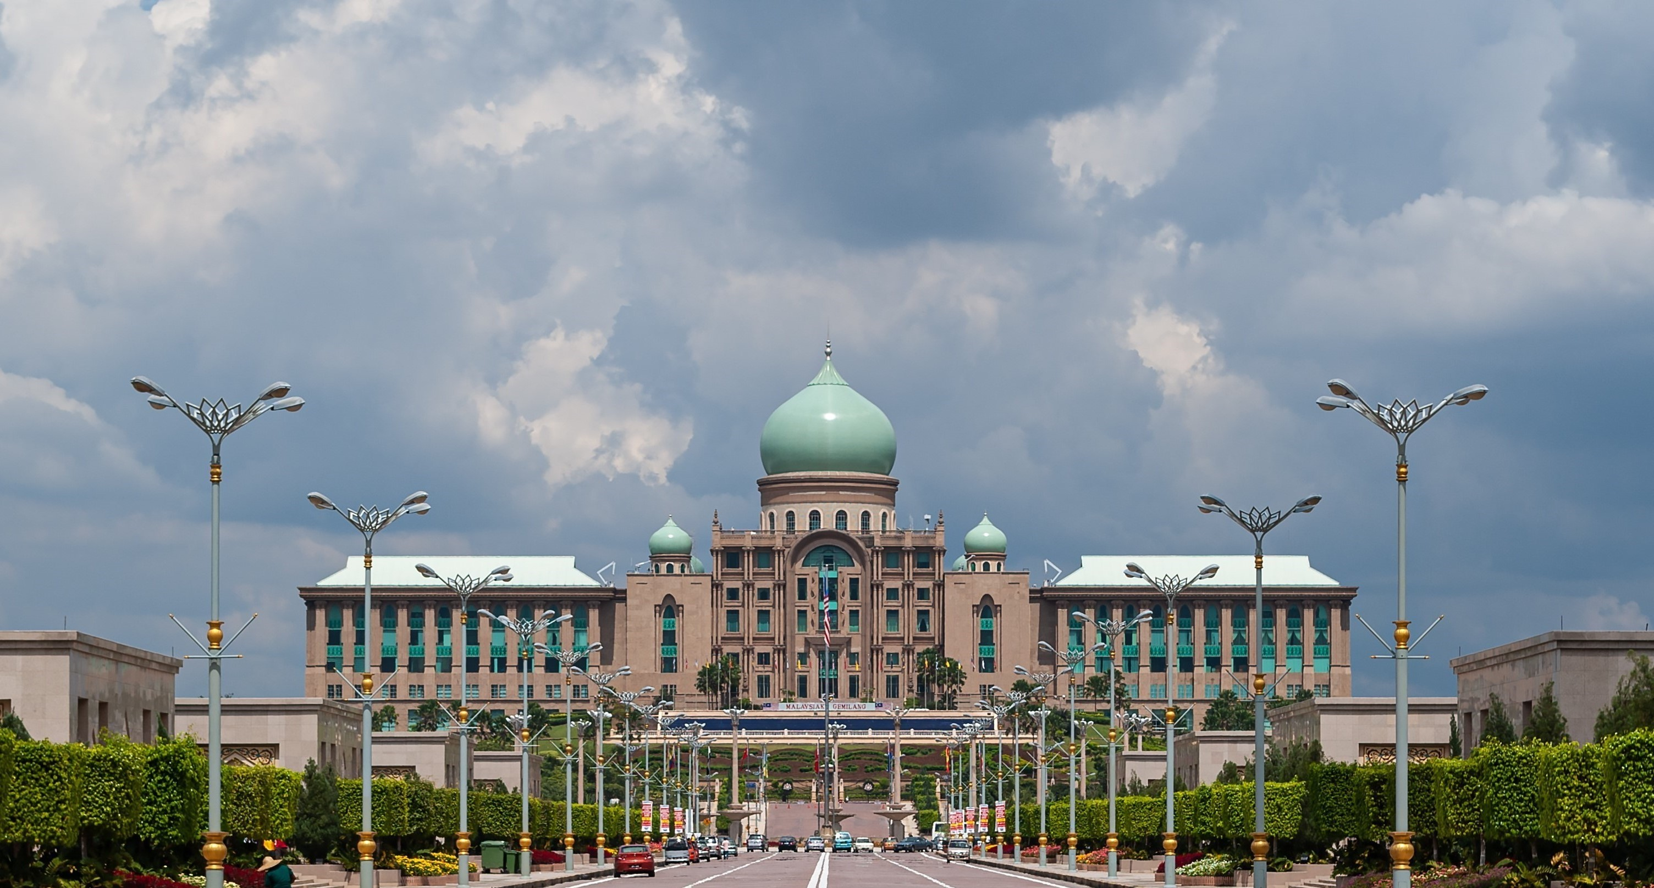












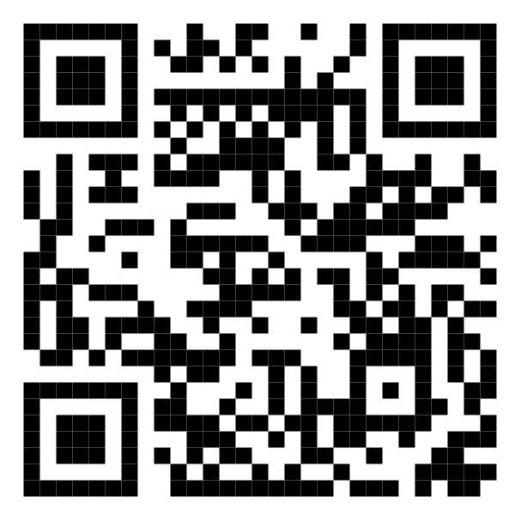






Malaysia Blood Donation Daily Updates (2024)
Data as of 2024-01-26
Cumulative count of blood donation from 2024-01-01 to 2024-01-26
KUALA LUMPUR
SELANGOR
14,405
1,990
New: daily_kl
MALAYSIA
New: daily_slgr
KEDAH
41,415
N. SEMBILAN
1,543
New: daily_ns
1,392
New: daily_kdh
New: daily_ns
PERAK
KELANTAN
3,274
1,415
New: daily_prk
New: daily_kltn
JOHOR
TERENGGANU
3,503
1,606
New: daily_jhr
New: daily_trgn
SARAWAK
Scan QR code below for more updates or click here
PAHANG
2,993
1,760
New: daily_srwk
New: daily_phg
PULAU PINANG
PERLIS
3,115
0
New: daily_png
New: daily_pls
SABAH
PUTRAJAYA
2,511
0
New: daily_sbh
New: daily_pjy
MELAKA
LABUAN
1,908
0
New: daily_mlk
New: daily_lbn

