Slide 1
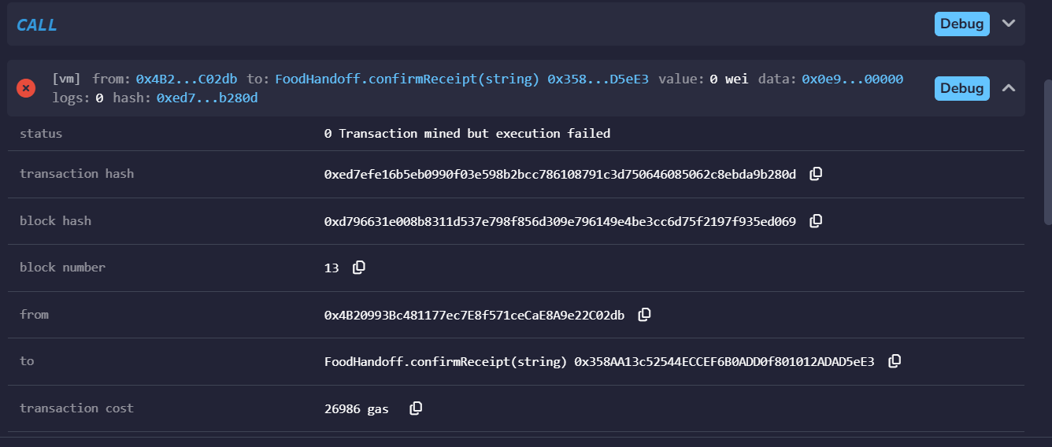
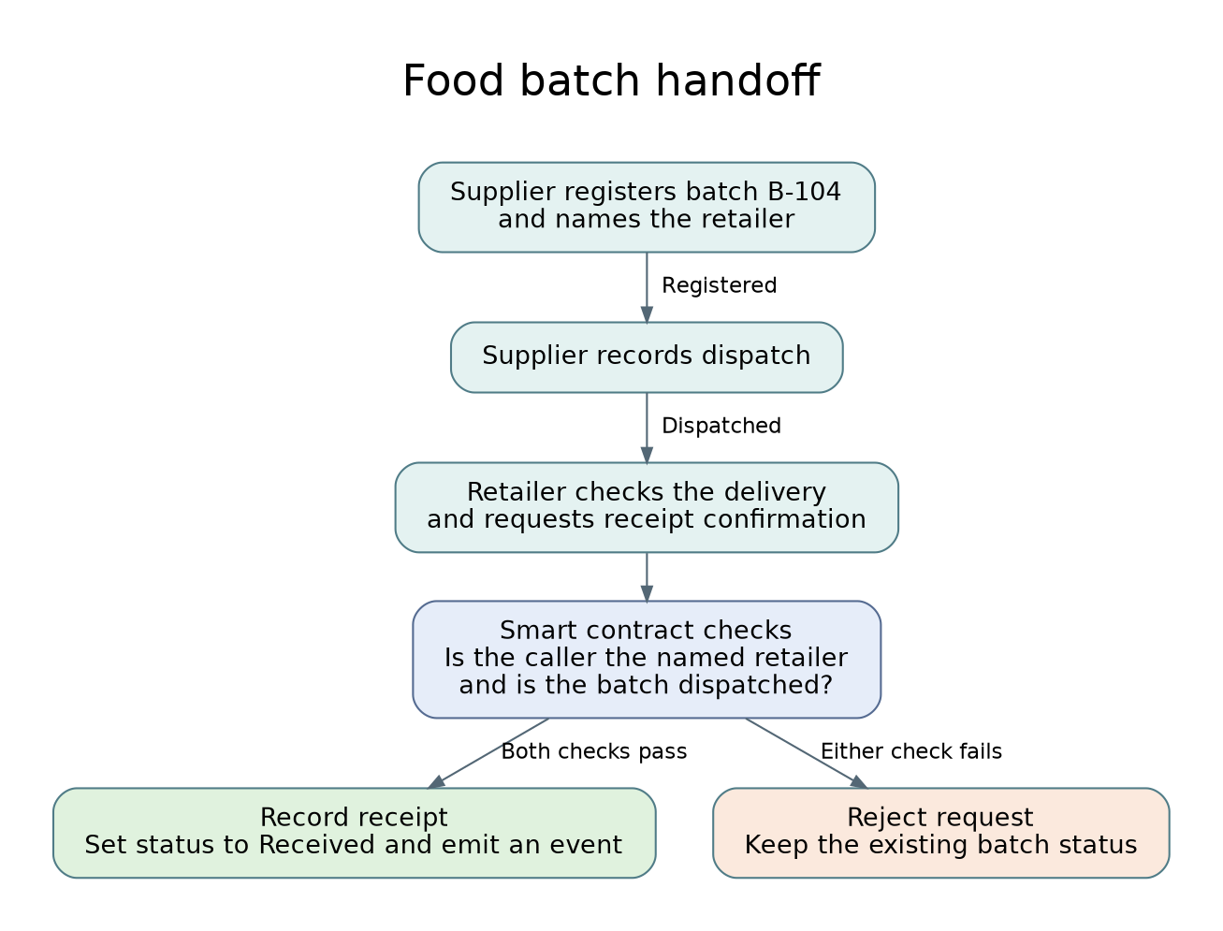
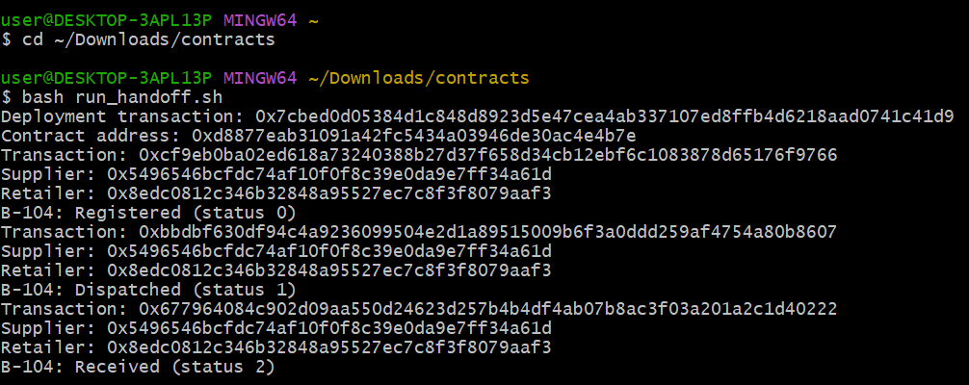
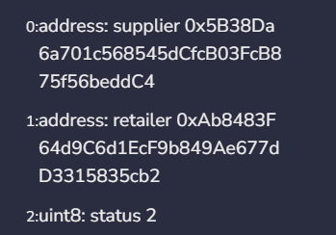
Food batch handoff on Ethereum
Ahmed Sadkh Abdi Hassanow • 2025786 • Distributed Digital Transactions
The delivery problem
How the contract works
Testing in Remix
Python and Ganache
A supplier records dispatch and a retailer records arrival. When their logs disagree, who can confirm whether batch B-104 reached the receiving desk? A shared contract lets both parties check which account acknowledged the delivery.
The Solidity contract sits between the supplier and retailer. It stores their addresses and the batch status. Only the registering supplier can dispatch the batch. Only the named retailer can confirm a dispatched batch.
We registered B-104 from the supplier account and used getBatch after each transaction. An early receipt attempt failed at status 0. Dispatch advanced the batch to status 1.
Python deployed the compiled contract to local Ganache. A Bash script then ran registration, dispatch and receipt with two test accounts. Each step read the stored status back from the contract.
Current practice
Tesco and ten suppliers trialled QR codes that capture batch numbers and use-by dates (GS1 UK, 2025). The label identifies the goods. Our proposal adds a signed record of the handoff between businesses.
A third account attempted receipt after dispatch. Remix reported “Only the named retailer can confirm”. The batch stayed Dispatched (1).
The shell run returned Registered (0), Dispatched (1) and Received (2) for B-104.
Proposed business model
Scaling the design
The supplier pays to register and dispatch each batch. The retailer pays to acknowledge receipt after checking the label. Each party controls its own entry. A supplier can follow up on an outstanding delivery without first reconciling two logs.
Both parties must agree on identifiers, recognise each other’s accounts and train staff. A shared database could cost less where both already trust one operator.
Cryptographic security
Ethereum’s Dencun upgrade introduced blobs in 2024. A live deployment could use a layer-2 rollup to spread data publication costs across many deliveries (Ethereum.org, n.d.-a). Ganache verified the workflow. Production fees would need separate measurement.
Ethereum uses ECDSA signatures to identify the account authorising a transaction (Ethereum.org, n.d.-b). The contract compares the caller’s address with the retailer assigned to B-104. Another retailer can provide a valid signature and still fail this check.
The named retailer confirmed receipt. The lookup returned Received (2). A duplicate confirmation then failed and the status stayed at 2. All six checks matched the design.
References and project
Conclusion
Operational limits
Ethereum.org (n.d.-a) Danksharding.
For B-104, both businesses can establish who acknowledged receipt. If the record still shows Dispatched, staff know which handoff to investigate before contacting the driver.
A stolen private key could allow a false acknowledgement. Staff must also check the physical goods. A signed receipt cannot establish the condition of the food.
Ethereum.org (n.d.-b) Ethereum accounts.
GS1 UK (2025) Tesco in early trials of next generation barcodes in move set to reshape UK retail. 23 April.
Online sources accessed 10 November 2026.
github.com/hazin-collab/food-handoff

