Slide 1












Module 10:
Enterprise Process Architecture
IS210 – Business Process Analysis and Solutioning
Singapore Management University
BPAS - Teaching Team
Model
Analyse
Solve
Innovate
Notes:
60 mins – BPAS Teaching Case Part 5 Activity

Slide 2
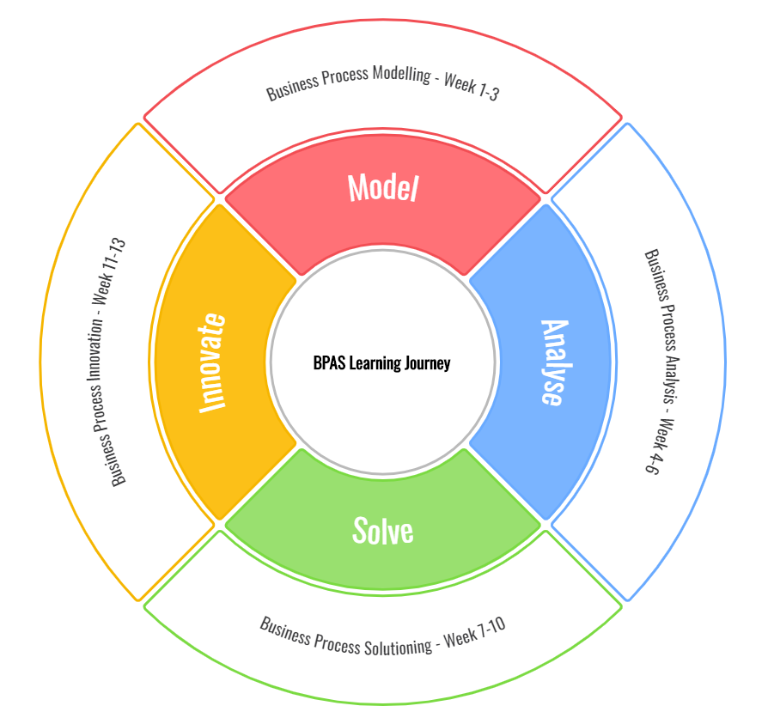

Learning Journey
Model
Analyse
Solve
Innovate
4 main chapters:
Model: Week 1 to 3
Analyse: Week 4 to 6
Solve: Week 7 to 10
Innovate: Week 11-13

Slide 3
Module 10 Learning Outcomes
Understand value chain in an organization
Familiarise with value chain modeling framework, process architecture
Familiarise with two notations for process architecture: Porter value chain models and SAP business maps.
Identify the components of Process architecture; functional units, business processes and process hierarchy.
Apply the process architecture design in each domain.
Model
Analyse
Solve
Innovate
Notes:
Recall
[Context] They should know 8 Business Models by now
Data Model (From Data Management Class)
Organization Model (Key discovery: Human Business Participants hierarchy and business relationships)
Resource Model (Key discovery: Human and System Business participants and if they are internal or external)
Location Model (Key discovery: Spatial context, online, offline, on-the-go, at the office, at-the-phone…)
Collaboration Model (Key discovery: External and Internal Business Participants including Human and Systems)
Process Catalogue (Key discovery: List of workflow models that we need to build)
Workflow Model (Key discovery: Business Events, activities, flow of work, ownership of work)
Business Rules Model (Key discovery: Business rules that applies to a specific activity: Loyalty, Entitlement, Fraud Detection)
We have the Business Analysis work products [RCI, Static Reports, RCR, selected TO-BE Model]

Slide 4




BPM: Levels of Alignment
Enterprise
Sales
Under Writing
Claims
Finance
Auto Quote
Quote Submission
Payment
Auto Claims
Process Architecture
Claims Submission
Settlement
Technology: Blueprinting, Implementation & Operations
Project
Process
Start
Activity 2
End
Workflow Model
Activity 1
?
Concept Blueprint
Sub Process A1
Activity 3
End
Notes:
We can ask the students to read these levels from text book.
Enterprise Level -------------------------------
-> Guess how many process in Citibank for instance?
- It depends on what level are we looking at?
-> What are the problems associated with many processes? (student to list)
- Too many processes to manage effectively
- There are common activities between different processes (key)
-> If you are an intern at Citibank and ask to change a particular process what should you do?
How should you start? (ask student to illustrate)
- You need a process architecture to show process interactions (key)
- Many organization do not have an overall process architecture
A process architecture is a view/diagram showing the
- overall processes in the organization and their interaction which
- can be used as a tool for analyzing existing processing and
- for developing new processes.
Process manager or Group from IT & Business responsible for Process Architecture
Process Level -------------------------------
-> What should you do if your boss asked you to reduce the turnaround time from 4 days to 2 days to approval a loan?
-> How would you go about do this task?
-> How do you go about understanding a particular process?
- Talk to different people involved in the process (key)
- What is happening?
- Who is involved?
-> What are some issues with talking to people?
- tendency to complaint
- Put the blame on others (finger pointing)
- Inaccurate information
- Conflicting/bais views
Technology Level -------------------------------
Technology is concerned with the implementation of the proposal solution
-> Can you list some technology?
-> What Technologies is needed for order-to-cash process?
- Database to hold information,
- Credit verification application to determines credit worthiness of customers,
- Order management system to capture and store customer orders, etc

Slide 5
Process Architecture - Overview
Process Executive Modeling
Define Functional units
Define value chains / processes
Process Hierarchy Modeling
Depict 2-3 levels
Define level3 processes
Depict sub-processes and tasks
Executive Model
Hierarchy Model

Slide 6
Value Chain
The value is the total amount (i.e. total revenue) that buyers are willing to pay for a firm’s products.
“Value Chain includes all activities to design, produce, market, deliver, and support the product/service” – Michael Porter
The processes that generate value in any organization is the value chain
Value Chain
Primary Processes (E.g. operations, distribution, sales)
Support Processes (E.g. R&D, Human Resources)
Management Processes (E.g. Regulations, Policy, Contracts)

Slide 7
Why study value chains?
Value Chain
Organizations typically support from 3 to 15 value chains.
To identify the sources of competitive advantage
To systematically examine the processes in an organization, their interactions and impact on business performance by each other.
To align the investment with the value chain

Slide 8
Process Architecture for Value Chain
Value Chain Models
Representation of value chain is by process architecture diagrams.
Several frameworks/notations for process architecture
Porter value chain models
SAP Process Maps
Porter Value Chain Models
SAP Business Maps

Slide 9
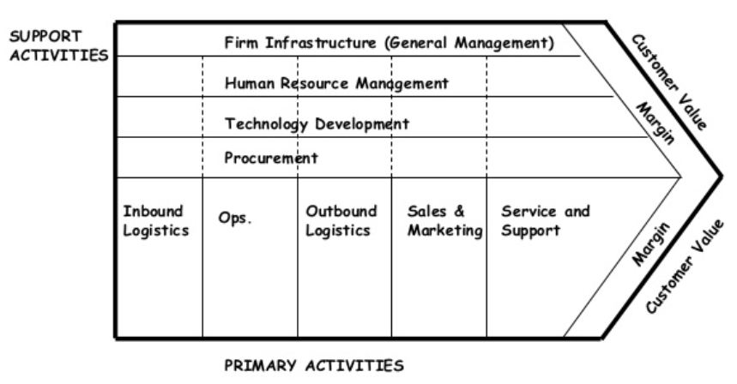
Porter Value Chain Model
Porter Value Chain Models
SAP Business Maps
Competitive Advantage
Michael E. Porter’s Competitive Advantage

Slide 10
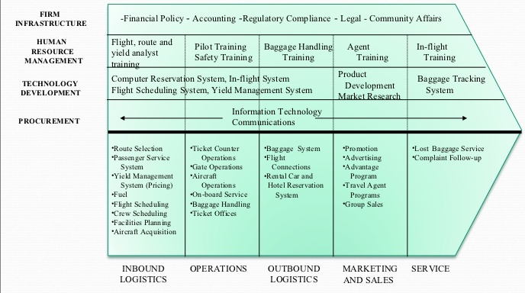
Porter Value Chain Model
Sub-Processes
Functional Units
Support Activities (Processes)
Primary Activities (Processes)
B2B e-marketplaces in the airline industry: Process drivers and performance indicators

Slide 11
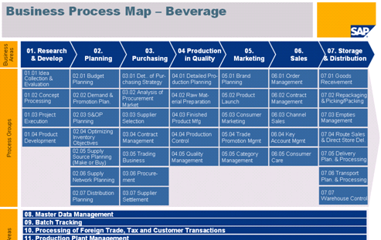
SAP Business Maps
Primary Activities (Processes)
Sub-Processes
Support Activities (Processes)

Slide 12
Process Architecture Framework
Reflect
What components do both frameworks contain?
Departments or Functional units, business areas (primary and supporting activities) or Business processes, categories of processes, levels, and external stakeholders.
Design considerations for Process architectures
Functional units
Processes
Levels

Slide 13
Process Architecture
Process Executive Modeling
Define Functional units
Define value chains / processes
Process Hierarchy Modeling
Depict 2-3 levels
Define level3 processes
Depict sub-processes and tasks
Executive Model
Hierarchy Model

Slide 14
Functional Units (1/3)
Process Architecture
Functional units helps operate the process.
Multiple functional units may collaborate to administer these processes.
Examples: HRM, Accounting, IT, Legal Office, Public Relations, etc.
Process Ownership is important to identify
Responsibility for performing the process or task
Accountability/approval authority for the results achieved by the process or task
Functional units
Processes
Levels

Slide 15
Processes (2/3)
Process Architecture
Core Process (Value Chain, Primary)
Embody critical corporate expertise
Produce products and services that are delivered to external customers
Supporting Process (Supplementary, Secondary)
Facilitate the operation of the core processes
Provide outputs which are inputs to core processes
Management Process (Regulations)
Provides directions, rules and best practices.
Plan, measure, control and meet the margins
Sub-process
Smaller process within a core or supporting process
Functional units
Processes
Levels

Slide 16
Relationship between 3 types of processes
Sign Contracts
Establishing Sources procedure
Evaluate Vendors
Management processes
Plan vendor process
Fill order process
Core Processes
Receive Order
Approve Order
Fill Order
Deliver Order
Order Supplies
Receive Supplies
Stock Supplies
Reorder Supplies process
Support Processes

Slide 17
Process example: Insurance Company
Management processes
Supporting processes
Policy Servicing, Agent management, Claims Management
Finance/Treasury
Legal/Audit
IT
HR
Risk assessment and management
Underwriting management
Payments collection, disbursements
Strategic management
Corporate development
Market Development
Investor Relations
Core processes

Slide 18
Enterprise Business Processes
Activity 10.1
Categorise the business processes in Singapore Management University. Map the given list of processes into Management, Core and Support
~10 minutes

Slide 19
List of Processes
Activity 10.1
Security management, Outreach and marketing, Admission, Curriculum design, Faculty management, Strategic management, Research management, Research labs management, Student services, Faculty services, HR, IP Management, Curriculum management, Professional courses management, industry collaboration, IT, Facility management, Teaching curriculum courses, Teaching professional courses, Student management, Research labs regulations, Fund Raising

Slide 20
Categorise the Processes
Core processes
Supporting processes
Management Processes

Slide 21
Solution 10.1
Management Processes
Fund Raising, Industry collaboration, IP Management, Outreach and marketing, Professional courses management, Research labs regulations, Strategic management
Core processes
Admission, Curriculum design, Curriculum management, Faculty management, Research labs management, Research management, Student management, Teaching curriculum courses, Teaching professional courses
Supporting processes
Facility management, Faculty services, HR, IT, Security Management, Student services

Slide 22
Levels (3/3)
Process Architecture
Two ways to represent the levels:
In Process Executive diagram
2-3 Levels
In Process Hierarchy diagram
Beyond 3 levels
Determining the numbers of levels is based on:
Complexity of the business value chains
Amount of information available
Resources and time
Size of the organization
Functional units
Processes
Levels

Slide 23
Putting all together
Process Architecture
Functional Units
Processes
Levels
Executive Model
Process Executive Modeling
Define Functional units
Define value chains / processes
Process Hierarchy Modeling
Depict 2-3 levels
Define level3 processes
Depict sub-processes and tasks
Hierarchy Model

Slide 24
Process Executive Model – Template
Source: Adapted from eTOM and Paul Harmon
Functional Unit
Functional Unit
Functional Unit
Functional Unit
Level 1
Core Process 1
Level 1
Core Process 2
Level 3
Level 2
Sub-Process 1
Sub-Process
Sub-Process
Sub-Process
Sub-Process
Sub-Process
Sub-Process
Level 2
Sub-Process 2
Executive Model
Supporting Process 1

Slide 25
Executive Model Example: Logistics Domain
Functional Units
Core process
Support process
How many levels?
Notes:
This needs domain experience. However you can make some guess if needed.
3 levels

Slide 26
Need of Process Hierarchy Model
Process Hierarchy Model
Shows the hierarchy of sub-processes in the Executive model that are related to a process along with descriptions
Process executive model usually depict only till level 3 mainly to manage the complexity of the diagram
For higher levels, Process Hierarchy models are used.

Slide 27
Process Hierarchy Model : Template
Process
(L3)
Lx – Level x
Sub
-
Process
Sub
-
Process
Sub
-
Process
…
(L4)
(L4)
(L4)
Sub
-
Process
Sub
-
Process
Sub
-
Process
…
(L5)
(L5)
(L5)
Sub
-
Process
Sub
-
Process
(L6)
Sub
-
Process
(L6)
(L5)
Sub
-
Process
Sub
-
Process
(L6)
Sub
-
Process
(L6)
Hierarchy Model
(L5)
Sub
-
Process
Sub
-
Process
(L5)
(L5)

Slide 28
Process Hierarchy Model Example: Order Handling in Logistics
3rd Level sub-process from process executive model
Order Handling
(L3)
Feasibility
Credit
Order
Order
Order
Order
Determination
Authorization
Issuance
Tracking
Completion
Satisfaction
(L4)
(L4)
(L4)
(L4)
(L4)
(L4)
Feasibility
Credit
Order
Status
Change
Feedback
Examination
Investigation
Validation
Establishment
Management
Request
(L5)
(L5)
(L5)
(L5)
(L5)
(L5)
Report
Credit
Order
Status Report
Completion
Feedback
Issuance
Approvals
Creation
Generation
Confirmation
Review
(L5)
(L5)
(L5)
(L5)
(L5)
(L5)
Credit Terms
Order
Delay
Payment
Specification
Amendment
Notification
Processing
(L5)
(L5)
(L5)
(L5)
Order
Delivery Date
Cancellation
Re
-
Negotiation
(L5)
(L5)

Slide 29
Process Architecture
Discussions
Watch the video and answer the questions given.
Why and what is inside it?
https://www.youtube.com/watch?v=TzTP17kv7eE
~15 minutes

Slide 30
Discussion Questions
Process Architecture
Why is process architecture/hierarchy map needed for an organization?
Examples of benefits.
What problems are associated with developing such a Process Architecture?
What should be done by the organization to use it?

Slide 31
Why is process architecture/hierarchy map needed for an organization?
Solution: Process Architecture
Process hierarchy is about knowledge and understanding. It will reveal what recurrent tasks we’re doing well, what could be better, where our blind spots are (the things we’re not seeing), places we could improve customer experience, where to eliminate waste, and even where economic, market and reputational risk could lie.

Slide 32
Examples of benefits
Solution: Process Architecture
By recording your processes, you give your employees a common language and a clear understanding of their responsibilities.
Incrementally improve the processes happening across your business, reducing waste and increasing effectivity.

Slide 33
What problems are associated with developing such a Process Architecture?
Solution: Process Architecture
Time consuming, everyone in an organization is fire fighting all the time!
Not easy to get the accurate picture in a large organization
Employee do not see the need
Sharing will highlight weakness which people dislike
Maintenance issues, too much details
No immediate ROI (key)

Slide 34
What should be done by the organization to use it?
Solution: Process Architecture
Must be a commitment from Top Management
Should be considered strategic advantage
Some organizations create the BPM Centre of Excellence

Slide 35
Architectures/Frameworks
Industry Process
eTOM (Enhanced Telecom Operations Map)
Telecoms industry
eTOM Video
http://www.tmforum.org/
SCOR (Supply Chain Operations Reference)
Supply Chain Management
http://www.supply-chain.org/
PCF (Process Classification Framework)
American Productivity and Quality Center (APQC)
PCF Video
http://www.apqc.org/process-classification-framework
SAP Business Maps
Industry Business Processes

Slide 36
In class activity
Class Activity
BPAS Teaching CASE-PART 5 (60 min)
Concept Solution Blueprinting - Micro Insurance CLAIMS business process management project.
Student Task (60 mins):
Complete student activity task – Project groups
Please submit the answers in class to eLearn

Slide 37
Class Reflection
Class Reflection
Reflect about module 10 and Case Study 5
Please submit your individual reflection at:
https://smu.sg/BPAS-Reflection
37

