Slide 1
LEAVE APPLICATION SYSTEM

Slide 2
OBJECTIVE
To make it easier for employees to request for a time off from their work to do personal matters such as having a child or for a medical treatment.

Slide 3
SCOPE
Focused on employee to apply their time off

Slide 4
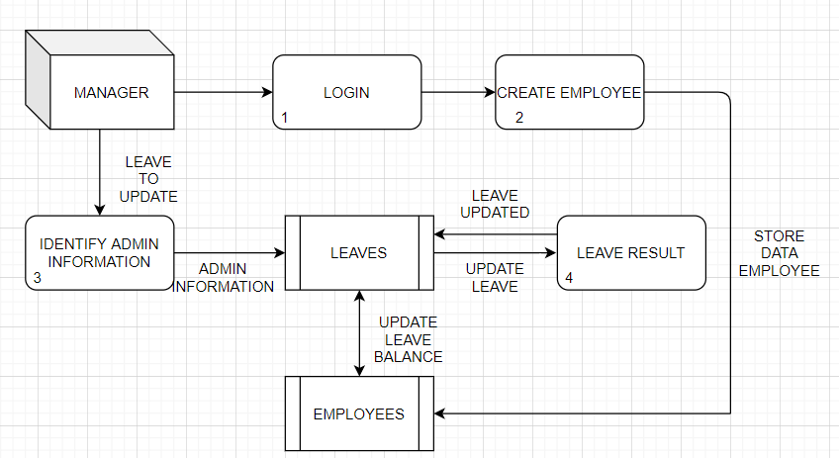
DFD (ADMIN)

Slide 5
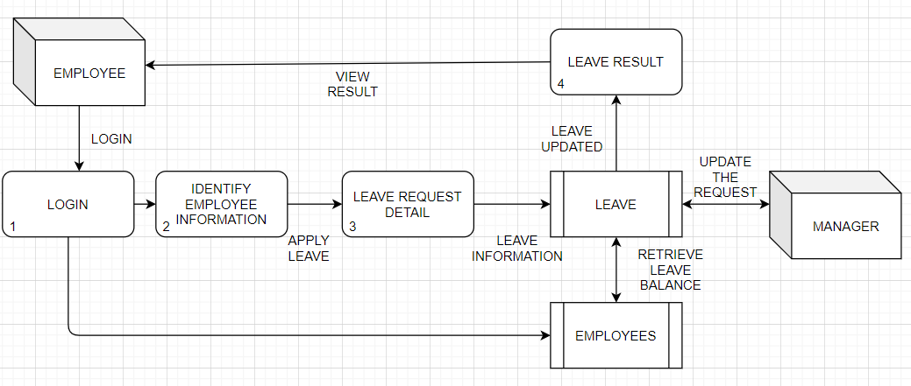
DFD (EMPLOYEE)

Slide 6
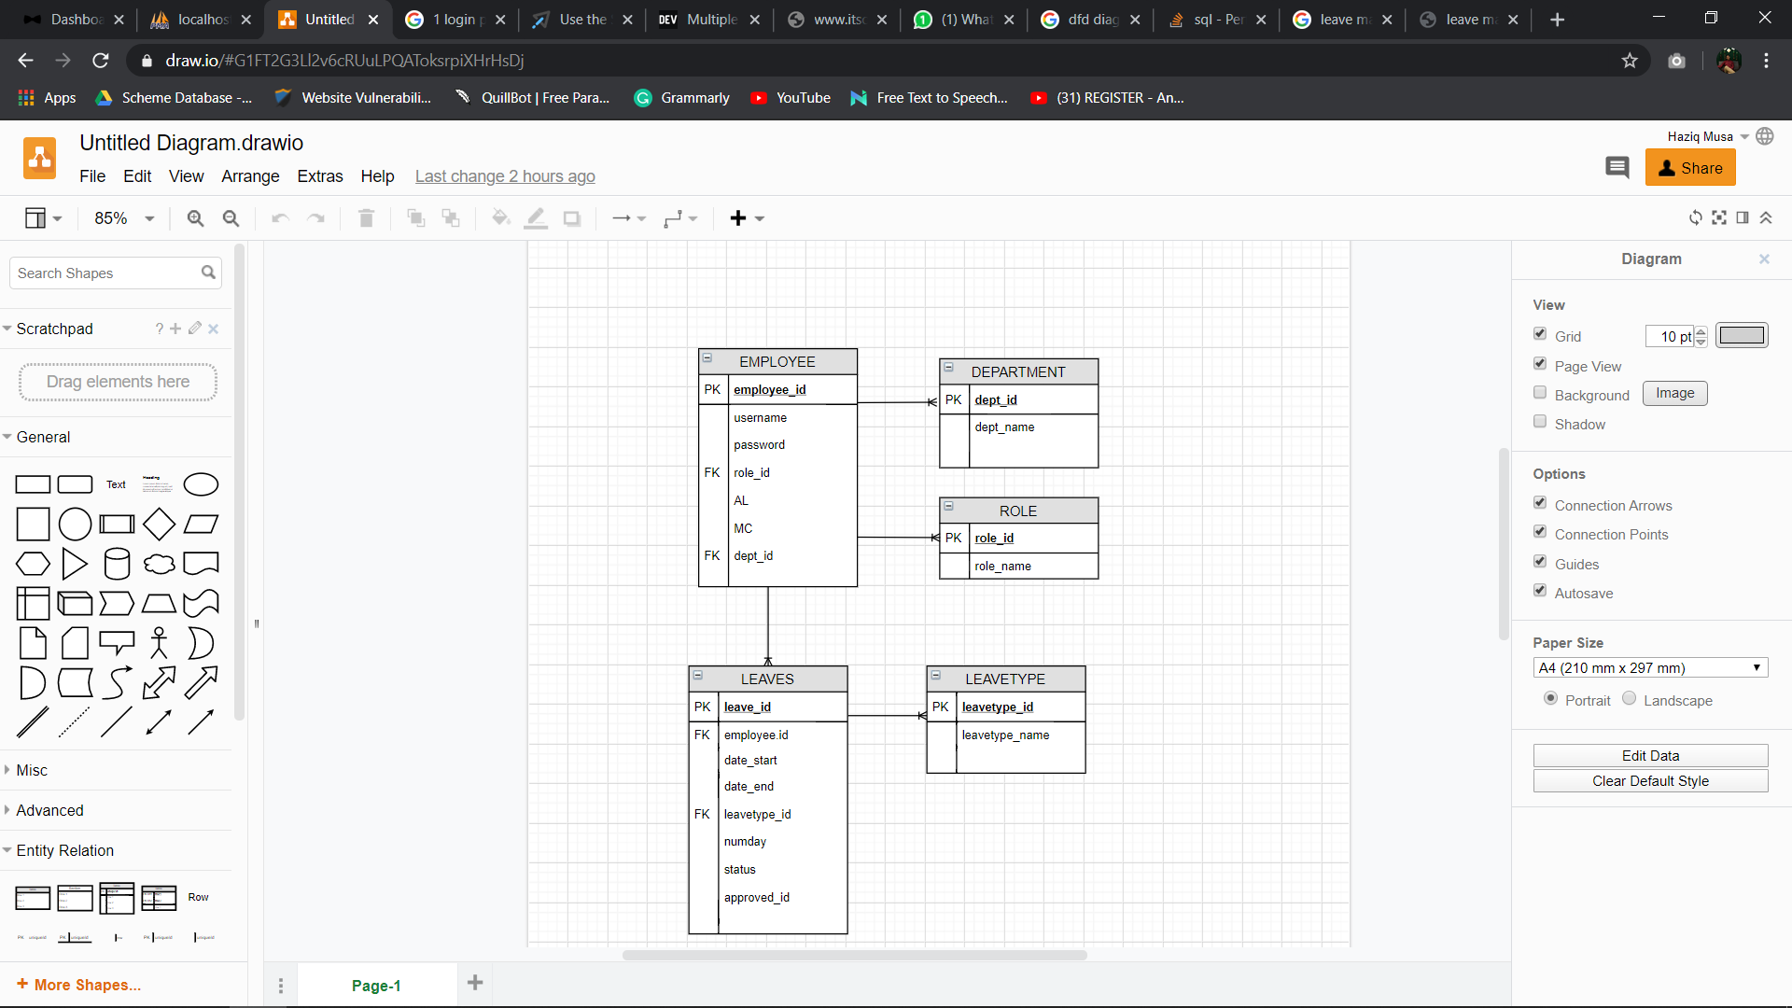
ERD

Slide 7
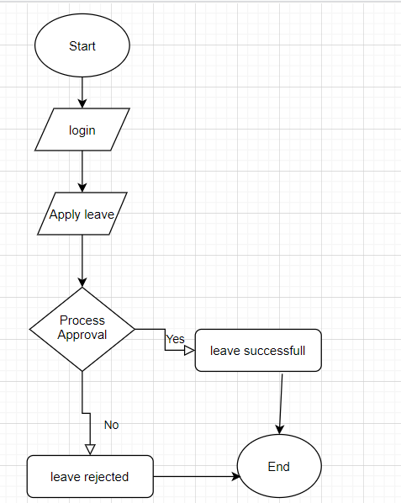
Flowchart

