Slide 1
Executive Summary
1 / 16
Objective: predict whether the Falcon 9 first stage will land successfully.
Data sources: SpaceX REST API and historical launch-record web scraping.
Workflow: data wrangling → EDA → SQL → Folium → Plotly Dash → classification.
Dataset: 90 Falcon 9 launch records, 3 launch sites, 11 orbit types.
Best model: Decision Tree — 80.6% cross-validated accuracy, 66.7% held-out test accuracy (n=18).
Key result: flight experience, payload mass and orbit type are the strongest predictors of landing success.
IBM Applied Data Science Capstone | SpaceX Falcon 9

Slide 2
Introduction
2 / 16
SpaceX reduced launch cost substantially through first-stage reusability.
For a competing launch provider, predicting first-stage recovery supports cost and mission planning.
Research question: can public launch characteristics predict first-stage landing success?
Key variables: payload mass, orbit, launch site, flight number, booster reuse and landing outcome.
Problem framing: binary classification — Class 1 = successful landing; Class 0 = unsuccessful / not recovered.
IBM Applied Data Science Capstone | SpaceX Falcon 9

Slide 3
Methodology
3 / 16
1. Collect launch records from the SpaceX REST API.
2. Web-scrape Falcon 9 / Falcon Heavy historical launch tables.
3. Clean missing values and create a binary landing-success label.
4. Explore patterns with Pandas, Matplotlib and SQL.
5. Build interactive geospatial and dashboard visualizations.
6. One-hot encode categorical features and standardize model inputs.
7. Tune Logistic Regression, SVM, Decision Tree and KNN with 5-fold GridSearchCV.
Tools
Python · Pandas · NumPy · BeautifulSoup · SQLite · Folium · Plotly Dash · scikit-learn
IBM Applied Data Science Capstone | SpaceX Falcon 9

Slide 4
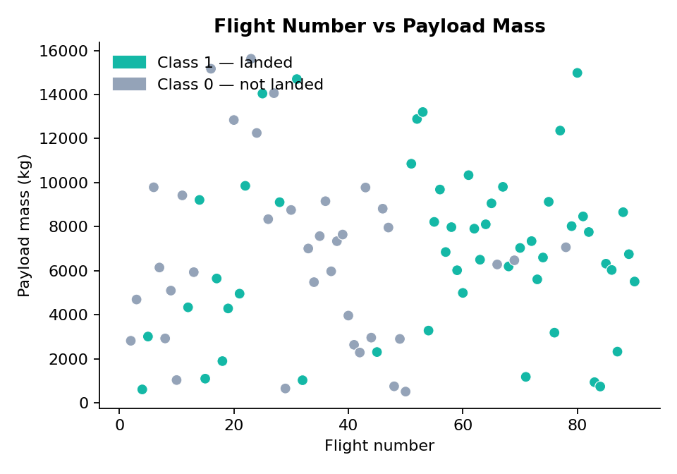
Data Collection — SpaceX API
4 / 16
GET requests retrieve launch history and associated rocket, payload, core and launch-site data.
Flow: GET /v4/launches → parse JSON → join rocket/launchpad/payload lookups → DataFrame.
Dataset filtered to Falcon 9 launches for consistent first-stage analysis.
Core fields: booster version, payload mass, orbit, launch site, landing outcome, reuse count, coordinates.
Result: 90 Falcon 9 records, 13 principal fields before the Class label.
IBM Applied Data Science Capstone | SpaceX Falcon 9

Slide 5
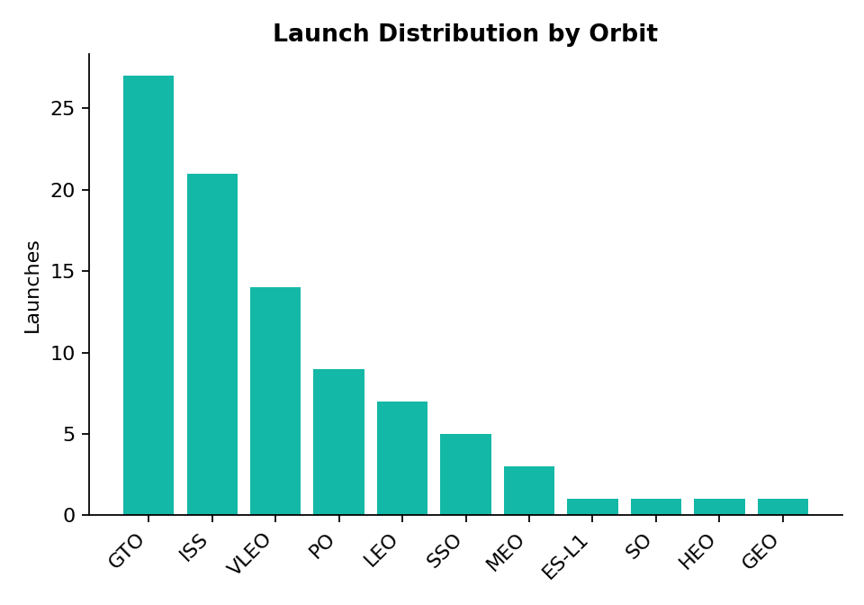
Data Collection — Web Scraping
5 / 16
BeautifulSoup parses historical Falcon 9 / Falcon Heavy launch tables from Wikipedia.
Flow: fetch page HTML → locate wikitable → iterate rows → extract date, site, payload, orbit, outcome.
Row-by-row parsing handles footnote references and inconsistent table formatting.
Scraped records provide an independent source for cross-checking the API dataset.
IBM Applied Data Science Capstone | SpaceX Falcon 9

Slide 6
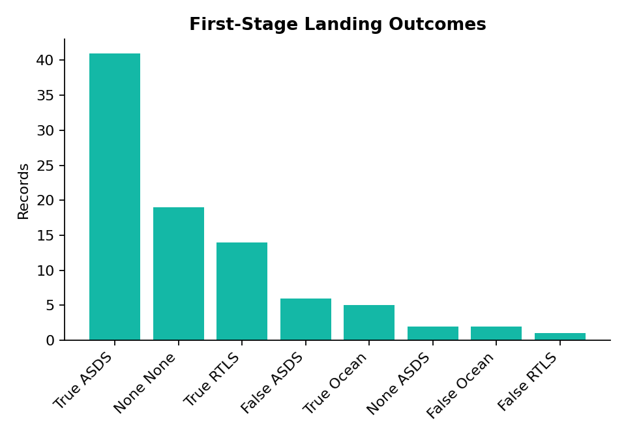
Data Wrangling & Processing
6 / 16
Falcon 1 records removed; Falcon 9 records retained.
Missing payload-mass values imputed with the column mean.
Missing LandingPad values retained — they represent genuine ocean / no-pad outcomes.
Outcome converted to Class: 1 for successful landing, 0 otherwise.
Categorical variables one-hot encoded for modeling.
Feature-engineered dataset: 90 observations, expands to 20+ numeric features after encoding.
IBM Applied Data Science Capstone | SpaceX Falcon 9

Slide 7
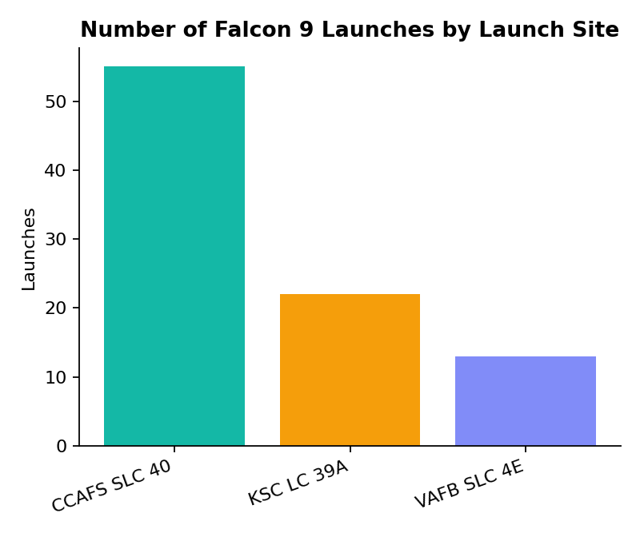
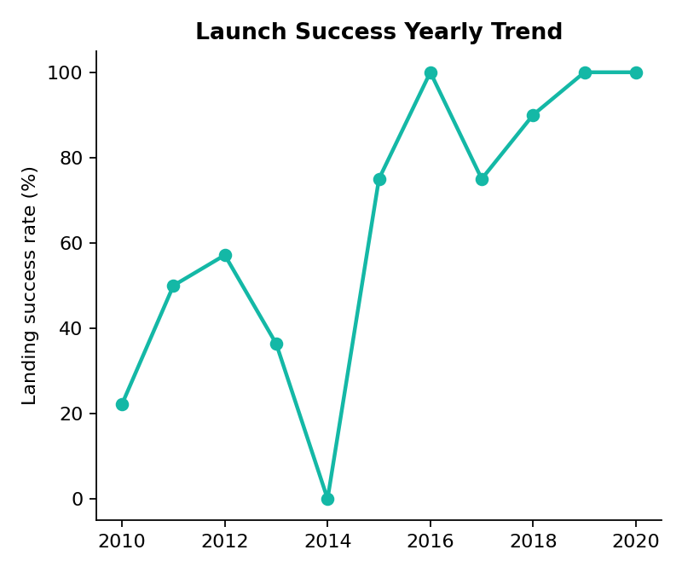
EDA with Data Visualization
7 / 16
Launch activity concentrated at CCAFS SLC 40 (55), then KSC LC 39A (22) and VAFB SLC 4E (13).
GTO is the most frequent orbit (27), followed by ISS (21) and VLEO (14).
Early flights contain most unsuccessful landings; success improves strongly with flight experience.
Lower-to-moderate payloads generally show more successful recoveries; GTO is the hardest orbit to recover from.
IBM Applied Data Science Capstone | SpaceX Falcon 9

Slide 8
EDA with SQL
8 / 16
SQLite loads the launch table; 7 analytical queries drive this section.
Distinct launch sites: CCAFS SLC 40, KSC LC 39A, VAFB SLC 4E.
NASA (CRS) total payload: 128,115 kg.
Average payload for Block 5 boosters: 6,486 kg.
First successful landing on record: 2010-01-08 (dataset start).
SELECT SUM(PayloadMass)
FROM SPACEXTABLE
WHERE Customer = 'NASA (CRS)';
Example query — full query set in the SQL notebook
IBM Applied Data Science Capstone | SpaceX Falcon 9

Slide 9
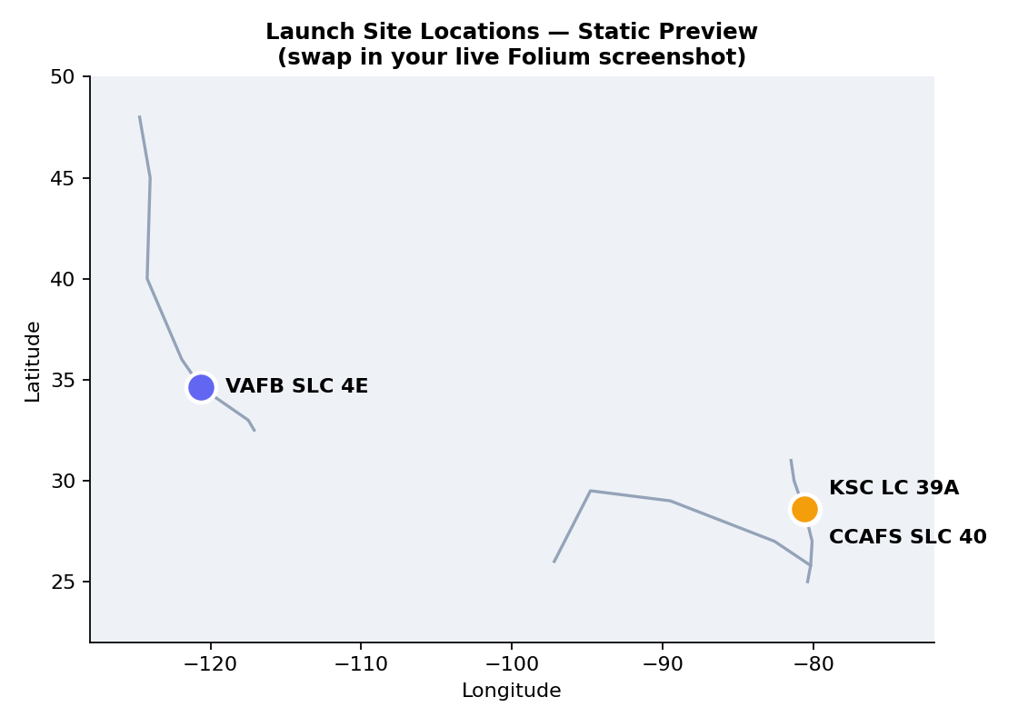
Interactive Visual Analytics — Folium
9 / 16
Interactive map marks all three Falcon 9 launch sites using latitude/longitude.
MarkerCluster groups nearby records for exploration at different zoom levels.
Proximity circles/lines relate each pad to the coastline and nearby infrastructure.
Finding: all three sites are coastal, consistent with safety corridors for launch and stage recovery.
Static geographic preview — generate the live interactive version with folium_map.py
IBM Applied Data Science Capstone | SpaceX Falcon 9

Slide 10
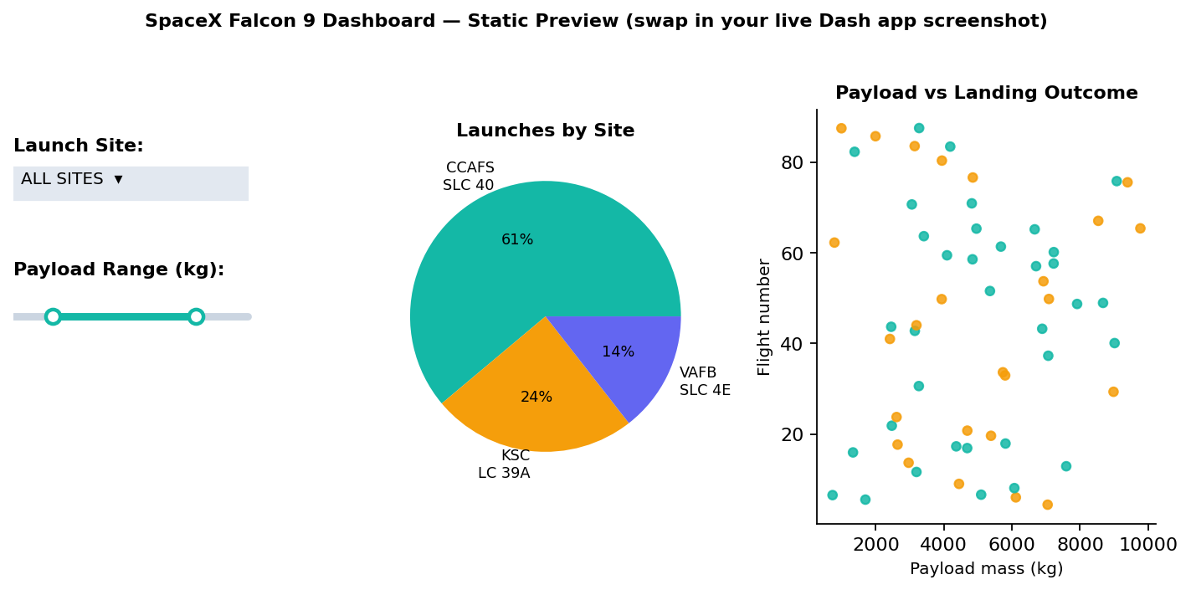
Interactive Visual Analytics — Plotly Dash
10 / 16
Dashboard controls: launch-site dropdown and payload-mass range slider.
Pie chart updates live to show landing-outcome distribution for the current selection.
Scatter plot relates payload mass, flight number and landing outcome.
Callbacks make every chart respond to the user's site and payload-range choice.
Static composite preview — generate the live app with dash_app.py
IBM Applied Data Science Capstone | SpaceX Falcon 9

Slide 11
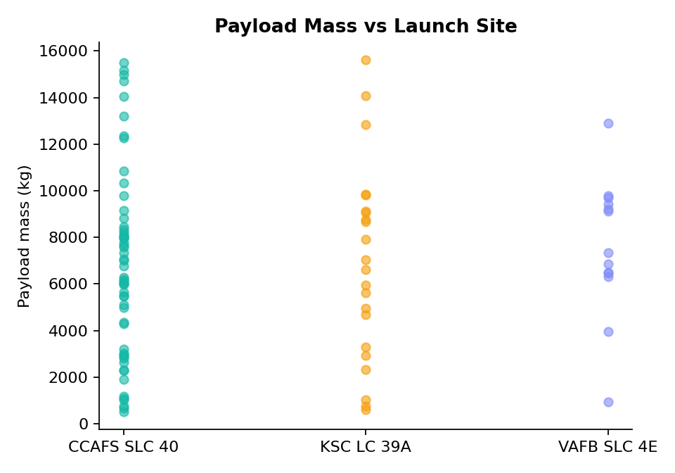
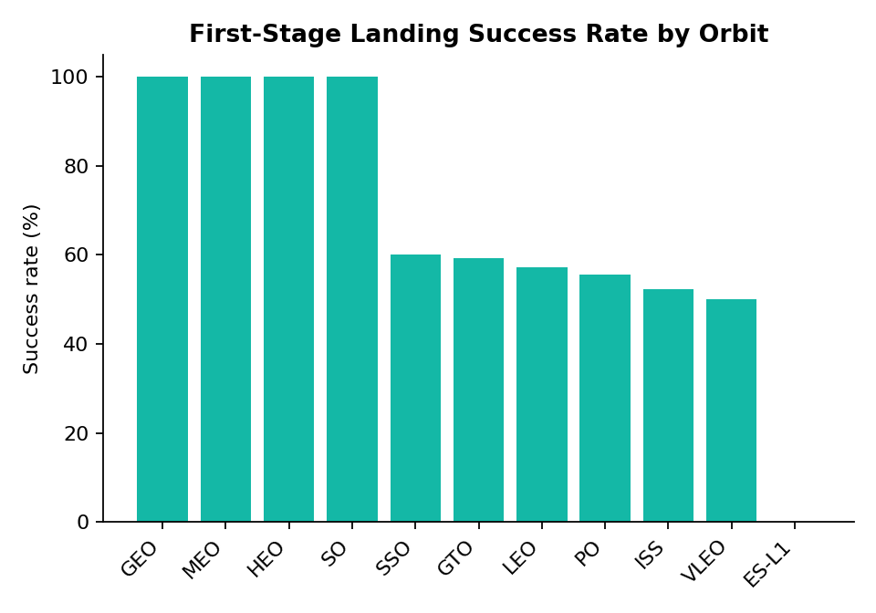
Required EDA Results
11 / 16
Flight number vs payload mass: later flights show a much stronger landing-success pattern.
Payload vs launch site: distributions differ by site; VAFB historically carries lighter payloads.
Success rate vs orbit: ES-L1, GEO, HEO and SSO show the strongest rates; GTO is comparatively difficult.
Flight number vs orbit: LEO success improves visibly with flight experience.
Yearly trend: landing reliability rises markedly across the dataset's history.
IBM Applied Data Science Capstone | SpaceX Falcon 9

Slide 12
SQL Results — Launch Analytics
12 / 16
Query | SQL | Result
NASA (CRS) total payload | SUM(PayloadMass) WHERE Customer='NASA (CRS)' | 128,115 kg
Avg. payload, Block 5 | AVG(PayloadMass) WHERE Block=5 | 6,486 kg
First successful landing | MIN(Date) WHERE Outcome LIKE 'True%' | 2010-01-08
Drone-ship landings, 4–6k kg | WHERE Outcome='True ASDS' AND PayloadMass BETWEEN 4000 AND 6000 | 12 boosters
Success vs failure split | GROUP BY (Outcome LIKE 'True%') | 60 success / 30 failure
IBM Applied Data Science Capstone | SpaceX Falcon 9

Slide 13
Folium Map — Launch Markers & Proximity
13 / 16
CCAFS SLC 40 — 55 launches.
KSC LC 39A — 22 launches.
VAFB SLC 4E — 13 launches.
Live map uses OpenStreetMap tiles, clustered markers and proximity circles (see folium_map.py).
Geospatial context: all three sites are coastal, positioned for controlled flight corridors.
IBM Applied Data Science Capstone | SpaceX Falcon 9

Slide 14
Plotly Dash — Payload & Outcome Analysis
14 / 16
Site dropdown filters the dashboard to an individual launch facility or all sites.
Payload-range slider filters missions from 0–16,000 kg.
Pie chart summarizes landing outcomes for the current selection.
Scatter plot reveals how payload mass and flight history relate to landing outcome.
Turns the static EDA into an interactive decision-support interface (see dash_app.py).
IBM Applied Data Science Capstone | SpaceX Falcon 9

Slide 15
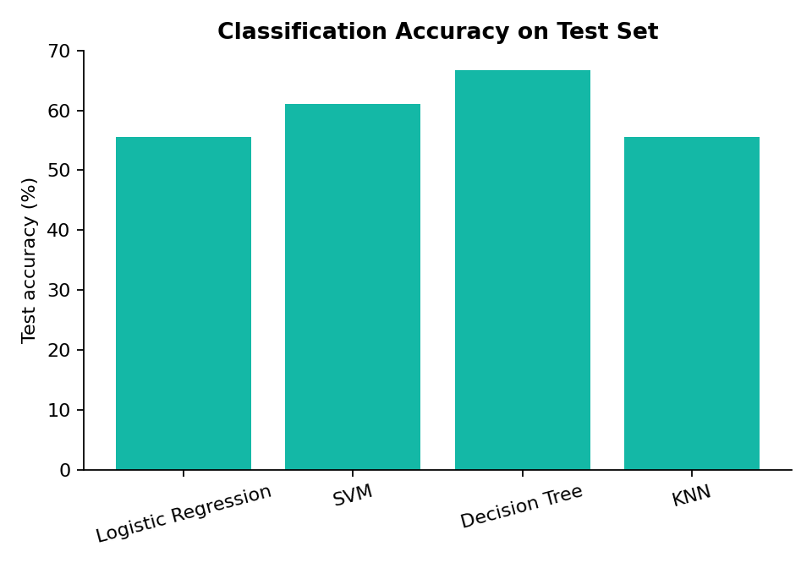
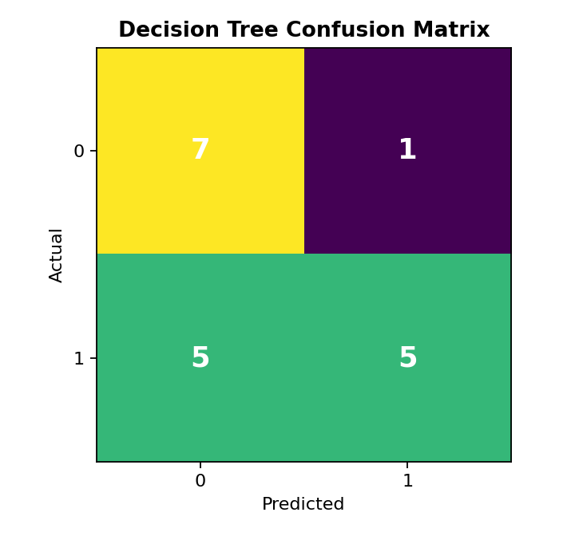
Predictive Analysis — Classification
15 / 16
Train/test split: 80/20, stratified, 18 held-out test records.
Pre-processing: StandardScaler + one-hot encoded features.
Models tuned with 5-fold GridSearchCV: Logistic Regression, SVM, Decision Tree, KNN.
Decision Tree wins on both metrics: 80.6% CV accuracy and 66.7% test accuracy (max_depth=2).
With only 18 test records each sample is ~5.5% of accuracy — Decision Tree's CV lead is the deciding factor, not the test set alone.
Confusion matrix (Decision Tree): TN=7, FP=1, FN=5, TP=5.
IBM Applied Data Science Capstone | SpaceX Falcon 9

Slide 16
Conclusion
16 / 16
Best model: Decision Tree (max_depth=2) — selected on cross-validated accuracy (80.6%), with the test-set tie among models expected given only 18 held-out records.
Landing success rises sharply with flight number, reflecting SpaceX's iterative hardware and procedure improvements over time.
Payload mass and orbit type matter: GTO missions are consistently the hardest to recover; ES-L1, GEO, HEO and SSO show the strongest success rates.
Business takeaway: a competing launch provider could use payload, orbit, site and reuse count as an early cost-planning signal before committing to a bid.
Limitation: the 90-record dataset caps precision — a larger sample or contract-level telemetry would likely separate the currently tied models further.
Creative extension: combining this classifier with real-time weather and drone-ship telemetry could turn it into a pre-launch go/no-go support tool.
IBM Applied Data Science Capstone | SpaceX Falcon 9

