Slide 1
INTRODUCTION
Operons — arrays of co-expressed and coregulated genes

Slide 2
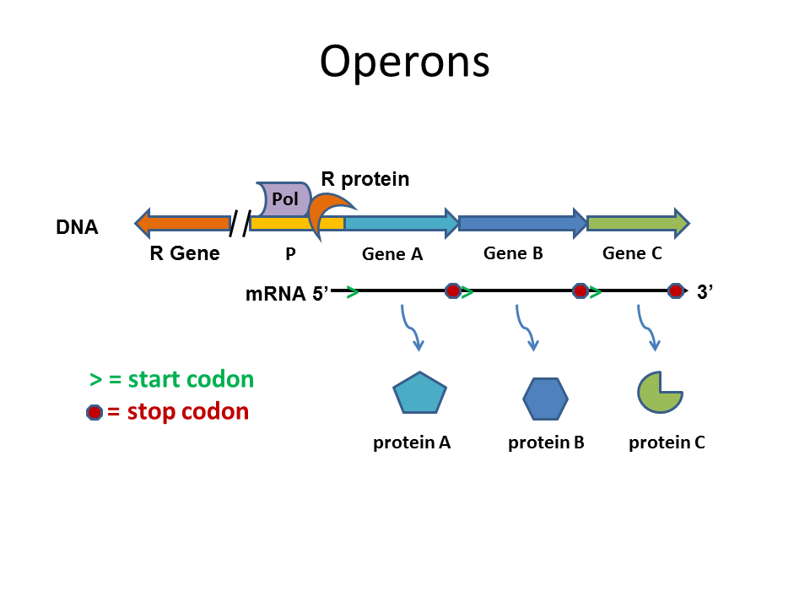
INTRODUCTION
Operons — arrays of co-expressed and coregulated genes

Slide 3
INTRODUCTION
Operons — arrays of co-expressed and coregulated genes
ICITY — protocol to systematic prediction of functionally linked genes in bacterial and archaeal genomes

Slide 4
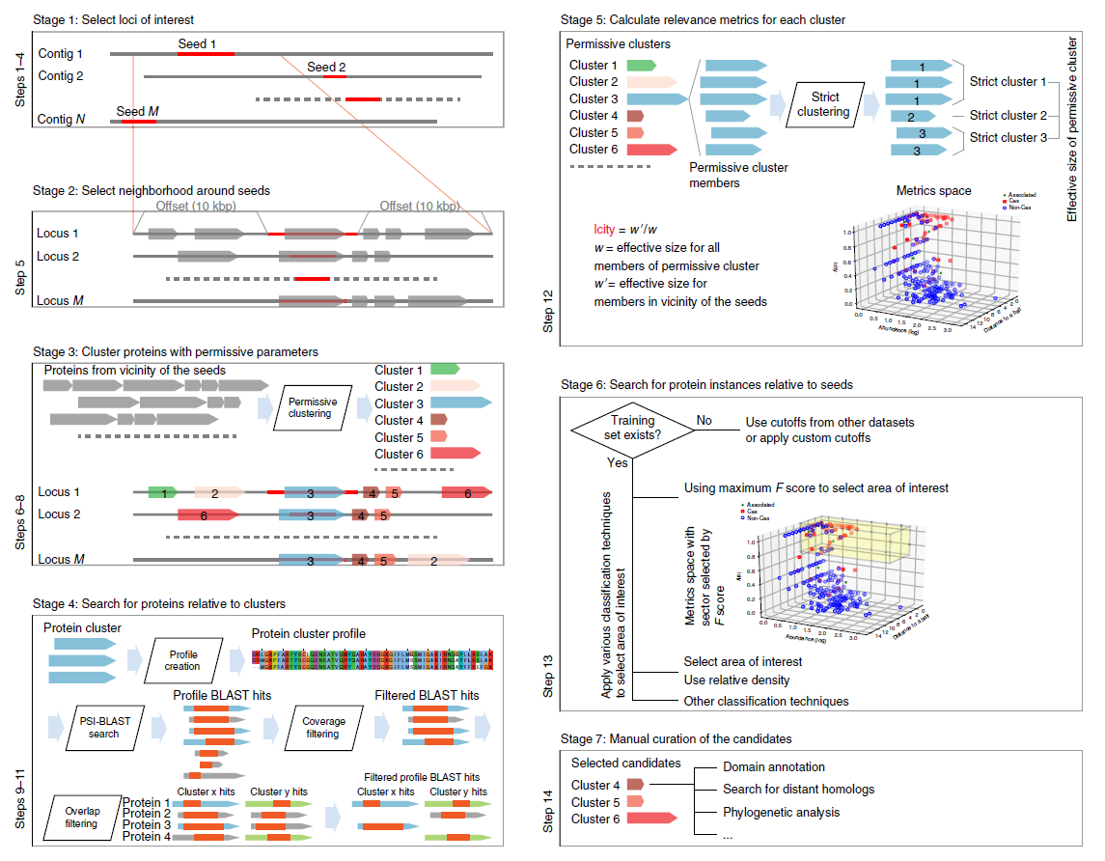
INTRODUCTION
Operons — arrays of co-expressed and coregulated genes
ICITY — protocol to systematic prediction of functionally linked genes in bacterial and archaeal genomes

Slide 5
INTRODUCTION
Operons — arrays of co-expressed and coregulated genes
ICITY — protocol to systematic prediction of functionally linked genes in bacterial and archaeal genomes
DGR —recently discovered operons

Slide 6
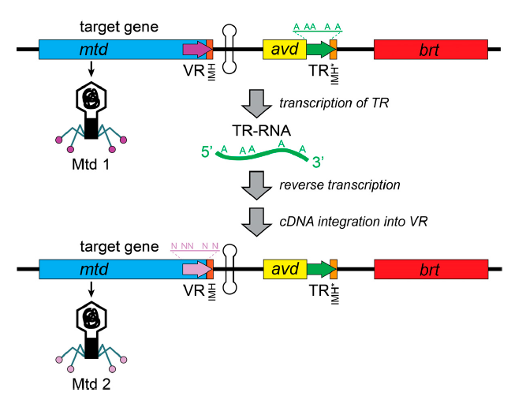
INTRODUCTION
Operons — arrays of co-expressed and coregulated genes
ICITY — protocol to systematic prediction of functionally linked genes in bacterial and archaeal genomes
DGR —recently discovered operons

Slide 7
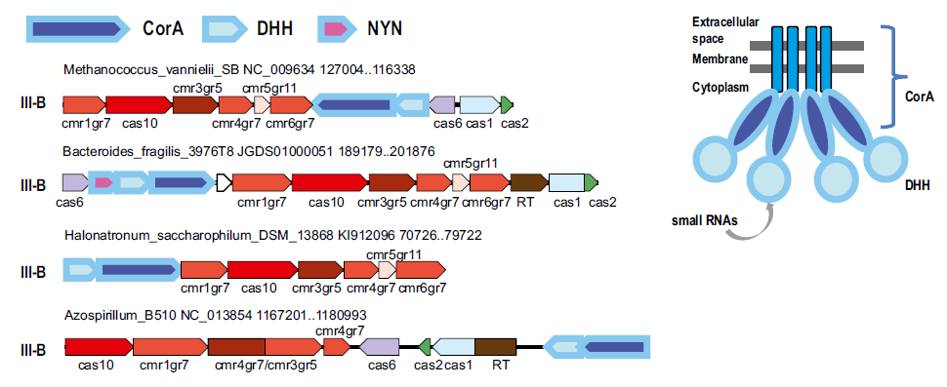
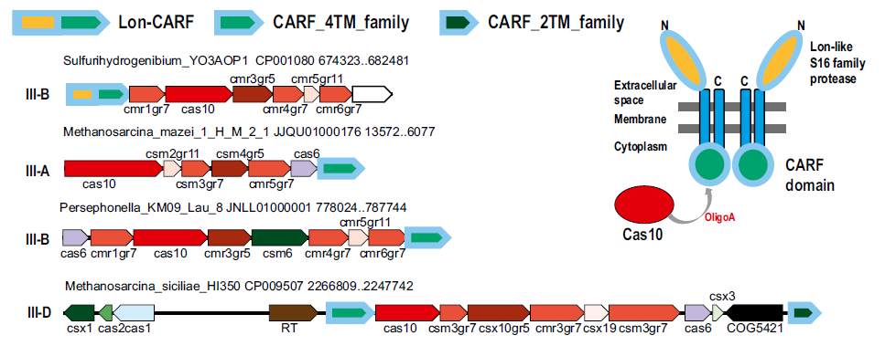
Our results

Slide 8
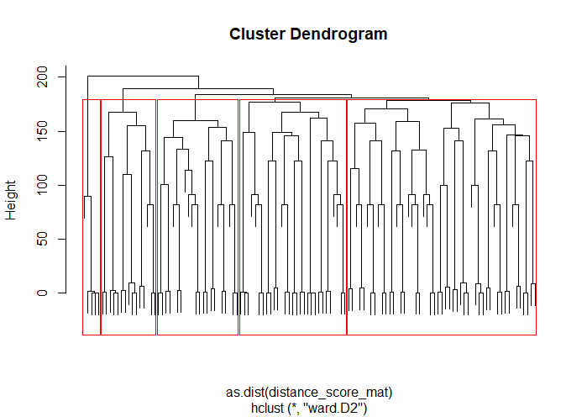
Our results

