Slide 1


Credit Card Fraud Detection
Presented By :
Team: Finance 4
Arindam Hazra
Shivani Srivastava
Varshini VS
Shashank Emani
Abhishek Zope
Prem Veerapaneni

Slide 2
Problem Statement
Credit Card Transaction Analysis & Insights:
Financial Instruction has huge number of Credit Card transactions. How to identify fraudulent transactions(unauthorized).
Identify fraudulent transactions based on historical data
Identify real time transactions and alert customers
Analyze credit card transactions of different customer persona and recommend personalized offers like bill payments, cash back offers etc.
Create customer persona based on demographics, transactions.
Share with Analyst/Data Science team to identify personalized offers

Slide 3
Process Flow
Data Source
(RDBMS/File System)
Data Lake(HDFS)
Consumption
Data Science
Raw Layer
Apache Spark
Prepared
Layer
Apache Spark
Curated
Layer
Analyst

Slide 4
Solution
The solution will be divided into multiple stages:
Collection - Capturing data from different data source consisting of two parts
Batch Data: database, filesystem etc.
Real Time Event Data: mobile, webapp, microservices etc.
Ingestion – Ingesting data in data lake (HDFS)
Batch data load: Sqoop can be used to pull data from relation databases.
Event data: Kafka can be used to manage event streaming data.
Preparation – Our focus is to prepare the dataset for fraud detection by machine learning. Will use Apache Spark SQL to join and transform dataset based on machine learning model build and load the data into data warehouse.
Consumption & Presentation – Data scientist can connect to warehouse and extract required model features(dataset) for building the model. Also, Power BI/Tableau dashboard can be created for analytical use.

Slide 5
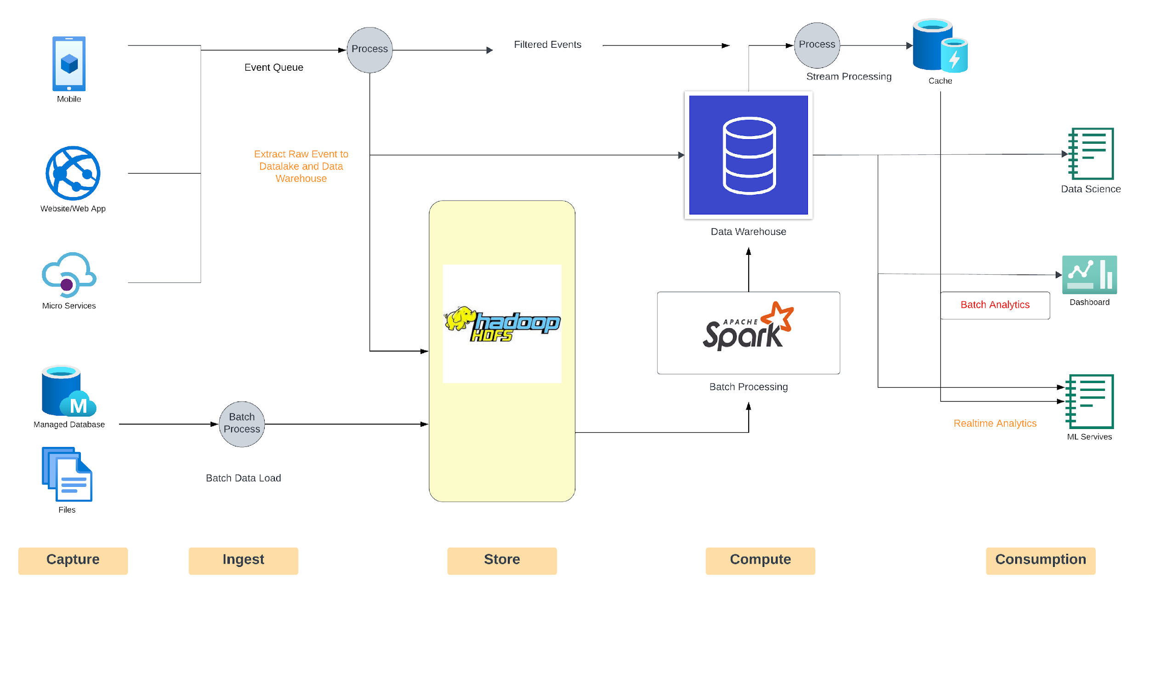
Architecture

Slide 6
Schema & Datasets
Our dataset consists of 5 files:
#transaction_table 'id long, date timestamp, amount string, card string, id_merchant long' #credit_card_table 'card string, id_card_holder long' #credit_card_holder_table 'ID long, name string' #merchant_table 'id long, name string, id_merchant_category long' #merchant_category_table 'ID long, name_category str
File_name | table_name | Schema
transaction.csv | transaction_table | “id long, date timestamp,amount string,card string, id_merchant long”
merchant_category.csv | merchant_category_table | “id long, name_category string”
merchant.csv | merchant_table | “id long, name string, id_merchant_category long”
card_holder.csv | credit_card_holder_table | “id long, name string”
credit_card.csv | credit_card_table | “card string, id_card_holder long”

Slide 7
Transformation & Optimizations
Optimizations:
Will be using broadcast hash join, it will improve our performance while performing joins.
Data which we need frequently we can cache it, to reduce repetitive compute.
We will perform bucketing on card_holder_id’s to improve our query performance
Transformations:
From dataset find credit card holders who have spent more than 1000 in single transaction. Subqueries will be useful for our case.
Data cleaning, handling null values in dataset.
Find total number of days between the first and last transaction of each credit card holder. Will be using DATEDIFF, joins and aggregation functions majorly.
Need year from date column we will use .withcolumn.
Using Window function rank( ) to obtain rank of credit card holders by their total transaction amount, month wise.
Will also be using other transformations like orderby groupby etc.

Slide 8


