Slide 1
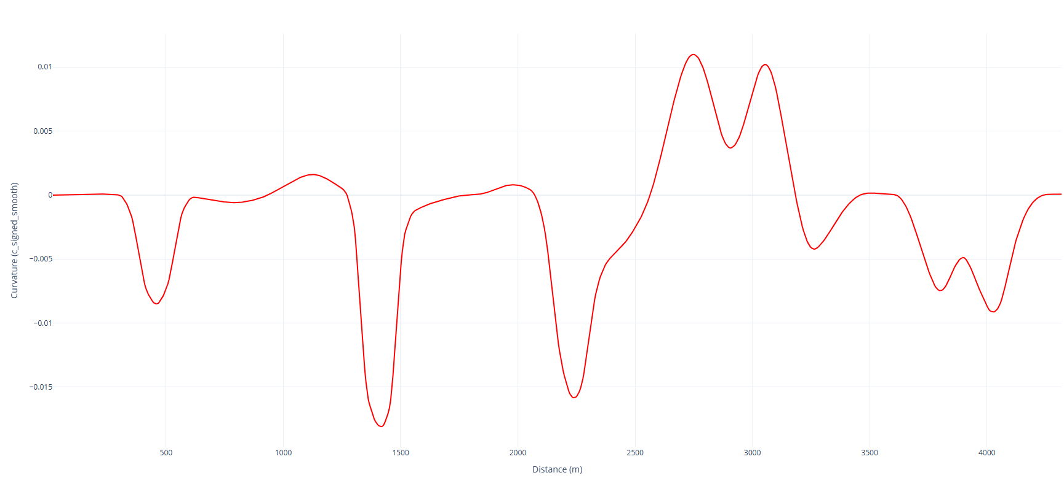
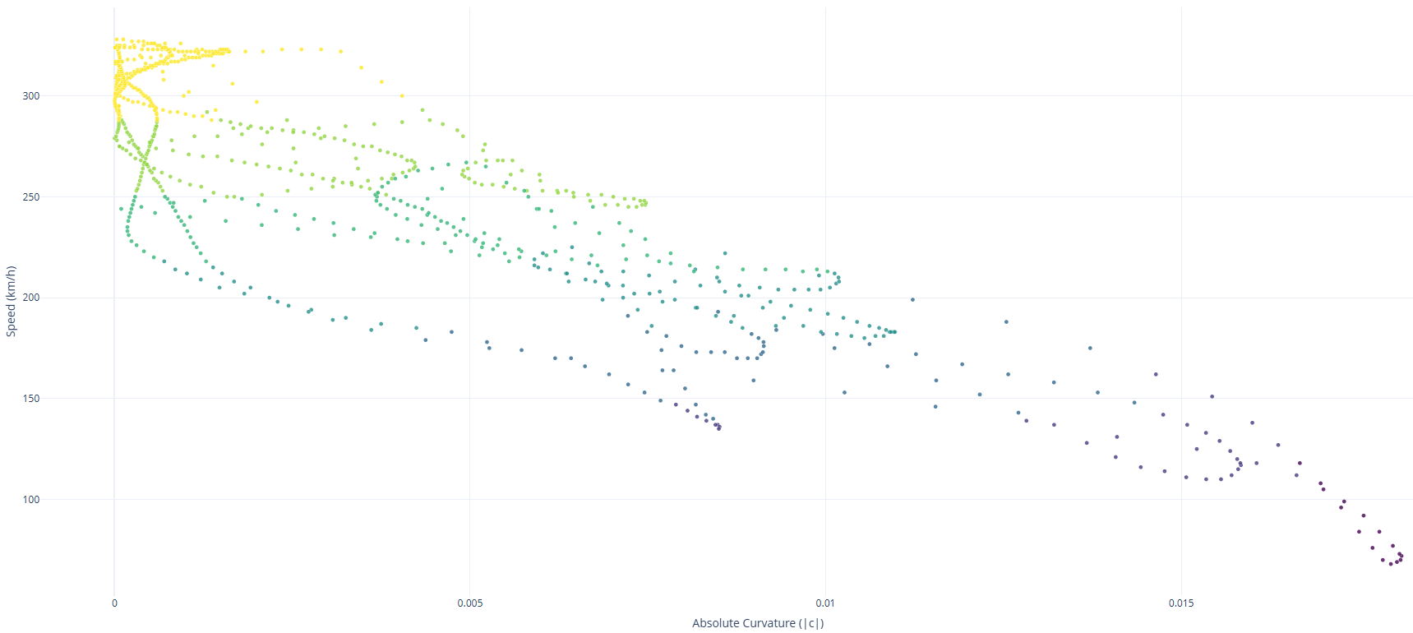
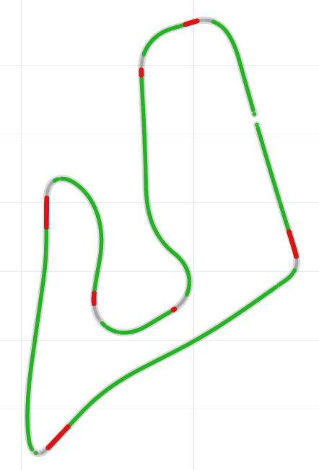
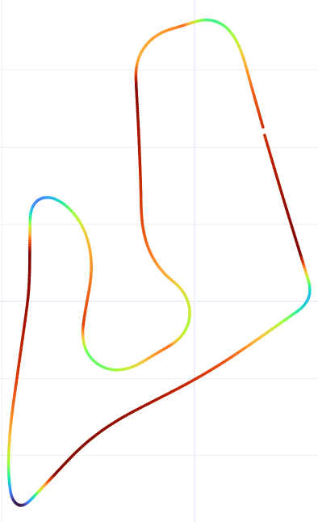
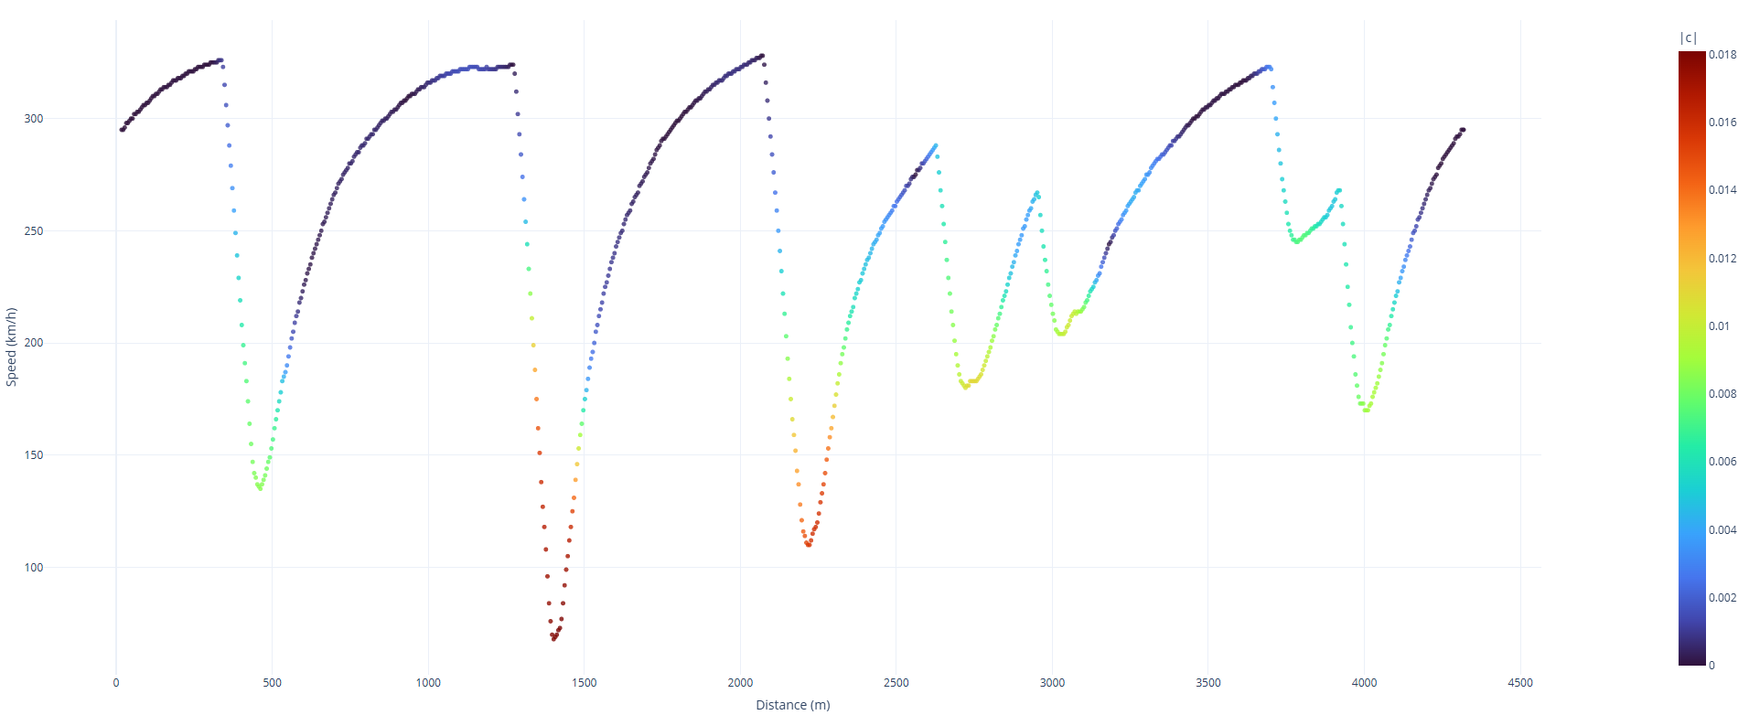
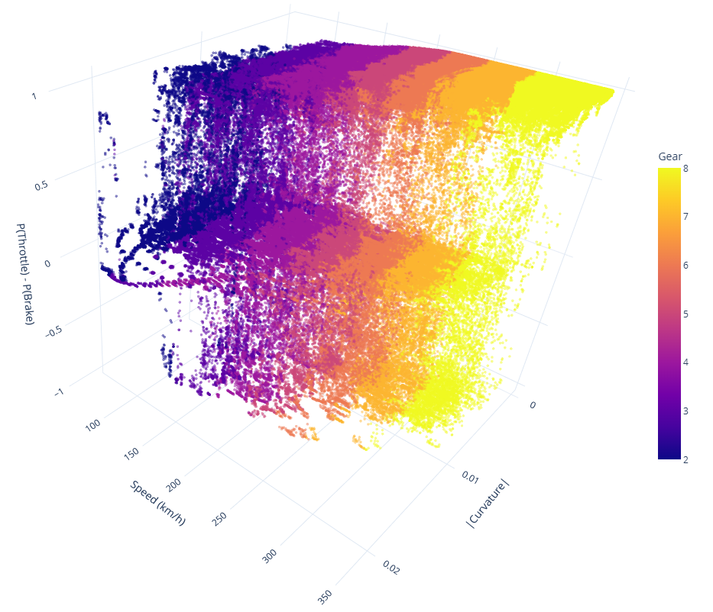
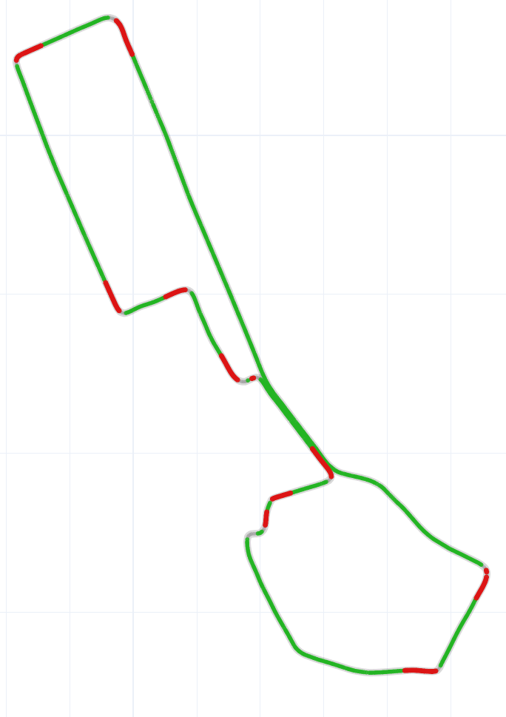
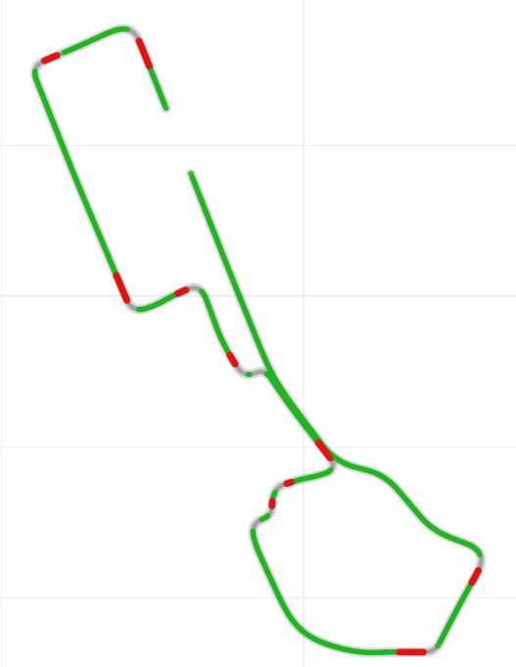
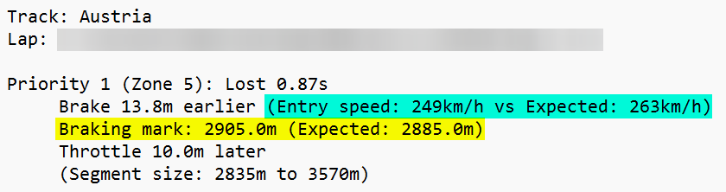
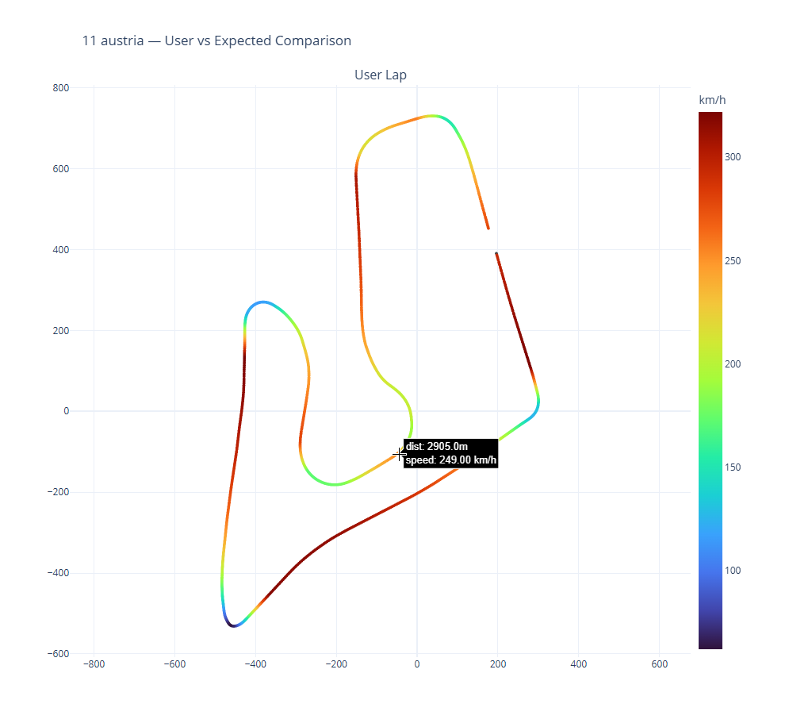
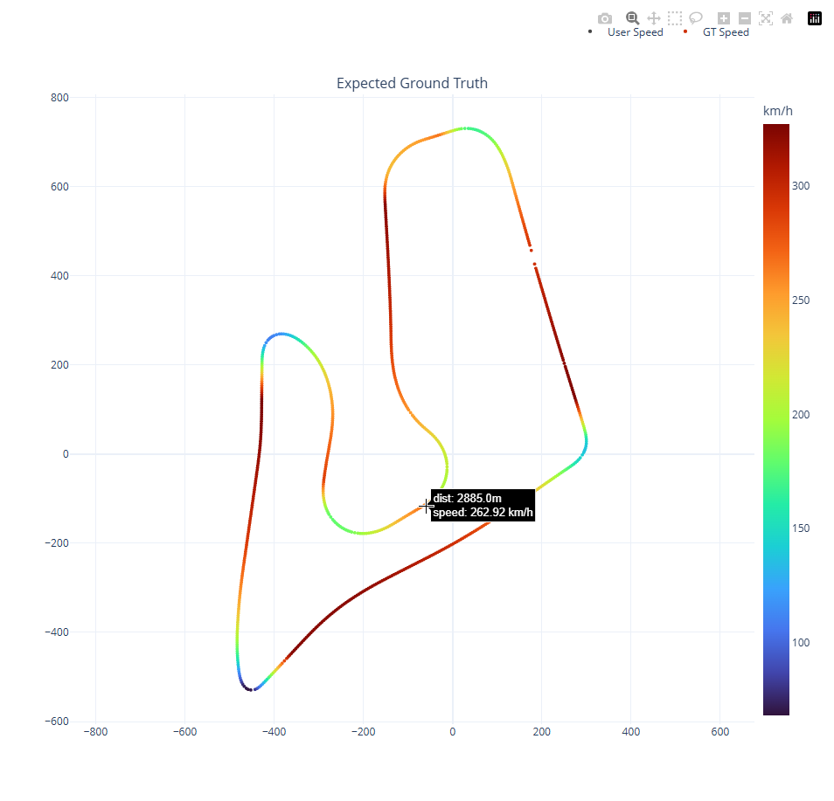
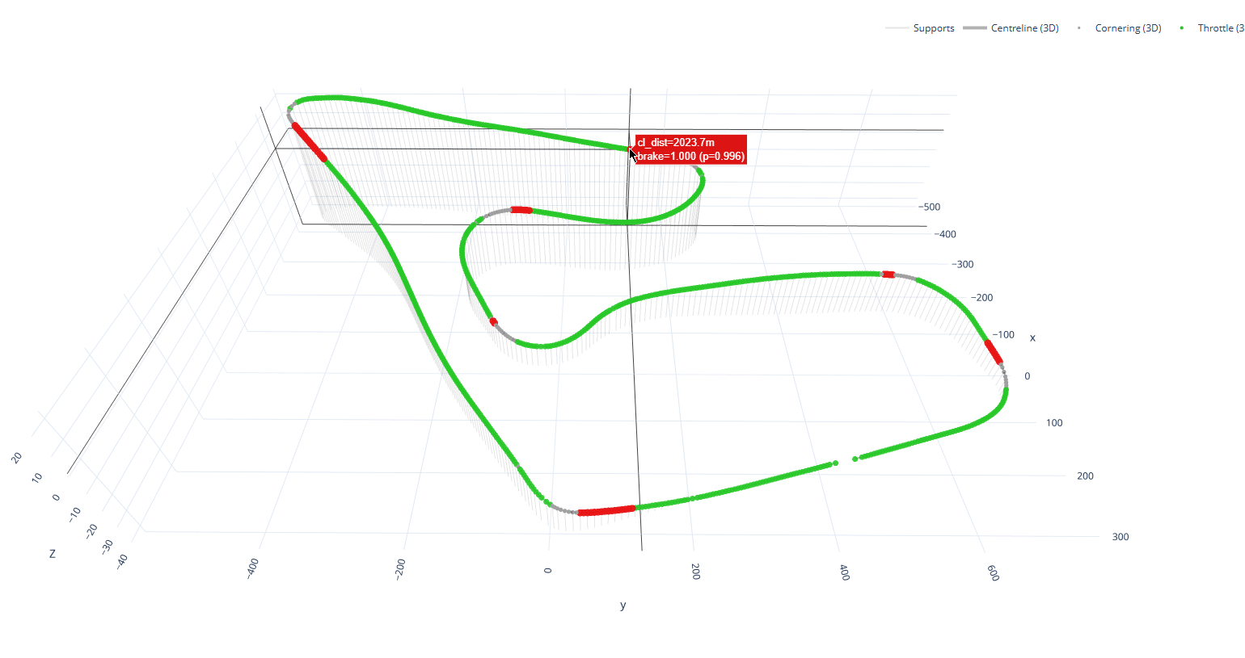
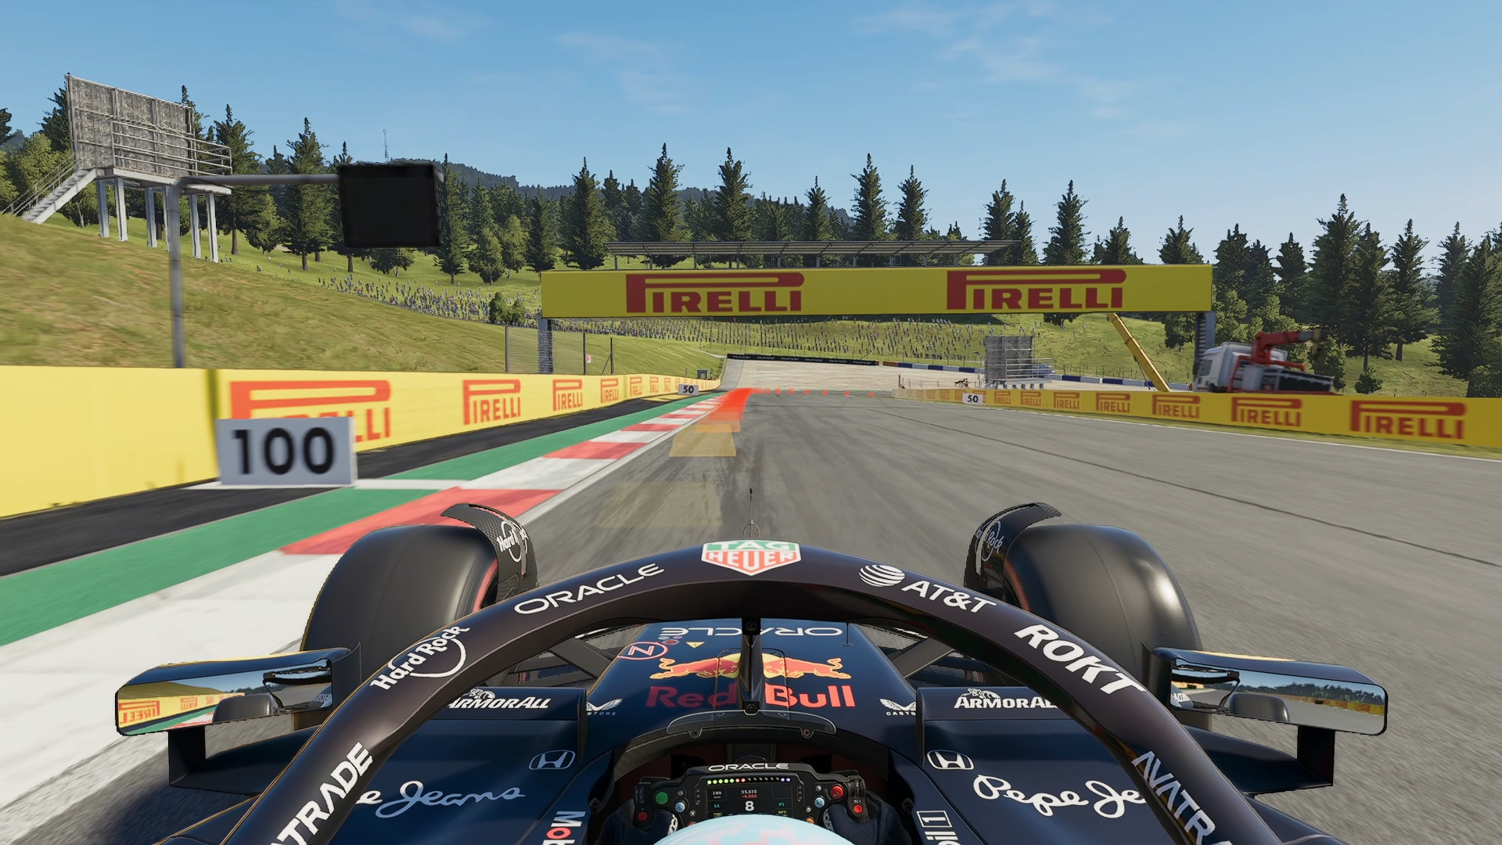

Using Machine Learning to Understand and Enhance Racing Driver Cornering Performance
Harry Gardner University of Exeter
Background & Objectives:
Improving and training the development and consistency of driver performance is crucial for a serious racing team; being able to reduce the human-factor variability of race results can elevate the team’s championship standings over the course of a full season through more consistent point-scoring opportunities. Helping the drivers to become more consistent in both real-life racing and sim racing settings by using the same tools, AI and ML can be utilised for drivers to be able to interpret and incorporate high level feedback without requiring an in-depth knowledge of the aerodynamics and logistics of the car beneath them.
This project aimed to build a ML system capable of extracting driving behaviour features from real Formula One race telemetry as well as sim racing video game telemetry to provide real-time feedback to drivers on how to improve their lap times, with a focus on improving cornering entry and exits.
Plots Generated from the F1 25 Game Model:
All graphs come directly from the game model’s outputs, using the ground truth data for each track on the Grand Prix calendar to produce accurate telemetric expectations for the fastest time trial run.
Data Collection & Preprocessing: Publicly available telemetric data from real Formula One races were accessed using the FastF1 Python library. From here, fast-lap qualifying data from events under dry conditions are taken to form the historical dataset.
AI (CPU) qualifying data from the F1 25 game was harvested using Telemetry Tool by Iko Rein. This was run under conditions with equal performance across all cars, as well as exclusively time-fixed dry conditions to eliminate potential variability.
Preprocessing was applied to all data collected. Historical throttle and braking values were binarised and temporally interpolated to every 0.05s (20hz). Game coordinates were realigned to match real-world values, with its throttle and braking values normalised to 0-1. The data were interpolated to match 5 metre track intervals, appropriate for the 20hz sample intervals, so that comparisons between laps had reliable accuracy.
Data had the following columns: distance, x, y, z, norm_speed, speed, time, throttle, brake, gear, drs, rpm.
Figure 1: Curvature over Distance Plot for the Red Bull Ring (Austria).
Figure 2: Curvature vs Speed scatter plot for the Red Bull Ring (Austria).
Figures 3 & 4: Car State and Speed plots for the Red Bull Ring (Austria).
Figure 5: Speed vs Distance scatter plot for the Red Bull Ring (Austria), coloured by curvature.
Data Points Visualised – F1 25 Circuits*:
Model Training & Optimisation: Game & Historical Model: - Uses Random Forest Classifier. - Classifies braking and throttle zone based on spatial telemetry (x, y, z coordinates) and track curvature (smoothed using look-ahead bands to predict future corners). - Labels dynamically generated by interpreting raw inputs against threshold values.
Speed Model: - Uses Random Forest Regressor. - Models trained independently per track; enables the model to learn track-specific speed boundaries to a higher accuracy. - GroupShuffleSplit used to prevent data leakage – distinct laps kept entirely in either training or testing set.
- Optimised by hyperparameter constraints on the depth and min/max samples and bootstrap limits. - Uses MAE and R² for evaluation.
Drawbacks - Historical Model:
- Historical data, even when interpolated, experiences data inaccuracies for braking zone sizes. The original FastF1 dataset, as well as all publicly available Formula One datasets, updates at a rate of only 4hz. - Interpolating to 20hz means data is highly likely to contain inaccurate braking/throttling zones.
- This is further made difficult to rectify by braking values only being TRUE or FALSE in the original dataset, meaning no decimal values are able to be retrieved.
Figure 6: 3D scatter plot (constellation) of Speed vs Curvature vs Input (+1 = full throttle, -1 = full brake). Visualises expected inputs across top laps for tracks in the F1 25 game. Coloured by the gear the car is in at each given speed/curvature level. 634,232 data points (not all data).
This helps visualise the average speeds at which the car is able to upshift and downshift, especially during and after taking a corner.
*Data from Monaco has been removed from this visual as it’s an outlier (slowest average speed track by a large margin).
Figures 7 & 8: The car state map for Baku (Azerbaijan).Historical data (left);F1 25 game data (right). Highlights braking zone differences.
Model Results: Game Model: - Average brake accuracy: 0.9853 - Average throttle accuracy: 0.9872 - Lowest accuracy: Vegas - 0.9761 /
Abu Dhabi – 0.9753
Historical Model: - Average brake accuracy: 0.9677 - Average throttle accuracy: 0.9885 - Lowest accuracy: Monaco – 0.9374 / 0.9606
Speed Model: - Average MAE: 1.6968
- Average R²: 0.9984 - Lowest accuracy: Miami – 1.3621 /
Jeddah – 0.9964
Feedback Generation:
Using the ground truth generated for each track in the datasets, I was able to generate advice for the user to make improvements on their next lap by gauging the braking zones from the lap they’ve driven.
Each braking zone is ranked in order of most time lost in that section of the track (beginning of current zone – beginning of next zone), allowing the user to focus on their biggest mistakes first.
Braking distance suggestions are modified based on the entry speed and the ground truth expected entry speed; if the user is slower than the ground truth in the entry to the corner, they can get away with braking slightly later than the expected braking mark.
These comparisons can be viewed by the user after their lap has concluded, or a simplified version is visible during the next lap via the on-screen overlay.
Comments:
The game model had overall more consistent accuracies across all tracks, as well as the brake and throttle accuracies being equal to 2 decimal places.
Vegas and Abu Dhabi having the lowest brake and throttle accuracies respectively is likely due to small inconsistencies in the data sample used – this can easily be improved by increasing the number of laps in the dataset.
The historical model’s brake accuracy is notably lower than its throttle accuracy and both accuracies from the game model – this is again due to braking values being exclusively TRUE or FALSE in the original datasets, while the games have normalised 0.0-1.0 values for exact input percentages.
For the speed model - the lower the MAE, the better: 1.6968 is a high performing score and can be improved further by growing the dataset. The closer R² is to 1, the better the model fits: 0.9984 is an extremely high-fitting score.
Figure 9: The top priority from advice generated for a user driven lap of the Red Bull Ring (Austria).
Figures 10 & 11: The speed map comparison between the user driven lap and the ground truth lap correlating with the advice above.
In-Game Testing:
Using the detailed ground truth and advice feedback, a user can visualise in detail where on the track they should be applying the brakes, how long they should apply them for, and when they should get back on the throttle for every key braking zone on a track.
In each session, every lap is saved to a .csv file which can be read as a Pandas DataFrame, allowing the user to generate these visuals for any of the laps they’ve driven at any time, as well as retrieve comparisons between laps to see where time is lost or gained throughout.
While driving, if the user has already driven a lap that session, the overlay on-screen will assist them with reaching time improvements at set increments by letting them know their speed against their target speed, as well as alerting the user at each braking zone. A sound is played to the user to do this more easily, factoring in human reaction times to allow for training the braking zones at a high accuracy.
Discussion & Future Work: Overall, this project successfully developed a system where detailed feedback and visualisations are generated to assist with a driver improving their lap times with a focus on cornering entry and exits.
The game model has the capacity to work with other sim-racing titles, such as Assetto Corsa or iRacing, with very little changes needed – the main adaptation
would be to create a different listener file, catering to the specific requirements of the game with different UDP packets.
While the historical model does work for generating advice for an existing lap by comparing all other laps for that track, there remain many inconsistencies and inaccuracies across the model. This could be improved with more accurate data, but this isn’t currently possible with what the FIA and Formula One make public.
Future work should aim on the following:
- Further enhancing the model for each of the games that it supports.
- Real-time feedback via Text To Speech (TTS). - Alternative modelling experimentation (such as Sequence Modelling). - Suggested track improvement goals may be unattainable to newer players; incorporate AI lap difficulty into the model so users learn from laps closer to their skill level.
To view all code and files related to this project, please scan the QR Code below!
Figure 12: 3D Car State map for the Red Bull Ring (Austria), with the third braking zone entry details.
Figure 13: The third braking zone, visible in-game in F1 25.

