Slide 1

Campaign data report

Slide 2
Goal and proposals
We plan to adjust our ad strategy and budget to maximize conversions. We propose:
Running more ads during peak conversion periods to increase traffic
Running fewer ads when session volume is high, but conversions are low

Slide 3
Key performance indicators (KPIs)
Metrics we examined:
Daily sessions (site visits)
Conversions (account creations)
Conversion rate

Slide 4
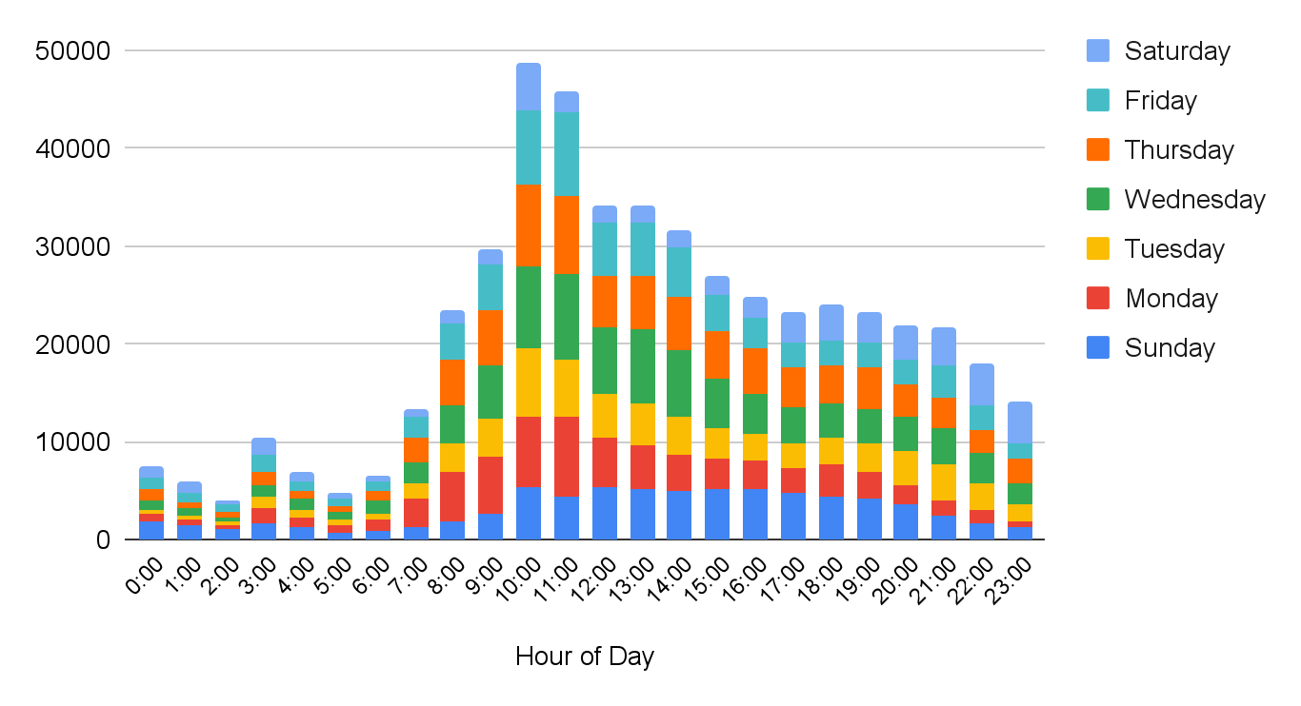
Total sessions by hour of day
Notes:
Summary: This chart shows the total number of sessions, broken down by times of day and days of the week. There is a general pattern to how this metric rises and falls over a 24-hour period: Sessions are at their lowest overnight, when many people are asleep. They climb sharply from 6:00 onward, until peaking around the 10:00 and 11:00 blocks. They then fall sharply around noon and level off before decreasing more slowly throughout the rest of the day. Overall session volume is highest from Wednesday to Friday, and lowest on Saturday. If we were considering session volume alone, weekdays between 10:00 and noon might seem like a the best time to run extra ads. But our conversion data tells a different story.

Slide 5
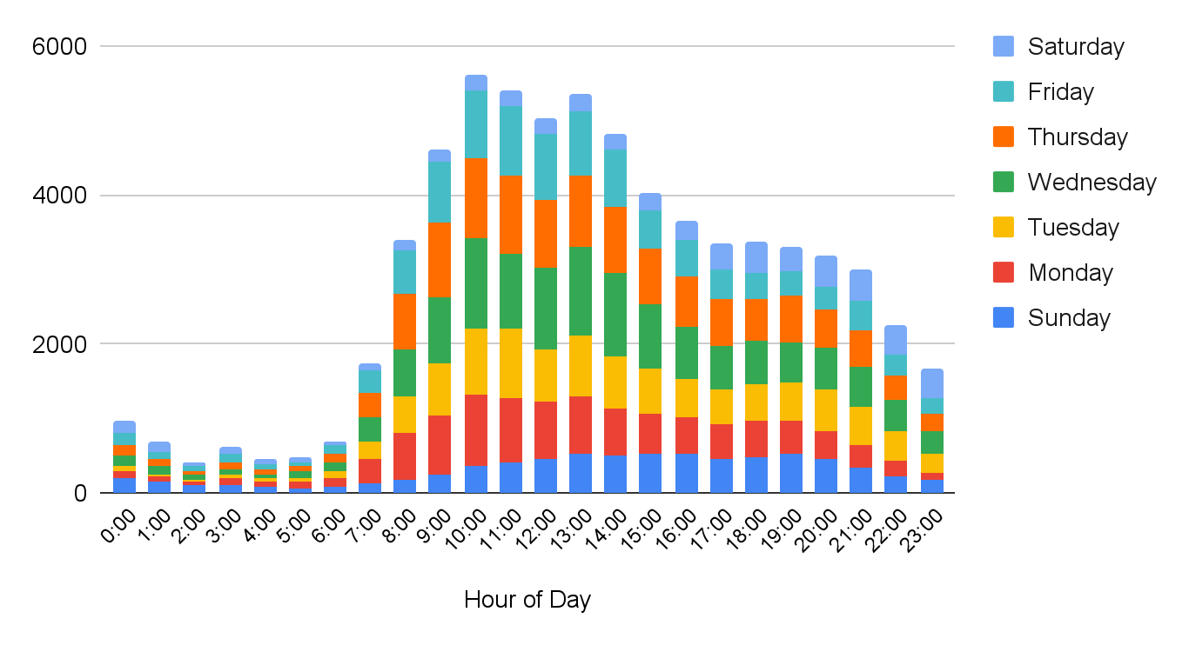
Total conversions by hour of day
Notes:
Summary: We then compared total conversions (broken down by hour of day and day of week) to the sessions data. The rise and fall of conversions broadly mirrors the number of sessions—they’re low overnight, then rise sharply and fall off slowly throughout the afternoon/evening. The number of conversions is also still highest during the 10:00 am and 11:00 am blocks, but given how many sessions there are in those blocks, we’d expect the conversions peak to be much higher. We can conclude that, while we’re getting a lot of sessions during that period, they aren’t translating to more conversions. We need to consider conversion rates to determine when to run more ads.

Slide 6
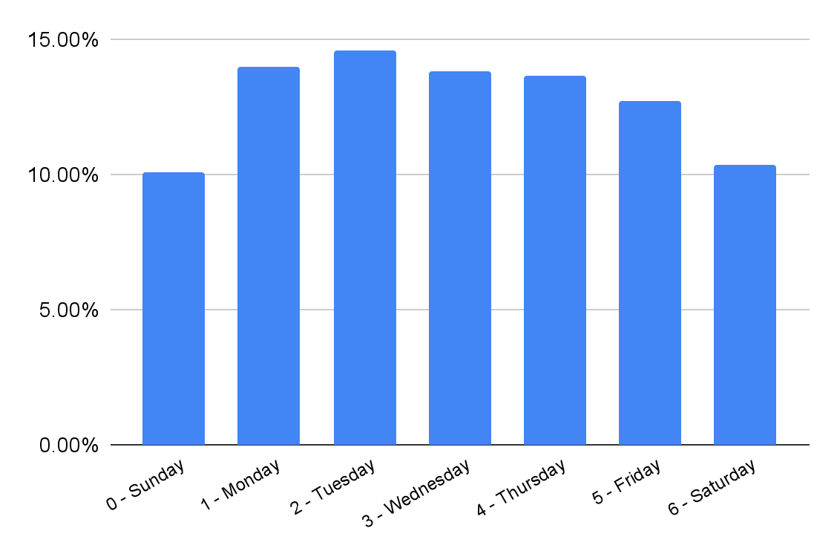
Average conversion rates by day of week
Average weekly CVR
12.75%
Notes:
Summary: To determine which days ti run more ads, we looked at the average conversion rates for each day of the week. The average conversion rate is 12.75, and Monday-Thursday all come in above the average. The top three days are Monday, Tuesday and Wednesday, so we focused on these days for running new ads. Friday, Saturday, and Sunday are all below the average, so we identified times to pull back on these days.

Slide 7
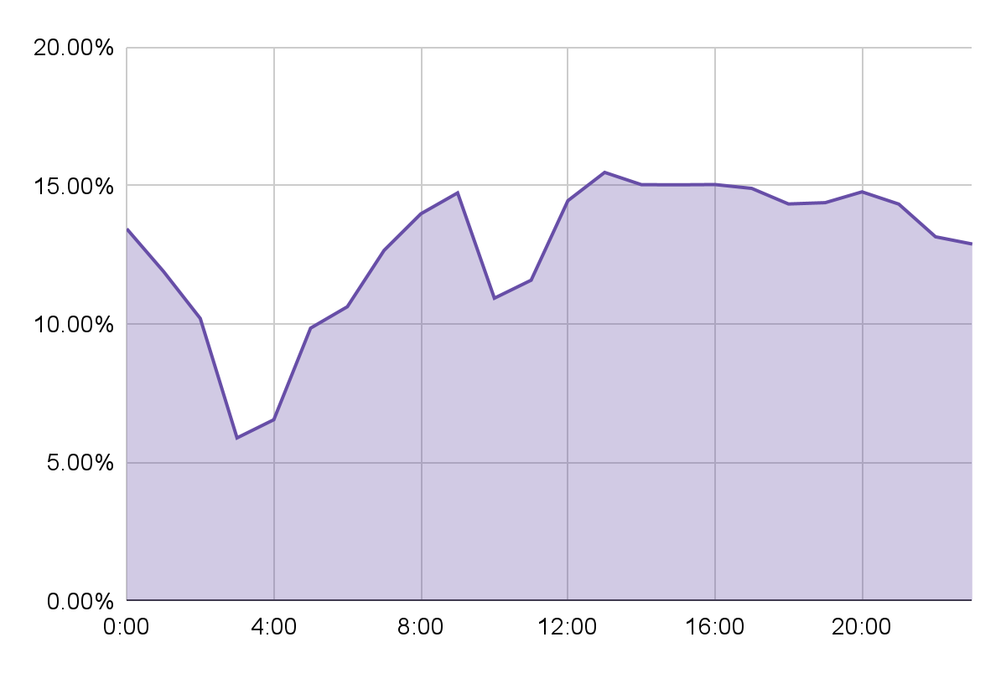
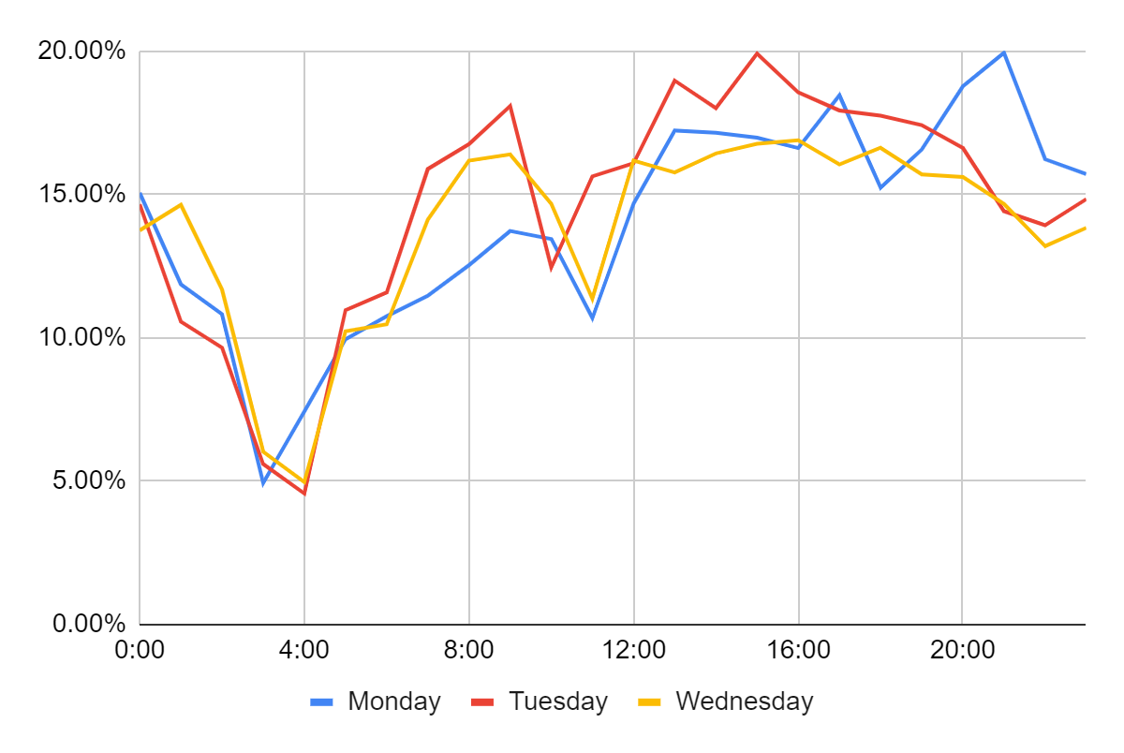
Weekly average conversion rates by hour of day
Monday-Wednesday conversion rates by hour of day
Notes:
Summary: If we compare average hourly conversion rate daya to the hourly data for Monday-Wednesday, it’s clear that these three days follow the general weekly pattern. However, we can also identify certain peaks that are far above the average (near 20%). Examples include Tuesday at 3:00 and Monday at 21:00 are examples.

Slide 8
Conclusions and next steps
We have identified:
20 hours to run more ads during the week
22 hours to run fewer ads during the week
These changes should:
Maximize conversions (new accounts created)
Support growth goals by boosting customer lifetime value (LTV)

