Slide 1



Predictive Analytics Insights
Turtle Games
Hazel Chan
July 4, 2022
Notes:
Welcome to my presentation of turtle games predictive analytics insights

Slide 2
Background
Business: Turtle Games is a game manufacturer and retailer that sells own products and products manufactured by other companies.
3 product category: Lego, various toys and games, and video games.
Objective of analysis: improve overall sales performance based on pricing model, customer sentiments, and sales prediction.
Methodology:
Analyse and predict product price using simple and multiple linear regression using Python.
Analyse age group most likely to leave reviews and highest price point for age 25 or above customers using R tidyverse package.
Conduct sentiment analysis to understand customer reviews to improve product quality using Natural Language Toolkit in R.
Predict global sales using multiple linear regression in R.
Notes:
Turtle Games is a game manufacturer and retailer that sells own products and products manufactured by other companies. They offer three product categories: Lego, various toys and games, and video games. As a global company, they have an objective of improving overall sales performance based on data analysis of price, customer sentiment and global sales forecast..
There are three aspects to analyse the dataset and improve sales performance.
Firstly, simple and multiple linear regression functions in python are used to build a pricing model for lego products based on pieces and customer age.
R tidyverse package is used to analyse the age group most likely to leave reviews and highest price point customers age 25 or above are willing to purchase.
Secondly, Natural Language Toolkit is used to conduct sentiment analysis and understand feedback from customers who purchased various toys and games.
Thirdly, multiple linear regression in R is used to predict total global sales of video games based on Europe and North America sales.

Slide 3

Lego Pricing
z
Notes:
First we will look at the insights of lego pricing

Slide 4
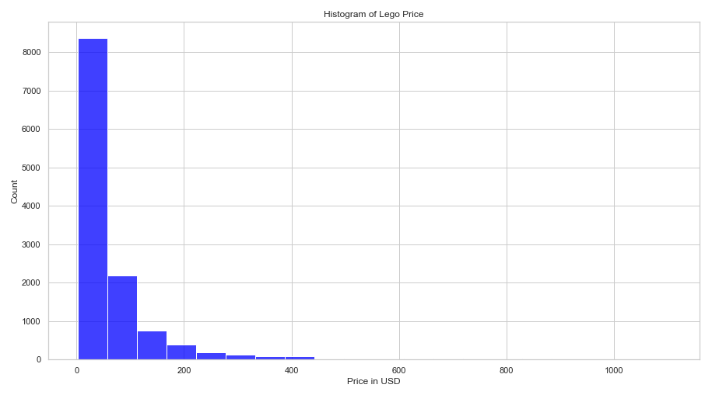
Price Trend (USD)
Descriptive Statistics
Minimum | 2.27
Quartile 1 (25%) | 20
Median (50%) | 37
Quartile 3 (75%) | 70
Maximum | 1105
Notes:
Set optimal price for business to capture maximum profit aligning with customer’s perceived value of lego products
Lego price distribution is strongly skewed to the right with a long tail on the positive side.

Slide 5
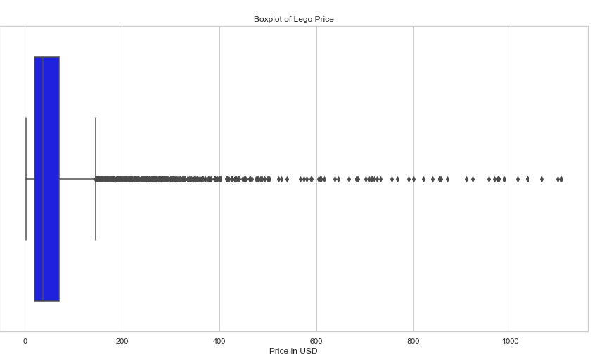
Price Trend
Majority of lego products is priced between USD20 to 70
Outliers range from USD 180 to USD1105.
Outliers are included as they represent expensive product ranges.
Notes:
Majority of the lego is priced between USD 20 to 70, while outliers represent expensive products from USD 180 to USD 1100.

Slide 6
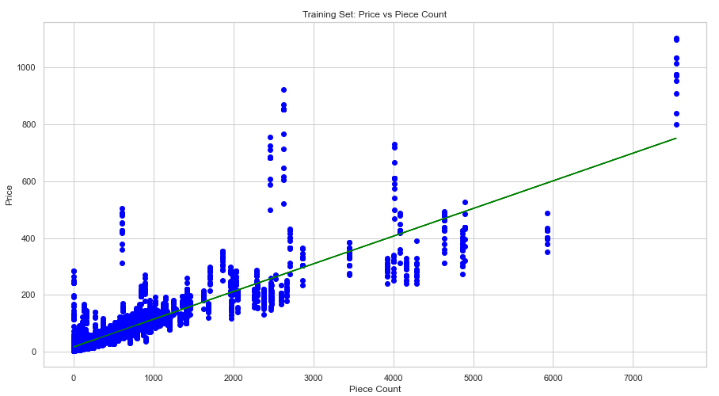
Predicted Price - 8000 pieces
Simple Linear Regression
R-squared | 0.74
Intercept value | 18.04
Coefficient value | 0.096
Predicted Price (USD) | 783
Notes:
The predicted price for lego containing 8000 pieces is USD 783 according to the output of test data set of lego prices.
As shown in the scatter plot, there is a positive linear relationship between price (dependent variable) and pieces (independent variable).
A strong R-squared value signifies an increase in pieces explains 74% variation, increase, in price.
-----------------
Model is sensitive to outliers, effecting prediction’s accuracy. However, given context of business question, these outliers represent expensive product range thus, included in analysis.
Simple linear regression assumes there is a straight line relationship between dependent and independent variable, which some relationships may be curved.

Slide 7
Predict Price – 8000 pieces & Age 30
Multiple Linear Regression
R-squared | 0.73
Intercept value | 16.52
Coefficient value – Piece Count | 0.0996
Coefficient value – Ages | 0.0292
Predicted Price (USD) | 814
Notes:
Since only one variable is considered, we need to explore whether other variables also affects the price. Therefore, next multiple linear regression is used to include age variable, as we assume that the older the customers are the higher purchasing power they have.
There is a strong r-squared meaning pieces and age explains 76% of the price variation.
The predicted price for 8000 pieces of lego purchased by 30 year old customer is 814.
This means that including the age factor, older customers can pay at a slightly higher price for 8000 piece lego set.

Slide 8

Customer sentiment of various toys and games
z

Slide 9
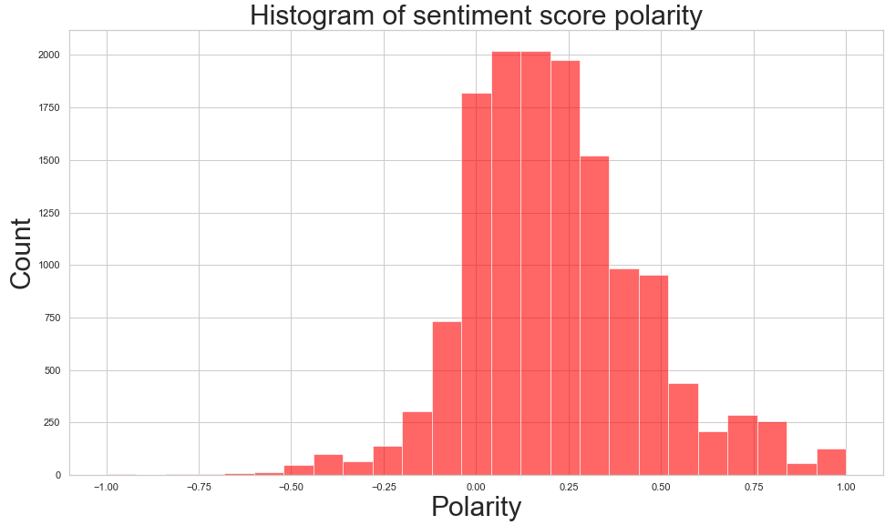
Customer sentiment
Notes:
Overall, majority of reviews are slightly positive with polarity score mainly between 0 to 0.35.

Slide 10
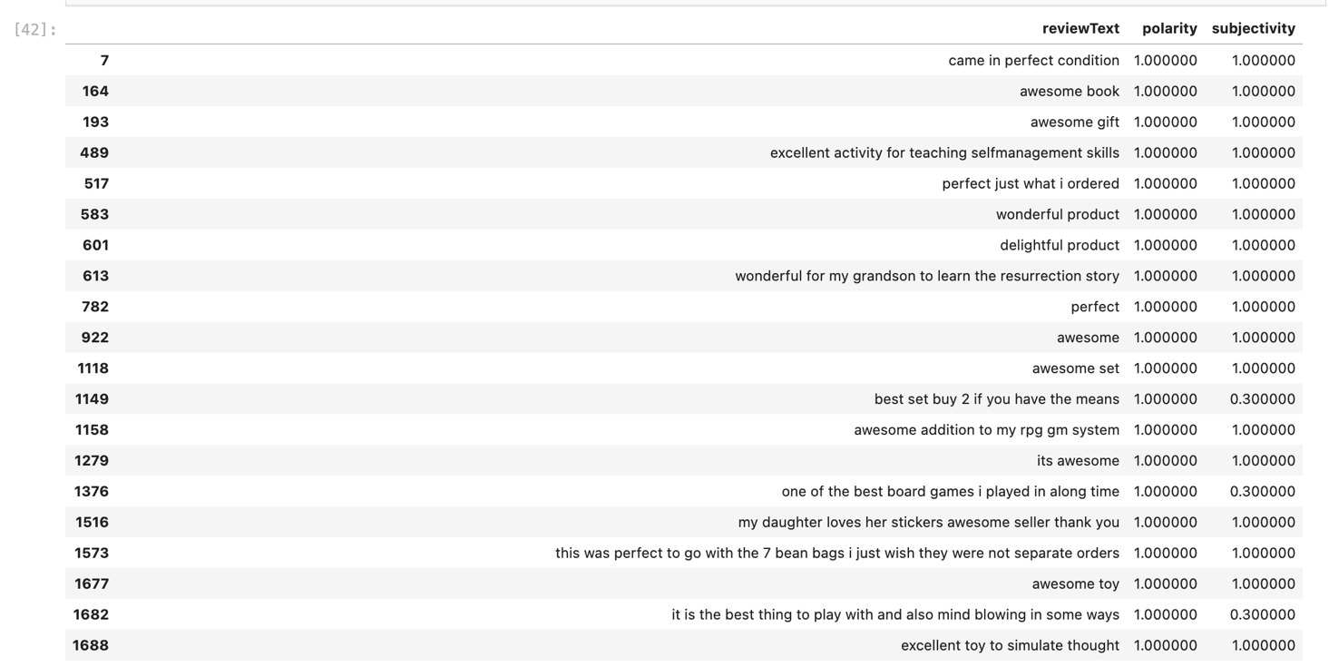
Top 20 Positive Reviews
Notes:
Top 20 positive reviews are identified with positive polarity score of 1

Slide 11
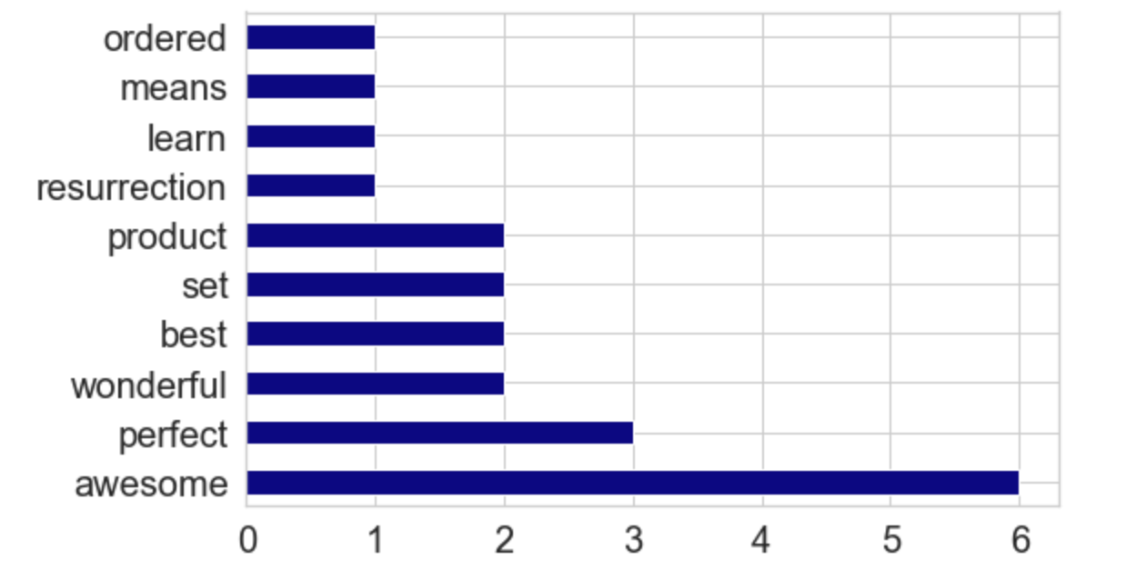
Most frequently mentioned positive features
Notes:
Majority mentioned that the games are awesome, perferct, wonderful

Slide 12
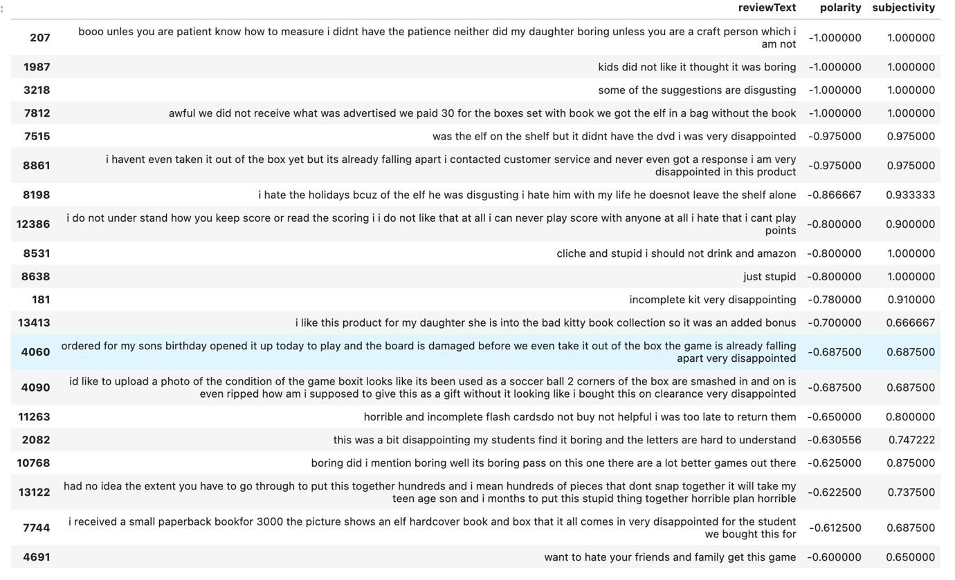
Top 20 Negative Reviews
Notes:
Top 20 positive reviews are identified with negative polarity score of -1 or close to -1

Slide 13
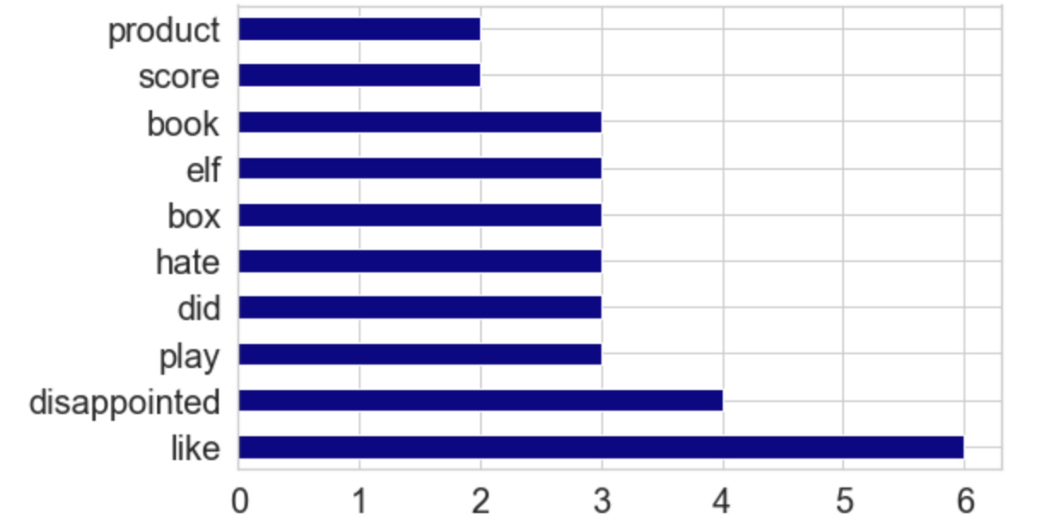
Most frequently mentioned negative features
Notes:
Most were disappointed, and mentioned issues with box, elf and book, signifying issues with packaging as an area of improvement

Slide 14
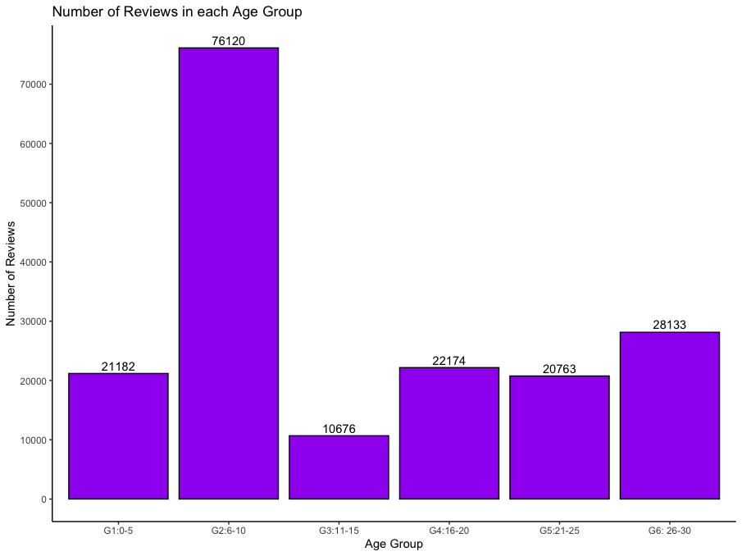
Age group most likely to leave reviews
Column graph identifies customers age 6-10 are most likely to leave reviews, then followed by age 26-30.
Notes:
Column graph identifies customers age 6-10 are most likely to leave reviews, then followed by age 26-30.
Business should understand whether key target customers are age 6-10 for lego products

Slide 15
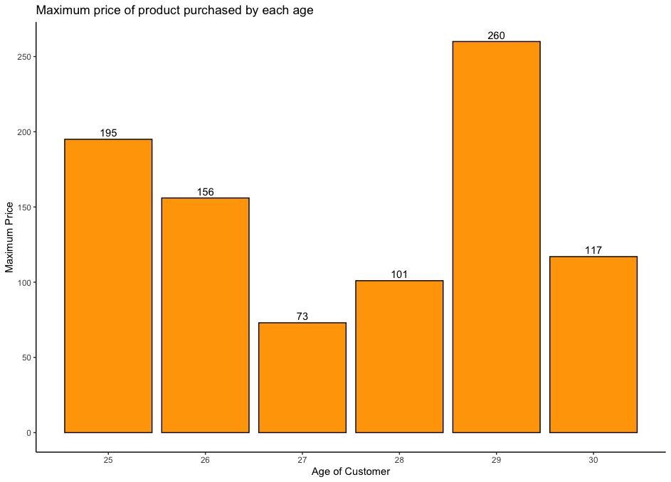
Maximum Price Point accepted by age 25+
Column graph indicates age 29 customers purchased the most expensive lego product at USD260, then age 25 customers at USD195.
Notes:
Column graph indicates age 29 customers purchased the most expensive lego product at USD260, then age 25 customers at USD195.
This signifies the older customers have higher purchasing power as they purchase more expensive lego products, while majority of lego products is priced between USD20 to 70.
Business should target expensive product ranges for older customers as they have higher purchasing power.

Slide 16

Predicted Global Sales of Video Games
z
Notes:
Next, the global sales of video games is predicted based on Europe and North America Sales.

Slide 17
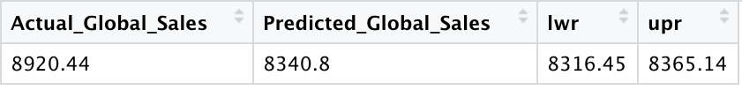
Predicted Global Sales based on EU & NA Sales
(in millions of units)
Correlation Coefficient | NA_Sales | EU_Sales | Global_Sales
NA_Sales | 1 | 0.768 | 0.941
EU_Sales | 0.768 | 1 | 0.903
Global_Sales | 0.941 | 0.903 | 1
Notes:
There is a strong positive relationship between EU/NA sales and Global sales as indicated by 0.9 correlation coefficient which is very close to 1.
Based on EU and NA historic sales, global sales of all video games are predicted to reach 8340M units in next financial year. Business should take forecasted sales into consideration when sourcing and manufacturing units to ensure enough inventory to capture potential sales.

Slide 18
Recommendation
Segment | Current Analysis | Further Analysis
Lego optimal price | Variables pieces and age are used to predict price. Simple and multiple linear regression model. | Difficulty level variable represents complexity of the game which may affect price. Other types of regression model can be explored as relationship may between variables may not be linear.
Customer sentiment | Polarity score of overall reviews Top 20 positive reviews Top 20 negative reviews | Reduce words using stemming and lemmatization Negative reviews to understand quality issue
Global Sales Prediction | Predict global sales based on EU and NA sales | Include online sales Compound annual growth rate in respective markets
Notes:
Recommendations (4 minutes): Based on the insights you have articulated, provide recommendations for any further analysis that can be conducted using the models you have built, addressing the following:
Based on the identified factors that may affect optimal price, suggest other variables for further analysis.
Current analysis uses pieces and age as independent variables to predict price by building simple and multiple linear regression model. However, these models assume a linear relationship between the varaibles, which may not always be the case ie. Having curved relationships if including other variables. Further analysis can be conducted using difficulty level of lego games because more complex games requires more resources to produce. Other types of regessio model can also be explored.
Based on the outputs of the customer sentiment analysis, suggest any other analysis approaches or considerations which may provide more useful insights into areas of opportunity for improving sales performance.
As the negative reviews derived initial insights that customers are disappointed in box packaging and quality of books materials and game is boring. Further analysis can be conducted to pinpoint specific of quality issue to source better packaging materials for future production.
Based on the identified factors that may affect optimal sales, suggest other variables for further analysis.
The definition of global sales includes EU, NA and online sales. The prediction did not include historic data of online sales which may lead to inaccuracy. Further analysis should be conducted include online sales and outlook of economic market such as CAGR compound annual growth rate in respective markets.

Slide 19
Conclusion
Lego with 8000 pieces should be priced at USD783 and slightly higher at USD814 if majority of customers are 30 year old.
Difficult level variable should also be explored.
Box packaging of toys and games needs to be improved with better quality to avoid damages during delivery.
Use negative review to identify quality issue and source better packaging material.
Customer age 6-10 left the most reviews at 76,120. Age 29 customers purchased more expensive lego product at USD260 signifying older customer has higher purchasing power and expensive products should be designed to target this customer group.
Global sales of video games is predicted to reach 8340M units next financial year.
Online sales and market growth rate in regions should be taken into account for more accurate prediction. Business should plan inventory based on predicted sales to capture maximum sales opportunities.
Notes:
Lego products with more pieces should be more expensive. 8000 pieces product should be priced at USD783 and slightly higher at USD814 if majority of customers are 30 year old. Optimal price within customers expected range will increase sales. Though, difficult level variable should also be explored.
Box packaging of toys and games needs to be improved with better quality to avoid damages during delivery. Further analysis is recommended to identify quality issue and source better packaging material.
Customer age 6-10 left the most reviews at 76,120. Age 29 customers purchased more expensive lego product at USD260 signifying older customer has higher purchasing power and expensive products should be designed to target this customer group.
Global sales of video games is predicted to reach 8340M units next financial year. Online sales and market growth rate in regions should be taken into account for more accurate prediction. Business should plan inventory based on predicted sales to capture maximum sales opportunities.

