Slide 1
SST · arXiv 2501.06749 · SAM 2 · OC-CCL
What reproduced,
what didn't, and where
the points actually are
Hunter Bridges · one-shot trait segmentation of museum specimens
findings to date · S14 (SAM 3 / SeC) still running
Notes:
≈40s. Frame: this is a reproduction of Static Segmentation by Tracking and an attempt to improve its OC-CCL loss. Two datasets, one of which reproduces. The last stage is still on the GPU.

Slide 2
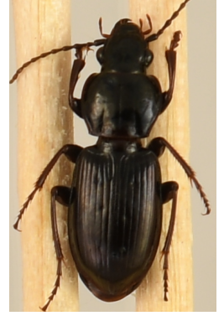
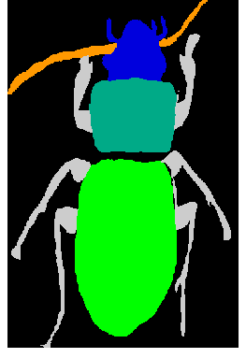
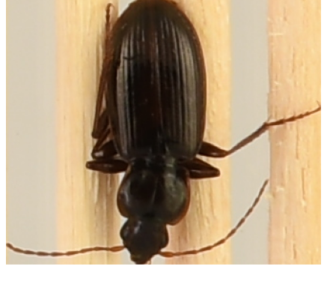
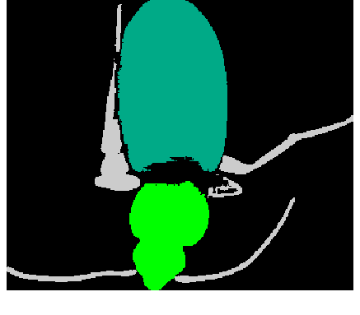
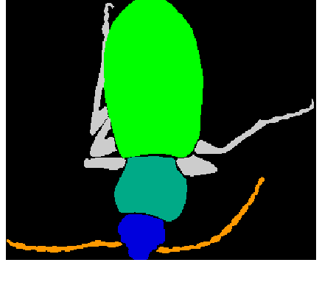
THE TASK
One labeled image. Everything else is tracking.
support
its trait masks
query
prediction
ground truth
SST concatenates the pair into a 2-frame pseudo-video; SAM 2's memory bank propagates the support's masks onto the query.
This query is pinned the other way up — and the prediction puts the head where the support's head was.
Notes:
≈70s. Walk the panels left to right. This is a real render from the S3 bundle, not an illustration. End on the failure: the beetle is upside down, and the model hands the query's elytra the support's pronotum label. Hold that image — it is the whole butterfly story too.

Slide 3
WHY THIS REPO EXISTS
No paper-faithful evaluator existed. So that came first.
per trait
every subspecies
20 seeded supports
paired CIs
not one merged
foreground blob
not one, chosen
model-independent,
prefix-nested
every arm compared
seed by seed
SST's own eval script does none of these — so any OC-CCL delta measured against it is uninterpretable.
Notes:
≈55s. The point to land: half the project is measurement infrastructure, and it is what made every later claim falsifiable. A stage is not complete until check_gate.py prints PASS.

Slide 4
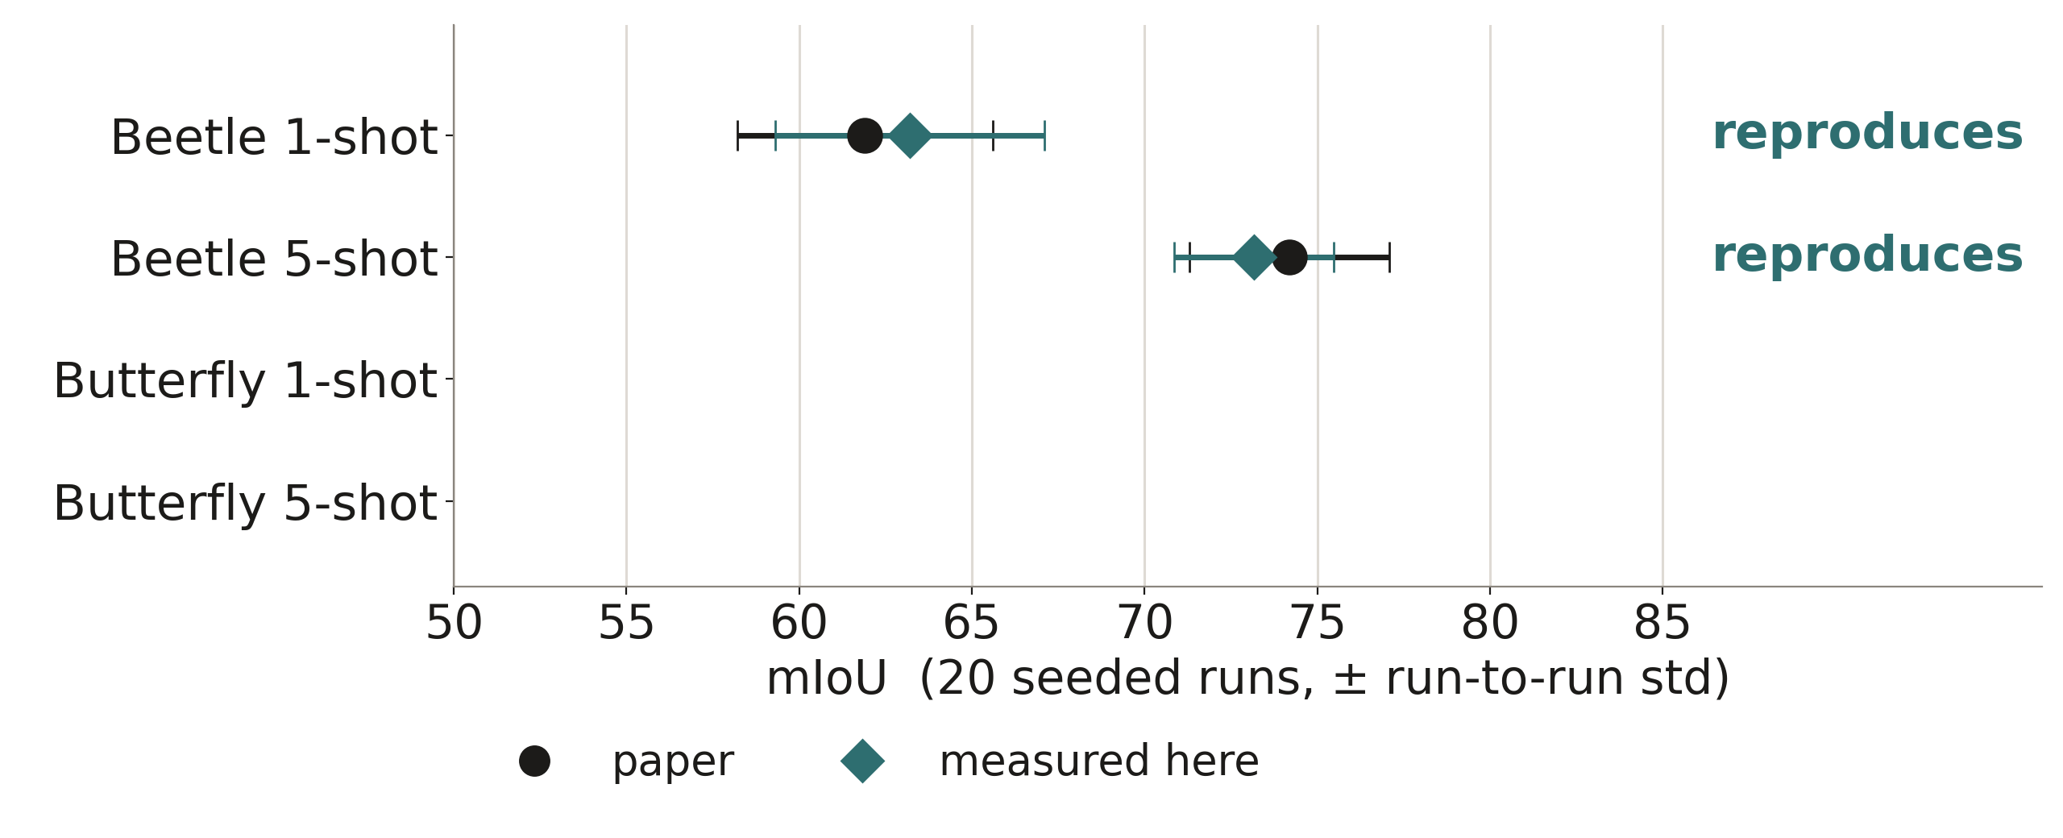
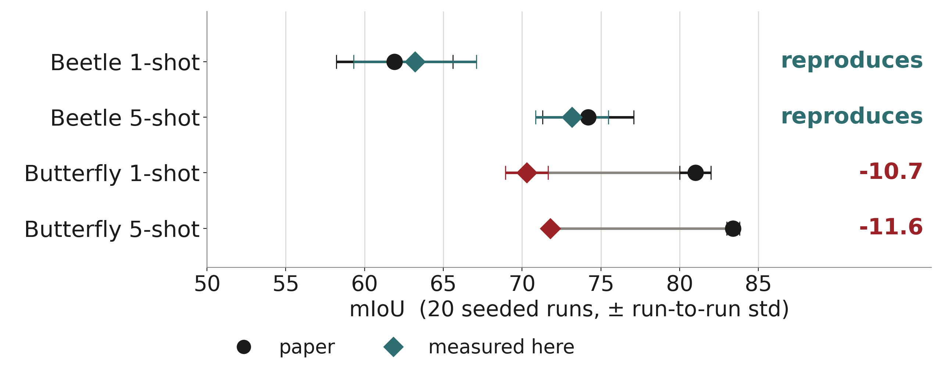
WHERE THE GATES STAND
Four reproduction gates. Two pass.
Beetle reproduces at both shot counts. Butterfly Major misses by ~10 points at both.
Notes:
≈60s. Beetle first: 63.20 ± 3.89 against 61.9 ± 3.7 — and the std is the load-bearing statistic, because it measures sensitivity to support choice rather than which supports were drawn. Then reveal butterfly: the same pipeline, ten points short.

Slide 5
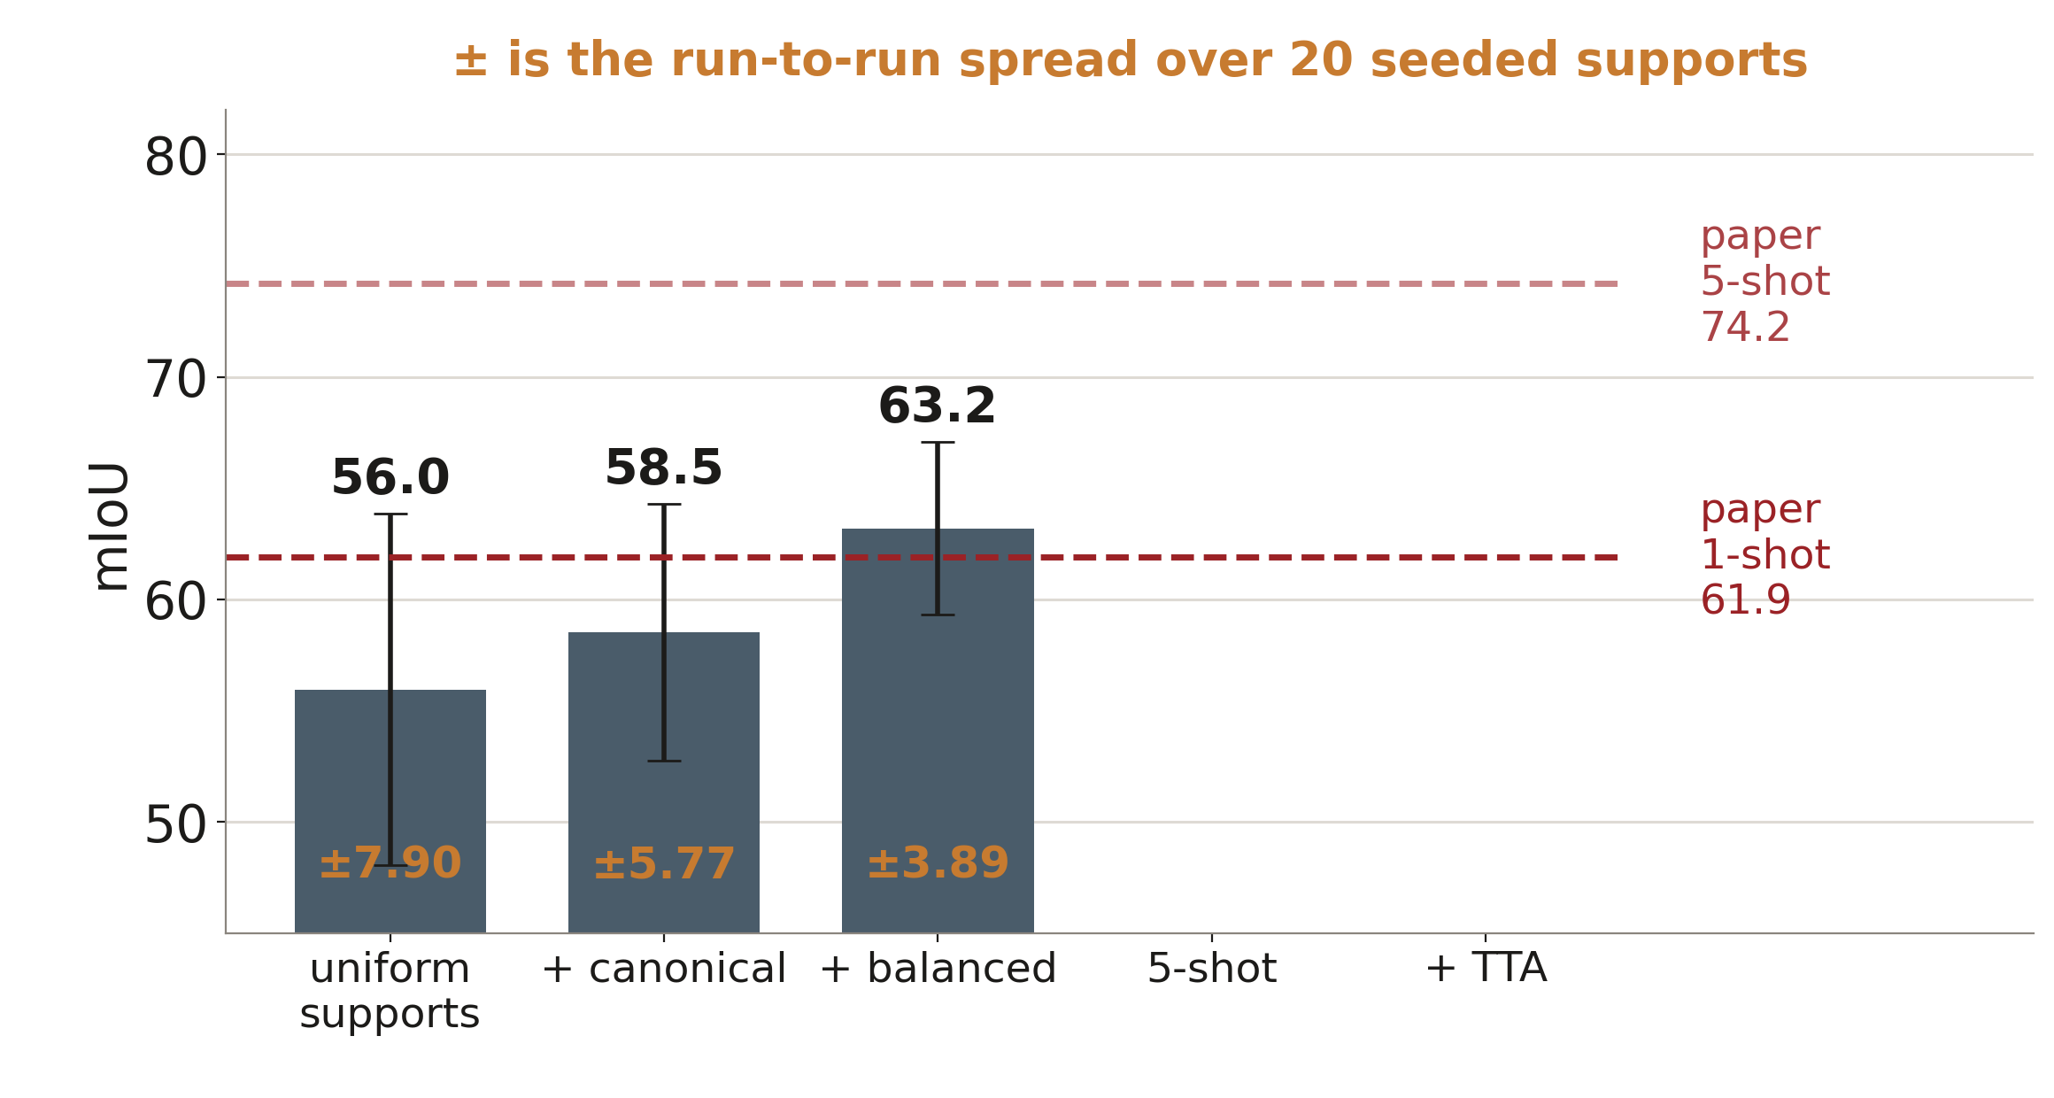
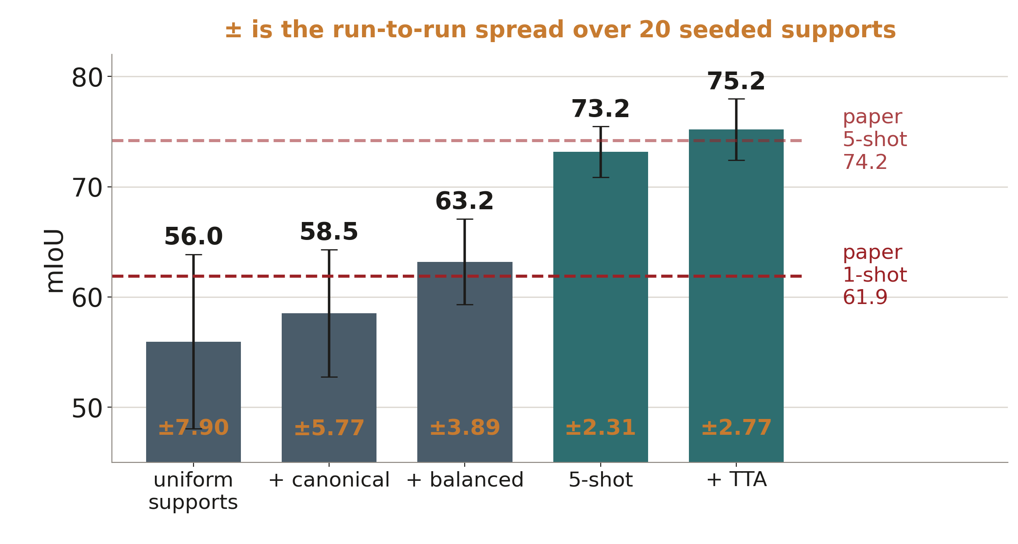
S4a → S4c BEETLE, 1-SHOT
A parenthetical in the paper was the whole 1-shot story.
“one labeled image (with canonical shapes and visually clear traits) is sampled as the reference”
Notes:
≈75s. We ignored that parenthetical at first and measured 55.96 with 2.1× the paper's spread. Curating the support pool by body-axis deviation — threshold set a priori from the train pool's own circular std, 55.6° — and then balancing species by round-robin walks it to 63.20 ± 3.89. Note the spread: 7.90 → 5.77 → 3.89 against the paper's 3.70.

Slide 6
THE RULE THIS PROJECT RUNS ON
Check the spread before the mean.
7.90
5.77
3.89
3.70
uniform supports
+ canonical
+ species-balanced
the paper
The std measures sensitivity to support choice, and is invariant to which supports were drawn.
The mean drifts by the SEM even with a correct implementation — the paper's 20 reference IDs were never published.
Notes:
≈45s. This is the methodological claim worth taking away from the beetle half: a matched mean with a doubled variance is not a reproduction, and a 0.5-point mean gap is not a bug.

Slide 7
S5 BUTTERFLY MAJOR, 1-SHOT
Butterfly Major: 70.30 against 81.0 — and eight causes ruled out.
70.30
metric aggregation
IoU space
support-absent traits
masks · splits · resize
measured
81.0
support completeness
stratum balance
the overlap rule
image resampling
the paper
The copy baseline — support label map pasted on, no model — reproduces the paper's Table A3 to 0.14, so masks, splits, vocabularies and resize are all exonerated.
Notes:
≈70s. Each tile is a hypothesis with a measurement behind it, and recording the negatives matters as much as the positive — each is a lever nobody needs to pull again.

Slide 8
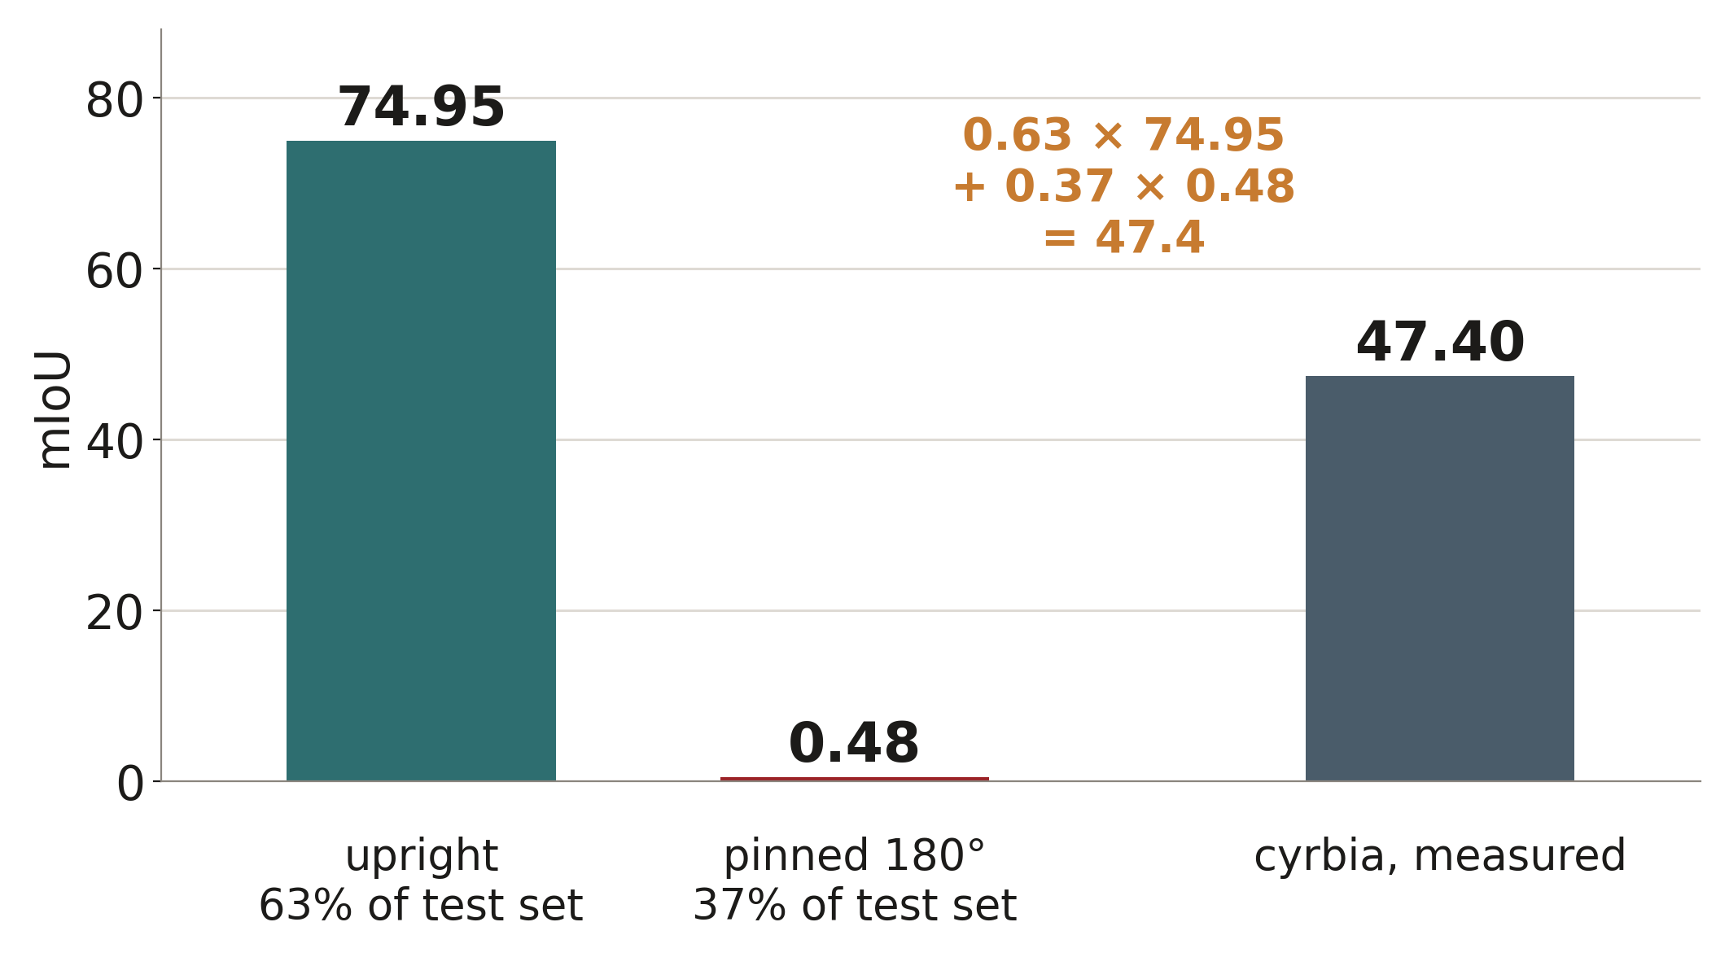
THE SPECIFIC DEFECT
37% of one subspecies is pinned upside down.
The copy baseline scores 0.00 on exactly those specimens.
No model is involved — so this is a property of the data, not a SAM 2 behaviour.
The paper reports 81.0 on a test set that contains this subpopulation, and describes no canonicalisation step.
Notes:
≈70s. cyrbia is not partially broken — it is two populations, one at paper level and one scoring zero. 0.63 × 74.95 + 0.37 × 0.48 gives its measured 47.4 to two decimals.

Slide 9
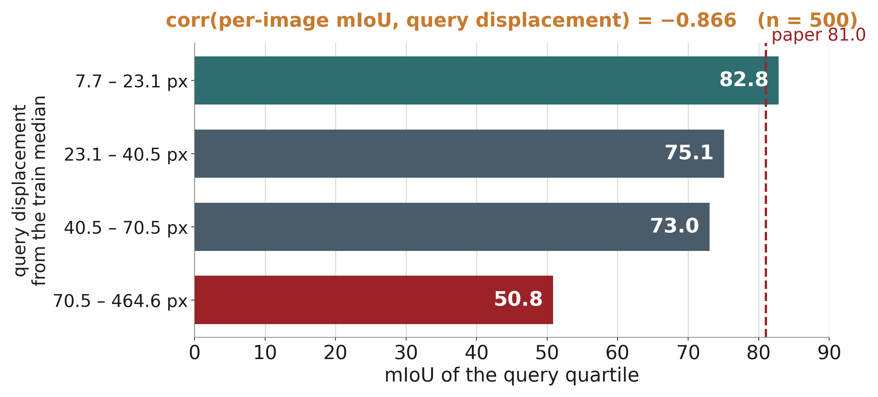
THE GENERAL DEFECT
The model transfers spatial layout, so the query's arrangement decides the score.
On well-arranged queries we already exceed the paper. The whole deficit lives in the badly-placed tail — and the test set cannot be curated.
Notes:
≈55s. Correlation −0.866 over 500 test images, and it holds within four of five subspecies, so it is general rather than a cyrbia artifact. Only 46% of that displacement is a global offset, so cropping or centring would fix less than half of the weaker half.

Slide 10
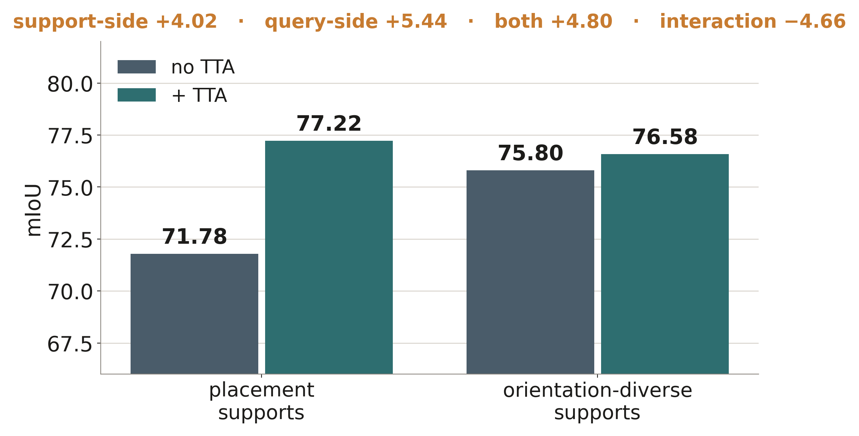
S6c THE ROTATION 2×2
Two fixes. One defect. Combining them costs score.
Support-side (draw both orientations) and query-side (predict twice, keep the confident one) buy the same +4 to +5.
Notes:
≈60s. TTA never touches the query and never consults ground truth — it picks by mean top-logit over claimed pixels. Best arm is TTA on placement-curated supports, 77.22; adding orientation-diverse supports on top makes it worse.

Slide 11
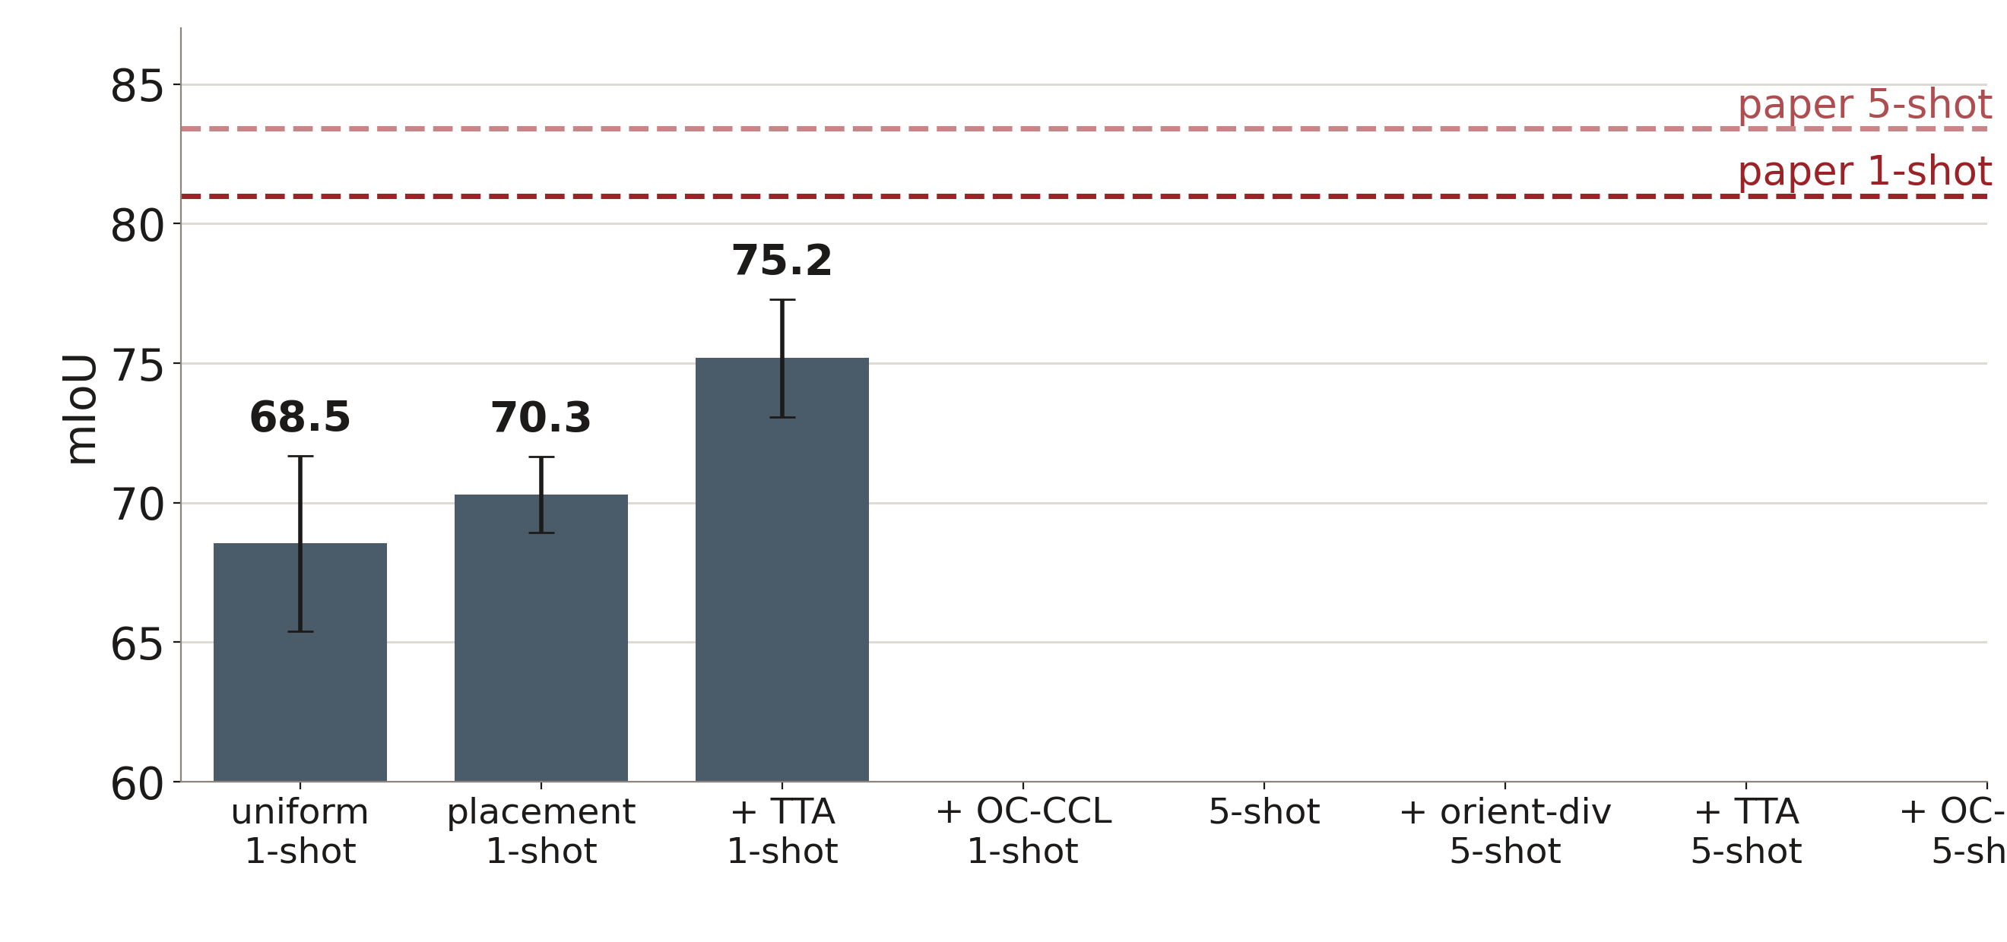
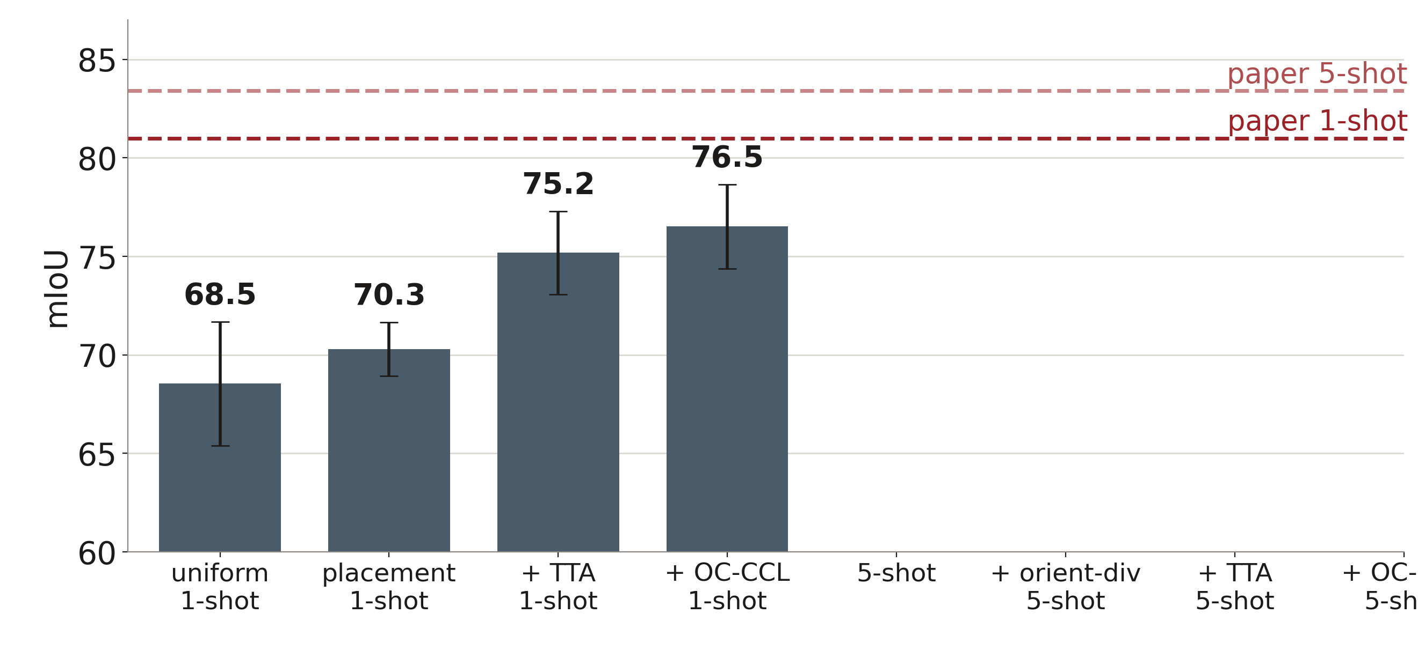
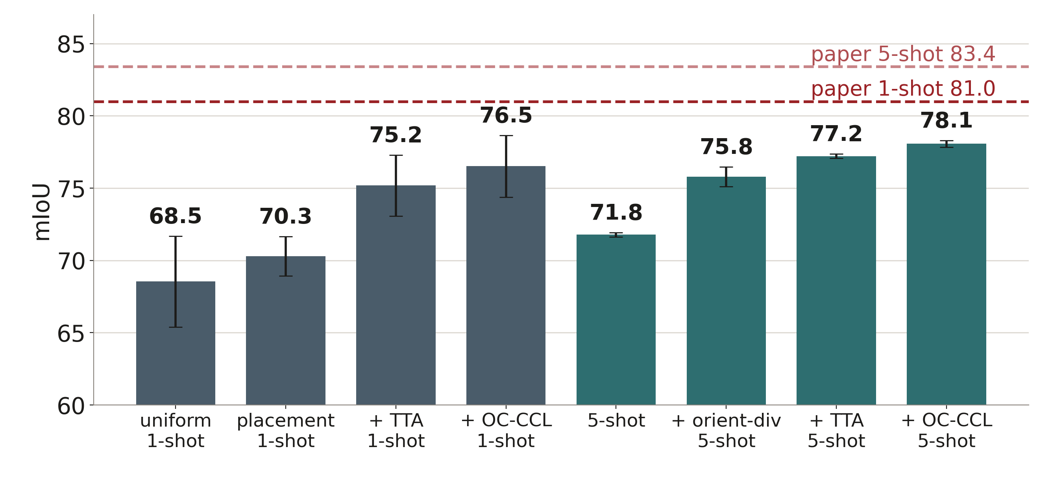
BUTTERFLY MAJOR · EVERY ARM
What each technique bought.
Best measured: 78.07. Still 5.3 short — and ~5 of that sits below the silhouette ceiling, where no assignment-side method reaches.
Notes:
≈65s. Grey is 1-shot, teal 5-shot. Rotation handling is worth about the same at both shot counts. The last bar is the only OC-CCL arm in the project that pays.

Slide 12
PART TWO
The loss
OC-CCL: one-shot cycle-consistency loss.
The paper reports +3.3 mIoU on Beetle.
Notes:
≈20s. Transition: the reproduction was the ground; the loss is what the project was actually assigned to improve.

Slide 13
S8a THE FIRST DEFECT
The released cycle prompt severs the gradient.
soft_query_mask = (pred_query_mask > 0).float()
0.00
26 × / 351 ×
forward-leg gradient, as released
forward ÷ reverse after the fix (merged / per-trait)
The fix is exact, not an approximation: SAM 2 maps a prompt mask to logits with fixed constants, so feeding (logits + 10) / 20 reconstructs them identically and the path becomes linear.
The paper says the prompt “remains differentiable”. The released code is what deviates — the first of five such axes.
Notes:
≈70s. `>` doesn't have a zero derivative — it severs the graph, so backward raises rather than returning zeros. The forward leg carries ~96% of the signal, so SST was training on the other 4%. Keep this in mind for the punchline: the broken threshold was protecting the model.

Slide 14
S10 PAPER ≠ RELEASE
The released code contradicts its own paper on five axes.
THE PAPER
THE RELEASE
cycle prompt
“remains differentiable”
(pred > 0).float()
supervision
C distinct trait channels
one merged foreground
method
LoRA r=32, α=64
full fine-tune, LoRA off
epochs
“train it for one epoch”
10 epochs
labels
one fixed labeled image
404 – 4,227 labels
The OC-CCL code landed ~16 months after the paper, from a different contributor. So “does OC-CCL reproduce?” had to be asked twice.
Notes:
≈70s. This is the finding that reorganised the whole S8 programme. We first measured the release's method, then implemented the paper's method from its text, because its code was never released.

Slide 15
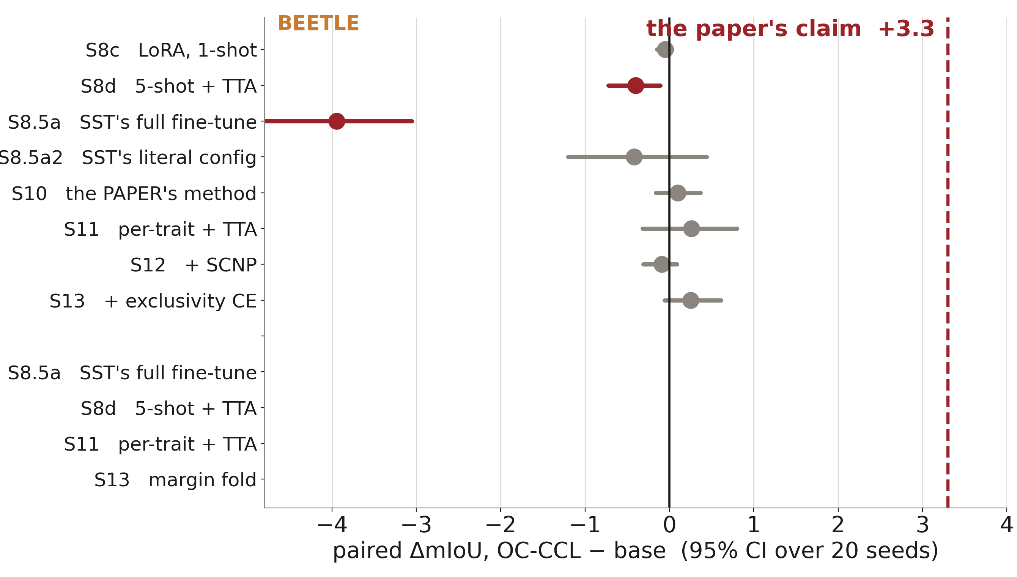
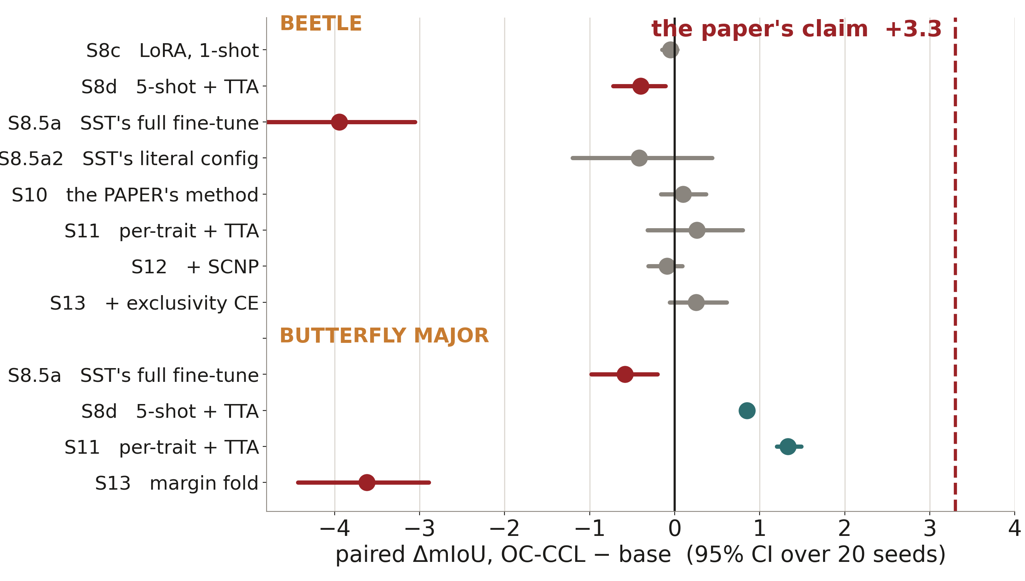
S8 → S13 EVERY OC-CCL CONFIGURATION WE COULD RUN
The claim is +3.3. Nothing we measure is near it.
Release config, paper config, three replicate references, per-run anchoring, both label budgets, ±augmentation, both overlap rules, five theory-selected loss variants.
Notes:
≈85s. Beetle first — every arm null or negative, including the paper's own recipe at +0.07 to +0.16 with every CI spanning zero. Then butterfly, where a silhouette objective does pay about +1, because that is where butterfly's own headroom is. One law fits both sides: OC-CCL helps where its actual objective has room.

Slide 16
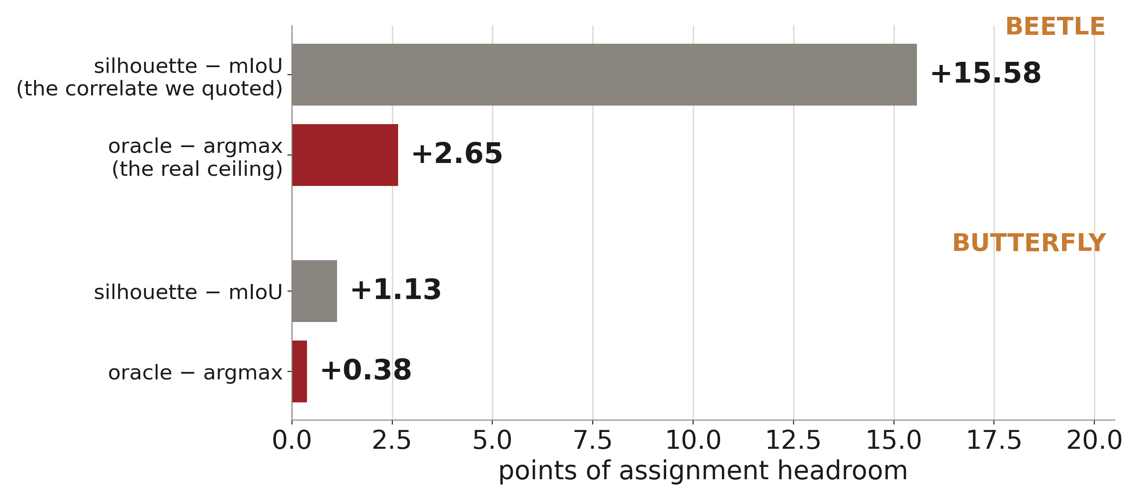
S13 THE CEILING WE HAD BEEN QUOTING
We were measuring a correlate, not a ceiling.
The loss arms had been competing for 2.65 points, not 15.6. The rest is detection failure — regions the tracker never proposes, which no loss on proposed logits can reach.
Notes:
≈65s. The oracle is the best IoU any channel achieves per ground-truth trait — free relabelling. It had never been computed on beetle. This one number closes the ledger on every null since S8, and it is the argument for changing the model rather than the objective.

Slide 17
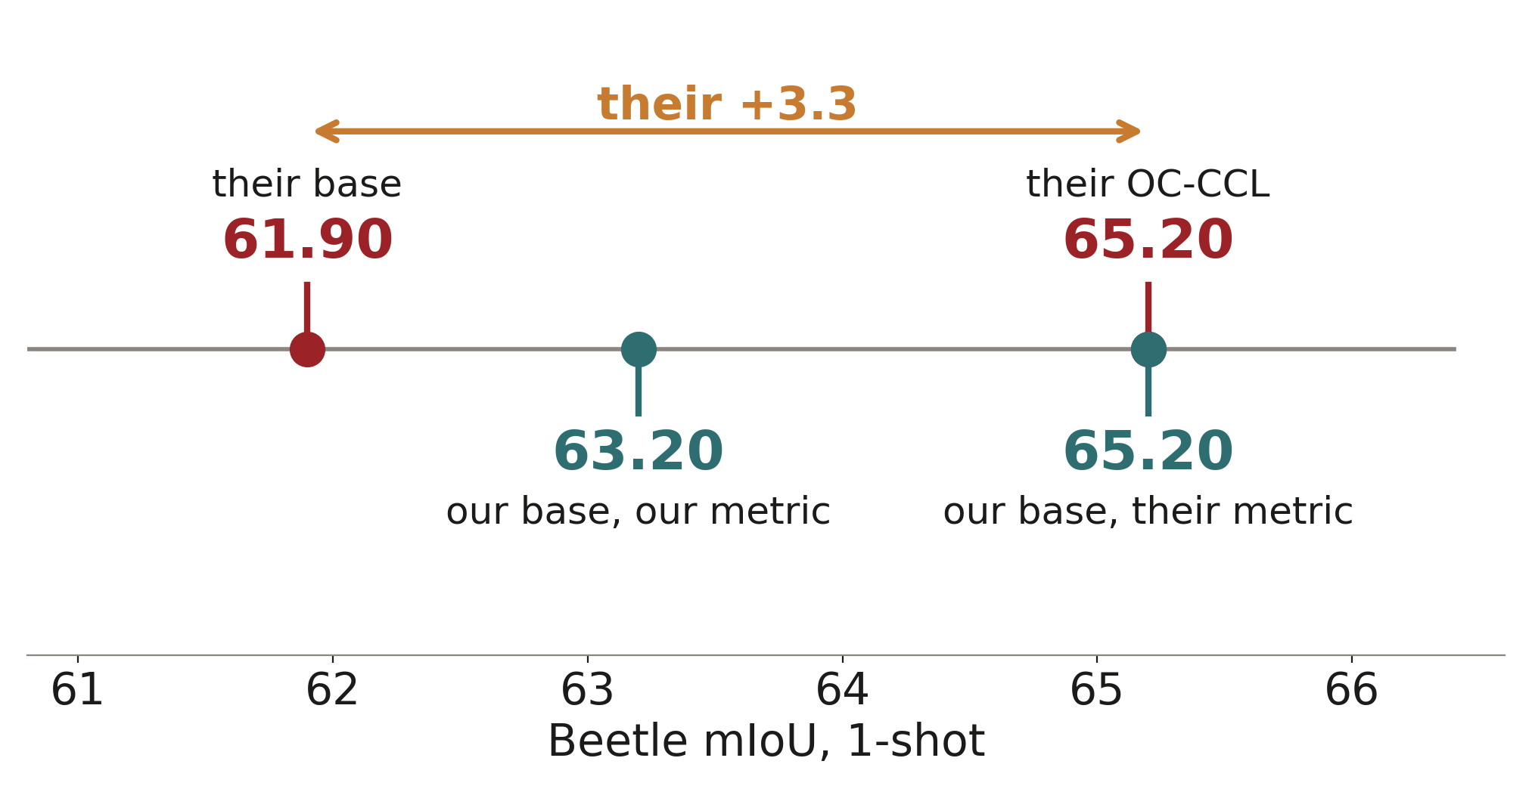
S11 THE SIXTH UNPUBLISHED DETAIL
Under the paper's own metric, every number locks together.
Their pipeline ran ~3 points below ours; their OC-CCL recovered roughly that deficit on their pipeline; on ours there was nothing left to recover. Caveat: 65.20 vs 65.2 is a coincidence-grade match at SEM ≈ 0.8.
Notes:
≈70s. The boundary tolerance — one-pixel dilation and erosion, best of three — came from author correspondence and appears in neither paper version. Rescoring under it moves our base to 65.20, exactly their OC-CCL row, while every delta stays put within ±0.3. That is the first reading under which all six numbers on both sides are simultaneously coherent.

Slide 18
WHAT THE PROJECT SUGGESTS
Four things, in order of how much they cost to learn.
1
Unpublished protocol decides the number
2
A delta needs a pairing and a band
Six evaluation details were never published — reference IDs, the beetle split, the pair code, the LR, the overlap rule, the boundary tolerance. Curation alone is worth +7.2.
Every arm here is paired per seed with a CI and a band frozen before the run. That is what turns “no effect” into a result instead of a failed experiment.
3
Measure the ceiling; never infer it
4
The remaining points are model capacity
“+15.6 headroom” was a correlate. The measured ceiling was 2.65, and it retired an entire line of work.
Support-side and inference-side levers are exhausted. ~5 of butterfly's 6 points sit below the silhouette; beetle's residual is unproposed regions.
Notes:
≈80s. This is the slide to slow down on — it is what the project says beyond its own numbers.

Slide 19
S14 RUNNING NOW
The swap the loss programme was built for.
SAM 3
SeC-4B
A newer tracker that keeps SST's mechanism wholesale.
Geometry pinned at 1008 / 1152 / 7, strict 0-0 weight load.
Concept-level identity on top of a SAM 2.1 tracker — the one mechanism that could reach the 180° cohort that no pixel memory does.
Held fixed: the same 20 seeded draws, each dataset's own best 1-shot protocol, and the crowned stack — per-trait OC-CCL + exclusivity CE + TTA.
Cross-family rows are the comparison the comparability key exists to refuse. They go through one sanctioned relaxation, and every row carries the fields it ignored and both their values.
Notes:
≈60s. S13 located the residual in regions SAM 2 never proposes — a model-capacity boundary. Every S13 arm was written on per-object logit stacks precisely so it transfers to a new family.

Slide 20
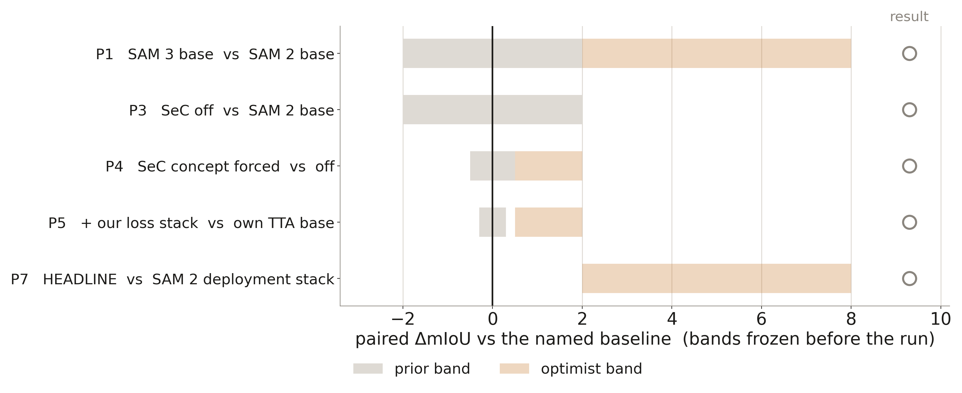
S14 PRE-REGISTERED, PENDING
The bands were frozen before the GPU ran.
Results drop into the open circles. The gates print the deltas against these bands and never gate on sign.
Notes:
≈55s. Say plainly that this stage is still running and the deck will be updated in place. P7 is the headline: our best SAM 2 deployment numbers are 76.52 butterfly and 64.12 beetle, and any CI above zero means the model upgrade pays.

Slide 21
S14 HOW TO READ THE RESULT
P2 decides which story S14 tells.
oracle − argmax > ~+5
oracle − argmax ≈ +2.65
The new backbone proposes what SAM 2 never did, and assignment now lags behind the proposals.
The assignment pot is real again — and the loss programme, closed on SAM 2, reopens on the new family.
Same proposal boundary as SAM 2 — the upgrade is cosmetic on this benchmark.
The residual is a property of the data and the task, not of the tracker generation.
P7, the headline: stack + TTA vs SAM 2's 76.52 / 64.12 → ___________
Either reading is a finding. Both are written down before the numbers exist, which is the only way that stays true.
Notes:
≈60s. Leave the blank visible. If the run lands before the talk, read the number off the gate output and fill it in.

Slide 22
WHAT STAYS UNFALSIFIABLE
Six things about the benchmark we cannot check.
the 20 reference image IDs
the Beetle train/test split
the Beetle pair-construction and eval code
the fine-tuning learning rate
how overlapping trait predictions are resolved
the one-pixel boundary tolerance
Our beetle split is synthesized; our curation approximates a human judgement the paper never defines. Both are reported as such, and all three support arms are always shown.
Notes:
≈50s. Honesty slide. The point is not that the paper is careless — it is that a one-shot protocol is decided by exactly the details that are hardest to publish.

Slide 23
WHERE IT STANDS
Beetle reproduces at both shot counts.
Butterfly Major does not — about half of that gap is orientation, and most of the rest is mask quality.
OC-CCL's +3.3 is not recoverable from the code, the paper, or the metric ambiguity.
The next points live in the model. That run is on the GPU now.
Notes:
≈40s. Close on the fourth line and take questions.

