Slide 1
THE SECOND REFERENCE
Rotate the support, or label another specimen
implicit: rotate
the one you have
explicit: label
a second specimen
the answer flips
between datasets
S16 / base SAM 2 / 4 runs / 20 seeds / Hunter Bridges
Notes:
Title. 20 seconds. Name the question in one sentence: a second reference can be the same specimen rotated, or a different specimen labelled, and this stage measures which one pays.

Slide 2
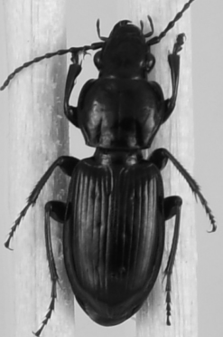
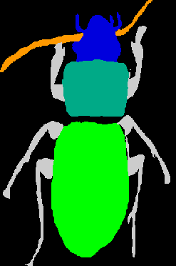
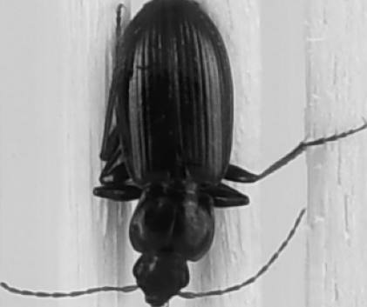
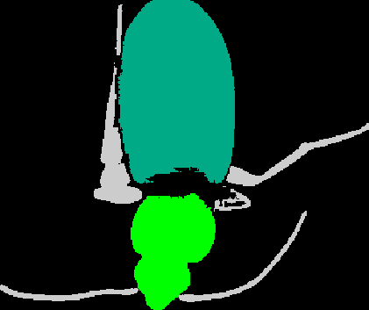
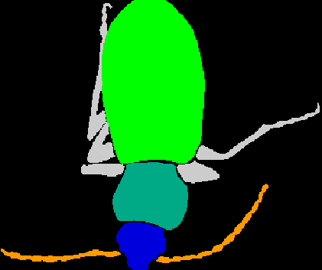
THE TASK
One labelled specimen, then a query
support
its trait masks
query
prediction
ground truth
One labelled mask is the whole supervision budget. Everything in this talk is about spending a second one, or not.
Notes:
45s, 4 clicks. Only enough setup to make the budget clear. One labelled mask in, one query out. Do not re-teach the task if they saw the main talk; go straight to the last line.

Slide 3
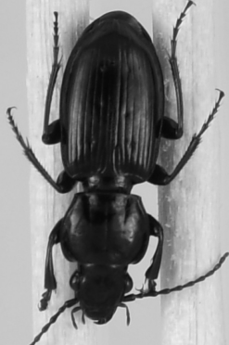
THE QUESTION
Two ways to spend a second reference
IMPLICIT (orientation TTA)
EXPLICIT (a real 2-shot)
the same specimen, turned 180 degrees, kept outside the memory bank and picked per episode by a confidence rule
a second individual from the same pool, inside the bank as one 3-frame video, selected by memory attention
cost: 0 labels, 2 forward passes
cost: 1 label, 1 forward pass
Panels are the project's own S3 render. Since S5c every headline arm has used the implicit version. The explicit one had never been measured at any budget, and it is the cheaper of the two at inference.
Notes:
70s, 3 clicks. The core distinction, so spend the time. Left: outside the bank, chosen per episode by confidence. Right: inside the bank, chosen by memory attention. Then the two costs, said out loud.

Slide 4
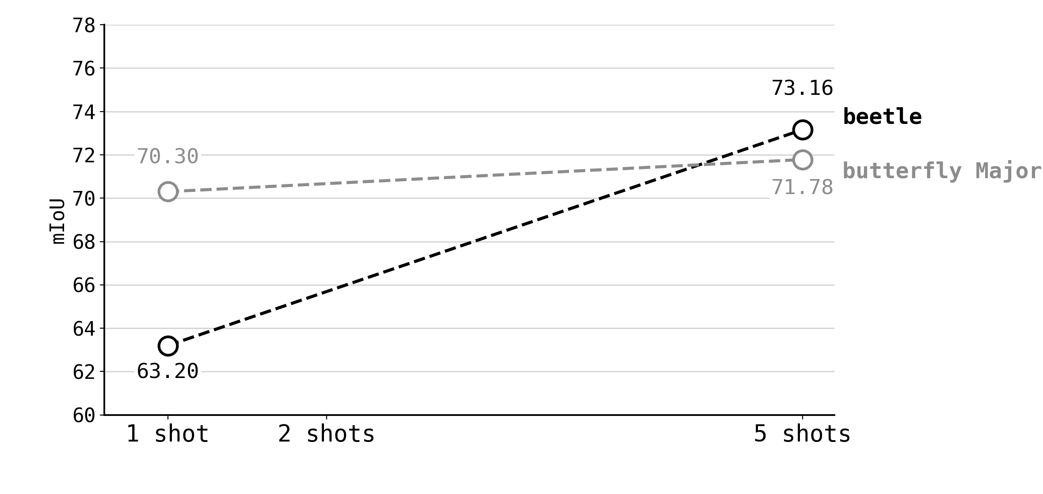
WHAT WAS ALREADY MEASURED
The shot axis had a hole at two
The project has 1-shot and 5-shot on both datasets, never 2. The dashed line is an interpolation nobody measured.
Notes:
35s, 2 clicks. Point at the gap. Say plainly that shot 2 was never run before this stage.

Slide 5
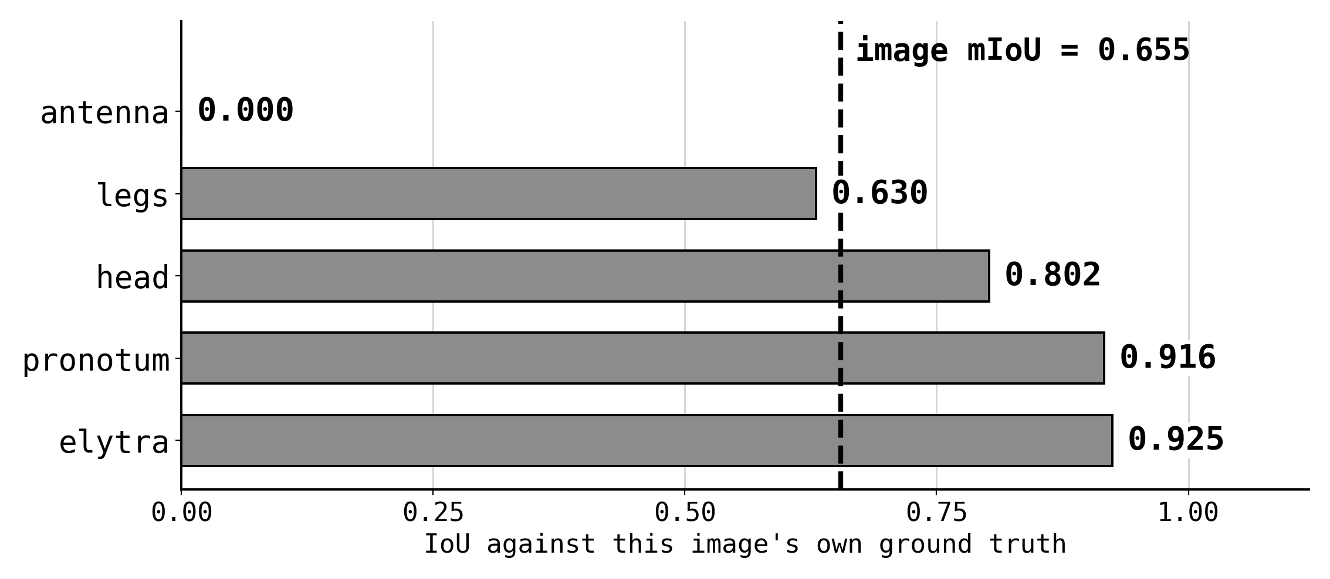
THE GRADING RULE
What one mIoU number means here
Per image: resize logits to the query, argmax over trait channels, IoU per ground-truth trait, then the mean over traits.
A trait the model never claims scores 0 and still counts, so a missed antenna costs as much as a botched elytra.
Notes:
40s, 3 clicks. Only if the audience has not seen the metric slide. Say the argmax rule and the zero-for-unclaimed rule. First candidate for cutting.

Slide 6
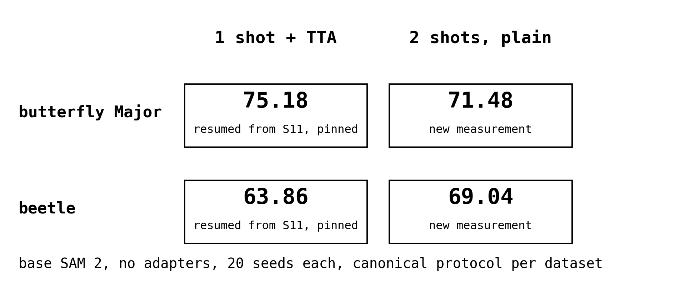
DESIGN
Four runs, two of them anchors
The two TTA cells resume the banked S11 cells, and the gate pins them to 75.18 and 63.86 within 0.5.
That certifies the wiring of the merge, not TTA itself. The two 2-shot cells are the only new measurement here.
Notes:
40s, 3 clicks. Four runs. Emphasise that half of them exist to catch a protocol slip rather than to produce a number.

Slide 7
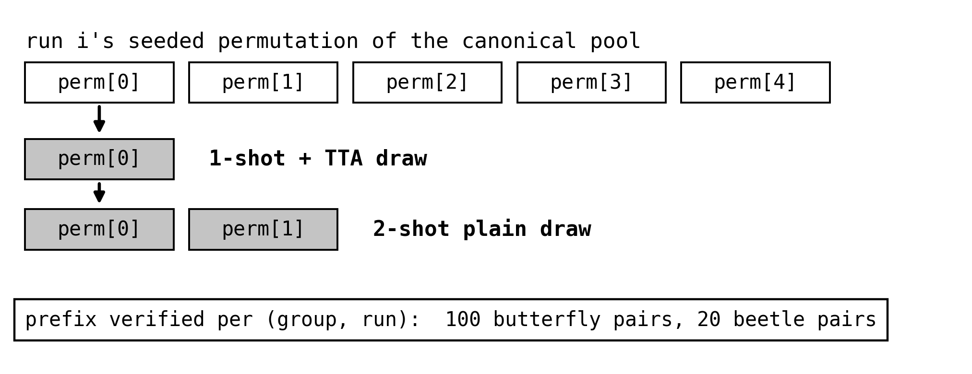
HOW IT IS IMPLEMENTED
Why this comparison is allowed
The row crosses protocol.shots and protocol.support_set_hash, both comparability fields, so registry.compare refuses it.
The licence is a property of the draws: both cells slice a prefix of one seeded permutation, so the 1-shot support is the first element of the 2-shot pair and the shared support's difficulty still cancels.
Notes:
70s, 3 clicks. This is the implementation question people ask. Say why compare refuses the row, then why the draws license it, then that the proof is embedded in the row rather than asserted.

Slide 8
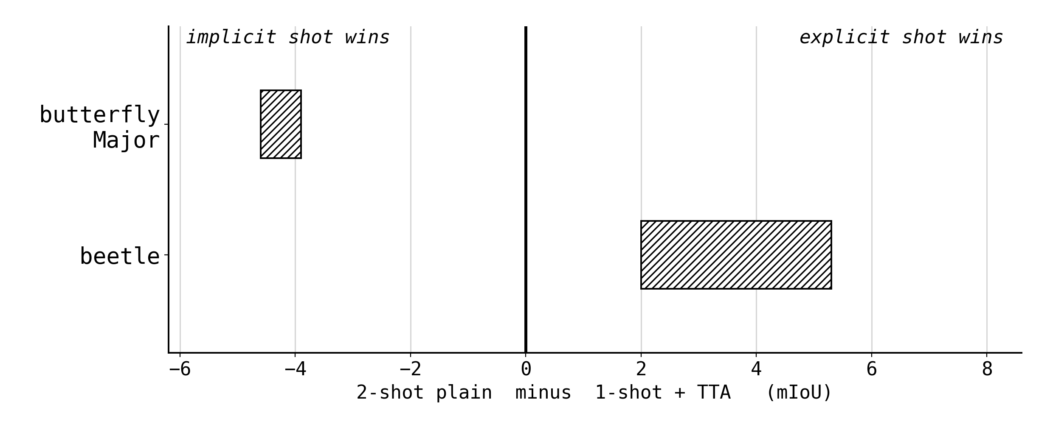
WRITTEN BEFORE THE RUN
Two predictions, opposite signs
Butterfly, band -3.9 to -4.6: Major's defect is query orientation, and 37% of cyrbia's test specimens are pinned upside down, so no upright second specimen reaches it.
Beetle, band +2 to +5.3: the 5-shot mechanism is species diversity, and a rotated copy of one specimen adds no species.
Notes:
60s, 3 clicks. Read the bands off the figure before showing anything measured. Say both mechanisms in one sentence each. Do not skip this: it is what makes the next slide a test rather than a report.

Slide 9
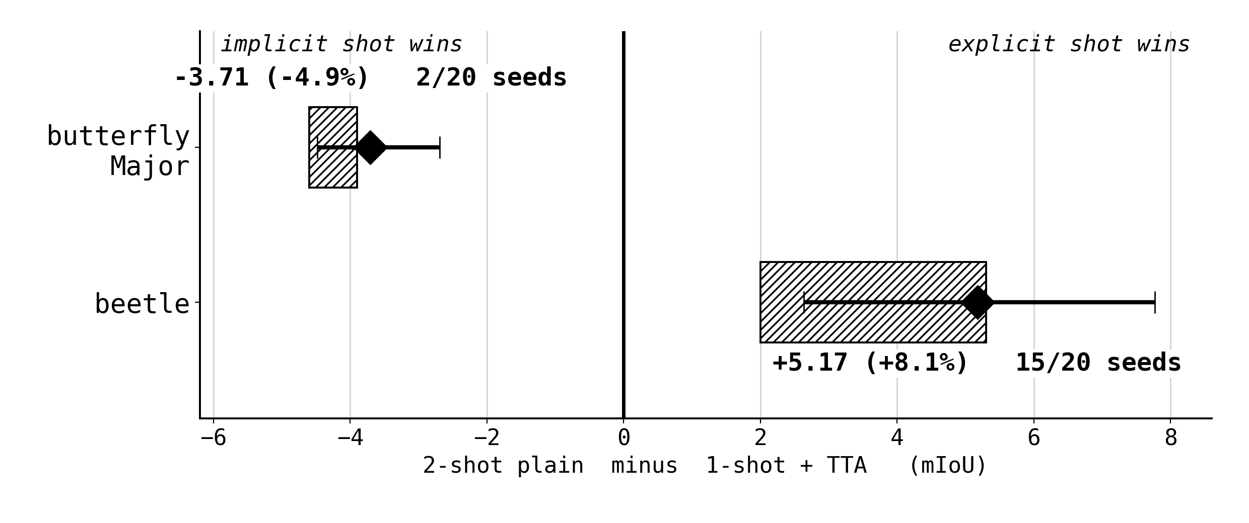
RESULT
The mirror image lands, both signs
butterfly 75.18 vs 71.48, -3.71 (-4.9%), significant, 0.19 short of the band edge
beetle 63.86 vs 69.04, +5.17 (+8.1%), significant, at the top of its band
Gate PASS 14 of 14. The anchors resume S11's cells; the 2-shot cells are new.
Notes:
70s, 4 clicks. Let the figure sit before speaking. Both predicted signs, both significant. Mention the 0.19 miss honestly and say it is on the 2-shot side, which the next slides explain.

Slide 10
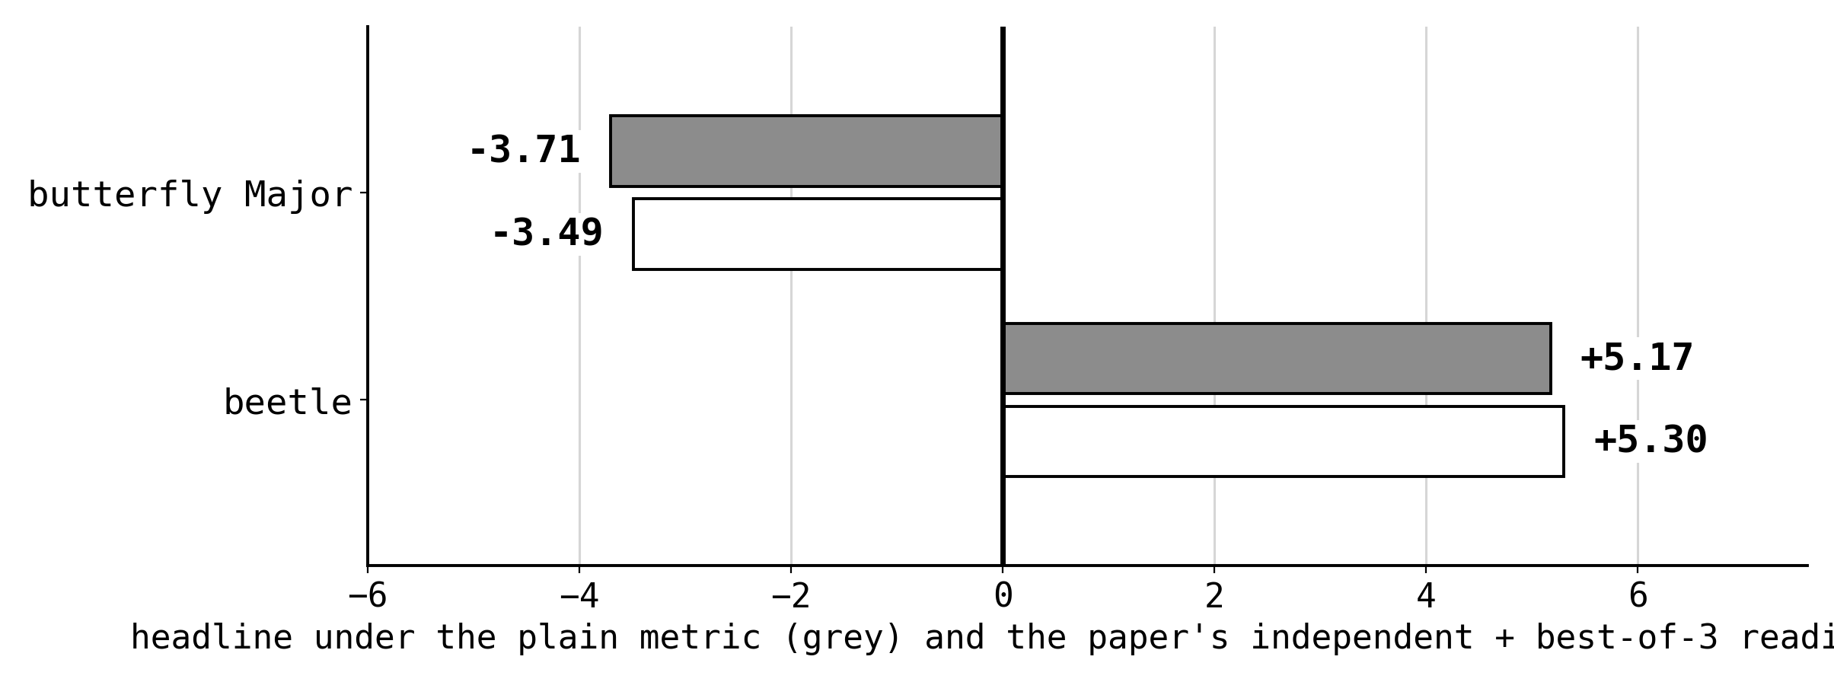
ROBUSTNESS
The sign survives the other reading
Under the paper's full reading, independent overlap plus boundary best-of-3, the headlines are -3.49 and +5.30, both still significant. That reading changes two things at once, and neither sign moves.
Notes:
30s, 2 clicks. Short. Two metrics, same signs, same conclusion.

Slide 11
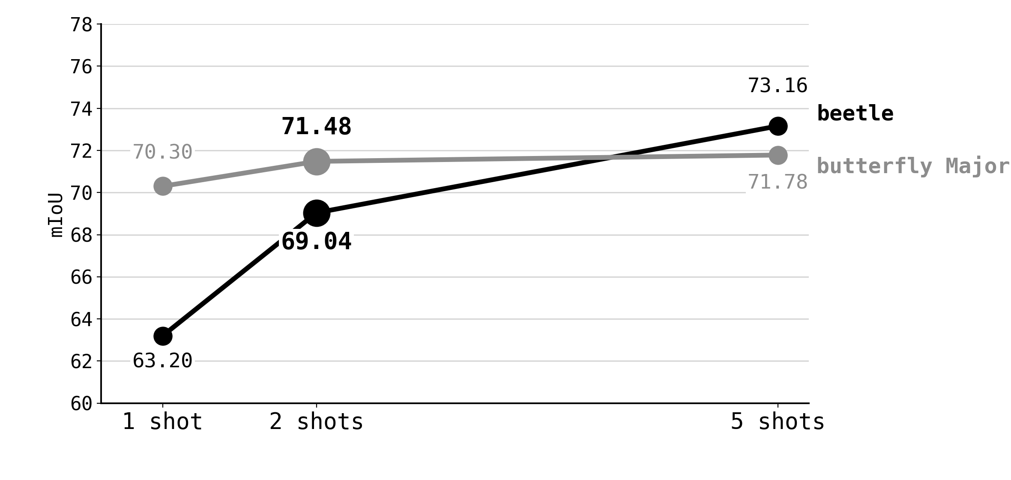
BUTTERFLY MAJOR
Major's shot curve is flat by two
2-shot came in at 71.48 against a predicted 70.6 to 71.3, so the band miss is on the 2-shot side.
+1.18 of the measured +1.48 five-shot lift, 80% of it, arrives with the first added specimen. Unpaired against the banked level.
Notes:
50s, 3 clicks. Explain the miss: the curve saturates. 80% of the 5-shot lift by shot 2 is the number to say.

Slide 12
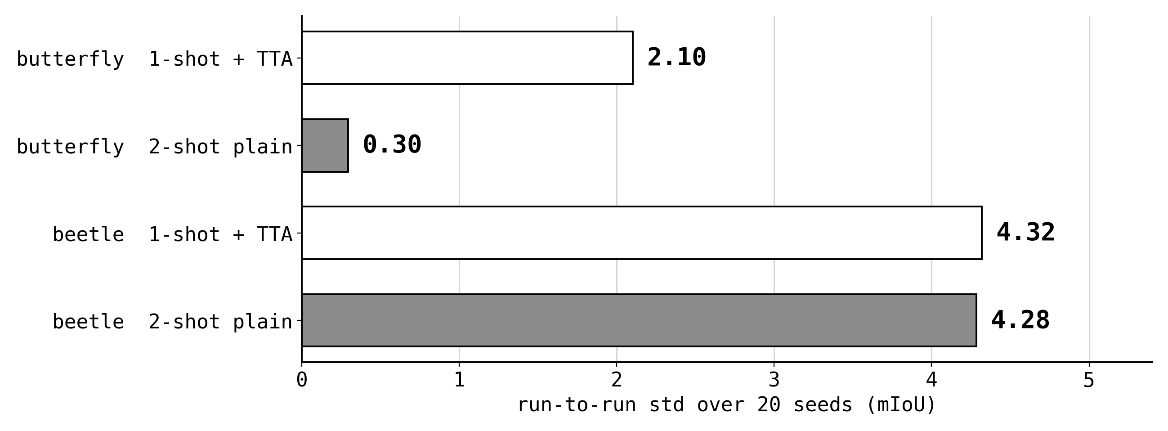
BUTTERFLY MAJOR
The second specimen bought spread
std 2.10 to 0.30, a drop of 86%, the tightest cell measured at 1 or 2 shots. The level stayed 3.71 below TTA.
That is what S5b and S6 said support-side levers do on Major. The residual is query-side, and support-side levers do not reach it.
Notes:
50s, 3 clicks. The second specimen did something real, just not to the level. Tie it back to what S5b and S6 predicted about support-side levers on Major.

Slide 13
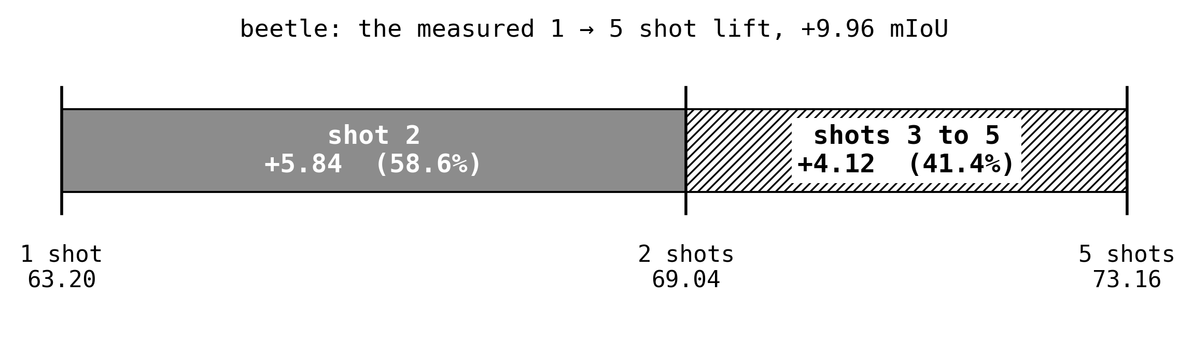
BEETLE
Beetle earns the lift on shot two
+5.84 (+9.2%) over the banked 63.20, unpaired, which is 58.6% of the whole 1 to 5 shot lift from one added specimen.
Concave as predicted, but past the top of the pre-registered 35 to 55% share band. Beetle overshot where butterfly undershot.
Notes:
45s, 3 clicks. Concave as pre-registered. 59% of the lift on the first added specimen.

Slide 14
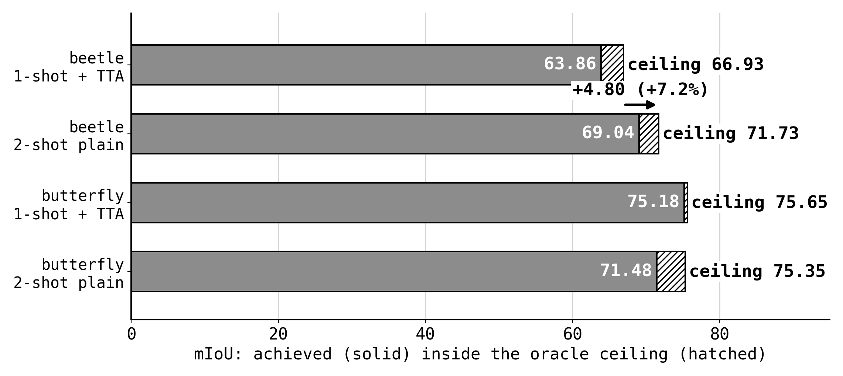
BEETLE
It changed what gets proposed
beetle oracle ceiling 66.93 to 71.73, +4.80 (+7.2%). The second specimen changed the proposals, not just the assignment.
Butterfly's ceiling is flat within a third of a point, 75.65 to 75.35, with no paired test on the oracle reading. S14sam3's arch arm moved this axis by training; here it moved by data.
Notes:
60s, 3 clicks. Give this room. The ceiling moved on beetle and did not on butterfly, which separates proposals from assignment. Connect to S14's arch arm if they were at that talk.

Slide 15
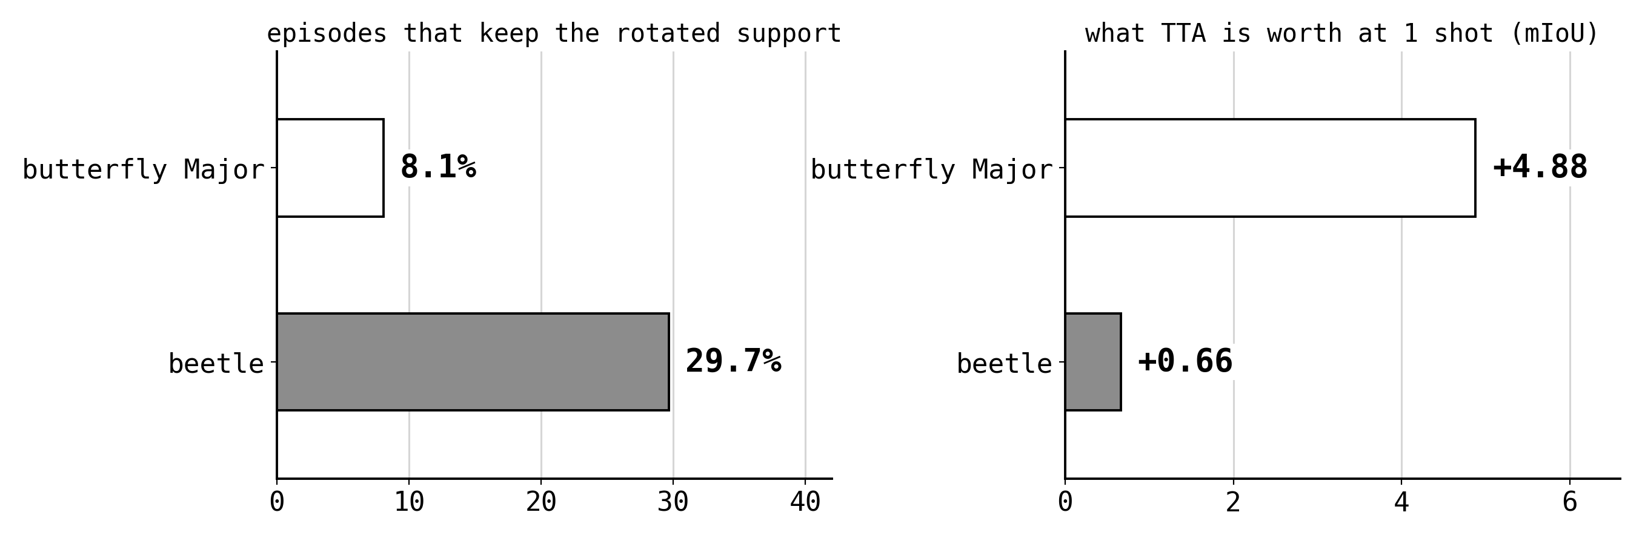
MECHANISM
TTA is an orientation shot only
On beetle the rotated support is kept in 29.7% of episodes and buys +0.66 (+1.0%). The explicit specimen is worth about 9 times that, because a rotated copy adds no species.
On Major it fires in 8.1% of episodes and is worth +4.88 (+6.9%), because those are the rotated queries nothing else reaches.
Notes:
60s, 3 clicks. The mechanism sentence of the whole stage. Fires often and pays little on beetle, fires rarely and pays a lot on Major.

Slide 16
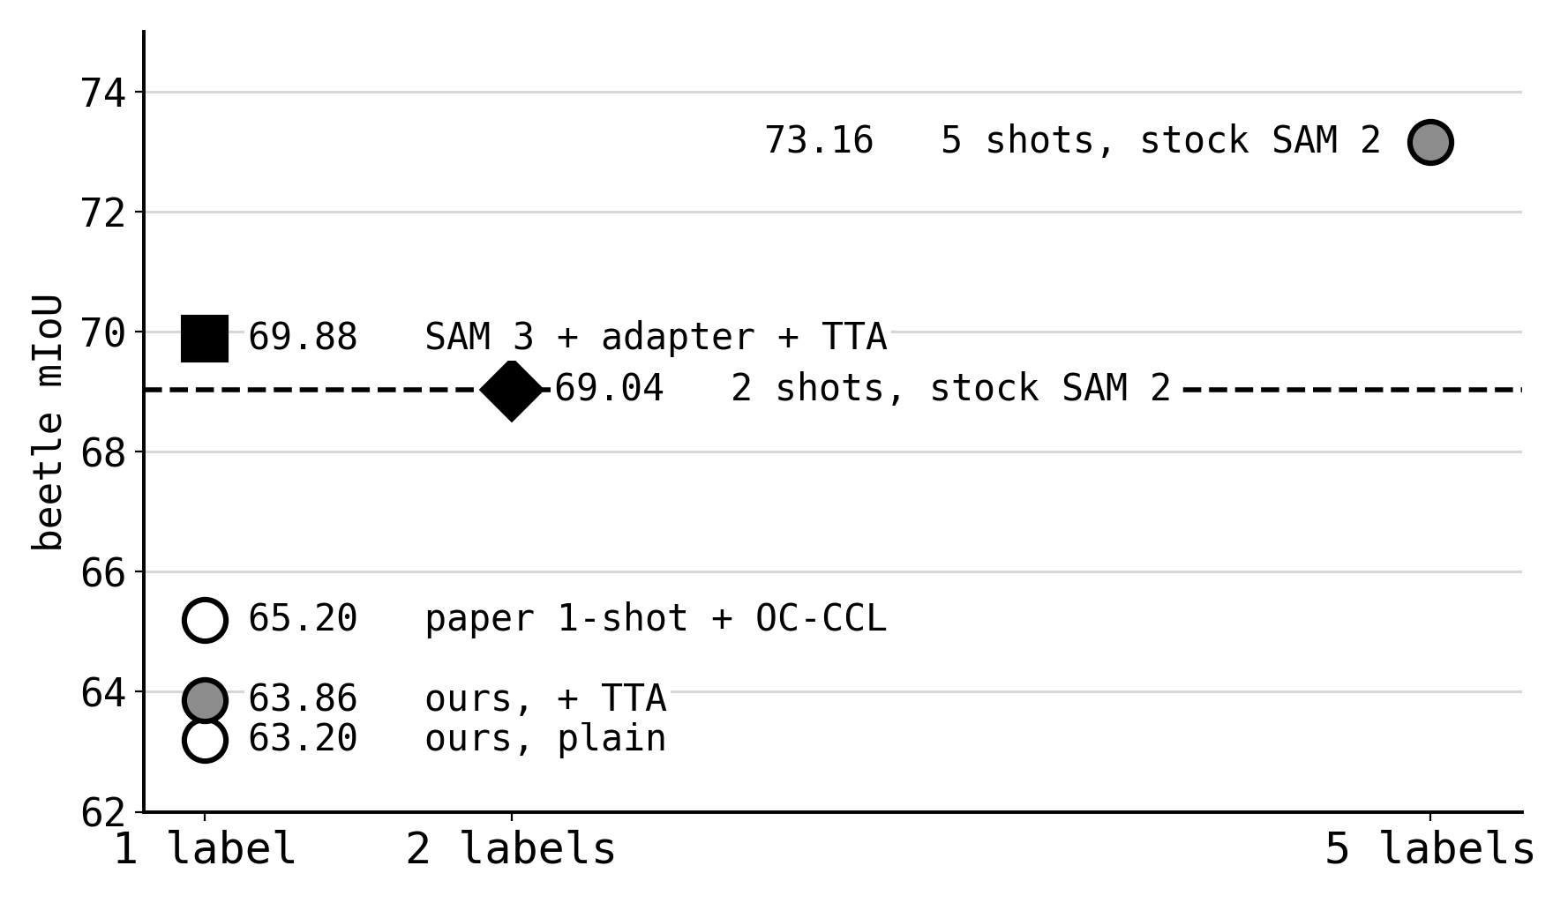
WHAT IT COSTS
What the second label actually buys
One extra labelled mask on stock SAM 2 puts beetle at 69.04, within noise of the project's champion at one label, 69.88, which is a model swap plus a trained adapter plus TTA.
On SST's own label axis the cheapest training-free point above the paper's 1-shot OC-CCL row of 65.2 is now 2 labels.
Notes:
55s, 3 clicks. The practical result. Two labels, no training, no TTA, is within noise of the trained champion at one label.

Slide 17
WHAT IT SUGGESTS
Three things this changes
01
The two datasets are mirror images, each by the mechanism its own residual named. Neither result generalises to the other.
02
Ask what a technique adds, not how many references it looks like. TTA adds an orientation, not a specimen.
03
A second label is the strongest per-label lever measured on beetle, and it needs no training at all. 5-shot is still larger.
S16, gate PASS 14 of 14, landed 2026-09-01. Every number here is in results/s16.zip.
Notes:
60s, 4 clicks. One line per click. Land the mirror image, then the framing point about what a technique adds, then the cost. Leave up for questions.

Slide 18
BACKUP
Every cell, as recorded
1-shot + TTA
2-shot plain
headline
butterfly plain
75.18 +/- 2.10
71.48 +/- 0.30
-3.71 (-4.9%)
butterfly best-of-3
76.72
73.23
-3.49
butterfly oracle
75.65
75.35
-0.30
beetle plain
63.86 +/- 4.32
69.04 +/- 4.28
+5.17 (+8.1%)
beetle best-of-3
65.45
70.75
+5.30
beetle oracle
66.93
71.73
+4.80
20 seeds per cell. CIs on the plain rows: butterfly [-4.48, -2.69], 2 of 20 seeds improved; beetle [+2.63, +7.77], 15 of 20. The oracle rows are differences, with no paired test run on that reading.
Notes:
BACKUP, not presented. Jump here for any per-cell number, spread, or CI.

Slide 19
BACKUP
What the gate checks, per dataset
01
both cells on the dataset's canonical protocol, 20 of 20 seeds each
02
the 1-shot TTA anchor reproduces the S11 ledger within 0.5
03
the headline carries its per-run prefix-nesting proof
04
the headline declares the model.tta toggle it crosses
05
2-shot clears the banked 1-shot level, so no conditioning frame is dropped
06
the paper's best-of-3 ran alongside the plain metric
07
the headline itself is recorded with its CI and seed count
Seven per dataset, 14 of 14 PASS. Naming a protocol field in ignore_fields is still refused; the relaxation must arrive with its evidence.
Notes:
BACKUP, not presented. Jump here when asked how the run was guarded or what would have made it fail.

