Slide 1
WHERE THE PROJECT STANDS
Six stages since the last talk, one established recipe, one open mechanism
beetle now passes
both shot counts
SAM 2's fine-tuning
program is closed
Major's residual is
not about the model
S15, S16, S17, S17b, S17c, S17d / S18 built and waiting / Hunter Bridges
Notes:
Title. 25 seconds. Frame the talk as a status report with a roadmap: six stages landed, one recipe came out of them, one mechanism question is still open. Do not preview the numbers.

Slide 2
RECAP
Where that talk left it
01
Seven techniques measured on SAM 2. The ones that paid all changed what the model is shown, not what it optimises.
02
The model swap paid on beetle: SAM 3 plus the architecture-adapted arm took the best 1-shot number from 64.12 to 69.88.
03
Every loss arm on SAM 2 was null, and nobody could say why.
04
Butterfly Major's residual survived curation, both rotation fixes, 5-shot, every loss and two model families.
Three questions were open: is a second labelled specimen worth more than a rotated one, what does the champion do at five shots, and why is every SAM 2 loss arm null.
Notes:
45s, 5 clicks. Recap only. If they were at the last talk, click through the first three and land on the three open questions.

Slide 3
SINCE THEN
What landed since that talk
S16
which second reference pays
PASS 14/14
S15
the champion at five shots
PASS 18/18
S17
what the fine-tune does to its own pairs
PASS 20/20
S17b
the repairs, and whether they compose
PASS 20/20
S17c
the rest of the branch, in one session
PASS 11/11
S17d
the last cell, and the sentinel itself
PASS 11/11
S18
what may cross the centre of the cycle
built, not yet run
Notes:
40s, 3 clicks. The map of the talk. Say the verdict column out loud once, then move; the detail is coming.

Slide 4
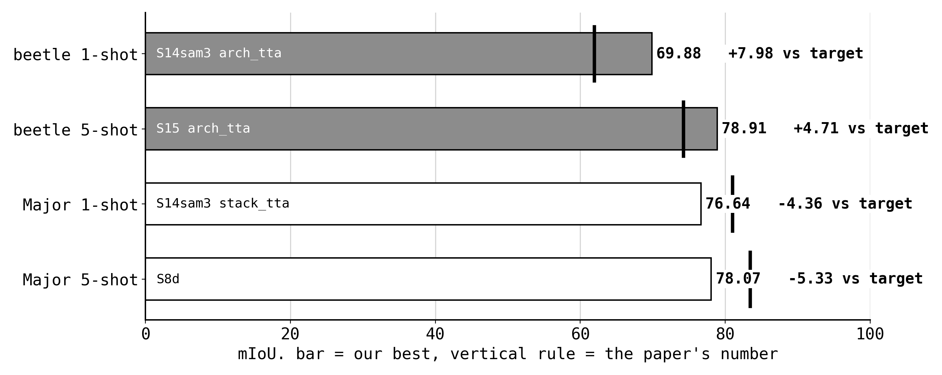
WHERE THE NUMBERS ARE
The scoreboard, as of today
Beetle reproduces at both shot counts and now exceeds the paper at both. Butterfly Major does not reproduce at either.
Everything in this talk is either one of those four numbers moving, or the reason one of them will not.
Notes:
60s, 3 clicks. Let them read the figure. Beetle passes both, Major fails both, and that split organises everything after this slide.

Slide 5
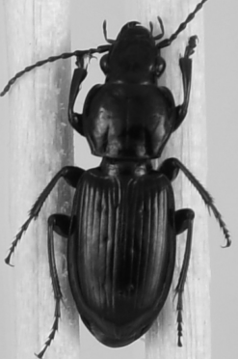
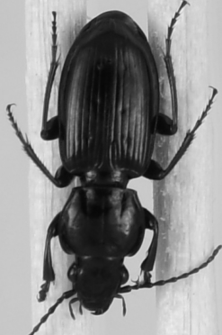
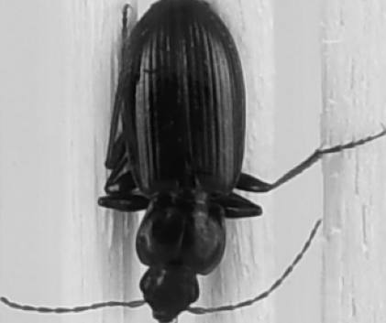
S16
Two ways to spend a second reference
IMPLICIT (orientation TTA)
EXPLICIT (a real 2-shot)
the same specimen turned 180 degrees, outside the memory bank, picked per episode by a confidence rule
a second individual from the same pool, inside the bank, selected by memory attention
cost: 0 labels
cost: 1 label
Every headline arm since S5c has used the implicit version. The explicit one had never been measured.
Notes:
45s, 3 clicks. Only the distinction and the two costs. If short, skip to the footer line.

Slide 6
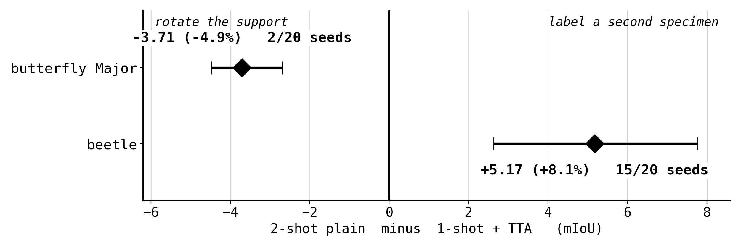
S16 RESULT
Which one pays flips by dataset
Both signs were pre-registered, from each dataset's own residual: Major's defect is query orientation, beetle's is species diversity, and a rotated copy adds no species.
The practical read: two labels on stock SAM 2 puts beetle at 69.04, within noise of the trained champion at one label.
Notes:
55s, 3 clicks. Both signs pre-registered, both landed. The label line is the one to land.

Slide 7
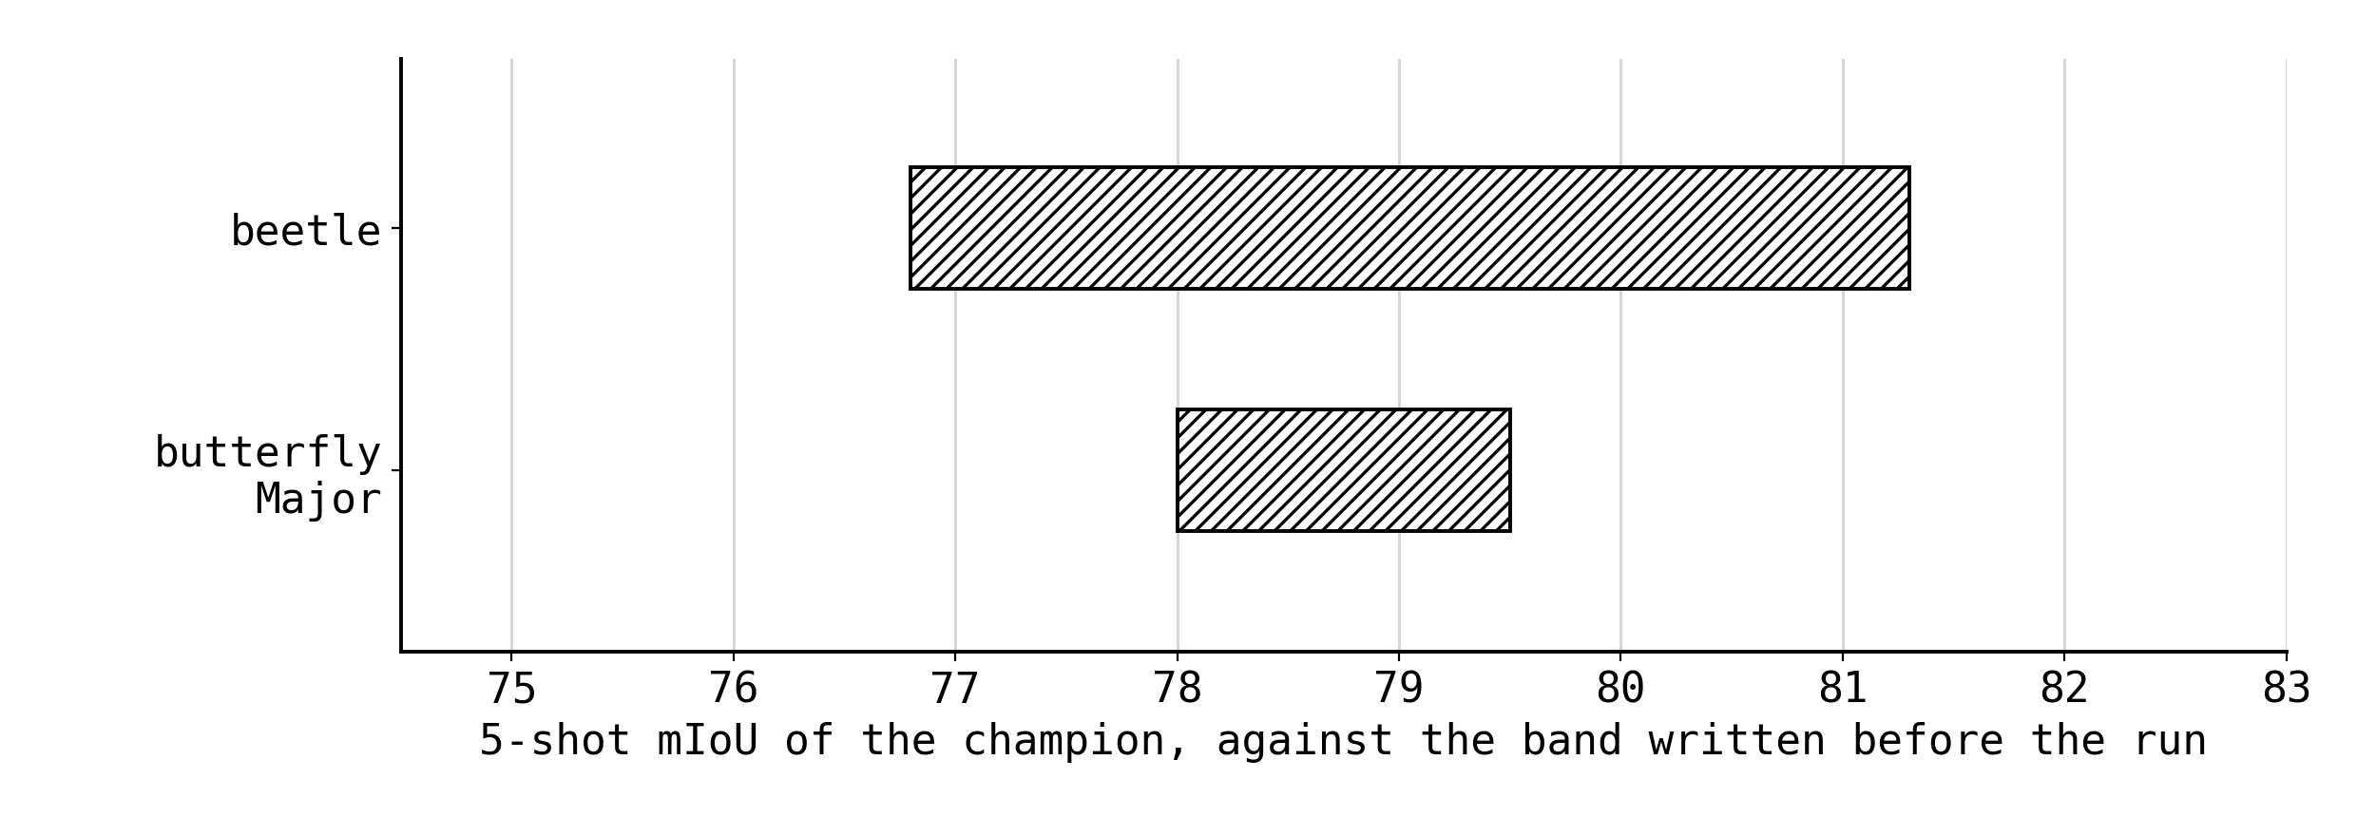
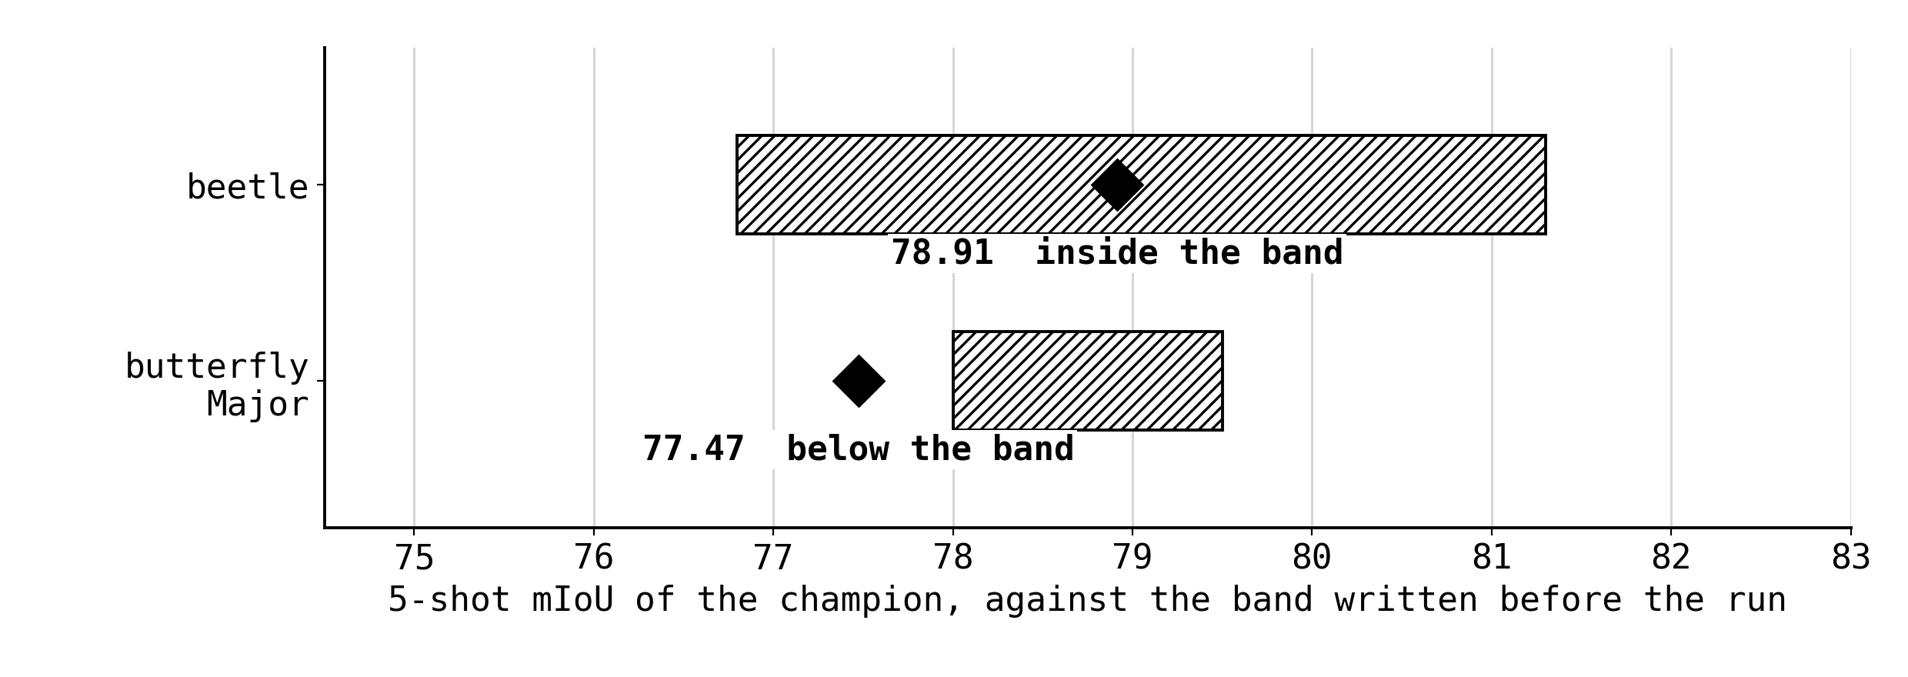
S15
The champion at five shots
Bands written before the run, from two independent anchors: the silhouette score and the 1-shot oracle ceiling plus the measured shot mechanism.
beetle 78.91, inside. Gate PASS 18 of 18, and +3.3 above the paper's best beetle row.
Major 77.47, below its band, and beaten by its own base.
Notes:
70s, 3 clicks. Bands first, then the landing, then Major. Name the two independent anchors, because that is what makes the beetle landing worth quoting.

Slide 8
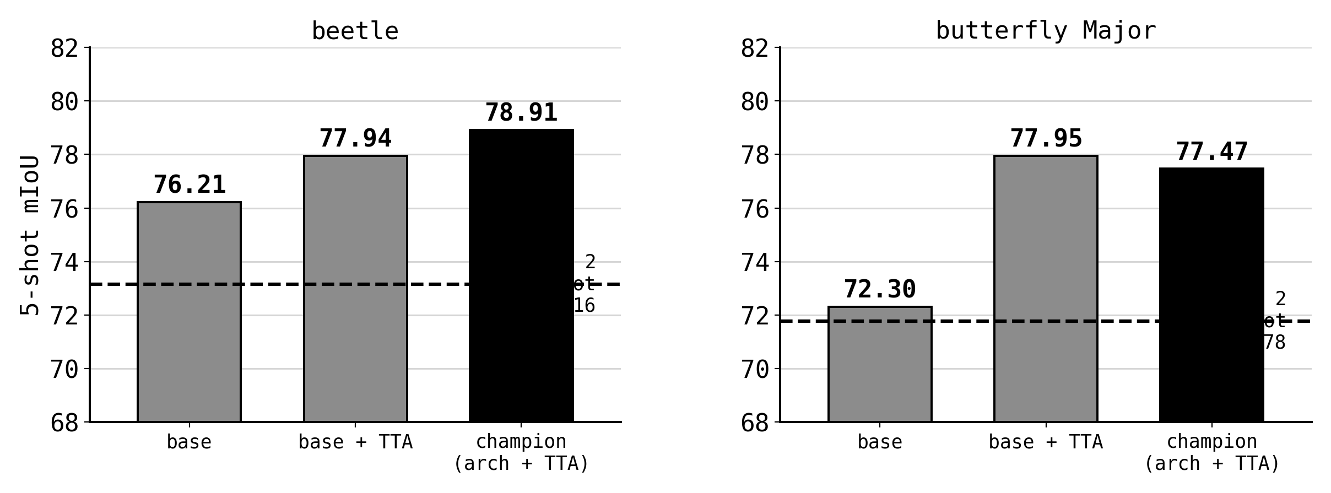
S15
Every cell, both datasets
On beetle the adapter is the top of the stack. On Major the honest number is 77.95 with no adapter at all.
The backbone edge is real on both: SAM 3's plain weights beat SAM 2's by +3.06 on beetle and +0.52 on Major.
Notes:
45s, 3 clicks. The cells. Do not read them all: say the adapter's place on beetle and the no-adapter number on Major.

Slide 9
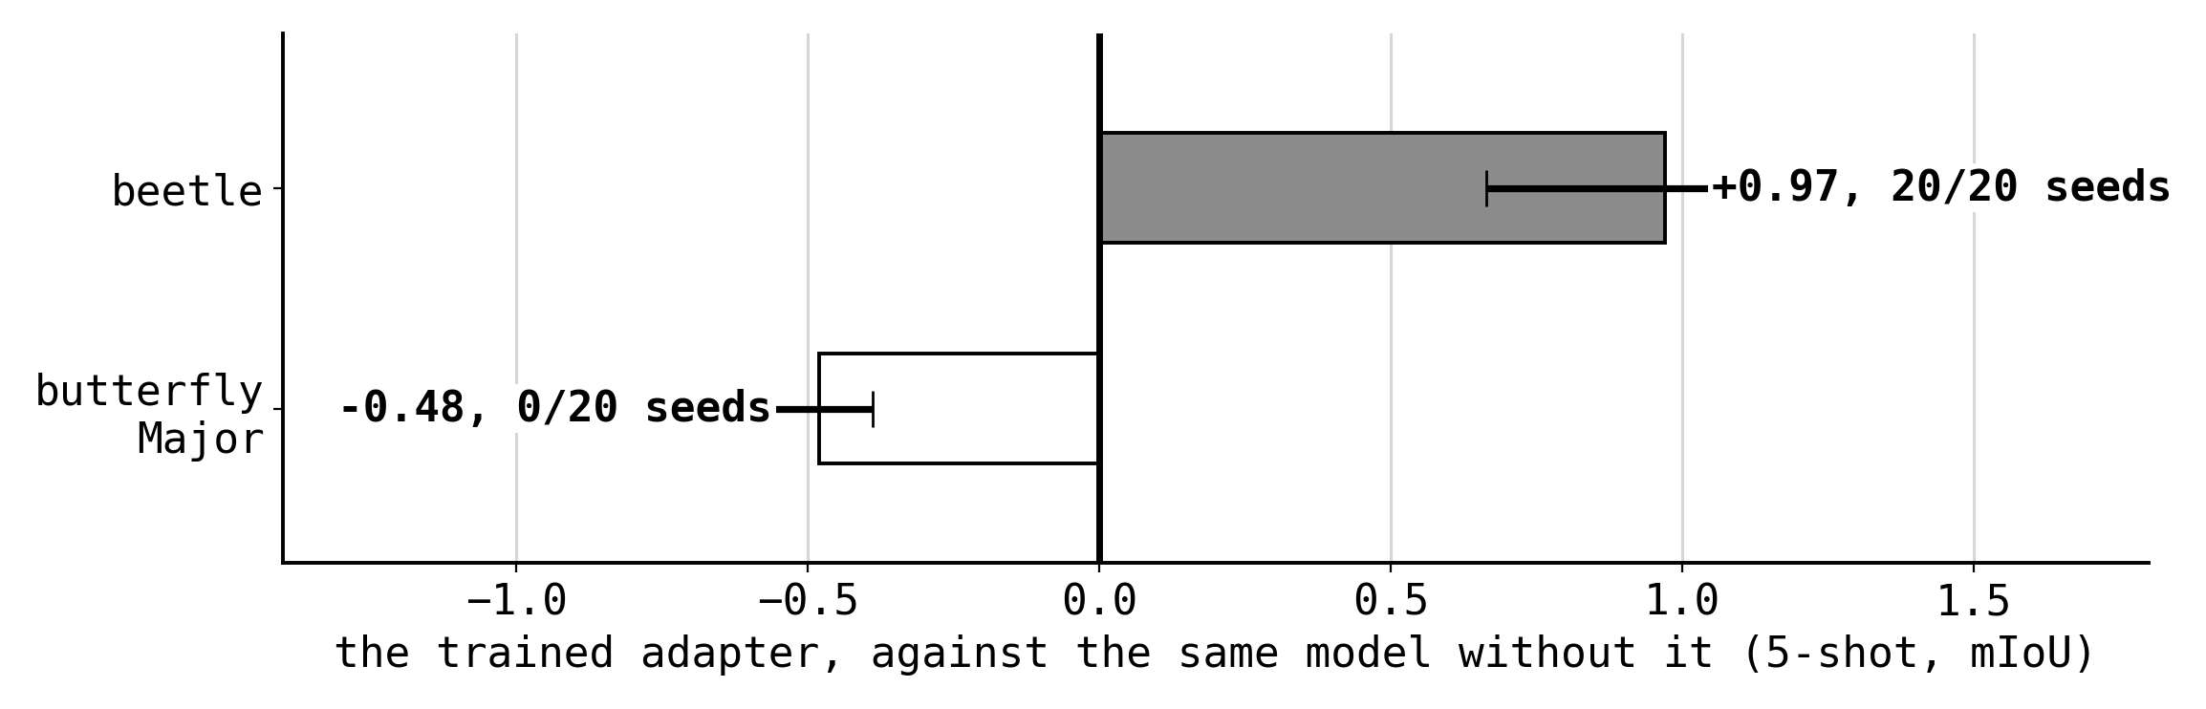
S15
The adapter is beetle-specific
Same adapter, same protocol, same seeds. On beetle it pays on every seed. On Major it costs on every seed.
At 1 shot the beetle contribution was +1.96. At 5 shots it is +0.97, and the next slide is why.
Notes:
40s, 3 clicks. Same adapter, opposite signs, every seed. Set up the next slide by saying the contribution halved from 1 shot to 5.

Slide 10
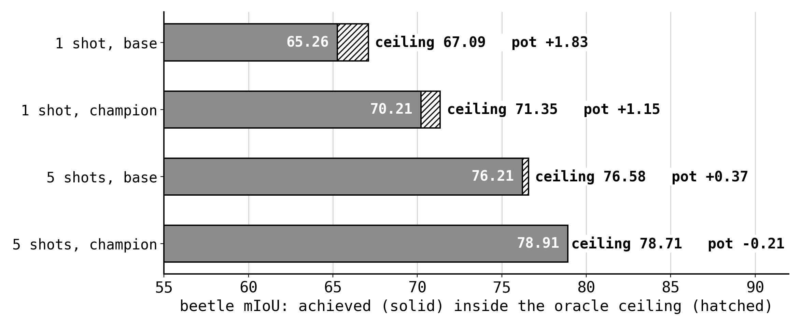
S15
Five labels close the pot
The hatched bar is what the same predictions would score if every proposed region were assigned to the right trait.
At five supports that gap is gone, so there is nothing left for an assignment loss to win. The pot is a function of the label budget, not of the objective.
Notes:
60s, 3 clicks. Give this room. Define the ceiling once, then say the pot is a function of the label budget. This is the bridge from S15 into the whole S17 branch.

Slide 11
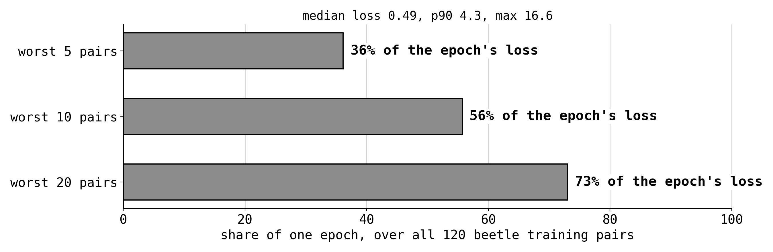
S17 ANATOMY
One epoch is ten bad pairs
Measured on the base model over all 120 beetle training pairs, before any arm was designed.
The merged-silhouette recipe has no such tail. So the question became what those ten pairs are charging for.
Notes:
40s, 3 clicks. The measurement that started the branch. Ten pairs, more than half the epoch.

Slide 12
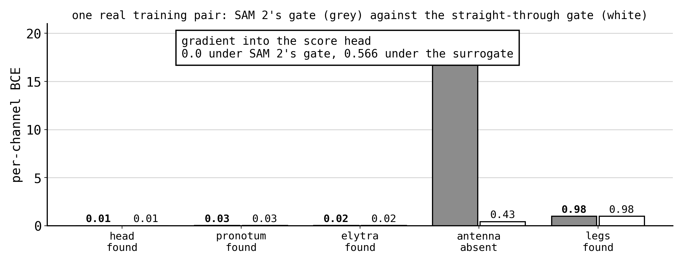
S17 ANATOMY
What they are charging for
When SAM 2 decides a trait is absent it replaces the mask with a constant of -1024. Per-trait BCE then charges 1024 times the trait's area, on all 20 of the worst channels.
62% of the loss value is that constant, and it has no gradient. Nothing in the objective can reach a channel the model did not find.
Notes:
70s, 3 clicks. The core mechanism of the talk. Say the -1024 constant, the 1024-times-area arithmetic, and then the consequence: no gradient, so no loss can reach an unfound channel.

Slide 13
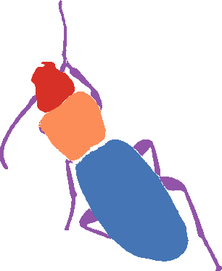
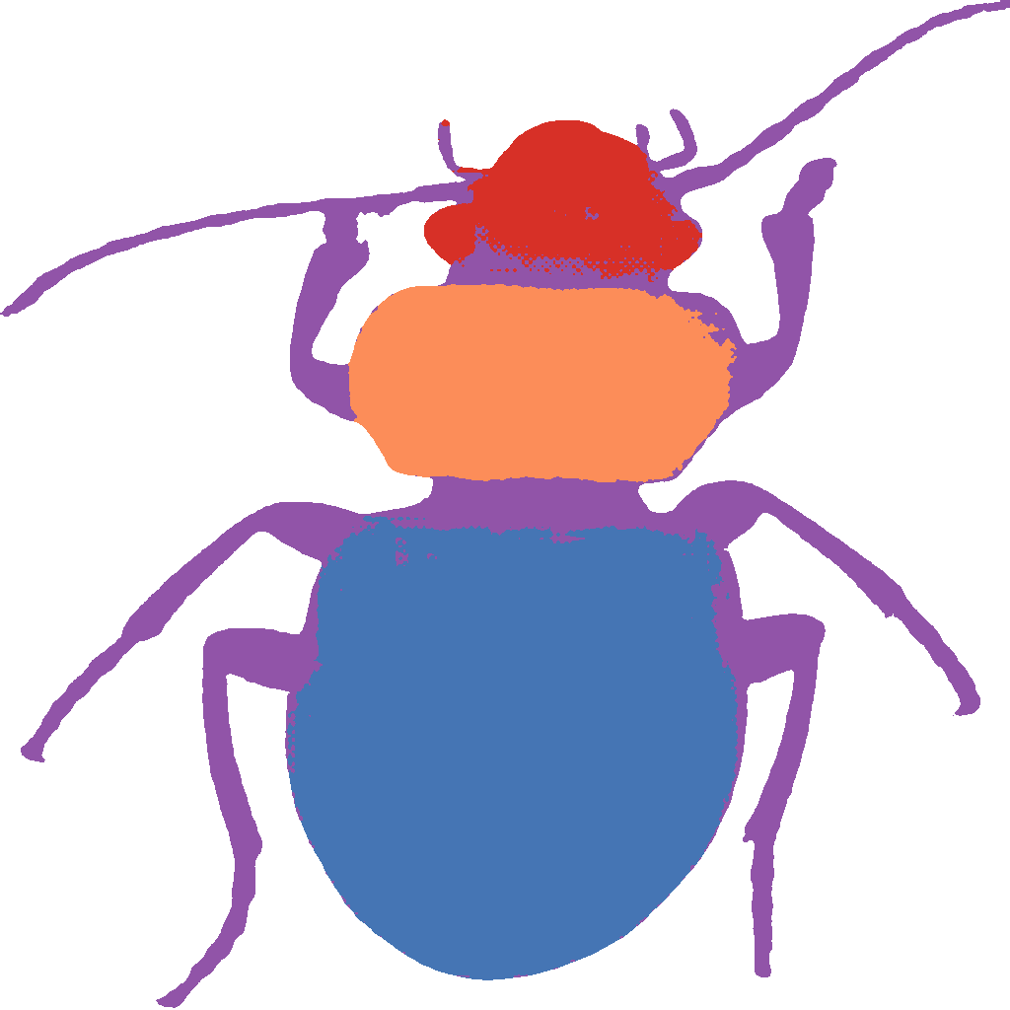
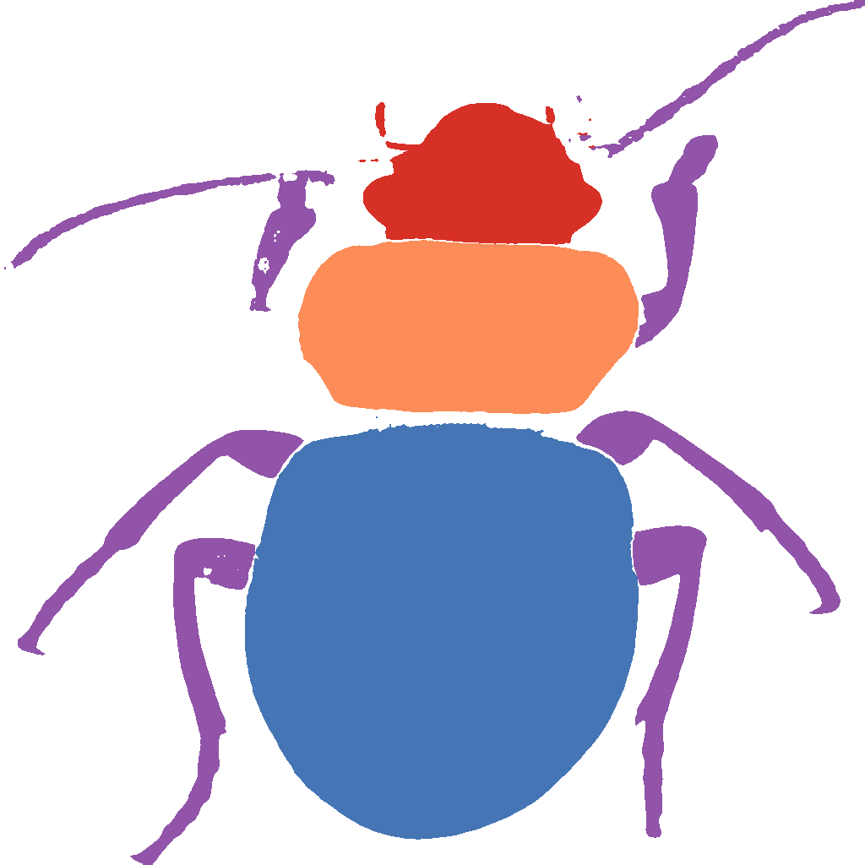
S17
The cycle's own images
forward leg, on the query
closing leg, back on the reference
closing leg, trained arm
base 68.19, trained 67.50
base 60.67
66.57
One real training pair, from the bundle. The antennae are missing from the forward prediction and taken over by the leg channel in the closing one.
Training moves the closing image. It does not move the forward one, which is the image the evaluator scores.
Notes:
60s, 4 clicks. Real images from the bundle. Point at the missing antennae, then at the leg channel taking them over in the closing image, then say what training moves and what it does not.

Slide 14
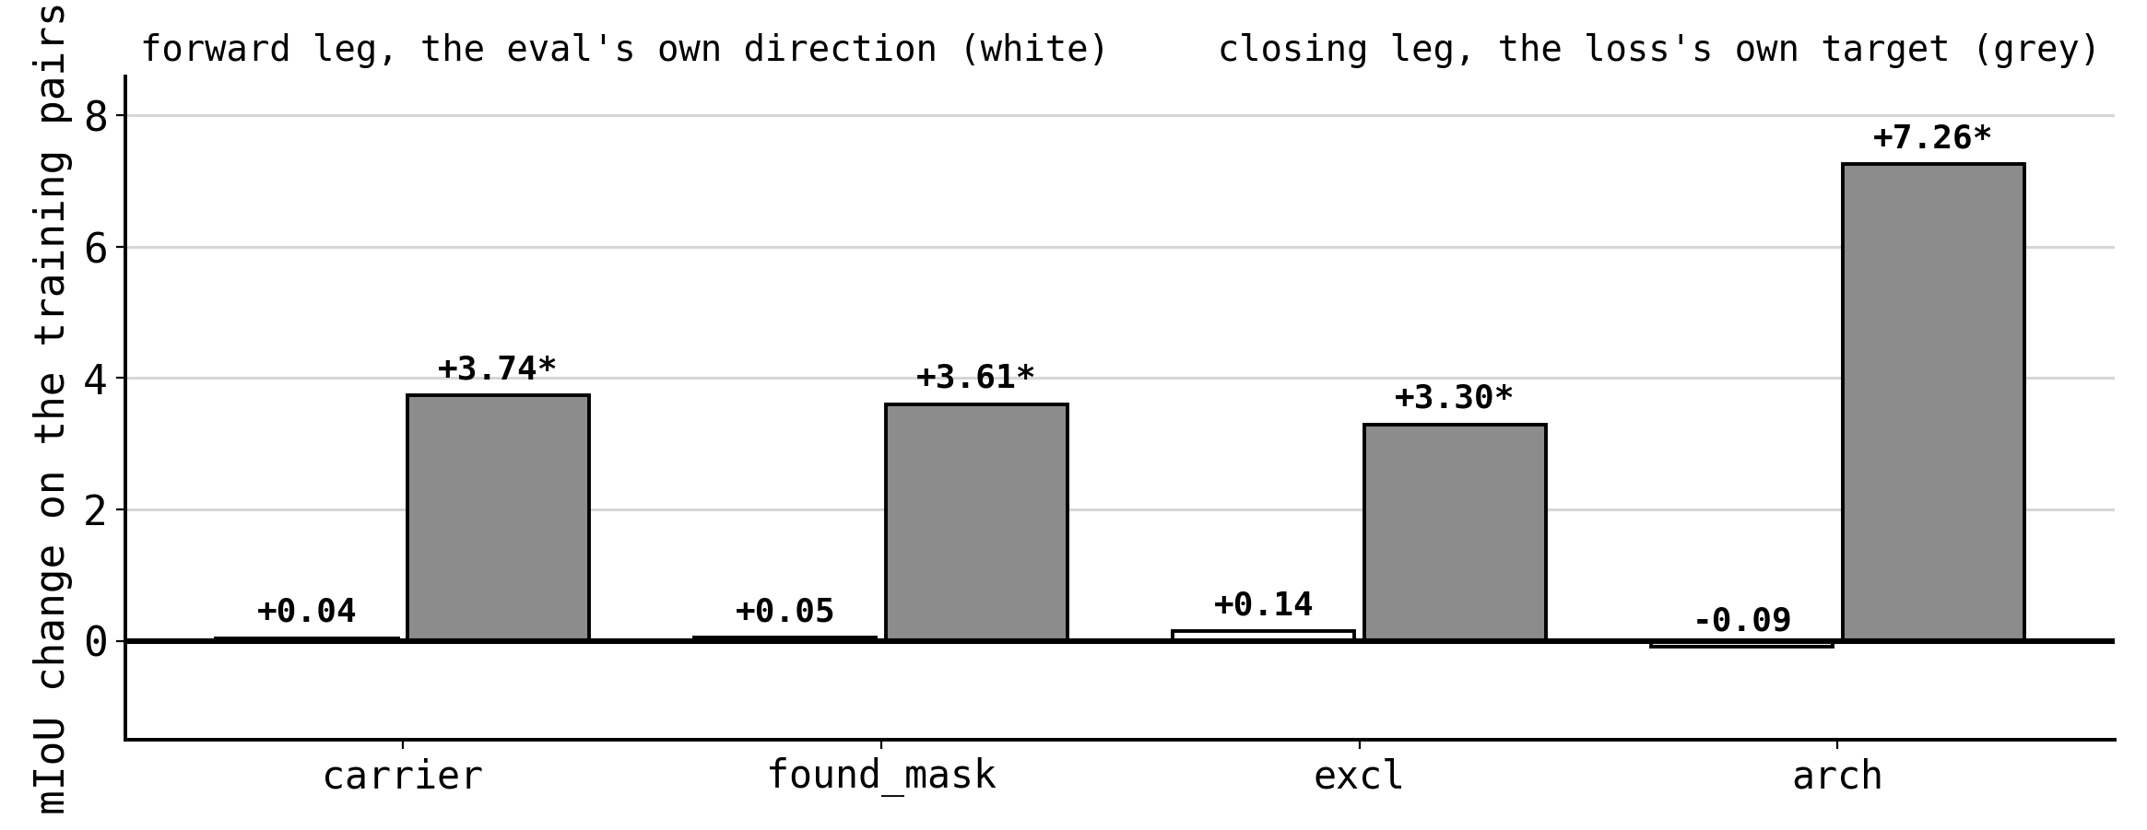
S17 RESULT
The reverse leg absorbs it all
Every arm lowers its own objective, and every arm does it on the closing leg. The correlation between the two legs is 0.01 to 0.31.
On butterfly the forward leg does move, +1.39, which is why OC-CCL pays there and not on beetle. The asymmetry is a property of the training pairs.
Notes:
55s, 3 clicks. The verdict of S17. Absorption on every arm, and butterfly as the control that shows why OC-CCL ever paid.

Slide 15
S17B
Three faults, three repairs
01
The closing head absorbs the objective. Repair: put the adapters on the forward legs only, so the closing frame cannot learn.
02
The sentinel cuts unfound channels out of the graph. Repair: a term on the forward objectness score, which is upstream of it.
03
Exclusivity, kept from the earlier slate: the one closing-loss change that paid on its own.
All three are inside the fine-tune. No model-code change, no extra labels, no change to the evaluator.
Notes:
50s, 4 clicks. One line per repair. Emphasise that all three are inside the fine-tune.

Slide 16
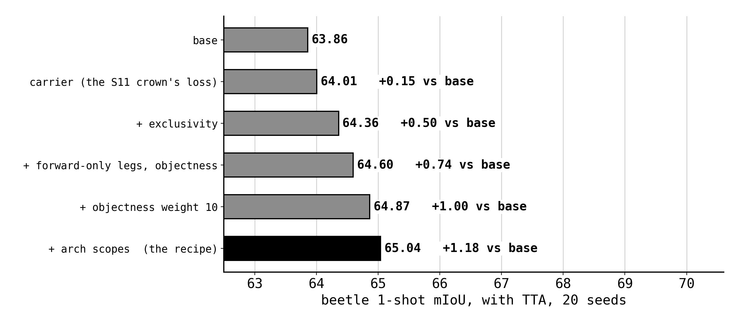
S17B AND S17C
The repairs compose
+0.69 with TTA on 19 of 20 seeds for the composition, the first beetle fine-tuning gain on SAM 2 that is not a reshuffle of channels the model already found.
Notes:
45s, 2 clicks. The ladder. Say the composition number and the phrase about it not being a reshuffle.

Slide 17
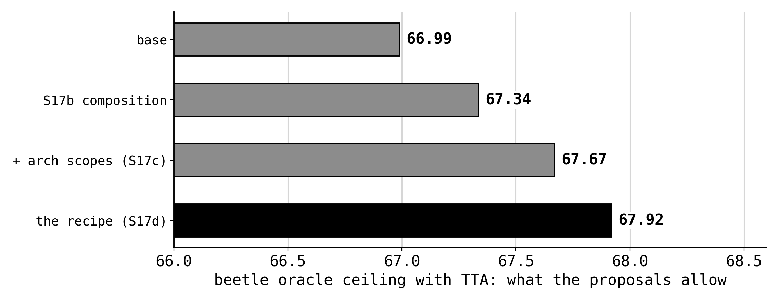
S17B
The ceiling moves, finally
The ceiling is what the proposals allow. On SAM 2 it had not moved for any loss arm in the project.
It moves here, which says the fine-tune changed what gets proposed rather than how the proposals are labelled.
Notes:
40s, 3 clicks. Short. First ceiling movement on this family.

Slide 18
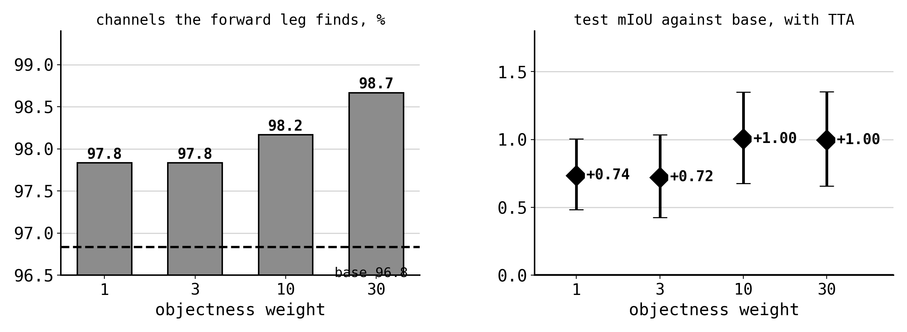
S17C
The prior is free up to 30x
The pre-registration expected a cost at 30. It never appeared: the curve is a plateau, not a peak.
The prior pushes on the objectness score, which is exactly the quantity the sentinel reads.
Notes:
35s, 3 clicks. The plateau, and the falsified prediction. Say that the prediction was wrong out loud.

Slide 19
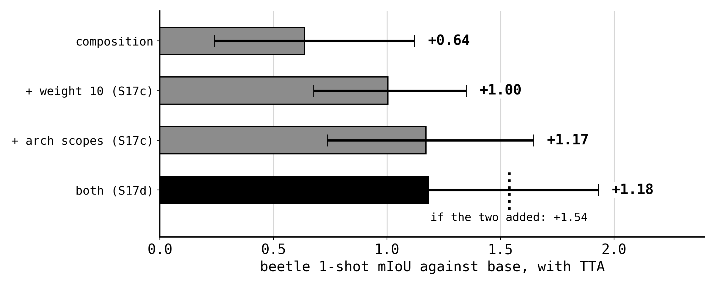
S17C AND S17D
Scope subsumes the weight
Two levers, each real on its own, and the composition lands below their sum. Pre-registered as either +0.71 if they add or +0.44 if the scope subsumes the weight.
65.04 against 65.03 for the scope alone, +0.01 on the same seeds across two sessions.
Notes:
45s, 3 clicks. Sub-additive, and pre-registered as one of two outcomes. The measured answer is the second one.

Slide 20
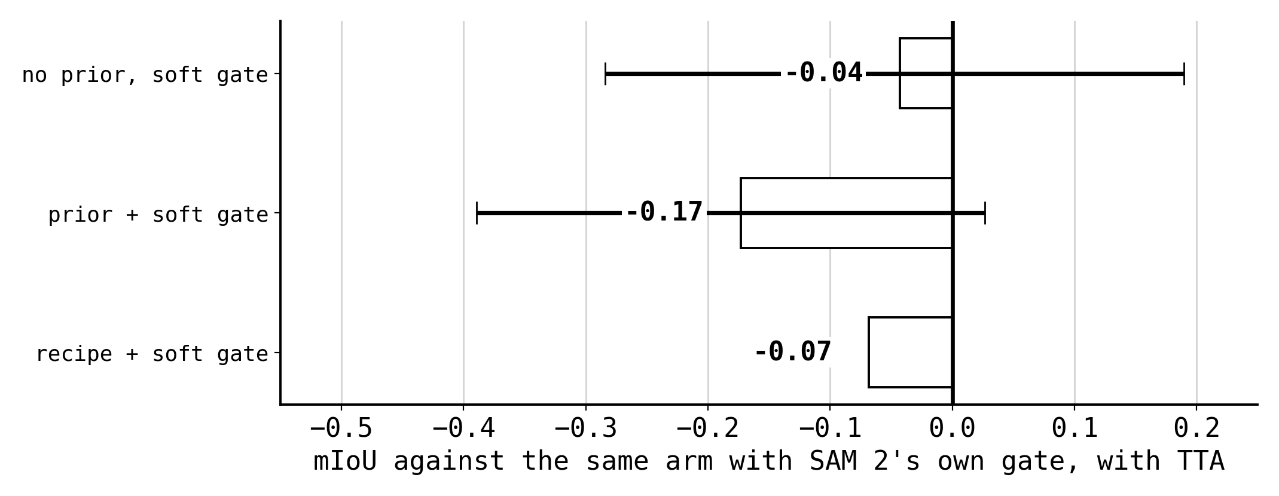
S17D
The fence, made differentiable
Replacing SAM 2's hard sentinel with a straight-through surrogate is exact at base weights and turns the score head's gradient from 0 into 0.566 on a real pair.
It then flips 1 of 19 fence channels on its own, and costs -0.13 on top of the prior. The loss is now honest about the fence and does not want it.
Notes:
55s, 3 clicks. The cleanest negative result in the branch. Exact at base weights, gradient turned on, and the loss still does not want the fence.

Slide 21
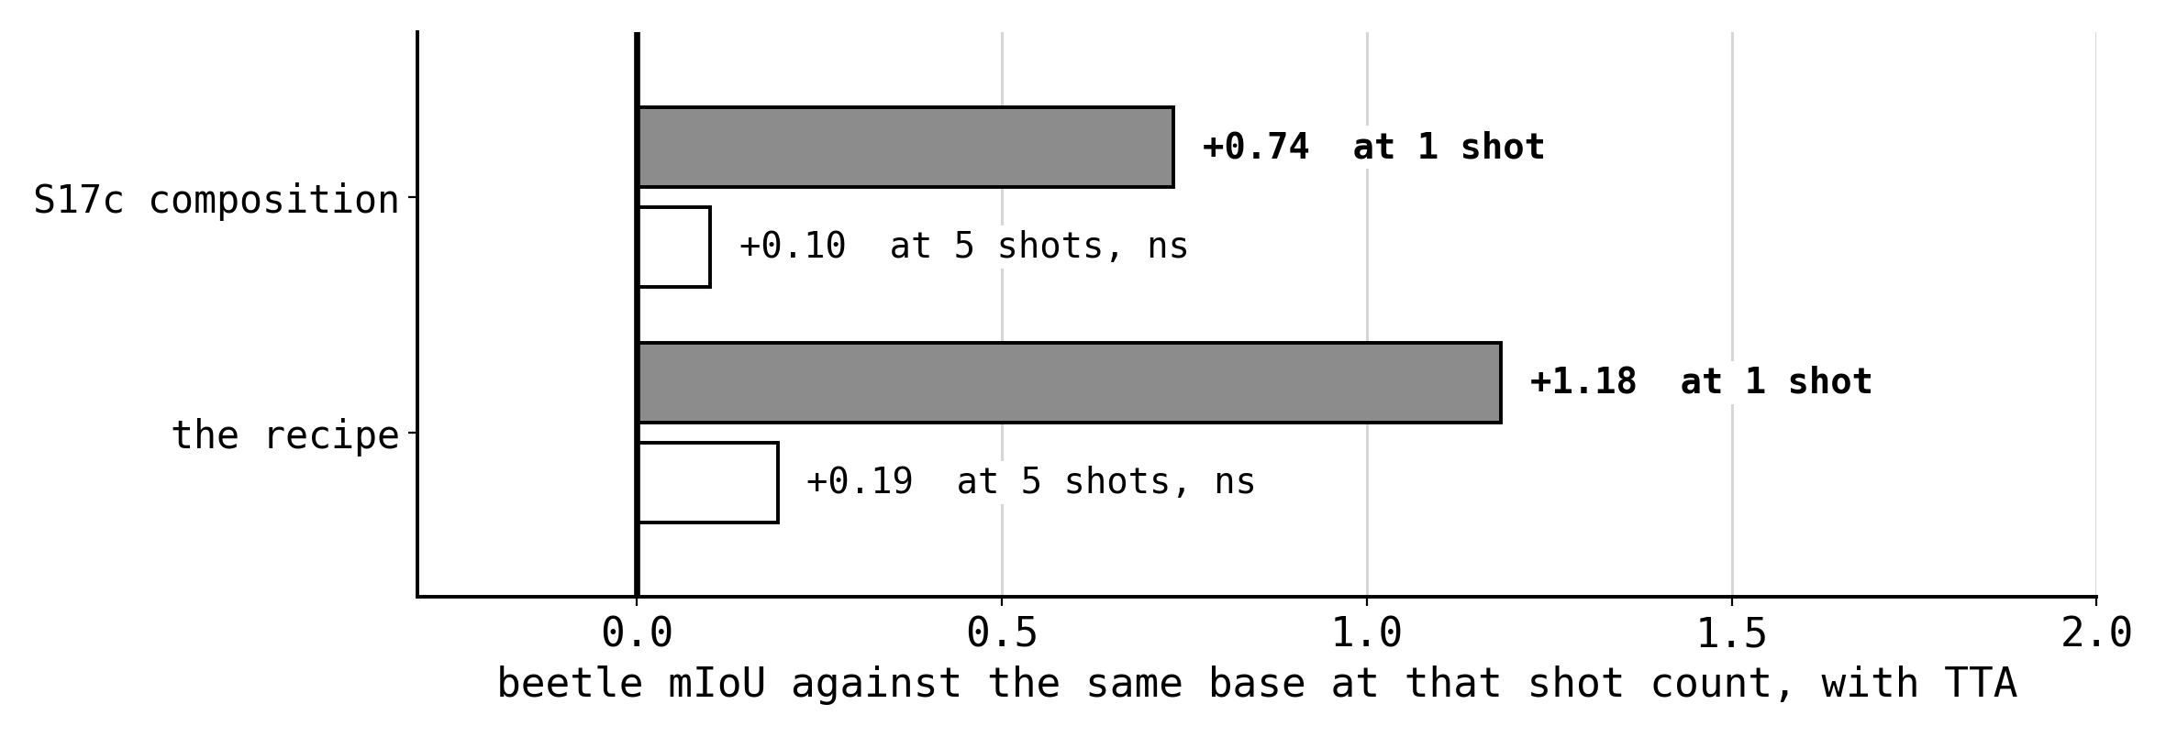
S17C AND S17D
None of it reaches five shots
Three SAM 2 adapters have now been measured at five shots and none of them moves the number.
Consistent with S15: at five supports a trait absent from one reference is present on another, so the fence the fine-tune repairs is not standing. That reading is not itself measured.
Notes:
40s, 3 clicks. Three adapters, no 5-shot effect. Flag the mechanism sentence as unmeasured.

Slide 22
THE OUTPUT
sam2_crown, established
forward-only legs
removes the absorption
objectness prior, weight 10
reaches past the sentinel
exclusivity
the one closing-loss change that paid
arch scopes
puts the proposal-forming module in scope
the S11 carrier
per-trait, lr 1e-5, one epoch, r=32
Pinned in the registry and re-derivable from a record's own fields. Every future SAM 2 fine-tune uses it, and a stage that departs from it says so in its brief.
Notes:
55s, 3 clicks. The deliverable. Read the five components, not the evidence column; leave that for questions.

Slide 23

THE FAMILY IS CLOSED
Where SAM 2 stops
65.04 with TTA, +1.18 over base, oracle ceiling 67.92. That is 0.16 short of the paper's own OC-CCL row and 4.8 below the SAM 3 champion.
Every remaining axis inside the family is measured and closed. What is left is outside it.
Notes:
50s, 3 clicks. Where the family stops, with the champion on the same axis. This is the handoff into the roadmap.

Slide 24
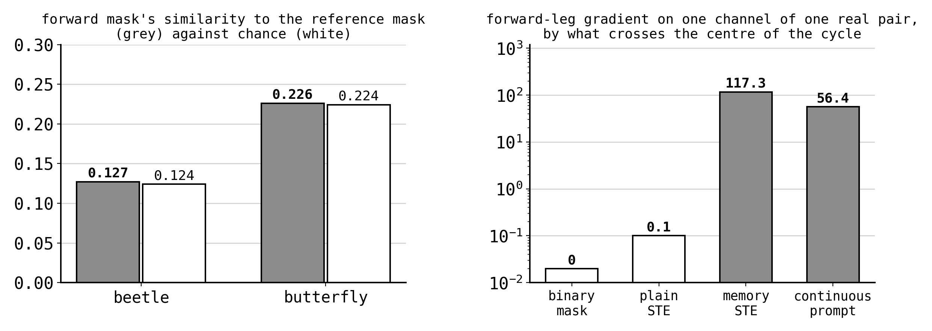
NEXT, BUILT AND WAITING
What S18 asks
The cycle is satisfied without the forward mask improving. The mask itself is not being carried: its similarity to the reference sits at chance.
What is left is the prompt. It hands the reverse leg a full continuous logit map, a channel the evaluator never scores. S18 binarises it and keeps the gradient.
Notes:
70s, 3 clicks. The mechanism question. Say the similarity-at-chance result first, because it rules out the obvious story, then the prompt as the only route left.

Slide 25
AFTER S18
The port that is left
01
Carry the two repairs that worked, forward-only legs and the objectness prior, to SAM 3, where the same memory-attention arm already sits at 69.88.
02
The parts are family-agnostic by construction: both were written against per-object logit stacks so they could transfer.
03
The 5-shot result says to expect this at one shot only, and that is a prediction worth writing down before the run.
Cost is one session. The alternative on the same axis is a second support, which S16 already priced at one label.
Notes:
55s, 4 clicks. The port. One session, and a prediction to pre-register.

Slide 26
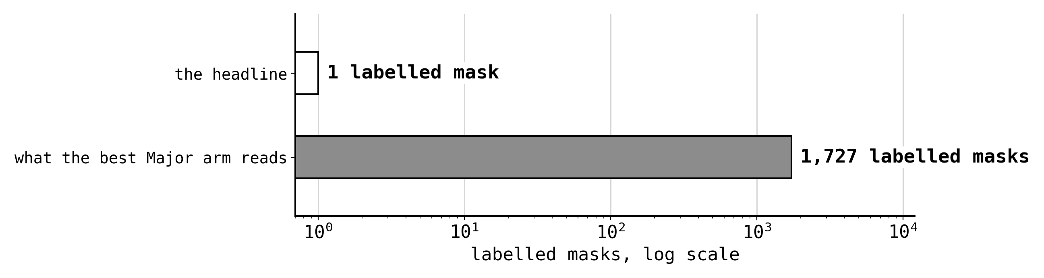
THE UNCOMFORTABLE AXIS
What the headline hides
SST's claim is about labels. The best Major arm reads 1,727 labelled masks to choose which single reference to use.
The defensible version is that curation stands in for human judgement, and a human does not need 1,727 masks. That is testable offline: shrink the pool and find where the drawn support stops changing.
If it converges at about 20, the headline becomes 20 labels, which is a different paper.
Notes:
60s, 4 clicks. The uncomfortable number. Do not defend it; state the test that would settle it and what each outcome would mean.

Slide 27
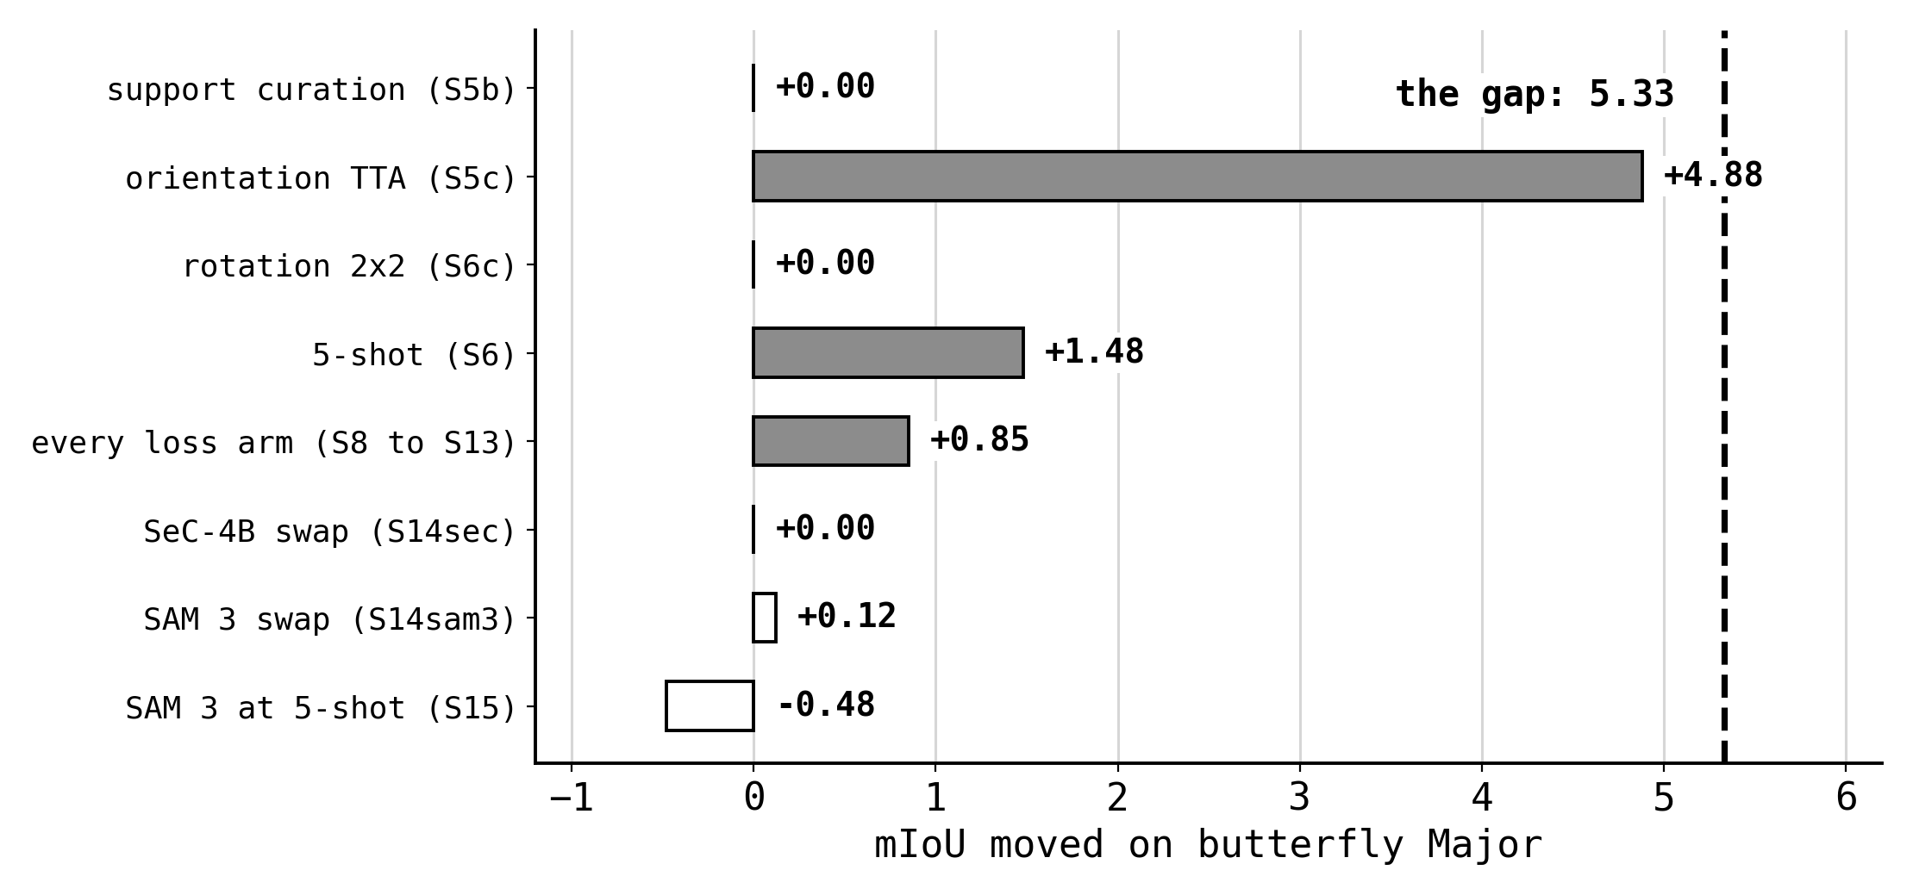
THE OPEN GAP
Major's residual, after all that
Rotation handling is worth 4 to 5 points and is the only lever that ever moved this dataset. Everything else lands at zero.
Two model families at two shot counts leave it where it was, so the remaining candidate is the protocol or the annotations, not capacity.
Notes:
55s, 3 clicks. Everything that has failed to move Major, against the gap. End on protocol or annotation, not capacity.

Slide 28
WHERE IT GOES
Three sentences
01
Beetle is done as a reproduction: it exceeds the paper at one shot and at five, and the label-cheapest routes to it are now priced.
02
SAM 2's objective has been taken apart and put back together, and it tops out 4.8 below what a model swap already gives.
03
The next three moves are S18's mechanism, the port of the two repairs to SAM 3, and the label-budget audit that decides what the headline can say.
Every number in this talk traces to a bundle in results/ and a gate that passed.
Notes:
45s, 4 clicks. Three sentences, one per click. Stop talking after the third.

Slide 29
BACKUP
The gates behind this talk
S15
champion at 5-shot, both datasets
PASS 18/18
2026-09-13
S16
implicit vs explicit second reference
PASS 14/14
2026-09-01
S17
the cycle's own images, 5 arms
PASS 20/20
2026-09-16
S17b
forward-only legs, objectness
PASS 20/20
2026-09-16
S17c
weight, lr, epochs, scope, link
PASS 11/11
2026-09-17
S17d
scope x weight, the soft sentinel
PASS 11/11
2026-09-17
S18
the palindrome's bottleneck
built, smoke green
pending
Owed, and named in the README: the s11, s13 and s14ft bundles for their formal gates, which sit on Drive rather than in results/inbox.
Notes:
BACKUP, not presented. Jump here for a gate verdict or a landing date.

Slide 30
BACKUP
The cells this talk quotes
beetle 1-shot, SAM 2 base
63.20 plain
63.86 + TTA
beetle 1-shot, the recipe
63.71 plain
65.04 + TTA
beetle 1-shot, SAM 3 champion
69.88 + TTA
beetle 5-shot, SAM 2 base
73.09 plain
75.16 + TTA
beetle 5-shot, SAM 3 champion
78.91 + TTA
Major 1-shot, best
76.64 + TTA
Major 5-shot, SAM 3 base
72.30 plain
77.95 + TTA
Major 5-shot, best (SAM 2)
78.07 + TTA
20 seeds per cell. Every cell and every paired delta is in the stage bundle it came from.
Notes:
BACKUP, not presented. Jump here for any level this talk quoted.

