Slide 1
SEVEN TECHNIQUES
Measured against one baseline / SAM 2 and SAM 3
Support-side curation
Orientation TTA
Loss and model swaps
A findings talk / about 20 minutes / Hunter Bridges
Notes:
35s. Frame the talk as a ledger: one baseline, seven techniques, each measured the same way. Flag that the last section changes the model, not the method.

Slide 2
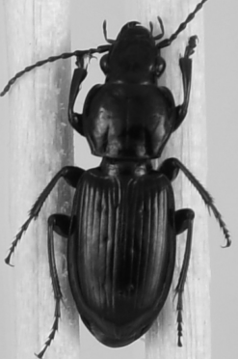
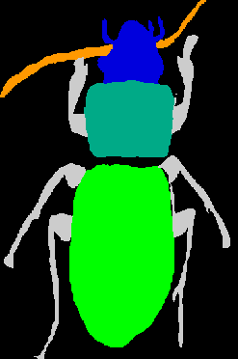
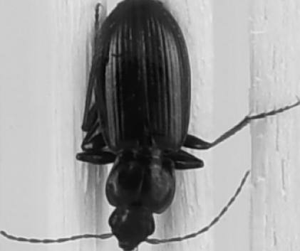
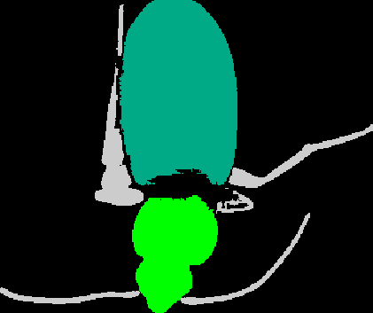
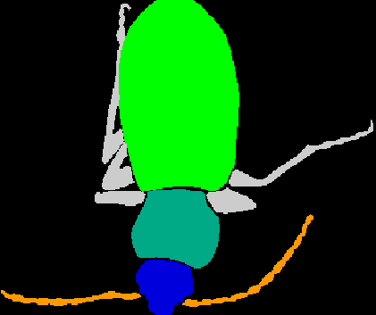
THE TASK
The task
support
its trait masks
query
prediction
ground truth
one 2-frame video · masks propagate from frame 0 to frame 1
the query is pinned 180°, and the prediction follows the support's layout
Notes:
50s, 6 clicks. Name each panel as it lands. Establish that this is real project output, not a diagram. End on the failure: the query is inverted and the prediction inherits the reference layout. Four of seven techniques exist because of it.

Slide 3
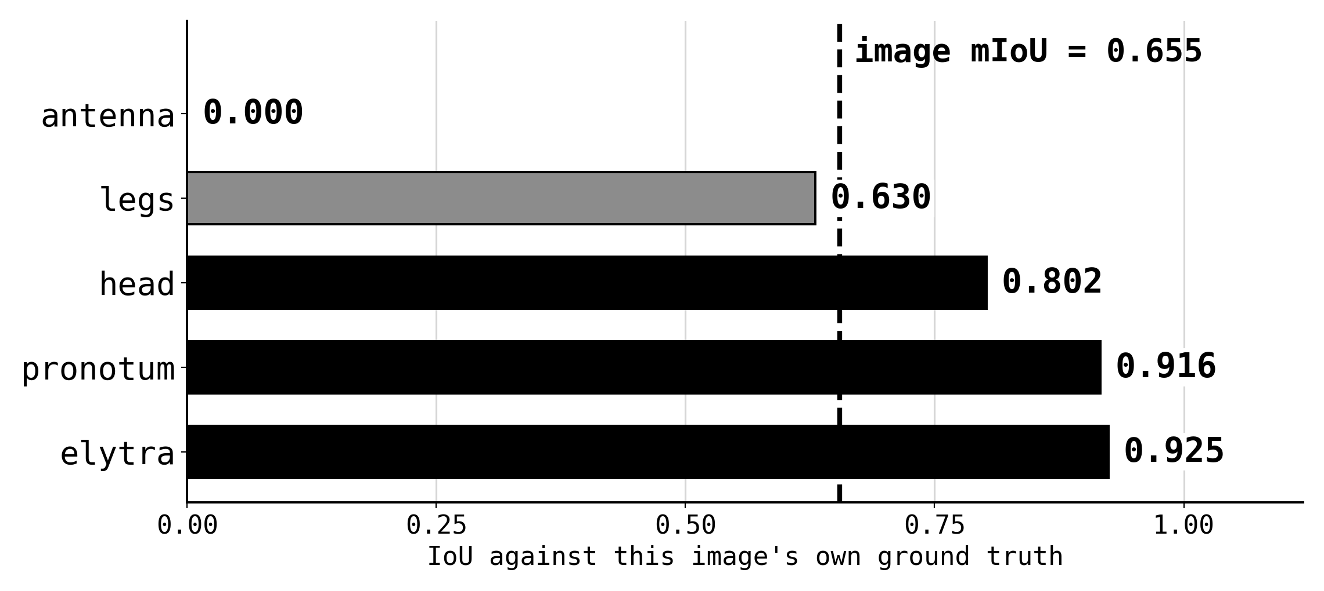
THE UNIT EVERY NUMBER IS IN
How a score is computed
1
resize logits to GT resolution
one real query: beetle_1166_231, run 0
2
each pixel takes its best-scoring trait
3
best logit <= 0 means background
4
IoU per trait present in this GT
5
image score = mean over those traits
what a number means
1.00 is every pixel of every trait correct.
Traits are averaged, not pixels, so a hair-thin antenna counts as much as the elytra.
A ground-truth trait the model never claims scores 0.
then the mean over the images in a run, and the mean over 20 runs
Notes:
45s, 8 clicks. Define the unit before any number is spoken. Build the five steps, then the worked example, then the semantics card. The line to land: traits are averaged, not pixels, so a missed antenna costs as much as a missed elytra. Say 0.655 and point at the zero.

Slide 4
THE PREMISE
The baseline
55.96
68.54
± 7.90
± 3.15
Beetle, 1-shot, uniform supports
Butterfly Major, 1-shot, uniform supports
target: 61.9 ± 3.7
target: 81.0 ± 1.0
how each technique is judged
20 draws / same draws both arms / paired per seed / CI / band frozen first
run-to-run spread is reported as a result, not an error bar
Notes:
55s, 4 clicks. Say all four numbers. Then the protocol line. Close on the spread and why it counts as a result: it measures sensitivity to the draw, so a matched mean with double the variance is not a reproduction.

Slide 5
TECHNIQUE 1 · SUPPORT-SIDE
Curating the reference
01
Measure the body axis
directed vector between two trait centroids
02
Take the threshold from the data
the train pool's own circular std, 55.6°, not tuned
03
Estimate on train only
no test orientation may touch the pool
04
Require every trait present
the second half of the criterion
120 candidate references → a pool of 79
Notes:
55s, 5 clicks. One click per step. Emphasise the threshold discipline: 55.6 degrees is the train pool's own circular std, pinned by a test. Give the train-only step ten seconds; otherwise you get a leakage question.

Slide 6
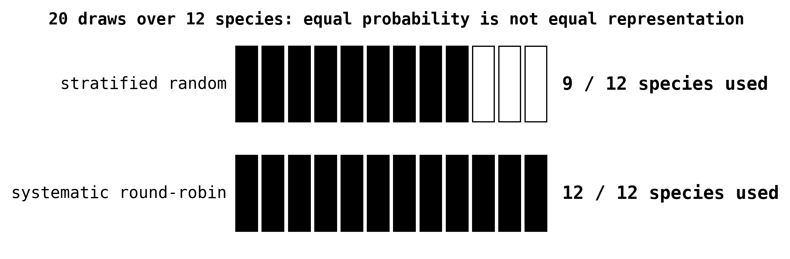
TECHNIQUE 2 · SUPPORT-SIDE
Fixing the draw
the filter keeps 10/10 of one species and 4/10 of three others
run r starts at species r mod 12
Notes:
45s, 3 clicks. A defect curation itself introduced. The middle click is the instructive one: stratified random fails at n=20, three species went unused. Skip the seeding details.

Slide 7
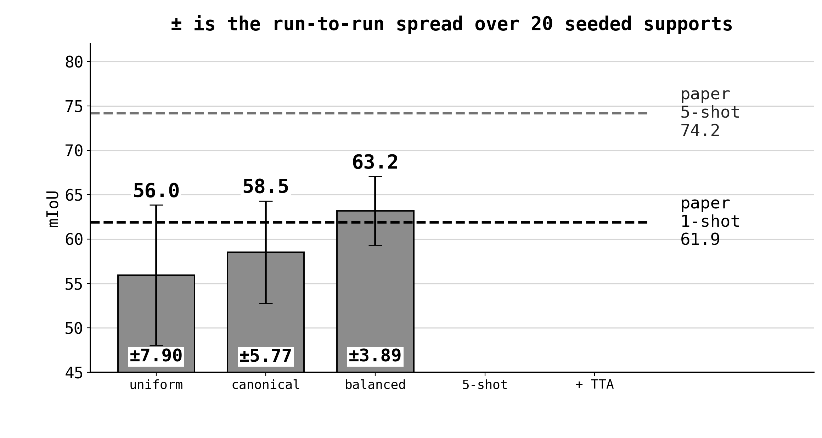
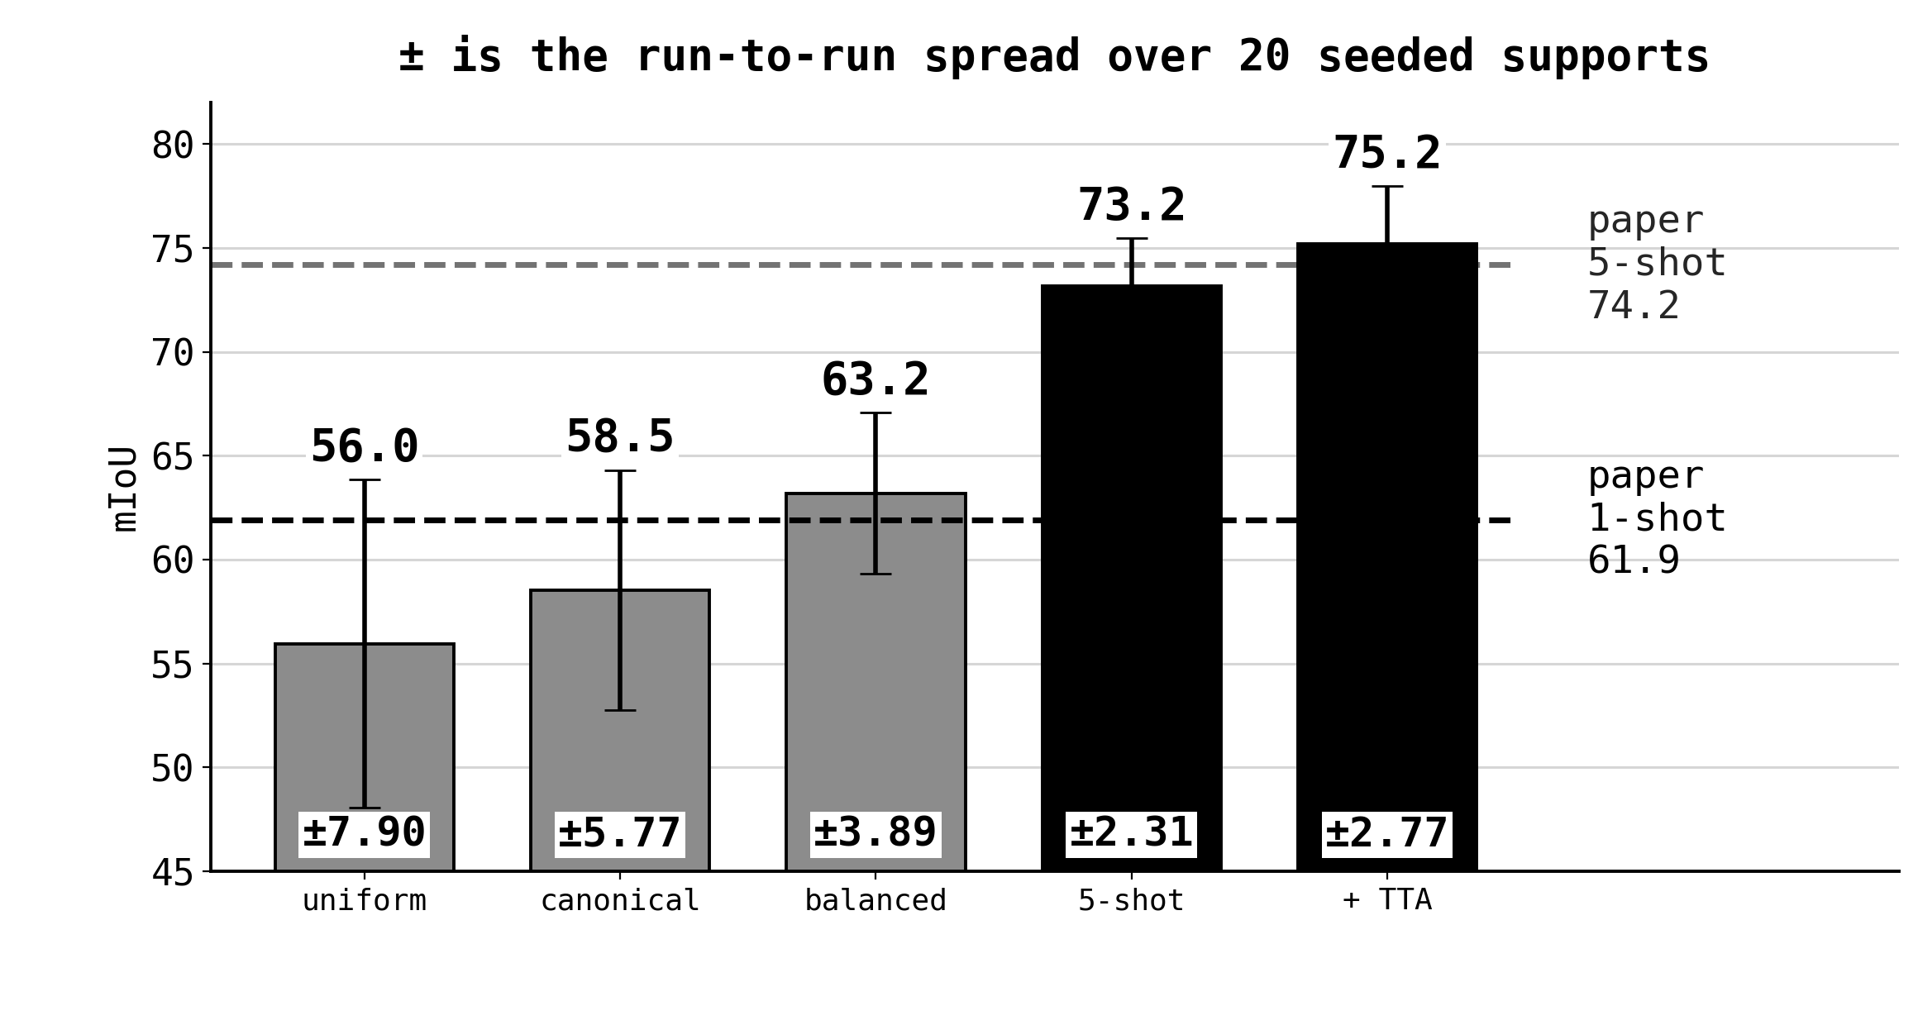
WHAT THOSE TWO BOUGHT · BEETLE
What those two bought
+7.24 mIoU (+12.9%) head 43.6 → 55.9 spread 7.90 → 3.89
Notes:
55s, 2 clicks. Say the three levels and the three spreads. Then the per-trait breakdown: head 43.6 to 55.9 for curation, pronotum +8.7 for balancing. Each fix moved the trait its diagnostic predicted.

Slide 8
TECHNIQUE 3 · SUPPORT-SIDE
Placement curation
Butterflies are not mis-oriented
Change the statistic, keep the rule
Pinned wings are already canonical.
They lie loosely on a sheet, so placement varies rather than angle.
Centroid displacement from the train median.
Threshold = mean + 1 std, the same discipline.
68.54 → 70.30 +1.90 (+2.8%)
the two criteria fired on disjoint subspecies, each where its diagnostic predicted
Notes:
50s, 4 clicks. Same rule, different statistic, because butterflies have a different defect. Say 68.54 to 70.30 and note the spread matters more. Close on the disjointness of the two criteria.

Slide 9
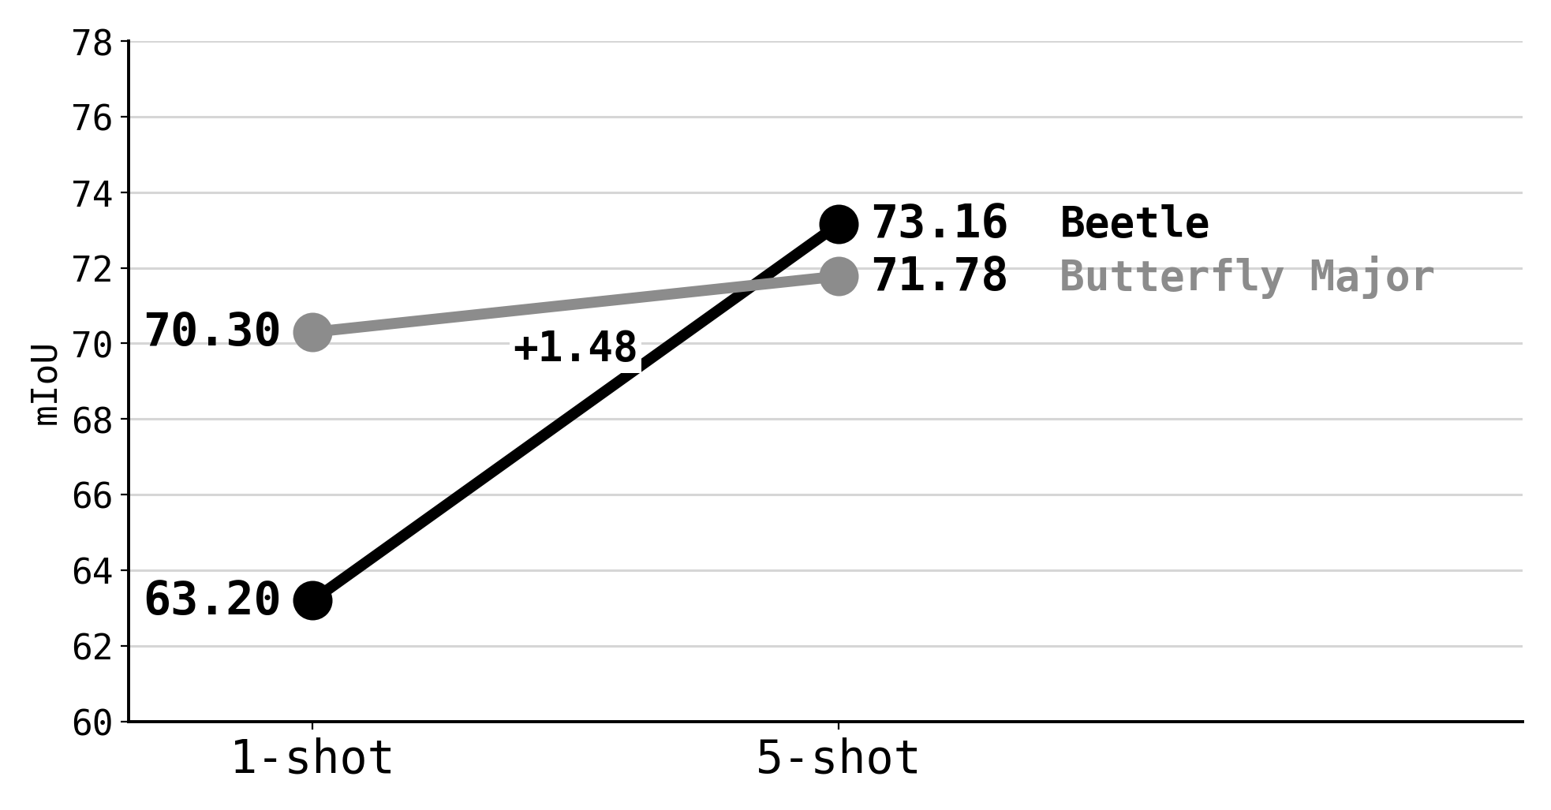
TECHNIQUE 4 · SUPPORT-SIDE
More references
beetle +9.96 (+15.8%) butterfly +1.48 (+2.1%)
butterfly gains 1.48; its defect is on the query side
Notes:
45s, 3 clicks. Contrast +9.96 and +1.48, then explain the asymmetry: five references fix defects whose cause is the draw. The ninefold spread collapse on butterfly is the signature of a draw-invariant defect.

Slide 10
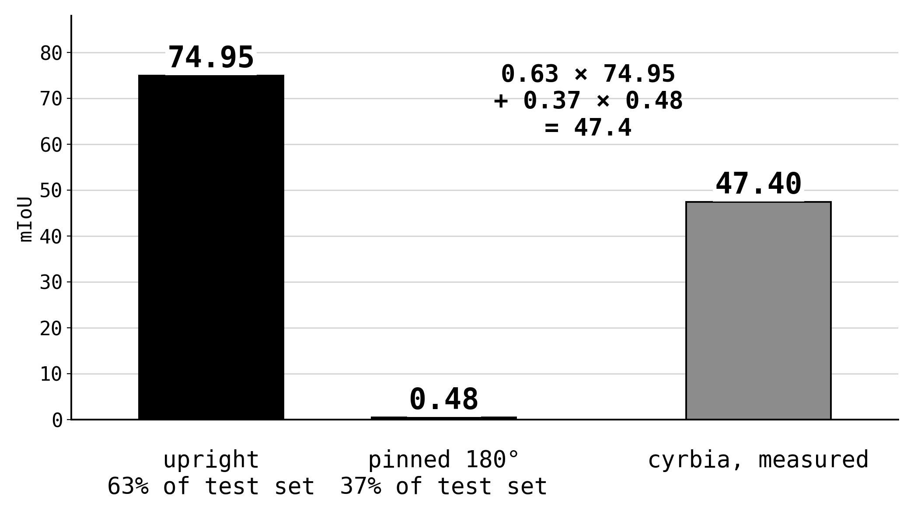
WHY SUPPORT-SIDE STOPS
The query-side defect
0.00 is what the copy baseline
scores on those specimens,
with no model involved
curation +3.56 · five shots +2.85 · the level did not move
Notes:
50s, 3 clicks. Say 37 percent, 74.95, 0.48, and that the weighting reproduces 47.4. The copy baseline at zero is the strongest evidence. Third click explains why nothing reference-side moved it.

Slide 11
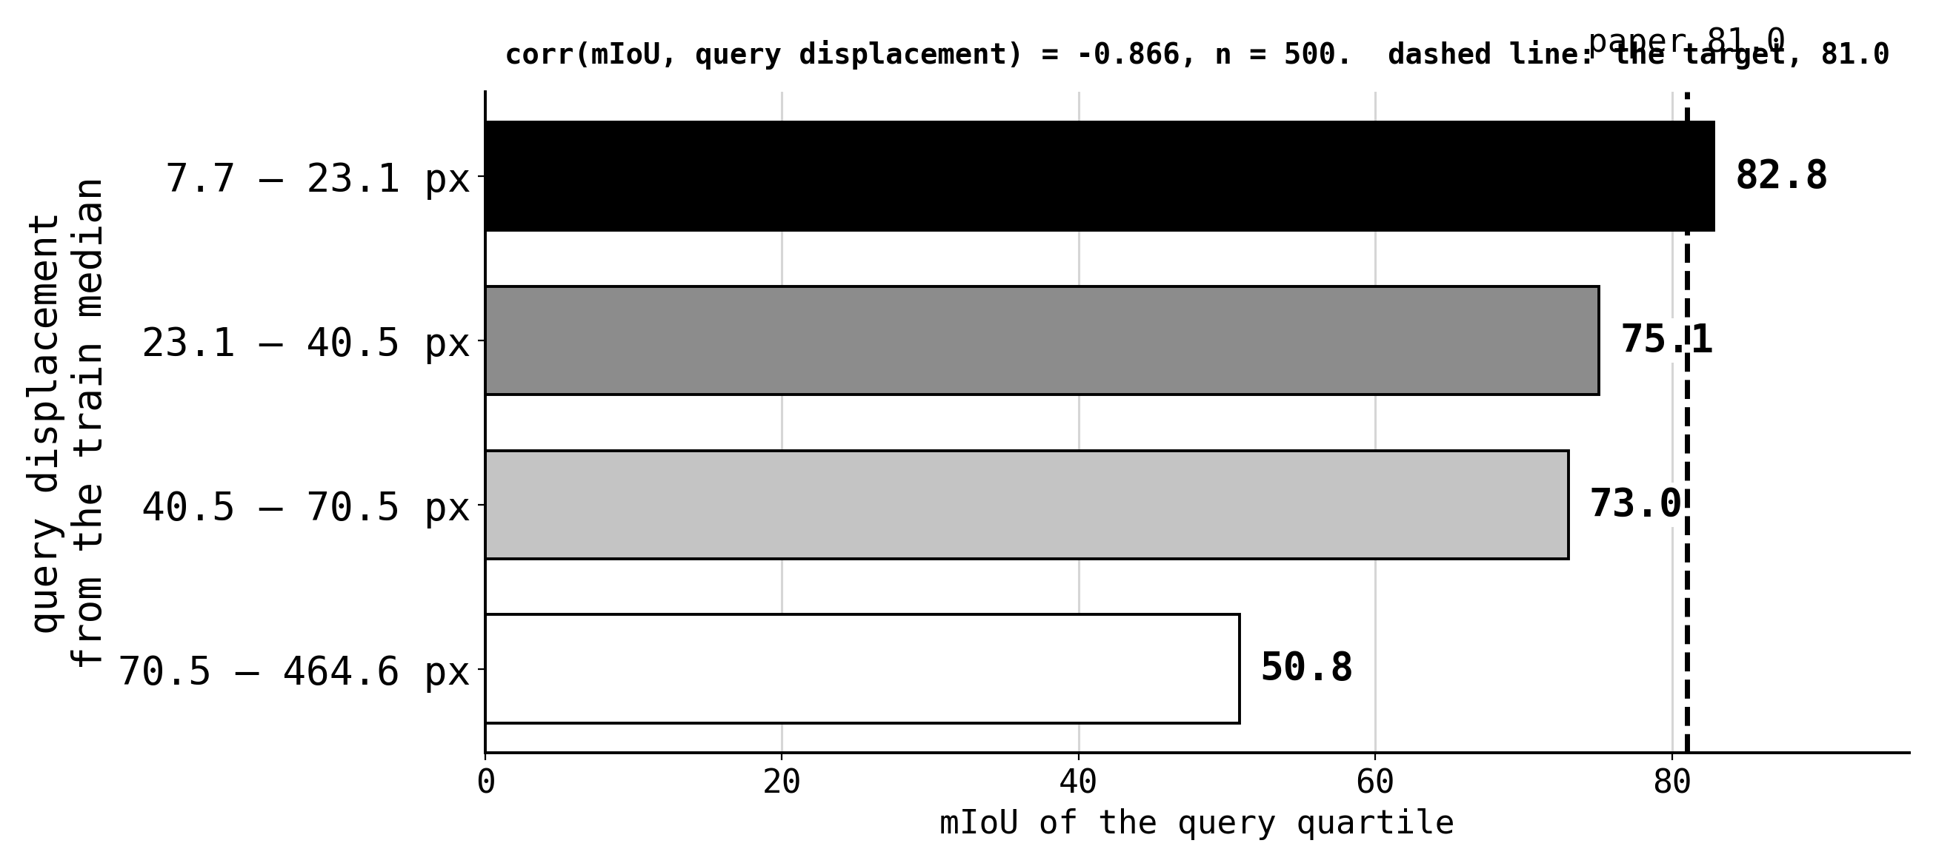
THE GENERAL FORM OF IT
Query arrangement decides the score
the top quartile already beats the target; the deficit is in the tail
Notes:
40s, 2 clicks. One correlation and the quartile spread. Establish that the top quartile already exceeds the target and the test set cannot be curated. Skip unless asked: only 46 percent is a global offset.

Slide 12
TECHNIQUE 5
ORIENTATION TTA
The largest single gain in the project, and the least machinery.
No training and no extra labels.
Notes:
15s. One sentence of framing: largest single gain, least machinery.

Slide 13
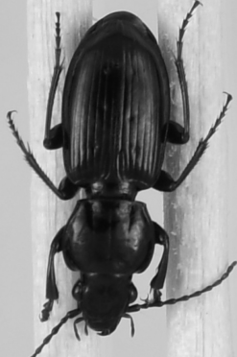
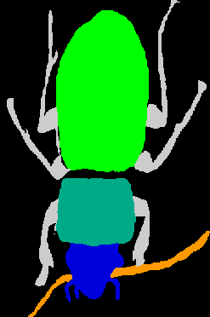
HOW IT WORKS · 1 OF 2
TTA, how it works: 1 of 2
pass 1, as given
01
Image and mask rotate together
the query, never touched
pixel-aligned, or the mask is useless
02
Only the support rotates
pass 2, support rotated 180°
its orientation relative to the query is what matters
03
The rotated variant is cached apart
@r180, or pass 2 gets the wrong embeddings
Notes:
60s, 6 clicks. Left column builds the two passes, right column the three properties. Note the bottom-left panel is the project's own render under the same rotation the code applies.

Slide 14
HOW IT WORKS · 2 OF 2
TTA, how it works: 2 of 2
top = logits.max(axis=0) # best trait score per pixel
fg = top > 0 # the pixels it claims
confidence = top[fg].mean() # −inf if it claims nothing
mismatched orientation → scattered and weak
matching orientation → compact and strong
No ground truth is consulted
2× inference, not 10×
the choice comes from logits alone
both orientations cached, so pass 2 is a hit
it chooses between two predictions; it cannot improve either one
Notes:
60s, 5 clicks. Read the criterion off the code. One sentence each for the two properties: no ground truth, and caching keeps it at two passes. Close on the limitation, that it selects and cannot improve.

Slide 15
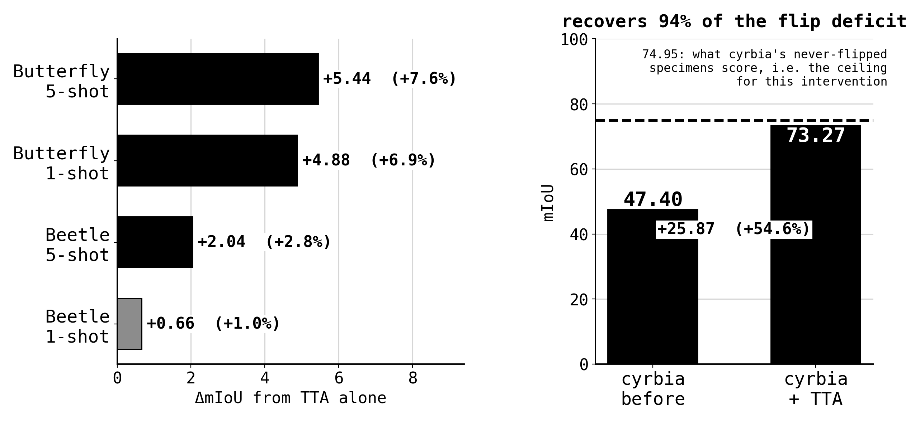
WHAT IT BOUGHT
What TTA bought
cyrbia 47.40 → 73.27 (+54.6%). cost: its spread rises 6.81 → 10.89
Notes:
60s, 2 clicks. Say the four deltas, then 47.40 to 73.27 against a 74.95 ceiling, 94 percent of the deficit. The silhouette rising with it makes this re-segmentation. Second click is the variance cost.

Slide 16
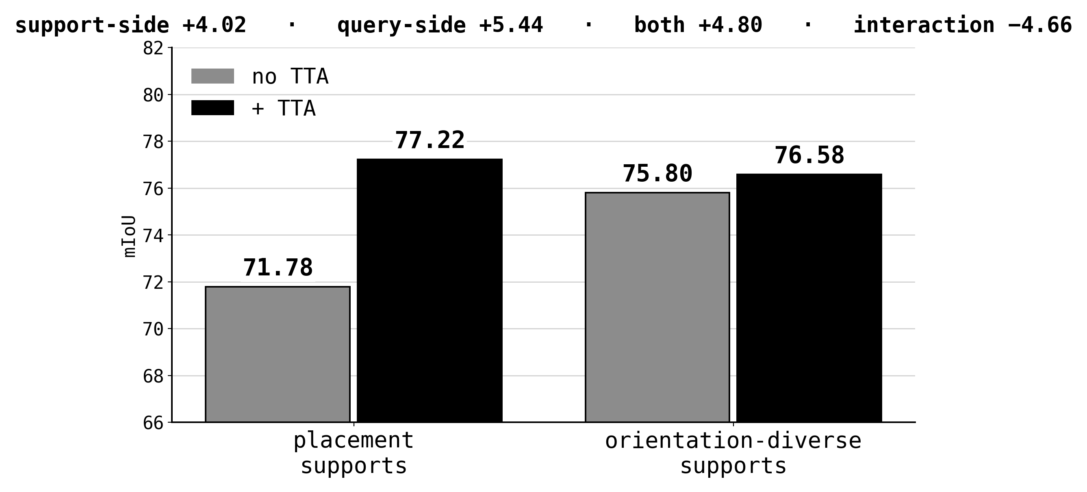
TECHNIQUE 6, AND A WARNING
Two fixes, one defect
technique 6 is support-side: the five references span both orientations, and the memory bank selects rather than blends
best arm: TTA on placement-curated references, 77.22 (+7.6%)
Notes:
50s, 3 clicks. Establish the reference-side fix and that attention selects rather than blends. Then the square and the interaction. State the procedural lesson: a one-dimensional sweep would have shipped the worse arm.

Slide 17
TECHNIQUE 7
CHANGING THE LOSS
OC-CCL, a cycle-consistency fine-tune.
The most machinery in the project.
Notes:
15s. Mark the shift: everything before this is inference-time, this is the only technique that changes weights.

Slide 18
HOW IT WORKS
The cycle, mechanically
1 / labeled reference
2 / propagate to the unlabeled query
3 / prompt back, reconstruct
loss = BCE + Dice between the reconstruction and the reference's own labels
no new labels required; the reference's own mask is the target
Notes:
55s, 6 clicks. Walk the four legs with the panels. Establish the appeal: supervision from a mask you already have, so it trains on unlabelled queries.

Slide 19
TWO THINGS IT NEEDS TO BE ABLE TO LEARN
Two preconditions
1 · the closing prompt
2 · what it supervises
(pred > 0).float()
One merged channel supervises the silhouette.
C trait channels supervise assignment.
Each pays where its own objective has room.
severs the graph, so nothing downstream reaches the forward leg.
(logits + 10) / 20
same logits, linear path.
forward ÷ reverse gradient: 0.00 → 26×, and 351× per-trait.
butterfly silhouette had room → +0.85 to +1.25 beetle silhouette at 90.8 → no effect
Notes:
55s, 4 clicks. Differentiability first, with the 0.00 to 26 and 351 ratios. Then the supervision axis and the law it implies: each objective pays only where it has room.

Slide 20
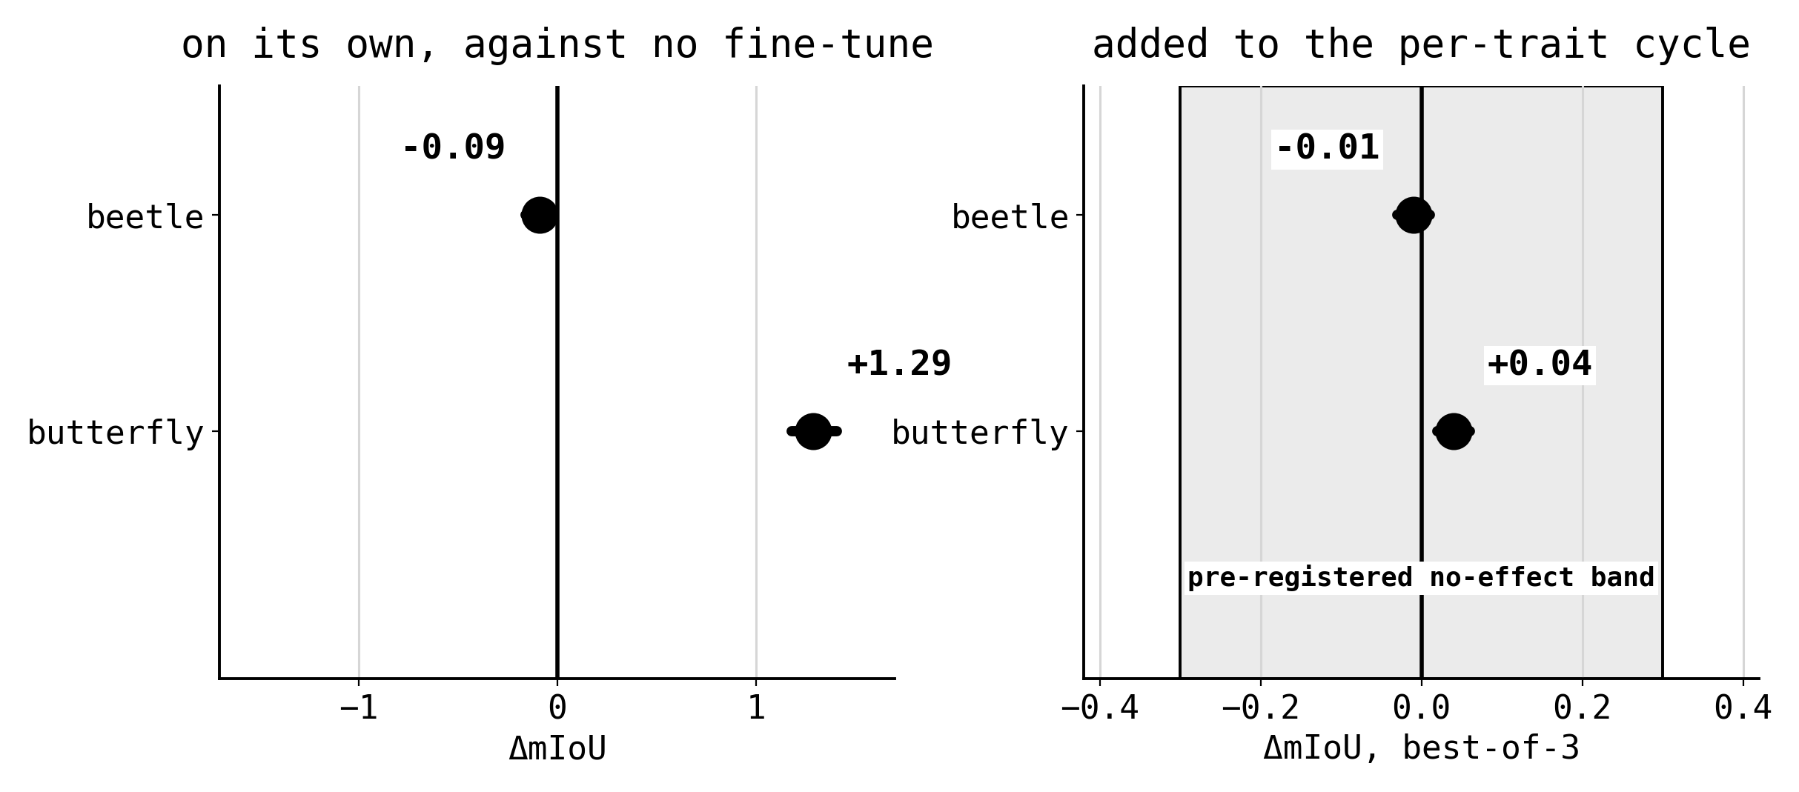
A TERM BORROWED FROM ANOTHER PAPER
SCNP
the transform
why it should have paid here
same class → min-pool the neighbours
other class → max-pool the neighbours
an isolated false positive is the worst neighbour of up to nine pixels
tried twice: on the merged silhouette, then on the per-trait cycle where “same class” means same trait
Notes:
60s, 4 clicks. Transform, then why it was a candidate here, then both attempts. Say the pre-registration: beetle was named as the detrimental case, and the composition was predicted at +0.5 to +2 and measured at -0.01. If short, compress the transform and keep the pre-registration.

Slide 21
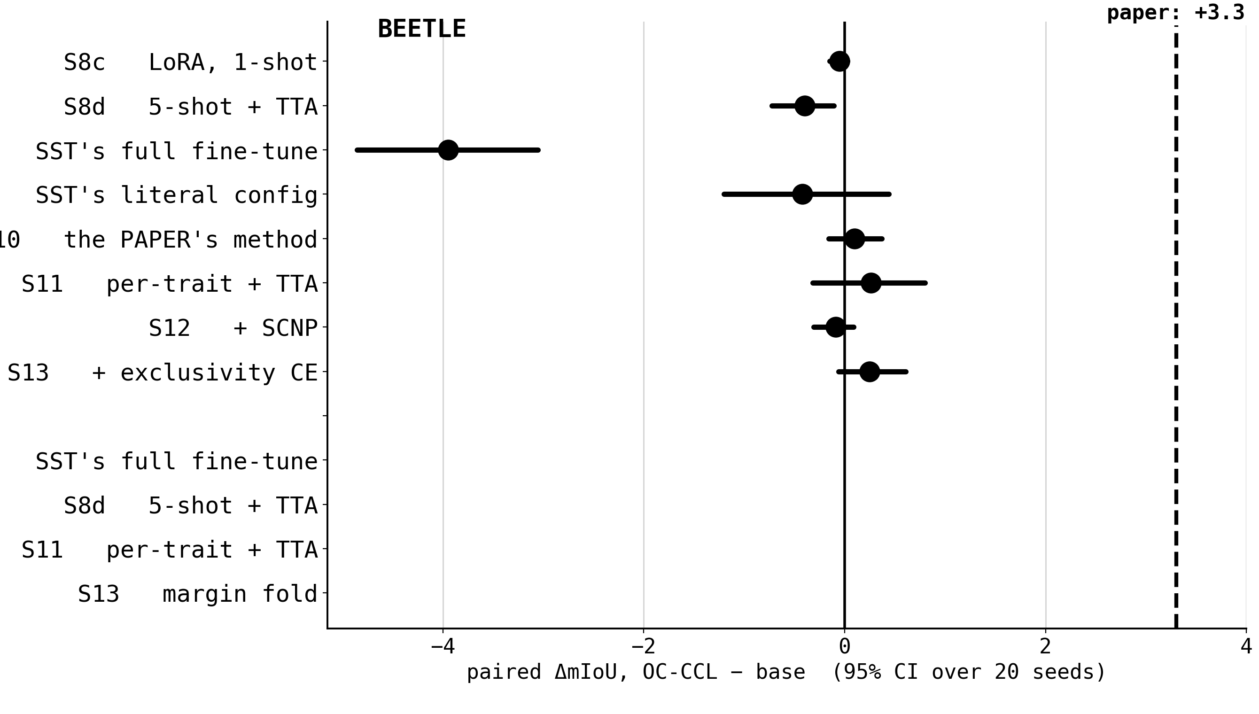
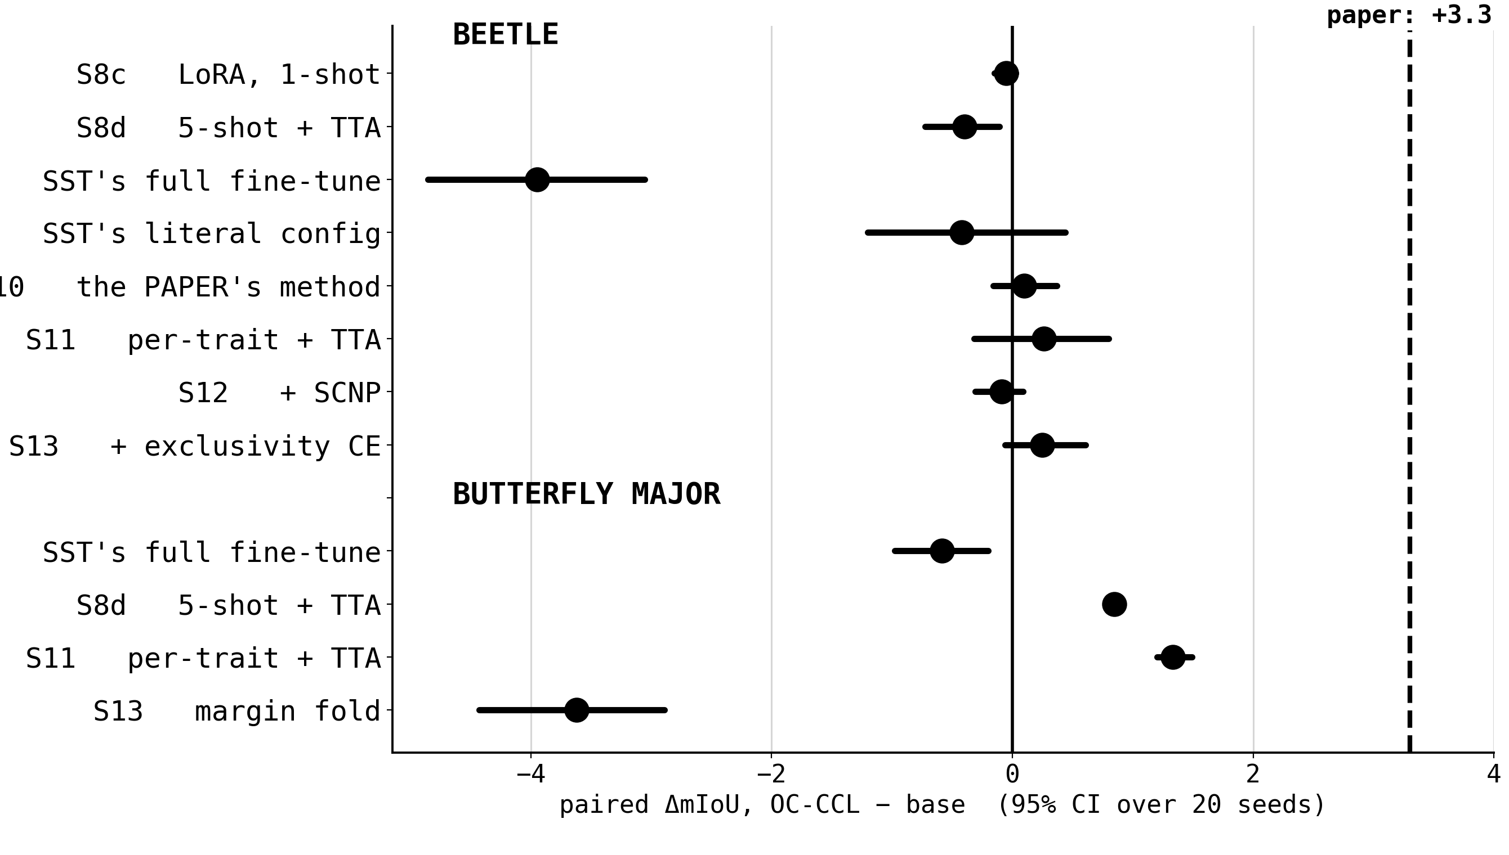
EVERY LOSS VARIANT WE RAN · ON SAM 2
Every loss variant
LoRA and full fine-tuning · 1 and 10 epochs · five learning rates · five loss terms · two datasets
Notes:
55s, 2 clicks. Do not enumerate the arms. Give the pattern, name the two that hurt, and say why the margin fold failed. State that this slate is on SAM 2, because the next section reverses it.

Slide 22
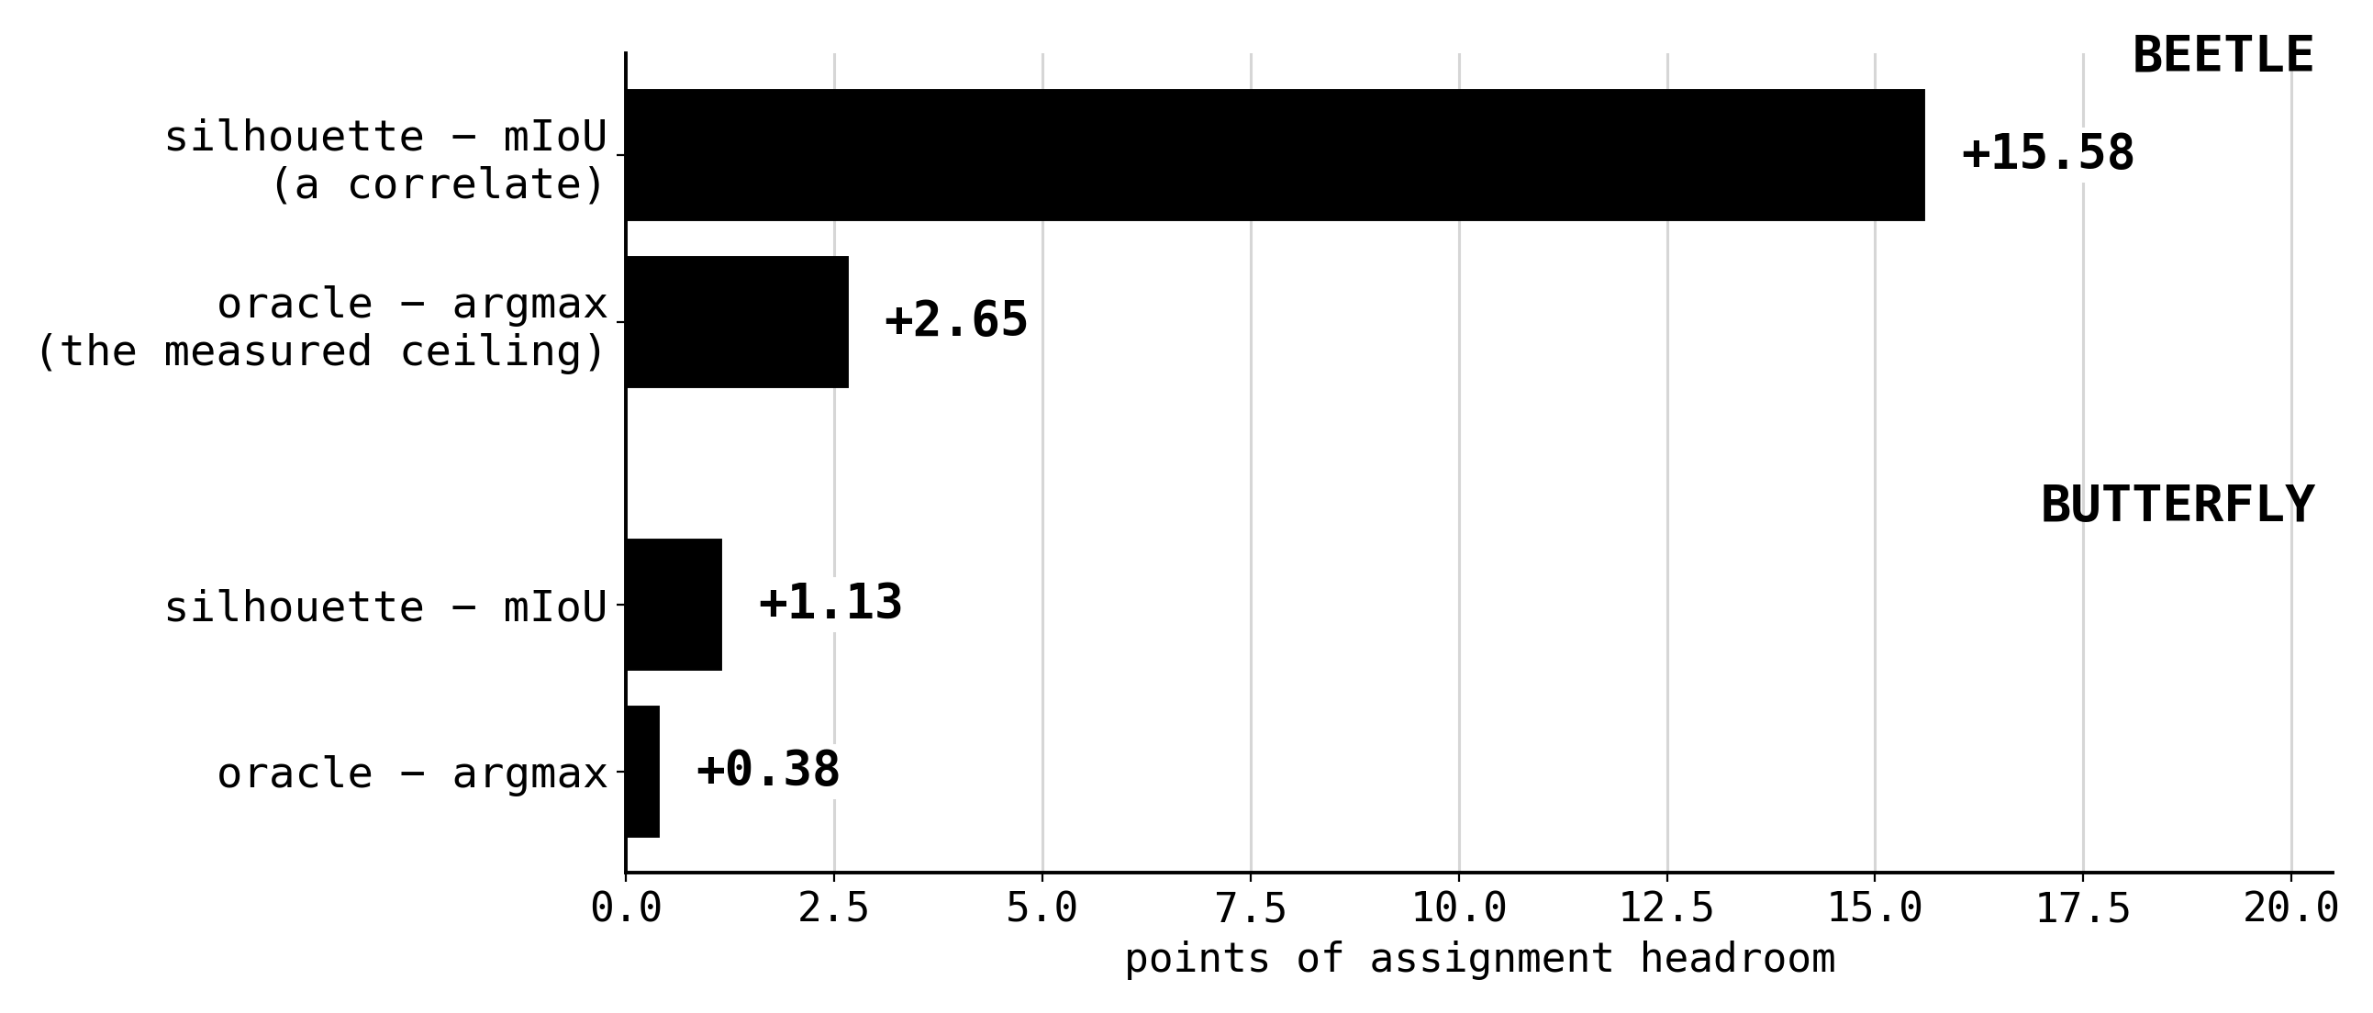
WHY
The pot they competed for
the rest is regions the tracker never proposes, which no loss on proposed logits reaches
Notes:
50s, 2 clicks. The correction: the quoted headroom was a correlate, the measured ceiling is 2.65 and 0.38. Then the sentence the last section depends on, about regions never proposed. Flag it.

Slide 23
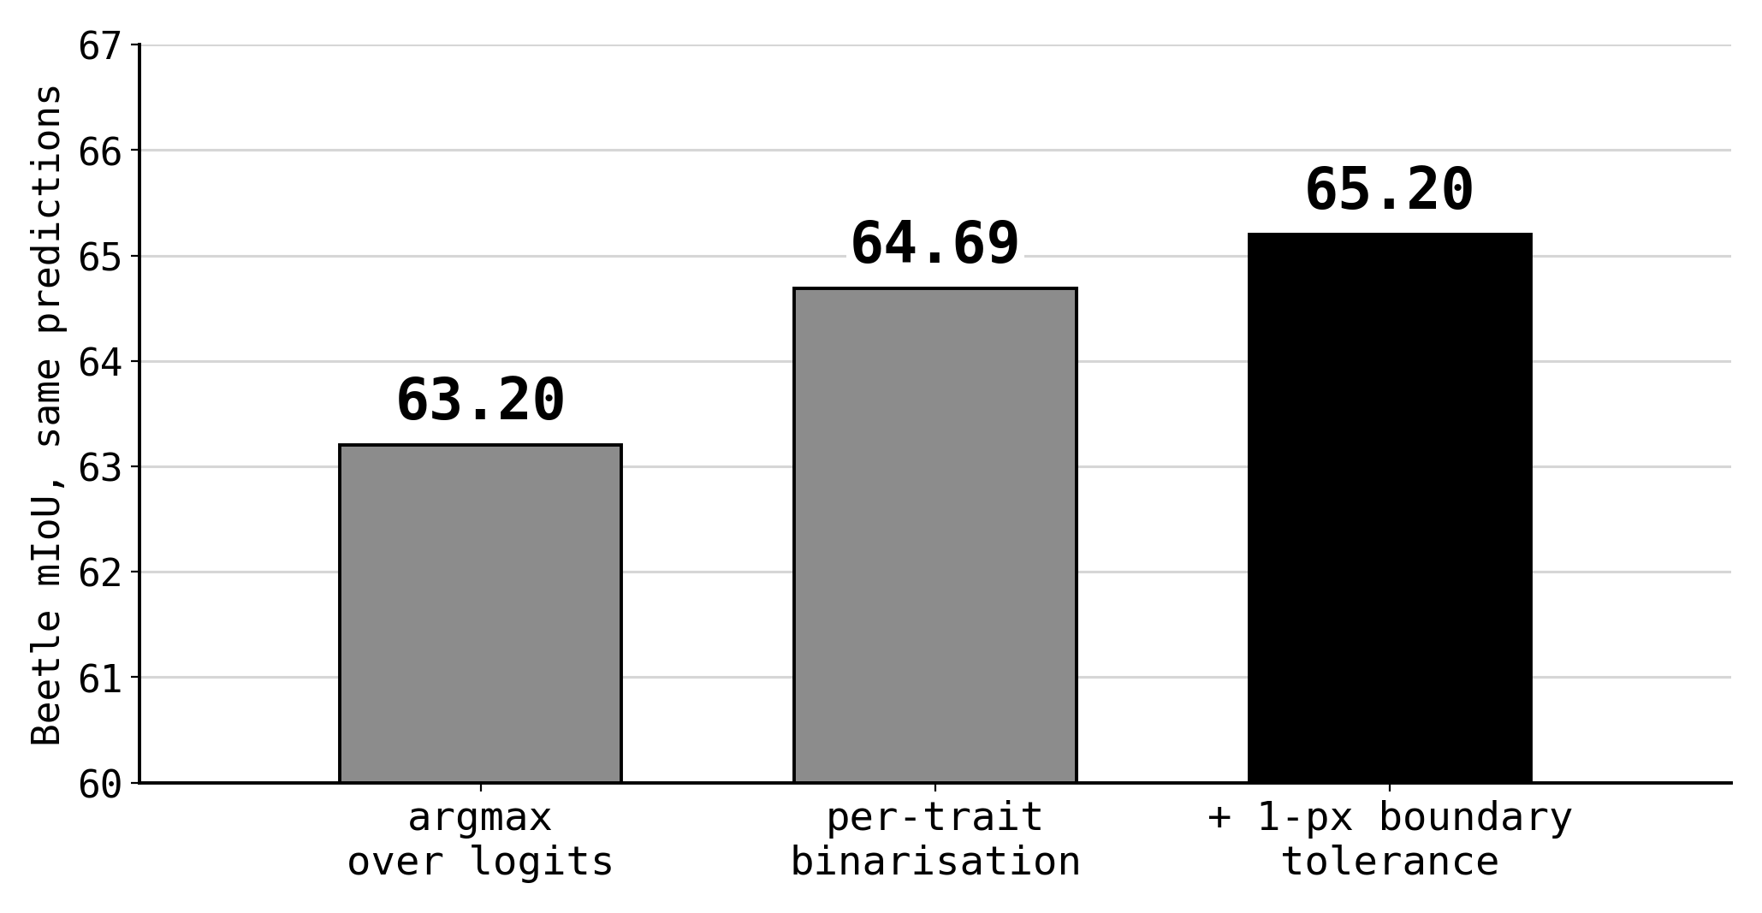
AND ONE THAT ISN'T A MODEL CHANGE AT ALL
Three defensible scorings
every fine-tune delta in this talk moved by less than 0.3 under all three readings
Notes:
35s, 2 clicks. Three readings of the same predictions. Two points of spread with no model change. Note the model-swap deltas move between readings and both are quoted. First candidate for cutting.

Slide 24
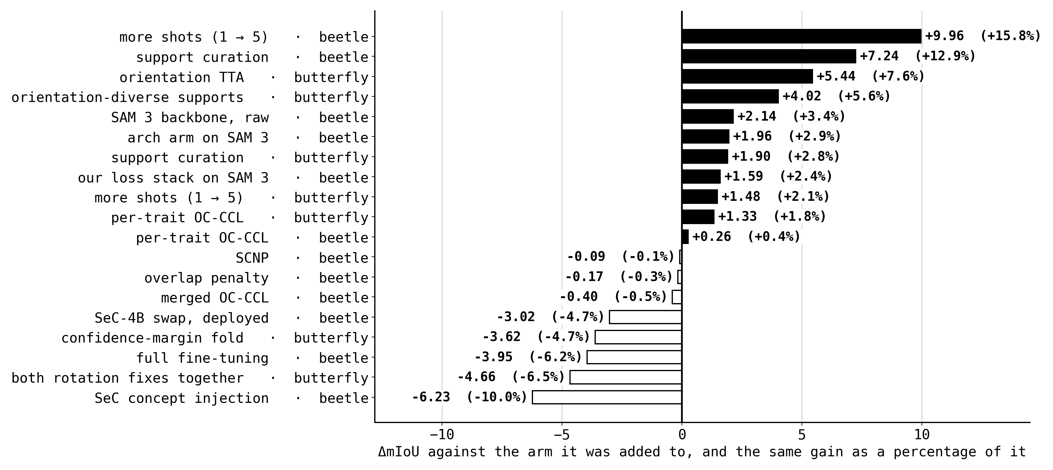
THE LEDGER
The ledger
Notes:
60s. Pause and let them read. Then the shape: on SAM 2 everything that paid changed what the model is shown. Point out the two compositions, the three new positive rows, and the bottom row. Leave this up for questions.

Slide 25
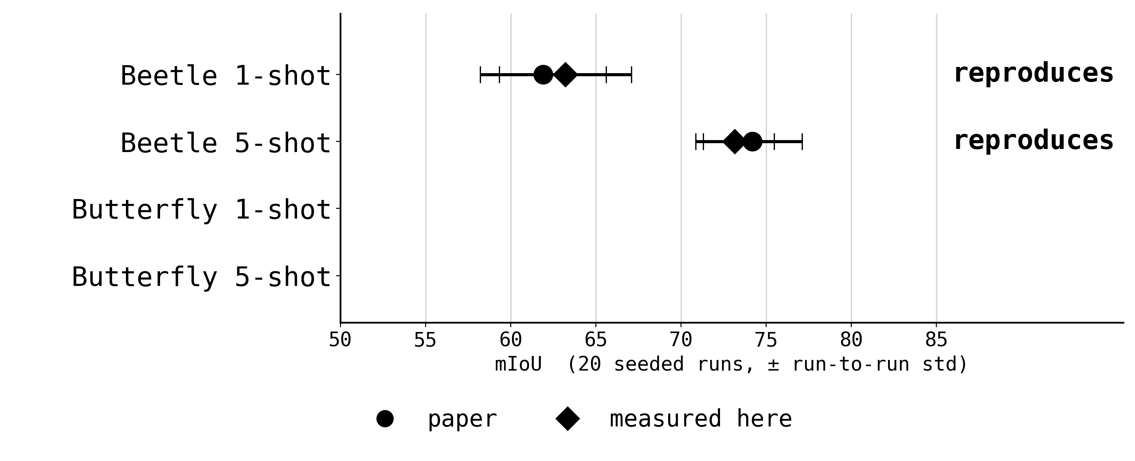
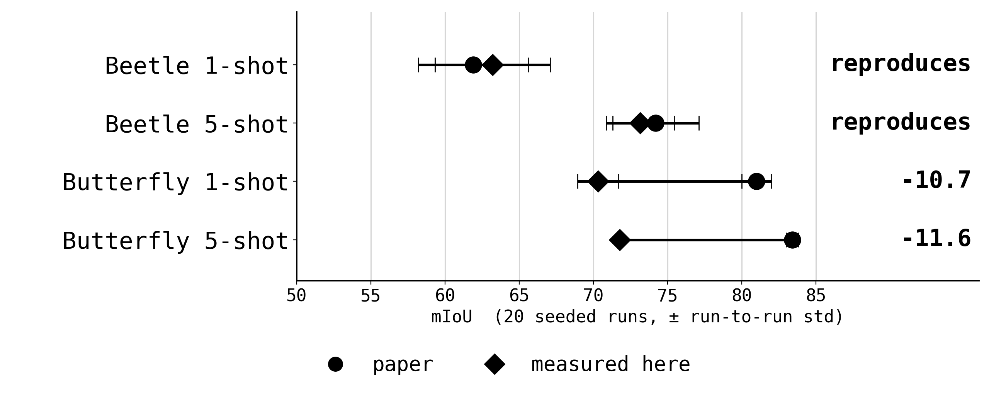
WHERE THAT LEAVES THE NUMBERS
Where the numbers land
~5 of butterfly's last 6 points sit below the silhouette ceiling
Notes:
40s, 2 clicks. Beetle passes both gates, butterfly does not, and five of its last six points sit below the silhouette ceiling. That is the argument for changing the model.

Slide 26
THE LAST TECHNIQUE · CHANGE THE MODEL
The two swaps
SeC-4B
SAM 3
A concept LVLM steering a retrained SAM 2.1
tracker: identity reasoning, not pixel memory.
The same tracker design one generation on,
so every technique here ports unchanged.
same 20 draws · same protocol · the winning stack on top
one new arm: LoRA on the memory attention, the module that forms proposals
Notes:
50s, 4 clicks. Both families and what was held fixed. One sentence on the cross-family pairing discipline: draws are model-independent and hash-pinned, and the one relaxation records what it ignored. Then the new arm.

Slide 27
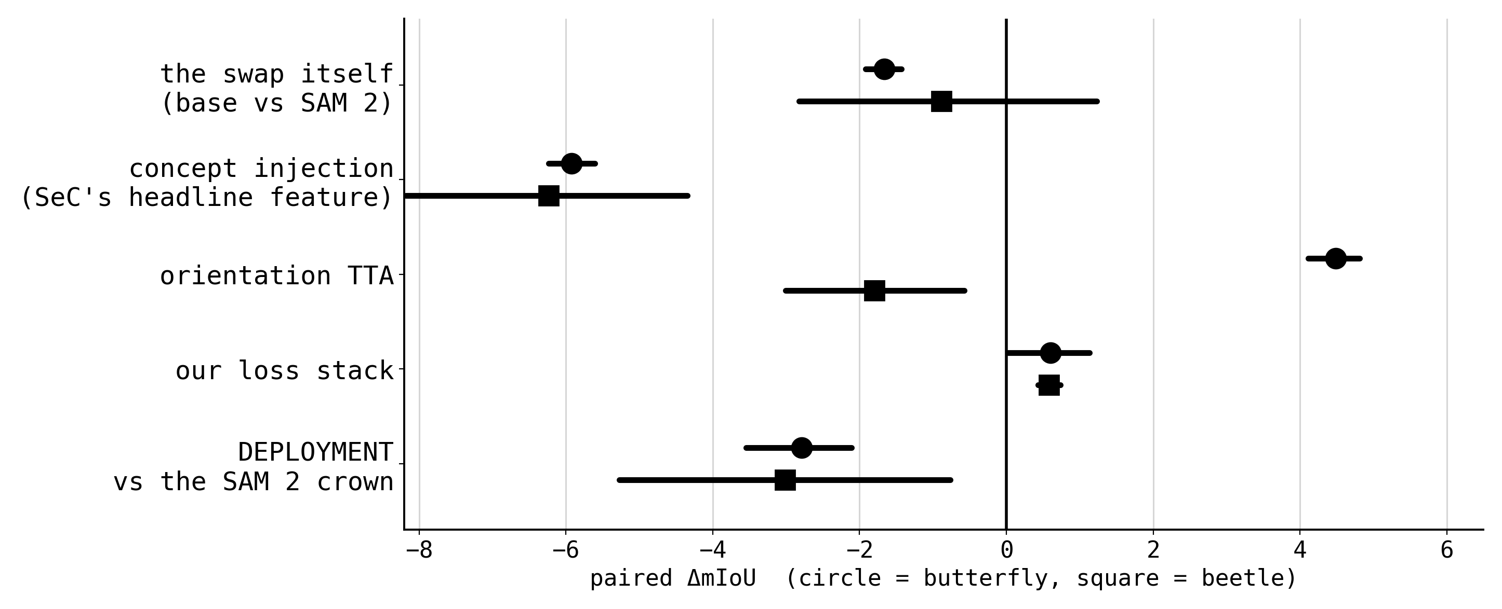
RESULT · SEC-4B
SeC-4B: the swap does not pay
concept injection costs 5.92 and 6.23 mIoU, which is 8.6% and 10.0% of what it was added to
the loss stack still pays on it: +0.60 (+0.8%) and +0.58 (+1.0%), above its value on SAM 2
Notes:
70s, 3 clicks. Deployment row first, then the oracle pot being unchanged. Concept injection at about -6 with 0 and 1 of 20 seeds. Report the falsified pre-registration directly, with the fire rates. Close on the loss stack still paying.

Slide 28
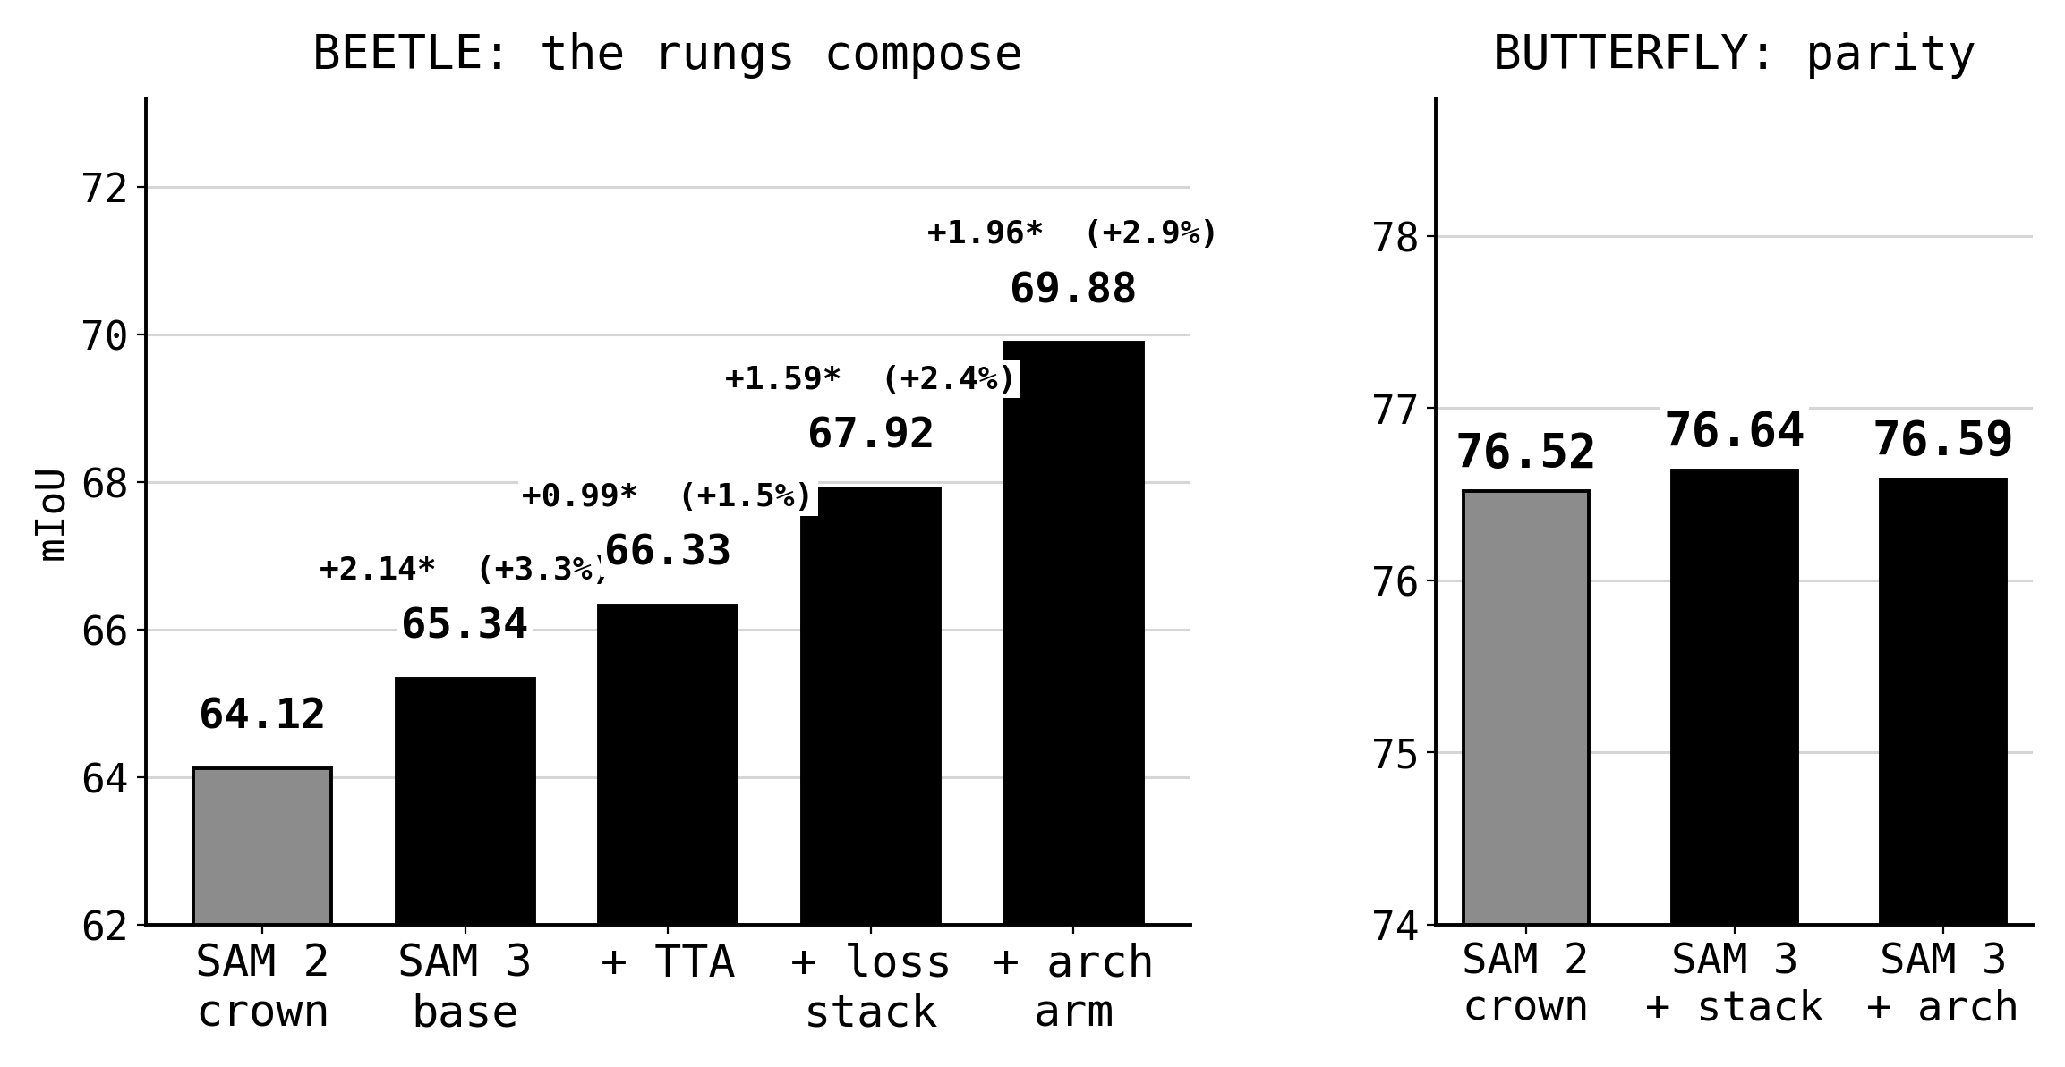
RESULT · SAM 3
SAM 3: the swap pays
beetle's best 1-shot number: 64.12 → 69.88, +5.77 ✱ (+9.0%) vs the SAM 2 stack
Notes:
75s, 2 clicks. Four rungs, every one significant, then 64.12 to 69.88 and 70.56 under the paper's own metric. Second click is butterfly as the control, flat, which is the third confirmation that its residual is protocol.

Slide 29
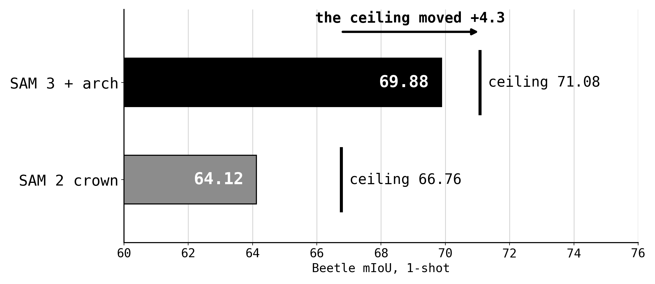
WHY IT WORKED · AND WHY THAT MATTERS
The ceiling itself moved
the arch arm trains the memory attention, the module that decides what is proposed
so it reaches error mass that a loss on proposed logits cannot
Notes:
65s, 3 clicks. Give this room. Smaller pot, larger gain, so the ceiling moved: 66.76 to 71.08. Connect back to the earlier slide explicitly. Add that the arms were written on per-object logit stacks so they could transfer.

Slide 30
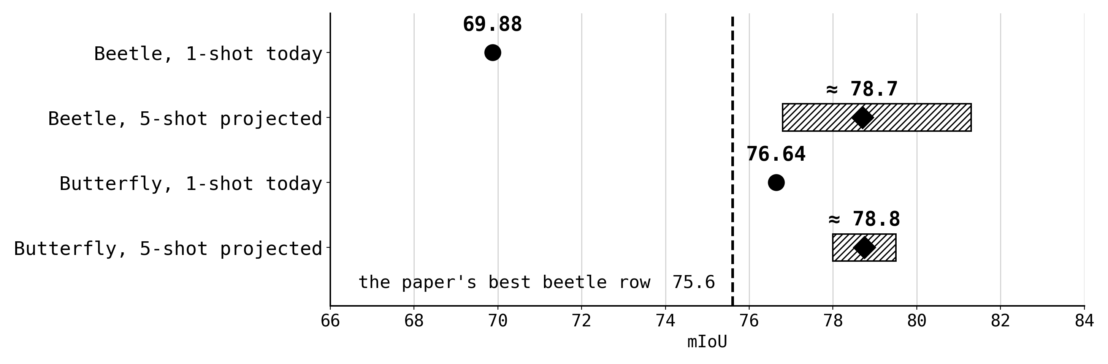
WHAT IS PRE-REGISTERED NEXT
What is pre-registered next
bands assembled from measured components: shot lift, TTA's growth with shot, the stack, the arch arm
a central landing sits ≈ +3 over the paper's best beetle row
Notes:
55s, 3 clicks. Present the projection as a projection. Bands from measured components, two caps near 81, a disqualifier at 72. Mention the conditioning-frame cap as configuration, not weights. Second candidate for cutting.

Slide 31
IN ONE LINE EACH
Where it lands
On SAM 2, every technique that paid changed what the model is shown, not what it optimises.
Orientation TTA is the largest inference-time gain: +5.44, or +7.6%, label-free and untrained.
On SAM 3 that ordering reverses: the loss stack and the arch arm are +3.55 of beetle's +5.77, which is +9.0%.
They moved the ceiling rather than the assignment. Butterfly's residual survived both swaps.
Notes:
45s, 4 clicks. One line per click. Land the reversal: on SAM 2 the objective was the wrong place to spend effort, on SAM 3 it is most of the gain, and butterfly's residual survived both swaps.

Slide 32
BACKUP · IMPLEMENTATION
Canonicalization, implemented
orientation
placement
completeness
body_axis_angle(lm, head, tail)
trait_centroids(lm, expected)
len(trait_ids(lm)) == expected
atan2(tail_cy - head_cy,
reference = per-trait MEDIAN
tail_cx - head_cx)
over the train split
the 180° test, used for strata:
directed, so a 180° rotation is a
displacement = mean distance over
orientation_of() compares against
different angle, not the same axis
the traits both configs share
the reference and the reference
accept if deviation
accept if disp
mirrored about the image centre,
<= circular_std(train)
<= train mean + 1 std
at the mask's own extent
circular_std = sqrt(-2 ln R), the train pool's own spread
every threshold is recorded per run and pinned by a test
Notes:
BACKUP, not presented. Jump here for how the criteria are computed. Three columns: the directed axis, the centroid displacement, and completeness plus the 180 degree test. See TECHNICAL_QA.md sections 1 to 3.

Slide 33
BACKUP · IMPLEMENTATION
From pool to draw
canonical_pool(ds, group, criteria)
reads TRAIN masks only, returns (pool_ids, stats); stats carry the thresholds and the rejection counts into the bundle
draw_supports(ds, group, pool, selection, shot, run)
the single dispatch point; three call sites had drifted before it existed
derive_seed(dataset, group, shot=0, run)
blake2b of the key string, no global RNG; shot is pinned to 0 so 1-shot is a strict prefix of 5-shot
stratified_supports(...)
run r takes stratum (r + k) mod S, member drawn by the run's seed; systematic coverage rather than equal probability
orientation_diverse_supports(...)
n_rot = round(shot × rotated fraction of the train pool), clamped to [1, shot-1]; degenerates to the ordinary draw where one orientation exists
support_set_hash(resolved ids)
sha1 of the IDs actually drawn per run; two arms may only be paired if this matches
memoised above canonical_pool, never inside it, so the leakage test cannot pass vacuously
Notes:
BACKUP, not presented. Jump here for the pool to draw pipeline and the seeding. See TECHNICAL_QA.md sections 4 to 6.

Slide 34
BACKUP · IMPLEMENTATION
What keeps it honest
threshold is the a priori train circular std
pool is unchanged when the test split is perturbed
so it cannot be retuned
no leakage
orientation is measured against the mask's own extent
balanced draws preserve prefix nesting
beetle crops are 172 to 431 px
1-shot vs 5-shot stays paired
the support draw is dispatched in exactly one place
registry refuses to pair two different support arms
the test discovers callers rather than listing them
protocol.support_selection is a comparability field
recorded per run: criteria, criteria_applied, pool_size, train_size, rejections by reason, threshold_deg, train_circular_mean_deg, train_resultant_R, threshold_rule, placement_threshold_px
the approximation is auditable after the fact, which is the point
Notes:
BACKUP, not presented. Jump here when asked how any of it is guarded, or what is recorded per run. See TECHNICAL_QA.md sections 7 and 8.

