Slide 1


PROPBUY
BY - Bhanderi Hardik Ashokbhai
EXAM NO: (2020019265)
AUG\ - SEP 2022 (Sem-5)
BACHELOR OF COMPUTER APPLICATION (BCA)
C. B. PATEL COMPUTER COLLEGE BHARTHANA, SURAT, GUJARAT

Slide 2
INDEX
SR.NO | Description | Page No.
1. | Introduction 1.1 - Objective of Project 1.2 - Project Profile 1.3 - Project Category 1.4 - Project Modules | 3
2. | Tools and Technology 2.1 - Front End 2.2 - Back End | 4
3. | System flow chart | 6
4. | UML diagram | 7
5. | Screecnshort | 11
6. | Reference | 16

Slide 3
INTRODUCTION
This online property buy System project developed using specific programming languages. The main aim of this project is to develop an online website which covers all the details of online Property i.e.
client attendance details, Event details, custermar detail transaction details,buy details,Offer detail etc. Admin is the Super user of this project.
All the record stores in MySQL Database. The proposed software will also reduce the cumbersome online property, manual labor as well as property

Slide 4
TECHNOLOGY USED
Front End
Html
css (Cascading Style Sheets)
bootstrap
java Script
Jquery
Angular.js
Php
Back End
Mysqli

Slide 5
OBJECTIVE
The objectives of the system are
To reduce property buy ng.
Reduced operational time
Increased accuracy and reliability.
Increased operational efficiency.
Data security
Reliable for free regitster and free charge
Reliable for smany offers in avelabel
New Home for customer requement
Key Words:
PHP, SQL Server,Angular.js, HTML, JavaScript, Browser, online property, information system, document management system etc.

Slide 6
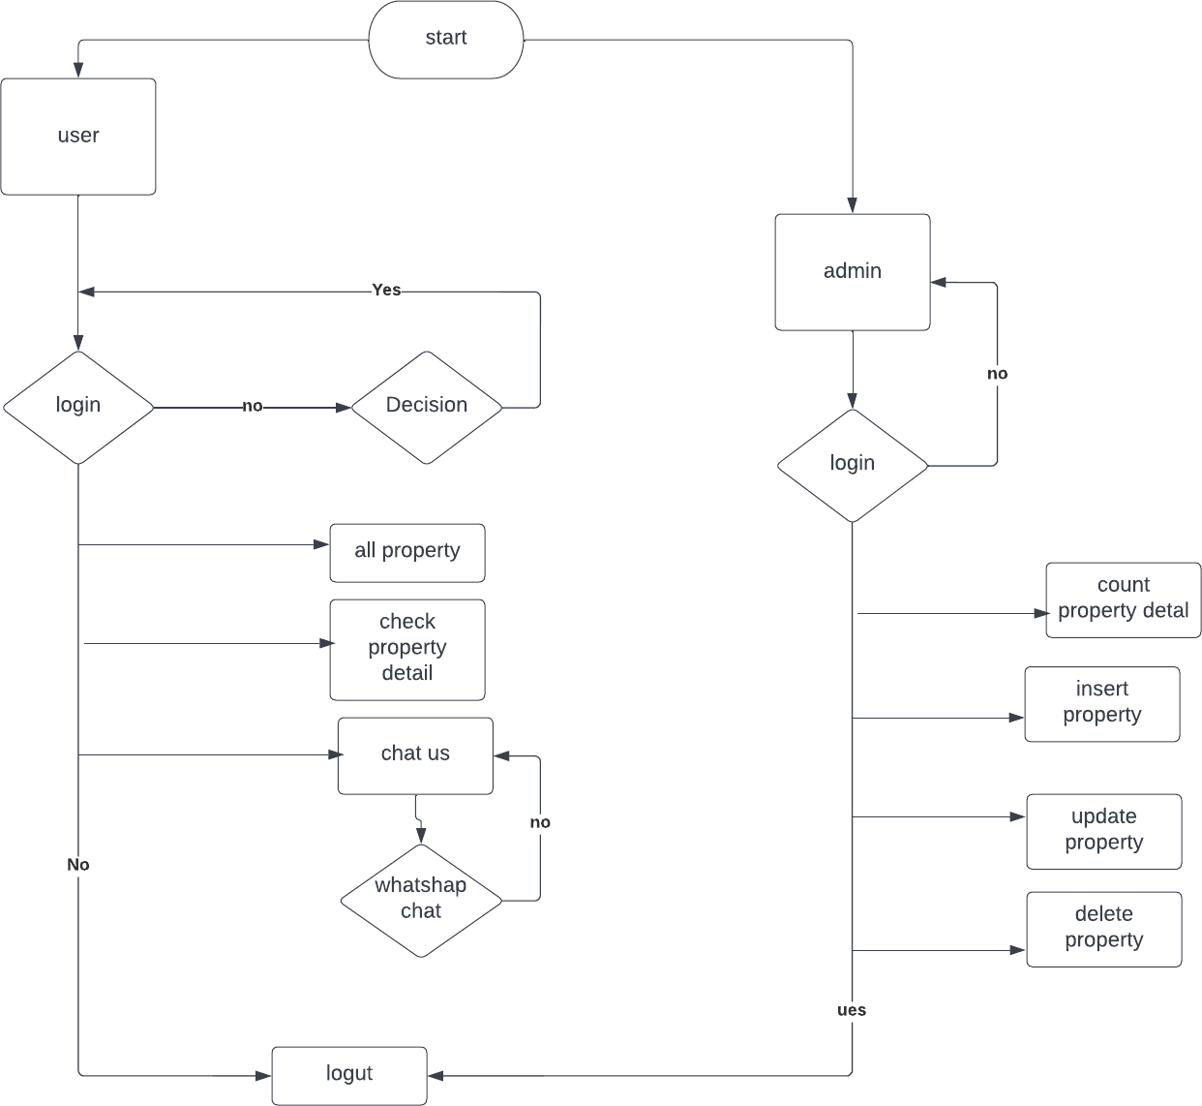
SYSTEM FLOW CHART

Slide 7
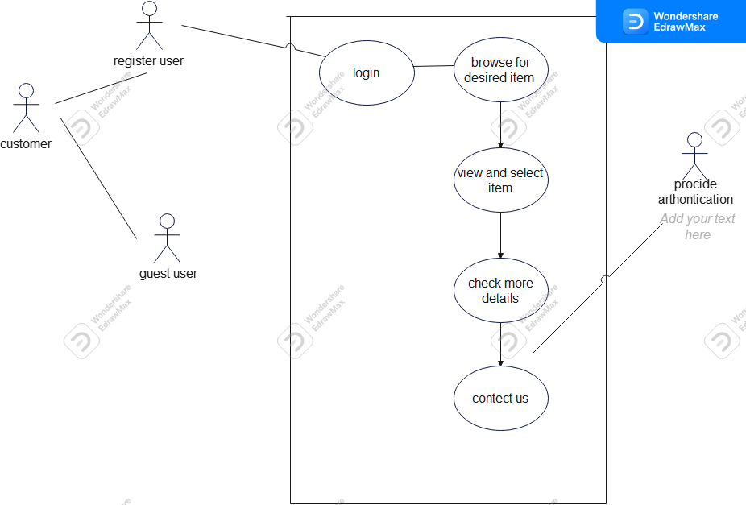
UML DIAGRAM

Slide 8
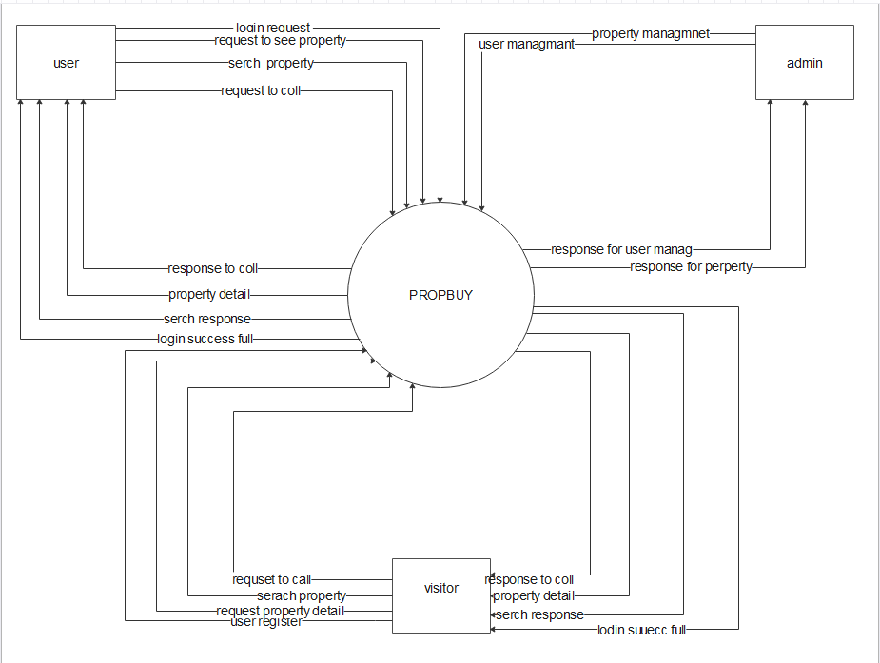
DFD DIGRAM
1) 0 LEVEL

Slide 9
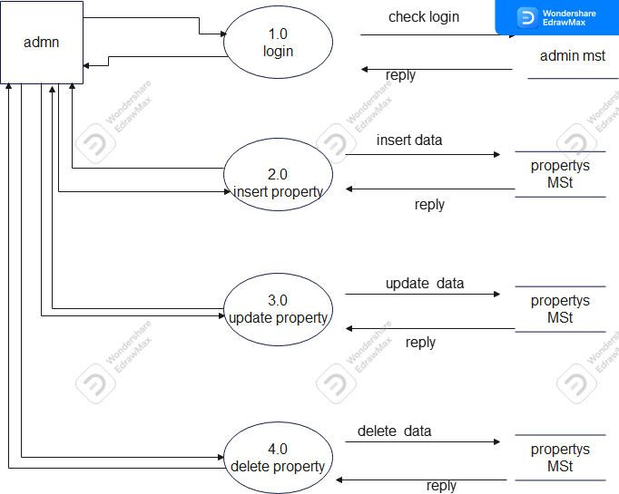

Slide 10
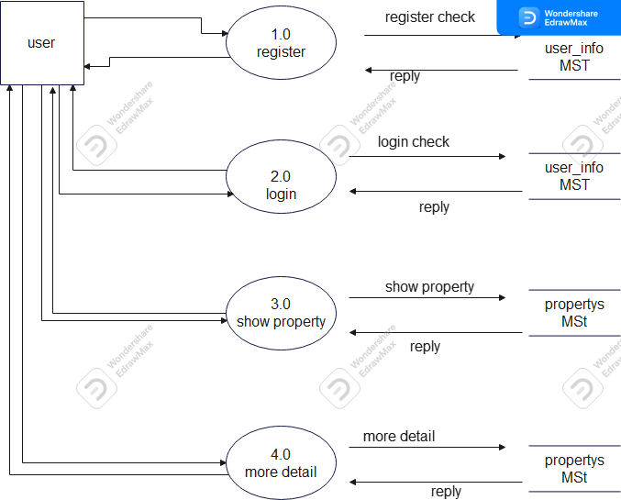

Slide 11
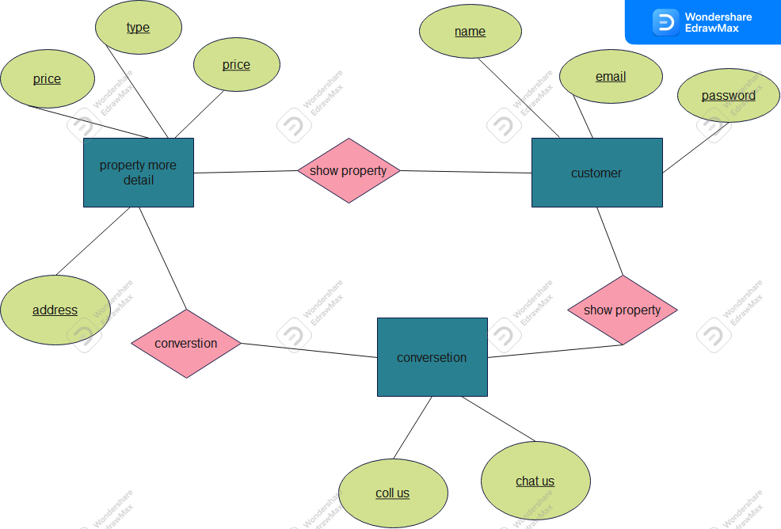
ERD DIAGRAM

Slide 12
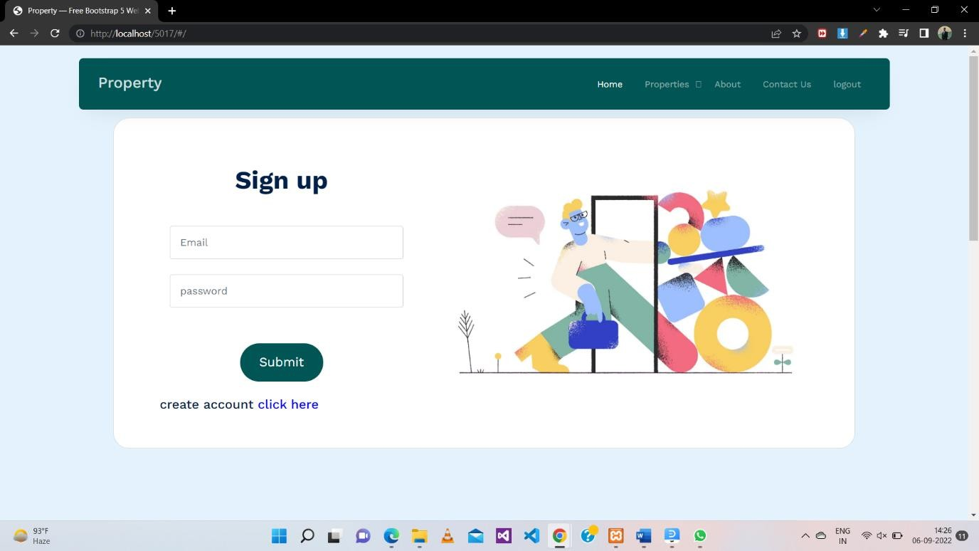
USER SIDE

Slide 13
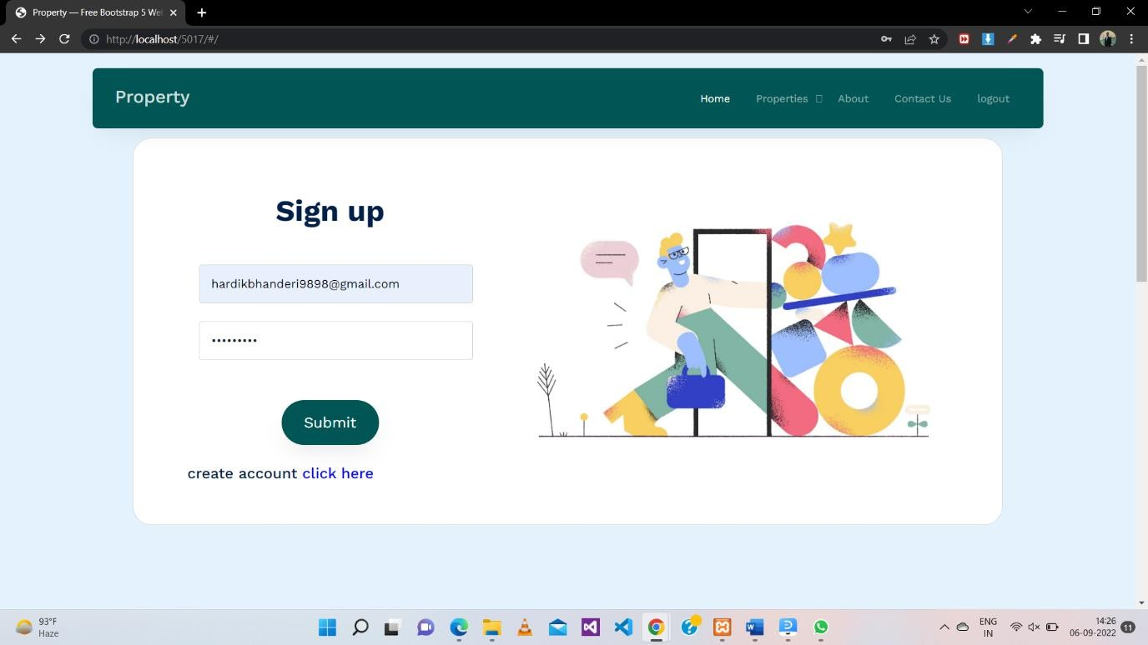

Slide 14
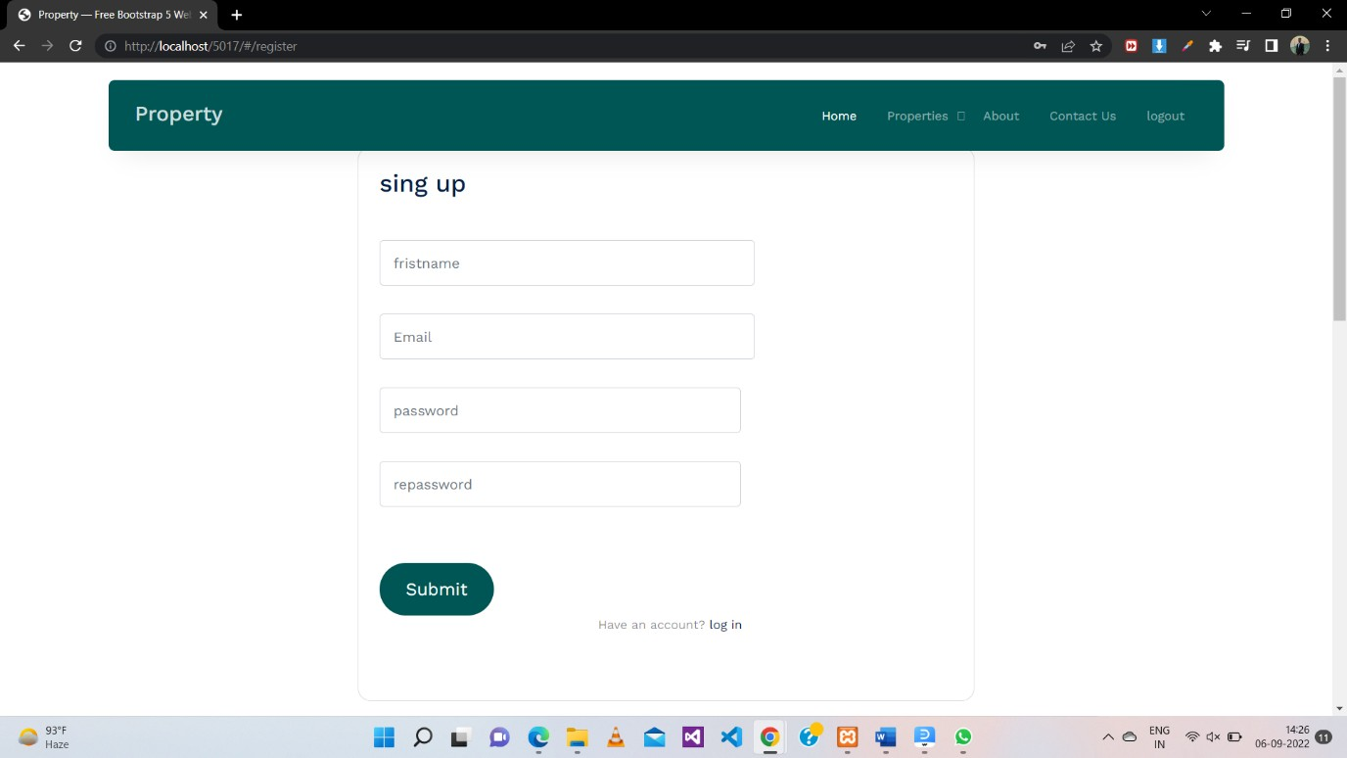

Slide 15
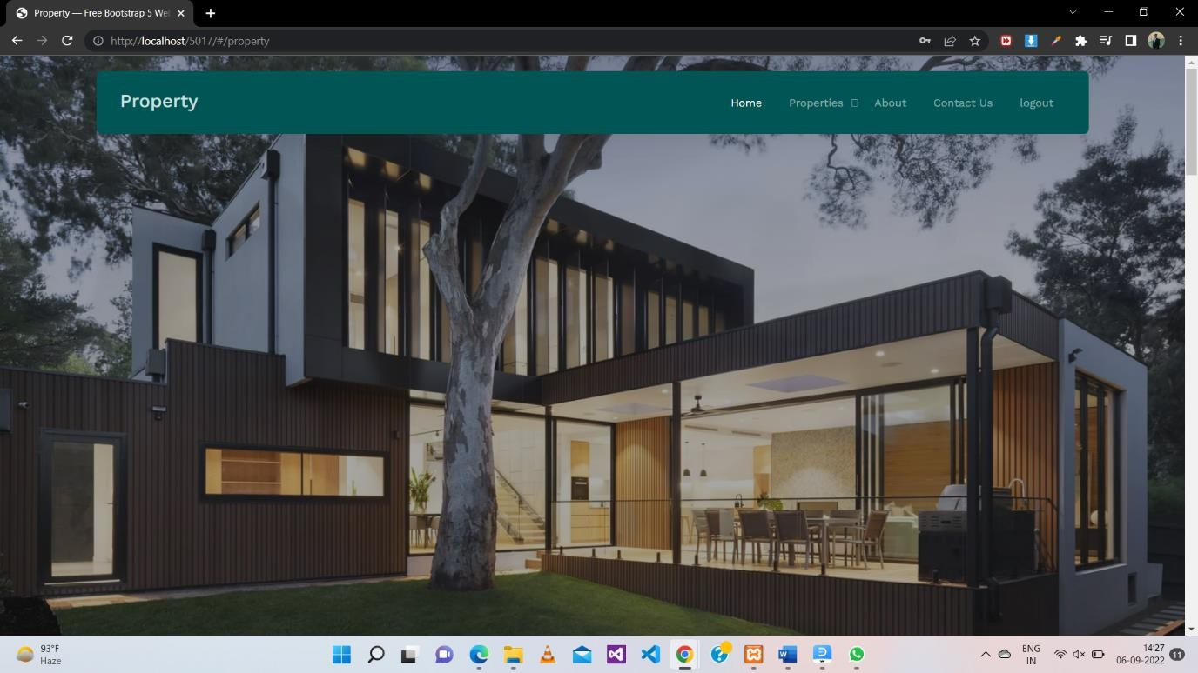

Slide 18
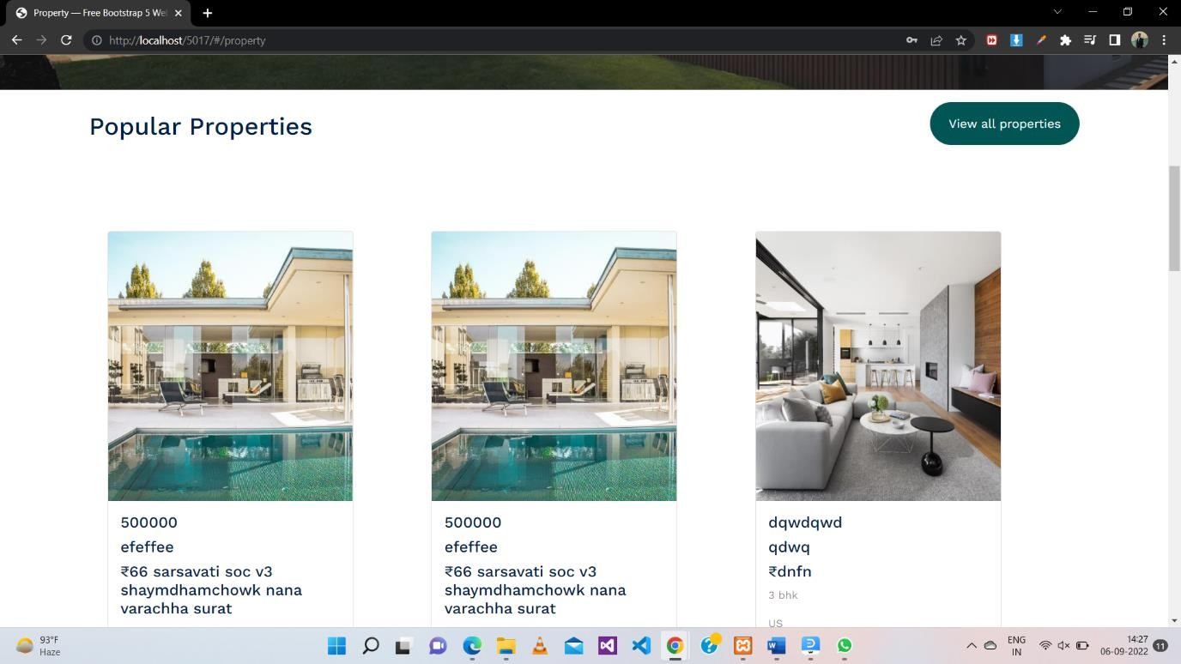

Slide 19
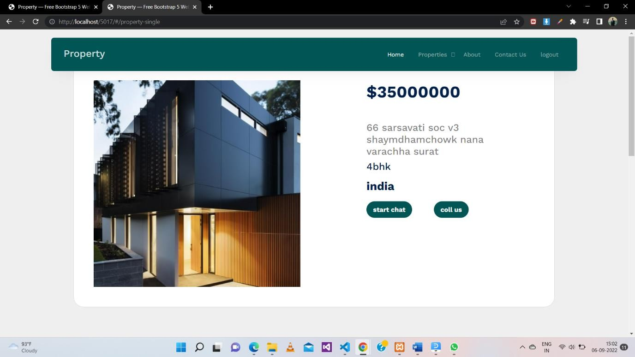

Slide 20
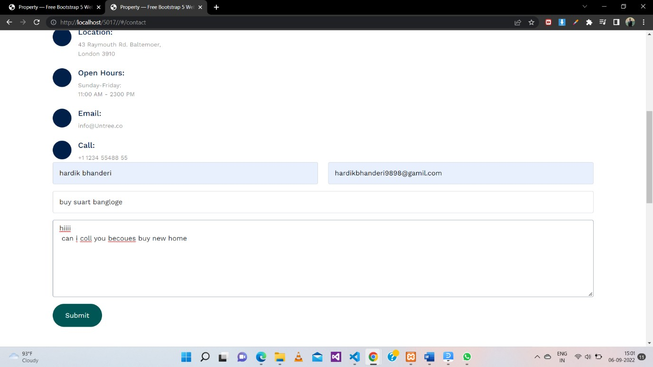

Slide 21

ADMIN SIDE

Slide 22
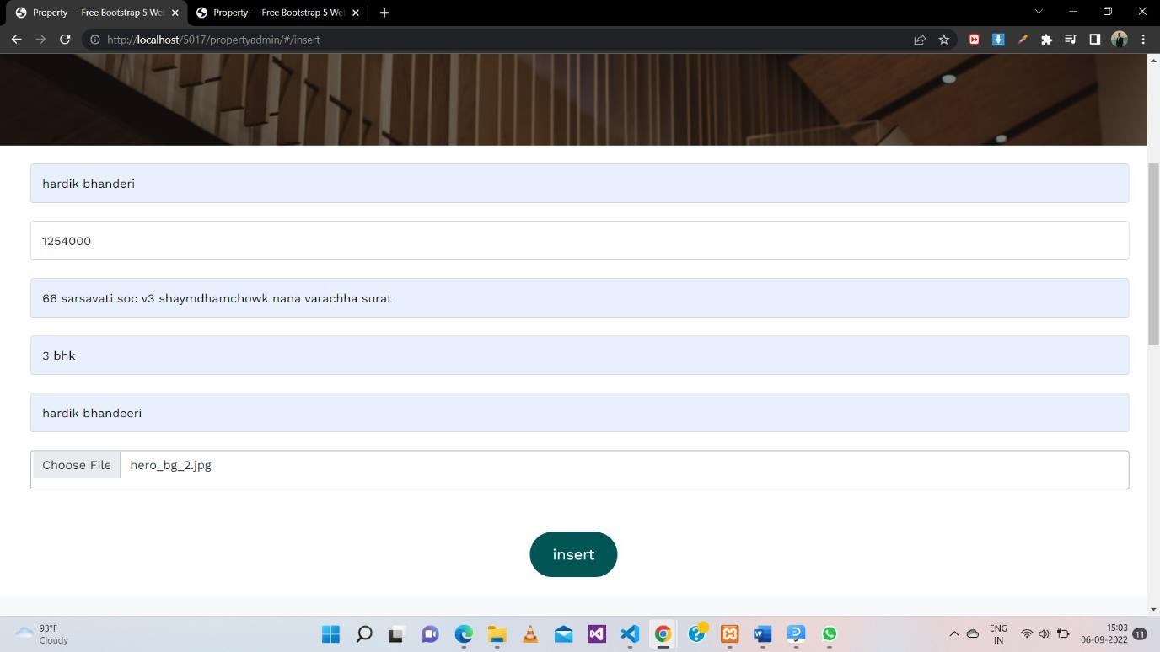

Slide 23
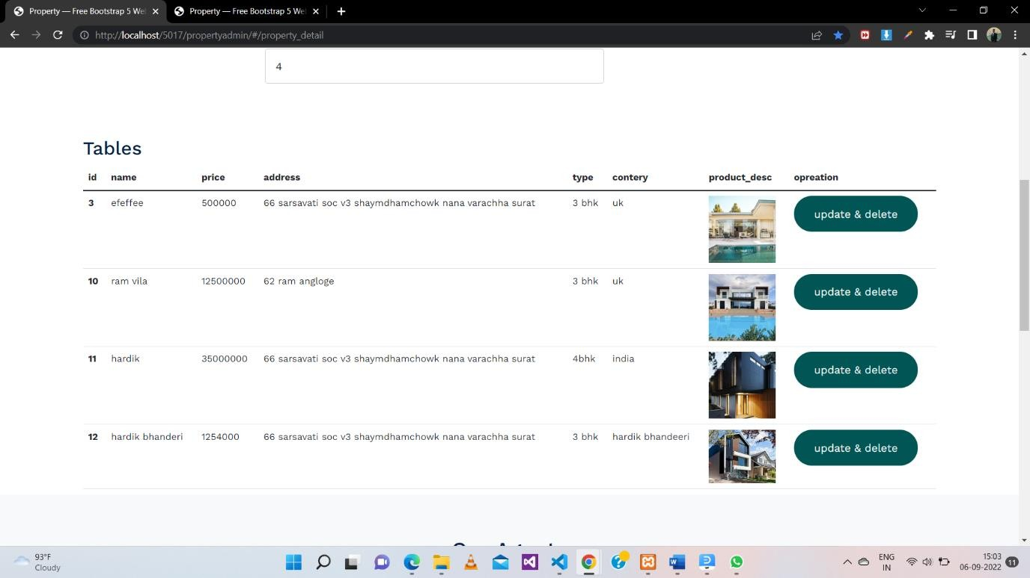

Slide 24
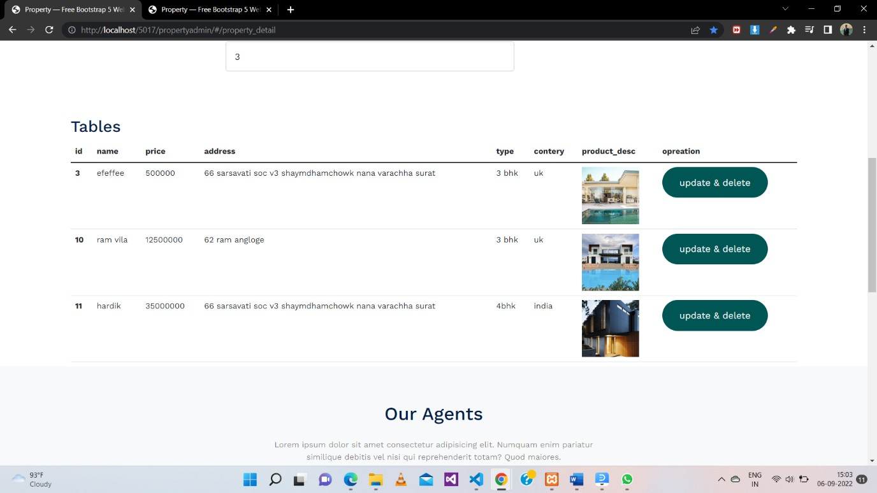

Slide 25
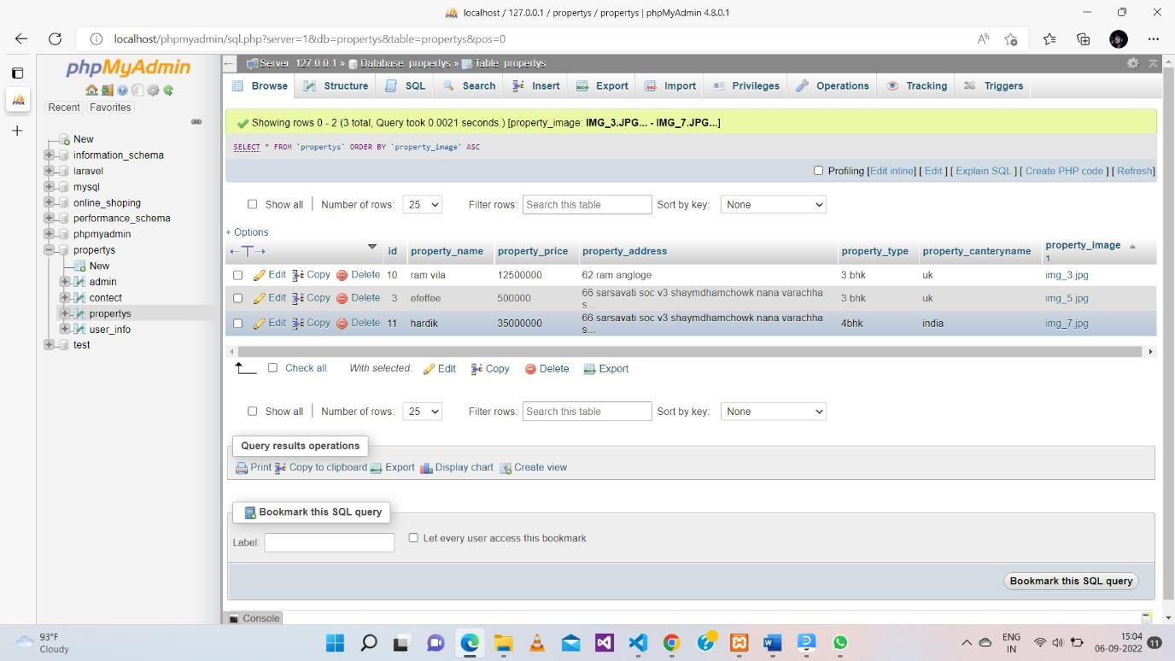
SQL DATA BASE

Slide 26
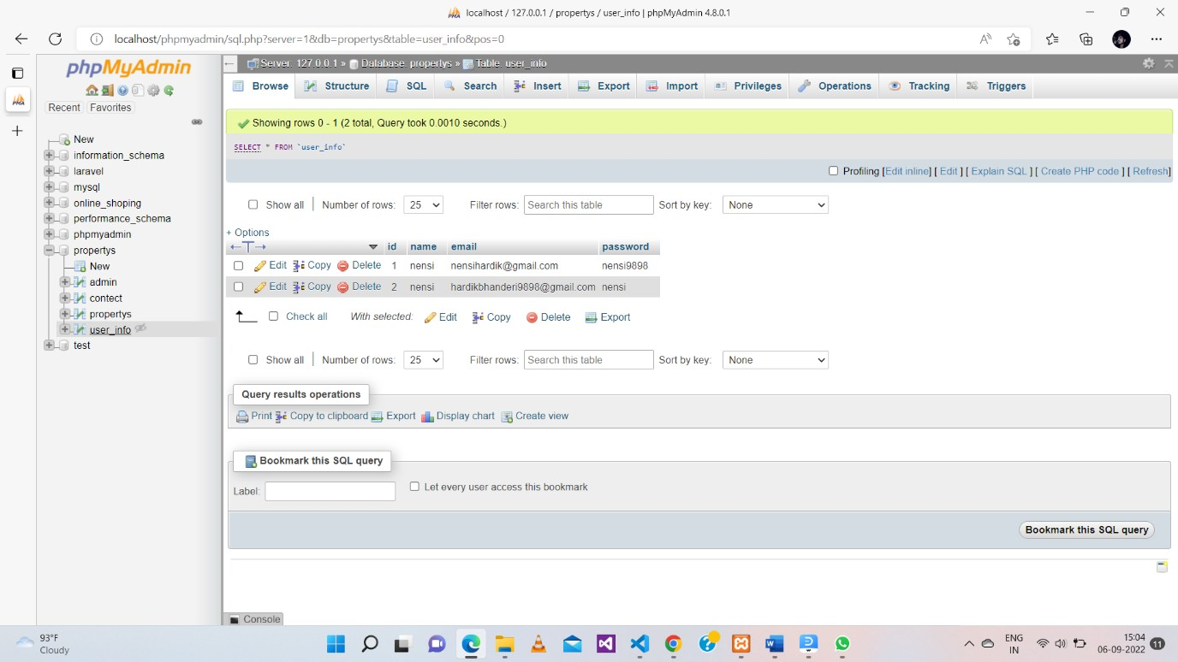

Slide 27
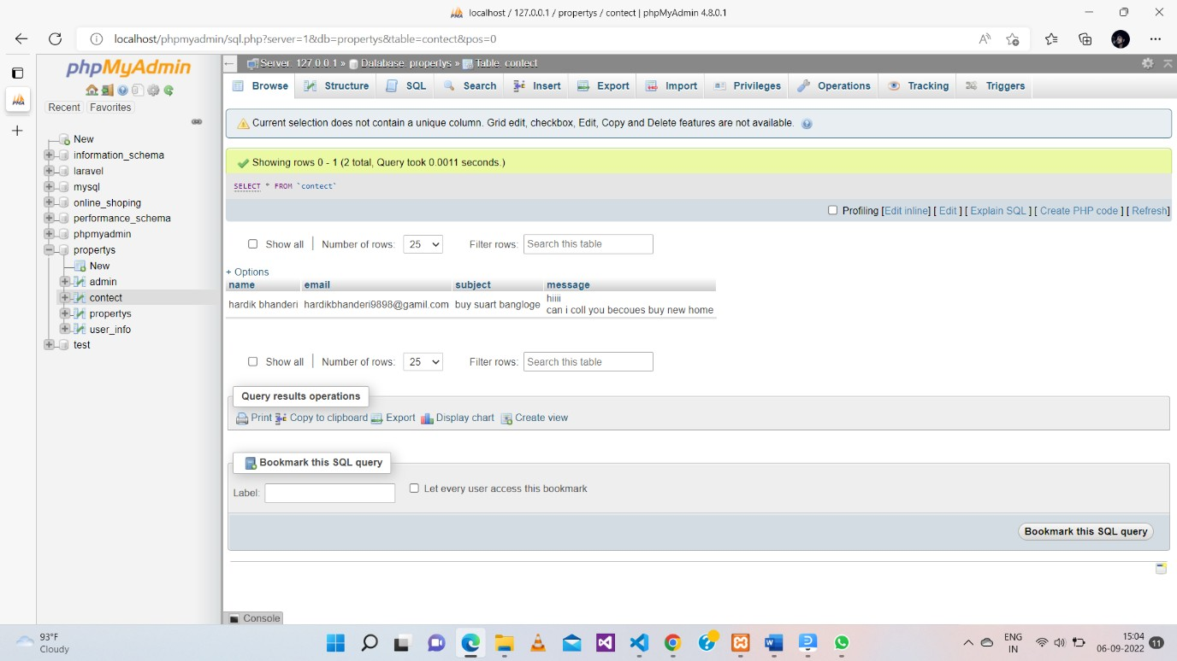

Slide 28
USER SIDE
index.html
<div class="site-mobile-menu site-navbar-target">
<div class="site-mobile-menu-header">
<div class="site-mobile-menu-close">
<span class="icofont-close js-menu-toggle"></span>
</div>
</div>
<div class="site-mobile-menu-body"></div>
</div>

Slide 29
<div class="container">
<div class="menu-bg-wrap">
<div class="site-navigation">
<a href="#index" class="logo m-0 float-start">Property</a>
<ul class="js-clone-nav d-none d-lg-inline-block text-start site-menu float-end">
<li class="active"><a href="#property">Home</a></li>
<li class="has-children">
<a href="#property">Properties</a>
<ul class="dropdown">
<li><a href="#property">Buy Property</a></li>

Slide 30
<li class="has-children">
<a>Dropdown</a>
<ul class="dropdown">
<li><a href="#property">Sub Menu One</a></li>
<li><a href="#property">Sub Menu Two</a></li>
<li><a href="#property">Sub Menu Three</a></li>
</ul>
</li>
</ul>
</li>
<li><a href="#about">About</a></li>
<li><a href="#contact">Contact Us</a></li>
<li><a href="#logout">logout</a></li>
</ul>

Slide 31
<a href="#” class="burger light me-auto float-end mt-1 site-menu-toggle js-menu-toggle d-inline-block d-lg-none" data-toggle="collapse"
data-target="#main-navbar">
</a>
</div>
</div>
</div>
</nav>
<div ng-view></div>
<script>
var app = angular.module("myApp", ["ngRoute"]); app.config(function($routeProvider) {
$routeProvider
.when("/", {
templateUrl : "login.php"
}).
when("/property-single", { templateUrl : "property-single.php"
})
.when("/property", { templateUrl : "property.php"
})
.when("/login", { templateUrl : "login.php", controller: 'loginController'
})
.when("/about", { templateUrl : "about.php"
})
.when("/contact", { templateUrl : "contect.php"
})

Slide 32
.when("/register", { templateUrl : "register.php",
})
.when("/logout", { templateUrl : "login.php",
});
});
</script>

Slide 33
ADMIN SIDE
index.html
<body ng-app="myApp">
</script>
<div class="site-mobile-menu site-navbar-target">
<div class="site-mobile-menu-header">
<div class="site-mobile-menu-close">
<span class="icofont-close js-menu-toggle"></span>
</div>
</div>
<div class="site-mobile-menu-body"></div>
</div>
<nav class="site-nav">

Slide 34
<div class="container">
<div class="menu-bg-wrap">
<div class="site-navigation">
<a href="#" class="logo m-0 float-start">Admin</a>
<ulclass="js-clone-nav d-none d-lg-inline-block text-start site-menu float-end">
<li class="active"><a href="#property">Home</a></li>
<li class="has-children">
<a href="#property_detail">Properties</a>
</li>
<li><a href="#insert">add </a></li>
<li><a href="#contact">Contact Us</a></li>
</ul>
<a href="#“ class="burger light me-auto float-end mt-1 site-menu-toggle js-menu-toggle d-inline-block d-lg-none" data-toggle="collapse"
data-target="#main-navbar">
<span></span>
</a>
</div>
</div>
</div>
</nav>

Slide 35
<div ng-view></div>
<script>
var app = angular.module("myApp", ["ngRoute"]); app.config(function($routeProvider) {
$routeProvider
.when("/", {
templateUrl : "login.php"
})
.when("/property_detail", { templateUrl : "property_detail.php"
})
.when("/property", { templateUrl : "property.php"
})
.when("/insert", { templateUrl : "insert.php"
})
.when("/contact", { templateUrl : "contect.php"
})
.when("/update", { templateUrl : "update.php"
})
.when("/delete", { templateUrl : "delete.php"
})
})
</script>

Slide 36
REFERENCES
https://www.php.net/
https://angularjs.org/

