Slide 1
John Magee
Student ID- OOO3937624 Public Diigo Link:-https://www.diigo.com/list/jamagee/Researching+Credible+Connetions+%28Bethesda+Softworks%2C+LLC%29/3qol0m51s

Slide 2
Bethesda Softworks
As an avid video game player and someone who enjoys a good story, I feel that Bethesda Softworks is one of the pre-eminent companies as far as video game design and development goes. I have always hoped to one day find a position of employment with them; as such, I’m very interested in their current and previous ventures, be they social media initiatives or the fine print inside of their game instruction manuals!

Slide 3
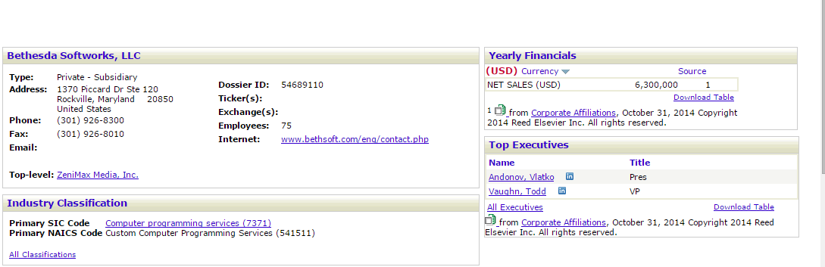

Slide 4
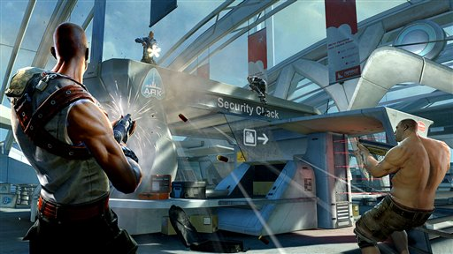

Slide 5
LexisNexis/EbscoHOST Originated Articles

Slide 6
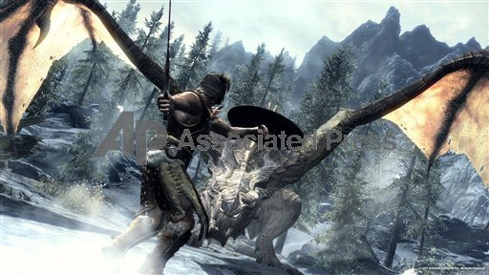

Slide 7
URL- http://web.a.ebscohost.com.oclc.fullsail.edu:81/ehost/detail/detail?vid=15&sid=239c8b8e-eccf-4414-a273-0bb78c8ff6fc%40sessionmgr4004&hid=4204&bdata=JnNpdGU9ZWhvc3QtbGl2ZQ%3d%3d#db=a9h&AN=35044658 Article: Games Get Real Author/Article Info Analysis: Author is easy to identify; a simple browser search led to numerous references of Mr. Steinberg’s expertise from sources as widely varying as Rolling Stone magazine and the Game Developer’s Conference notes, which indicate that he was a speaker, keynote and otherwise, at multiple events. Mr. Steinberg has a proven track history as a contributor to Popular Science, itself one of the most widely-known scientific magazines in publication today. The timestamp of the article is November, 2008, and has not been revised. The crux of the article was regarding the increased appearance of realism in videogames, with Bethesda Softworks being named as a forerunner in such. The article’s information is incredibly brief, almost scant, but does not seem biased towards any particular company or game preference. I believe that the author is attempting to convince people that video game realism is increasing, which is not a difficult argument to accept. There are no sources or citations, nor are there other links to active additional resources. The site is relatively easy to navigate. It is clear that the article has been copyrighted by Popular Science.

Slide 8
Personal Take: As far as my opinions of the article, I found it informative despite its brevity, as well as something that instilled some measure of hope in me. I found other articles later on in terms of publication (2011, 2013) that indicate Bethesda Softworks is still very much on the forefront of gaming realism, something that appeals to me a great deal. I would say the article seems credible, but lacks a great deal of exposition that would have enhanced its poignancy and effectiveness.

Slide 9
URL- http://web.a.ebscohost.com.oclc.fullsail.edu:81/ehost/detail/detail?sid=5cec9ec0-8465-4d6d-8df0-1a65fc5fe91f%40sessionmgr4005&vid=0&hid=4204&bdata=JnNpdGU9ZWhvc3QtbGl2ZQ%3d%3d#db=bwh&AN=201302110830PR.NEWS.USPR.LA51691 Article- Future US and Bethesda Softworks Announce The Elder Scrolls Online Food Truck Tour
Author/Article Analysis- The organization that posted the article, Future US, has a vested position in technology and video gaming journalism due to their print and media holdings that focus, among others, around the aforementioned interests. The tonal nature of their document, which fails to identify any particular author, comes from the PR Newswire, which seems appropriate in retrospect.
The article is dated February 11th, 2013, and the date does not appear to have been revised. To claim that the publication that first ran the story has a solid standing is a matter of some slipperiness; as a venue for PR firms to run ‘feel good’ style stories, it is certainly not objective, though it is accessible. Ebscohost is, however, accessible and relatively easy to navigate. The article contains no links to other articles/resources nor does it cite or reference any. The article’s focus was to tout the combined efforts of Future US and Bethesda Softworks, with a seeming emphasis bias towards Future US (the writer of the article). To be honest, it seems like a non-credible resource, somewhat more of a propaganda piece than actual objective reporting.

Slide 10
Personal Take: What I gleaned from the article, however, is a social networking and societal initiative on the part of Bethesda that appeals to me as someone who not only consumes the media that Bethesda produces, but also as a person who would enjoy very much to find himself employed by said company at a future date in time. Experimentation and a willingness to deviate from a standard press junket/build-up/release scenario like many video game companies seem to embrace is a positive, as far as I am concerned.

Slide 11
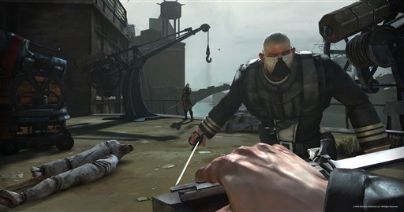

Slide 12
Search Engine Originated Articles

Slide 13
URL- http://law.unh.edu/assets/images/uploads/publications/idea-vol53-no1-eichner.pdf Article- Game Over, Insert Coin to Continue: Entering a New Era of Video Game Intellectual Property Author/Article Info Analysis- Finding the author, Andrew W. Eichner, was as simple as viewing the footnote on the first page that has his information and indication of expertise included in it. The University of New Hampshire is an old institution with a storied history; the article itself is included in an independent student organization’s intellectual property law review, each issue of which bears a copyright in physical and non-excerpt electronic form. This excerpt did not bear one, but it is, as stated, an excerpt. The article was created and printed on January 27th, 2013, and there has not been a revised date added to the article. The IDEA review is easily accessed and considered to have solid standing in the realm of intellectual property law discourse. The document itself contains 189 footnotes, many of which are resources that are easily located with a simple web browser search. The article seems to avoid, or at least attempt to avoid as best as possible, any sort of bias; if anything, it seems dedicated to providing an even-handed analysis of the changes in terms of intellectual property law regarding physical and virtual media, specifically with reference to End User License Agreements, otherwise known as EULAs.

Slide 14
It is in reference to the EULAs specific to Bethesda’s The Elder Scrolls V: Skyrim (Eichner, p 113, footnote 104) and their other materials that the article had particular relevance to my interest in Bethesda Softworks’ overall culture, corporate identity, content, and the crux of my curiosity: ostensibly, whenever a physical copy’s package of the game is opened, the EULA in the user’s manual takes effect, even if it has not been read or consciously agreed to by said purchaser. It creates, to me, an ultimate statement from the developer (Bethesda Softworks) that the intellectual property they’ve created is assumed to be being used by authorized users as intended and prohibits unauthorized replication of said intellectual property; it seems almost to me like a social contract as well as a legal one, like a company statement to the consumer that says, “You know you’re playing a game you’re going to love, and we know it too. You should give us a little credit.” Naturally, one assumes that ‘credit’ in question would be of a monetary variety since the end-user is well aware as to who created what they intend to enjoy.

Slide 15
URL- http://www.gamasutra.com/view/news/218899/Being_BJ_Blazkowicz_Storytelling_in_Wolfenstein_The_New_Order.php Article- Being B.J. Blazkowicz: Storytelling in Wolfenstein: The New Order Author/Article Info Analysis: Author is very easy to identify, as his name is hyperlinked. The author is editor-in-chief of Gamasutra, Kris Graft, who has an extensive resume in video game programming, planning, and journalism able to be referenced from the article website as well as independently on the Internet. The article originates from the same magazine. The timestamp on the article is June 5th, 2014; the article has not been revised. The publication, which has been reporting on video game news and stories since 1997, is certainly an accessible and has a solid standing within the video game community and as a wider resource for articles by other writers covering tangential topics. The article has no sources or citations, nor does it have links to other similar or explanatory articles. The site was easy to navigate and provided an easily accessible wealth of information.

Slide 16
Personal Take: The focuses of the article were the buy-out of Machine Games, the development of a long-overdue Wolfenstein video game, and the development issues, process, and story-writing behind the game. I think that the article was credible, as it was a direct interview of someone with an obvious professional background and who has a working relationship with the company that my project is based on. The interviewer does not seem to ask much in the way of leading or disingenuous questions, and leaves most of the actual article dedicated to what the interviewee has to say.

Slide 17


Slide 18
References
Steinberg, S. (2008, November 1). Games Get Real. Retrieved November 8, 2014, from http://web.a.ebscohost.com.oclc.fullsail.edu:81/ehost/detail/detail?vid=15&sid=239c8b8e-eccf-4414-a273-0bb78c8ff6fc@sessionmgr4004&hid=4204&bdata=JnNpdGU9ZWhvc3QtbGl2ZQ==#db=a9h&AN=35044658 Future US And Bethesda Softworks® Announce The Elder Scrolls® Online Food Truck Tour. (2013, February 11). Retrieved November 9, 2014, from http://web.a.ebscohost.com.oclc.fullsail.edu:81/ehost/detail/detail?sid=5cec9ec0-8465-4d6d-8df0-1a65fc5fe91f@sessionmgr4005&vid=0&hid=4204&bdata=JnNpdGU9ZWhvc3QtbGl2ZQ==#db=bwh&AN=201302110830PR.NEWS.USPR.LA51691
Eichner, A. (2013, January 27). GAME OVER, INSERT COIN TO CONTINUE: ENTERING A NEW ERA OF VIDEO GAME INTELLECTUAL PROPERTY ENFORCEMENT.IDEA: The Intellectual Property Law Review, 107-130. From http://law.unh.edu/assets/images/uploads/publications/idea-vol53-no1-eichner.pdf
Graft, K. (2014, June 5). Being B.J. Blazkowicz: Storytelling in Wolfenstein: The New Order. Retrieved November 8, 2014, from http://www.gamasutra.com/view/news/218899/Being_BJ_Blazkowicz_Storytelling_in_Wolfenstein_The_New_Order.php

Slide 19
Photo References
Brink Double Shotgun Image: Associated Press Image ID 110510133157
Skyrim Dovakhiin v. Dragon Image: Associated Press Image ID 111111167636
Dishonored Knife Fight Image: Associated Press Image ID 47041226751
Wolfenstein: The New Order Killin’ Nazis Image: Associated Press Image ID 576755117769

