Slide 1

Major Project Office Automation System
Submitted by:
Bhawana Sharma(220723304006)
Kartik Sharma(220723304008)
Pallavi Sharma(220723304014)
Shagun Sharma(220723304020)

Slide 2
CONTENTS
INTRODUCTION
ABOUT DATABASE
ER DIAGRAM
STUDENT ENTITY
EMPLOYEE ENTITY
BRANCH ENTITY
FEE ENTITY
CONCLUSION

Slide 3

INTRODUCTION
The “Office Automation System” will help to manage employee and leave record , students record and their fees status.
This system will help to manage student registration and employee registration.
With the help of this system teacher will be able to see their leave record , students will be able to see their fees and fine record.
It will help employee to easily view their record and their leave status based on which they can take holiday.Also students will be keep updated with their examination fees.

Slide 4

ABOUT DATABASE
The sqlite3 module was written by Gerhard Haring.
SQLite is a C library that provides a lightweight disk-based database that doesn’t require a separate server process .
Some applications can use SQLite for internal data storage.
It can be used to create a database, define tables, insert and change rows, run queries and manage an SQLite database file..

Slide 5
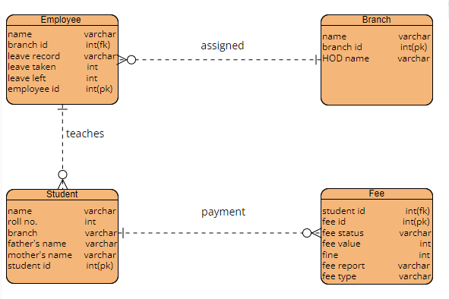
ER DIAGRAM

Slide 6
STUDENT ENTITY
Attributes : Name , Roll No. , Branch , Father’s Name , Mother’s Name , Student ID
Primary Key : Student ID
Example:-
Name | Roll No. | Branch | Father’s Name | Mother’s Name | Student ID
John | 101 | computer | Sohan | Kiran | CS101
Jack | 102 | electrical | Mohan | Lisa | EE102
David | 103 | Mechanical | Abhishek | Simran | ME103
Michael | 104 | civil | Prashant | Neha | CV104

Slide 7
EMPLOYEE ENTITY
Attributes : Name, Branch ID , Leave Record , Employee ID
Primary Key : Employee ID
Foreign Key : Branch ID
Example:-
Name | Branch ID | Leave Record | Employee ID
John | BR001 | 10 days | EMP001
Smith | BR002 | 8 days | EMP002
David | BR003 | 12 days | EMP003
Michael | BR004 | 6 days | EMP004

Slide 8
BRANCH ENTITY
Attributes : Name , Branch ID , HOD Name
Primary Key : Branch ID
Example:-
Name | Branch ID | HOD Name
John | BR001 | Alex
Smith | BR002 | Daniel
David | BR003 | Jack
Michael | BR004 | Sohan

Slide 9
FEE ENTITY
Attributes : Student ID , Fee Status , Fee Value , Fine , Fee Report , Fee Type
Primary Key : Fee ID
Example:-
Student ID | Fee ID | Fee Value | Fine | Fee Status | Fee Type
101 | fee111 | Rs.500 | Rs.0 | Paid | Tuition
102 | fee122 | Rs.450 | Rs.50 | Unpaid | Tuition
103 | fee145 | Rs.600 | Rs.0 | Paid | Library
104 | fee176 | Rs.700 | Rs.100 | Unpaid | Exam fee

Slide 10
CONCLUSION
Our project “Office Atuomation System” minimizes paperwork and ensures accurate and up-to-date leave balances for all employees.
It also manages student registration and allows them to see their fees status.
Fees record provides the status of fees and fine of the student .
Overall, by integrating employee leave record , student records , and fees record into office automation system , organization can achieve improved data accuracy of these records and enhanced communication across departments.
This simplifies administrative tasks and reduces need for manual data entry.
Ultimately, the improved efficiency, data accuracy and communication benefit both employees and students.

Slide 11


